Slide 1

Empowering PME with AI
a practical path through uncertainty
Trish Harris | Moodle Proposal Writer; former Learning Architect for USAF Global College
Jim Mezzanotte | Moodle Product Manager

Slide 2

Workshop series objectives
This series will equip PME professionals to strategically integrate AI, enhancing learning aligned with doctrine, even with limited resources.

Slide 3
Session 1 Objectives
1 | Understand the current PME landscape & AI's role.
2 | Identify curriculum areas for AI integration.
3 | Explore practical AI applications & ethical considerations.
4 | Introduce rapid prototyping & GAI partnerships.

Slide 4
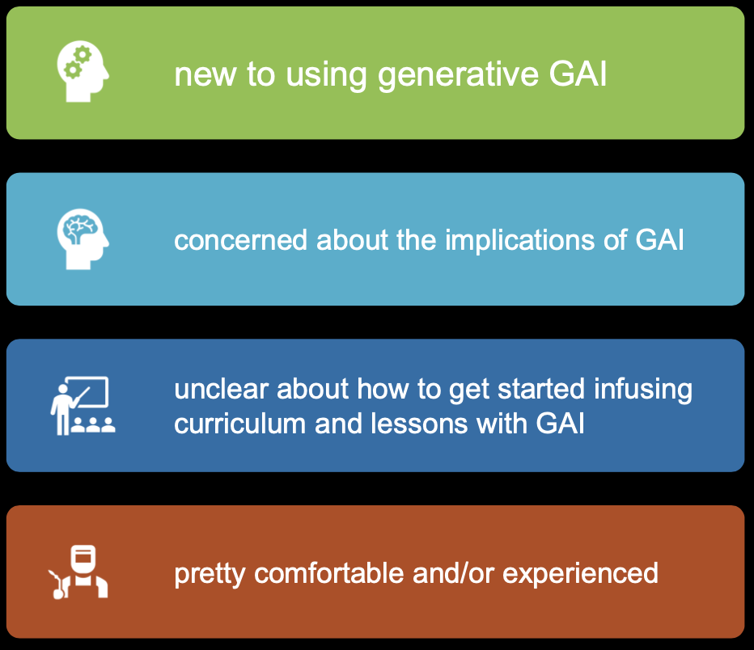
Where do you fall?

Slide 5
Which word captures your current view of AI in PME?

Slide 6


Challenges and Opportunities
Challenges
Opportunities
uncertain budgets
shifting org structures
reduced/uncertain staffing
information overload
AI for efficiency
AI for deeper learning
AI for personalization
AI for scaling expertise
Focus on what AI can do for you, not what you must do for AI.

Slide 7
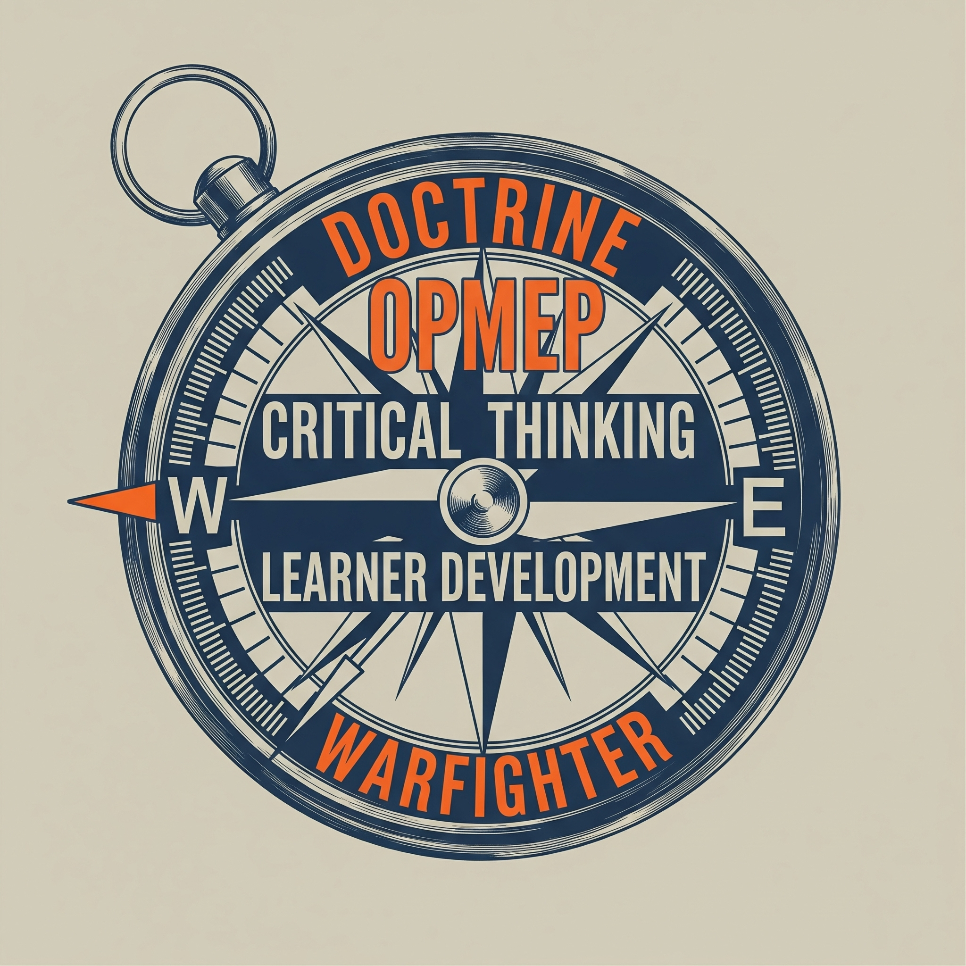

Addressing Uncertainty: Core Requirements & Doctrinal Alignment
The constant: OPMEP & Doctrinal Guidance.
The focus: Critical & Creative Thinking as foundational warfighter skills.

Slide 8
Addressing Uncertainty: Core Requirements & Doctrinal Alignment
AI must serve these goals, not dictate them.
The question: How can AI help us better achieve existing doctrinal requirements for cognitive skill development?

Slide 9
Part 2:
Deconstructing the Demand
Learning Loss and AI Integration

Slide 10

Understanding learning loss in PME
Learning loss can reference the decay of complex skills, outdated knowledge due to rapid change, or gaps from previous training models.
The PME context requires ensuring readiness, adaptability, and retention of critical decision-making skills.
AI can identify gaps (data analysis), provide refresher/adaptive learning, and simulate scenarios to reinforce skills.

Slide 11
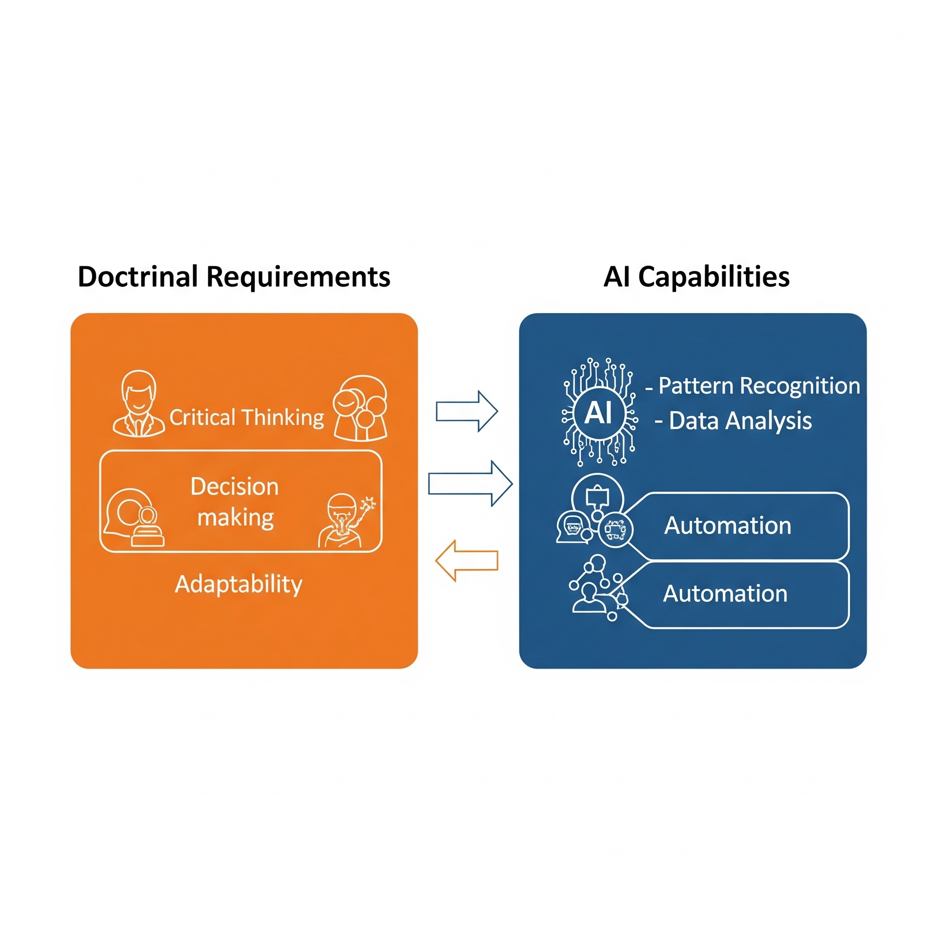
Connecting requirements with AI capabilities
Emphasize Human-in-the-Loop.
AI augments these skills.
It doesn't replace these human cognitive skills.

Slide 12
Framework for Analyzing Curricula for AI Integration
Step 1: Select Module/Learning Objective.
Step 2: Identify Key Learning Outcomes & Doctrinal Links.
Step 3: Analyze Current Activities & Assessments – Where are the pain points or opportunities?
Step 4: Brainstorm Potential AI Enhancements (How could AI help students learn this better/faster, or help instructors teach/assess more effectively?).
Step 5: Consider Feasibility & Impact.

Slide 13

Initial Curriculum Scan (activity)
Take a few minutes to consider ONE module or learning objective you are familiar with.
Guiding Questions:
What are the core skills/knowledge?
Where do students typically struggle?
Where do instructors spend excessive time on repetitive tasks?
Jot down your thoughts. We won't collect them today, but this primes you for the intersession project.

Slide 14
Part 3:
Introduction to AI
in PME
Practical and Ethical Considerations

Slide 15



Demystifying AI
Natural Language Processing (NLP): AI understanding + processing human language.
(some practical definitions)
Our focus is accessible tools within the current DoD stack or ecosystem, not highly complex bespoke systems.
Machine Learning (ML): Systems that learn from data
Generative AI (GAI): AI creating or generating new content.

Slide 16
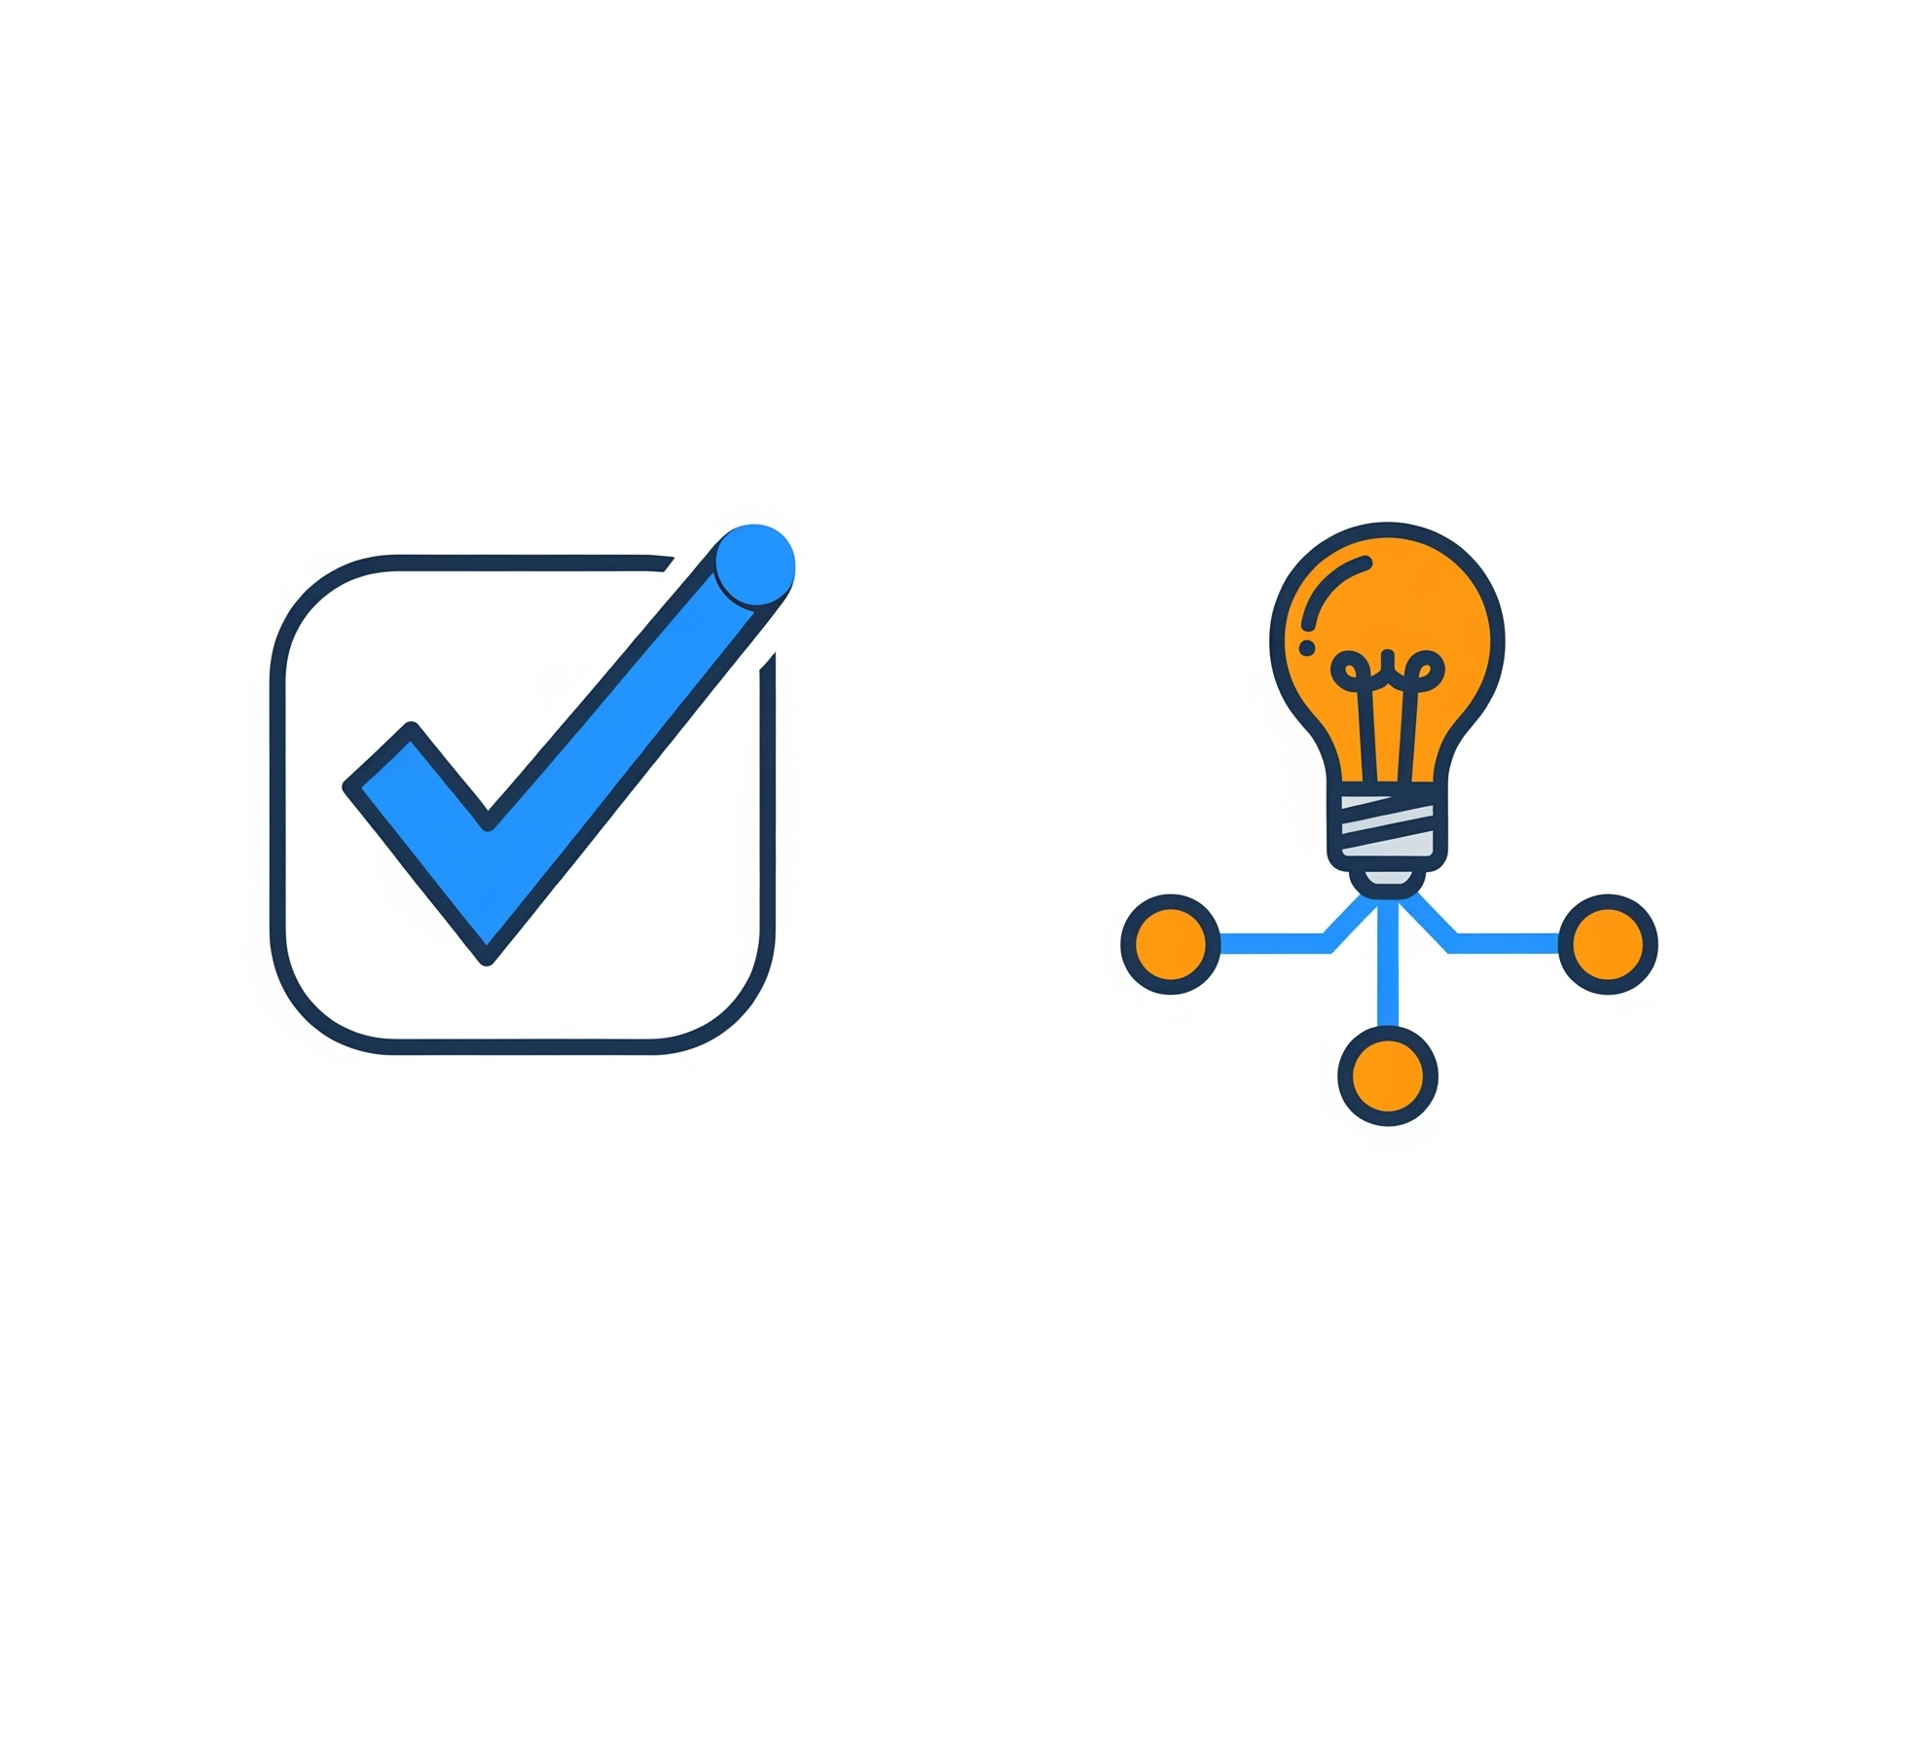
AI Application Examples for PME
Assessment Support. Automating grading for objective items, plagiarism checkers, supporting instructors in developing rubrics or assessment items.
Idea Generation & Scenario Building. AI as a brainstorming partner for course activities, generating diverse scenarios for wargames or ethical dilemmas (for human review & refinement).

Slide 17

AI Application Examples for PME
Content Curation & Knowledge Discovery. AI tools to summarize articles, identify relevant research, extract key themes from doctrinal texts. (Example: AI research assistants)
Personalized Feedback & Adaptive Learning. AI thinking partners for foundational concepts, automated feedback on draft writing (grammar, structure), tailored review paths based on quiz performance. (Example: Moodle quizzes with adaptive feedback)

Slide 18

Critical Ethics Questions
About data privacy & security: How is student/PME data used, stored, protected? (Especially important for .mil/.gov).
About algorithmic bias: Can AI perpetuate or introduce bias in content, feedback, or assessment? (Sources: training data, algorithm design).
About transparency & explainability (XAI): Can we understand why an AI made a certain recommendation or decision?

Slide 19
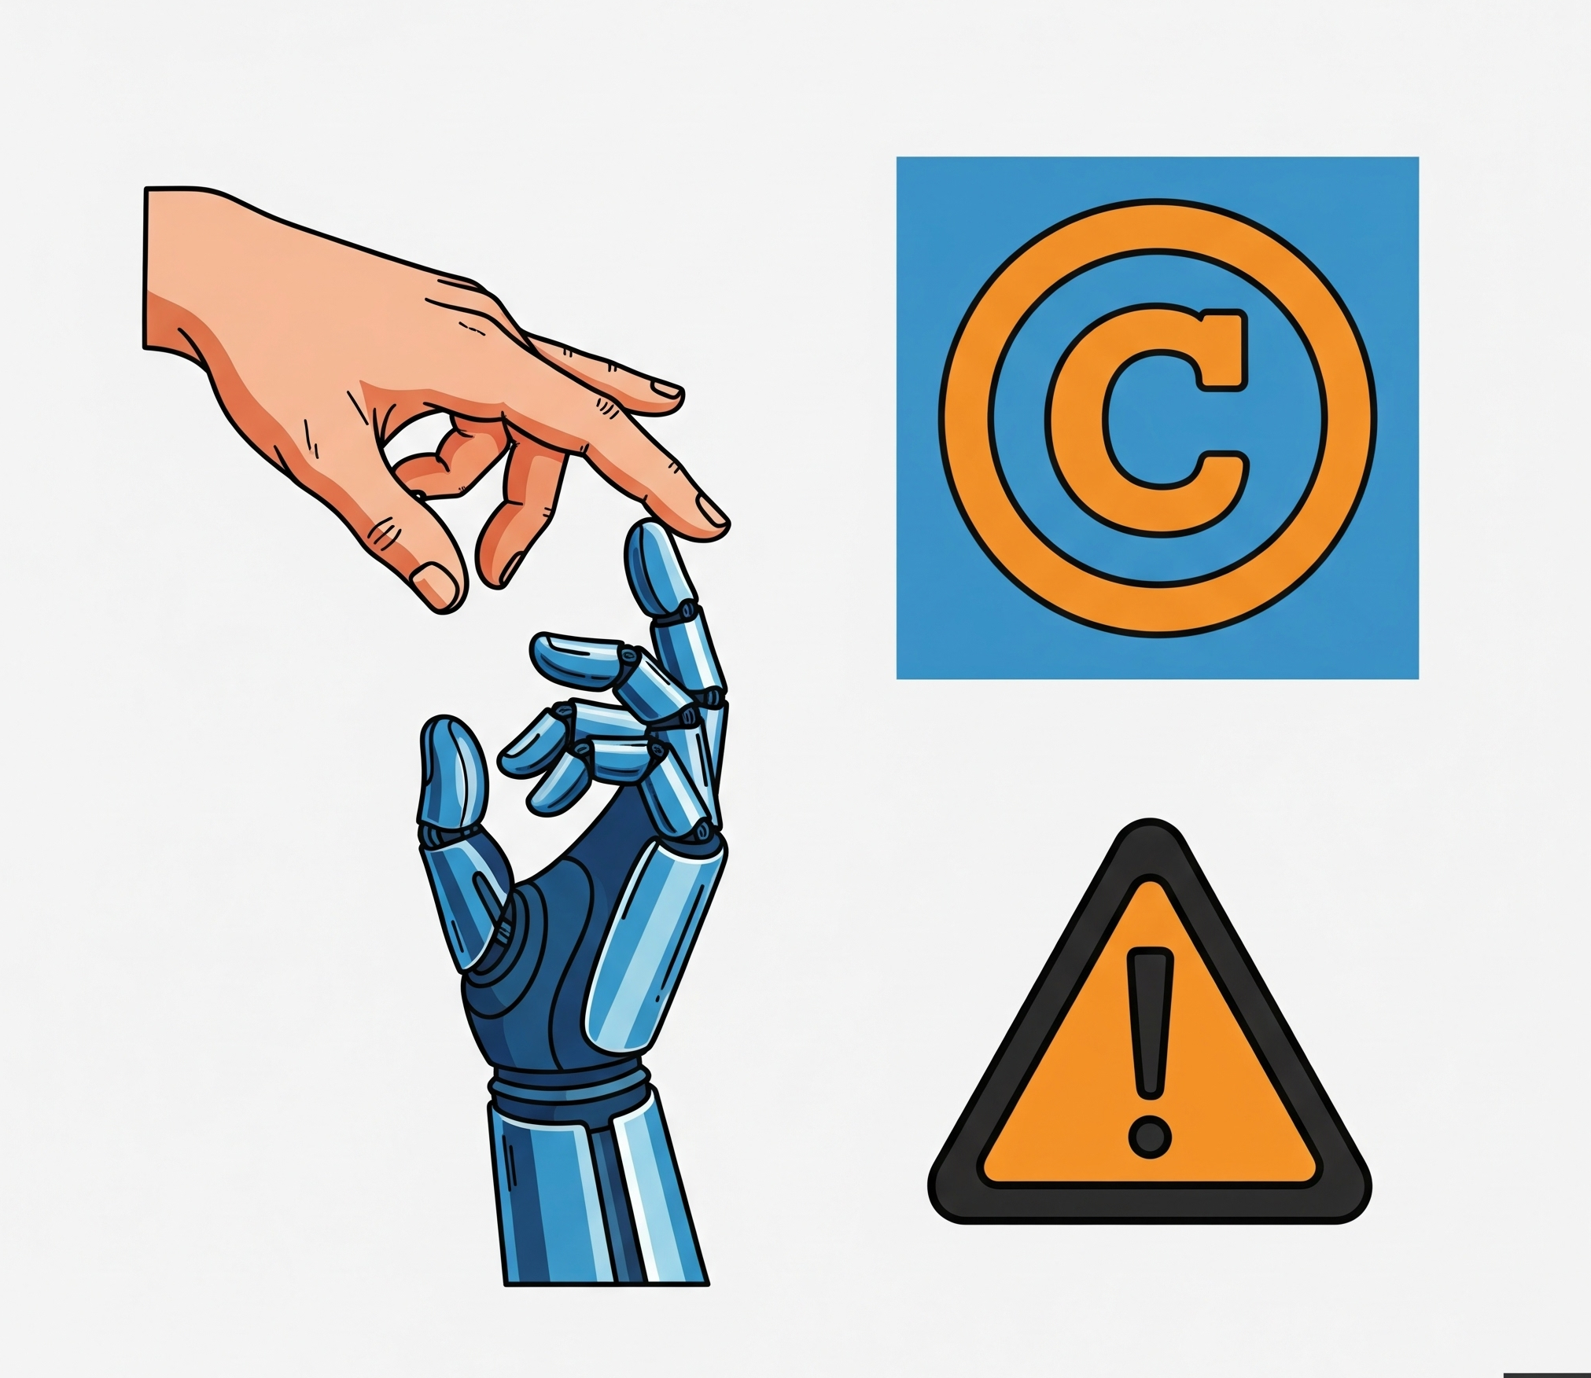
Critical Responsible AI Questions
Maintaining human oversight & critical judgment. AI as a tool, not the final authority. Ensuring learners and instructors remain critical thinkers.
Intellectual property & authorship. Who owns AI-generated content? How to cite AI assistance?
The "automation dilemma." Over-reliance and skill atrophy.

Slide 20

Let’s talk.
What excites you most about AI in PME?
What are your primary concerns right now?
Any initial thoughts on specific ethical challenges in your context?
(Or what else is on your mind before we move on to rapid prototyping?)

Slide 21
Part 4:
Introduction to Rapid Prototyping and GAI Partnership

Slide 22
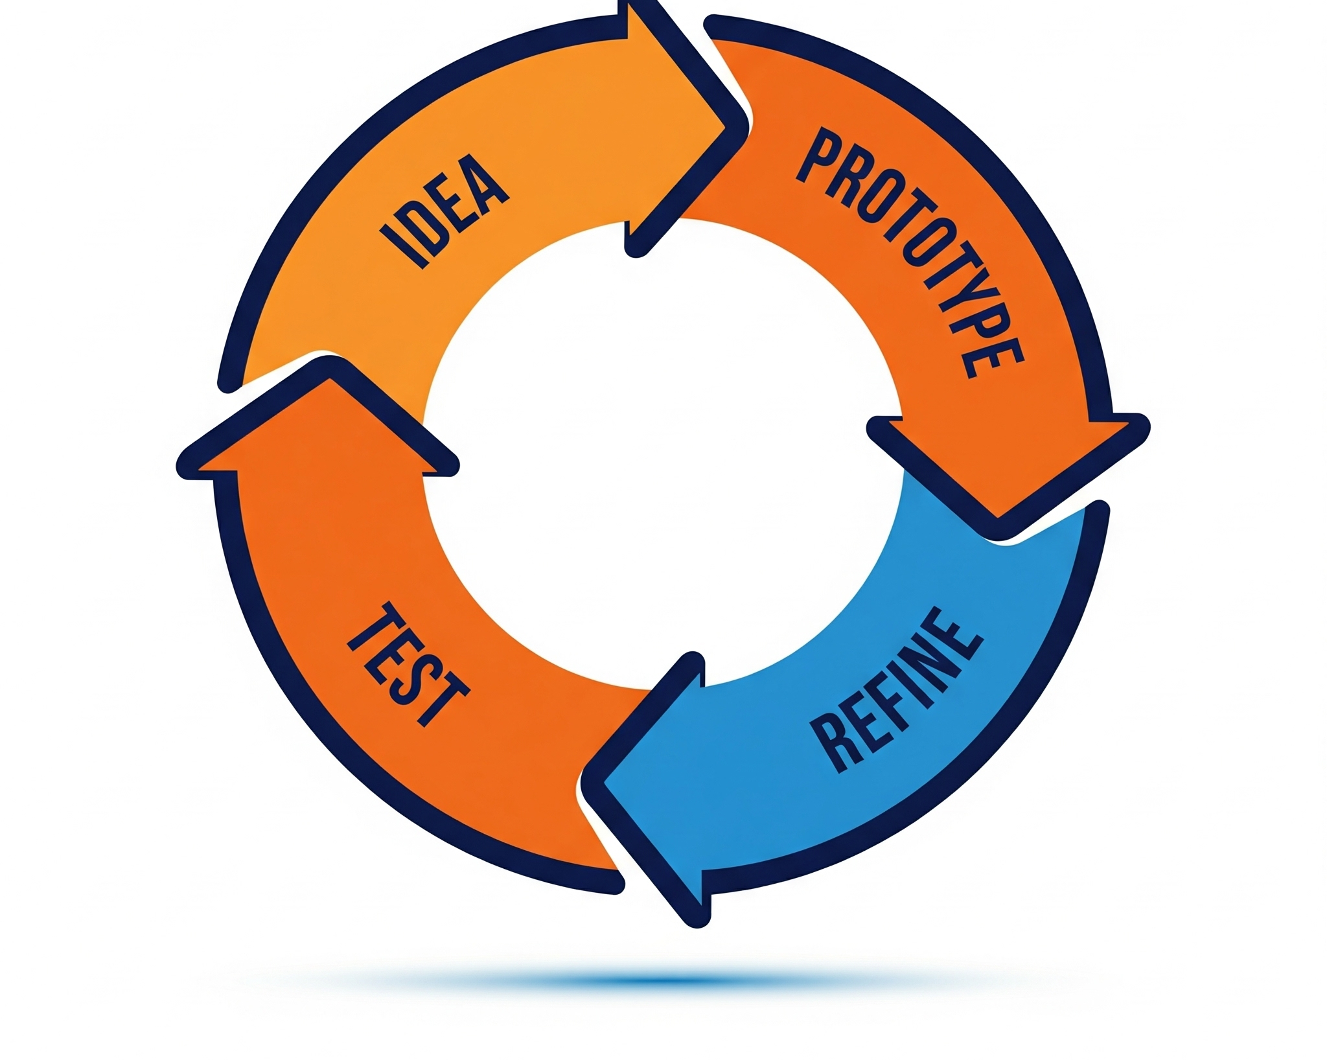
rapid prototyping in curriculum development
rapid prototyping = quickly creating a working model of an idea to test and refine
think: sketch v. masterpiece
upends organizational inertia

Slide 23
Why do this in PME?
You can –
test AI integrations on a small scale.
get user feedback early.
iterate quickly, adapt to changing needs/tech.
It’s resource-efficient. Avoid large investment in unproven ideas.

Slide 24
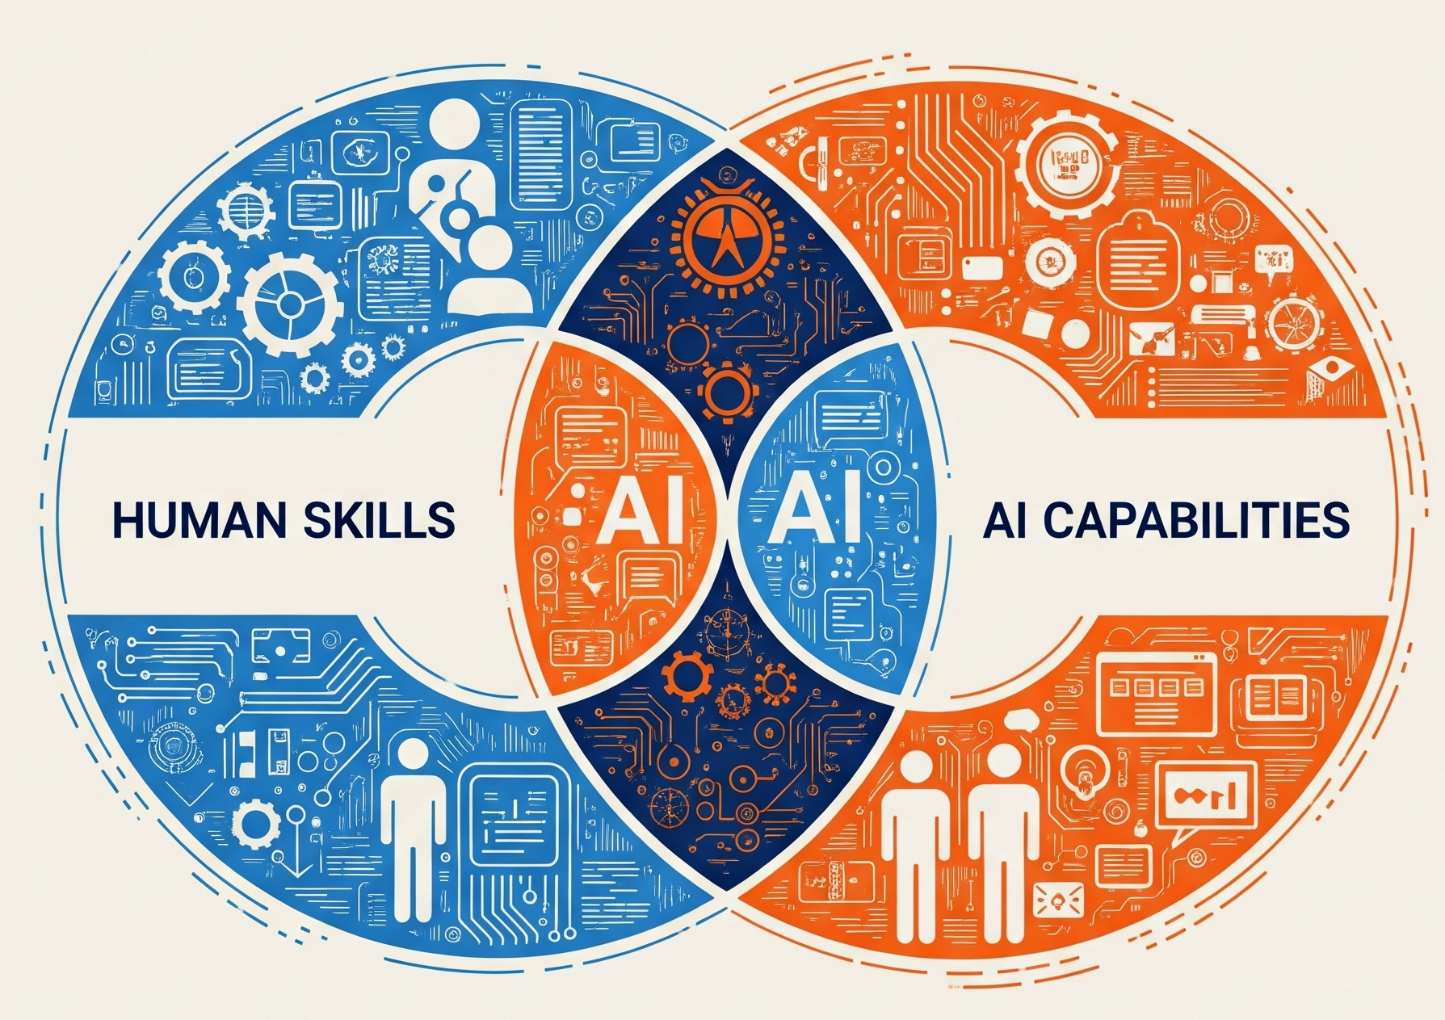
GAI as a collaborator
Shift from GAI as replacement
to GAI as a supplement
Focus on augmenting critical thinking, research, and drafting rather than replacing human effort
Example: Student uses GAI to brainstorm research questions, then conducts research manually, then uses GAI to outline, then drafts, then uses GAI for initial feedback before instructor review.

Slide 25
human idea or problem
prelim outline, branching ideas, research questions
redraft and rethink
How can I apply these insights to my human work?
03
ask GAI to QC
What helps?
What is unhelpful?
01
02

Slide 26
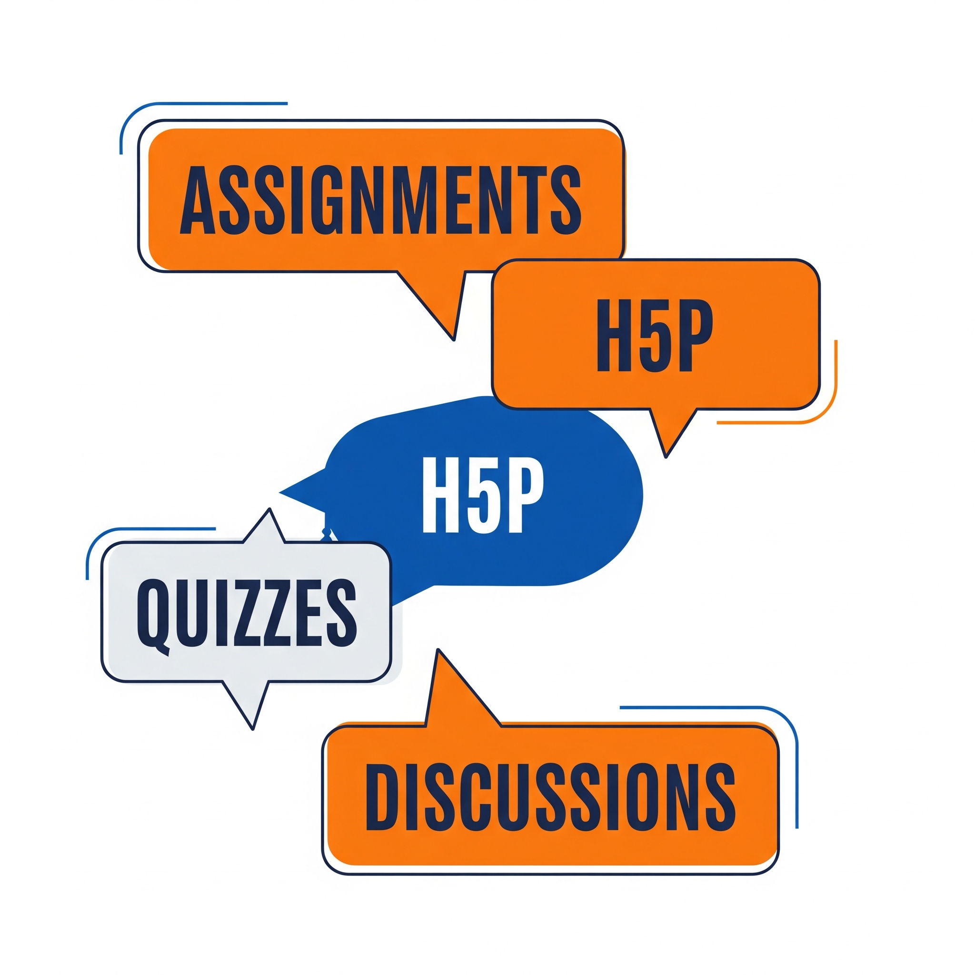
course level tools for rapid prototyping
two initial toolsets to leverage:
your LMS
low-fidelity prototyping

Slide 27
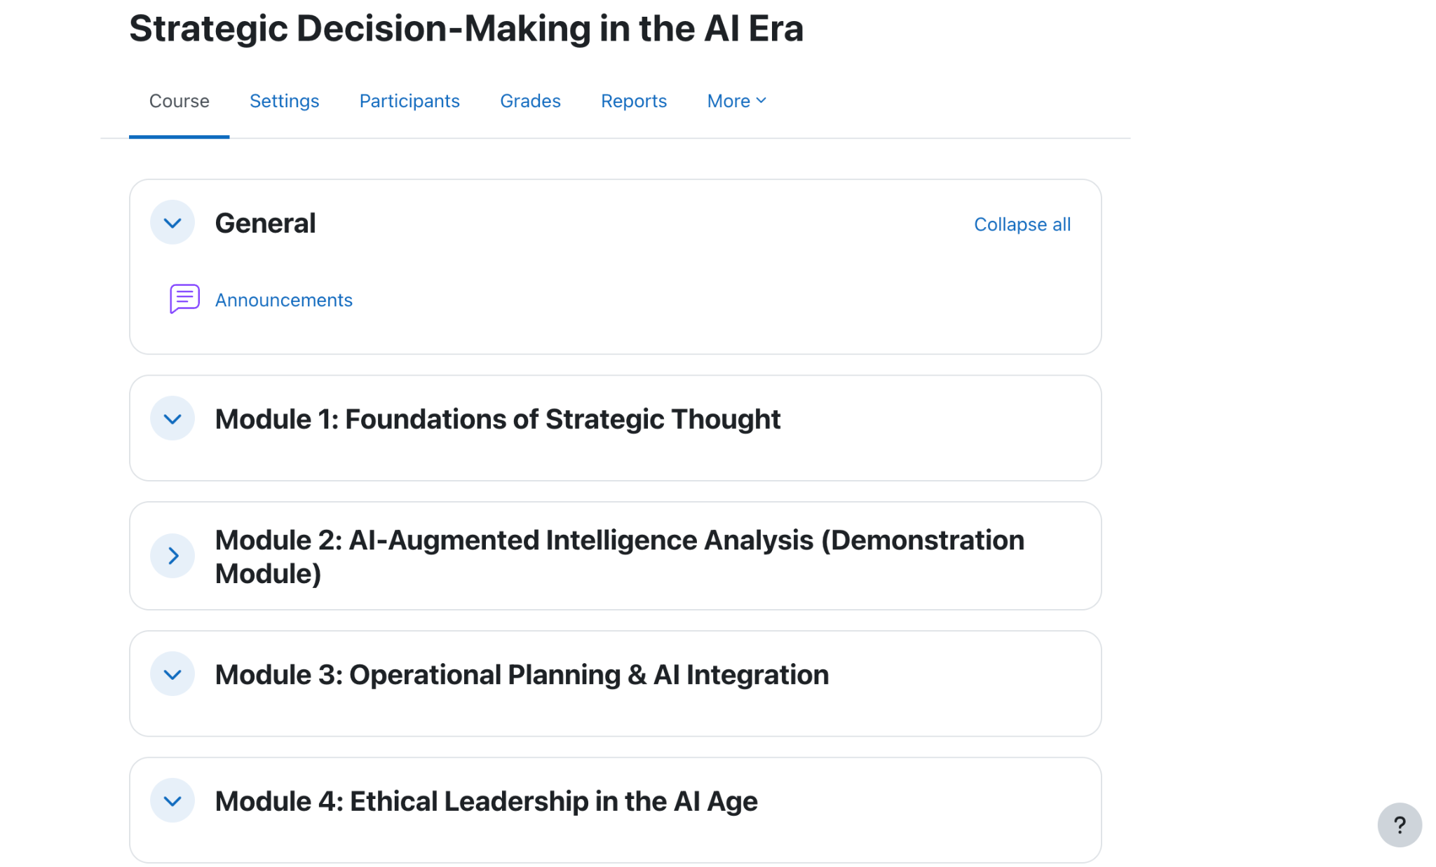
Let’s start with a standard course that’s part of a larger curriculum.

Slide 28
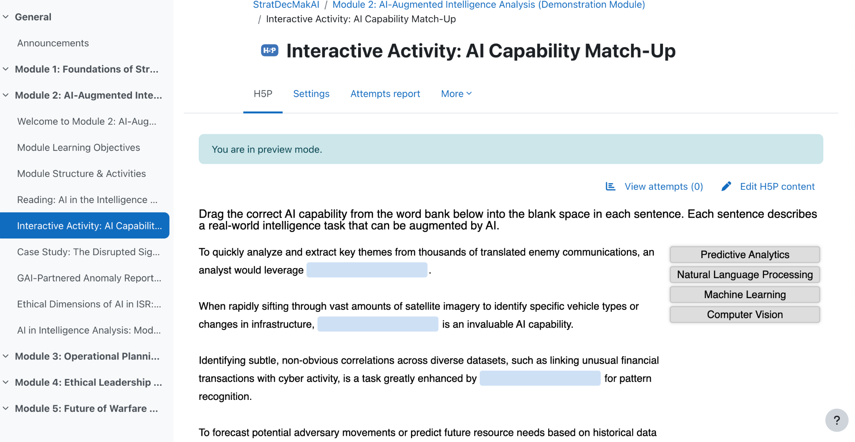

Slide 29
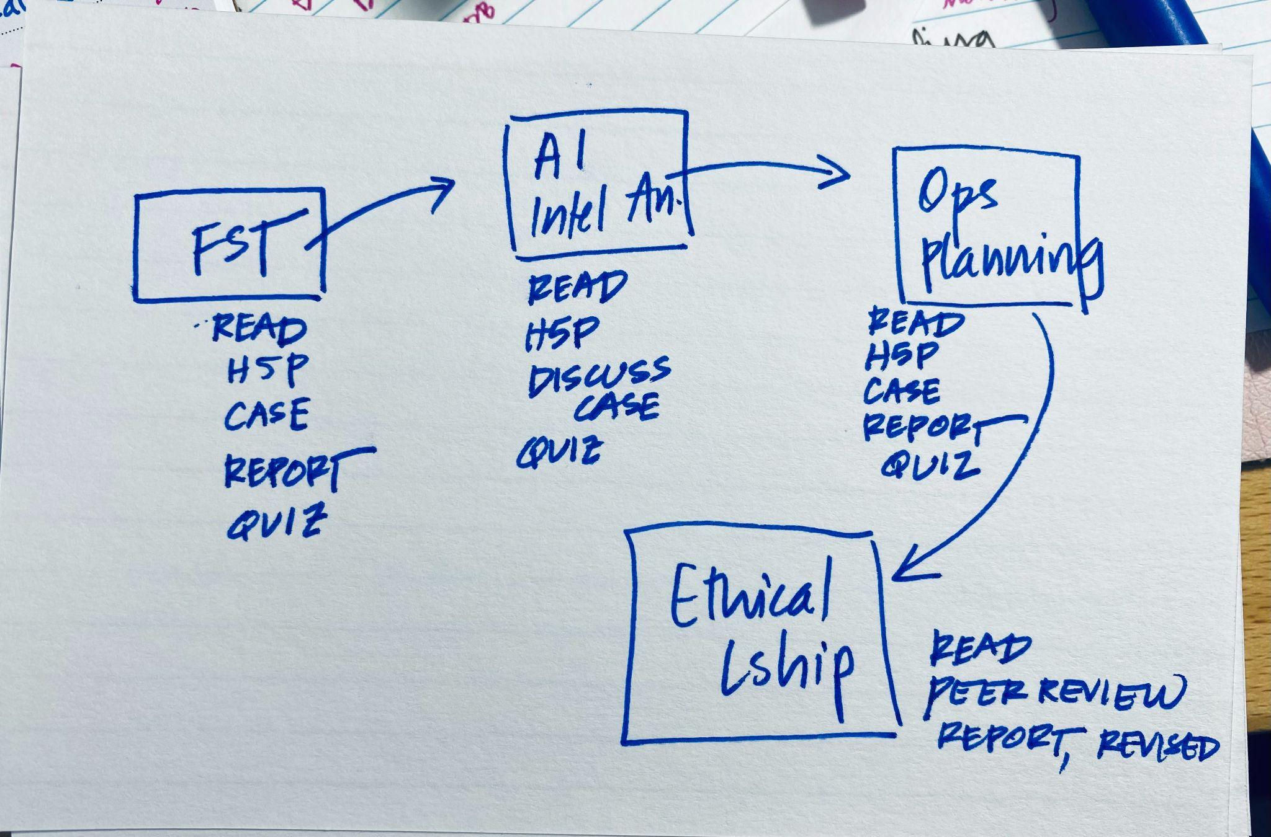
We can simplify the modules and start sketching our low-fidelity prototype.

Slide 30
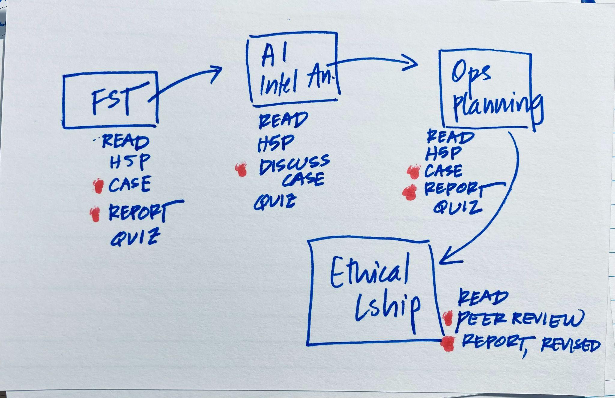
Then, identify the nodes for possible change.
idea

Slide 31
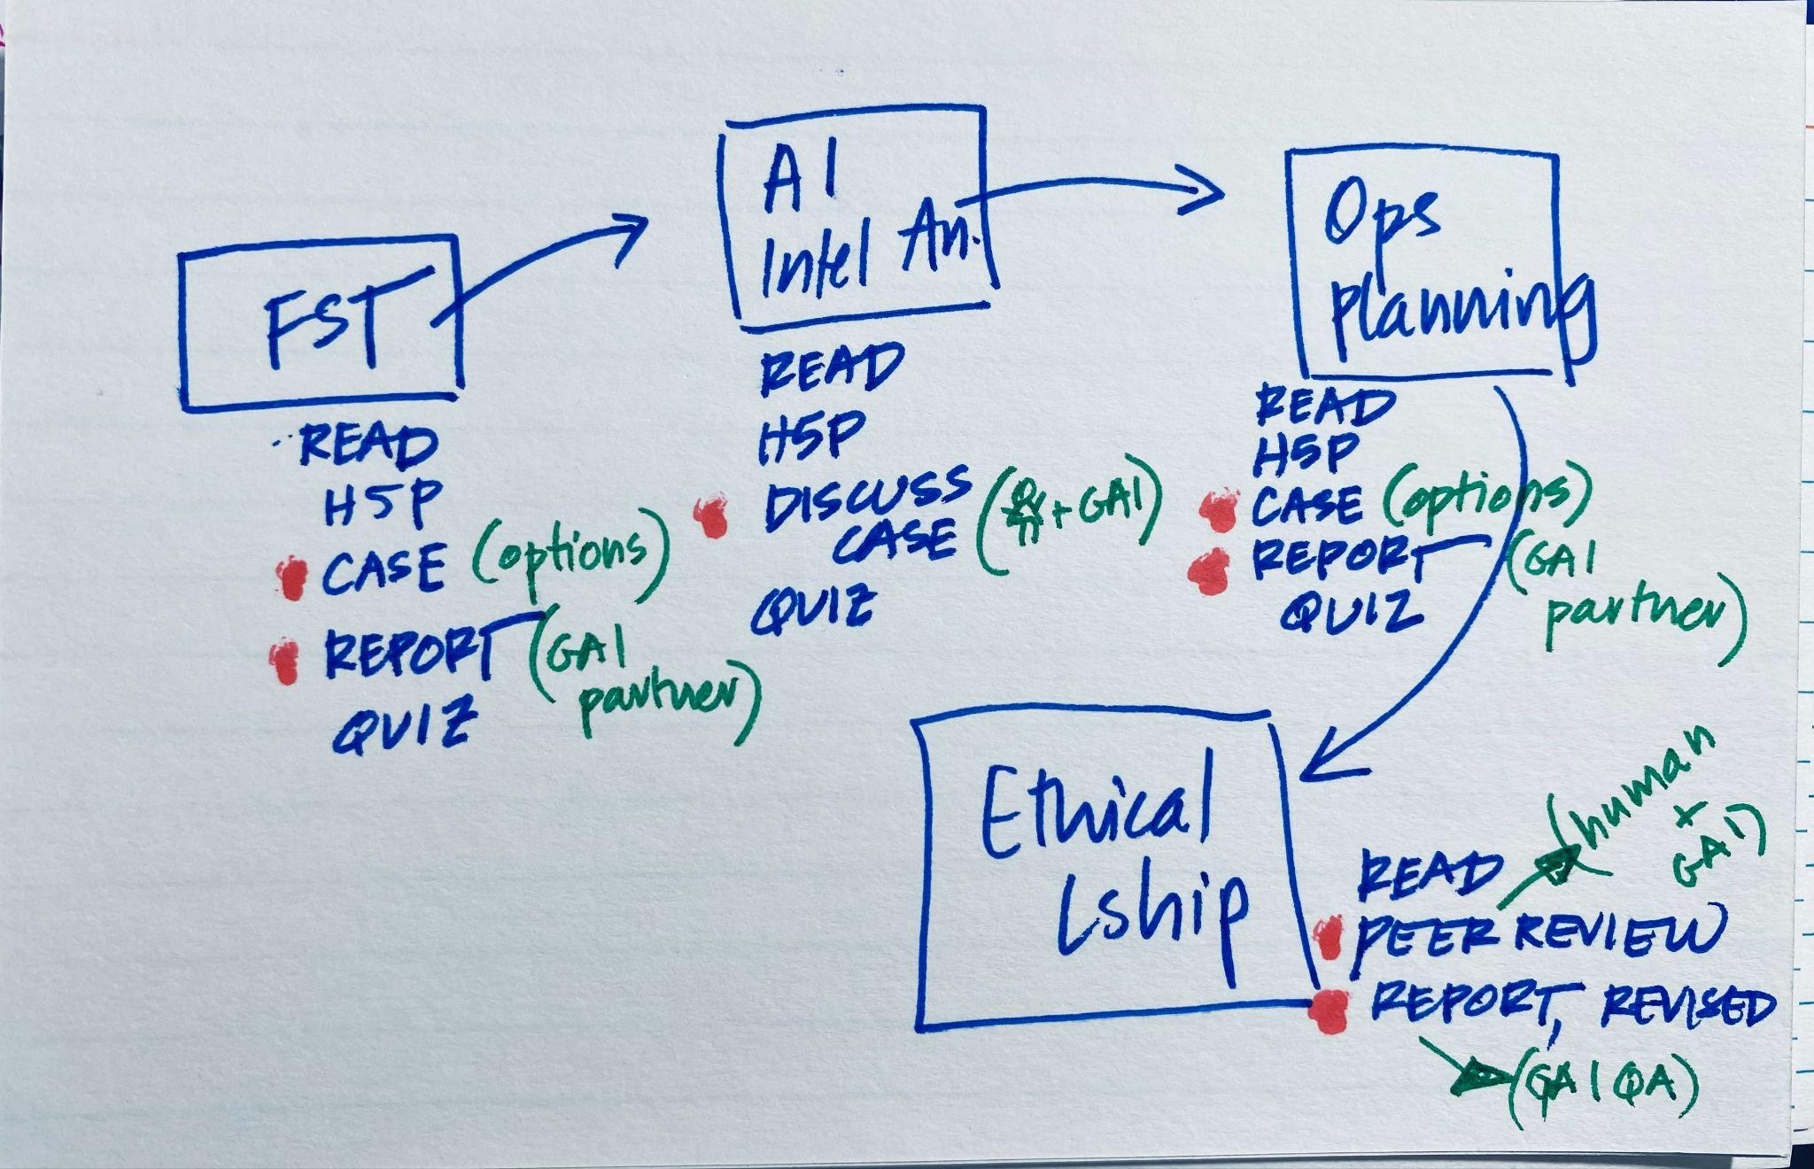
Finally, layer in the type of change you want to make.
prototype

Slide 32

curriculum level rapid prototyping
two initial toolsets to leverage:
educational vignettes
low-fidelity prototyping

Slide 33
educational vignette key characteristics
concise and focused
descriptive and engaging
open ended
thought provoking
relevant and relatable

Slide 34
a sample vignette
Wargaming in PME
Blue Team student has great tactical idea
Briefs fellow students
They do not all agree but do not speak up
How to manage the hesitant silence?

Slide 35
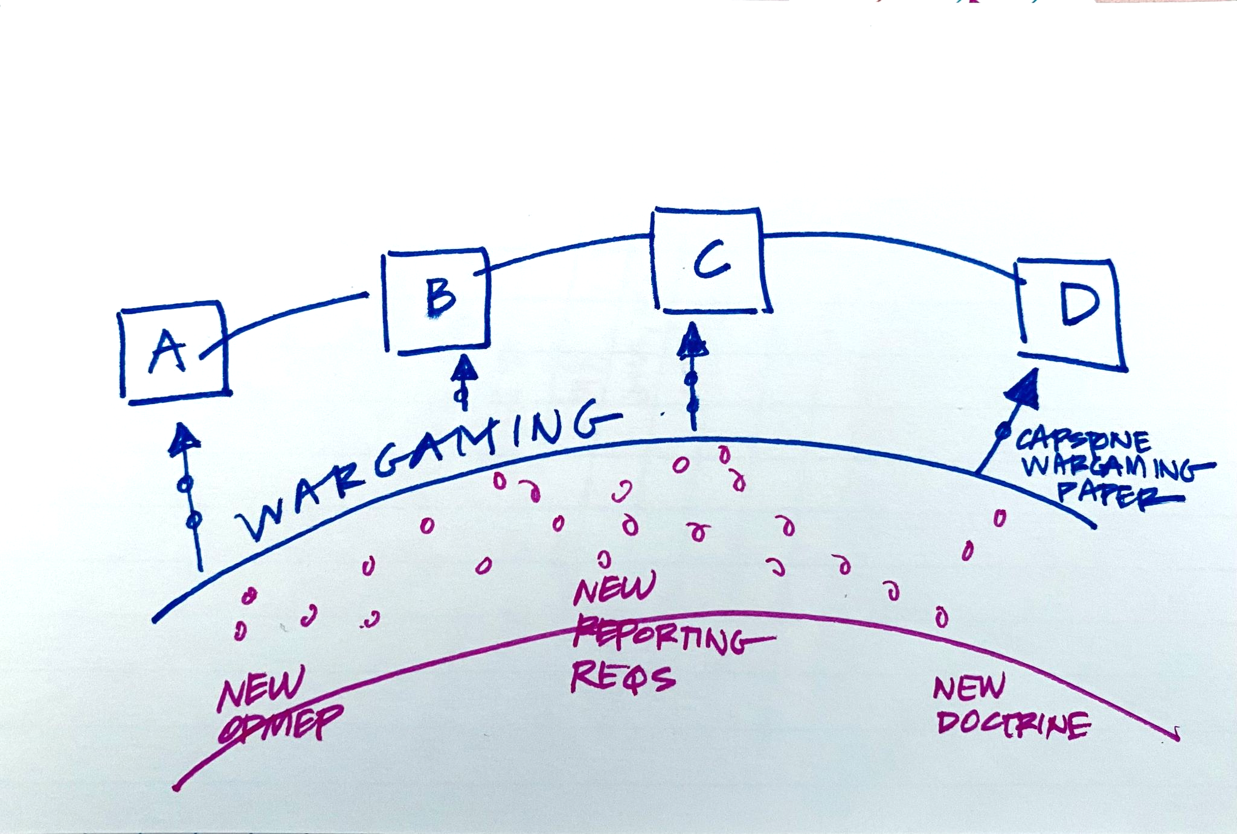
We can view the curriculum through the lens of the vignette and start sketching our low-fidelity prototype.

Slide 36
Then, identify the nodes for possible change.
idea

Slide 37
Finally, layer in the type of change you want to make.
prototype

Slide 38
curriculum analysis
Looking ahead to intersession work:
Select one module/learning objective.
Analyze using the framework.
Brainstorm 2-3 AI integration ideas.

Slide 39
opportunity mapping
Where are the problem nodes? Identify them as GAI partner opportunities.
What is the current approach?
What would a GAI partnered approach look like?
(This directly prepares you for Session 2.)

Slide 41
Questions?

