Slide 1


Organizational Learning Embraces Video
Randy Palubiak
Media Business Strategist
November 30, 2017
Notes:
Organizational Learning Embraces Video
The Impact of The Internet of Things (IoT) and Video Content Management Systems (VCMS)
The Internet of Things (IoT) is all about connecting and controlling devices. According to some, it may be the next greatest thing since…the microwave, smart phones, the Internet. It’s the means by which individuals can control devices throughout their house, car and other connected environments. For organizations, including government agencies, it provides the ability to manage the flow of information and content across the enterprise, managing networks, controlling devices and managing the content, including contributions, access, and tracking views, usage and business results.
Organizations have used centralized video management systems for decades to control media devices in widely dispersed offices and facilities. This includes, what may now be considered basic functions such as, turning on and off designated televisions and devices, issuing record and playback commands, and opening microphones in select training rooms. Leading organizations have used their networks to gather data to track viewing trends and measure business outcomes. So essentially, the concept of IoT is not new to knowledgeable and experienced enterprise video users and vendors. However, today’s technology is far more advanced, providing extensive functionality and video content management capabilities. This enables video content to be readily available and easily accessible, usage to be tracked, and results measured to provide actionable, meaningful business data. In addition, today’s technology facilitates the recording of the entire employee learning experience.
This session will provide insight and guidance to learning, video/media and IT professionals on what organizations are doing to educate, inform and support employees.

Slide 2
The Impact of The Internet of Things (IoT) and Video Content Management Systems (VCMS)
Randy Palubiak
Media Business Strategist
November 30, 2017
Notes:
Organizational Learning Embraces Video
The Impact of The Internet of Things (IoT) and Video Content Management Systems (VCMS)
The Internet of Things (IoT) is all about connecting and controlling devices. According to some, it may be the next greatest thing since…the microwave, smart phones, the Internet. It’s the means by which individuals can control devices throughout their house, car and other connected environments. For organizations, including government agencies, it provides the ability to manage the flow of information and content across the enterprise, managing networks, controlling devices and managing the content, including contributions, access, and tracking views, usage and business results.
Organizations have used centralized video management systems for decades to control media devices in widely dispersed offices and facilities. This includes, what may now be considered basic functions such as, turning on and off designated televisions and devices, issuing record and playback commands, and opening microphones in select training rooms. Leading organizations have used their networks to gather data to track viewing trends and measure business outcomes. So essentially, the concept of IoT is not new to knowledgeable and experienced enterprise video users and vendors. However, today’s technology is far more advanced, providing extensive functionality and video content management capabilities. This enables video content to be readily available and easily accessible, usage to be tracked, and results measured to provide actionable, meaningful business data. In addition, today’s technology facilitates the recording of the entire employee learning experience.
This session will provide insight and guidance to learning, video/media and IT professionals on what organizations are doing to educate, inform and support employees.

Slide 3
Broadcast Television
Who am I?
Video Production
Media Business Strategist for
Enterprise Communications & Training
November 30, 2017
Notes:
Organizational Learning Embraces Video
The Impact of The Internet of Things (IoT) and Video Content Management Systems (VCMS)
The Internet of Things (IoT) is all about connecting and controlling devices. According to some, it may be the next greatest thing since…the microwave, smart phones, the Internet. It’s the means by which individuals can control devices throughout their house, car and other connected environments. For organizations, including government agencies, it provides the ability to manage the flow of information and content across the enterprise, managing networks, controlling devices and managing the content, including contributions, access, and tracking views, usage and business results.
Organizations have used centralized video management systems for decades to control media devices in widely dispersed offices and facilities. This includes, what may now be considered basic functions such as, turning on and off designated televisions and devices, issuing record and playback commands, and opening microphones in select training rooms. Leading organizations have used their networks to gather data to track viewing trends and measure business outcomes. So essentially, the concept of IoT is not new to knowledgeable and experienced enterprise video users and vendors. However, today’s technology is far more advanced, providing extensive functionality and video content management capabilities. This enables video content to be readily available and easily accessible, usage to be tracked, and results measured to provide actionable, meaningful business data. In addition, today’s technology facilitates the recording of the entire employee learning experience.
This session will provide insight and guidance to learning, video/media and IT professionals on what organizations are doing to educate, inform and support employees.

Slide 4
Thought Provoking Perspectives
Vide For Learning

Slide 5
For Video-Centric Organizations…
Vide For Learning
Think Video
….Enterprise Wide!

Slide 6
Anything involving visual (and audio) content, including recordings on hard media, the transmission of the content over a proprietary network (terrestrial or satellite) or content delivery network (CDN) via the public Internet.
Vide For Learning
What is Enterprise Video?
It may be an animation, converted film or series of pictures, PowerPoint or computer generated message.
It may feature a live program, event, training session, executive meeting or other communication.

Slide 7
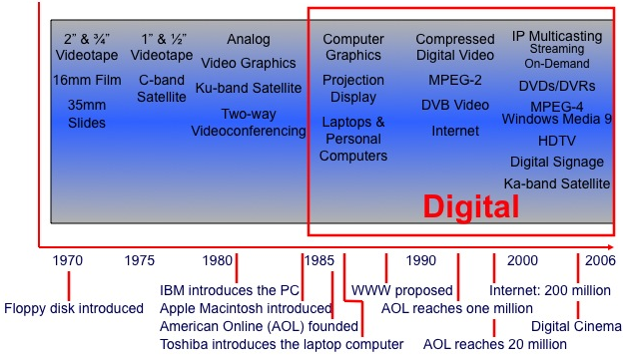
Vide For Learning
Technology Timeline

Slide 8
Vide For Learning
Technology Timeline
Mobility
Social Media
Virtual Reality / Augmented Reality / 360 Video
Internet of Things (IoT)
Artificial Intelligence (AI)
Video Content Management Systems (VCMS)
Top Disruptive Technologies
2017

Slide 9
Vide For Learning
IoT & VCMS
What Employees Want/Need:
Quick, easy, logical access to… concise videos that guide them and support their ability to perform well…where and when required.
Readily Available
Easily Accessible

Slide 10
Vide For Learning
Excellent Resource
Think…
Media Selection Guide
Dr. Jolly Holden
Dr. Philip Westfall
www.fgdla.us
Resource Tab

Slide 11
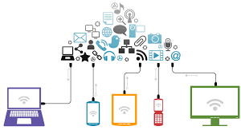
Vide For Learning
Mobility
Reach Targeted Audiences
Anytime,
Anywhere, on Device of Choice

Slide 12









Vide For Learning
Social Media
Create, Share, Collaborate, Interact

Slide 13
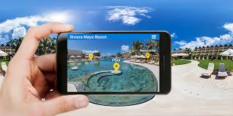
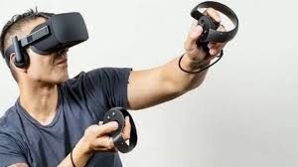
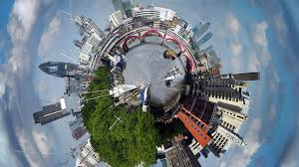
Vide For Learning
VR/AR/360 Video

Slide 14
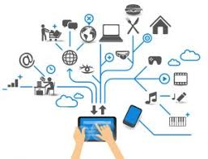

Vide For Learning
Internet of Things
The Internet of things (IoT)
is controlling devices and driving opportunity.
IoT is the inter-networking of physical devices, vehicles, buildings, and other items embedded with electronics, software, sensors, actuators, and network connectivity that enable these objects to collect and exchange data.
Digital Touch Points

Slide 15
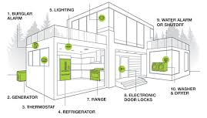
Vide For Learning
Internet of Things
Consumer Devices
Smoke Detector
Lighting
Burglar Alarm
Water System Alarm
Washer & Dryer
Generator
Electric Door Lock
Range
Thermostat
Refrigerator

Slide 16


Vide For Learning
Internet of Things
Business Uses
Devices
Gateways
Backend

Slide 17
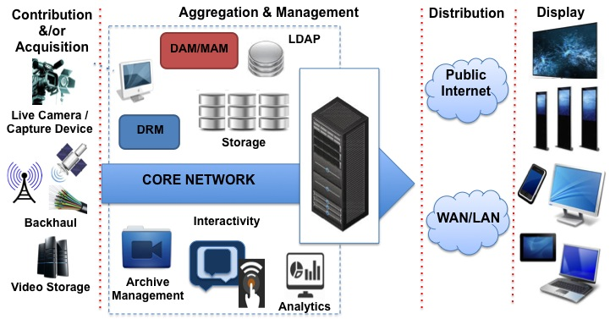


Vide For Learning
Internet of Things
Video Networks
VCMS

Slide 18
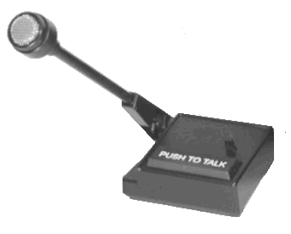
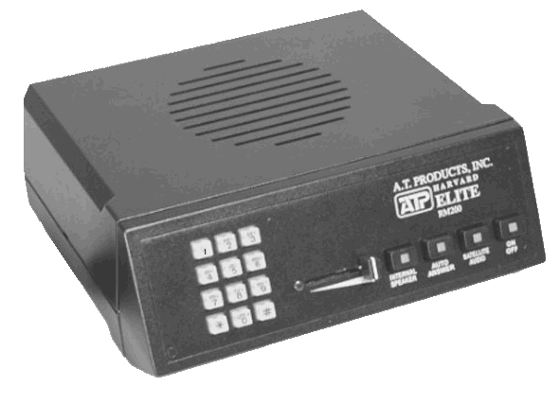
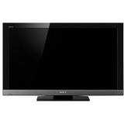
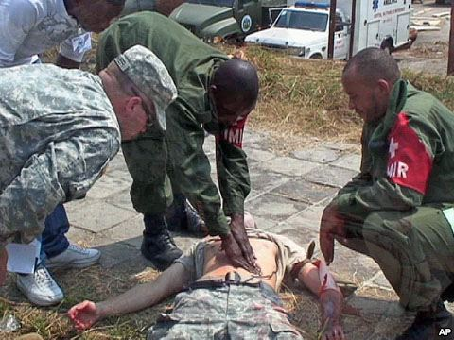

Vide For Learning
Internet of Things
DETN / GETN / MIST
IRD
DVD
IP enabled headend
uplink
Centralized Control of
Network Devices
WAN or WWW return path for interactivity

Slide 19

Vide For Learning
IoT & Big Data
To Track:
Offices
Customers
Investments
Financial Company 1989
uplink
IRD
analog encoder
Centralized Control of
Network Devices
Dial up return path for interactivity

Slide 20

Vide For Learning
Artificial Intelligence
Artificial Intelligence (AI) Machine Learning (ML)
The ability of a digital computer or computer-controlled device to perform tasks commonly associated with intelligent beings.

Slide 21


Vide For Learning
Artificial Intelligence
Visual Perception
Voice Recognition
Decision-making
Language Translation
Learning
Problem Solving
Manipulate Objects
Statistical Methods
Probability
Analytics
Business Results

Slide 22
Vide For Learning
In Today’s Business Environment, Training Organizations MUST:
Leverage Technology
Provide Business Value
Drive Business Results!

Slide 23
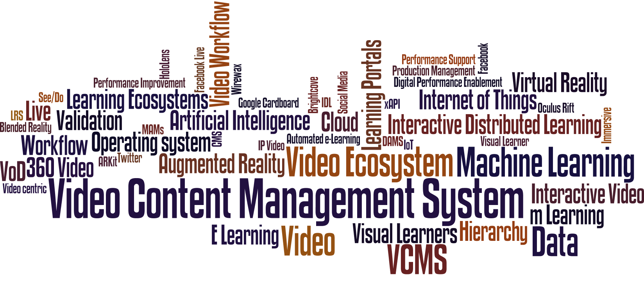
Vide For Learning
Video CMS

Slide 24
Vide For Learning
CMS by Many Names
Training
Content Management System
Communications
Media
Video
Asset Management System
Media Management System
Digital Asset Management System
Document Management System
Enterprise Content Management System
Web Content Management System
IT

Slide 25
Vide For Learning
VCMS Business Drivers
Saving on the cost of large virtual meetings
Driving remote employee engagement
Improving communications from leadership
Improving training effectiveness
Encouraging employees to share best practices
Forrester Research

Slide 26
Vide For Learning
Video Content Mgt
Retail Company
VCMS

Slide 27
Vide For Learning
Video Content Mgt
Content Catalog
Registration
Authentication
Notifications
Interactivity
Testing
Polling
Sharing
Track Viewing Information
Integration with Company Systems:
Human Capital Mgt (HCM)
Human Resource Information (HRIS) and
Management (HRMS)
Employee Training Records
and Accomplishments
VCMS
Business Results

Slide 28
Vide For Learning
VCMS Goals
Eliminate Siloes
Eliminate Redundant Systems…and Costs
May Reduce Number of Vendors/Contracts
Leverage Tools / Systems Across Ecosystem
Leverage / Train Media Staff Resources
Make Video Content
Readily Available & Easily Accessible

Slide 29


Vide For Learning
VCMS Goals
Preserve, Protect
& Leverage
Company Media Assets

Slide 30
Vide For Learning
IoT & VCMS
For Organizations That Use Video…
Leverage the Knowledge and Experience of
Video Providers
They Know IoT &
Video Content Management

Slide 31
Vide For Learning
VCMS Criteria
Understand the company’s learning needs, including content.
What are the types, amount and frequency of training?
Who are the current sources of content and content resources?
Understand the employee interests/needs – from their perspective and terms.
How do they prefer to be trained? When, where and on what device(s)?

Slide 32
Vide For Learning
VCMS Criteria
Identify Stakeholders.
Who are the executives, departments and individuals to use or support corporate learning?
Understand how critical video’s role is in the learning process.
Differentiate between live, live interactive and on-demand uses.

Slide 33
Vide For Learning
VCMS Criteria
Identify how video will be supplemented, complemented with other media.
Identify existing technologies, systems and capabilities or limitations.
How are the learning systems performing and meeting your needs?
Understand technology and system gaps?
What functionality and capabilities and/or are needed?

Slide 34
Vide For Learning
VCMS Criteria
Identify how video will be supplemented, complemented with other media.
Are there unnecessary redundancies of technology or vendors?

Slide 35
Vide For Learning
VCMS Next Steps
Identify existing and additional capabilities that are available from current vendors.
Establish business justification criteria, including: budgetary costs, timeline and service agreement conditions.
Identify and staff knowledgeable and skilled resources.
Identify viable video vendors and solutions for consideration.

Slide 36
Time for Questions, Answers and Engaging Interaction
Vide For Learning

Slide 37
Thank You
Randy Palubiak
770-590-1590
rp1@enliten.net
enliten.net
November 30, 2017

Slide 38
  Media Business Strategies
  on
  Video & Dynamic Media
  in the Enterprise

