Slide 1









Slide 2
Telepresence in the U.S.
Federal Government
Russ Colbert, US Federal Government Market Director &
Board Member FGDLA
Notes:
In equipping students for the global workplace, educators must teach differently. Enabled by virtual technologies, more ubiquitous Internet access and the proliferating tools of Web 2.0, educational institutions are more empowered than ever to meet the demands of our rapidly changing society. Through knowledge sharing and collaboration educators can transform the learning environment, motivate and engage students.
Today we will talk about how universities are working together by utilizing our technologies to connect, collaborate and create! But first let’s talk a moment about the why…
What trends are forcing us to change…

Slide 3
Agenda
What is Telepresence?
Global Trends
Applications- What’s Hot
Unified Communications (UC) Demonstration- David Colbert, Briefing Manager (Telepresence link)
  Interactive content (all rooms bridged together from Herndon, VA), flexibility/walking throughout the training location, ITP RPX, OTX, Room-based Truman-Eagle Eye Director
Case Studies, FAU and Navy Learning Network
Summary, Discussion, Q & A

Slide 4
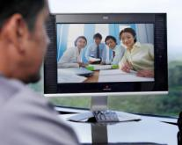
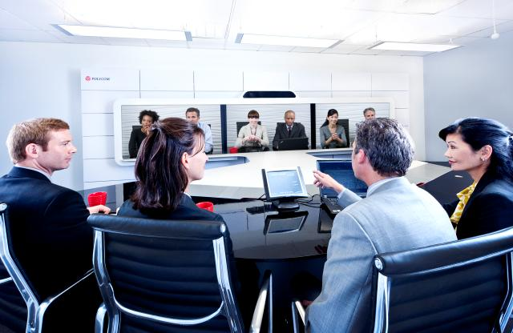
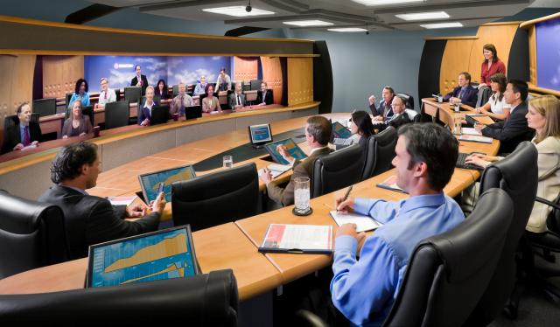
What is Telepresence?
Personal Telepresence
  Desktop solutions (Skype, CMA, m100)
  Mobile devices (smart phones & tablets)
Room Telepresence
Immersive Telepresence (ITP)
Specialty solutions- practitioner cart, education packages, kiosk and more…
Specialty capabilities- automated cameras, annotation, SRS, closed caption, content sharing, LPR, chat, redundancy…
+90% of global communications travel over IP circuits for increased quality, speed and efficiency
Bridges used for automated multipoint connections
Communications can be synchronous or asynchronous, streamed, archived, edited and integrated into Learning Management Systems

Slide 5








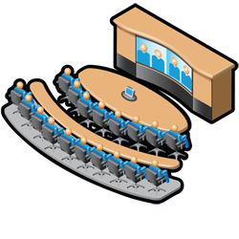






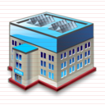


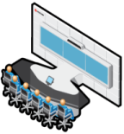
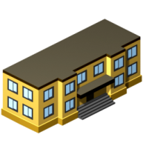



Telepresence Connectivity Examples
EDUCATION & TRAINING
HOME STUDENT
Remote Students
SIP Phone and HD Video End Point
Dorm Living Spaces
Fully Immersive
Classroom
Teacher
SIP Phone and Personal Telepresence
SIP Voice and Video Application Phone
Room Participants
Expert/Facilitator
CONTENT PROVIDERS
MOBILITY
University
Wireless Network
Wi-Fi/3G/4G/Satcom
Museum
Music School
Mobile Phone or Tablet
HR Department
Mobile Video
Conferencing Unit
Wearable Video Communication
Video Conferencing Client on Laptop
Science Lab
Text Author

Slide 6


Federal Government Trends
Organizational Challenges
Technology Enablers
Global Economy
Shrinking Budgets
Increased competition
Technology certification
Need for increased performance, efficiencies, team collaboration, remote workers, ROI
UC Platforms/BB IP Networks
Ease of connecting in real time, recording or archiving
Presence
Telepepresence
Mobility
Automated, Integrated and Cloud Solutions
Social / Cultural Shifts
Lifestyle Choices
Instant Communications
Desire for the best content anytime, anywhere
Remote teams
Secure Agencies/Departments
Traditional vs. Virtual Offices
Workforce Development

Slide 7

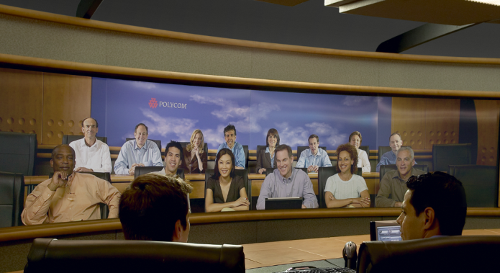
Federal Government Applications- What’s Hot
  Training, Education and Development- E Learning
  Administrative meetings/briefings
  Interviewing and recruiting
  Telejustice, C4I
  Crisis management
  Procurement and contracting
  Resource sharing
  Campus extensions
  Connecting to enterprise partners
  Professional development
  Access to content experts and
  guest lecturers
  Digital content – stored libraries, lectures, proceedings, meetings, development progress
  Equity building
Notes:
7
Pick 3 hot applications depending on the audience to mention and draw out the specific associated benefits. It’s not intended to review every bullet.
For Example: Travel for administrators-
Hard to manage schedules that are inundated with meetings
In some areas, administrators travel to different campuses
Applications
Administrative Meetings – enable collaboration and information sharing between key organizations, staff, and locations, board of regents, government agencies and partners. Virtual attendance enables administrators to be in more than one place at a time and allows you to manage geographically dispersed activities all in a single day.
Student Services – meet mandated requirements to provide access to student services at all locations by providing a virtual presence at remote campuses
Interviewing, Recruiting – increase student placement opportunities and streamline recruitment of new employees by virtually conducting interviews
Grant Coordination – streamline coordination to develop grant applications and meet grant requirements between all participating parties and governing entities
Research Projects – coordinate efforts across all institutions and with joint partners quickly and efficiently while optimizing collaboration and meeting documenting requirements
Applications
Degree and Non-Degree Programs – expand course offerings to remote campuses, businesses, and students
Global Studies – expand international programs through providing a natural, "across the table" experience where on-screen participants are shown in true-to-life dimensions. Participants can interact with and read the body language of others—just as if all were in the same room.
Professional Development – bring in the guest speaker or subject matter expert, promote graduate degree and certificate programs and deliver knowledge to business partners
Active and Group Learning – enhance the student experience in online courses by adding synchronous work groups and collaborative team projects to the curriculum
Dual Enrollment and Advanced Placement – extend course offerings to secondary schools through utilizing synchronous visual communications
Campus to Campus Teaching – expand reach by using Polycom advanced infrastructure solutions to connect point to point or with multiple class locations
Research Projects – meet personnel at all locations, define and assign work, collaborate, then discuss findings and publish results faster and more efficiently
Guest Speakers/Lecturers – remotely bring in guest speakers and lecturers to save travel expenses and realize lower speaking rates, or have the speaker on site, stream the presentation live, and also record for later viewing
Benefits
Increase Student Enrollment – utilize virtual connections that are scalable and enable access to more geographically dispersed students
Manage a Faculty Shortage – expand faculty reach to remote campuses and students through virtual extensions of the classroom without investing in bricks and mortar
Rapidly Transfer Knowledge – provide a higher level of information for staff and organizational leaders with the ability to collaborate and coordinate faster
Enhance Safety, Security, Efficiency, and Effectiveness – instantly verify points of contact, communicate instantaneously with vocal and visual access, view reactions to decisions, provide greater safety, security, and rapid communications with a sound of a voice or the touch of a button
Improve Mobility – comply with a changing society to allow administrators, faculty, and staff to connect and collaborate where and when desired
Achieve Cost Avoidance and Generate Revenue – save resources by reducing travel while increasing revenue through reaching alumni, offering professional development to businesses, and increasing student enrollment from the extended reach
Provide Greater Accessibility – extend the reach by enabling faculty and students to connect and collaborate quickly
Improve Student Learning Outcomes, Reduce Attrition – blend video, audio, and online technologies to create the optimal environment for learning. Video conferencing provides a synchronous face-to-face environment in which remote students interactively engage with content and subject matter experts.
Achieve Time Savings – allow faster course transitions and better economies of scale compared to traditional teaching by reaching more students for less money
Enhance Instructional Design – virtually access resources including content, content providers, and subject matter experts to greatly improve course design and the learners experience
Integrate with Other Learning Tools – easily integrate with leading learning management and course management systems, annotation boards, multimedia content, network infrastructure, and phones

Slide 8
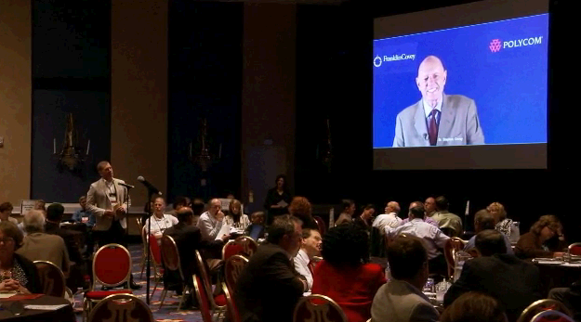
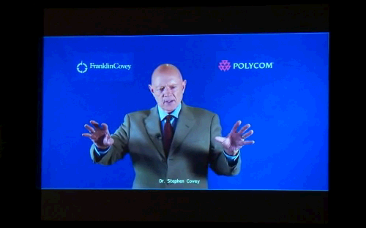
Applications Example – Guest Speaker
Dr. Stephen R. Covey

Slide 9
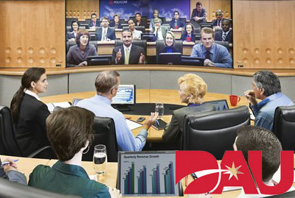
Best Practice: Defense Acquisition University
Challenges
  Expand Senior Service College Fellowship (SSCF) Program
  to other DAU locations
  Legacy ISDN Network
  Difficulty Connecting Locations, Continuity of Connectivity
Solution
  RealPresence™ Experience (RPX™) immersive telepresence solution
  RMX 2000 real-time media conference platform
  Converged Management Application™ (CMA™) solution
  Video Network Operations Center (VNOC) service and full suite of services
Results
  Quarterly in person meetings replaced with Telepresence, resulting in estimated savings of $41,000 over 500 hours of travel time and 21,000kg of carbon emissions
  Savings of $255,000 in first year of operation
  More engaged students in SSCF program
  Ability for students to interact with nationally known speakers
  More effective face-to-face communication with DOD and armed services senior leadership
  Time and cost savings associated with reduced travel
Improved quality of learning and increased student engagement
“With Telepresence, you become one with your environment. In about two to three minutes, you forget you’re separated from other participants.”
─ James McCullough, Dean – South Region, Defense Acquisition University“
Notes:
Defense Acquisition University (DAU) educates and certifies acquisition, technology and logistics (ATL) professionals for DOD, along with other government agencies and defense-related private industry.
DAU students manage acquisition and logistics for all military systems and administer contracts worth billions.
Daily Use
Distance learning
Internal communications
Administrative meetings
Training
Interviewing
Remote site communications

Slide 10
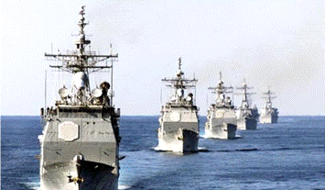
Success Story: U.S. Navy VTT Project
Challenges
  To effectively and efficiently provide updated training programs to service members deployed on ships and shore facilities while keeping morale up with little access to family
Solution
  Polycom Custom Equipment Suites
  Polycom MCU
  Desktop platforms
  Touch Control
  Tracking Cameras
Results
  A nationwide, 44-classroom implementation that enables a multitude of distance education and training programs, ship-to-shore communications, emergency communications and and face-to-face and family reunions
  ROI
  Much more!
“The network is in constant
demand with a multitude of applications that allow Navy
trainers, administrators,
officers and enlisted personnel
to video communicate
on shore or at sea.”
─ Jean Jones, AGT Program Manager
Video Teletraining Solutions
for the U.S. Navy e-Learning System
Notes:
Defense Acquisition University (DAU) educates and certifies acquisition, technology and logistics (ATL) professionals for DOD, along with other government agencies and defense-related private industry.
DAU students manage acquisition and logistics for all military systems and administer contracts worth billions.
Daily Use
Distance learning
Internal communications
Administrative meetings
Training
Interviewing
Remote site communications

Slide 11
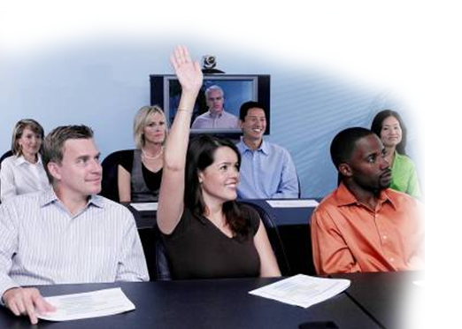
Summary, Discussion, Q & A
russ.colbert@polycom.com
Thank You!

