Slide 1
Utilizing the MIST to Provide Diabetes Patient Education
Nina Watson MSN, RN, CDE
Diabetes Center of Excellence
Wilford Hall Ambulatory Surgical Center, Joint Base San Antonio, TX

Slide 2
Acknowledgements
DSME MIST Team
Dave Beavers
DCOE Support
Connie Morrow
Ellen Cobb
Jana Wardian
Tom Sauerwein
Austin Hoover
Disease Management
  Randolph AFB
  Doris Acuna
  Debbie Mason
  Jennifer Wilhelm
  Charles Foulk
  Corpus Christi NAS
  Christine Yuhas
  Laughlin AFB
  Pinky Martinez

Slide 3

Air Force Medical Operations Agency (AFMOA) conducted enterprise wide AFSO21 (Air Force Smart Operations for the 21st Century) on diabetes care and education [2010]
  Diabetes care non-standardized and fragmented
  Diabetes Center of Excellence (DCOE) tasked with addressing/standardizing care and education

Slide 4
Efforts to Standardize:
Diabetes care:
  Diabetes Champion Course
  Diabetes ECHO
  Diabetes Central
  Diabetes webinars
Education
  Hub & Spoke Model
  Scripted slide set on AF Knowledge Exchange
Notes:
If you attended my colleague, Connie Morrow’s presentation earlier, she covered the initiatives we implemented for professional education to promote standardization of care. All efforts targeted the healthcare team.
For education, we initially looked at a Hub & Spoke Model, but it proved cost prohibitive as it would require at least 10 FTEs as well as travel funds.
We did develop a series of scripted powerpoint presentations that could be utilized to provide education at a local area. These proved helpful, but effectiveness varied according to the level of the educator’s expertise, comfort with the material, and the time that could be dedicated to providing the education.
And while the Navy Health Promotion office did adopt our powerpoints as their diabetes education template, the varied experience levels of the educators and resource availability did not provide the desired standardization.
So we still had a ways to go providing standardized education programs.

Slide 5

Notes:
In 2013, I was sitting in a conference of the American Association of Diabetes Educators and listened to a presentation on providing diabetes education via a televised broadcast to outlying clinics in a large metropolitan area in the Great Lakes area. A light bulb went on. Why couldn’t we use something like this in the DoD? We currently communicate via satellite all over the world, even at the most isolated forward bases.

Slide 6

Notes:
There are a number of small medical treatment facilities throughout the DoD that are located in areas with limited healthcare resources.
The DCOE has a Diabetes Self-Management Education Course recognized by the American Diabetes Association.
The AF/DoD has the technology.
Seemed like a no-brainer, right?

Slide 7

Notes:
Well as we all realize, things in the DoD don’t come that easily. So how to make this work. Today, I want to share some of our experiences, challenges, and successes, that we encountered to make this happen.

Slide 8


Prevalence of Diabetes
Notes:
First, to understand the value of Diabetes Self-Management Education, I want to provide you a crash course in Diabetes.
We’ve been sitting for awhile, so I would like everyone to stand up. Stretch a little bit, get the kinks out.
Now
If you have no idea of what diabetes is, you’ve never seen a commercial, read an article in a paper or magazine or known of someone with diabetes, please sit down.
Remain standing if you actually know of someone who has diabetes.
Remain standing if that someone is a close friend or family member.
Remain standing that someone is you or a family member.
Diabetes tends to touch us all.

Slide 9
Crash Course in Diabetes
Diagnosis
Types of Diabetes
Prediabetes
  Fasting blood glucose
  A1C
Diabetes
  Fasting blood glucose
  A1C
Type 1
  Autoimmune
  Insulin required
  Lifestyle
Type 2
  Genetic/lifestyle
  Lifestyle
  Medications
    Oral
    Injections
Notes:
Diabetes is a metabolic disorder where the body is unable to produce and or utilize the insulin needed to process glucose for energy.
Diabetes has many faces. It is not a one size fits all, nor is the treatment or management one size fits all.
Diagnosis is pretty straight forward.
A normal blood glucose is 70-100
Fasting blood glucose of 100-125 or an A1C of 5.7-6.4 diagnoses Prediabetes
Fasting blood glucose of 126 or greater or an A1C >6.5 diagnoses diabetes
A random blood glucose of 200 or greater, with symptoms, can also be used but is usually followed up with a fasting glucose.
Typically, diabetes is designated as Type 1, Type 2, Gestational, and Other.

Slide 10


Prevention!!
  Healthy weight
  Active Lifestyle
Treatment/ Management
  Diabetes self-management education and support (DSMES)
  Lifestyle
  Medication
Notes:
The best way to manage diabetes is to prevent it in the first place.
Diabetes is a progressive disorder. It will progress, which can be very frustrating for patient and provider alike, but how fast it progresses is dependent on how well the individual manages their diabetes.
The Diabetes Prevention Program (DPP) was a major multicenter clinical research study that was published in winter of 2002. The DPP showed that by maintaining an active lifestyle and healthy weight, one can prevent or at least delay the onset of Type 2 diabetes.
Regardless of the type of diabetes, be it 1 or 2, the principle treatment strategies are education, medication, and, especially for Type 2’s, lifestyle modifications. Type 1 will always require insulin. Healthy lifestyles are important for quality of life.
There are many professional organizations, including the VADoD, that define what diabetes care and management should be.
At the DCOE, we primarily use the VADoD, and American Diabetes Association guidelines for management. And the ADA and American Association of Diabetes Educators guidelines for education.

Slide 11

Prevalence
  >30 million with diabetes in the US (9.4%)
  24% unaware they have it
  Medical costs 2x as high
  Risk of death 50% higher
https://www.cdc.gov/diabetes/pdfs/data/statistics/national-diabetes-statistics-report.pdf
Notes:
As we saw in our exercise earlier, there are a large number of individuals touched by diabetes.
It is a costly disorder, both directly (hospitalizations, medications to treat diabetes and the complications of diabetes, provider office visits) and indirectly (absenteeism, reduced productivity, inability to work due to disability, and early mortality)
Health & Human Services report on Texas for Calendar Year (CY) 2011. Diabetes in Texas was responsible for an estimated $18.5 billion in costs during CY2011: $12.3 billion in direct medical costs and $6.2 billion in indirect costs.

Slide 12
Prevalence
  >30 million with diabetes in the US
  25% unaware they have it
  Medical costs 2x as high
  Risk of death 50% higher
>156,000 people with diabetes in the DoD (6.7%)
  Air Force > 58,000 (7.8%)
  Army > 60,000 (6.9%)
  Navy >37,000 (6.7%)
Notes:
A bit closer to home…

Slide 13

Bulk of diabetes care in the US Air Force provided by Primary Care
  9 endocrinologists
  ~10 CDEs in dedicated positions
  Varying levels of expertise/interest
    Diabetes Champions
    Disease Managers
  Inconsistent levels of care/education

Slide 14

Diabetes Self-Management Education and Support (DSMES)
Critical element of care for all people with diabetes and those at risk for developing diabetes
Facilitates knowledge, skills and ability necessary for diabetes self-care
Assist implementing and sustaining behaviors needed to self-manage
Individualized / patient-centered
  Priorities
  Concerns
On-going, lifetime need
2017 National Standards for Diabetes Self-Management Education and Support. The Diabetes Educator, 43(5), 449-464
Notes:
Diabetes education is not a “cookie cutter” program. In other words one size does not fit all
A common misconception in diabetes is that everyone needs the same thing.
A common misconception in education or health care is that giving someone facts, telling an individual what they need to do, translates into an action that improves health.
If that were true, none of us would be overweight, fast food businesses would not exist, and I wouldn’t have a job.
Each individual with diabetes has different needs, lives in a different environment, responds differently to medications, etc.
Another misconception is that diabetes education is a one time deal. It is not. It is a life long learning process as situations change, bodily needs change, and treatments change.

Slide 15

Components of a DSMES Program
Curriculum
  Diabetes pathophysiology and treatment options
  Healthy eating
  Physical activity
  Medication usage
  Monitoring and using patient-generated health data
  Preventing, detecting, and treating acute and chronic complications
  Healthy coping
  Problem solving
Notes:
So what does diabetes education look like?
If the program is recognized, it is overseen by a Quality Coordinator who is responsible for managing, monitoring and maintaining the program.
Interdisciplinary team is ideal to provide the education and support. Each member in addition to the expertise they bring to the table in their field, also should stay up on the latest research and developments in diabetes. For a recognized program, they are expected to complete 15 continuing education hours in a diabetes related topic each year.
Here you see a list of the topics that should be covered during diabetes education. This cannot be done in a couple of hours. Typical recognized programs are up to 10 hours long. At WHASC, we provide 10 hours of initial education over 4 classes.
Most insurances and Medicare will pay for that initial 10 hours education and 2 hours annually for subsequent refresher education or as needed for documented changes in treatment.
There is a significant difference between incidental education that happens at a provider visit and a diabetes education and support program or service.
That was where those 10 FTEs came in on the original recommendation.

Slide 16

Notes:
Back to the no-brainer.
The DCOE could provide a standardized DSME program that is recognized by the American Diabetes Association.
So we talked to the ADA to see what our options were for broadcasting our DSMES program.

Slide 17

DSME via Telehealth
An interactive real time telecommunications system is required. The patient and provider must be able to see and hear each other.*
Patient must be present and participate in the telecommunication
ADA Education Recognition Program Guidelines
Notes:
Do come to find out, the ADA already had guidelines in place for DSME via Telehealth.
The guidance is reflective of the current definition by Medicare for Telehealth, but is still restrictive when you look at all the options we have for telehealth today.
Telemedicine unfortunately means different things to different people. In the strictest interpretation, the encounter must be real time, face to face in order to code as such and get reimbursed.
Research however supports a variety of modalities, timing, and structures to be effective.

Slide 18
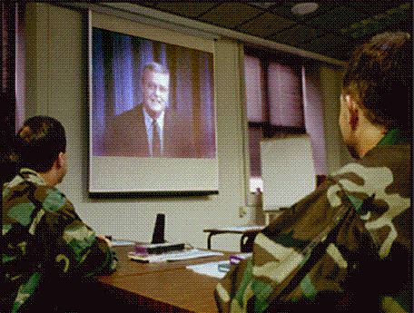

DSME via Telehealth
Originating Site
  Location of the patient
Distant Site
  Location of the educator
Notes:
Originating Site
Location of the patient
Does not have to be ADA/AADE recognized and may bill for third party insurance
Distant Site
Location of the educator
Distant site has to be ADA/AADE recognized
DCOE DSME recognized by ADA since 2007
Reimbursement same as if provided in person

Slide 19
DSME via Telehealth
Diabetes education via telemedicine and in person was equally effective in improving glycemic control, and both methods were well accepted by patients. Diabetes-related stress reduction was observed in both groups.
Izquierdo, Knudson, Meyer, Kearns, Ploutz-Snyder, & Weinstock (2003)
Multi component telehealth strategies effectively utilized to conduct remote DSME to rural, underserved, and clinically diverse primary care setting.
Davis, Hitch, Salaam, Herman, Zimmer-Galler, & Mayer-Davis (2010)
Literature review (852 publications) suggests that both teleconsultation and videoconferencing are practical, cost-effective, and reliable ways of delivering a worthwhile health care service to people with diabetes.
Verhoeven, van Gemert-Pijnen, Dijkstra, Nijland, Seydel, & Steehouder (2007)
Literature review (58 publications) supports DSME-T as useful, appropriate, and acceptable to patients and providers.
Fitzner & Moss (2013)

Slide 20

Diabetes Patients
Healthcare
Bridge?
ADA Recognized DSME Program
Technology source?
Notes:
So that “no brainer” of an idea seemed like it might just fill the patient education gap by providing a standardized education program throughout the AFMS.
We just needed all the pieces…
The patients are there, but need a way to coordinate classes locally – schedule patients, arrange for classroom, check them in, etc.
We have the ADA recognized program, but what source can we use for transmission?

Slide 21
Healthcare
Bridge?
Disease Managers
  Population identification
  Evidence-based clinical practice guidelines to reduce practice variation and improve care*
  Collaborative practice models*
  Patient self-management education**
  Process and outcome measurement, evaluation, and management*
  Feedback and reporting to stakeholders
Notes:
In the Air Force medical systems, there are nurses who have been identified as Disease Managers to help the PCMH team identify and manage their chronic disease populations.
Not that 2-5 all reflect aspects of a DSMES program, especially number 4.
We thought, great, we can become a tool in their tool box and assist them by providing a standardized program.

Slide 22
Diabetes Patients
Disease Managers
ADA Recognized DSME Program
Technology source?
Notes:
We identified potential facilitators at the MTFs, now how to get the education to them?

Slide 23



Technology source?
Skype and other web-based conference software
Video Tele-Conference (VTC)
  Not available at all MTFs
Medical Interagency Satellite Training Program – MIST
  VTC interim
  Studio at WHASC
Notes:
Air Technology Network (ATN) is located at Wright-Patterson AFB, Ohio
Mission is to promote, manage and deliver instructional broadcasting for DoD distance learning programs and other interactive television (ITV) users

Slide 24
Diabetes Patients
Disease Managers
ADA Recognized DSME Program
Technology source
Notes:
Okay, we now we have all the pieces, but will it work?

Slide 25
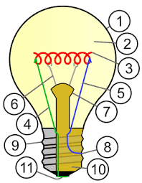
Implementation-Pilot Study (2016)
Partnered with Randolph AFB Disease Managers
Provide DSMES to Patients at Randolph
DMs help to evaluate and improve the program
Notes:
After we validated they had a MIST classroom, the DMs agreed that we would provide education for their patients sitting at Randolph Clinic and they would help us evaluate and improve the program.
This in turn led to a:
Curriculum Review
Identifying Assessment Tools for evaluation of the patient needs and effectiveness of the program
Documentation Tool
As well as Training for DMs

Slide 26

Challenges: Originating Site
Leadership/Clinic support
Venue/MIST Classroom
Broadcast issues
  Location of TV screen
  Quality of picture
  Technical difficulties
  Lack of tech support
  Patient flow
Notes:
Originating site:
Location of TV within conference room
Quality of picture, especially when using whiteboard
Loss of audio or video
Microphone issues
Changes in equipment/lack of technical support
Reserving the conference room
Learning how to operate the MIST equipment
Computer unavailable in room
Delayed documentation

Slide 27

Challenges at WHASC
Faculty buy-in
Scheduling
VTC venue
  Poor images
  Camera position
  Power outages
  High circuit volume, audio/visual loss
  Background noise
Time lag for 2-way conversation
Notes:
Getting faculty buy-in
Scheduling classes
VTC room—location, conflicts
Coordination with Randolph for attendance
Comfort in front of camera
Remembering to look at camera
Soliciting input from distant audience
VTC to satellite link, technical issues
Power outages
High circuit volume, audio and visual loss
Overhead mikes—difficulty hearing speaker, picks up background noise
Time lag for 2-way conversation (3-6 seconds) [emphasize length of time by pausing 3 sec]

Slide 28
Provider Experience
Overall satisfaction was high: 5.24 on 6pt scale
All 25 responses stated they would organize another class in this format

Slide 29
Provider Issues
Some issues with audio/video reported.
Four reports of difficulties in setting up technology early in the process. They are now resolved.

Slide 30
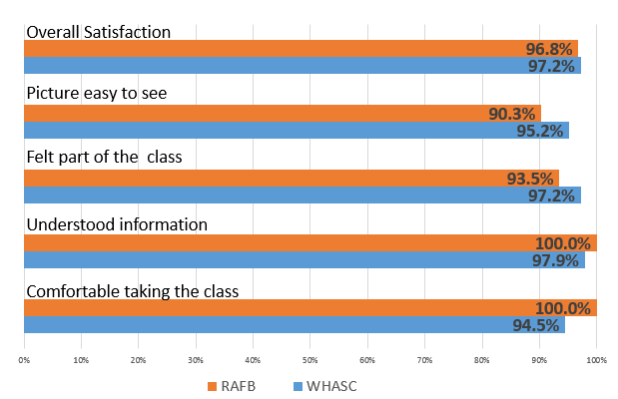
Patient Experience:
No Significant Differences

Slide 31
Significant Differences in Patient Experience (n=289)
Convenient**
Notes:
Ways we have addressed:
Questions: DM would ask the questions, encourage them to talk, place mike conveniently
Hear well: Challenge was the soft spoken faculty. Studio will have collar microphones.

Slide 32
Knowledge at Baseline and Completion
N=76
*=p<0.05; **=p<0.01
No differences by gender

Slide 33

It Appears to Work!
  Presented findings at the American Association of Diabetes Educator Annual Meeting August 2016
  Began process to stand-up MIST studio
    DETN
      Equipment
      Training
  WHASC
    Bureaucracy
    Move to new building
    Contracting issues

Slide 34


Slide 35

To the Rescue
External support
  DETN
  AFMOA
  AF Surgeon General Office
Internal support
  DCOE Medical Director
  Commander
  Project Coordinators
Notes:
Fortunately some saw the potential of our project.

Slide 36
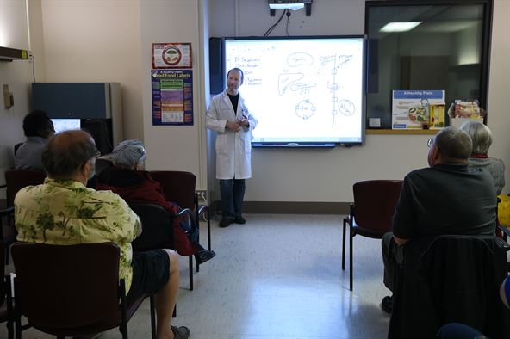
http://www.airforcemedicine.af.mil/MTF/Randolph/News-Events/Article/1051495/wing-pioneers-innovative-diabetes-education-program/
59TH MEDICAL WING NEWS
Wing pioneers innovative diabetes education program
By Staff Sgt. Kevin Iinuma, 59th Medical Wing Public Affairs / Published January 17, 2017
The DCOE, part of the 59th Medical Operations Group, began piloting a satellite-based real-time interactive DSME program in 2016, providing up to 10 hours of ADA-recognized educational material directly to patients via the MIST platform,
and an in-person class at the Wilford
Hall Ambulatory Surgical Center. The
program, a series of four 2.5-hour
classes, delivers the components of
diabetes education as defined by the
ADA.
Many military treatment facilities do
not have the resources to provide
DSME to patients, Dr. Wardian said.
“We developed the current DSME via telehealth model to allow disease managers to provide ADA recognized DSME in their clinics,” said Dr. Jana Wardian, DCOE research director.
Dr. Tom Sauerwein teaches patients to self-manage diabetes during a classroom session
Notes:
In January 2017, we received some publicity about our program. And were looking forward to expanding.
We were hitting snags with equipment installation. It didn’t help that the facility had a big inspection coming up and then the move to our new building was being finalized…why put new equipment in the old building.
So on we were on hold.

Slide 37

Proof of Concept
2 FTEs provided by AFSG office
Sites added
  Corpus Christi Naval Air Station
  Laughlin AFB
Study funding
  Additional staff
  Data collection
Notes:
About this time we were approved for a “Proof of Concept” The Surgeon General’s office provided funding for 2 FTEs beginning July 2017.
We started soliciting other sites to help us look at our program and how we could improve. We still needed to work out how to get referrals from facilities outside our catchment area, coordinate with the disease managers, and ensure appropriate timely documentation.
Added CCNAS and Laughlin AFB
Our research director Jana Wardian also identified research grant possibilities and submitted proposals. If approved, we will receive additional staff to help broadcast the offerings as well as collect data to support continuation of the program.
Currently, our WHASC Science & Technology will be funding 3 positions to support research efforts at about $860,000 over 3 years.

Slide 38

Currently
1 FTE hired
2 sites added
Waiting on final connection
New DSMES guidelines
Training for disease managers
Notes:
We are now waiting on one final connection to the Broadcast Center Network at Wright Pat. Just waiting on the contracting wheels to turn.
As I mentioned before there are new DSMES guidelines in place, so we are looking at our curriculum and updating as needed.
We are developing a training program for the disease managers which we will probably provide via both MIST and DCS depending on the audience.

Slide 39
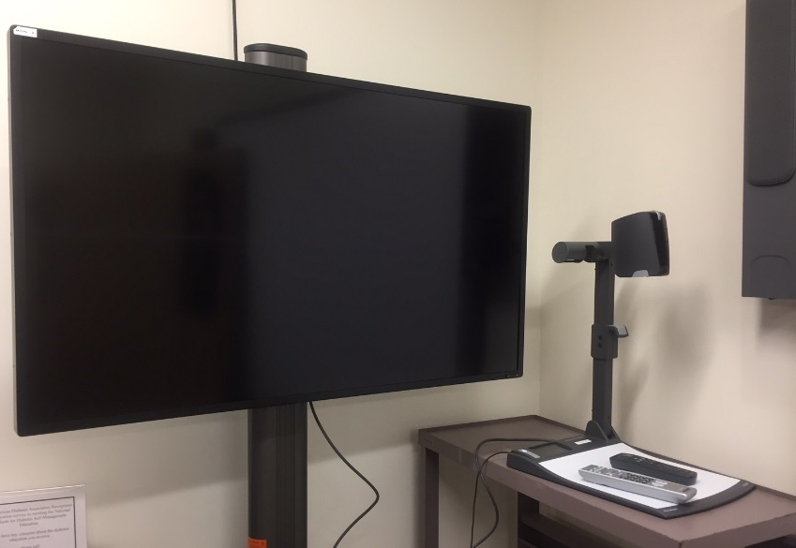
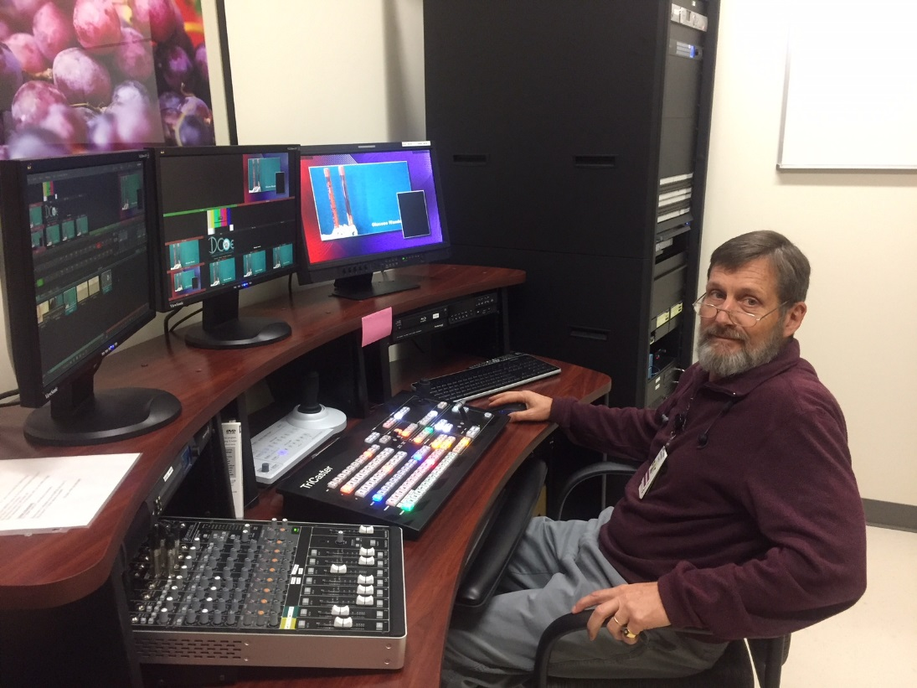
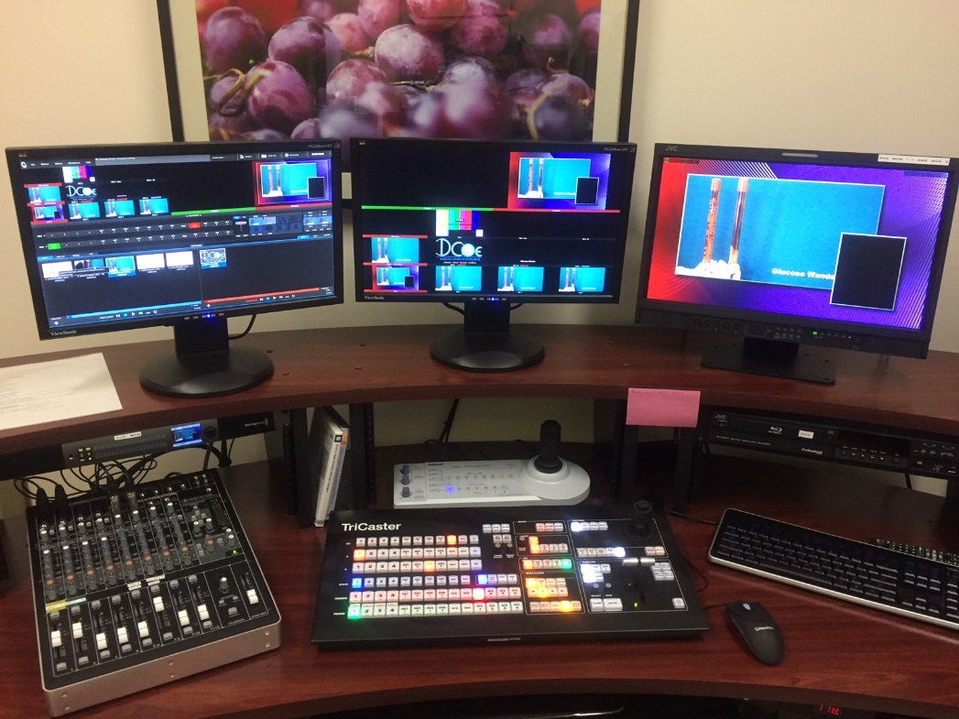
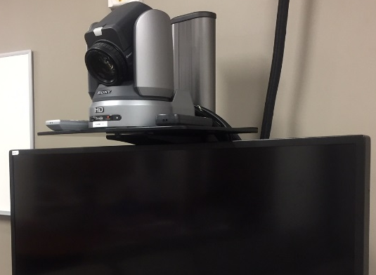
Our Studio

Slide 40
Interim data
The class was convenient for me to organize.
I was comfortable with the format of this class.
The handouts for patients were accessible.
Instructions for organizing the class were clear.
Setting up the technology was convenient.
The picture on the video was easy to see.
I could hear the educators well.
The educators made us feel like part of the class.
Pre-assessment instructions were clear.
Pre-assessment documentation was easy.
Documentation for class participation was easy to accomplish.
Would you organize another class in this format?

Slide 41
Interim data
Satisfied
I could hear the educators
Notes:
Interim data for 2017

Slide 42
Would you take another class in this format?
Only 15 patient encounters reported they would not take another class in this format.
Only 3 of these were in class one. So, it’s apparent that 12 patient encounters reflect they took more than one class.

Slide 43

Looking to the Future
March 2018
Diabetes Prevention Program
  CDC Recognition
  1 year program
    12 weekly sessions
    9 monthly sessions
Other MIST utilization
  Training for Disease Managers
  Other professional education

Slide 44
In Summary
Diabetes Self-Management Education and Support Services can be effectively provided to our DoD beneficiaries via Telehealth
DSME
DCOE
DMs
MIST
Notes:
We believe…..

Slide 45

Questions

Slide 46
References
https://www.cdc.gov/diabetes/pdfs/data/statistics/national-diabetes-statistics-report.pdf
http://www.diabetes.org
http://hhsc.state.tx.us/reports/2012/direct-indirect-costs-diabetes-texas.pdf
Beck, J., Greenwood, D. A., Blanton, L., Bollinger, S. T., Butcher, M. K., Condon, J. E., ... & Kolb, L. E. (2017). 2017 National Standards for Diabetes Self-Management Education and Support. The Diabetes Educator, 43(5), 449-464.
http://www.airforcemedicine.af.mil/MTF/Randolph/News-Events/Article/1051495/wing-pioneers-innovative-diabetes-education-program/

Slide 47
Demographics (n=183)

Slide 48







