Slide 1

Lake Shamineau
Lake Improvement District
Informational Meeting – August 5, 2021
Informational Meeting:
Provide information to Property Owners regarding the Annual Meeting, voting and the West Outlet High-Water Project.
High-Water Project Goal:
Determine a solution to the high-water problem that is most feasible, cost-effective, and timely, and will minimize ongoing maintenance and future operating costs.

Slide 2
Lake Shamineau LID Informational Meeting 8/5/21
Meeting Agenda
Welcome and Introductions
Voting and Annual Meeting Information
High-Water Project Background
West Outlet Project Engineering (Houston Engineering)
Project Steps Est Costs and Est Timeline
Questions/Comments- Be concise and respectful. Use Chat feature and limit your comments to the topic.
Next Steps
Adjourn
Note that meeting will be recorded
Notes:
Note – You must check-in and register prior to voting. If you have not checked in see DON at the back of the room. Use your secrecy envelope for your Voting cards. All secrecy envelopes should be stamped prior to putting it in the ballot box located in the back of the room. You may put your secrecy envelope in the ballot box up to agenda item number 10 when we will call for the vote. Out of a total of 314 possible votes, we have received ________ mail in voting cards.
Each property was handed a pink index card which we will use for voting on the minutes and treasurers report. You can also use it to jot down a question or comment. Be sure to give us your name, email or phone number if you want us to respond.
One more thing – there is a sign up sheet at the back of the room for you to subscribe to our newsletter PLEASE print clearly. Also note list of those that already have subscribed.

Slide 3
Lake Shamineau
LID Informational Meeting
Welcome and Introductions
Rick Rosar
LSLID Board Chair
Notes:
Bob - Introductions
LSLID Board Members: Rick, Fred, Cindy, Don (in rear of room)
Morrison County Board Members:
Jeffrey Jelinski
Mike LeMieur (Commissioner for our district)
Greg Blaine
Deb Gruber, County Administrator
Shannon Wettstein, Soil and Water???
Chelsey Robinson, County Auditor
Brian Ross and Paul Strong, WSN
Sheriff Deputy Name??
Next – Cindy to review agenda

Slide 4
Lake Shamineau LID Informational Meeting
Meeting Code of Conduct –
  Use chat feature to indicate that you have a question or comment
  Wait until question period for questions unless relevant to gain understanding of topic
  Participants should wait to be recognized by meeting organizer and speak one at a time
  Mute all cell phones, mute your microphone and please be quiet so the audience can hear the speakers
  Be respectful and wait your turn to speak. Be brief and please keep your questions to the topic under discussion.
  When asking questions, participants should state their name and their property address on Lake Shamineau. Property Owners will have priority for questions
  Should any participant become disrespectful or distracting, they will be asked to leave the meeting.
Notes:
Read through the code of conduct.
We will be trying to keep the agenda moving in the interest of time. If you have a question, please raise your hand for acknowledgement. Please do not shout out questions or comments. We have time reserved on the agenda for your comments. We handed our FAQ’s which may answer some of your questions
Please note that we will be using the gavel to get attention back to the meeting and reduce noise in the audience.
Thanks for your help in keeping the meeting orderly.

Slide 5
LSLID Informational Meeting
Voting and Annual Meeting Information
LSLID using Survey and Ballot Systems (SBS) to administer Voting Process
Voting Information mailed by SBS on August 4, 2021
  Includes Letter, 2022 Budget Sheet, Candidate Information, Ballot and return envelope
Voting process includes opportunity for mailing ballots OR online voting which will open on Aug 5th. NO in-person voting.
Paper Ballots need to be postmarked by August 30, 2021
Online Voting closes at Midnight on August 30, 2021
Online Tabulation of results will be available after 6 PM on September 8, 2021

Slide 6
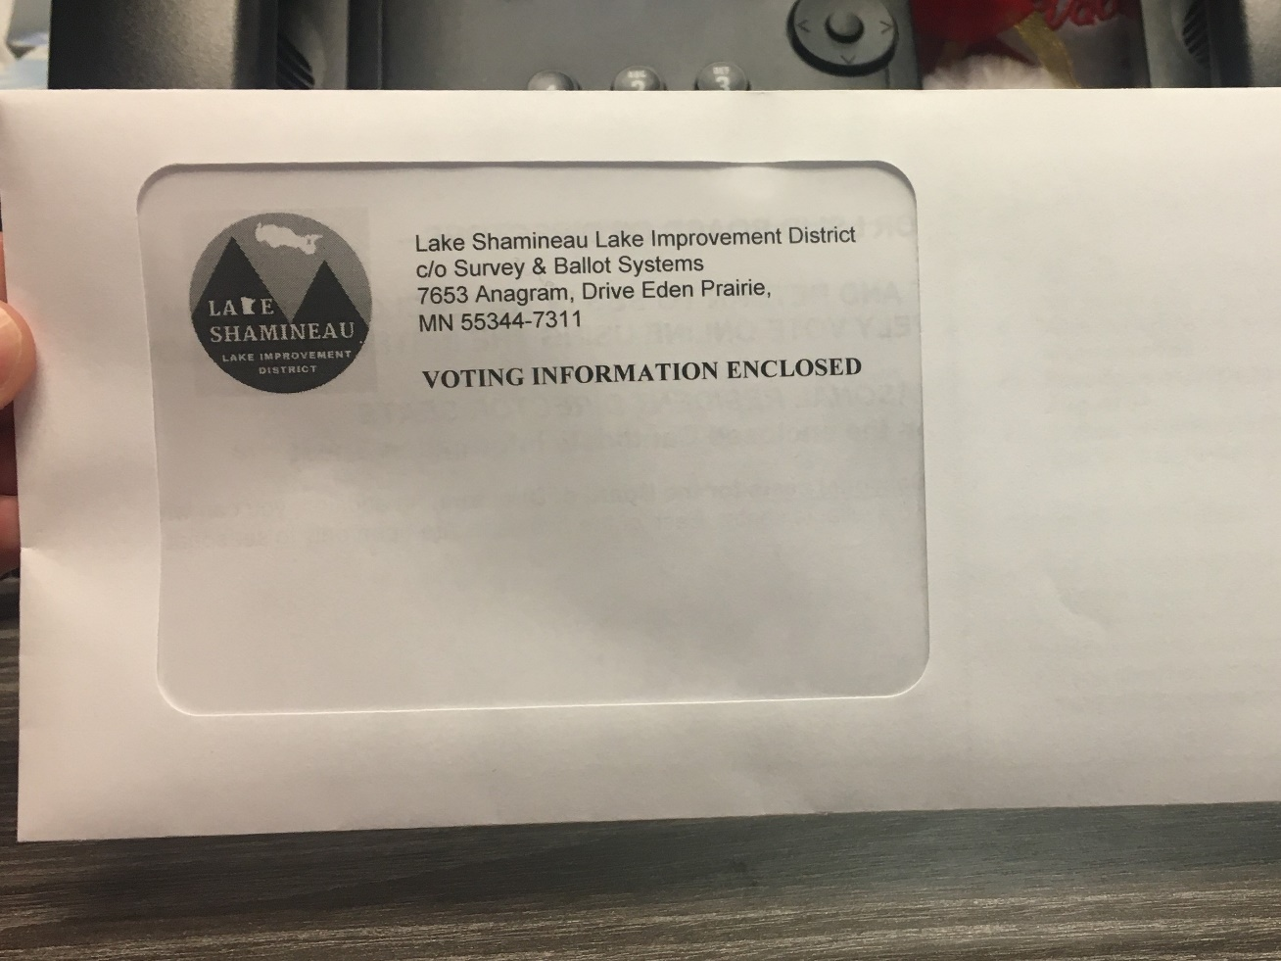
LSLID Informational Meeting
Look for Voting Materials

Slide 7
LSLID Informational Meeting
2021 Annual Meeting
Annual Meeting will be held online
Scheduled for August 28th at 9:30 AM
Send email to fred@homeinspectionsofmn.com to receive invitation to the meeting
Meeting will be recorded
Voting will only be through mail-in ballots or online voting.

Slide 8
LSLID Informational Meeting
Voting Information
Election of Directors
  Vote for 2 Permanent Residency Seats
2022 Budget Information
  Non-Project Operations Budget
      Includes administrative and LID Operation Costs
  Aquatic Invasive Species (AIS) Budget
      Includes AIS control, surveys and ambassador program.
  2022 Lake Shamineau High-Water Outlet Project Budget for Pre-Construction and Operations –
      Includes Pre-construction expenses to finalize design, plans, bidding and right of way. Also includes estimate for operational expenses for 2022 for electricity, maintenance and monitoring elevations.

Slide 9
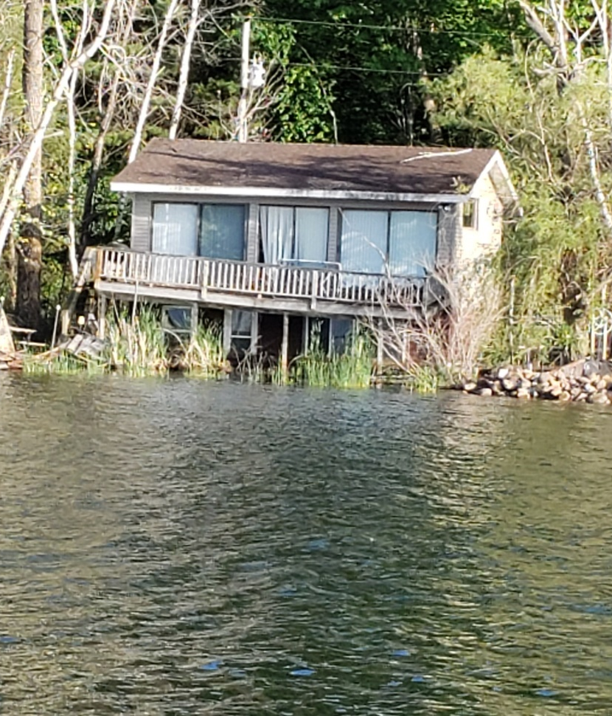
Lake Shamineau
Shamineau is a 1434-acre lake located east of Hwy 10 in Morrison County
There are approximately 300 homes, cabins and commercial properties on the lake
The lake is closed watershed basin with no outlet
There have been Increasing water levels for many years
Water has risen over 7 feet since 1962
Lake is now 1.7 feet over the Ordinary High-Water Level (OHWL)
The rise in the water is caused by higher-than-normal precipitation and the lake having no natural outlet
Notes:
Many of you are most likely familiar with the lake which is located just east of Highway 10.
There are 300…… and they are of various sizes, age, seasonal and permanent, and at various elevations.
Closed basin
Increasing water level
7 feet
2.3 over OHW. To explain what this means, imagine that the OHW is at the base of a tree. Now go up 2.3 feet and imagine how far the water may go back on the shoreline.
Rise in water
The LSLID has the support of the majority of property owners to develop a high Water Outlet Project. Last August over 74% of the lake owners voted in favor of a project to construct an outlet.

Slide 10
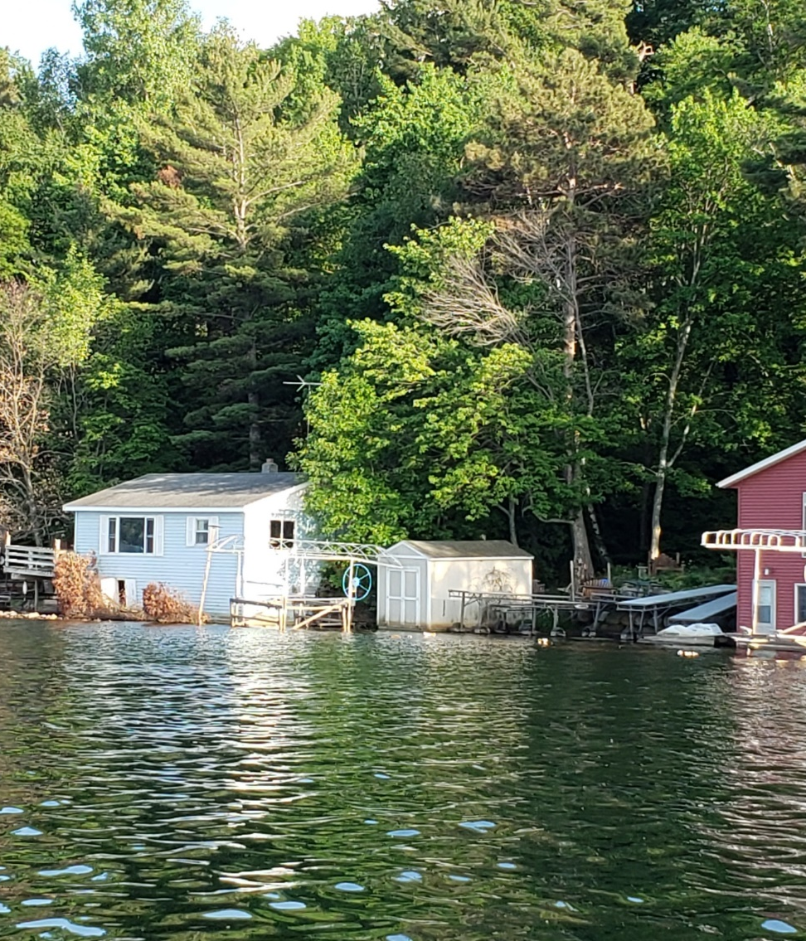
High Water Outlet Project
During Spring 2020, routes were analyzed for pumping water out of Lake Shamineau
Engineers provided guidance on options
Preliminary engineering and environmental analysis of alternatives was completed
West option through Ditch 41 was determined to be most feasible
If left to naturally overflow in uncontrolled fashion, water from Lake Shamineau would flow downstream within watershed area of Ditch 41 and Long Prairie River
Construction of Project will move water downstream in more controlled manner, water quality can be managed, and adverse impacts can be avoided

Slide 11
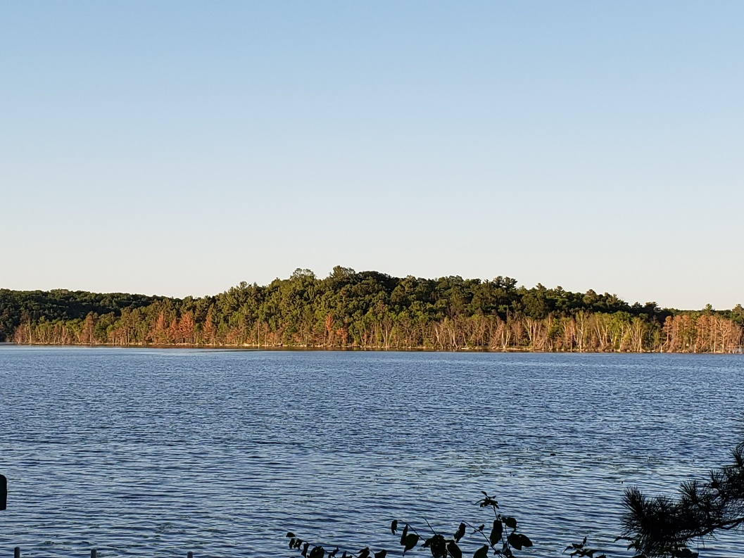
High Water Outlet Project
August 2020 – Approval by LID Membership of High-Water Outlet project with 74% approval vote.
Board has Worked to complete preliminary design and route, wetland delineation, surveys, soil borings, groundwater monitoring
Meetings with DNR have been held regularly to provide updates and discuss technical details

Slide 12
High Water Outlet Project
Purpose of High-Water Project is to establish a maximum operating level
Project includes the installation of a lake outlet structure and pumping station at the west end of the lake
Water will then flow west, eventually to Ditch 41, flowing to the Long Prairie River (route will be reviewed later in presentation)
The LSLID has worked closely with property owners along the route, including those along Todd Co. Ditch 41, to ensure our project is not detrimental to their property
The LSLID has obtained agreements for easements with Morrison and Todd County property owners west of Highway 10.

Slide 13
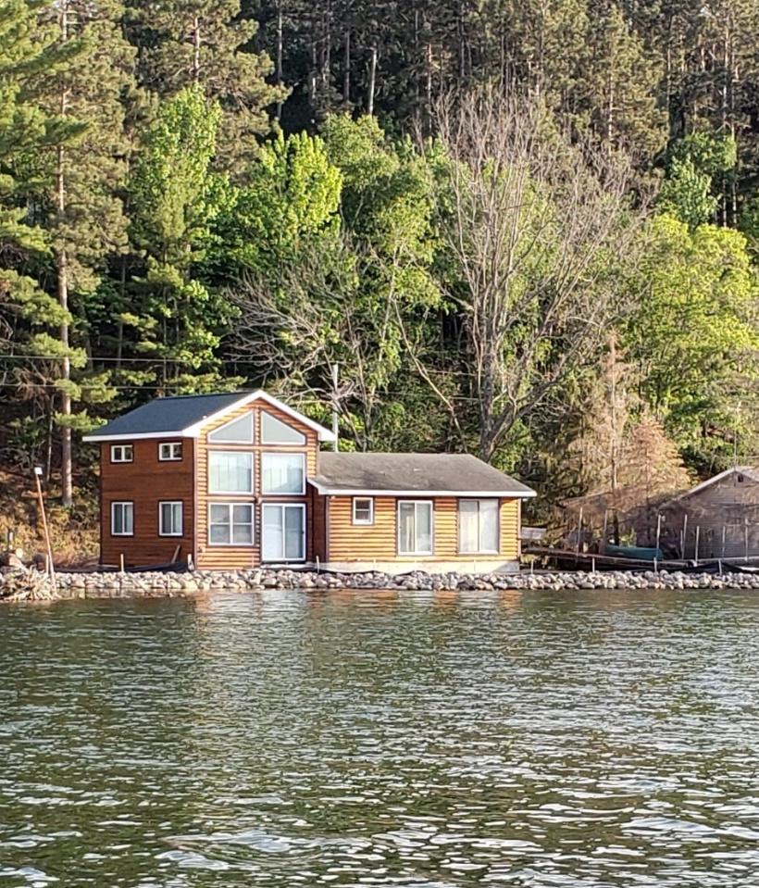
High Water Outlet Project
Route from the lake to the Long Prairie River includes flowing through Todd County Ditch 41
Petition to utilize Ditch 41 in Todd County has been submitted.
Petition was accepted, Informational Meeting held June 1.
  Todd County Public Hearing was held on June 29 to gain input on the petition. At the Public Hearing, Houston presented data to show that the Ditch has capacity.
Todd County has contracted with an Engineering firm for a second opinion.
A second Public Hearing to gain input from Todd County Ditch 41 landowners will be held on August 31 at 6 PM.

Slide 14
High Water Outlet Project
High-Water Outlet Project Timeline has been included in mailing to Property Owners and will be discussed at the end of this meeting.
The technical information regarding the High-Water Outlet Project will be presented next by Houston

Slide 15
Lake Shamineau LID Informational Meeting
Preliminary Engineering Report:
  Mike Opat, Project Manager
  Houston Engineering

Slide 16

LSLID project overview- approach & timeline
Feasibility Study
Preliminary Design (30%)
Right of way needs
Preliminary permit coordination
Budget
Ditch Outlet Petition
Petition approval and conditions
Operating Plan
Preliminary Design (60%)
Permitting
Right of way
Final Design
Bidding & Contract Award
Construction
Operation
Multiple options studied
Most feasible option identified

Slide 17
LSLID project overview
Feasibility Studies
Multiple options and routes were studied
Outlet to TCD 41 is the most feasible
Preliminary Permit Coordination
MnDOT: Project is permittable & LSLID can hold the permit; permit application following advanced design after petition approval
Morrison County:
Zoning-
Pump station design conforms with zoning requirements
Requested formal permit application after ditch outlet petition approval
Highway Department-
Will allow use of road of way, including road crossings
Wetlands:
Wetlands have been delineated and approved by Technical Evaluation Panel (TEP)
SWCDs, BWSR, DNR
US Army Corps of Engineers
Design will address wetland impacts; to be completed following ditch petition approval
DNR: Reviewed preliminary plans→ no issues; permit application following advanced design after petition approval
Notes:
Mike will cover this slide…

Slide 18
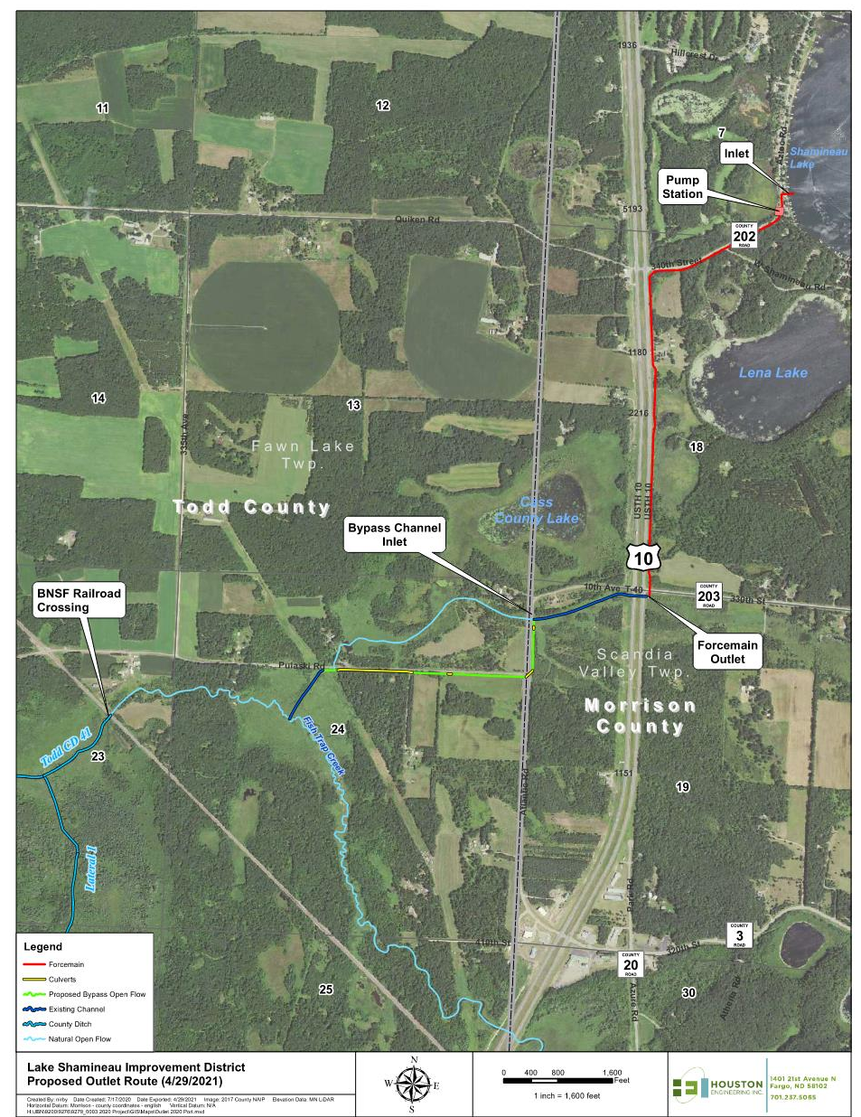
LSLID project overview
Lake Intake
Pump Station
  Pump
  AIS Filter
  Building
Forcemain (Pipe)
Outlet
Downstream
  “Blue Line Ditch”
  Bypass Channel
  Fisht Trap Creek/TCD 41
Notes:
Mike will cover this slide…

Slide 19
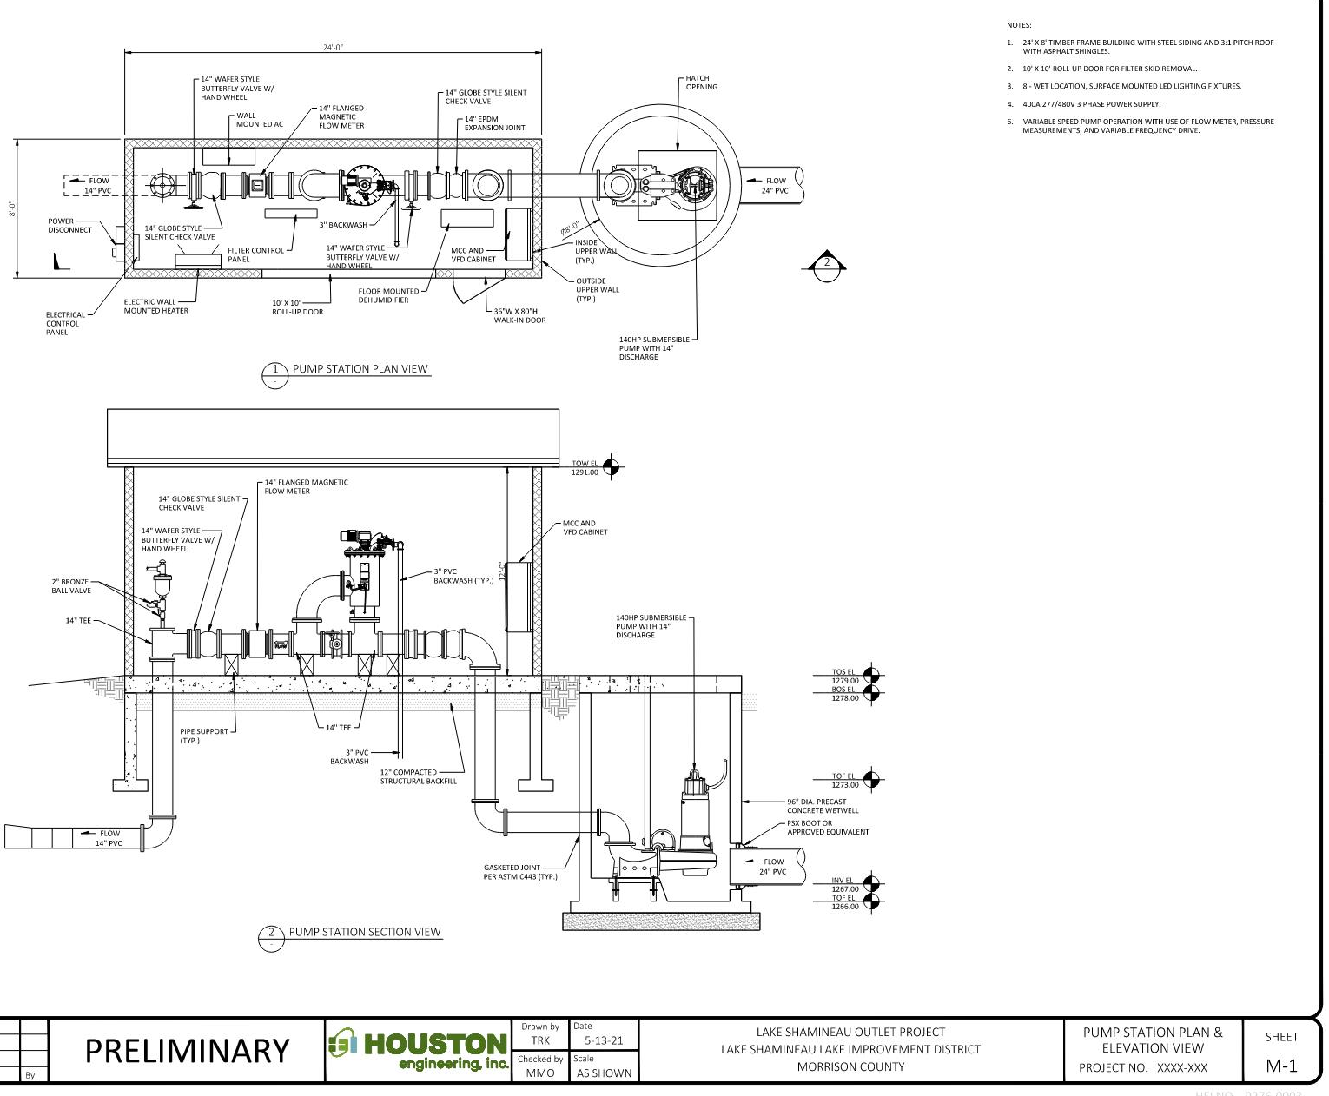
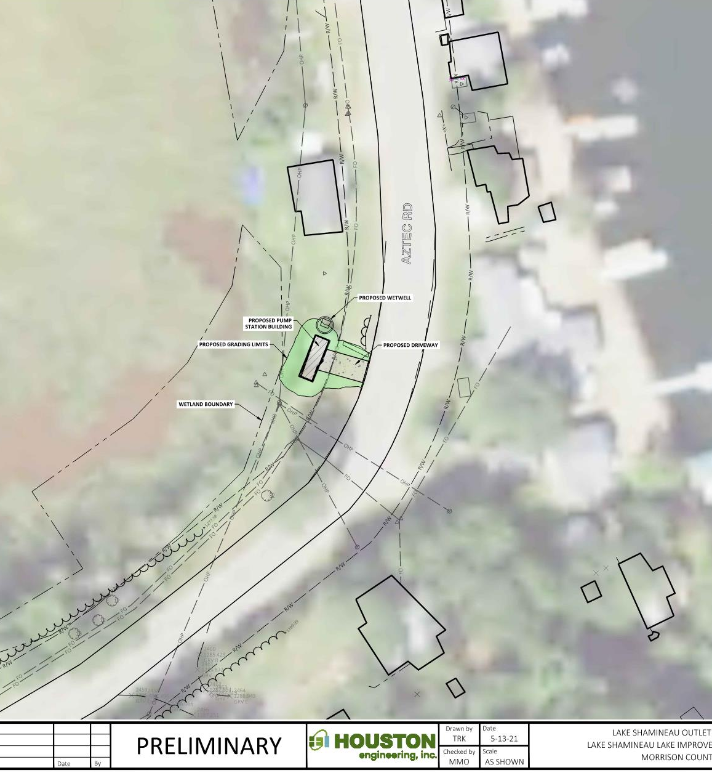
Pumpstation schematic

Slide 20
Operating plan
What is it?
  The Operating Plan is a formal document that governs the operation of the LSLID High-Water Outlet project
    States when pump can be turned on, including specific criteria for TCD 41
    States when it must be turned off, including specific criteria for TCD 41
    Specifies when and where downstream water flow conditions must be monitored, including specific locations along TCD 41
  The Operating Plan will be a condition attached to the DNR permit for the project
  Operation is dependent upon downstream conditions, even if properties around the lake are flooding

Slide 21
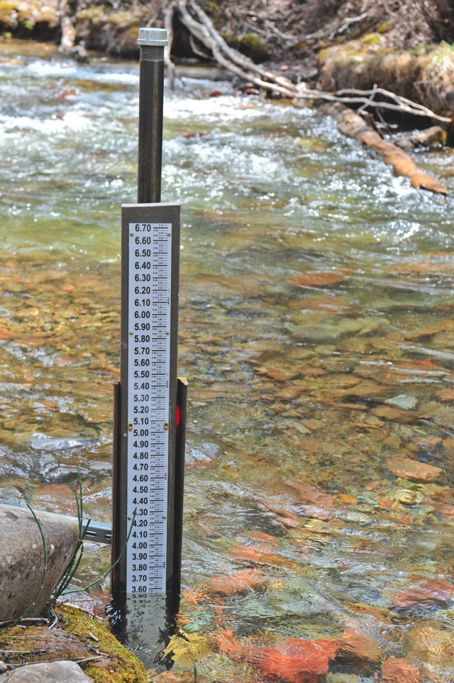
Operating plan
Key Points:
  LSLID will be required to monitor downstream conditions both prior to and while operating the pump.
    Gauges/markers will be installed at key locations for the LSLID and the public to monitor
      Primary & Secondary Gauges
    Monitoring will occur more frequently as water levels approach critical elevations

Slide 22
Estimated Project Costs
Preliminary level design → Preliminary level cost estimate
  Currently at ~30% level design
  Estimates will be refined as level of design increases
  Reference recently constructed similar projects (LMKP LID, etc)
  Focus on higher cost items (pumps, filters, etc)
  Estimates include a contingency in the budget to account for uncertainties involved with the concept level design and unknowns that might come up

Slide 23
Estimated Project Costs
  Costs include estimates for all anticipated costs; including construction, engineering, right-of-way, permitting, utilities, legal, administration, etc.
  The construction estimates are based on recent bids submitted by contractors on similar projects. A better picture of the actual cost of the LSLID project won’t be known until the project is let for bids.
    Actual costs could vary from estimates as market conditions, weather conditions, construction schedules, and other factors all impact the bids submitted by contractors.

Slide 24
Estimated Project Costs
  Estimated Total Construction Phase Costs: $3,350,000
    Construction, right-of-way, legal, engineering, permitting, contingency, etc.
    Included contingency amount: $394,500
  Estimated cost is consistent with what was presented in August of 2020
    Some items have increased & some have decreased, but total remains unchanged

Slide 25
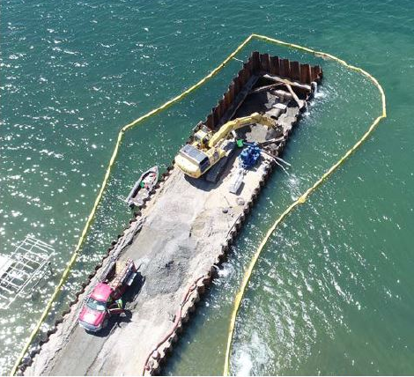
Estimated Project Costs
Key Cost Factors:
  Dewatering: Required for intake installation, wet well construction, pipe installation; Costs will vary depending on contractor’s desired means and methods, weather conditions, ice, etc; costs from similar LMKP LID project used
  Filtration: Mechanical filter provides potential for resale if DNR determines filters are not required in the future; Eurasian watermilfoil
  System Capacity: Costs currently reflect a 10 cfs system and will be further refined during future design phases
LMKP Intake Installation (https://www.lmkp-lid.com/)

Slide 26
Estimated Project Costs
Key Cost Factors:
  Forcemain: Pipe prices are often impacted by petroleum prices and other variables, so actual costs will depend on conditions at the time of the bid
  Pump Station Building: Will house filtration system and controls; Building allows for year around operation and will provide added sound abatement; Pump will be underground in a concrete structure

Slide 27
Estimated Project Costs
Key Cost Factors:
  Contingencies: The goal is to not spend any of the contingency funds. Any funds not spent would translate to a lower bond amount.
    Including a contingency is good practice and mitigates delays and financial challenges
  Value engineering has been ongoing and will be considered during future design phases to identify potential cost savings (dewatering, filtration, route, etc.)

Slide 28

Next Steps
After annual meeting:
  Continued stakeholder outreach
  TCD 41 petition process
  Continue with preliminary design (60%)
  EAW
  Permitting
  Final design
    Right of way acquisition
  Bidding
  Construction

Slide 29
High Water Outlet Timeline
 | Project Task | Description | Est. Completion Period
1 | Todd County Petition | Approval of use of Todd Co Ditch 41 | September 2021
2 | Environmental Assessment Worksheet | EAW issuance | October 2021
3 | Detailed Design to 60% | Further develop construction plans | October 2021
4 | 429 Hearing | Hold 429 Hearing for Project Approval | November 2021
5 | Permitting | Approval from key agencies, landowners | December 2021
6 | Detail Design, Right of Way | Plans, bid and contract documents | January 2022
7 | Bidding | Issue bidding docs and select contractor | February 2022
8 | Bonding | Issue bonds for construction | February 2022
9 | Construction | Start construction of West Outlet | Spring 2022
10 | Pumping Begins | Testing and Pumping | Summer 2022
The chart provides an estimated timeline for project completion.
Note that the dates are estimated and the final timeline for construction will depend on the timing of the approval of the Todd County petition, completion of agency permitting, and lead times for construction materials.
Notes:
Brian talked through many of the technical tasks.
Let me highlight some of the financing steps.
Approval today
Approval of Budget at County Board
Approval to enter into the 429 process
Public Hearing

Slide 30
High-Water Outlet Project
West-Outlet Project Budget
The 2021 Budget included a Vote 4 at an estimated cost (as of July 2020) of $3,350,000 to establish a project to construct a High-Water Outlet. This budget item was approved in August 2020 with 74% voting in favor of the budget question. The legal counsel for the LSLID has advised that the LSLID will not need to hold another membership vote for the Lake Shamineau High Water Outlet Project.
The 2022 Budget includes $257,000 for Pre-Construction and Operation Expenses
The estimated total project costs do not include any possible DNR grants that may be available for of up to 50% of future costs including construction. The High-Water Outlet Project is on list of Flood Hazard Mitigation Needs
The LSLID Board continues to pursue grant opportunities.
Notes:
Timing caveats
DNR grants

Slide 31
High-Water Outlet Project
Lake Shamineau
Elevation Readings (data from MN DNR)
Date | Elevation | Feet Above OHW | Notable Events
9/6/1962 | 1270.55 | -4.55 | Lowest Recorded Reading
4/24/2017 | 1276.09 | 0.99
7/11/2017 | 1275.92 | 0.82
8/26/2017 | 1276.28 | 1.18 | Positive Vote for High-Water Project
10/14/2017 | 1276.38 | 1.28
5/13/2018 | 1276.51 | 1.41
7/1/2018 | 1276.87 | 1.77
8/23/2018 | 1276.37 | 1.27 | Positive Vote for High-Water Project
10/5/2018 | 1276.09 | 0.99
5/21/2019 | 1276.84 | 1.74
7/1/2019 | 1277.13 | 2.03
8/31/2019 | 1276.82 | 1.72 | Positive Vote for High-Water Project
10/6/2019 | 1277.52 | 2.42
5/26/2020 | 1278.08 | 2.98 | Highest Recorded Lake Level
7/21/2020 | 1277.96 | 2.86
8/30/2020 | 1277.76 | 2.66 | Positive Vote for High-Water Project
9/20/2020 | 1277.52 | 2.42
4/14/2021 | 1277.55 | 2.45
5/19/2021 | 1277.44 | 2.34
5/27/2021 | 1277.32 | 2.22
7/8/2021 | 1276.97 | 1.87
7/22/2021 | 1276.78 | 1.68
7/29/2021 | 1276.80 | 1.70
OHW = Ordinary High Water |  |  | The OHW Level for Lake Shamineau is 1275.10
Answers to Commonly Asked Questions:
How much has the water elevation changed?
According to the DNR elevation readings, since the Fall of 2020, the lake has gone down .72 feet or 8.64 inches

Slide 32
High Water Project
Answers to Commonly Asked Questions
How much has been spent on Engineering Costs to Date?
Firm | Time Period | Project | Expense | DNR Reimb. | Net Expense
Houston | 2017-2018 | West Outlet Plan | $42,573 |  | $42,573
WSN | 2019-2020 | Infiltration | $198,700 | $65,000 | $133,700
Houston | 2020-2021 | West Outlet Project Eng. Expenses To Date | $191,257 | $51,000 | $140,257
Total |  |  | $432,530 | $116,000 | $316,530

Slide 33
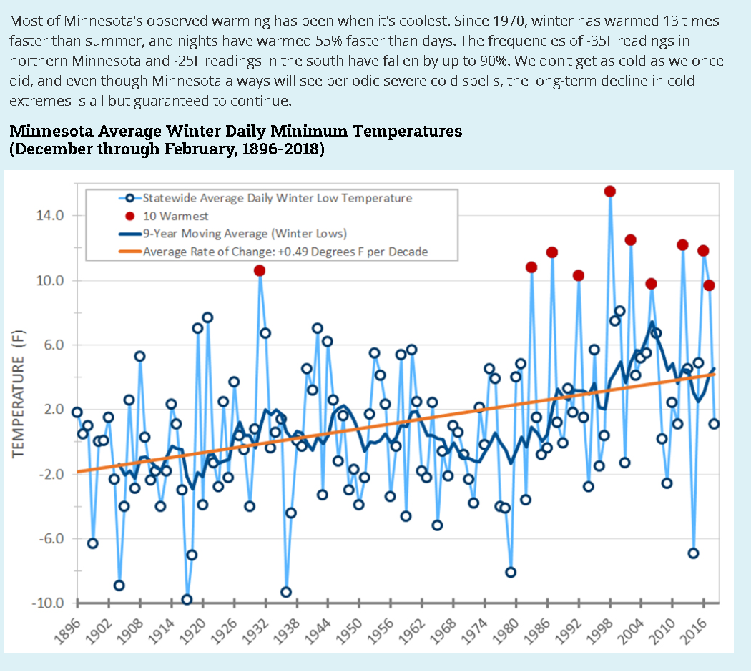
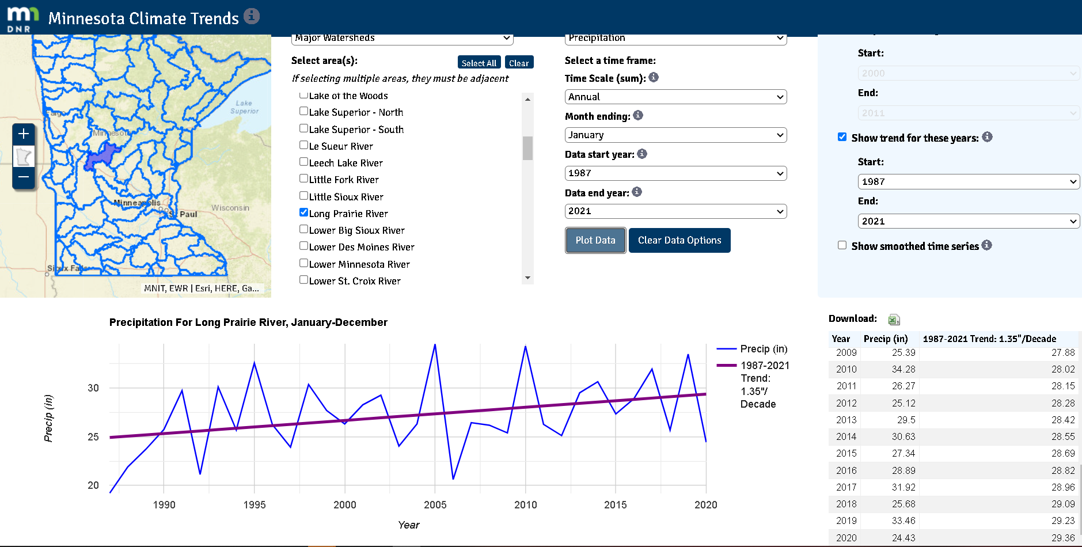
High-Water Outlet Project
Answers to Commonly Asked Questions:
What are the climate trends that may be affecting lake levels?
According the DNR, “Substantial warming during winter and at night, increased precipitation, and heavier downpours already have affected our natural resources… The decades ahead will bring even warmer winters and nights, and even larger rainfalls….”

Slide 34
High-Water Outlet Project
Answers to Commonly Asked Questions:
What are the climate trends that may be affecting lake levels?
According to the DNR, “Heavy rains are now more common in Minnesota and more intense than at any time on record. Long-term observation sites have seen dramatic increases in 1-inch rains, 3-inch rains, and the size of the heaviest rainfall of the year…..Climate projections indicate these big rains will continue increasing into the future.”

Slide 35
High Water Outlet Project
Answers to Commonly Asked Questions
Why is the project taking so long?
  It has taken time to obtain agreements from landowners for easements, in addition to complete the technical design and route plan. These tasks were important to complete prior to submitting the Petition to utilize Todd County Ditch 41. The LSLID has managed risk by responsibly completing tasks and gaining approvals prior to moving on to the next effort.
Where can I find more information on the project?
  the LID website includes information regarding engineering reports, financial information, and other information that may be of interest to property owners.
  Website: https://minnesotawaters.org/lakeshamineau/lid/

Slide 36
Lake Shamineau LID Informational Meeting
Questions and Comments
Use Chat feature to indicate that you have a question or comment
Wait for Chair to recognize you
State your Name and Lake Address to the audience
Lake Owners will have priority for questions/comments
Be concise and respectful
Please limit your time to 2 minutes or less
Notes:
Bob

Slide 37
LSLID Informational Meeting
Next Steps
  A link to the recording of today’s meeting will be posted to the website
  Voting Materials Mailed on August 2
  ONLINE Annual Meeting Held on
  August 28th at 9:30 AM
  Voting open until August 30
  Questions: Send email to LSLIDBD@gmail.com

Slide 38
Meeting CONCLUSION
Notes:
Bob

