Slide 1
Incident Management
February 2022
Notes:
KLP: You set the tone. If you believe safety is important, the audience will believe safety is important.
The facilitator opens the session by welcoming everybody to the training and noting the monthly focus – Stop Work Authority (SWA).
F: Today’s task is to attend Stop Work Authority (SWA). Cell phones should be turned off or silenced during this training. If you need to take a call, please go to (designated area), take the call and return as soon as possible. {Address any other important announcements or business now.}

Slide 2
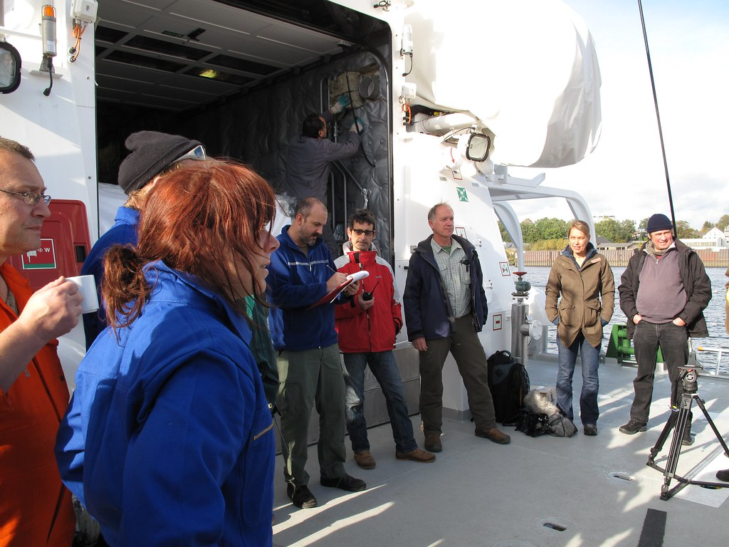
Housekeeping
Muster Point
Notes:
F: Prior to training, determine if any fire drills are planned and the response expected from the facility and muster points if alarms should go off. It is important to remind employees that should they need to leave the location at any time, they should inform the Facilitator because, in the event of a fire incident, we need to know their whereabouts. This is an opportunity right at the start of the day to brief the employees on HSE procedures in general for the running of the training course. [If your job site is outdoors, don’t overlook this safety moment. Adjust the plan in the event of a job site fire.]
F: Hello Team, I have verified with the HSE department and have confirmed that there are no Fire Drills or Emergency Drills scheduled for today. If we hear an alarm, we will follow site protocol for emergency response.
F: {Point out the fire exits and muster point}
F: Once we are at the muster points, we will do a role call to account for all attendees.

Slide 3

Presenter & Introductions
Safety begins with me!
Notes:
F: {This is your moment! This is a chance to visibly “Walk the Talk”}
Share:
Your personal experience of safety and impact on the company
Importance of making the most of this opportunity to think about the importance of HSE and discuss with employees
Appreciate that you are a leader and that you make an impact
Importance of taking personal responsibility to make a positive impact
You get out of this training what you put into it
HSE matters to our company
The safety program is going to help people feel empowered and take the initiative to improve their own HSE performance through proactive attitudes and behaviors.
You may wish to share:
A story of your experience in the safety program and how it is has changed the way in which you behave.
Some lessons learned from an incident when you have been involved in the investigation, highlighting the devastating impact that accidents have on people’s lives, or you can describe your experience of being involved in an environmental incident. How did this affect the company, and more importantly, affect the lives of others not working for the company.
F: Go around the room and ask everyone to give their name and what their position is. {Wait for their responses, smile, and nod as they participate. Be careful about timing here---if you ask an additional intro question of the participants and give a long-winded answer yourself, your participants will follow with long stories/explanations, and you can accidentally take up a lot of time.}

Slide 4
What is Incident Management?
Incident management is the process of identifying, preventing, responding to, recording, and analyzing workplace health and safety risks and makes workplaces safer for employees and the environment, while also ensuring organizations stay productive and mitigate unnecessary costs.
Notes:
KLP: Incident management is essential to ensure that future incidents are avoided.
F: What is Incident Management?? {This question gets everyone thinking about the topic at hand. After collecting a few answers, thank them}
By Definition: Incident Management is the process of identifying, preventing, responding to, recording, and analyzing workplace health and safety risks and makes workplaces safer for employees and the environment, while also ensuring organizations stay productive and mitigate unnecessary costs.

Slide 5

Management Support
Senior Management Role:
  Create a culture that promotes incident and near miss reporting and establishes clear expectations and responsibilities.
  Holds employees and contractors accountable for not reporting incidents and near misses.
Supervisors and Managers:
  Promotes a culture where reporting incidents and near misses is standard practice
  Ensure that all incidents are reported to the HSE Department in a timely manner, to participate as needed in the investigations, and to support HSE in implementing any resulting corrective actions.
HSE Department:
  Monitors reported near misses and incidents by tracking the leading key performance indicators to capture and provide current information about effective performance, activities, and processes of HSE management.
  Identification and elimination or control of risks in the workplace that can otherwise lead to incidents and injuries.
Company employees and contractors:
  Reporting all incidents and near misses to your supervisor or manager immediately.

Slide 6
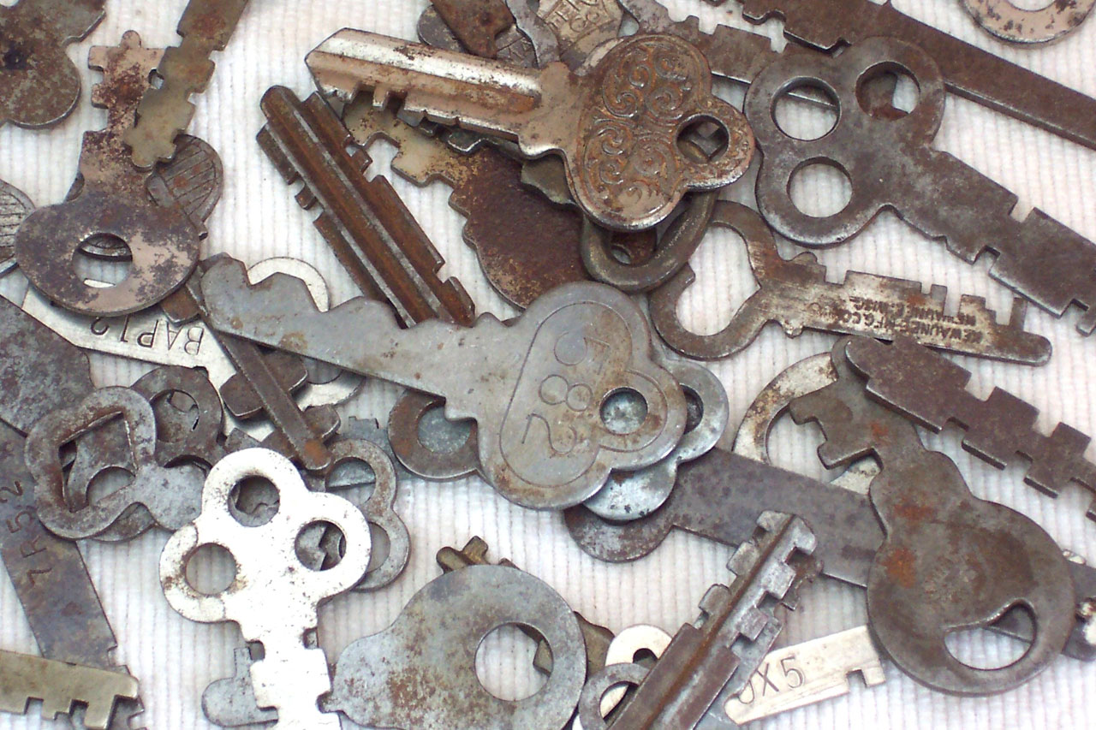
Why am I here?
You are the KEY to SAFETY!
Notes:
Slide 6: Why am I here? (1 Minute)
F: Each one of us is the last line of defense to protect workers from injury or the environment from damage, should management systems and collective protections fail. Supervisors and workers are the KEY to HSE. We can promote or destroy the HSE climate through our own behavior and how other workers perceive it.
Supervisors and workers are responsible for enforcing safety rules. Regardless of our position, employment status, or background, everyone is responsible for HSE, and everyone can be a HSE leader by demonstrating positive attitudes and behavior.

Slide 7
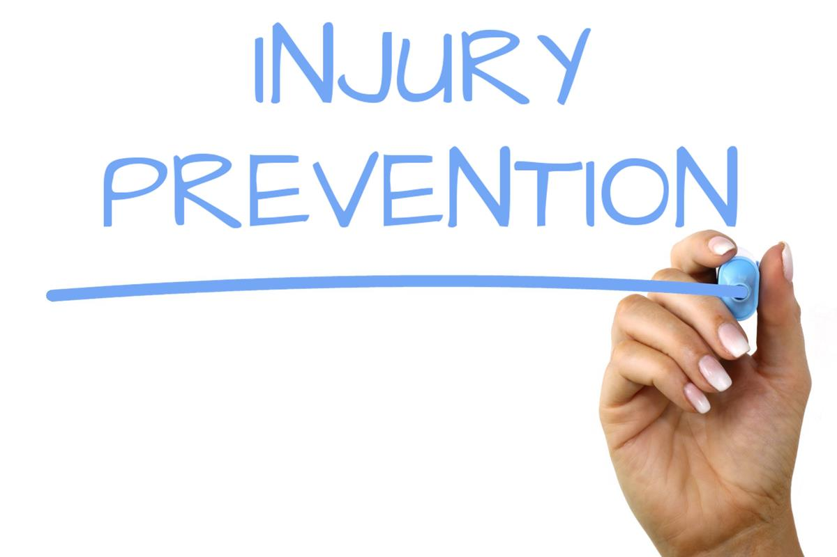
Why Is Incident Management Important?
Notes:
KLP: Reporting injuries and near misses prevents future incidents and injuries at work.
F: Who here is familiar with incident management process? {Wait for their responses, smile, and nod as they participate.}
F: Does anyone here know why reporting near misses and incidents is so important to not just the company but to you in the workforce? {Wait for their responses, smile, and nod as they participate.}
F: We understand that reporting injuries and illnesses is important. We must report these incidents to prevent further injuries to our co-workers or ourselves. It is equally important to report near misses. It must be remembered near misses are warnings that something isn't working and that they enable you to learn lessons before a serious incident occurs. As such, it's important that they are reported so that you can deal with the hazard before anyone does get hurt.
F: Incident management allows us to see what we need to change in our processes and day to day activities to prevent our employees from being injured.

Slide 8
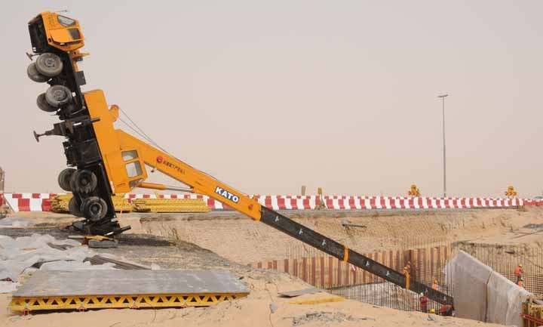
Why Is Incident Management Important?
What types of incidents should be reported?
  Near Miss
  Injuries / First Aid
Property Damage Accidents
Notes:
KLP: All incidents should be reported immediately
F: Now that we understand why Incident Management is important let's discuss what types of incidents we should be reporting.
F: What types of incidents do you think should be reported? {Wait for their responses, smile, and nod as they participate. While they answer begin clicking the slide to show the process on screen.}
Near Miss
Injuries / First Aid
Property Damages
F: Who should the incidents be reported to? All incidents, near misses, or injuries need to be reported immediately to your Supervisor or the HSE team. Fast reporting allows for more accurate incident details, better investigations, and faster corrective actions.

Slide 9

What is near miss, incident, accident?
Notes:
VIDEO

Slide 10

What would you do?
Notes:
KLP: Reporting near misses and first aids are just as important as reporting serious injuries.
F: What would you do if you suffered a first aid injury? (Examples: bee sting, cut requiring a bandage, debris in eyes) {Wait for their responses, smile, and nod as they participate. While they answer begin clicking the slide to show the process on screen.}
F: What would you do if you saw a near miss? (Examples: a worn step causing an employee to stumble, or a leaky air conditioner dripping on the sidewalk resulting in an employee slipping and nearly falling) {Wait for their responses, smile, and nod as they participate. While they answer begin clicking the slide to show the process on screen.}
F: What would you do if you saw an employee severely injured? {Wait for their responses, smile, and nod as they participate. While they answer begin clicking the slide to show the process on screen.}
F: What would you do if you didn’t see the accident, but found the injured employee? {Wait for their responses, smile, and nod as they participate. While they answer begin clicking the slide to show the process on screen.}
Get workers to a safe place. Move any injured workers away from an area if it is dangerous and make sure other employees stay clear.
Assess the situation. How severe is the injury? What caused the accident? Evaluate carefully to ensure no one else gets hurt.
Assist the injured. For minor cuts, scrapes, and burns, first aid might be all that's required, but for major injuries be sure to stabilize the injured. The employee might not be aware of the severity of an injury.
Professional help will minimize risk of further injury, and emergency medical services should always be called if a workplace injury requires treatment beyond basic first aid.
NEVER PROVIDE AID BEYOND YOUR UNDERSTANDING

Slide 11
The Five Stages of Incident Management
Notification/ Report
Initial Review
Investigation
Actions
Final Review /Closure
Notes:
KLP: Understanding the stages of incident management.
F: Let’s move on, The injured employee has been tended too, let’s talk about what’s next?

Slide 12
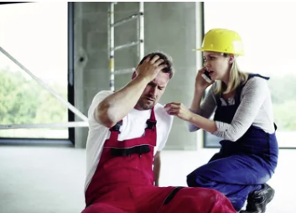
The Five Steps of Incident Resolution
NOTIFY ​/ REPORT
INITIAL REVIEW
INVESTIGATION
ACTIONS
FINAL REVIEW
Notes:
The Notification or Report stage is when preliminary information about an incident is submitted to management. This is usually done by a worker on the shop-floor, where most workplace incidents take place. The Notification should include:
Location and sublocation
Date and time
Equipment involved
Incident type and subtype
Expected severity
Title
Brief explanation of what happened
Who the incident involved
Details of any immediate actions that were taken
Attached images

Slide 13

The Five Steps of Incident Resolution
NOTIFY ​/ REPORT
INITIAL REVIEW
INVESTIGATION
ACTIONS
FINAL REVIEW
Notes:
The reviewer (HSE or Management Team) must be educated in company policy and local health and safety legislation, and will confirm the:
Actual severity
Categorization and type
Immediate actions that were taken
They will then determine if further investigation is needed. Usually, an investigation is only required in medium to high severity incidents. (If an investigation is not required, the process should skip the next step.)
This stage can be particularly important when capturing near misses. When Initial Review is complete, it's time to move to Investigation.

Slide 14
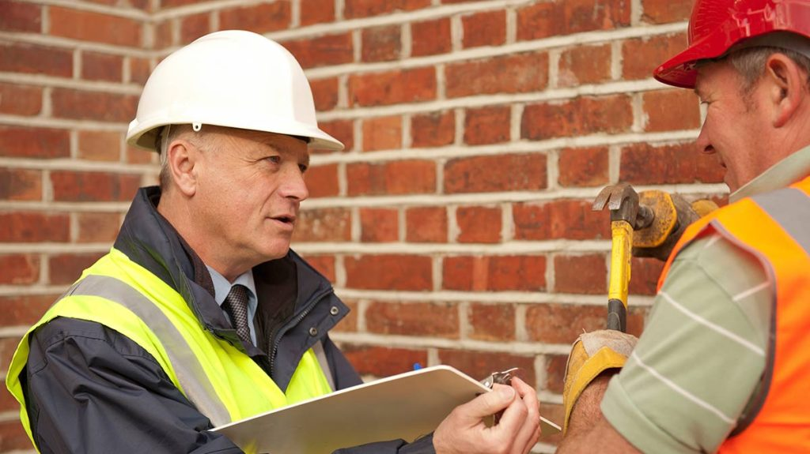
The Five Steps of Incident Resolution
NOTIFY ​/ REPORT
INITIAL REVIEW
INVESTIGATION
ACTIONS
FINAL REVIEW
Notes:
F: Investigation is probably the most time-consuming step of safety incident management. It mainly involves qualitative data, which takes time to collect. It's so important because it answers the questions of what happened, how and why.
After the lead investigator organizes an investigation team, a safety incident investigation typically involves:
Reviewing the applicable policies and training
Determining a sequence of events
Documenting the personnel who were involved
Categorizing the injury or illness and tracking restricted work
Obtaining witness statements
Conducting Root Cause Analysis
Collating further supporting evidence
Setting out a Corrective and Preventative Action (CAPA) plan
Once the Investigation has been approved, it's time to correct and prevent based on the findings. Therefore, the next stage is Actions.

Slide 15
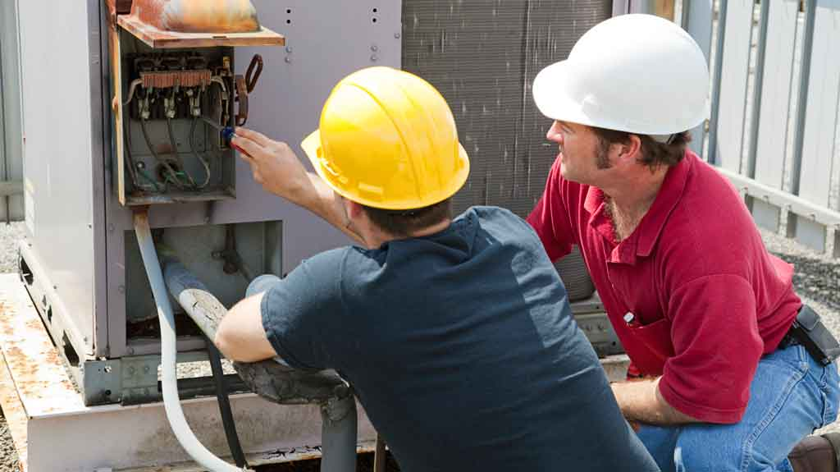
The Five Steps of Incident Resolution
NOTIFY ​/ REPORT
INITIAL REVIEW
INVESTIGATION
ACTIONS
FINAL REVIEW
Notes:
F: Corrective and preventative actions are important for almost every safety incident, especially following an investigation. These exist to reduce the risk of recurrence. Therefore, every action should be timebound and trackable, to ensure it gets completed.
As well as a title and description of what's required, actions should include:
Priority
Owner
Category
Due date
Status (automated if using software)
Whether any evidence is required
Customarily, actions addressing immediate causes are carried out onsite, whereas those for latent failures are handled by management and take longer to complete.

Slide 16

The Five Steps of Incident Resolution
NOTIFY ​/ REPORT
INITIAL REVIEW
INVESTIGATION
ACTIONS
FINAL REVIEW
Notes:
The Final Review controls whether a safety incident can be closed. After Final Review is signed off, the incident is closed. But - this is not the end of the Safety Incident Management process. It’s important to regularly look at the safety performance to manage risk and to understand the difference your corrective actions have made – and if any more are required. Keeping track of your near misses will identify gaps in your safety program and could indicate training needed.

Slide 17

One Team
QUESTIONS?

