Slide 1
Occupational Heat Exposure
May 2024
Notes:
KLP: You set the tone. If you believe safety is important, the audience will believe safety is important.
The facilitator opens the session by welcoming everybody to the training and noting the monthly focus – Occupational Heat Exposure.
F: Today’s task is to attend Occupational Heat Exposure training. Cell phones should be turned off or silenced during this training. If you need to take a call, please go to (designated area), take the call and return as soon as possible. {Address any other important announcements or business now.}

Slide 2
Housekeeping
Muster Point
Notes:
Prior to training, determine if any fire drills are planned and the response expected from the facility and muster points if alarms should go off. It is important to remind employees that should they need to leave the location at any time, they should inform the Facilitator because, in the event of a fire incident, we need to know their whereabouts. This is an opportunity right at the start of the day to brief the employees on HSE procedures in general for the running of the training course. [If your job site is outdoors, don’t overlook this safety moment. Adjust the plan in the event of a job site fire.]
F: Hello Team, I have verified with the HSE department and have confirmed that there are no Fire Drills or Emergency Drills scheduled for today. If we hear an alarm, we will follow site protocol for emergency response.
F: {Point out the fire exits and muster point}
F: Once we are at the muster points, we will do a role call to account for all attendees.

Slide 3
Presenter & Introductions
Safety begins with me!
Notes:
F: {This is your moment! This is a chance to visibly “Walk the Talk”}
Share:
Your personal experience of safety and impact on the company
Importance of making the most of this opportunity to think about the importance of HSE and discuss with employees
Appreciate that you are a leader and that you make an impact
Importance of taking personal responsibility to make a positive impact
You get out of this training what you put into it
HSE matters to our company
The safety program is going to help people feel empowered and take the initiative to improve their own HSE performance through proactive attitudes and behaviors.
You may wish to share:
A story of your experience in the safety program and how it is has changed the way in which you behave.
Some lessons learned from an incident when you have been involved in the investigation, highlighting the devastating impact that accidents have on people’s lives, or you can describe your experience of being involved in an environmental incident. How did this affect the company, and more importantly, affect the lives of others not working for the company.
F: Go around the room and ask everyone to give their name and what their position is. {Wait for their responses, smile, and nod as they participate. Be careful about timing here---if you ask an additional intro question of the participants and give a long-winded answer yourself, your participants will follow with long stories/explanations, and you can accidentally take up a lot of time.}

Slide 4
Why am I here?
You are the KEY to SAFETY!
Notes:
F: Each one of us is the last line of defense to protect workers from injury or the environment from damage, should management systems and collective protections fail. Supervisors and workers are the KEY to HSE. We can promote or destroy the HSE climate through our own behavior and how other workers perceive it.
Supervisors and workers are responsible for enforcing safety rules. Regardless of our position, employment status, or background, everyone is responsible for HSE, and everyone can be a HSE leader by demonstrating positive attitudes and behavior.

Slide 5
Our Bodies & Heat
The body burns calories and produces heat to keep its temperature at 98.6 degrees Fahrenheit.
Problems develop when the body’s cooling mechanisms do not work properly.
Notes:
F: The body burns calories and produces heat to keep its temperature at 98.6 degrees Fahrenheit. In a hot environment or during vigorous physical activity, the body will rid itself of excess heat. Two effective ways it does this are sweating and dilation of blood vessels. When sweat evaporates from the skin, you begin to cool off. When blood vessels dilate, blood is brought to the skin surface to release heat.
F: Problems develop when the body’s cooling mechanisms do not work properly. For example, when the air temperature exceeds body temperature, the body cannot easily cool itself. If the air is humid, sweat also does not evaporate quickly. Sweat also does not evaporate from a person who works hard or exercises while wrapped in heavy clothing or protective gear. That makes heat-related illness a concern in any weather, anywhere.

Slide 6
What is Heat Illness?
Notes:
F: “Heat Illness” is a serious medical condition resulting from the body’s inability to cope with a particular heat load. The body normally cools itself by sweating. During hot weather, especially with high humidity, sweating isn't enough. Body temperature can rise to dangerous levels if precautions are not taken.
F: When the body starts to overheat, the blood vessels get bigger and the heart beats faster and harder. More blood flows to the outer layers of the skin from the internal "core" so that the heat can be released into the cooler outside environment. If this process does not cool the body fast enough, or the outside air is warmer than the skin, the brain triggers sweating to cool the body. Sweat glands in the skin draw water from the bloodstream making sweat. The sweat evaporates and releases the heat from the body. During an hour of heavy work in hot weather, the body can easily sweat out one quart of water.
F: Heat illnesses range from heat rash and heat cramps to heat exhaustion and heat stroke. Heat stroke can result in death and requires immediate medical attention.

Slide 7
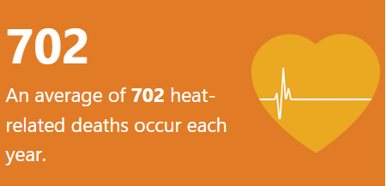
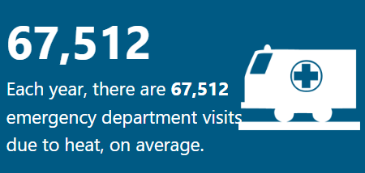
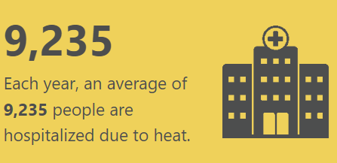
In the United States…
Notes:
F: Extreme heat is responsible for more weather-related deaths in the United States in an average year than any other hazard. Excessive heat claimed an average of 158 lives per year in the U.S. from 1992 through 2021, according to National Oceanic and Atmospheric Administration (NOAA). That's higher than the average annual death tolls from flooding (88), tornadoes (71), hurricanes or tropical storms (45) and lightning (37) in that 30-year period.
F: According to the Centers for Disease Control and Prevention (CDC), there is an estimated 702 deaths, 67, 512 ER visits and 9,235 individuals hospital per year due to environmental heat exposure.
F: Extreme hot weather strains the heart and lungs, causing heart attacks, strokes and respiratory disease in vulnerable individuals.
F: Extreme summer heat is increasing in the United States. Climate projections indicate that extreme heat events will be more frequent and intense in coming decades.

Slide 8
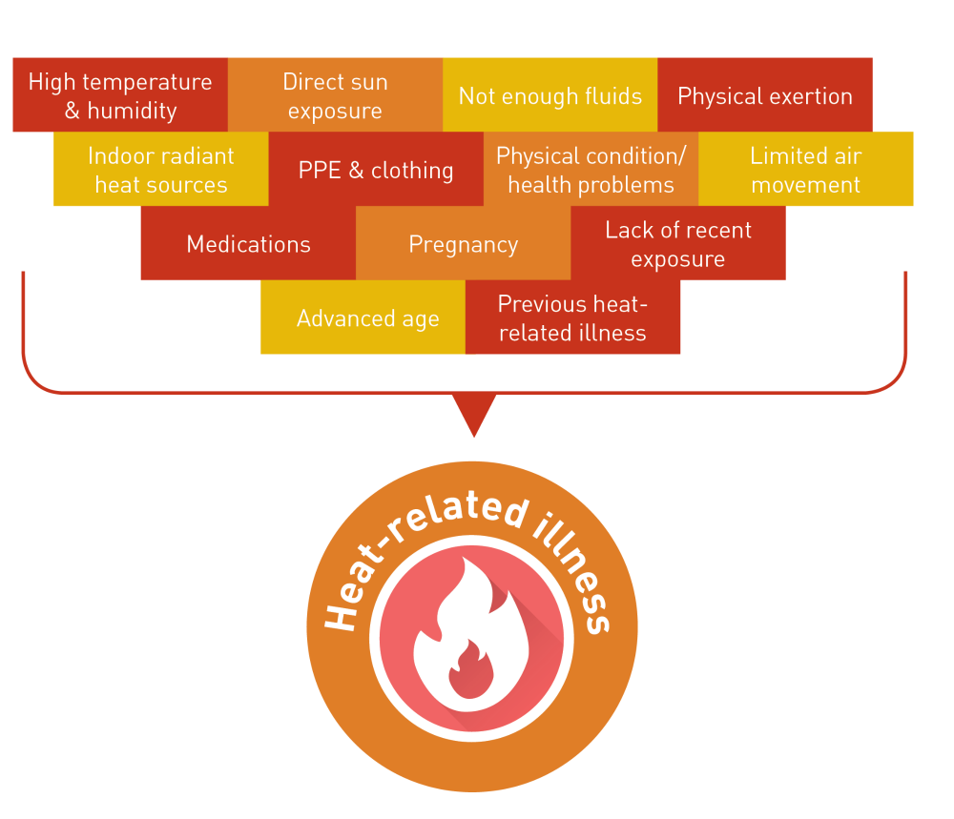
Factors that Increase Risk of Heat Illness
Notes:
F: There are several factors that can increase an individual’s risk of heat-related illness. These factors can be described as either “Environmental” or “Personal” factors.
F: Environmental factors are working conditions that create the possibility that heat illness could occur, including:
Air temperature
Relative humidity
Radiant heat from the sun and other sources
Conductive heat sources such as the ground
Air movement
Workload severity and duration
Protective clothing and personal protective equipment worn by employees
F: Personal factors are factors such as:
Water consumption
Alcohol consumption
Degree of acclimatization
Caffeine consumption
Pregnancy
Use of prescription medications that affect the body’s water retention or other physiological responses to heat.
An individual’s age
Health

Slide 9
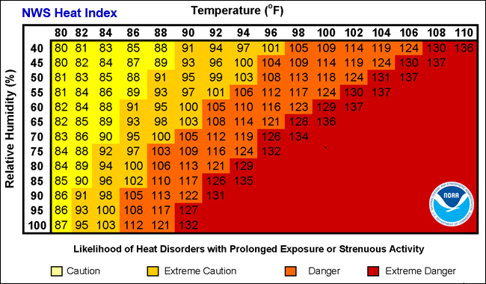
Heat Index
Notes:
F: The heat index, also known as the apparent temperature, is what the temperature feels like to the human body when relative humidity is combined with the air temperature. In order to determine the heat index using the chart provided, you need to know the air temperature and the relative humidity. For example, if the air temperature is 100°F and the relative humidity is 55%, the heat index will be 124°F.
F: The heat index values in the chart are for shady locations. If you are exposed to direct sunlight, the heat index value can be increased by up to 15°F.
F: The heat index is broken down into 4 classifications:
80°F - 90°F - Caution
90°F - 103°F – Extreme Caution
103°F - 124°F – Danger
125°F or higher – Extreme Danger

Slide 10
Signs and Symptoms of Heat Illness
Heat Cramps
Fainting
Heat Rash
Notes:
F: The symptoms of heat illness can come in many forms. Heat cramps, fainting, and heat rash are symptoms commonly associated with different heat illnesses.
F: Heat Cramps may occur alone or simultaneously with other heat-related illnesses. Heat cramps are painful muscle spasms caused by sweating while performing hard physical labor in a hot environment. Sweating makes the body loose salts, fluids, and minerals. If only the fluids are replaced and not the salts and minerals painful muscles cramps may result. Heat cramps can also be caused by too much salt. Tired muscles are very susceptible to heat cramps. Heat cramps are painful muscle spasms in the stomach, arms, legs, or other body parts that my occur after working in excessive heat.
F: Fainting may occur when an employee who is not used to the heat stands in one position for an extended period of time. Dehydration and lack of acclimatization to work in warm or hot environments can increase the susceptibility to fainting. An employee who has fainted should recover after a brief period of sitting or lying down. Moving around, rather than standing still, will reduce the possibility of fainting. The general symptoms that someone may faint are sudden dizziness or light-headedness.
F: Heat Rash (also known as prickly heat) often occurs in hot, humid environments where sweat does not easily evaporate from the skin. The sweat ducts become clogged, resulting in a rash. Heat rash can be very uncomfortable if the rash is extensive or complicated by infection. Taking frequent breaks in a cool place during the work-day and bathing and drying the skin regularly can help prevent heat rash. The symptoms of heat rash are red clusters of pimples or small blisters, usually occurring around the neck, chest, groin, under the breasts, or in elbow creases.

Slide 11
Dehydration
Notes:
F: Dehydration occurs when you use or lose more fluid than you take in, and your body doesn't have enough water and other fluids to carry out its normal functions. If you don't replace lost fluids, you will get dehydrated.
F: Workers should be encouraged to drink at least one cup (8 ounces) of water every 20 minutes while working in the heat, not just if they are thirsty. For longer jobs that last more than two hours, employers should provide electrolyte-containing beverages such as sports drinks.
F: Some of the early warning signs of dehydration include:
feeling thirsty and lightheaded
a dry mouth
tiredness
having dark colored, strong-smelling urine
passing urine less often than usual

Slide 12
The Effects of Fluid Loss On Performance
2% - Impaired Performance
4% - Capacity for muscular work declines
6% - Heat Exhaustion
8% - Hallucination
10% - Circulatory collapse and heat stroke
Notes:
F: Water is the most abundant molecule in the human body, accounting for ~60-70% of body mass and is the nutrient that is lost and consumed in the largest amount each day. Maintaining and balancing the body’s fluid level is imperative.
F: Our bodies naturally lose fluid several ways. Factors that contribute to fluid loss include:
Sweating
Exhaling
Urination
Diuretic intake
Natural body exertion to maintain core temperature
F: When the body loses too much water, it can impact our work and lead to heat exhaustion. Some of the consequences of fluid loss and neglect of fluid balance are:
2% of body weight - Impaired Performance
4% of body weight - Capacity for muscular work declines
6% of body weight - Heat Exhaustion
8% of body weight - Hallucination
10% of body weight - Circulatory collapse and heat stroke

Slide 13
Dehydration - Video
Notes:
VIDEO – 2:40 Min​
​
(Click play to play clip)​
​

Slide 14
Electrolytes
You can imagine electrolytes are like antifreeze in an automobile. Without antifreeze or the proper mix of antifreeze, the car quickly overheats during intense use. Without electrolytes, the body responds similarly.
Notes:
F: Electrolytes in your body support a number of functions. Your nerve cells use sodium and potassium electrolytes to transmit signals throughout your nervous system, and also use these electrolytes to communicate with your muscles. In addition, electrolytes regulate your blood pressure and blood volume, helping to support the proper circulation of oxygen-rich blood throughout your body.
F: For example, you can imagine electrolytes are like antifreeze in an automobile. Without antifreeze or the proper mix of antifreeze, the car quickly overheats during intense use. Without electrolytes, the body responds similarly. The hard it is worked, the quicker it overheats.
F: Workers lose salt and other electrolytes when they sweat. Substantial loss of electrolytes can cause muscle cramps and other dangerous health problems. Water cannot replace electrolytes; other types of beverages are needed.

Slide 15
Heat Exhaustion
Notes:
F: When the body has insufficient water and salt intake, it causes the body’s cooling structure to break down. Heat Exhaustion is caused by the loss of large amounts of fluid by sweating, sometimes with excessive loss of salt.
F: An employee suffering from heat exhaustion still sweats but may experience the following signs and symptoms:
headache
dizziness
weakness
mood changes (confused or irritable)
feeling sick to stomach
vomiting
decreased and dark-colored urine
light-headedness or fainting
pale clammy skin
F: Heat exhaustion is usually gradual to onset.

Slide 16
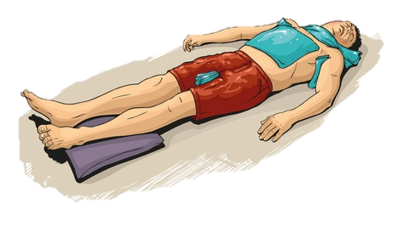
Heat Exhaustion First Aid
Move victim to a cool place and elevate their feet.
Keep victim lying down with legs straight and elevated 8-12 inches.
Cool the victim by applying cold packs or wet towels or cloths. Fan the victim.
Give the victim cold water if he or she is fully conscious.
If no improvement is noted in 30 minutes, seek medical attention.
Notes:
F: If you witness someone showing signs of heat exhaustion, you should immediately:
Move the victim to a cool place and elevate their feet.
Keep the victim lying down with legs straight and elevated 8-12 inches.
Cool the victim by applying cold packs or wet towels or cloths. Fan the victim.
Give the victim cold water if he or she is fully conscious.
If no improvement is noted within 30 minutes, seek medical attention.

Slide 17
Heat Stroke
Heat stroke is a medical emergency!
Symptoms of heat stroke include:
Confusion, altered mental status, slurred speech
Loss of consciousness (coma)
Hot, dry skin or profuse sweating
Seizures
Very high body temperature
Fatal if treatment delayed
Notes:
F: Heat Stroke is life threatening and the most serious of the heat related illnesses. Heat stroke is a central nervous system failure and occurs when the body can no longer control its temperature. The body's temperature rises rapidly, the sweating mechanism fails, and the body is unable to cool down. When heat stroke occurs, the body temperature can rise to 106°F or higher within 10 to 15 minutes.
F: It is a medical emergency!
F: Symptoms of heat stroke include:
Confusion, altered mental status, slurred speech
Loss of consciousness (coma)
Hot, dry skin or profuse sweating
Seizures
Very high body temperature
Fatal if treatment delayed

Slide 18
Heat Stroke First Aid
Notes:
F: If you notice an individual is suffering from heat stroke, you should:
Move the victim to a cool place. Remove heavy clothing; light clothing can be left in place.
Immediately cool the victim by any available means. Such as placing ice packs at areas with abundant blood supply (neck, armpits, and groin). Wet towels or sheets are also effective. The cloths should be kept wet with cool water.
Continue cooling the victim until their temperature drops to 102 degrees Fahrenheit.
Keep the victim's head and shoulders slightly elevated.
Seek medical attention immediately. All heat stroke victims need hospitalization.
Care for seizures if they occur.
Do not use aspirin or acetaminophen.

Slide 19
Heat Illness Prevention
Workers should:
Learn to recognize the symptoms of heat stress.
Pace the work, taking adequate rest periods.
Use adequate fans for ventilation and cooling.
Wear light-colored, loose clothing (unless working around equipment with moving parts).
Keep shaded from direct heat where possible
Drink plenty of water.
Supervisors should:
Allow time for employees to adjust to hot jobs when possible. Adjust the work schedule, if possible.
Reduce the workload.
Establish a schedule for work and rest periods during hot days.
Train workers to recognize signs and symptoms of heat stress disorders and be prepared to give first aid if necessary.
Choose appropriate employees
Realize individual employees vary in their tolerance to heat stress conditions.
Notes:
F: Supervisors and workers can work together by recognizing their role in preventing heat stress and illness.
F: Supervisors should:
Allow time for employees to adjust to hot jobs when possible. It often takes two to three weeks for an employee to become acclimated to a hot environment.
Adjust the work schedule, if possible. Assign heavier work on cooler days or during the cooler part of the day.
Reduce the workload. Increase the use of equipment on hot days to reduce physical labor.
Establish a schedule for work and rest periods during hot days.
Train workers to recognize signs and symptoms of heat stress disorders and be prepared to give first aid if necessary.
Choose appropriate employees: Avoid placing "high risk" employees in hot work environments for extended time periods. Realize individual employees vary in their tolerance to heat stress conditions.
F: Workers should:
Learn to recognize the symptoms of heat stress. Pace the work, taking adequate rest periods (in shade or a cooler environment).
Use adequate fans for ventilation and cooling, especially when wearing personal protective equipment (PPE).
Wear light-colored, loose clothing (unless working around equipment with moving parts).
Keep shaded from direct heat where possible (e.g., wear a hat in direct sunshine).
Drink plenty of water: in hot environments the body requires more water.

Slide 20
Toolbox Talk on Heat Stress Safety - Video
Notes:
VIDEO – 5:03 Min​
​
(Click play to play clip)​
​

Slide 21
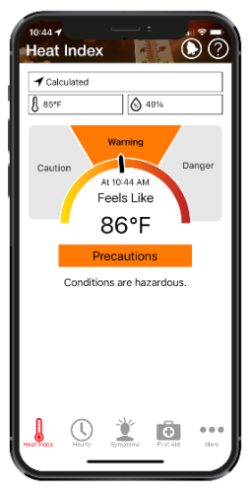
NIOSH Heat Safety Tool iPhone & Android App
NIOSH Heat Safety Tool iPhone & Android App
Notes:
F: The National Institute for Occupational Safety & Health (NIOSH) Heat Safety Tool app for iPhone and Android is a useful, free resource for planning outdoor work activities based on how hot it feels throughout the day. It has a real-time heat index and hourly forecasts specific to your location. It also provides occupational safety and health recommendations from OSHA and NIOSH.
F: The OSHA-NIOSH Heat Safety Tool features:
A visual indicator of the current heat index and associated risk levels specific to your current geographical location
Precautionary recommendations specific to heat index-associated risk levels
An interactive, hourly forecast of heat index values, risk levels, and recommendations for planning outdoor work activities
Location, temperature, and humidity controls, which you can edit to calculate for different conditions
Signs and symptoms and first aid for heat-related illnesses
F: You can use the cameras on your cellphones to scan the QR code on the slide. This will pull up the NIOSH website with links to both the iPhone and Android smartphone apps.

Slide 22
One Team
QUESTIONS?

