Slide 1
Driving Safety
April 2022
Notes:
KLP: You set the tone. If you believe safety is important, the audience will believe safety is important.
The facilitator opens the session by welcoming everybody to the training and noting the monthly focus – Driving Safety
F: Today’s task is to attend Driving Safety. Cell phones should be turned off or silenced during this training. If you need to take a call, please go to (designated area), take the call and return as soon as possible. {Address any other important announcements or business now.}

Slide 2
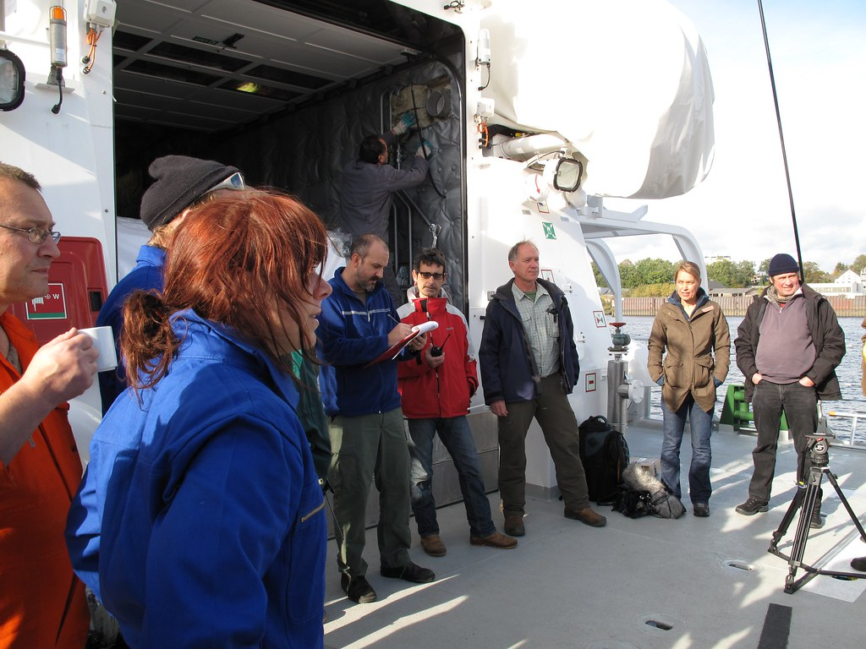
Housekeeping
Muster Point
Notes:
F: Prior to training, determine if any fire drills are planned and the response expected from the facility and muster points if alarms should go off. It is important to remind employees that should they need to leave the location at any time, they should inform the Facilitator because, in the event of a fire incident, we need to know their whereabouts. This is an opportunity right at the start of the day to brief the employees on HSE procedures in general for the running of the training course. [If your job site is outdoors, don’t overlook this safety moment. Adjust the plan in the event of a job site fire.]
F: Hello Team, I have verified with the HSE department and have confirmed that there are no Fire Drills or Emergency Drills scheduled for today. If we hear an alarm, we will follow site protocol for emergency response.
F: {Point out the fire exits and muster point}
F: Once we are at the muster points, we will do a role call to account for all attendees.

Slide 3

Presenter & Introductions
Safety begins with me!
Notes:
F: {This is your moment! This is a chance to visibly “Walk the Talk”}
Share:
Your personal experience of safety and impact on the company
Importance of making the most of this opportunity to think about the importance of HSE and discuss with employees
Appreciate that you are a leader and that you make an impact
Importance of taking personal responsibility to make a positive impact
You get out of this training what you put into it
HSE matters to our company
The safety program is going to help people feel empowered and take the initiative to improve their own HSE performance through proactive attitudes and behaviors.
You may wish to share:
A story of your experience in the safety program and how it is has changed the way in which you behave.
Some lessons learned from an incident when you have been involved in the investigation, highlighting the devastating impact that accidents have on people’s lives, or you can describe your experience of being involved in an environmental incident. How did this affect the company, and more importantly, affect the lives of others not working for the company.
F: Go around the room and ask everyone to give their name and what their position is. {Wait for their responses, smile, and nod as they participate. Be careful about timing here---if you ask an additional intro question of the participants and give a long-winded answer yourself, your participants will follow with long stories/explanations, and you can accidentally take up a lot of time.}

Slide 4

Why am I here?
You are the KEY to SAFETY!
Notes:
Slide 6: Why am I here? (1 Minute)
F: Each one of us is the last line of defense to protect workers from injury or the environment from damage, should management systems and collective protections fail. Supervisors and workers are the KEY to HSE. We can promote or destroy the HSE climate through our own behavior and how other workers perceive it.
Supervisors and workers are responsible for enforcing safety rules. Regardless of our position, employment status, or background, everyone is responsible for HSE, and everyone can be a HSE leader by demonstrating positive attitudes and behavior.

Slide 5
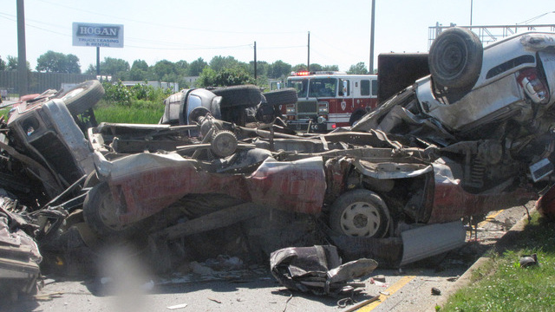
Driving Safety
Motor vehicle crashes are the 1st or 2nd leading cause of death in every major industry group.
Notes:
F: When you think of work-related safety hazards, you probably think about what goes on inside the workplace. But one of the greatest threats to your safety is not in the workplace, but rather on the road. When you drive defensively, you are driving safely to save lives, time, and money.
F: Millions of workers drive or ride in a motor vehicle as part of their jobs and motor vehicle crashes are the leading cause of work-related deaths in the U.S. The type of company or job doesn’t matter — the risk is there. All workers are at risk of crashes, whether they drive light or heavy vehicles, or whether driving is a main or incidental job duty. Work-related crashes include:
Single- or multiple-vehicle crashes, on or of public roadways, which occur on the job
Events in which a pedestrian worker (e.g., a law enforcement officer) is struck by a motor vehicle in operation, on or of a public roadway”
F: According to National Institute for Occupational Safety & Health (NIOSH), motor vehicle crashes are the leading cause of work-related deaths in the U.S. From 2003-2018, more than 29,000 workers in the U.S. died in a work-related motor vehicle crash.
F: In 2019 alone, work-related crashes cost employers $39 billion.
$75,000 per nonfatal injury
$751,000 per death

Slide 6
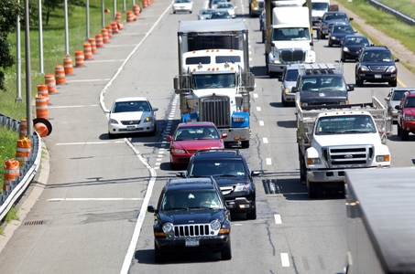
Defensive Driving
Defensive driving is anticipating other drivers’ mistakes, maintaining a safe speed, keeping an appropriate distance from other vehicles, and staying alert for possible risks on the road.
Notes:
F: Our driving affects everyone around us. Everyone CAN and SHOULD drive defensively.
F: Defensive driving is anticipating other drivers’ mistakes, maintaining a safe speed, keeping an appropriate distance from other vehicles, and staying alert for possible risks on the road. Practicing defensive
driving requires focus and attention and can help motorists avoid crashes and other roadway dangers. While motorists cannot control other drivers' actions, the following defensive driving skills can help reduce the hazards caused by other people’s bad driving behaviors.

Slide 7
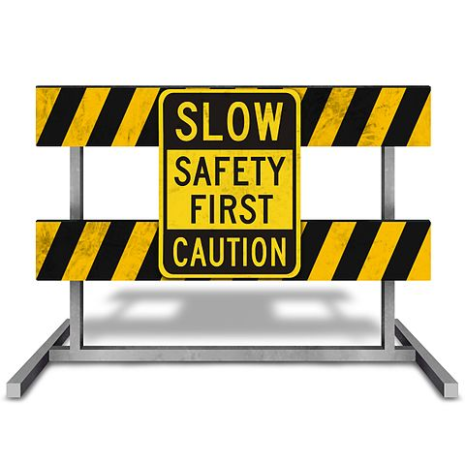
Driving Hazards
Driving hazards can include:
Distracted Driving
Speeding
Aggressive Driving
Driver Fatigue
Severe Weather
Unexpected Road Conditions
Driving Impaired (under the influence of drugs and/or alcohol)
Notes:
F: You can be exposed to driving hazards every day, on and off the job.
F: Driving hazards can include:
Distracted Driving
Speeding
Aggressive Driving
Driver Fatigue
Severe Weather
Unexpected Road Conditions.
Driving Impaired (under the influence of drugs and/or alcohol.)

Slide 8

Safe Driving Practices
DO:
Obey the speed limit
Make sure that you are well rested
Drive Sober - ALWAYS
Always wear a seatbelt
DO NOT:
Drive in severe weather
Use your cell phone or eat and drink while driving
Engage in or respond to aggressive driving
Notes:
F: Here are a few Do’s and Don'ts to protect yourself and others :
Do: (Click mouse to trigger animation)
Obey the speed limit
Make sure that you are well rested
Drive Sober - ALWAYS
Always wear a seatbelt.
Do Not: (Click mouse to trigger animation)
Drive in severe weather
Use your cell phone or eat and drink while driving
Engage in or respond to aggressive driving

Slide 9

Speeding
According to the National Safety Council, speeding is the cause for about 30% of roadway fatalities.
Notes:
F: Speeding is a major factor in traffic deaths and injuries. The role of speeding in crashes is described in terms of its effect on the driver, the vehicle, and the road. Excessive speeding reduces the amount of time the driver has to react in a dangerous situation to avoid a crash, increases vehicle stopping distance, and reduces the ability of road safety structures (such as guardrails, impact attenuators, crash cushions, median dividers, and concrete barriers) to protect vehicle occupants in a crash.
F: Stay aware of the posted speed limit and watch your speed.

Slide 10
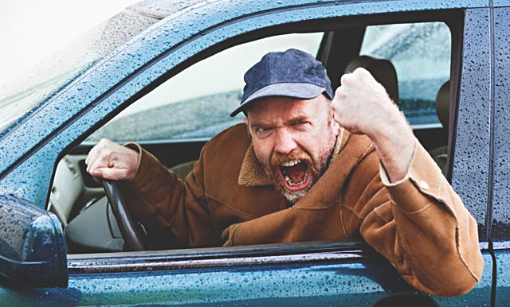
Aggressive Driving
While drivers have no control over others on the road, they can control their behaviors and reactions to circumstances around them.
Notes:
F: Aggressive driving is any unsafe behavior performed purposely with ill intent or disregard for safety that puts other drivers or property at risk. It is a moving violation subject to fines or jail time.
F: Examples of aggressive driving include:
speeding in heavy traffic;
tailgating;
cutting in front of another driver, then slowing down;
running red lights or stop signs;
weaving in and out of traffic;
changing lanes without signaling;
blocking cars attempting to pass or change lanes; or
passing a vehicle on the wrong side of the road.
F: Extreme cases of aggressive driving escalate to road rage, which can end in violence. Road rage behaviors (other than shouting or inappropriate gesturing) is a criminal offense.
F: Examples of road rage include any of the following behaviors:
cursing or making rude or obscene gestures at other drivers;
throwing objects at another vehicle; •ramming or sideswiping a vehicle;
forcing a driver off the road; or
physically assaulting a driver
F: While drivers have no control over others on the road, they can control their behaviors and reactions to circumstances around them. Remaining calm and courteous behind the wheel of a vehicle
lowers a driver’s risk of an unpleasant confrontation or negative driving encounter.
F: You should always avoid confrontation:
Avoid eye contact.
Eye contact with aggressive drivers increases the chance of confrontation.
Steer clear and ignore angry drivers, when possible.
Keep the encounter as impersonal as possible.
Do not respond to aggression with aggression.
Traffic problems and drivers’ behaviors are not a personal challenge or an affront.
Avoid becoming reactive.
Get out of the other drivers’ way as soon as safely possible.
Be tolerant and forgiving.
Another driver may be having a really bad day.
Always assume their behavior is not personal.
Report aggressive drivers by calling 311.
If necessary, police departments invite motorists to report unsafe drivers by calling 311.
Include the vehicle description, location, license plate number, and direction of travel to authorities, if possible.
Call 911 if threatened.
Anytime a motorist is concerned for their safety, contact emergency services at 911.
Continue to drive to a public place, such as a police station, hospital, or fire station, if possible.

Slide 11
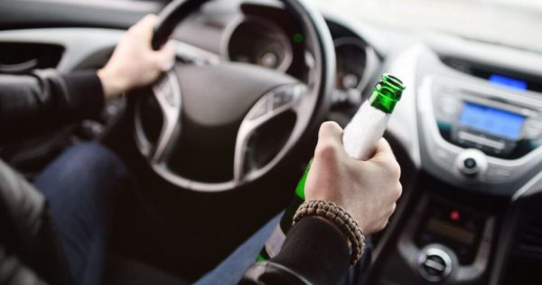
Driving Under the Influence
Every day, about 28 people in the United States die in drunk-driving crashes. That’s 1 person every 52 minutes.
Notes:
F: Alcohol-impaired driving continues to be one of the biggest safety issues on U.S. roads. In 2020, 11,654 people were killed in alcohol-impaired crashes, an increase of 14.3% from the 10,196 deaths in 2019 and the most deaths recorded since 2009. Alcohol-impaired driving crashes involve at least one driver or motorcycle operator with a blood alcohol concentration (BAC) of 0.08 grams per deciliter (g/dL) or higher. Progress has been made in reducing alcohol-impaired crashes. In 1982, 48% of all traffic deaths involved alcohol-impaired crashes. This is down to 30% of deaths in 2020.
Do not drive if you have taken illegal drugs or have drunk alcohol.
Do not take over the counter medicines that could impair your ability to drive.
Check your prescription warnings about driving.
F: A standard drink is equal to 0.6 ounces of pure alcohol. Generally, this amount of pure alcohol is found in:
12-ounces of beer (5% alcohol content)
8-ounces of malt liquor (7% alcohol content)
5-ounces of wine (12% alcohol content)
1.5-ounces or a “shot” of 80-proof (40% alcohol content) distilled spirits or liquor (e.g., gin, rum, vodka, whiskey)

Slide 12
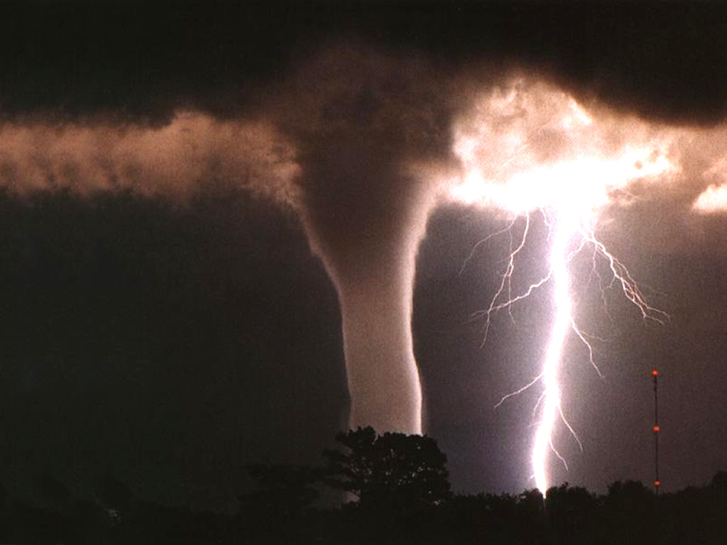
Severe Weather
Check weather reports before beginning your trip, and always avoid driving in severe weather.
Notes:
F: Severe weather to avoid driving in includes:
Floods and heavy rainstorms
Snowstorms and Hail
Dense Fog
Tornadoes

Slide 13
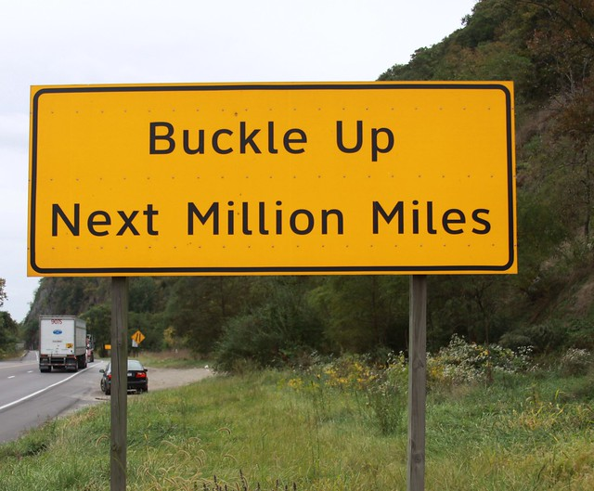
Seat Belts
According to OSHA seatbelts save 14,000 lives each year.
Notes:
F: The U.S. Department of Labor's Occupational Safety and Health Administration (OSHA) states that seatbelts save 14,000 lives each year.
Using seat belts cuts the risk of death by 45% for people riding in cars and by as much as 60% for those traveling in trucks or SUVs.
Seat belts save 14,000 lives each year and every state in the nation has a law mandating seat belt use.
F: Buckle-Up every time you drive.

Slide 14
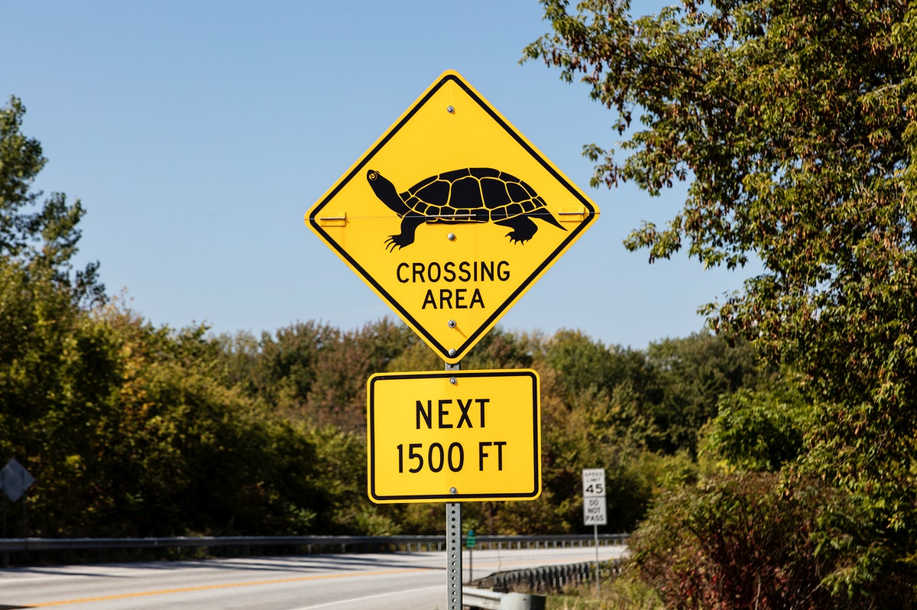
Unexpected Roadway Conditions
10% of collisions with wildlife result in injuries to drivers and passengers.
Notes:
F: Unexpected roadway conditions can include:
Road work,
Heavy traffic,
Car accidents,
Wildlife crossings
F: Driving defensively could save your life or someone else's life. Remember to drive safely and watch out for common driving hazards.

Slide 15
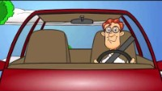
Defensive Driving Video
Notes:
VIDEO

Slide 16
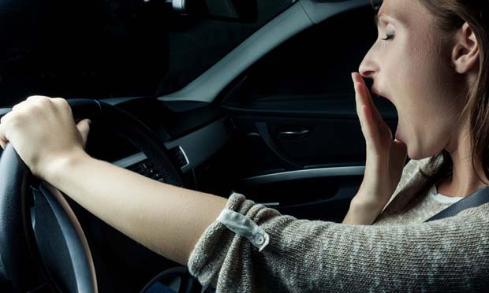
Driver Fatigue
Factors in driving fatigue include:
  lack of sleep due to long or irregular shift work hours;
  poor sleep quality;
  driving during normal sleeping hours
(midnight to 6 am);
driving on rural roads and highways;
consuming alcohol or taking medications that can cause drowsiness.
Notes:
F: Driver fatigue mimics alcohol impairment and compromises drivers’ alertness, decision making, and reaction times, making driving while drowsy a dangerous risk on the road. According to the National Institute for Occupational Safety and Health, 37% of U.S. workers get less than the recommended minimum of seven hours of sleep. Workers whose job involves long hours of driving, shiftwork, or a long commute, are at increased risk of driving fatigue.
F: Factors in driving fatigue include: (Click mouse to trigger animation)
• lack of sleep due to long or irregular shift work hours; (Click mouse to trigger animation)
• poor sleep quality; (Click mouse to trigger animation)
• driving during normal sleeping hours (Click mouse to trigger animation)
F: Does anyone know what is considered normal sleeping hours? (Click mouse to trigger animation) {Wait for their responses, smile, and nod as they participate.} Answer: (midnight to 6 am); (Click mouse to trigger animation)
• driving on rural roads and highways; and (Click mouse to trigger animation)
• consuming alcohol or taking medications that can cause drowsiness.

Slide 17
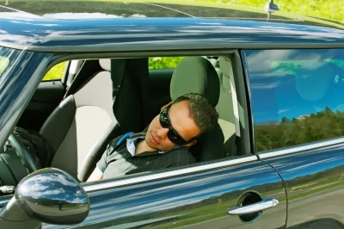
Driver Fatigue Symptoms
Signs and Symptoms of driving fatigue include:
burning or a heavy sensation in the eyes,
an inability to focus, or frequent blinking;
muscle twitching;
back tension;
yawning;
wandering or disconnected thoughts, including difficulty remembering the past few miles driven;
missing an exit, drifting in a lane, crossing roadway lines, or hitting a rumble strip on the side of the road;
heavy, tingly, or a numb sensation in limbs; and
shallow breathing.
Notes:
F: What are some symptoms of driver fatigue? {Wait for their responses, smile, and nod as they participate.}
F: Symptoms driving fatigue include: (Click mouse to trigger animation)
burning or a heavy sensation in the eyes,
an inability to focus, or frequent blinking;
muscle twitching;
back tension;
yawning;
wandering or disconnected thoughts, including difficulty remembering the past few miles driven;
missing an exit, drifting in a lane, crossing roadway lines, or hitting a rumble strip on the side of the road;
heavy, tingly, or a numb sensation in limbs; and
shallow breathing.

Slide 18
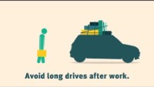
Driver Fatigue Video
Notes:
VIDEO

Slide 19

Driver Fatigue Prevention
Notes:
F: Lets test our knowledge. Now that we know the factors that cause driver fatigue, how can we prevent it? {Wait for their responses, smile, and nod as they participate.}
Possible Answers:
Get enough sleep. Most adults need seven to eight hours per night.
Start trips as early in the day as possible.
Avoid driving during normal sleeping hours.
Keep trips to reasonable distances.
Watch for road and traffic signs.
Before driving, eat light rather than heavy meals.
Stop to eat snacks or light meals.
Limit coffee to one or two cups. The effects of coffee or energy drinks last only a short time.
Take breaks every two hours or 100 miles. On a break, get out of the vehicle and walk, jog, or stretch.
Keep the driver’s area cool and well ventilated.
Sing or listen to the radio to keep alert.
Avoid alcohol and medications that can cause drowsiness.
Drive with an erect posture, with legs at a 45-degree angle.
Pull over at a rest stop or other safe place and take a 20-minute nap (any longer will make you feel groggy).

Slide 20
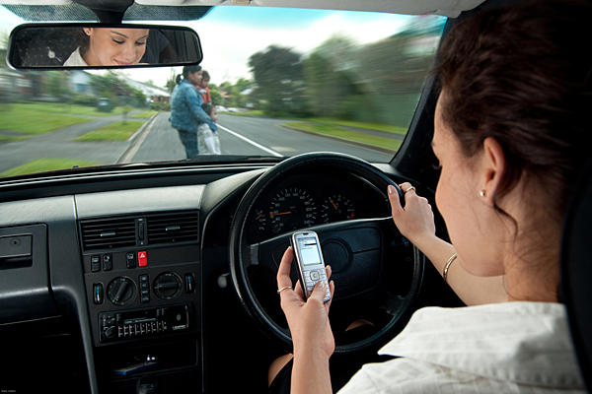
Distracted Driving
Snacking
Putting on Makeup
Texting
Talking on the Phone
Adjusting the Radio
Reaching for a moving object
Reading
Notes:
F: Distracted driving occurs any time you take your eyes off the road, hands off the wheel, and mind off of your primary takes – driving safely. Any non-driving activity that you engage in is a potential distraction and increases your risk of being involved in a crash.
F: Each year more workers are killed in motor vehicle crashes than any other cause,1 and thousands of those deaths are a result of distracted driving.
F: What would be some examples of distracted driving? {Wait for their responses, smile, and nod as they participate.}
(Click mouse to trigger animation for each bullet point)
Snacking
Putting on Makeup
Texting
Talking on the Phone
Adjusting the Radio
Reaching for Moving Objects (coffee cup on the floor etc)
Reading (text, emails, news articles etc)

Slide 21
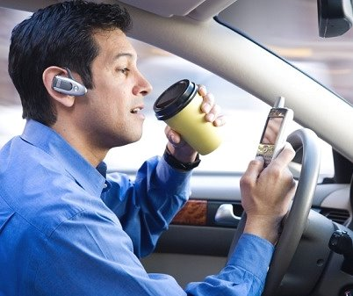
Distracted Driving Facts
Distracted drivers lead to about 391,000 injuries and almost 3,500 deaths in the United States each year.
Over 100 people die each day in car crashes. Nine of those fatalities are a result of distracted driving.
Notes:
F: Distracted Drivers are more likely than other drivers to:
Have a near collision
Fail to stop at an intersection
Exceed the speed limit
(Click mouse to trigger animation)
F: Distracted drivers lead to about 391,000 injuries and almost 3,500 deaths in the United States each year.
(Click mouse to trigger animation)
F: Over 100 people die each day in car crashes. Nine of those fatalities are a result of distracted driving.

Slide 22

Main Driving Distractions
Manual: Keep your hands on the wheel.
  Visual: Keep your eyes on the road.
  Cognitive: Stay focused, Stay sober.
Notes:
F: There are three main types of distraction: (Click mouse to trigger animation)
Manual: Keep Hands on the Wheel (manual distractions are anything that require you to take your hands off the wheel such as, reaching for things inside the vehicle, using a handheld device, eating or drinking, or applying makeup)
Save the texts and web browsing for later.
Finish grooming, eating, and drinking before driving.
(Click mouse to trigger animation)
Visual: Keep Eyes on the Road (visual distractions are anything that take your eyes off the road in front of you such as reading a text, looking up directions, “rubbernecking”)
Read directions before starting a trip.
Use the voice command feature when using navigation.
(Click mouse to trigger animation)
Cognitive: Stay Focused, Stay Sober (cognitive distractions are anything that can interrupt your focus on driving such as, talking on the phone, arguing with a passenger, having a drink or two when you stop for a meal.)
Avoid the risks of any speech-to-text application on cell phones or electronic devices.
Avoid driving fatigued or drowsy.
Never drive with alcohol or drug impairment.

Slide 23
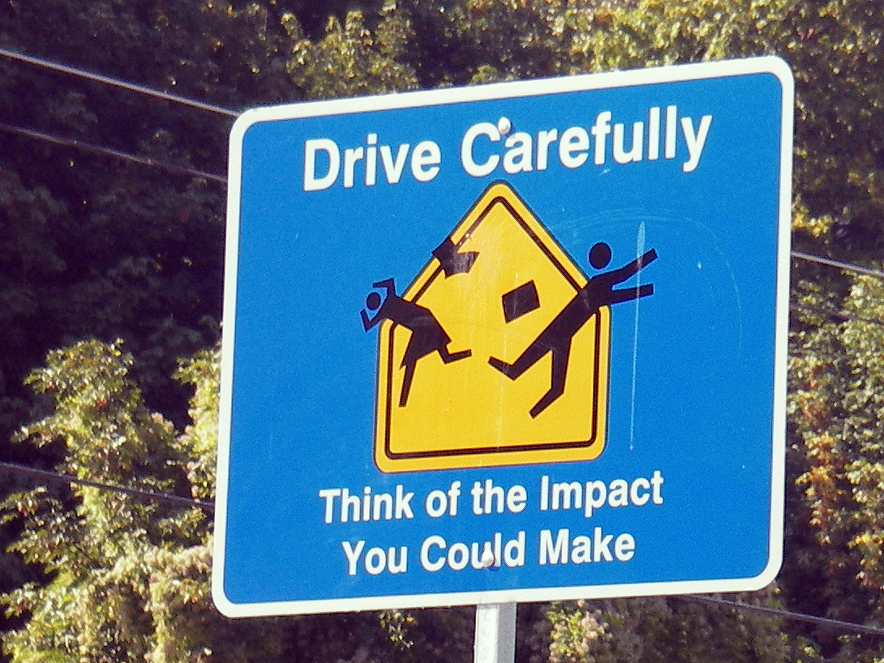
Tips to Avoid Distractions
Turn Off Temptation
Stop to Call or Text
Have a Plan
Pull Off the Road When Drowsy
Limit the Number of Passengers in Your Vehicle
Avoid Eating, Drinking, and Smoking While Driving
Keep Your Eyes Moving
Keep a Safe Distance
Notes:
F: Here are the actions to take to Avoid Distraction:
(Click mouse to trigger animation)
Turn Off Temptation Do not text or talk on your phone while driving.
Turn off your cell phone until you reach your destination. Research from the National Safety Council shows that hands-free phones are as much of a distraction as handheld phones. Place your device out of sight – in the glove box or the console -- so it’s out of mind.
(Click mouse to trigger animation)
Stop to Call or Text If you cannot wait to make a call or text, pull to a safe and legal place.
It’s illegal to text and drive. Many cities have stricter laws that prevent all handheld cell phone use while on the road. While traveling, cell phones should only be used for emergency purposes.
(Click mouse to trigger animation)
Have a Plan
Don’t wait until you are driving to plan your route. Use navigation devices with voice directions and set your destination before leaving. GPS and navigation systems can be as distracting as cell phones. Know where you are going in advance. Even with voice input, miss-heard words and bad-routing can take your attention off the road.
(Click mouse to trigger animation)
Pull Off the Road When Drowsy Drowsiness increases the risk of a crash by nearly four times.
A study by the AAA Traffic Safety Foundation found that 37% of drivers report having fallen asleep behind the wheel. An estimated 21% of fatal crashes and 13% of crashes with severe injuries involve a drowsy driver. If you feel tired, get off the road.
(Click mouse to trigger animation)
Limit the Number of Passengers in Your Vehicle
Talking with passengers is a cognitive distraction, but passengers can also help alert you to dangers outside the vehicle. Suspend conversations when approaching locations with heavy traffic, road construction, or severe weather conditions. Do not engage in stressful or emotional conversations with passengers.
(Click mouse to trigger animation)
Avoid Eating, Drinking, and Smoking While Driving
A busy day is no excuse for distracted driving. Eating and drinking while driving may seem like a time-saver, but it makes you less attentive to drivers around you. Dropping a cigarette or spilling food or a drink are major causes of distracted driving.
(Click mouse to trigger animation)
Keep Your Eyes Moving
Make a full-mirror sweep with your eyes every five-to-six minutes to ward off a wandering mind. When possible, vary your route so routine trips like commuting to and from work don’t become mundane.
(Click mouse to trigger animation)
Keep a Safe Distance
Driver training professionals suggest a following distance of three-to-four seconds in good weather. This gives you more time to react to what is happening in front of you, reducing the risk to you and your passengers.

Slide 24
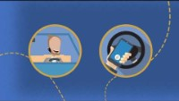
Distracted Driver Video
Notes:
VIDEO

Slide 25
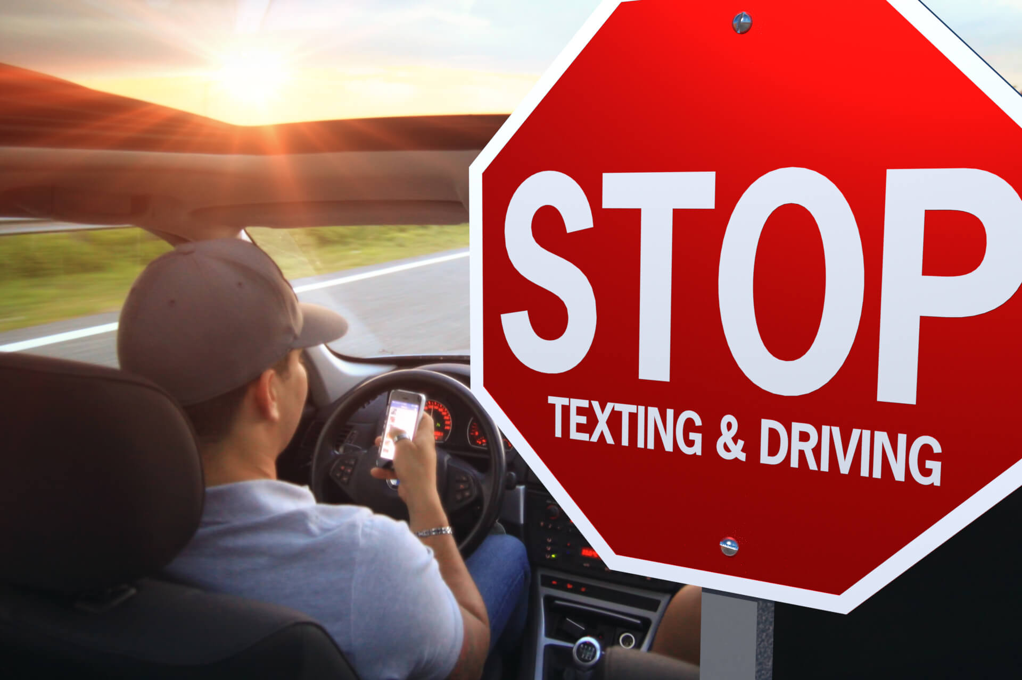
Distracted Driving
Notes:
F: As we discussed in the previous slides, talking and texting on a cell phone are driving distractions. Texting is one of the most serious driving distractions.
F: What type of distraction do you think texting and driving falls under? (Manual, Visual, or Cognitive) Answer: All three.
F: Texting while driving can be visual, manual, and cognitive distractions all at once! Your eyes are off the road reading your phone, your hand is off the wheel, holding the phone, and your mind is off the road and focused on your phone.
F: Always follow the Company’s safe driving policies. In addition to your company’s policies, you should also follow these safe practices to prevent distracted driving:
Do NOT text or use handheld phones when driving
Avoid using hands-free phones as much as possible
Pull over to a safe location if you MUST use your phone or do anything else that distracts you from driving.

Slide 26

One Team
QUESTIONS?

