Slide 1
Confined Spaces
November 2022
Notes:
KLP: You set the tone. If you believe safety is important, the audience will believe safety is important.
The facilitator opens the session by welcoming everybody to the training and noting the monthly focus – Confined Spaces.
F: Today’s task is to attend Confined Spaces training. Cell phones should be turned off or silenced during this training. If you need to take a call, please go to (designated area), take the call and return as soon as possible. {Address any other important announcements or business now.}

Slide 2
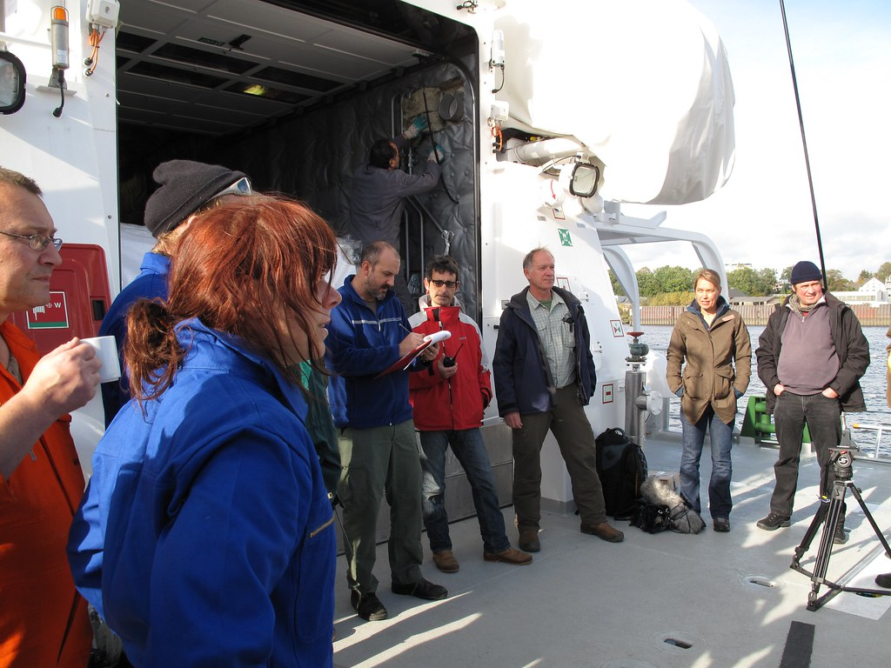
Housekeeping
Muster Point
Notes:
Prior to training, determine if any fire drills are planned and the response expected from the facility and muster points if alarms should go off. It is important to remind employees that should they need to leave the location at any time, they should inform the Facilitator because, in the event of a fire incident, we need to know their whereabouts. This is an opportunity right at the start of the day to brief the employees on HSE procedures in general for the running of the training course. [If your job site is outdoors, don’t overlook this safety moment. Adjust the plan in the event of a job site fire.]
F: Hello Team, I have verified with the HSE department and have confirmed that there are no Fire Drills or Emergency Drills scheduled for today. If we hear an alarm, we will follow site protocol for emergency response.
F: {Point out the fire exits and muster point}
F: Once we are at the muster points, we will do a role call to account for all attendees.

Slide 3

Presenter & Introductions
Safety begins with me!
Notes:
F: {This is your moment! This is a chance to visibly “Walk the Talk”}
Share:
Your personal experience of safety and impact on the company
Importance of making the most of this opportunity to think about the importance of HSE and discuss with employees
Appreciate that you are a leader and that you make an impact
Importance of taking personal responsibility to make a positive impact
You get out of this training what you put into it
HSE matters to our company
The safety program is going to help people feel empowered and take the initiative to improve their own HSE performance through proactive attitudes and behaviors.
You may wish to share:
A story of your experience in the safety program and how it is has changed the way in which you behave.
Some lessons learned from an incident when you have been involved in the investigation, highlighting the devastating impact that accidents have on people’s lives, or you can describe your experience of being involved in an environmental incident. How did this affect the company, and more importantly, affect the lives of others not working for the company.
F: Go around the room and ask everyone to give their name and what their position is. {Wait for their responses, smile, and nod as they participate. Be careful about timing here---if you ask an additional intro question of the participants and give a long-winded answer yourself, your participants will follow with long stories/explanations, and you can accidentally take up a lot of time.}

Slide 4

Why am I here?
You are the KEY to SAFETY!
Notes:
F: Each one of us is the last line of defense to protect workers from injury or the environment from damage, should management systems and collective protections fail. Supervisors and workers are the KEY to HSE. We can promote or destroy the HSE climate through our own behavior and how other workers perceive it.
Supervisors and workers are responsible for enforcing safety rules. Regardless of our position, employment status, or background, everyone is responsible for HSE, and everyone can be a HSE leader by demonstrating positive attitudes and behavior.

Slide 5

Confined Space Video
Notes:
F: Play Video (8 Minutes)

Slide 6
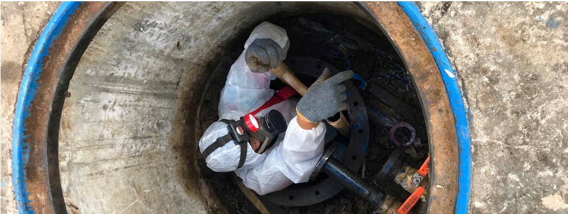
Confined Spaces Characteristics
Notes:
F: Confined Spaces is an area that:
• is large enough and configured so that an employee can bodily enter and perform assigned work;
• has limited or restricted means for entry or exit, such as tanks, vessels, silos, storage bins, hoppers, vaults, or pits; and
• is not designed for continuous employee occupancy
F: •Confined spaces are dangerous because they can be unsafe in design and may contain harmful substances, affect breathing, increase fire hazards, or limit an employee's ability to enter and exit easily.
•The Occupational Safety and Health Administration (OSHA) outlines confined space safety requirements for general industry in 29 code Federal Regulations (CFR) 1910.146.
•Separate requirements for confined spaces in construction are found in 29 CFR 1926 Subpart AA.

Slide 7
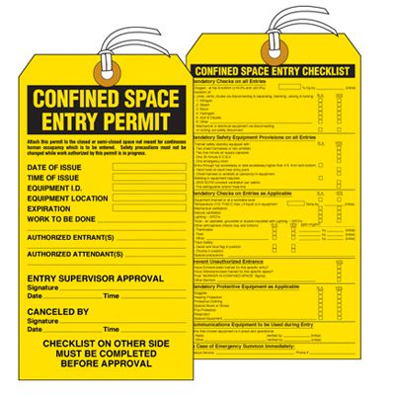
Confined Spaces Entry Permit
Notes:
F: The entry supervisor must sign all entry permits and post them at all entrances to the confined space, or otherwise make them available to entrants before anyone enters the space.
Permits must confirm that all pre-entry preparations have been completed. The permit must contain a time limit that does not exceed the time needed to do the task inside the confined space.
Entry permits must include:
•the name of the permit-required confined space to be entered;
• the names of the entry supervisor, all entrants, and attendants involved;
• the atmospheric test results;
• the tester’s initials or signature;
• the entry supervisor’s signature;
• the purpose of entry;
• all known hazards;
• measures to isolate the space;

Slide 8
Confined Spaces Entry Permit Cont.
Notes:
F: • measures to eliminate or control hazards;
• the names and phone numbers of rescue and emergency personnel;
• the date and authorized duration of entry;
• acceptable entry conditions;
• communication procedures and equipment used to ensure communication during entry;
• additional permits, such as hot work permits, that authorize specific work in the confined space;
• special equipment and procedures needed for the entry; and
• any other information needed to ensure employee safety.
KLP: The entry supervisor must cancel the permit when the work is complete or new conditions arise. New conditions must be noted on the permit and used to revise the confined space entry program. Permits must be kept on file for at least one year.

Slide 9
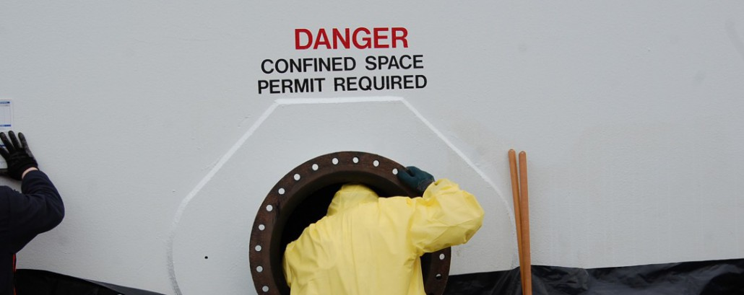
Permit Required Confined Spaces
Notes:
F: A permit-required confined space is a more hazardous area that has one or more additional characteristics:
• Contains or has a potential to contain a hazardous atmosphere;
• Contains a material that could engulf an employee;
• Has an inside layout that could trap or smother (asphyxiate) an employee, such as walls that lean inward or a floor that slopes downward to a smaller cross-section;
• Contains any other recognized serious safety or health hazard

Slide 10
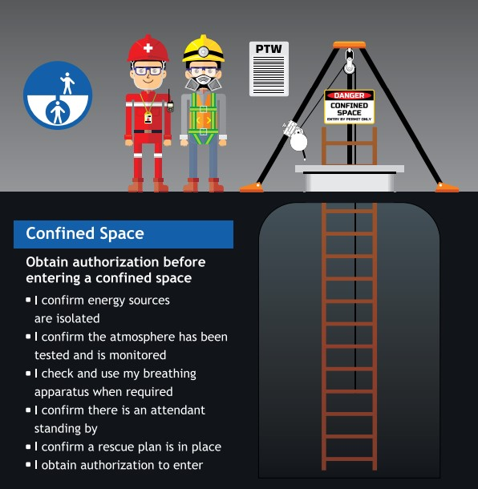
Permit Required Confined Spaces Cont.
Notes:
F: Employers must inform employees of the locations and hazards of permit-required confined spaces. This is often done by posting signs around the space that state, “DANGER – PERMIT-REQUIRED CONFINED SPACE – AUTHORIZED ENTRANTS ONLY.” Only authorized and trained personnel with a permit from the entry supervisor may enter a permit-required confined space.
KLP: Under certain circumstances, employees may enter a confined space without a permit if all hazards can be removed by isolating the confined space or the only hazard is atmospheric, which can be controlled by ventilation. In this instance, the employer must perform pre-entry atmospheric testing and provide continuous atmospheric monitoring thereafter.

Slide 11

Written Program (Permit Required)
Notes:
F: An employer that allows employees to enter permit-required confined spaces must develop and implement a written program. The program should include:
•measures to prevent unauthorized entry;
•a review of all confined space hazards; and
•procedures and practices for safe entry into permit-required confined spaces including:
•creating acceptable entry conditions;
•allowing authorized personnel to observe the monitoring process;
•isolating permitted spaces;
•eliminating or controlling atmospheric hazards;
•providing barriers to protect entrants from external hazards; and
•verifying that conditions are acceptable throughout an authorized entry.

Slide 12
Written Program (Permit Required)
Notes:
F: Equipment needed for a permit required confined space such as:
•testing and monitoring equipment;
•ventilation equipment;
•communications equipment;
•personal protective equipment;
• lighting equipment;
•barriers or shields;
•equipment needed for safe ingress and egress; and
• any other needed equipment.
F: Explanation of how permitted spaces must be evaluated;
Assignments for attendants, supervisors, and rescuers;
Designations and definitions of roles of attendants, supervisors, and rescuers;
Rescue procedures; and
Descriptions of the processes for issuing, using, and canceling confined space permits.

Slide 13
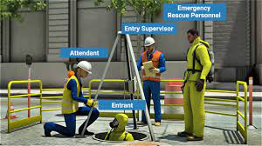
Confined Space Personnel
Notes:
F: •Entrant- An entrant is a person who enters the space to perform the work.
•Attendant- An attendant is the person on duty outside the space whose only function is to monitor the space as long as entrants are working inside. The attendant is responsible for knowing what is going on inside the space at all times to react in event of an emergency.
•Entry Supervisor- An entry supervisor is the person in charge of confined space entry and is responsible for all activities. To work safely in a confined space, the entrant must be able to communicate with the attendant on duty outside the space. A system of communication must be set up before beginning work.
• Rescuers- This personnel must be able and available to rescue the entrant by remote means (such as a winch) or to enter the space with sufficient gear (including personal protective equipment) to do the job safely.

Slide 14
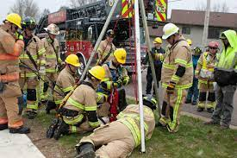
Use of Fire Department Rescue Squads
Notes:
F: OSHA’s 29 CFR 1910.146 standard does not prohibit an employer from using a fire department rescue team for confined space rescue. However, employers must take the following precautions:
• The employer must evaluate the fire department rescue truck and personnel to determine that the rescue squad is properly trained and equipped to undertake a confined space rescue in the employer’s permit-required confined space.
• The employer must determine that the fire department rescue squad can respond and deploy promptly.
• Before beginning a permit-required confined space entry, the employer must determine that the rescue squad is available to respond if needed and prepared to abort the entry if the rescue personnel go out on another call.

Slide 15
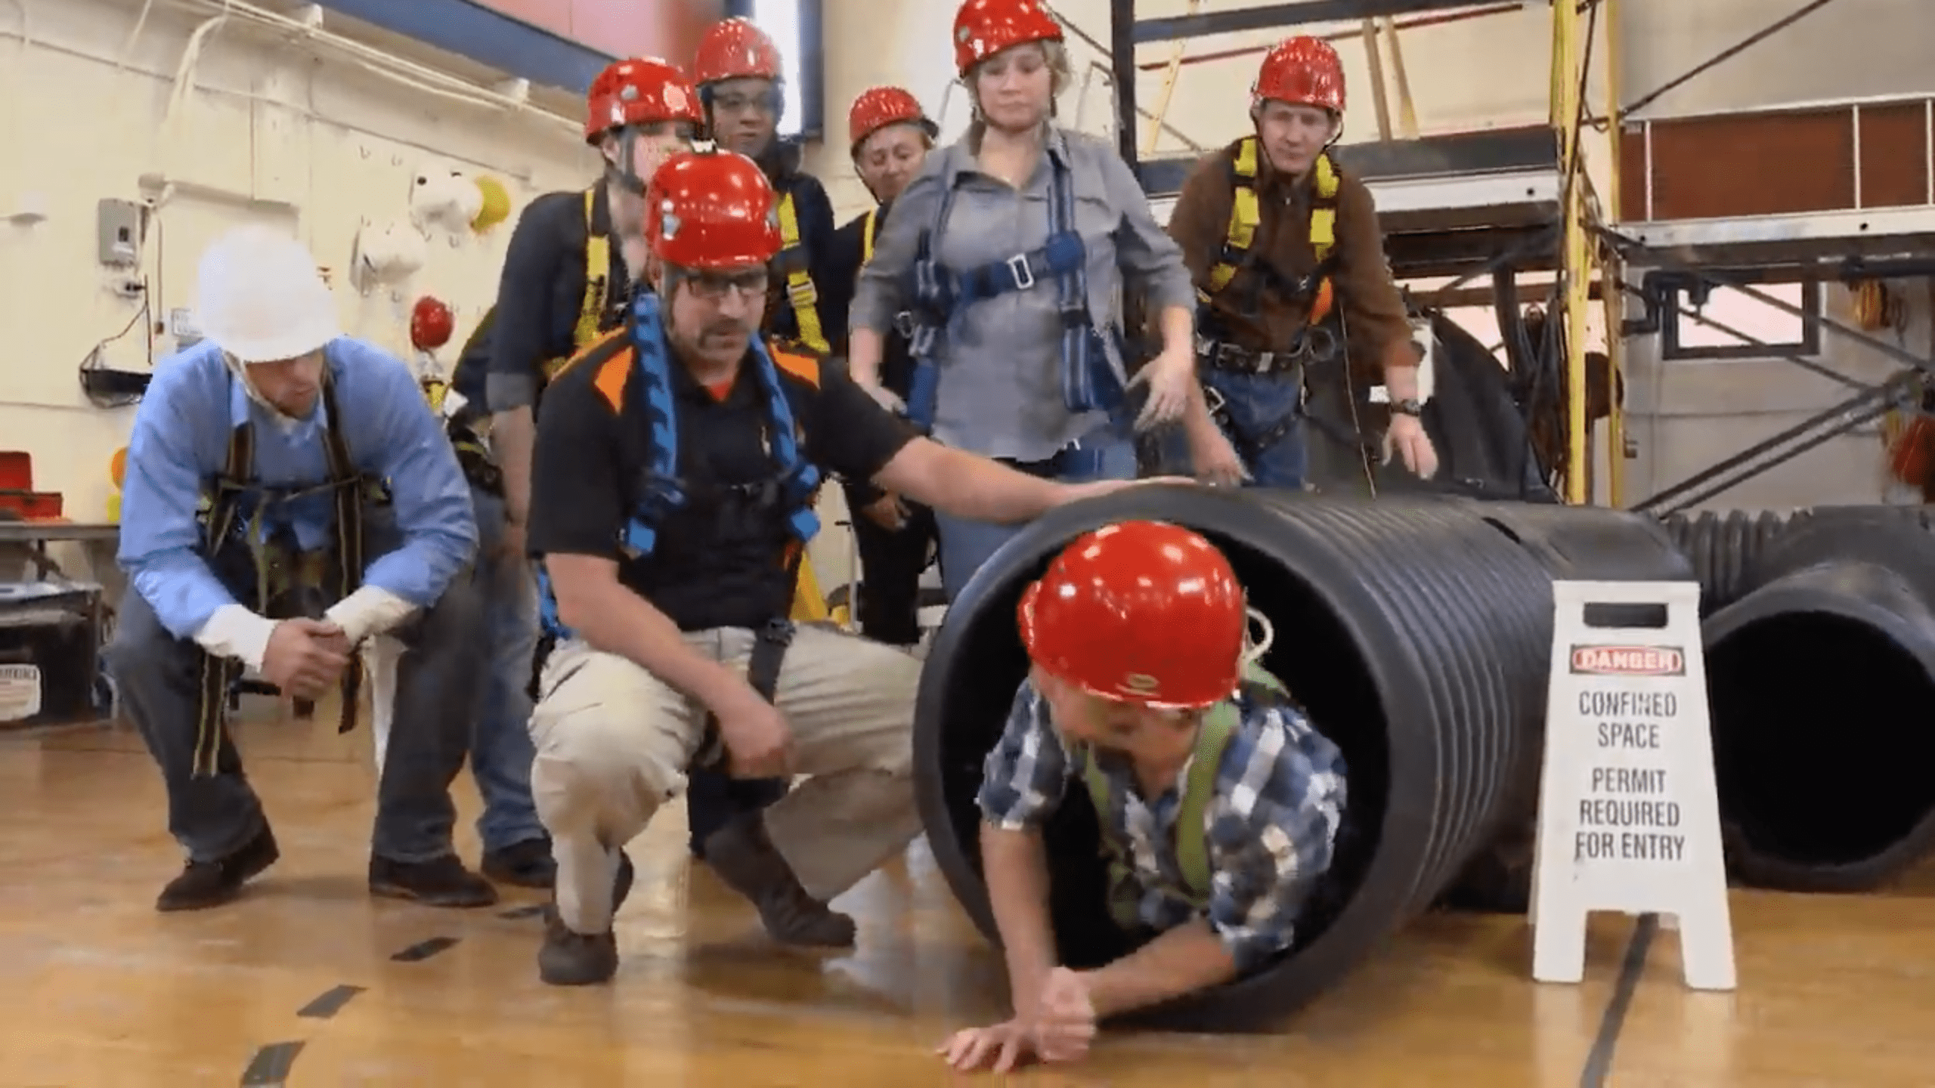
Training
Notes:
F: Entrants, attendants, entry supervisors, and rescuers must be trained in their duties before attempting a confined space entry.
The employer must ensure that all affected employees understand and can perform their tasks fully.
Rescuers must be trained in the hazards they are likely to encounter in the employer’s confined spaces.
Additional training is required if job duties change, new permit-required confined spaces are identified, or if affected employees show a lack of understanding or proficiency.
In addition, rescuers should be trained in first aid and cardiopulmonary resuscitation (CPR) and perform practical rescue exercises at least annually.
KLP: All training must be documented, and records retained for three years from the date training occurred.

Slide 16
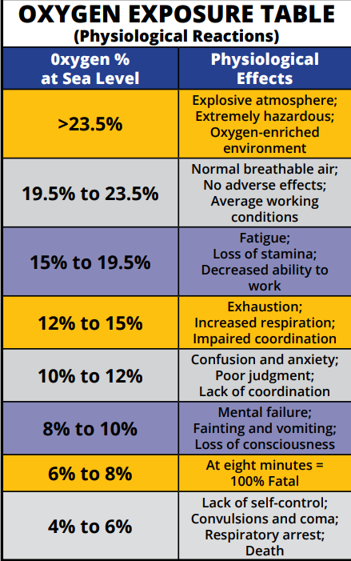
Atmospheric Hazards (Oxygen-Deficient)
Notes:
F: Normal air contains about 20.8% oxygen by volume. Oxygen-deficient atmospheres have less than 19.5% oxygen by volume. Changes in normal concentrations are a serious hazard in confined spaces. (See Table 1)
Oxygen levels decrease as a result of:
• welding, cutting, or brazing;
• chemical reactions such as rusting;
• bacterial action such as fermentation; or
• displacement by other gases such as carbon dioxide or nitrogen.

Slide 17

Atmospheric Hazards (Oxygen-Enriched)
Notes:
F: Oxygen-enriched atmospheres occur when oxygen levels exceed 23.5% by volume. At that point, the atmosphere becomes flammable, and materials such as clothing or hair will burn rapidly when ignited. Unattended or leaking oxygen lines or cylinders can increase oxygen concentration to an unsafe level.

Slide 18
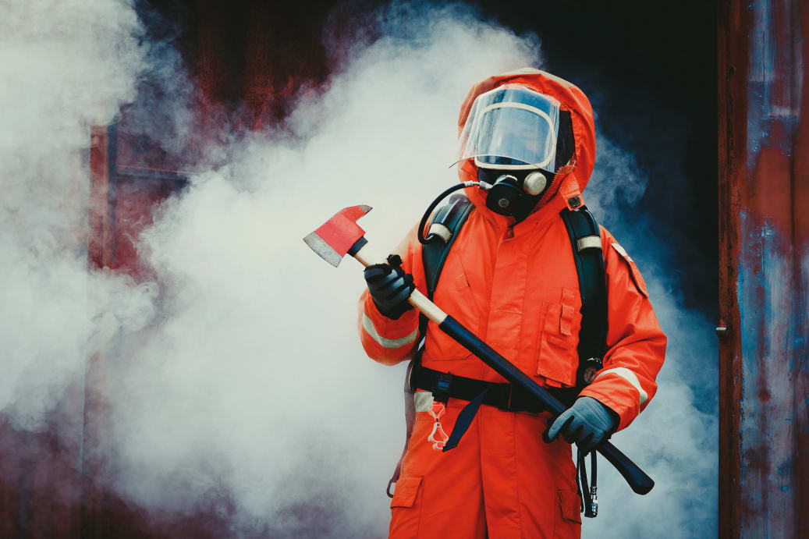
Toxic Atmospheres
Notes:
F: Toxic atmospheres can be caused when:
• products stored in a confined space get absorbed into the walls and give off toxic gases during removal;
• welding, sanding, or degreasing occur in the confined space; and
• hazardous liquids, vapors, mists, solid materials, or dust are produced nearby, then enter and gather inside the confined space.

Slide 19
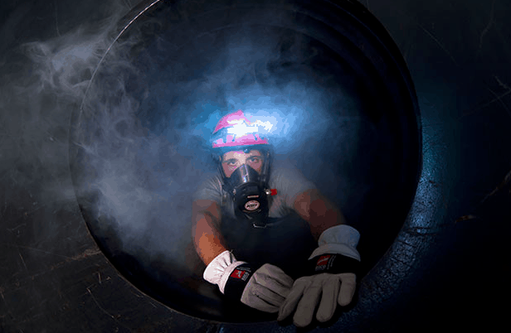
Toxic Gases
Notes:
F: Toxic gases can irritate the skin, eyes, nose, and throat. Some can prevent the body from using oxygen effectively, and all of them can injure or kill. Some of the most common toxic gases found in confined spaces are:
• carbon monoxide, a colorless, tasteless, and odorless byproduct of combustion and
• hydrogen sulfide, a colorless gas with the distinct smell of rotten eggs.
KLP: Before employees begin work, employers should investigate any confined space to determine whether any of these conditions exist and take proper precautions to safeguard employees.

Slide 20

Confined Space Hazard Video
Notes:
F: Play Video (4 Minutes)

Slide 21
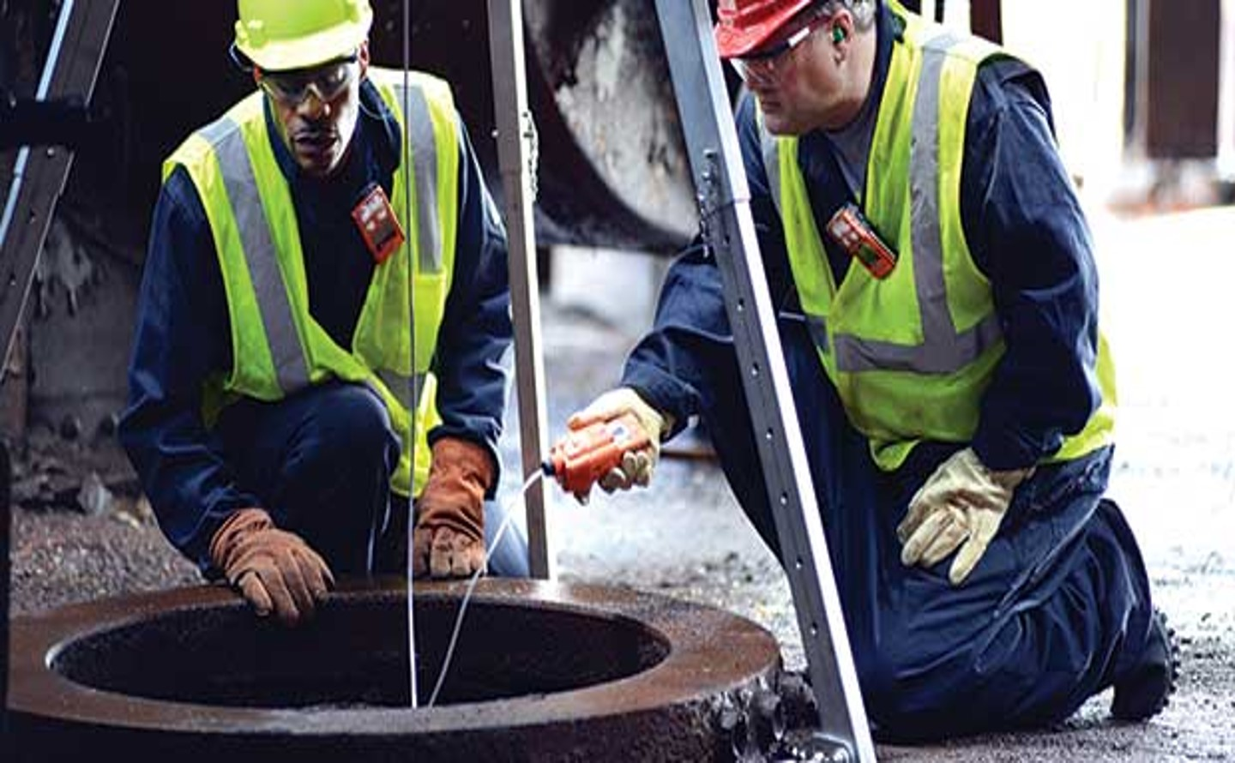
Atmospheric Testing
Notes:
F: Hazardous gases can be found at the top, middle, or bottom of a confined space and can vary in density.
Atmospheric testing must be performed at all three levels to determine which gases are present.
If a toxic or combustible gas or an oxygen-deficient or enriched atmosphere is present, employers must ventilate and retest the confined space before permitting entry.
KLP: If ventilation is impossible and entry is necessary, employees must wear the proper respiratory protection for the detected contaminants.

Slide 22
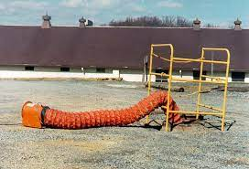
Ventilation
Notes:
F: Several methods exist for ventilating a confined space. The method and equipment chosen depend on the size of the confined space openings, the gases to be removed, and the source of replacement air.
Under certain conditions where flammable gases or vapors have displaced the oxygen level but are too rich to burn, forced air ventilation may dilute the gases until they are capable of exploding. The same is true if inert gases (for example carbon dioxide, nitrogen, or argon) exist in the confined space.
Ventilate and retest the space before allowing entry. Ventilation should be continuous where possible because, in many confined spaces, the hazardous atmosphere will form again when the airflow is stopped.

Slide 23
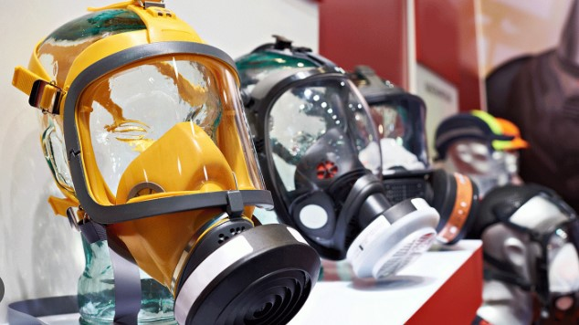
Types of Respiratory Protection
  Air-Purifying Respirators (APRs)
Supplied-Air Respirators (SARs)
Self-Contained Breathing Apparatus (SCBA)
Notes:
F: There are three types of respirators allow employees to breathe safely without inhaling toxic gases or particles:
•Air-Purifying Respirators (APRs)
• Supplied-Air Respirators (SARs)
• Self-Contained Breather Apparatus (SCBA)

Slide 24
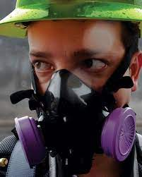
Air-Purifying Respirators (APRs)
Notes:
F: APRs are best used with gases or vapors that are detected by odor, taste, or irritation. These respirators use a filter or sorbent to remove airborne contaminants from the air before they are inhaled.
However, some disadvantages exist to using APRs. These respirators require wearers to use more effort while breathing and must be medically surveilled to ensure a proper fit.
In addition, the filter must be selected specifically to absorb or counteract the contaminants that are present. If overused, APRs may become saturated with particles or other contaminants. This can cause added breathing difficulties for wearers until the masks or filters are changed.
Also, employers must develop regular cartridge or mask change schedules.
KLP: If there is room inside the confined space, powered air-purifying respirators (PAPRs), which use a fan to draw air through the filters, can be used. However, they do not supply oxygen, so they cannot be used in oxygen-deficient atmospheres.

Slide 25
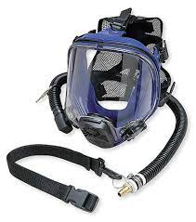
Supplied-Air Respirators (SARs)
Notes:
F: SARs supply air to the user from a source such as a compressor or compressed air cylinder. One of the major disadvantages of using SARs is that they have a maximum allowable hose length of 300 feet. The hose, which can become twisted and tangled, gives the employee only one path of entry and exit.

Slide 26
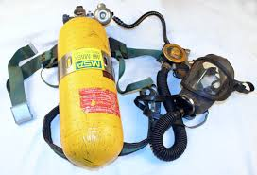
Self-Contained Breathing Apparatus (SCBA)
Notes:
F: SCBAs use a tank of breathable air carried by the employee. Although the SCBA has a limited wear time and is often heavy and bulky, it provides the highest level of respiratory protection available.
It also allows the employee greater mobility while performing the job. This is the best type of respirator for work in a confined space if there is room to use one.

Slide 27
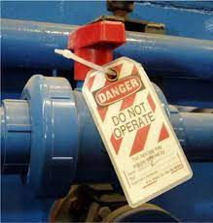
Isolation
Notes:
F: Isolation of a confined space is a process for removing the area from service by:
• locking out electrical sources, preferably at disconnect switches away from the equipment;
• blanking and bleeding pneumatic and hydraulic lines;
• disconnecting belt and chain drives and mechanical linkages on shaft-driven equipment when possible; and
• securing with latches, chains, chocks, blocks, or other devices all mechanical moving parts in a confined space

Slide 28
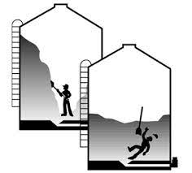
General and Physical Hazards
Notes:
F: Employers should consider the following when evaluating a confined space:
• Temperature extremes can be harmful to employees. For example, if a space has been steam cleaned, it must cool before any employees enter.
•Engulfment hazards Loose material such as grain, sand, coal, and other materials can crust over in a bin, break loose under an employee’s weight, and trap employees during entry.
• Noise Sound can become excessive in a confined space. In addition to possibly causing hearing damage, it can affect communication and cause warnings to go unheeded.

Slide 29

General and Physical Hazards Cont.
Notes:
• Wet surfaces: Slick or wet surfaces can cause slips and falls. It can also increase the chances of electric shock inside a confined space.
•Falling objects: Falling objects are a danger if work is being done above the entry of a confined space.
•Falls: All employees working four feet or more above a lower level must wear fall protection.

Slide 30

One Team
QUESTIONS?

