Slide 1
Hand Safety
January 2023
Notes:
KLP: You set the tone. If you believe safety is important, the audience will believe safety is important.
The facilitator opens the session by welcoming everybody to the training and noting the monthly focus – Hand Safety.
F: Today’s task is to attend Hand Safety training. Cell phones should be turned off or silenced during this training. If you need to take a call, please go to (designated area), take the call and return as soon as possible. {Address any other important announcements or business now.}

Slide 2

Housekeeping
Muster Point
Notes:
F: Prior to training, determine if any fire drills are planned and the response expected from the facility and muster points if alarms should go off. It is important to remind employees that should they need to leave the location at any time, they should inform the Facilitator because, in the event of a fire incident, we need to know their whereabouts. This is an opportunity right at the start of the day to brief the employees on HSE procedures in general for the running of the training course. [If your job site is outdoors, don’t overlook this safety moment. Adjust the plan in the event of a job site fire.]
F: Hello Team, I have verified with the HSE department and have confirmed that there are no Fire Drills or Emergency Drills scheduled for today. If we hear an alarm, we will follow site protocol for emergency response.
F: {Point out the fire exits and muster point}
F: Once we are at the muster points, we will do a role call to account for all attendees.

Slide 3

Presenter & Introductions
Safety begins with me!
Notes:
F: {This is your moment! This is a chance to visibly “Walk the Talk”}
Share:
Your personal experience of safety and impact on the company
Importance of making the most of this opportunity to think about the importance of HSE and discuss with employees
Appreciate that you are a leader and that you make an impact
Importance of taking personal responsibility to make a positive impact
You get out of this training what you put into it
HSE matters to our company
The safety program is going to help people feel empowered and take the initiative to improve their own HSE performance through proactive attitudes and behaviors.
You may wish to share:
A story of your experience in the safety program and how it is has changed the way in which you behave.
Some lessons learned from an incident when you have been involved in the investigation, highlighting the devastating impact that accidents have on people’s lives, or you can describe your experience of being involved in an environmental incident. How did this affect the company, and more importantly, affect the lives of others not working for the company.
F: Go around the room and ask everyone to give their name and what their position is. {Wait for their responses, smile, and nod as they participate. Be careful about timing here---if you ask an additional intro question of the participants and give a long-winded answer yourself, your participants will follow with long stories/explanations, and you can accidentally take up a lot of time.}

Slide 4

Why am I here?
You are the KEY to SAFETY!
Notes:
Slide 6: Why am I here? (1 Minute)
F: Each one of us is the last line of defense to protect workers from injury or the environment from damage, should management systems and collective protections fail. Supervisors and workers are the KEY to HSE. We can promote or destroy the HSE climate through our own behavior and how other workers perceive it.
Supervisors and workers are responsible for enforcing safety rules. Regardless of our position, employment status, or background, everyone is responsible for HSE, and everyone can be a HSE leader by demonstrating positive attitudes and behavior.

Slide 5
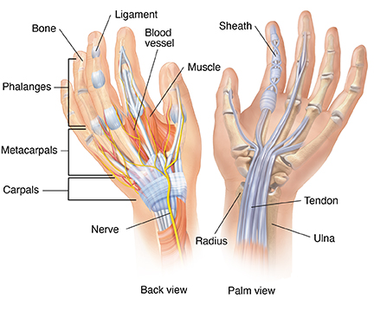
The Human Hand
Notes:
F: We use our hand constantly. A disabling hand injury can have a dramatic effect on your quality of life. A hand injury can impact not only your ability to perform your job, but daily routines as well. A hand injury can occur in a second, but the social, financial and emotional effects can last a lifetime.
F: Our hands consist of 27 bones, ligaments, muscles, tendons, nerves, blood vessels, skin and nails. Working in unison, they provide strength and dexterity which enables us to perform routine tasks and accomplish precision movements.

Slide 6

Hand Injuries in The Workplace
There are 100,000 lost time cases due to hand injuries annually
One million workers are treated in an ER for hand injuries annually
23% of all work-related injuries involved the hands and/or fingers.
Notes:
F: According to the U.S. Bureau of Labor Statistics, there are 110,000 lost time cases due to hand injuries each year. They have also determined that each year, one million workers are treated for hand injuries in the ER.
F: A recent study conducted by the U.S. Department of Labor found that 23% of all work-related injuries involved the hands and/or fingers, making hand injuries “the most frequent preventable injuries”. It was determined that a large majority of those employee reported hand injuries were not wearing any gloves at the time, and several others suffered injuries due to wearing the wrong kinds of gloves.

Slide 7
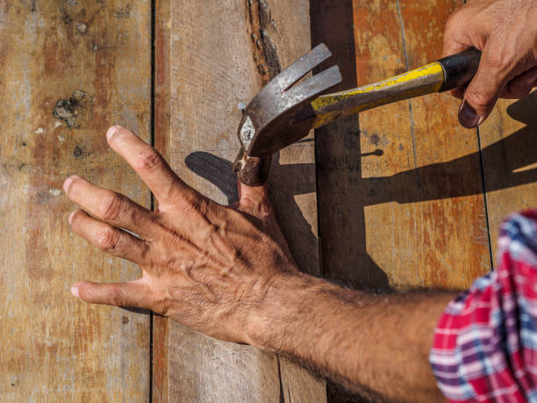
Risks and Cost of Hand Injuries
Median number of workdays missed for hand injuries is 5 days
Older individuals often need 12 to 14 days to recover
Average hand injury claim costs is over $6,000
Average lost-time workers’ compensation for hand injury claims cost is $7,500
Notes:
F: While the median number of workdays missed overall for hand injuries is five, older workers who experience these injuries often need 12 to 14 days to recover. And hand injuries don’t just cost employers and employees missed days. It’s very easy for these injuries to quickly grow more and more expensive financially, depending on the type of injury. According to the Bureau of Labor Statistics (BLS), the average hand injury claim has cost more than $6,000 in recent years. Lost-time workers’ compensation claims for hand injuries have exceeded that, costing an average of $7,500.

Slide 8
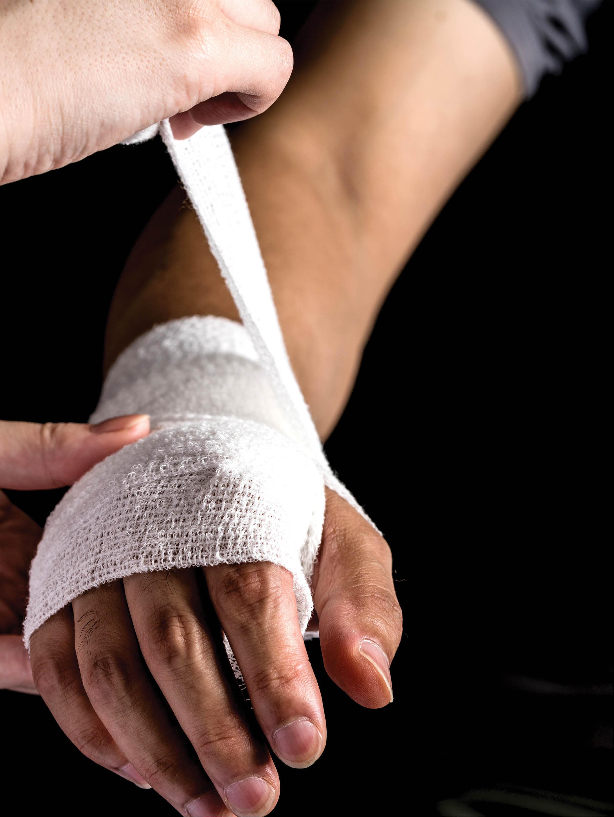
Potential Hazards for Hands
Lacerations or severe cuts
Skin absorption of hazardous substances
Punctures
Chemical burns
Thermal burns
Crush injuries
Notes:
F: There are several types of injuries that our hands can sustain.
F: Some of the most common injuries posed to our hands are:
Lacerations or severe cuts
Skin absorption of hazardous substances
Punctures
Chemical burns
Thermal burns
Crush injuries

Slide 9

Hand Safety
Notes:
VIDEO – 3:20 Min
(Click play to play clip)
F: Can anyone think of and provide an example of a hand injury sustained by yourself or a coworker in your work experience? What happened to the individual? What task were they performing? What went wrong? (Pause and wait for answers)
Can anyone name some of the areas of our workplace where there is the increased potential for hand injuries? (Pause and wait for answers)

Slide 10

Safety Hazards
Pinch Points
Hot or Cold spots
Rotating Equipment Pieces
Automated Machines
Notes:
F: Several factors can play a part in the cause of hand injuries. Safety hazards are the most common and will be present in most workplaces at one time or another. These are the unsafe conditions that can cause injury, illness, or death. These hazards can include injuries such as those caused by unguarded machinery or faulty equipment.
Machinery with pinch points can cause a person’s hand to get caught between two pieces of the machine, such as those machines with multiple parts moving at a high speed.
Equipment that gets extremely hot or extremely cold can cause severe burns to hands and fingers when touched without protection.
Rotating pieces of equipment, as a fan or spindle could catch onto loose fitting gloves or clothing, causing injury or amputation to a worker’s hand.
Automated machinery programed to start on its own could start unexpectedly and injure a worker that is too close and not paying attention.

Slide 11

Chemical Hazards
Rashes
Chemical burns
Cancer
Notes:
F: A worker’s hands can be exposed to hazardous chemicals that can lead to several injuries, even some that are extremely long-term. Some exposures happen suddenly, and some exposures could take years for the symptoms to develop.
Contact with chemicals can cause the worker to develop uncomfortable skin issues, like rashes.
Skin exposures to acidic chemicals can lead to burns or even dissolve employee’s flesh.
Some chemicals can enter a person’s bloodstream by passing through their skin and make their way to vital organs, causing cancer cells to begin to grow and spread rapidly.
Most chemicals require the use of gloves made of a specific material. You want to make sure you always use the right glove for the chemical hazards you are exposed to. If you are unsure of the right glove for the job, the container label and Material Safety Data Sheet can provide valuable information for proper selection.

Slide 12
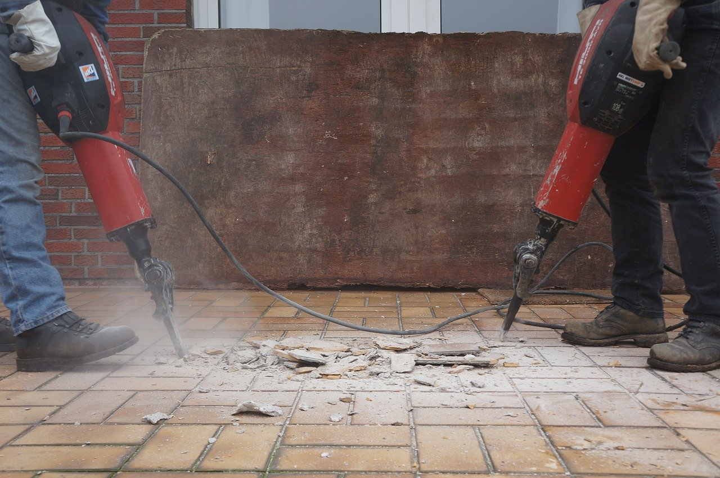
Ergonomic Hazards
Repetitive motion
Vibration
Tissue compression
Notes:
F: Ergonomics is the process of designing or arranging workplaces, products, and systems so that they fit the people who use them. The goal is to increase efficiency and productivity while reducing discomfort.
Repetitive motion can affect tendons and joints, causing the individual to develop carpal tunnel syndrome, tendinitis, or other musculoskeletal disorders. Musculoskeletal disorders, MSD’s, also referred to as repetitive motion injuries are caused by excessive force, excessive repetition and awkward posture. These types of injuries are beneath the skin to the muscles, tendons, and ligaments of the hand and wrists.
Regular exposure to significant vibration while using tools such as chainsaws, jackhammers, or even lawn mowers can lead to nerve damage in the hands.
Often, using hand tools requires a firm grip. The resulting compression of soft tissue in the palm and fingers can obstruct blood circulation, resulting in numbness and tingling.

Slide 13
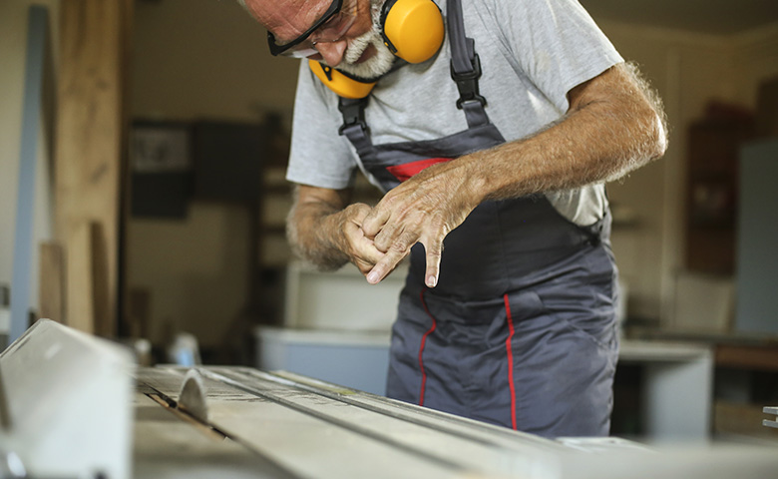
Personal Factors
Carelessness
Lack of Awareness
Boredom
Disregard for Safety Procedures
Distractions
Notes:
F: Most hand injuries occur when we stop thinking about safety; when we don’t accurately assess the risk; or, when we lack awareness of the position of our hands. Often, injuries are caused by one or more personal factors. Some personal factors that play into hand injuries are:
Carelessness
Lack of awareness
Boredom
Disregard for safety procedures
Distractions

Slide 14
Check on Learning
      Which type of hazard do Musculoskeletal disorders fall under?
      A ) Chemical Hazards
      B ) Personal Factors
      C ) Safety Hazards
      D ) Ergonomic Hazards
Notes:
Check On Learning
Which type of hazard do Musculoskeletal disorders fall under?
F: The answer is: (Click the mouse to get answer)
D ) Ergonomic Hazards

Slide 15

Preventing Hand Injuries
  Engineering Controls
  Administrative Controls
  Personal Protective Equipment
Notes:
F: There are several ways a workplace can prevent hand injuries to their employees.
If there is no way to eliminate or substitute hazards in the workplace, the employer should implement Engineering Controls to isolate people from the hazard. Employers should research if there is a way to create a physical barrier between their workers and the hazard. When workers are not directly exposed to the hazard, the likelihood of injury is reduced.
Where engineering controls cannot be implemented, administrative controls are put in place to reduce the likely hood of an incident. Employers should explore ways to change the process of the task or the way that workers are performing the hazardous job.
Finally, if none of the previously mentioned controls are realistic, Personal Protective Equipment (PPE) should be provided to protect employees from the hazard. PPE is the last line of defense and requires workers to wear protective clothing or equipment to protect themselves form the hazard.

Slide 16
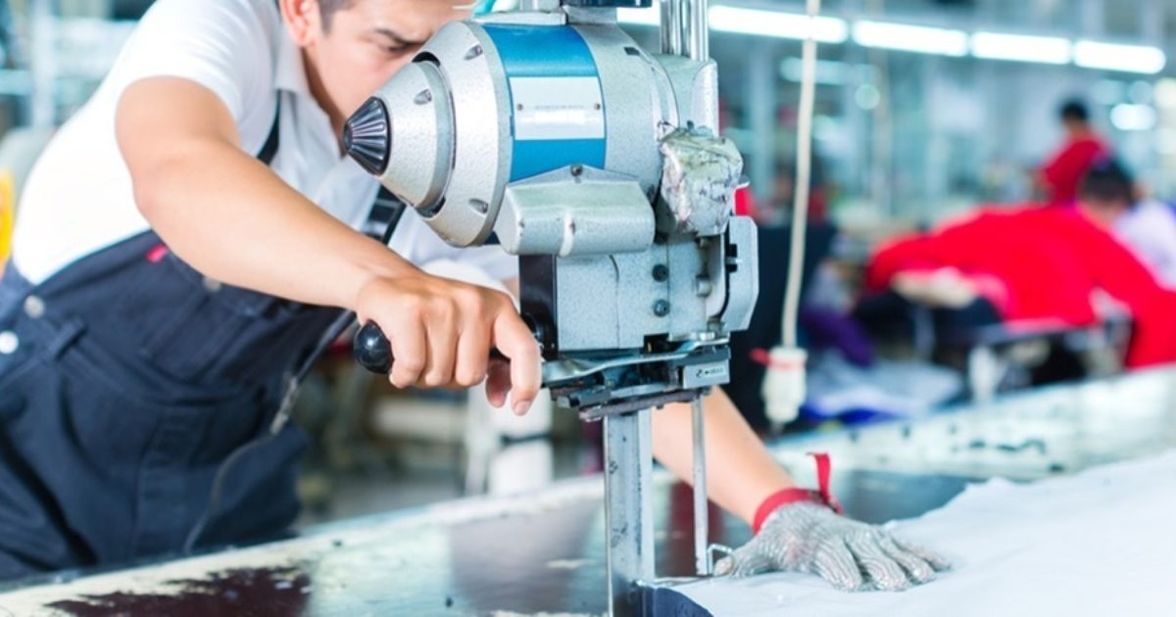
Engineering Controls
Physical safety guards
Sensors
Light beams
Safety switches
Notes:
F: The purpose of engineering controls is to remove hazardous conditions or by placing a barrier between the worker and the hazard.
We see machines fitted with protective guards to provide a barrier between protect workers’ hands and sharp objects, rotating parts, and pinch points.
Several machines have sensors, light beams, and safety switches that are programed to automatically turn off the machine when it senses an object is getting too close.
Engineering controls must be checked and calibrated regularly to ensure they will work every time they need to, the way they are supposed to.

Slide 17
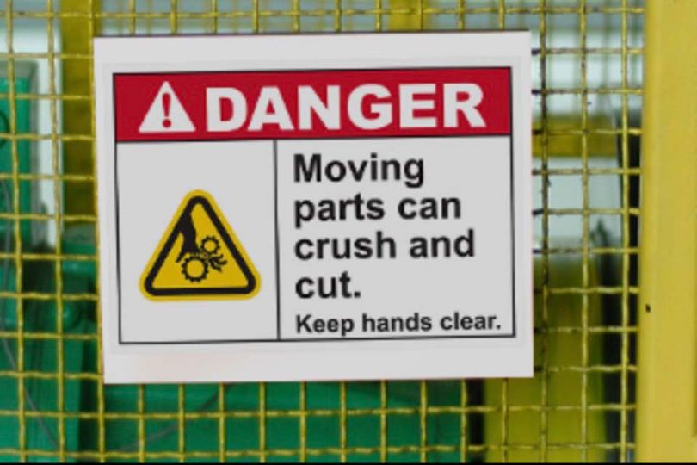
Administrative Controls
Safety policies
Safety training
Lockout Tagout
Warning signs
Notes:
F: Administrative controls include training, procedures, or design shifts that lessen the threat of a hazard to a worker. Administrative controls typically involve changing the behavior of employees rather than removing the hazard from the workplace.
Implementing effective administrative controls should include ensuring policies and safety training are provided to and reviewed with new employees, as well as reviewing regularly with all employees.
Several companies implement No-Touch Tool policies, No Jewelry policies, and/or 100% Glove policies.
Workers should receive proper safety training and be aware of the hazards associated with the tools and equipment they are working with.
Implementing and enforcing programs, such as Lockout Tagout, to establish processes for working and performing maintenance safely.
Warning signs can be fixed to equipment or in areas where there is a potential for injury.

Slide 18

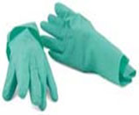
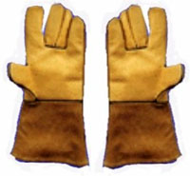
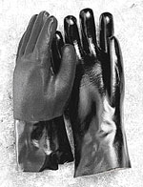
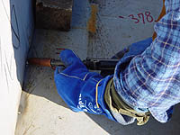

Personal Protective Equipment (PPE)
Anti-vibration
Chemical-resistant
Leather Palm
Permeation-resistant
Heat-resistant
Cut-resistant
Notes:
F: Pictured here are the different types of gloves
Anti-vibration gloves are used to block the amount of damaging frequency vibration transmission from impact powered tools and protect you from the negative health consequences which are associated with exposure to vibration.
Chemical resistant gloves are essential to protecting employees from hazardous and toxic chemical exposures. They are the final barrier between the employee and a potentially fatal health hazard.
Leather palm gloves provide maximum protection against abrasive and puncture hazards. They are made of durable cotton or canvas with leather palms and fingers.
Permeation Resistant is also a chemical resistant glove that protect the hands when working with solvents.
Heat resistant gloves are designed for protection from high temperatures found in laboratories. They are usually made of heat- and/or flame-resistant materials. Heat resistant gloves should be used for such tasks as removing hot objects from autoclaves and drying ovens.
Cut resistant gloves are intended for use with sharp objects such as knives and they provide little or no protection from puncture injuries. The use of these gloves requires a tradeoff between loss of dexterity and the probability of being cut by a sharp object.

Slide 19
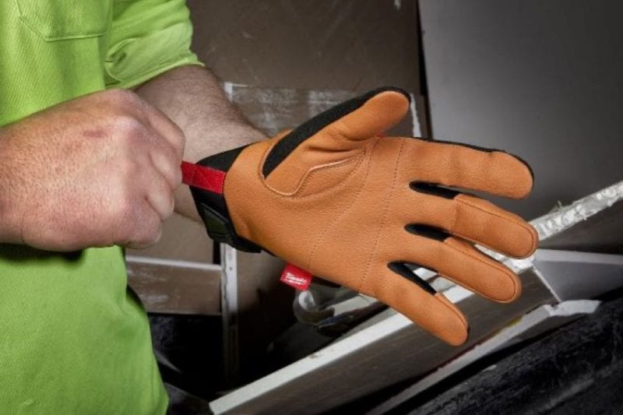
Proper Use of Gloves
Choose the right type and size of glove
Inspect gloves before each use for wear
Remove contaminated gloves using the proper technique to avoid contact with skin
Properly decontaminate and dispose of the gloves
Wash your hands
Notes:
F: When properly selected and utilized, gloves can help reduce hand injuries.
The wrong glove selection and use can also pose a hazard. The wrong size glove can cause extra stress on the hands. The wrong type can provide a false sense of protection, and used in the wrong situation, can create a safety hazard.
Inspect gloves before each use for wear, cracks and other signs of defects that may inhibit the protection they provide you. Be familiar with their care and storage requirement.
To remove contaminated gloves, use your thumb and forefinger to roll down the top of one of the gloves an inch or two. Next, remove the other glove. Use your bare hand, touching only the non-contaminated rolled down portion, to remove the other glove.
Properly decontaminate and store or dispose of the gloves
Wash your hands.

Slide 20
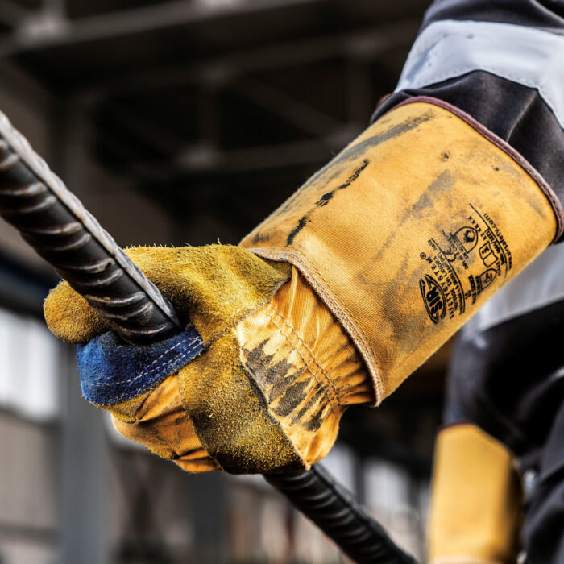
Best Practices
Know the limitation of your gloves and what task they are appropriate for
Never put your hands in an area where you cannot see them
Ensure equipment is locked and tagged out prior to performing maintenance to prevent an unintentional start-up.
Use tools to keep your hands out of the line of fire, such as using push sticks when using a table saw.
Notes:
F: You never know when an injury is going to happen. You should, however, be prepared and know some safe work practices that can keep you and your coworkers safe.
Always wear the proper hand protection for the task you are doing. Understand the limitations of your gloves and what tasks they are appropriate for.
Never put your hands in an area where you cannot see them.
Never work on an energized piece of equipment. Lock and tag out the equipment to ensure there will not be an unintentional start-up while you are working on that piece of equipment.
Use tools to remove your hands from the line of fire when doing a work task that could result in injury to your hands or fingers. Using tools such as push sticks when using a table saw is an example of how you can remove your hands from the line of fire.

Slide 21
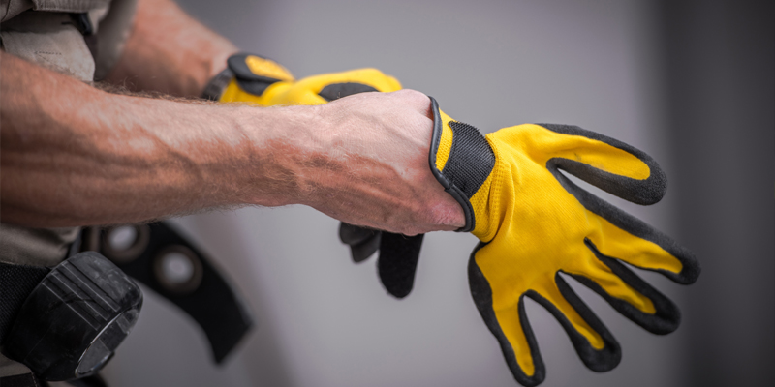
Common Mistakes
Taking off gloves
Deactivating safety features
Wearing jewelry such as rings, bracelets, or watches.
Notes:
F: Even the simplest mistake can lead to an injury.
The most common mistake seen when it comes to hand injuries starts with simply not wearing or removing gloves. Several studies demonstrate that wearing safety gloves can prevent hand injuries by as much as 70%.
It is important to NEVER remove or deactivate a machine’s safety feature. This includes guards or any other safety mechanism designed to prevent injuries to the operator.
Not removing any jewelry prior to beginning work is also a mistake that can lead to a severe injury. Rings or watches can get caught on or in a piece of machinery, causing serious injury the wearer.

Slide 22
Check on Learning
      What is an administrative control an employer can put in place to reduce hand injuries?
      A ) Machine safety guards
      B ) Warning signs
      C ) Gloves
      D ) Safety switches
Notes:
Check On Learning
F: What is an administrative control an employer can put in place to reduce hand injuries?
F: The answer is: (Click the mouse to get answer)
B ) Warning signs

Slide 23

Four Basic Principles of Hand Safety
Notes:
VIDEO – 2:08 Min

Slide 24

One Team
QUESTIONS?

