Slide 1
Working Alone
January 2024
Notes:
KLP: You set the tone. If you believe safety is important, the audience will believe safety is important.
The facilitator opens the session by welcoming everybody to the training and noting the monthly focus – Working Alone.
F: Today’s task is to attend training on Working Alone. Cell phones should be turned off or silenced during this training. If you need to take a call, please go to (designated area), take the call and return as soon as possible. {Address any other important announcements or business now.}

Slide 2
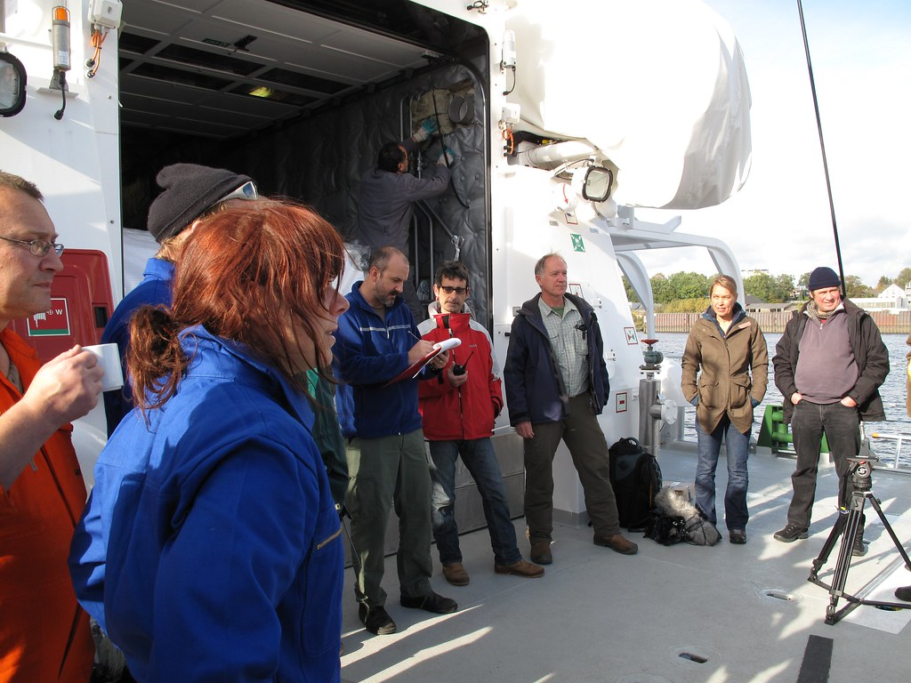
Housekeeping
Muster Point
Notes:
Prior to training, determine if any fire drills are planned and the response expected from the facility and muster points if alarms should go off. It is important to remind employees that should they need to leave the location at any time, they should inform the Facilitator because, in the event of a fire incident, we need to know their whereabouts. This is an opportunity right at the start of the day to brief the employees on HSE procedures in general for the running of the training course. [If your job site is outdoors, don’t overlook this safety moment. Adjust the plan in the event of a job site fire.]
F: Hello Team, I have verified with the HSE department and have confirmed that there are no Fire Drills or Emergency Drills scheduled for today. If we hear an alarm, we will follow site protocol for emergency response.
F: {Point out the fire exits and muster point}
F: Once we are at the muster points, we will do a role call to account for all attendees.

Slide 3

Presenter & Introductions
Safety begins with me!
Notes:
F: {This is your moment! This is a chance to visibly “Walk the Talk”}
Share:
Your personal experience of safety and impact on the company
Importance of making the most of this opportunity to think about the importance of HSE and discuss with employees
Appreciate that you are a leader and that you make an impact
Importance of taking personal responsibility to make a positive impact
You get out of this training what you put into it
HSE matters to our company
The safety program is going to help people feel empowered and take the initiative to improve their own HSE performance through proactive attitudes and behaviors.
You may wish to share:
A story of your experience in the safety program and how it is has changed the way in which you behave.
Some lessons learned from an incident when you have been involved in the investigation, highlighting the devastating impact that accidents have on people’s lives, or you can describe your experience of being involved in an environmental incident. How did this affect the company, and more importantly, affect the lives of others not working for the company.
F: Go around the room and ask everyone to give their name and what their position is. {Wait for their responses, smile, and nod as they participate. Be careful about timing here---if you ask an additional intro question of the participants and give a long-winded answer yourself, your participants will follow with long stories/explanations, and you can accidentally take up a lot of time.}

Slide 4
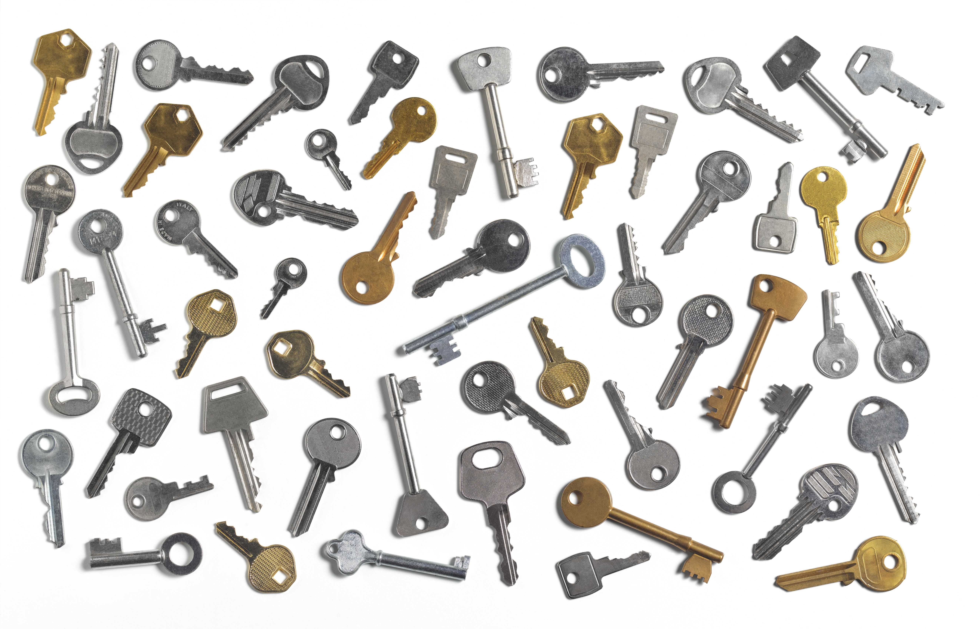
Why am I here?
You are the KEY to SAFETY!
Notes:
F: Each one of us is the last line of defense to protect workers from injury or the environment from damage, should management systems and collective protections fail. Supervisors and workers are the KEY to HSE. We can promote or destroy the HSE climate through our own behavior and how other workers perceive it.
Supervisors and workers are responsible for enforcing safety rules. Regardless of our position, employment status, or background, everyone is responsible for HSE, and everyone can be a HSE leader by demonstrating positive attitudes and behavior.

Slide 5

Working Alone
Notes:
VIDEO – 1:08 Min​
​
(Click play to play clip)​

Slide 6
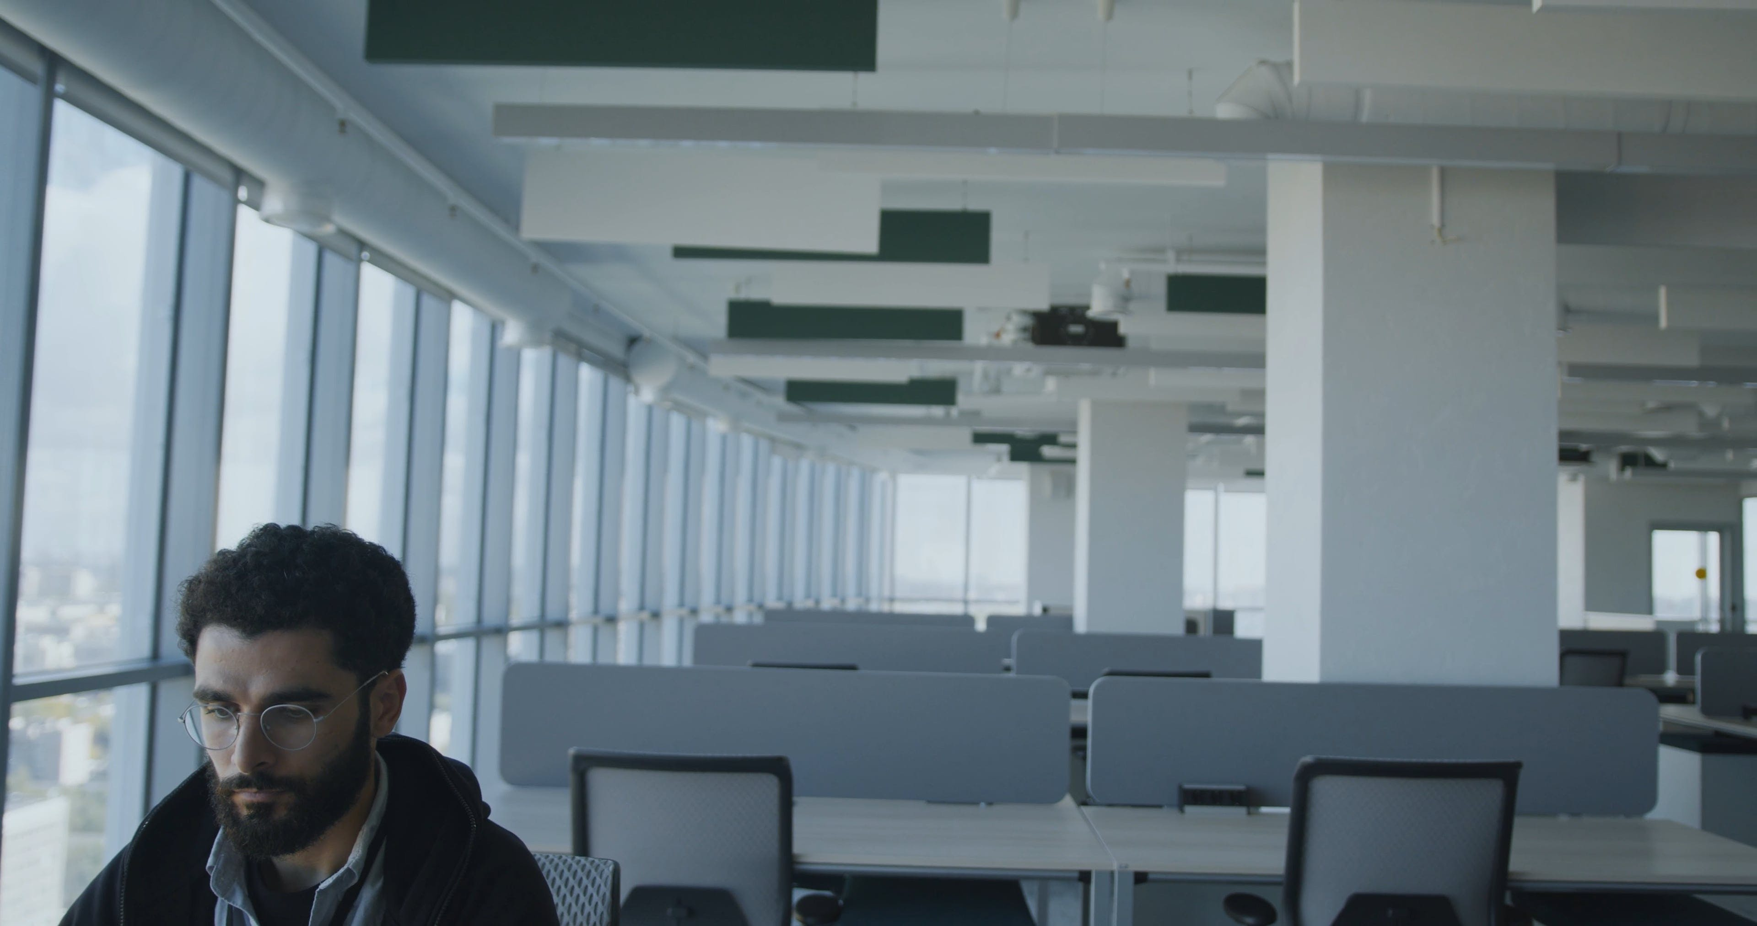
Working Alone
“Working alone” is working anywhere a person is unable to get immediate assistance from colleagues or other people.
Notes:
F: “Working alone” is working anywhere a person is unable to get immediate assistance from colleagues or other people. In some cases, other people may be close by, such as a cleaner working by themselves in a city office building. In other cases, the employee could be in a remote location, such as a researcher undertaking field work by themselves in a park.
F: There are many scenarios in many occupations where these circumstances could apply, for example:
sales representatives, including real estate agents
all-night convenience store and service station attendants
transport freight and public transport drivers
doctors, health and community workers
rural and agricultural workers
F: Even individuals who work from home are considered “lone workers”.
www.worksafe.vic.gov.au

Slide 7
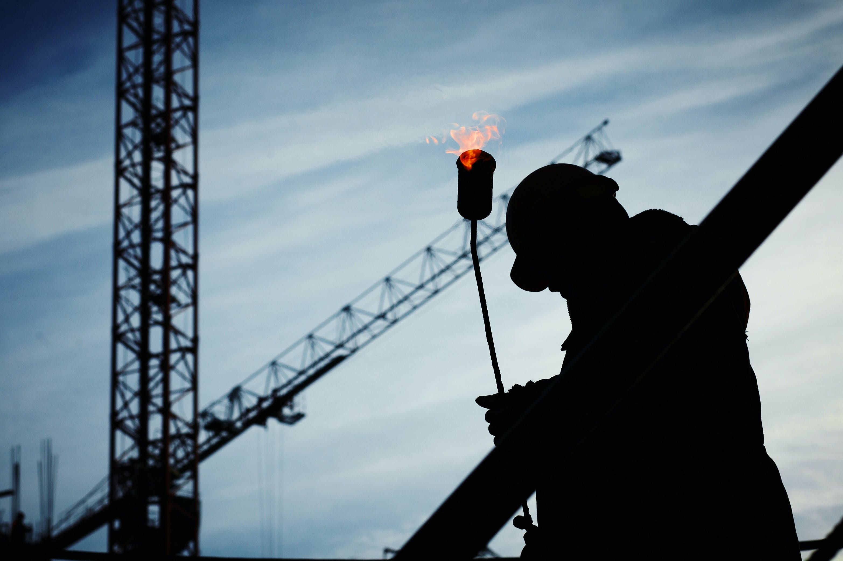
Working Alone vs. Working in Isolation
Notes:
F: There is a difference between working alone and working in isolation.
F: Working Alone is the performance of any work function by a worker who:
Is the only worker for that employer at that workplace at any time
Is not directly supervised by the employer, or another person designated as a supervisor by the employer, at any time.
F: Working in Isolation is working in circumstances where assistance is not readily available in the event of injury, ill health or emergency.

Slide 8
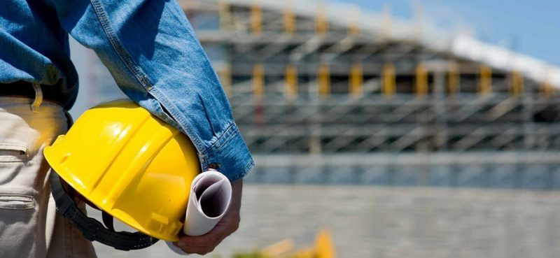
Hazard Assessment
  Employers should determine if it is safe for an employee to be working alone.
Notes:
F: Employers should determine if it is safe for an employee to be working alone.
F: Employers should assess and ask:
Does the workplace present a special risk to the lone worker?
Is there a safe way in and a way our for one person?
Can any temporary access equipment, such as portable ladders or trestles, be safety handles by one person?
Can all the machinery and goods involved in the workplace be safely handled by one person?
Are there any chemicals or hazardous substances being used that may pose a risk to the worker?
Does the work involve lifting objects too large for one person?
Is more than one person needed to operate essential controls for the safe running of equipment or workplace transport?
Is there a risk of violence?
Are young, pregnant, or disabled workers at risk if they work alone?
If the lone worker’s first language is not English, are arrangements in place to ensure clear communication, especially in an emergency?

Slide 9
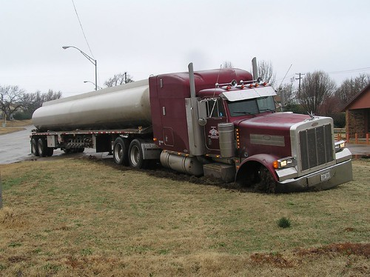
Potentially Hazardous Work Alone Situations
  When identifying potential situations that may cause harm to a lone worker, it is important to consider the task at hand and the hazards associated with that task.
Notes:
F: When identifying potential situations that may cause harm to a lone worker, it is important to consider the task at hand and the hazards associated with that task. Possible situations which may impact on employees who work alone could include the environment itself, or how it might be changed. For example, a worker slipping on a wet floor.
F: Consider these scenarios:
F: Night shift or work during hours of darkness pose their own possible hazards. This includes distance from building to parking lot, availability to summon help due to a person-to-person incident, and traffic problems. Often dark areas are possible ambush points.
F: The Transportation Industry for trucking is subjected to seasonal concerns which could lead to accidents. Hijackings are also possible, as well as problems between trucks and motorists may happen to cause tempers to flare resulting in altercations.
F: Utility Line Workers can be subjected to electrical hazards during all types of weather. Since downed lines and disruptions may be caused by bad weather, restoration may also have to be performed during the same conditions. Vehicular incidents may also occur if the line truck needs to park on the berm or close to intersections.
F: Shipping and Receiving incidents may include driving forklifts off edges or on uneven terrain. Struck-by situations may also occur due to visibility problems. Since shipping concerns moving a product “out,” cuts may occur during packaging or opening, lifting strains may also happen.
F: Forklifts improperly powered for an environment may be a hazard, e.g. propane powered or gasoline powered inside an enclosed area (causing carbon monoxide build-up).

Slide 10

Medically Fit to Work Alone
Notes:
F: Employers should also ensure the person working alone is medically fit and suitable to do so. They should consider factors such as any medical conditions which make the employee unsuitable for working alone and should seek medical advice if necessary. Employers should consider both routine work and foreseeable emergencies which may impose additional physical and mental burdens on the individual.

Slide 11
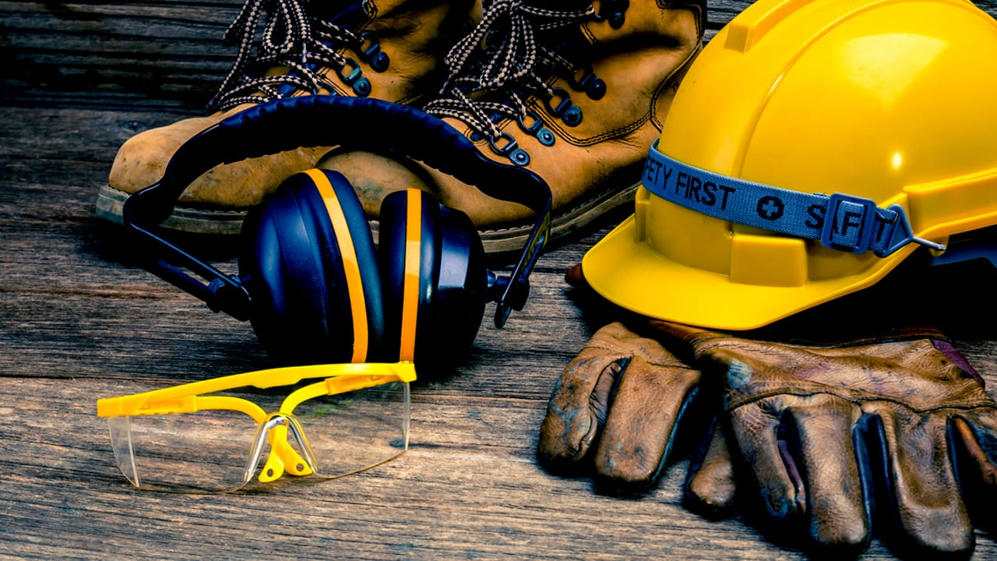
Preparing to Work Alone
Notes:
F: It is extremely important to properly prepare prior to working alone. Before starting work, lone workers should ensure the following procedures are followed:
Notify others. They should let their manager or supervisor know when they will be working and what they will be doing, and ensure they have approval to work alone.
Implement a buddy system and ask they buddy to check in on them periodically.
Ensure they have a way to contact emergency services in their workspace.
Assess the risks of the activity with their supervisor beforehand.
Do not perform tasks that are not appropriate for working alone.
Minimize the amount(s) of hazardous materials used.
Document their work plan and include emergency contacts.
Be alert and aware of their surroundings. For example, avoid wearing ear buds or headphones as it reduces situational awareness.
Wear the required personal protective equipment (PPE) in the workplace, even after hours.
Know the location of and maintain clear access to emergency equipment (e.g., first aid kit, safety shower, eye wash, fire extinguisher, spill kits).
Check alarm systems (e.g., oxygen sensors) frequently and immediately take action upon alarm activation.
Review plans for transportation and travel routes. Avoid walking in dark, secluded, deserted areas if possible. Request a safety escort when working after dark or in secluded areas, if necessary.

Slide 12
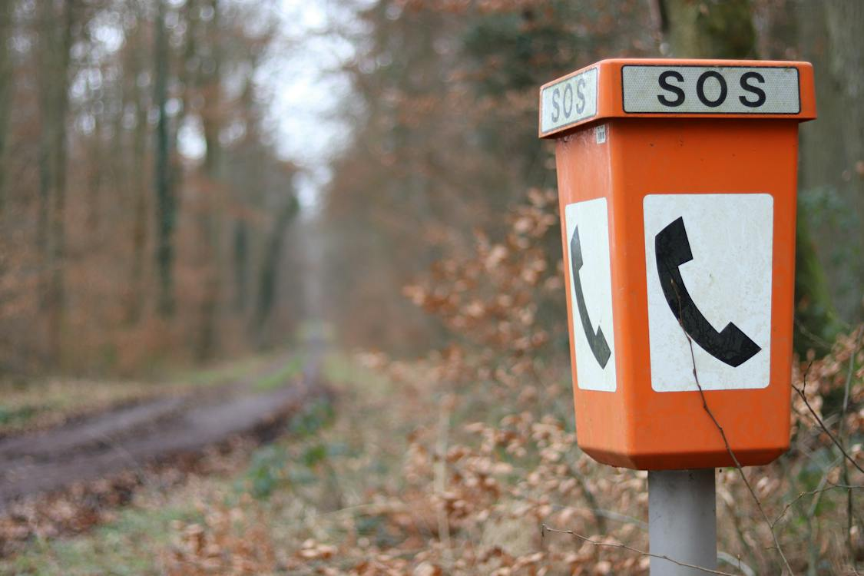
Emergency Response
Emergency procedures should be established, and employees trained in them.
Information about emergency procedures and danger areas should be given to long workers who visit your premises.
Lone workers should have access to adequate first-aid facilities and mobile workers should carry a first-aid kit suitable for treating minor injuries.
Notes:
F: Ideally, the risk assessment should identify foreseeable events that may lead to an emergency.
F: In the case that there is an emergency, lone workers should be capable of responding correctly. Emergency procedures should be established, and employees trained in them. Information about emergency procedures and danger areas should be given to long workers who visit your premises.
F: Lone workers should have access to adequate first-aid facilities and mobile workers should carry a first-aid kit suitable for treating minor injuries.

Slide 13
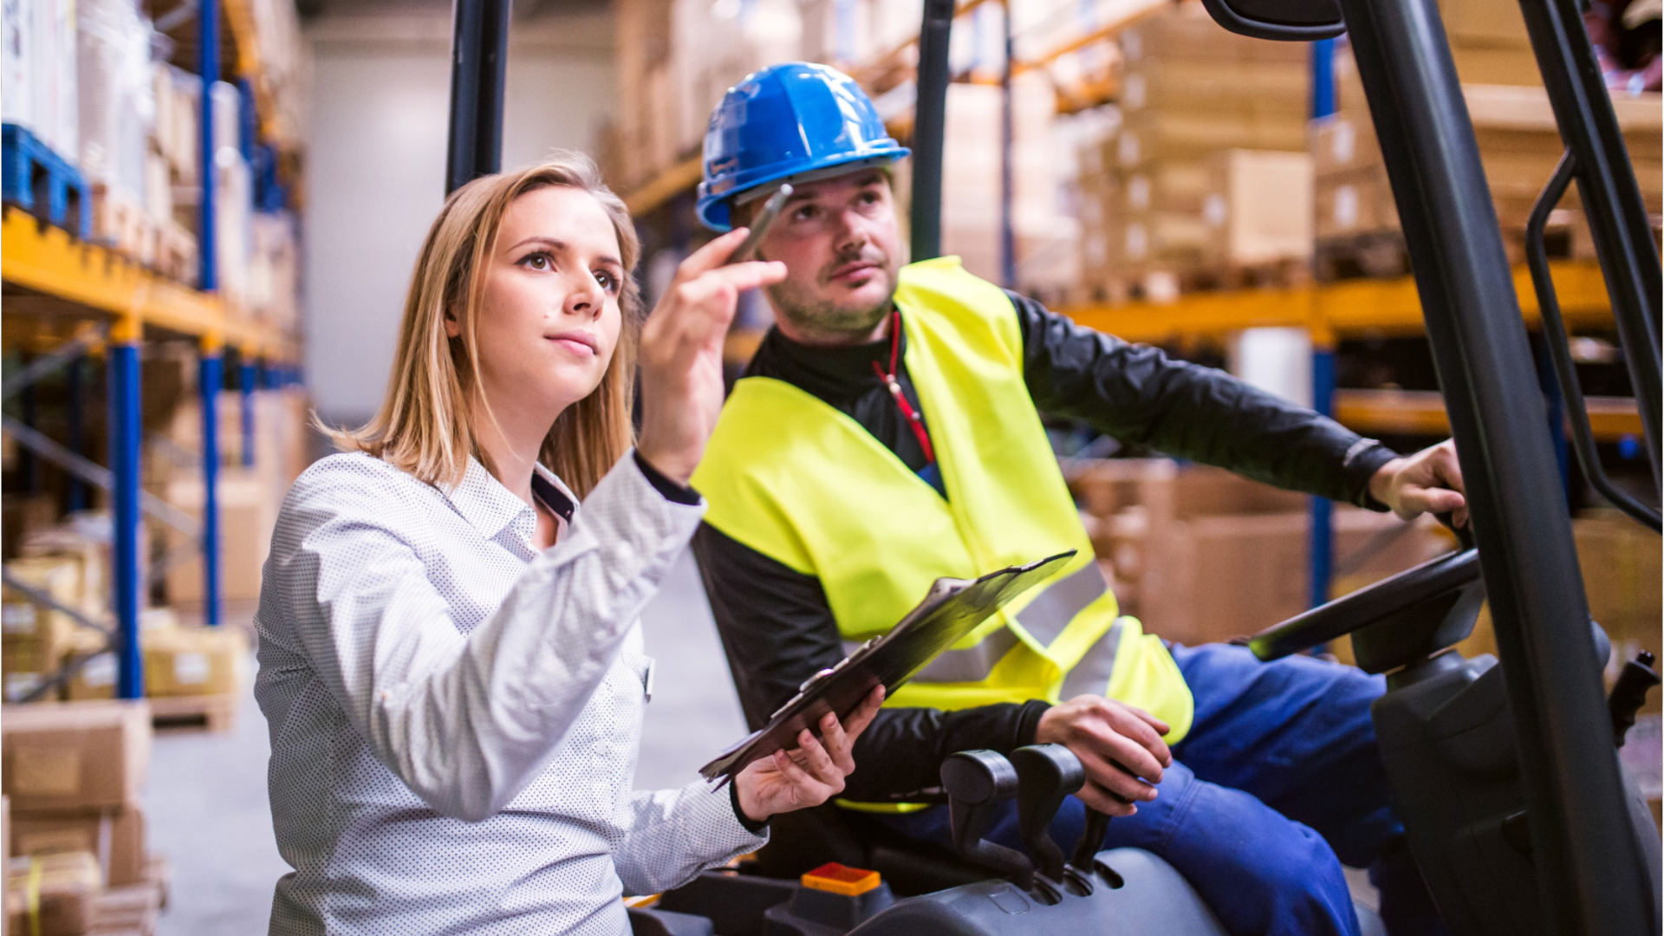
Supervision of Lone Workers
Notes:
F: Although lone workers cannot be subject to constant supervision, it is still an employer’s duty to ensure their health and safety at work.
F: Supervision can help to ensure that employees understand the risks associated with their work and the necessary safety precautions are carried out. Supervisors can also provide guidance in situations of uncertainty.
F: Supervision of health and safety can often be carried out when checking the progress and quality of work. This could take the form of periodic site visits combined with discussions in which health and safety issues are raised.

Slide 14

The Buddy System
Notes:
F: If it is an option, implementing a buddy system can reduce the risk of certain tasks by ensuring a second person (the “buddy”) can provide assistance or get help if the person working alone is injured or incapacitated in the course of their work.
F: There are several types of buddy systems that can provide a safer way to work alone:
In-person buddy: A second person is within hearing range while maintaining physical distancing requirements.
Semi-in-person buddy: A second person is located nearby and checks in regularly (e.g., every 30 minutes) in person while maintaining physical distancing requirements.
Live or asynchronous remote buddy: The person working alone checks in regularly via video conferencing or phone, but not in-person. You should discuss the frequency of check-ins, and give instructions on actions they should take if you do not check in at the agreed-upon times.

Slide 15

Hazards That Require More Than One Worker
  Permit-required Confined Spaces
  High energy materials (radioactive, high temperature)
  Cryogenic (low temperature) materials/processes
  Toxic gases, liquids or solids
  Flammable liquids
  High pressure or high voltage systems
  Using fall arrest equipment and scaffolding
  Equipment or machinery
  Extreme weather conditions
  Shop Machinery
  Restraining or handling animals capable of causing injury
  Services where cash or goods are handled that may attract criminals
  Certain laboratory work
Notes:
F: There are some high-risk activities where safety regulations require that at least one other person be present.
F: Some examples hazards created by work functions that require more than one worker include:
Permit-required Confined Spaces
High energy materials (radioactive, high temperature)
Cryogenic (low temperature) materials/processes
Toxic gases, liquids or solids
Flammable liquids
High pressure or high voltage systems
Using fall arrest equipment and scaffolding
Equipment or machinery
Extreme weather conditions
Shop Machinery
Restraining or handling animals capable of causing injury
Services where cash or goods are handled that may attract criminals
Certain laboratory work

Slide 16
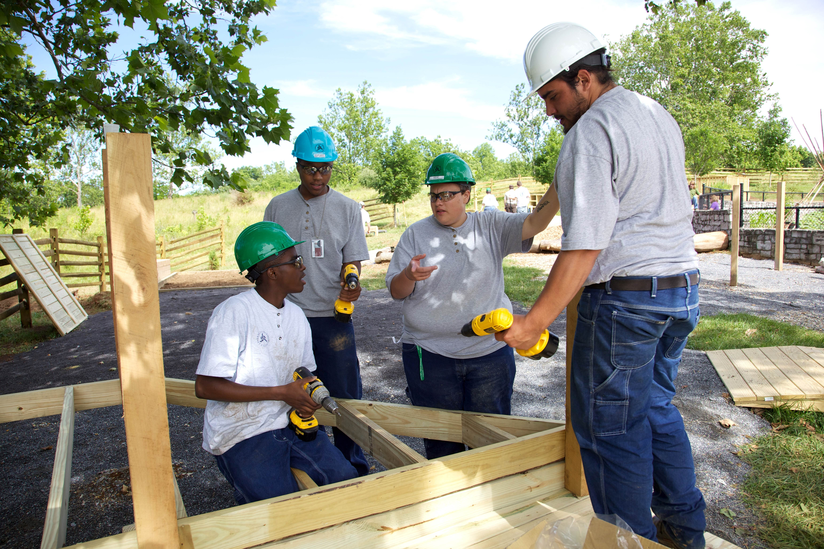
Training
Ensure employees are competent to deal with circumstances which are new, unusual or beyond the scope of training, such as when to stop work and seek advice from a supervisor and how to handle potential workplace violence.
Notes:
F: Training may be critical to avoid panic reactions to unusual situations. Training is particularly important where there is limited supervision to control, guide, and help in situations of uncertainty.
F: Lone workers need to be sufficiently experienced and to understand the risks and precautions fully. Limits should be set to what can and cannot be done while working alone.
F: Ensure employees are competent to deal with circumstances which are new, unusual or beyond the scope of training, such as when to stop work and seek advice from a supervisor and how to handle potential workplace violence.

Slide 17
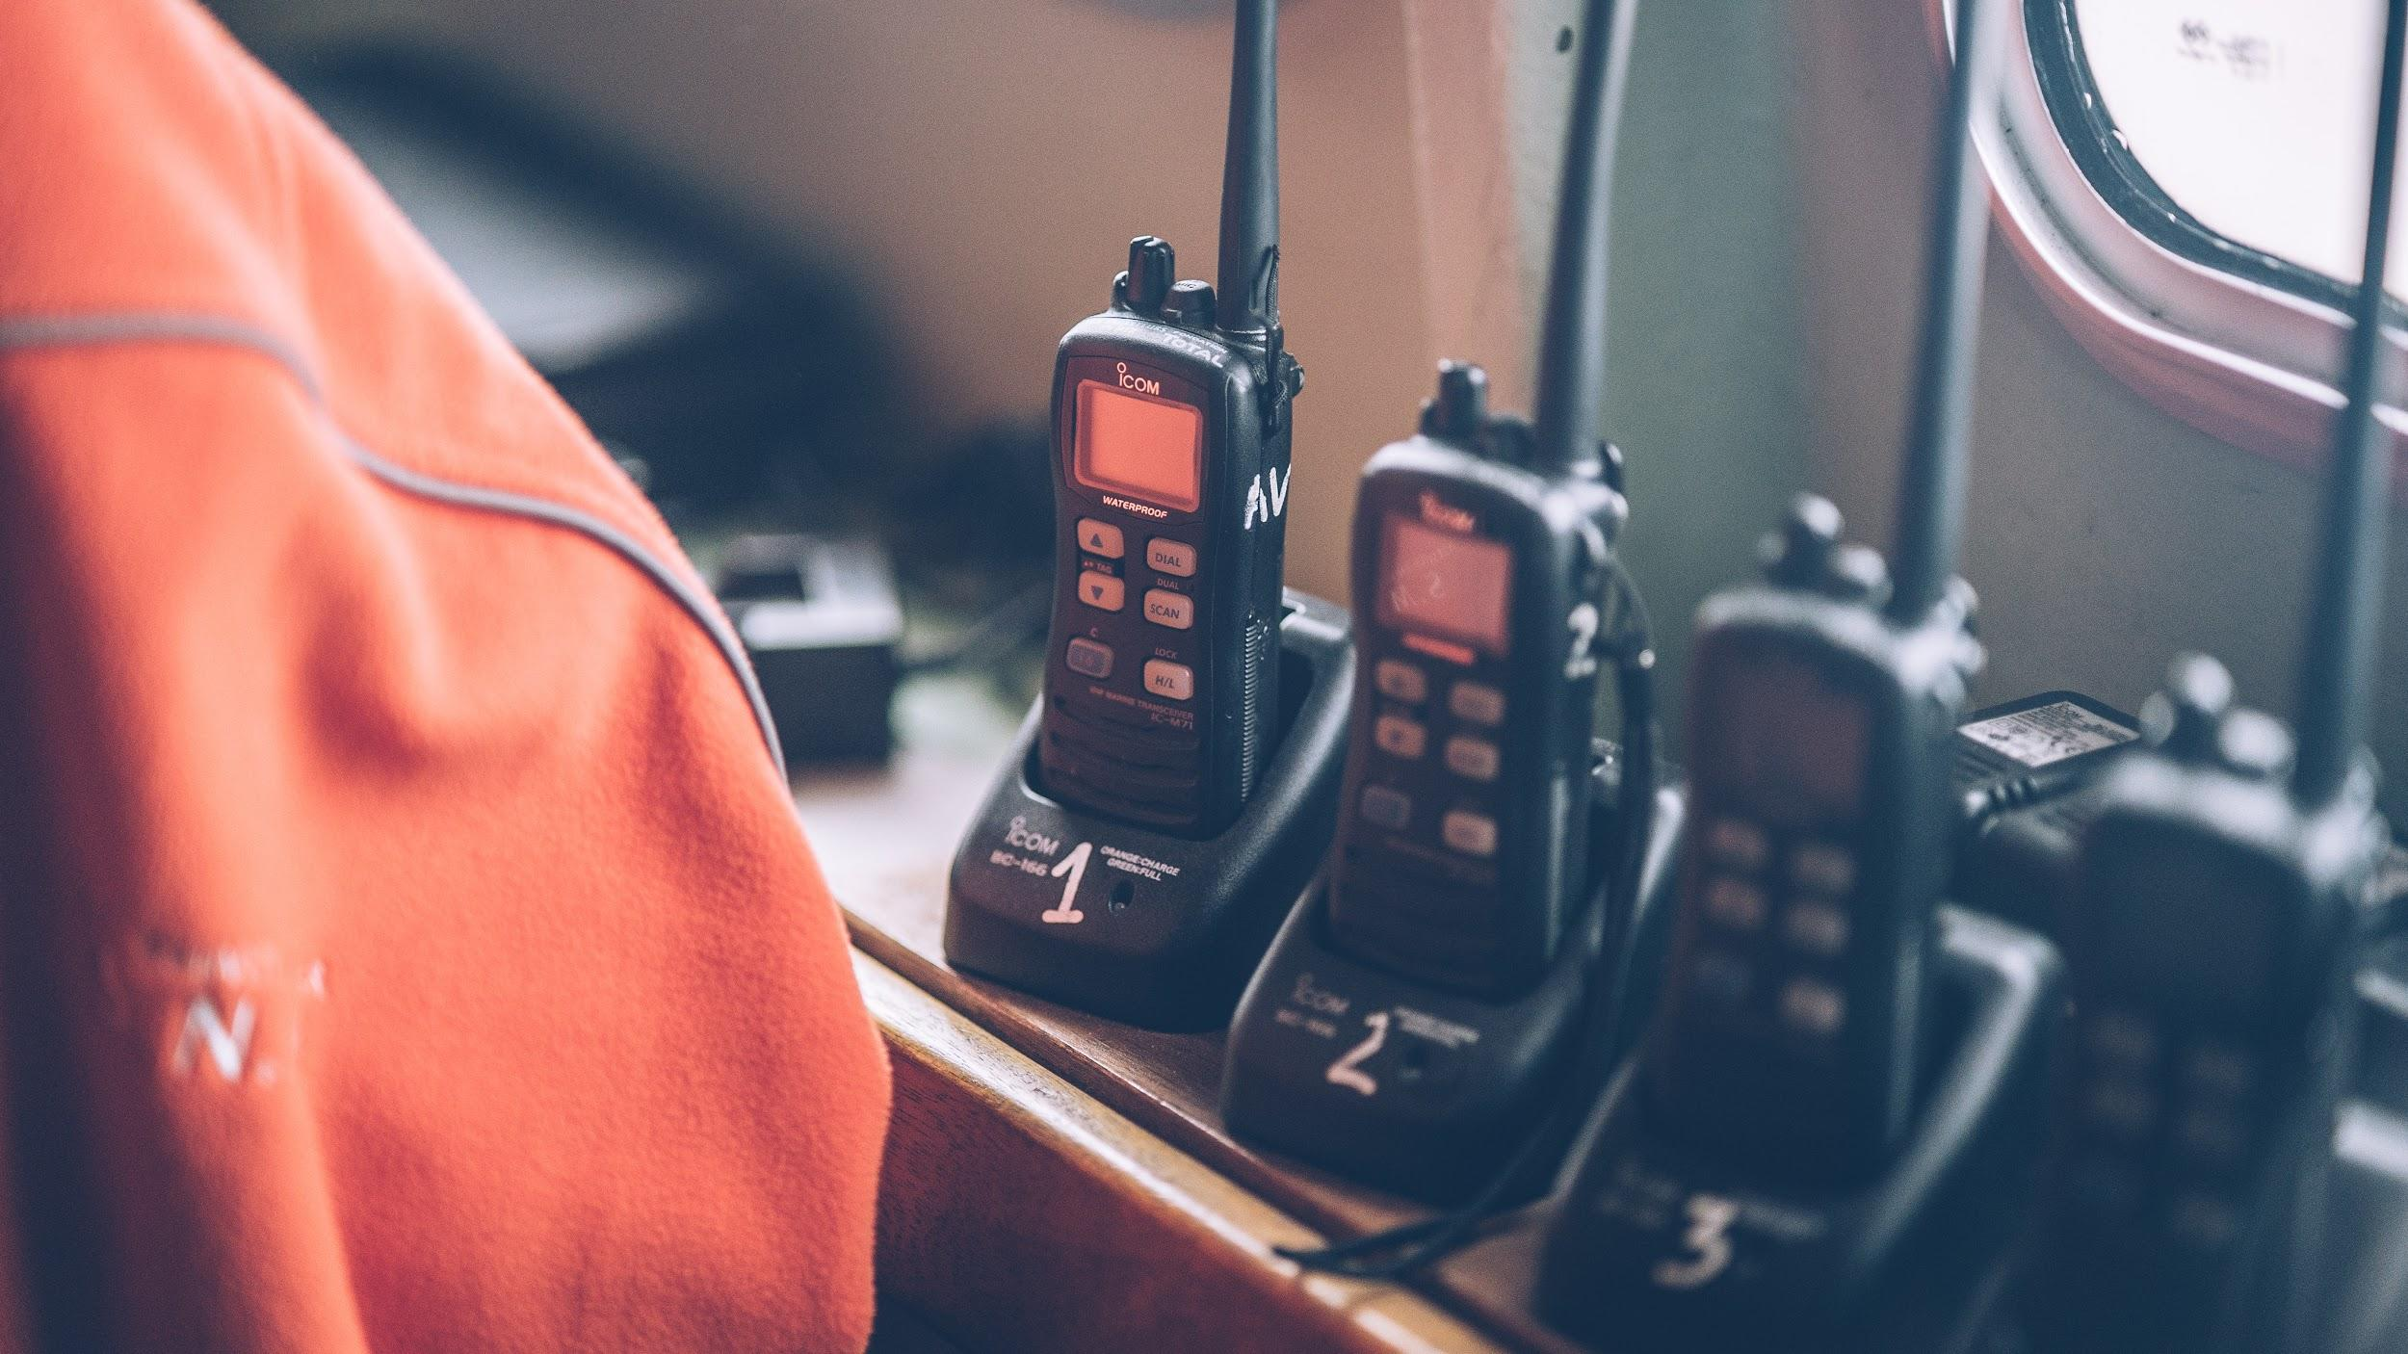
Keeping Lone Workers Safe
Notes:
F: There are procedures that can be implemented to help keep lone workers safe, such as:
Supervisors periodically visiting and observing people working alone.
Keeping regular contact between the lone worker and supervision using either a telephone or radio.
Providing automatic warning devices that operate if specific signals are not received periodically from the lone worker, such as systems for security staff. There are several devices designed to raise the alarm in the event of an emergency, and which are operated manually or automatically by the absence of activity.
Establish code words to alert coworkers and supervisors that help is needed.
Check that a lone worker has returned to their base or home on completion of a task.

Slide 18

Working Alone
Notes:
VIDEO – 2:41 Min​
​
(Click play to play clip)​

Slide 19

One Team
QUESTIONS?

