Slide 1
Personal Protective Equipment (PPE)
March 2022
Notes:
KLP: You set the tone. If you believe safety is important, the audience will believe safety is important.
The facilitator opens the session by welcoming everybody to the training and noting the monthly focus – Personal Protective Equipment.
F: Today’s task is to attend Personal Protective Equipment (PPE). Cell phones should be turned off or silenced during this training. If you need to take a call, please go to (designated area), take the call and return as soon as possible. {Address any other important announcements or business now.}

Slide 2

Housekeeping
Muster Point
Notes:
F: Prior to training, determine if any fire drills are planned and the response expected from the facility and muster points if alarms should go off. It is important to remind employees that should they need to leave the location at any time, they should inform the Facilitator because, in the event of a fire incident, we need to know their whereabouts. This is an opportunity right at the start of the day to brief the employees on HSE procedures in general for the running of the training course. [If your job site is outdoors, don’t overlook this safety moment. Adjust the plan in the event of a job site fire.]
F: Hello Team, I have verified with the HSE department and have confirmed that there are no Fire Drills or Emergency Drills scheduled for today. If we hear an alarm, we will follow site protocol for emergency response.
F: {Point out the fire exits and muster point}
F: Once we are at the muster points, we will do a role call to account for all attendees.

Slide 3

Presenter & Introductions
Safety begins with me!
Notes:
F: {This is your moment! This is a chance to visibly “Walk the Talk”}
Share:
Your personal experience of safety and impact on the company
Importance of making the most of this opportunity to think about the importance of HSE and discuss with employees
Appreciate that you are a leader and that you make an impact
Importance of taking personal responsibility to make a positive impact
You get out of this training what you put into it
HSE matters to our company
The safety program is going to help people feel empowered and take the initiative to improve their own HSE performance through proactive attitudes and behaviors.
You may wish to share:
A story of your experience in the safety program and how it is has changed the way in which you behave.
Some lessons learned from an incident when you have been involved in the investigation, highlighting the devastating impact that accidents have on people’s lives, or you can describe your experience of being involved in an environmental incident. How did this affect the company, and more importantly, affect the lives of others not working for the company.
F: Go around the room and ask everyone to give their name and what their position is. {Wait for their responses, smile, and nod as they participate. Be careful about timing here---if you ask an additional intro question of the participants and give a long-winded answer yourself, your participants will follow with long stories/explanations, and you can accidentally take up a lot of time.}

Slide 4
Training Objectives
Describe the hierarchy of controls as it relates to personal protective equipment.
Identify types of personal protective equipment utilized in General Industry.
Understand personal protective equipment training requirements.
Understand the responsibilities of the employer regarding personal protective equipment.
Understand the responsibilities of the employee regarding personal protective equipment.
Notes:
F: OSHA requires employees to protect their employees from workplace hazards through the use of engineering or work practice controls. When these controls are not feasible or do not provide sufficient protection, the use of personal protective equipment (PPE) is required.
Objectives:
Describe the hierarchy of controls as it relates to personal protective equipment.
Identify types of personal protective equipment utilized in General Industry
Understand personal protective equipment training requirements.
Understand the responsibilities of the employer regarding personal protective equipment.
Understand the responsibilities of the employee regarding personal protective equipment.

Slide 5

Responsibilities
Notes:
F: To ensure the greatest possible protection for employees in the workplace, the cooperative efforts of both employers and employees will help in establishing and maintaining a safe and healthful work environment. In general, employers are responsible for:
Performing a “hazard assessment” of the workplace to identify and control physical and health hazards.
Identifying and providing appropriate PPE for employees.
Training employees in the use and care of the PPE.
Maintaining PPE, including replacing worn or damaged PPE.
Periodically reviewing, updating and evaluating the effectiveness of the PPE program
F: The employer is required to pay for PPE used to comply with OSHA standards. Examples of PPE that Employers Must Pay for Include:
Metatarsal foot protection
Rubber boots with steel toes
Non-prescription eye protection
Prescription eyewear inserts/lenses for full-face respirators
Goggles and face shields
Fire fighting PPE (helmet, gloves, boots, proximity suits, full gear)
Hard hats
Hearing protection
Welding PPE
F: Employers are not required to pay for some PPE in certain circumstances:
Non-specialty safety-toe protective footwear (including steel-toe shoes or boots) and nonspecialty prescription safety eyewear provided that the employer permits such items to be worn off the job site. (OSHA based this decision on the fact that this type of equipment is very personal, is often used outside the workplace, and that it is taken by workers from jobsite to jobsite and employer to employer.)
Everyday clothing, such as long-sleeve shirts, long pants, street shoes, and normal work boots.
Ordinary clothing, skin creams, or other items, used solely for protection from weather, such as winter coats, jackets, gloves, parkas, rubber boots, hats, raincoats, ordinary sunglasses, and sunscreen.
Items such as hairnets and gloves worn by food workers for consumer safety.
Lifting belts because their value in protecting the back is questionable.
When the employee has lost or intentionally damaged the PPE and it must be replaced.”

Slide 6

Why am I here?
You are the KEY to SAFETY!
Notes:
Slide 6: Why am I here? (1 Minute)
F: Each one of us is the last line of defense to protect workers from injury or the environment from damage, should management systems and collective protections fail. Supervisors and workers are the KEY to HSE. We can promote or destroy the HSE climate through our own behavior and how other workers perceive it.
Supervisors and workers are responsible for enforcing safety rules. Regardless of our position, employment status, or background, everyone is responsible for HSE, and everyone can be a HSE leader by demonstrating positive attitudes and behavior.

Slide 7
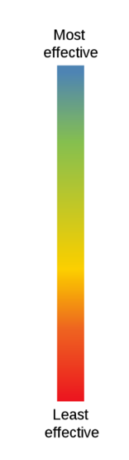
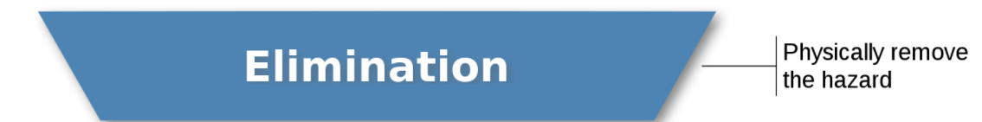
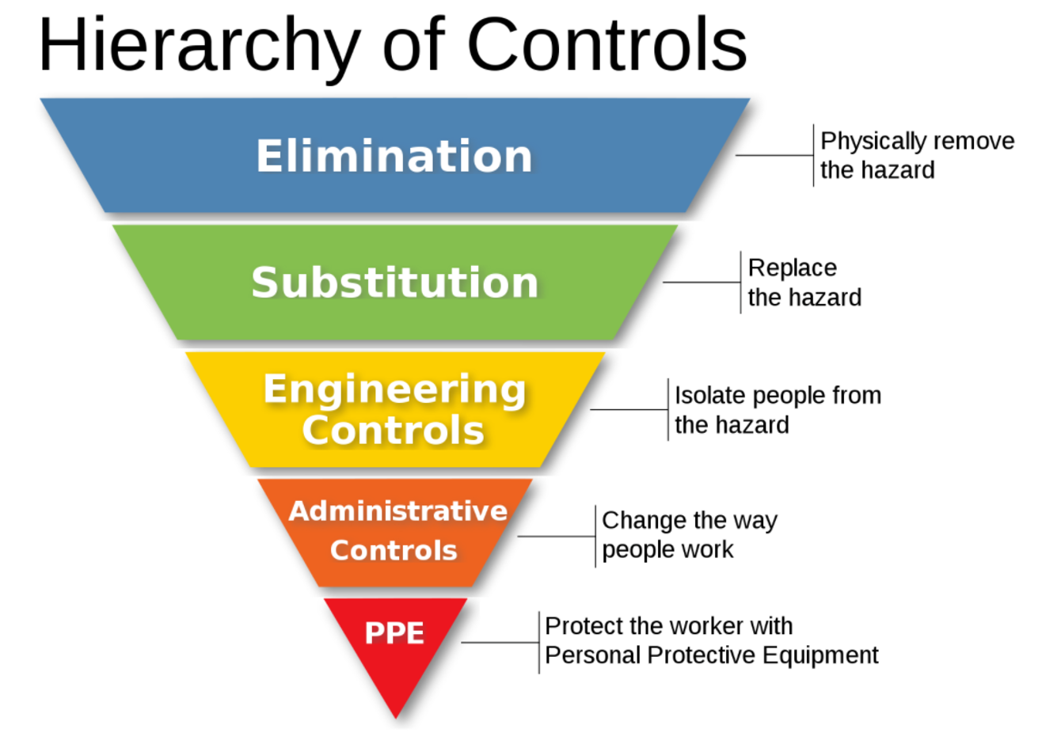
Hierarchy of Controls
Notes:
KLP: Hierarchy of Controls: elimination, substitution, engineering controls, administrative controls and personal protective equipment. The hierarchy is arranged beginning with the most effective controls and proceeds to the least effective.
F: The hazard controls in the hierarchy are, in order of decreasing effectiveness: Do you know what they are?
(Click mouse to trigger animation)
F: Elimination: This is always where you should start. Is it possible to physically eliminate the hazard entirely? Notice that this type of corrective action doesn’t depend on your worker remembering to do something.
(Click mouse to trigger animation)
F: Substitution: Is it possible to replace the hazard, for example changing the equipment or tools used to perform a hazardous task? The effectiveness of this type of preventative action is, like elimination, also not worker-dependent.
(Click mouse to trigger animation)
F: Engineering Controls: Is it possible to create a physical barrier between your workers and the hazard? If your workers are not directly exposed to the hazard, the likelihood of injury is reduced.
(Click mouse to trigger animation)
F: Administrative Controls: Is it possible to change the process or the way that your workers are performing a hazardous job? This type of control is highly dependent on workers following the preventative process.
(Click mouse to trigger animation)
F: Personal protective equipment is our last line of defense and requires worker to wear something to protect themselves from hazards. If none of the above are realistic, is it possible to provide PPE that will protect your workers from the hazard? Again, you must don PPE each time you encounter the hazardous situation.

Slide 8

Hierarchy of Controls
Notes:
VIDEO

Slide 9
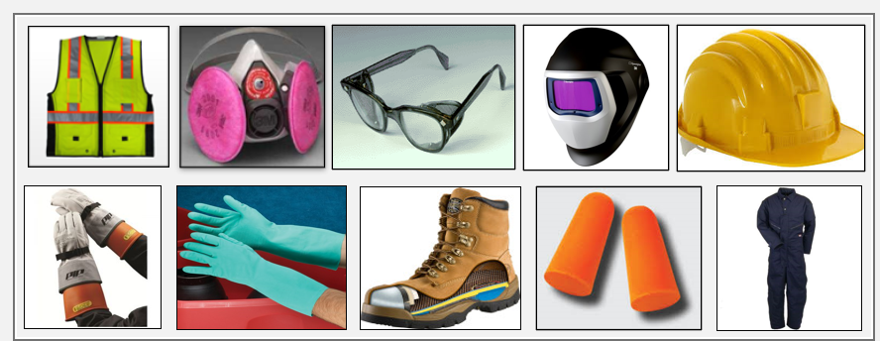
PPE
Notes:
F: After all the engineering and administrative controls have been exhausted, PPE is left to be the last line of defense against injuries. Choosing the correct Personal Protection Equipment (PPE) and wearing it properly can go a long way towards preventing injury to yourself and to others.

Slide 10
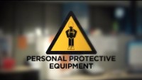
PPE Video
Notes:
VIDEO

Slide 11

Types of PPE: Head Protection
Frequent causes of head injuries
  Falling objects from above striking on the head;
  Bump head against fixed objects, such as exposed pipes or beams; or
  Accidental head contact with electrical hazards.
Notes:
F: Wearing a safety helmet or hard hat is one of the easiest ways to protect an employee's head from injury. Hard hats can protect employees from impact and penetration hazards as well as from electrical shock and burn hazards.
Employers must ensure that their employees wear head protection if any of the following apply:
Objects might fall from above and strike them on the head;
They might bump their heads against fixed objects, such as exposed pipes or beams; or
There is a possibility of accidental head contact with electrical hazards.

Slide 12
Types of PPE: Head Protection
Head protection:
Your head is a very delicate part of your body.
Injuries to the head are very serious. For this reason, head protection and safety are very important.
Notes:
F: Protecting employees from potential head injuries is a key element of any safety program. A head injury can impair an employee for life, or it can be fatal.
Your head is a very delicate part of your body. In and around your head are:
Your eyes, with which you see;
Your ears, with which you hear;
Your nose, with which you smell;
Your mouth, with which you eat and speak; and
Your brain, with which you think.
Injuries to the head are very serious. For this reason, head protection and safety are very important.

Slide 13
Types of PPE: Head Protection
  CLASS G (General)
    Protect against impact, penetration
    Low-voltage electrical protection (proof-tested to 2,200 volts)
  CLASS E (Electrical)
    Designed for electrical/utility work
    Protect against falling objects, impact
    Electrical protection against high-voltage
    (proof-tested to 20,000 volts)
  CLASS C (Conductive)
    Designed for comfort; offers limited protection
    Protects heads that may bump against fixed objects
    Does not protect against falling objects or electrical hazards
Notes:
F: There are many types of hard hats available in the marketplace today. In addition to selecting protective headgear that meets ANSI standard requirements, employers should ensure that employees wear hard hats that provide appropriate protection against potential workplace hazards.
Class G hard hats are intended for general service use, such as building construction, shipbuilding, lumbering, and manufacturing. Class G hard hats provide good impact protection, but limited voltage protection (proof-tested at 2,200 volts).
Class E hard hats are designed for electrical/utility work. They protect against falling objects and provide protection against conductors with higher voltage levels (proof-tested at 20,000 volts).
Class C hard hats provide limited protection, mostly from bumps against fixed objects. Class C hard hats do not provide any protection against electrical hazards.
Type I: provides protection from objects fall directly on top of the helmet, but not from objects that strike the side, front, or back of the head.
Type II: provides protection from strikes to the top of the head and also provides protection from blows to the sides, front, and back of the head. More suitable for workers who are not always in a standing position

Slide 14

PPE Video
Notes:
VIDEO 5 Min

Slide 15
Types of PPE: Head Protection
Frequent causes of head injuries:
  Falling objects from above striking on the head;
  Bump head against fixed objects, such as exposed pipes or beams; or
  Accidental head contact with electrical hazards.
Notes:
F: Wearing a safety helmet or hard hat is one of the easiest ways to protect an employee's head from injury. Hard hats can protect employees from impact and penetration hazards as well as from electrical shock and burn hazards.
Employers must ensure that their employees wear head protection if any of the following apply:
Objects might fall from above and strike them on the head;
They might bump their heads against fixed objects, such as exposed pipes or beams; or
There is a possibility of accidental head contact with electrical hazards.”

Slide 16

Types of PPE: Eye and Face Protection
Safety Glasses
Safety Goggles
Face Shield
Welding Face Shield
Notes:
F: You can be exposed to a large number of hazards that pose danger to your eyes and face. OSHA requires employers to ensure that employees have appropriate eye or face protection if they are exposed to eye or face hazards from flying particles, molten metal, liquid chemicals, acids or caustic liquids, chemical gases or vapors, potentially infected material or potentially harmful light radiation.”
F: If you do not have the proper eye and face protection or if you have questions about any of your PPE, go to your supervisor or HSE representative immediately.
F: Eye and face protection – must comply with ANSI Z87.1-2003, or ANSI Z87.1-1989 (R-1998)
F: The following minimum requirements must be met by all protective devices.
Protectors shall:
Provide adequate protection against the particular hazards for which they are designed.
Be of safe design and construction for the work to be performed.
Be reasonably comfortable when worn under the designated conditions.
Fit snugly and not unduly interfere with the movements of the wearer.
Be durable.
Be capable of being disinfected.
Be easily cleanable.
Be distinctly marked to facilitate identification only of the manufacturer.

Slide 17
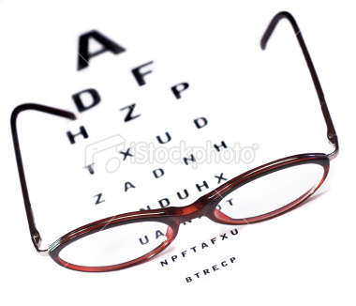
Types of PPE: Safety Glasses
Employees who use prescription glasses while performing operations with potential eye hazards must use eye protection that:
Incorporates the prescription in its design, or
Can be used over your prescription glasses without interfering with the proper positioning of the prescription glasses or goggles.
Notes:
F: Safety glasses are used to protect against moderate impacts from particles.
F: Employees who use prescription glasses while performing operations with potential eye hazards must use eye protection that:
Incorporates the prescription in its design, or
Can be used over your prescription glasses without interfering with the proper positioning of the prescription glasses or goggles

Slide 18
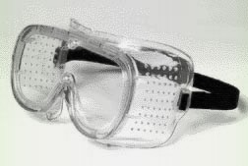
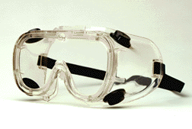
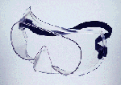
Types of PPE: Safety Goggles
Direct-ventilated
Indirect-ventilated
Non-ventilated
Resist direct passage of large particles into the goggle
Prevents fogging by allowing air circulation
Prevents fogging by allowing air circulation
Protects against liquid or chemical splash entry
Does not allow the passage of air into the goggle
Prevents splash entry
May fog and require frequent lens cleaning
Notes:
F: Safety goggles are used to:
Protect eyes, and the facial area immediately surrounding the eyes from impact, dust, splashes.
Can be used over corrective lenses, if they fit them.
F: Safety goggles are used as primary protection to shield the eyes from heat hazards. Goggles form a protective seal around the eyes, preventing objects or liquids from entering under or around the goggles. This is especially important when working with or around molten metals that may splash.
F: When employees are exposed to high temperatures, additional protection beyond that offered by primary protectors may be required. Use safety goggles in combination with a heat-reflective face shield for severe temperatures exposure. Consider specific lens, frame, and ventilation options when selecting safety goggles.
F: Ventilated goggles allow air circulation while providing protection against airborne particles, dust, liquids, or light.

Slide 19
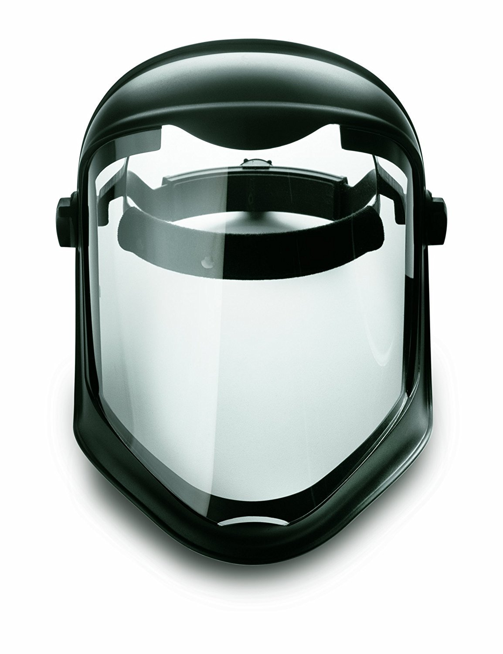
Types of PPE: Face shields
Protect face from nuisance dusts and potential splashes or sprays of hazardous liquids
Shields do not protect from impact hazards unless so rated
Shields are for face protection, not eye protection.
Notes:
F: Face shields protect face from nuisance dusts and potential splashes or sprays of hazardous liquids
F: Shields do not protect from impact hazards unless so rated, shields are for face protection, not eye protection.
F: To protect the eyes, wear safety glasses with side shields, or goggles under the face shield.

Slide 20
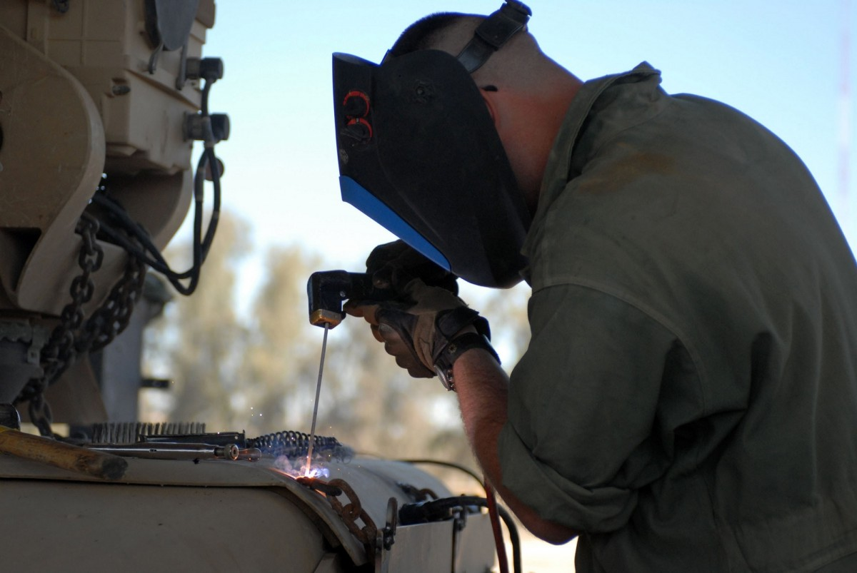
Types of PPE: Welding Shields
Protect eyes from burns caused by:
Infrared light
Intense radiant light
Protect eyes and face from flying sparks, metal spatter, and slag chips
Notes:
F: Constructed of vulcanized fiber or fiberglass and fitted with a filtered lens, welding shields protect eyes from burns caused by infrared or intense radiant light; they also protect both the eyes and face from flying sparks, metal spatter, and slag chips produced during welding, brazing, soldering and cutting operations. OSHA requires filter lenses to have a shade number appropriate to protect against the specific hazards of the work being performed in order to protect against harmful light radiation

Slide 21
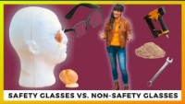
PPE Video
Notes:
VIDEO 5 Min

Slide 22
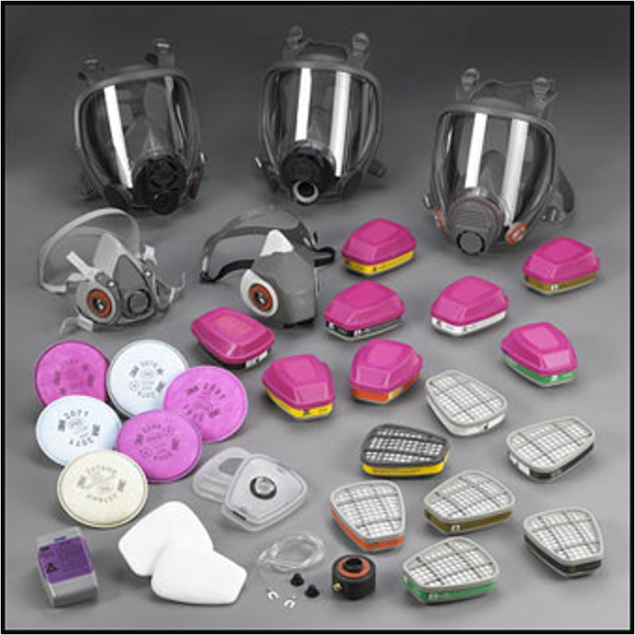
Types of PPE: Respiratory Protection
Air-Purifying (APR) – remove contaminants from the air
Particulate respirators
Chemical cartridge/ gas mask respirator
Powered Air-Purifying Respirator (PAPR)
Powered Air-Purifying Respirator (PAPR)
Atmosphere-Supplying – provide clean, breathable air
Self-Contained Breathing Apparatus (SCBA)
Supplied-Air Respirator (SAR)
Notes:
F: Only when engineering controls are not feasible, will respirators be used. There are 2 types of respirators.
Air-Purifying (APR) – remove contaminants from air
Particulate respirators
Chemical cartridge/ gas mask respirator
Powered Air-Purifying Respirator (PAPR)
Atmosphere-Supplying – provide clean, breathable air
Self-Contained Breathing Apparatus (SCBA)
Supplied-Air Respirator (SAR)

Slide 23
Types of PPE: Respiratory Protection - Continued
Air-Purifying (APR) – remove contaminants from the air
Particulate respirators
Chemical cartridge/ gas mask respirator
Powered Air-Purifying Respirator (PAPR)
Powered Air-Purifying Respirator (PAPR)
Atmosphere-Supplying – provide clean, breathable air
Self-Contained Breathing Apparatus (SCBA)
Supplied-Air Respirator (SAR)
Notes:
F: Only when engineering controls are not feasible, will respirators be used. There are 2 types of respirators.
F: Air-purifying respirators (APRs) work by removing gases, vapors, aerosols (droplets and solid particles), or a combination of contaminants from the air through the use of filters, cartridges, or canisters. These respirators do not supply oxygen and therefore cannot be used in an atmosphere that is oxygen-deficient or immediately dangerous to life or health. The appropriate respirator for a particular situation will depend on the environmental contaminant(s).
F: Powered Air-Purifying Respirators (PAPRs) are powerful breathing tools that support movement and provide a very high level of respiratory protection.
F: People with underlying medical conditions may put themselves at risk if they work while wearing one. The Occupational Safety and Health Administration (OSHA) requires medical evaluation before any employee can even be fit-tested for — let alone wear — a respirator. There is not a specific annual requirement for medical evaluations in the standard. However, the physician or other licensed healthcare provider (PLHCP) may prescribe annual tests to ensure employees' continued ability to wear a respirator.
F: NOTE: The employer needs only to ensure that the dust masks are not dirty or contaminated, that their use does not interfere with the employee's ability to work safety and provide a copy of Appendix D to each voluntary wearer.
Select the hyperlink below to show the regulation explaining the need for the voluntary use form.
App D https://www.osha.gov/laws-regs/regulations/standardnumber/1910/1910.134AppD

Slide 24
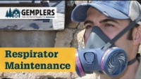
PPE Video
Notes:
VIDEO 5 Min

Slide 25
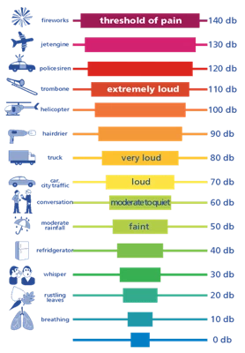
Types of PPE: Hearing Protection
Exposure to noise levels over 85 dB can cause hearing loss
Hearing protection required at 90 dB
Implement effective Hearing Conservation Program
Notes:
F: A simple method to know potentially damaging sound would be to focus on warning signals that a sound may be harmful to your hearing loss. A sound could be detrimental if:
You have trouble talking or hearing other people speak over the noise.
The noise makes your ears hurt.
Other sounds seem muffled when you leave a place where there’s loud noise.
Most instances of noise-induced hearing loss are due to repeated exposure to moderate levels of sound over several decades, not by some instances of very loud sound. Wearing hearing protectors will help stop harm from the moderate and loud sound.
F: According to the Occupational Safety and Health Administration (OSHA), a hearing conservation program is required “whenever employee noise exposures equal or exceed an 8-hour time-weighted average sound level (TWA) of 85 decibels measured on the A scale (slow response) or, equivalently, a dose of fifty percent.”

Slide 26

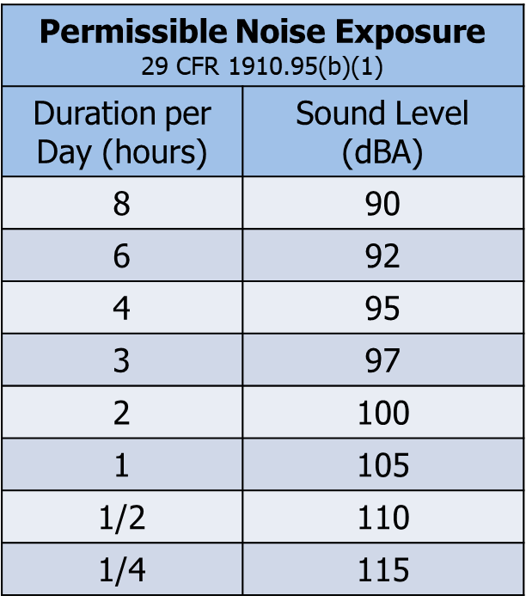
Types of PPE: Hearing Protection
Impact noise should not exceed 140 dB
Notes:
F: The employer must provide ear protection when the noise level in the work area is greater than indicated in this table.

Slide 27



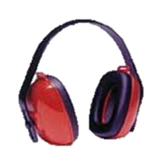
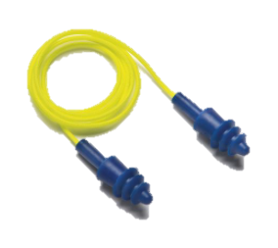
Types of PPE: Hearing Protection
Notes:
F: Here are some examples of hearing protection:
Disposable foam plugs
Molded ear plugs
Noise-cancelling ear plugs
Earmuffs
F: When purchasing hearing protection, the company will consider Noise Reduction Rating (NRR) of devices, Noise Reduction Rating (NRR) is a unit of measurement used to determine the effectiveness of hearing protection devices to decrease sound exposure within a given working environment.

Slide 28
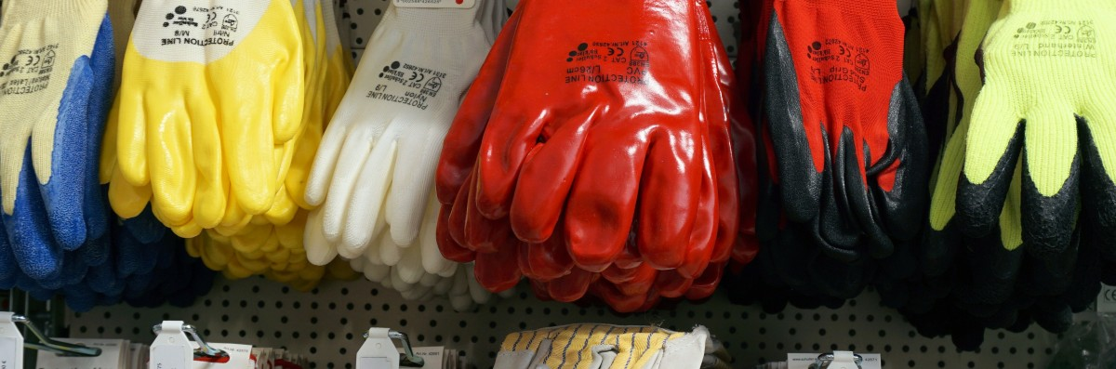
Types of PPE: Hand Protection
Potential hazards for hands
Skin absorption of hazardous substances
Lacerations or severe cuts
Punctures
Chemical burns
Thermal burns
Extreme temperatures
Notes:
F: Potential hazards for hands are:
Skin absorption of hazardous substances
Lacerations or severe cuts
Punctures
Chemical burns
Thermal burns
Extreme temperatures

Slide 29
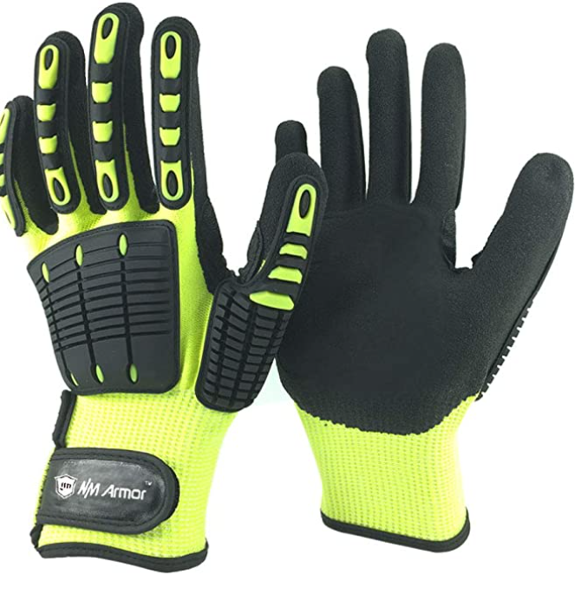
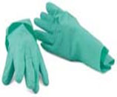
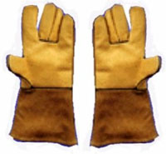
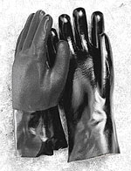
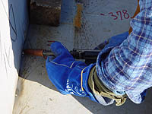
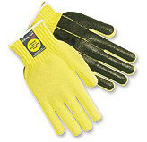
Types of PPE: Hand Protection
Anti-vibration
Chemical-resistant
Leather Palm
Permeation-resistant
Heat-resistant
Cut-resistant
Notes:
F: Pictured here are the different types of gloves
F: Anti-vibration gloves are used to block the amount of damaging frequency vibration transmission from impact powered tools and protect you from the negative health consequences which are associated with exposure to vibration.
F: Chemical resistant gloves are essential to protecting employees from hazardous and toxic chemical exposures. They are the final barrier between the employee and a potentially fatal health hazard.
F: Leather palm gloves provide maximum protection against abrasive and puncture hazards. They are made of durable cotton or canvas with leather palms and fingers.
F: Permeation Resistant is also a chemical resistant glove that protect the hands when working with solvents.
F: Heat resistant gloves are designed for protection from high temperatures found in laboratories. They are usually made of heat- and/or flame-resistant materials. Heat resistant gloves should be used for such tasks as removing hot objects from autoclaves and drying ovens.
F: Cut resistant gloves are intended for use with sharp objects such as knives and they provide little or no protection from puncture injuries. The use of these gloves requires a tradeoff between loss of dexterity and the probability of being cut by a sharp object.

Slide 30
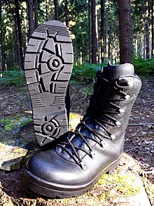
Types of PPE: Foot and Leg Protection
Causes of foot injuries:
Falling or rolling of heavy objects
Crushing or penetrating materials
Sharp objects that can penetrate the sole
Exposure to molten metal
Working on, or around, hot, wet, or slippery surfaces
Working when electrical hazards are present
Notes:
F: Employees who face possible foot or leg injuries from falling or rolling objects or from crushing or penetrating materials should wear protective footwear. Also, employees whose work involves exposure to hot substances or corrosive, or poisonous materials must have protective gear to cover exposed body parts, including legs and feet….
Examples of situations in which an employee should wear foot and/or leg protection include:
When heavy objects such as barrels or tools might roll onto or fall on the employee's feet;
Working with sharp objects such as nails or spikes that could pierce the soles or uppers of ordinary shoes;
Exposure to molten metal that might splash on feet or legs;
Working on or around hot, wet, or slippery surfaces; and
Working when electrical hazards are present.”

Slide 31
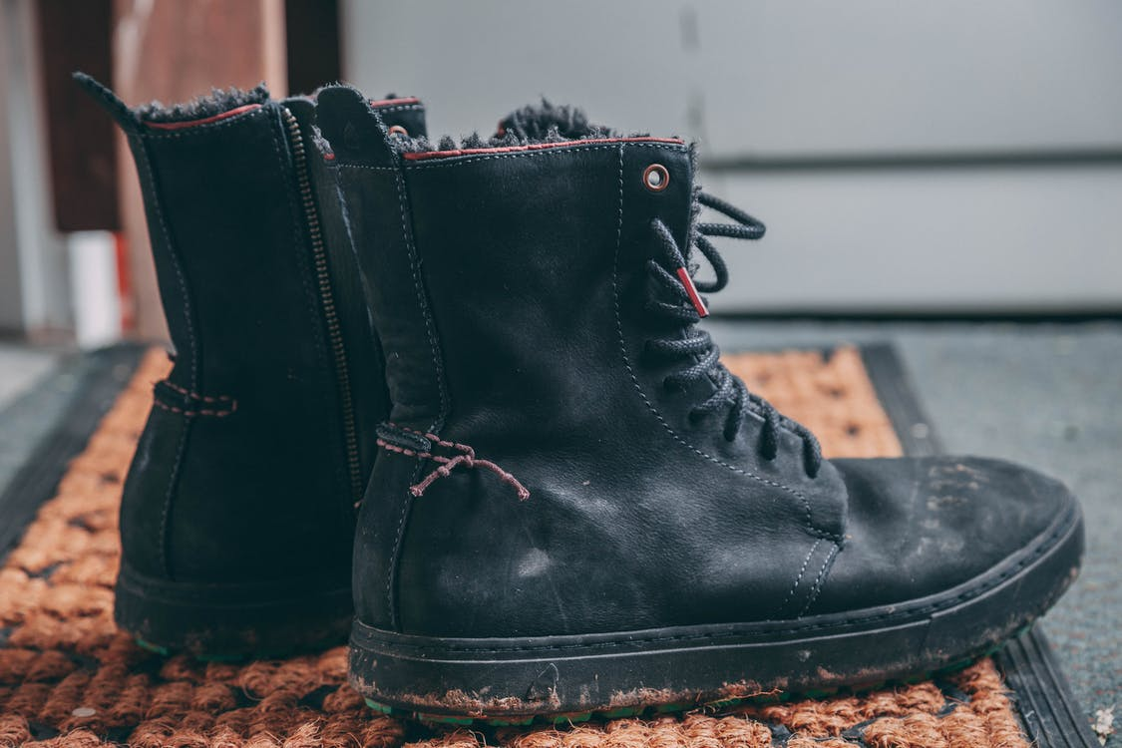
Types of PPE: Foot and Leg Protection
Conditions requiring foot protection
Impacts
Compressions
Cuts/punctures
Chemicals
Temperatures
Notes:
F: Conditions requiring foot protection:
IMPACTS – loading or handling materials such as packages, equipment or heavy objects that could fall
COMPRESSIONS – activities involving vehicles (manual material handling carts)
CUTS/PUNCTURES – sharp objects such as nails, wire, tacks, staples, screws, scrap metal
CHEMICALS – verify with your supervisor and/or the SDS (Safety Data Sheet) for adequate protection
TEMPERATURES – extreme hot or cold work surfaces and/or materials

Slide 32
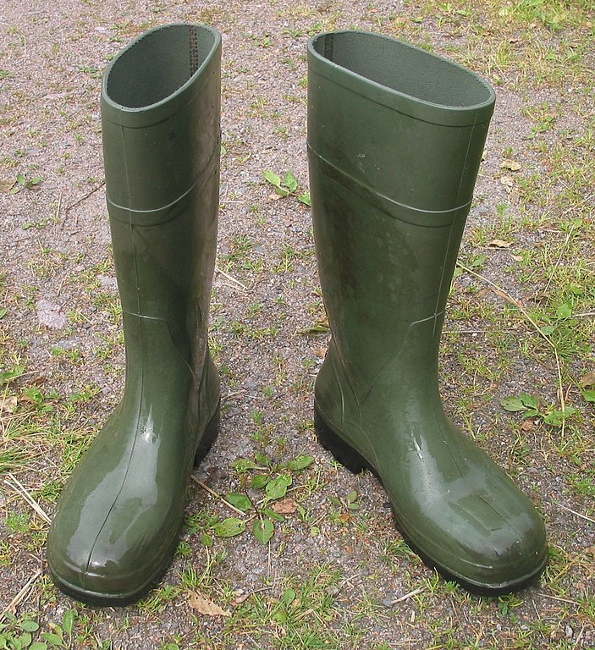
Types of PPE: Foot and Leg Protection
Examples of foot and leg protection
Impact-resistant toe and/or instep
  Steel
  Composite
Heat-resistant soles
Metal shanks
Specialty footwear may be needed
  Metatarsal guards
  Liquid- or chemical-resistant
  Conductive or nonconductive
Notes:
F: Safety shoes have impact-resistant toes and heat-resistant soles that protect the feet against hot work surfaces common in roofing, paving and hot metal industries. The metal insoles of some safety shoes protect against puncture wounds. Safety shoes may also be designed to be electrically conductive to prevent the buildup of static electricity in areas with the potential for explosive atmospheres or nonconductive to protect workers from workplace electrical hazards.
“Metatarsal guards protect the instep area from impact and compression. Made of aluminum, steel, fiber or plastic, these guards may be strapped to the outside of shoes.”
“Electrically conductive shoes provide protection against the buildup of static electricity…. Employees exposed to electrical hazards must never wear conductive shoes.”
“Electrical hazard, safety-toe shoes are nonconductive and will prevent the wearers' feet from completing an electrical circuit to the ground. These shoes can protect against open circuits of up to 600 volts in dry conditions and should be used in conjunction with other insulating equipment and additional precautions to reduce the risk of a worker becoming a path for hazardous electrical energy. The insulating protection of electrical hazard, safety-toe shoes may be compromised if the shoes become wet, the soles are worn through, metal particles become embedded in the sole or heel, or workers touch conductive, grounded items.
Note: Nonconductive footwear must not be used in explosive or hazardous locations.
Shoes with metal toe-cap protects against knocks, falling objects
Rubber shoes protect against chemical materials, as directed by the SDS
Protective footwear must comply with any of the following consensus standards:1910.136(b)(1)(i)
ASTM F-2412-2005, "Standard Test Methods for Foot Protection," and ASTM F-2413-2005, "Standard Specification for Performance Requirements for Protective Footwear," which are incorporated by reference in § 1910.6;1910.136(b)(1)(ii)
ANSI Z41-1999, "American National Standard for Personal Protection -- Protective Footwear," which is incorporated by reference in § 1910.6; or1910.136(b)(1)(iii)
ANSI Z41-1991, "American National Standard for Personal Protection -- Protective Footwear," which is incorporated by reference in § 1910.6.1910.136(b)(2)

Slide 33
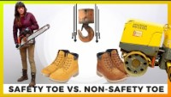
PPE Video
Notes:
VIDEO 5 Min

Slide 34
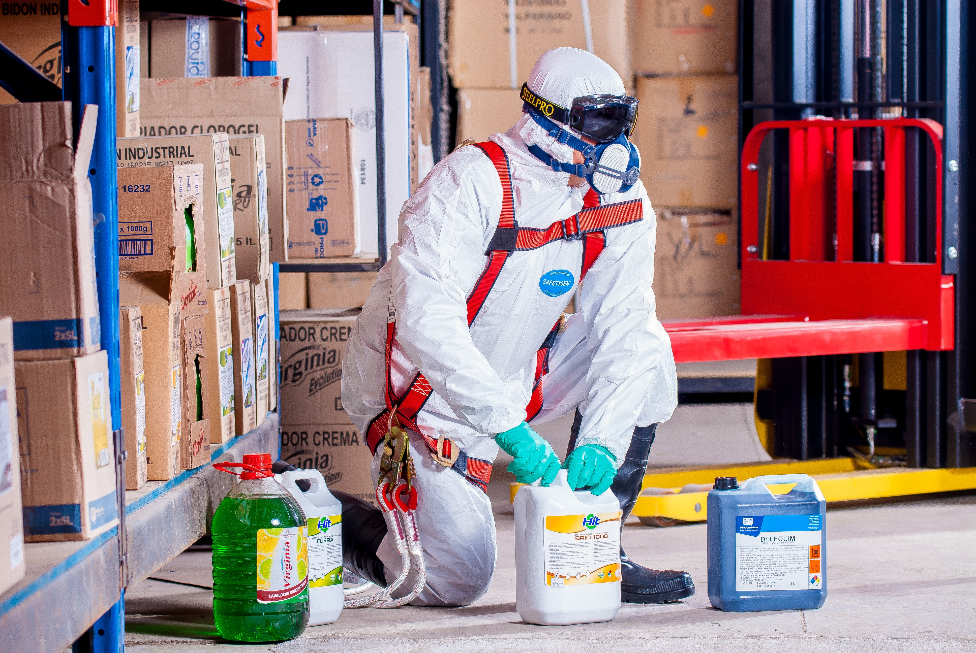
Types of PPE: Protective Clothing
Provide protective clothing for those parts of the body exposed to possible injuries.
Types of body protection:
Laboratory coats
Coveralls
Vests
Jackets
Aprons
Surgical gowns
Full-body suits
Notes:
F: Employees who face possible bodily injury of any kind that cannot be eliminated through engineering, work practice or administrative controls, must wear appropriate body protection while performing their jobs. In addition to cuts and radiation, the following are examples of workplace hazards that could cause bodily injury:
Temperature extremes;
Hot splashes from molten metals and other hot liquids;
Potential impacts from tools, machinery and materials;
Hazardous chemicals.
F: There are many varieties of protective clothing available for specific hazards. Employers are required to ensure that their employees wear personal protective equipment only for the parts of the body exposed to possible injury. Examples of body protection include laboratory coats, coveralls, vests, jackets, aprons, surgical gowns and full body suits.
F: Protective clothing comes in a variety of materials, each effective against particular hazards, such as:
Paper-like fiber used for disposable suits provide protection against dust and splashes.
Treated wool and cotton adapts well to changing temperatures, is comfortable, and fire-resistant and protects against dust, abrasions and rough and irritating surfaces.
Duck is a closely woven cotton fabric that protects against cuts and bruises when handling heavy, sharp or rough materials.
Leather is often used to protect against dry heat and flames.
Rubber, rubberized fabrics, neoprene and plastics protect against certain chemicals and physical hazards. When chemical or physical hazards are present, check with the clothing manufacturer to ensure that the material selected will provide protection against the specific hazard.”

Slide 35

One Team
QUESTIONS?

