Slide 1
Winter Weather Preparedness
December 2022
Notes:
KLP: You set the tone. If you believe safety is important, the audience will believe safety is important.
The facilitator opens the session by welcoming everybody to the training and noting the monthly focus – Winter Weather Preparedness
F: Today’s task is to attend Winter Weather Preparedness training. Cell phones should be turned off or silenced during this training. If you need to take a call, please go to (designated area), take the call and return as soon as possible. {Address any other important announcements or business now.}

Slide 2
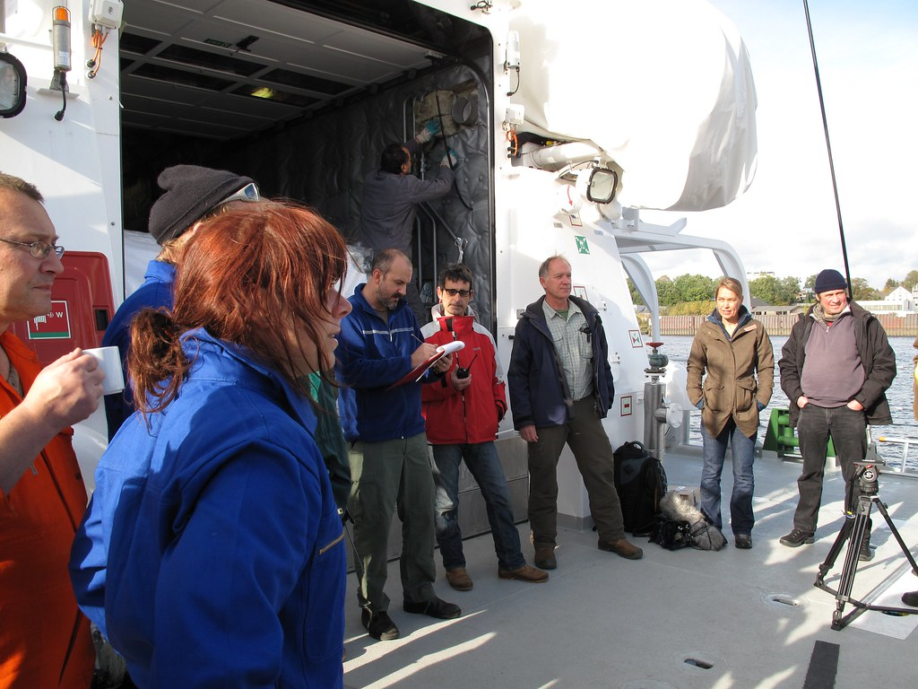
Housekeeping
Muster Point
Notes:
F: Prior to training, determine if any fire drills are planned and the response expected from the facility and muster points if alarms should go off. It is important to remind employees that should they need to leave the location at any time, they should inform the Facilitator because, in the event of a fire incident, we need to know their whereabouts. This is an opportunity right at the start of the day to brief the employees on HSE procedures in general for the running of the training course. [If your job site is outdoors, don’t overlook this safety moment. Adjust the plan in the event of a job site fire.]
F: Hello Team, I have verified with the HSE department and have confirmed that there are no Fire Drills or Emergency Drills scheduled for today. If we hear an alarm, we will follow site protocol for emergency response.
F: {Point out the fire exits and muster point}
F: Once we are at the muster points, we will do a role call to account for all attendees.

Slide 3

Presenter & Introductions
Safety begins with me!
Notes:
F: {This is your moment! This is a chance to visibly “Walk the Talk”}
Share:
Your personal experience of safety and impact on the company
Importance of making the most of this opportunity to think about the importance of HSE and discuss with employees
Appreciate that you are a leader and that you make an impact
Importance of taking personal responsibility to make a positive impact
You get out of this training what you put into it
HSE matters to our company
The safety program is going to help people feel empowered and take the initiative to improve their own HSE performance through proactive attitudes and behaviors.
You may wish to share:
A story of your experience in the safety program and how it is has changed the way in which you behave.
Some lessons learned from an incident when you have been involved in the investigation, highlighting the devastating impact that accidents have on people’s lives, or you can describe your experience of being involved in an environmental incident. How did this affect the company, and more importantly, affect the lives of others not working for the company.
F: Go around the room and ask everyone to give their name and what their position is. {Wait for their responses, smile, and nod as they participate. Be careful about timing here---if you ask an additional intro question of the participants and give a long-winded answer yourself, your participants will follow with long stories/explanations, and you can accidentally take up a lot of time.}

Slide 4

Why am I here?
You are the KEY to SAFETY!
Notes:
Slide 6: Why am I here? (1 Minute)
F: Each one of us is the last line of defense to protect workers from injury or the environment from damage, should management systems and collective protections fail. Supervisors and workers are the KEY to HSE. We can promote or destroy the HSE climate through our own behavior and how other workers perceive it.
Supervisors and workers are responsible for enforcing safety rules. Regardless of our position, employment status, or background, everyone is responsible for HSE, and everyone can be a HSE leader by demonstrating positive attitudes and behavior.

Slide 5
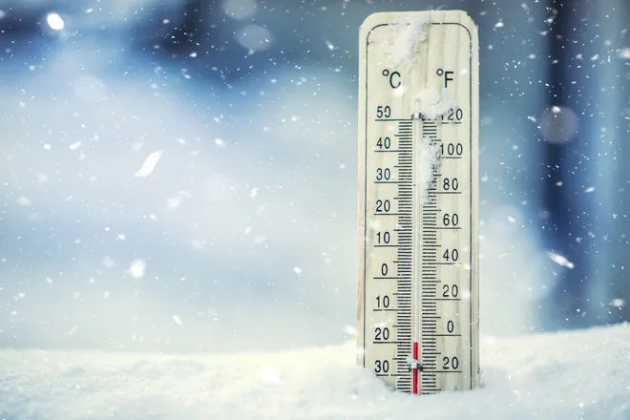
Winter Weather Statistics
Researchers have found that “Patients who died because of cold temperatures were responsible for 94% of temperature-related deaths.” (University of Illinois at Chicago, 2020)
Cold and winter weather-related accidents are common. According to the U.S. Bureau of Labor Statistics (BLS), in 2017, there were over 20,000 occupational injuries related to ice, sleet and snow.
Notes:
F: Researchers have found that “Patients who died because of cold temperatures were responsible for 94% of temperature-related deaths.” (University of Illinois at Chicago, 2020)
F: Cold and winter weather-related accidents are common. According to the U.S. Bureau of Labor Statistics (BLS), in 2017, there were over 20,000 occupational injuries related to ice, sleet and snow.
{Play video on the next slide}

Slide 6
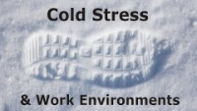
Cold Stress
Notes:
VIDEO – 3:20 Min
F: During the video, the narrator mentioned “three of the MOST common cold induced illness.” Can you name them? (Smile and wait for answers).
(Click Mouse to next slide to display the answers)

Slide 7
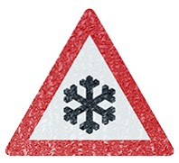
Common Cold Induced Injuries
Hypothermia
Frostbite
Trench Foot
Chilblains
Notes:
F: Here are the most common cold induced injuries and we added Chilblains.
Hypothermia:
Frostbite:
Trench Foot:
Chilblains:
F: Now that we are familiar with the terminology, lets learn a bit more about each and how to prevent them.

Slide 8
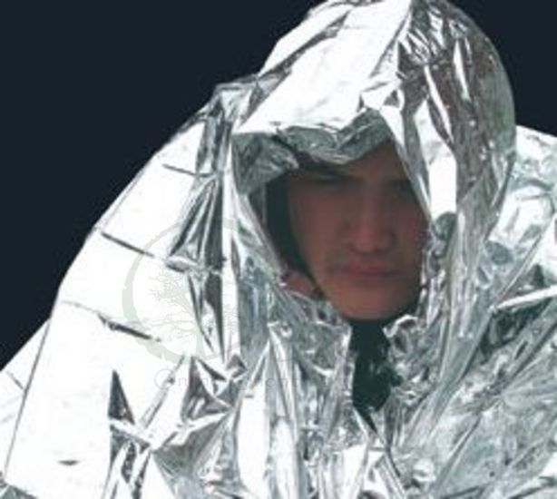
Hypothermia
A condition in which the body uses up stored energy and can no longer produce heat. Often occurs after prolonged exposure to cold temperature.
Notes:
F: Hypothermia: A condition in which the body uses up stored energy and can no longer produce heat. Often occurs after prolonged exposure to cold temperature.

Slide 9
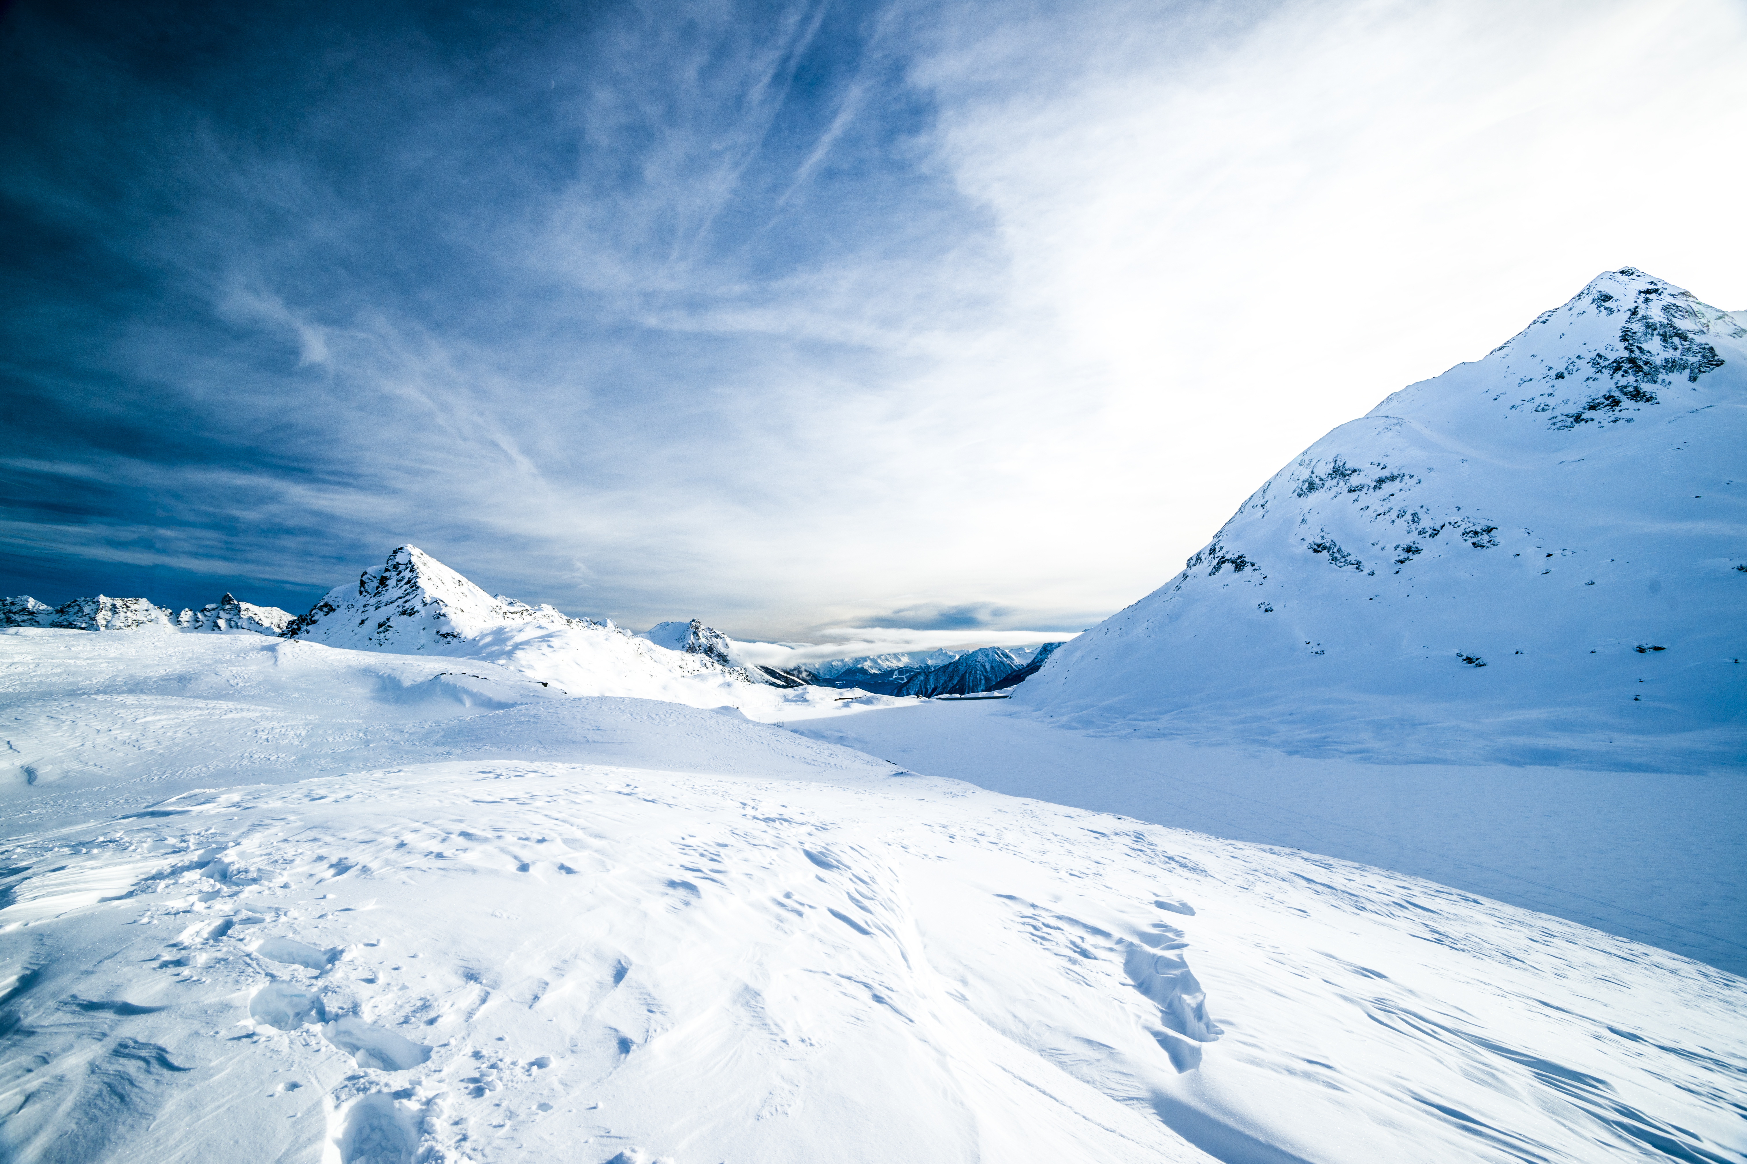
Hypothermia Early Symptoms
Shivering
Fatigue
Confusion
Disorientation
Loss of Coordination
Notes:
F: Early Symptoms of Hypothermia:
Shivering
Fatigue
Confusion
Disorientation
Loss of Coordination

Slide 10
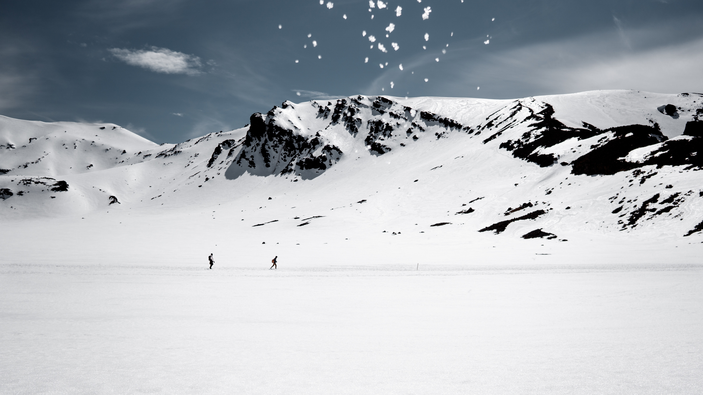
Hypothermia LATE Symptoms
No Shivering
Blue skin
Dilated pupils
Slow pulse and breathing
Loss of consciousness
Notes:
F: Hypothermia late symptoms:
No Shivering
Blue skin
Dilated pupils
Slow pulse and breathing
Loss of consciousness

Slide 11
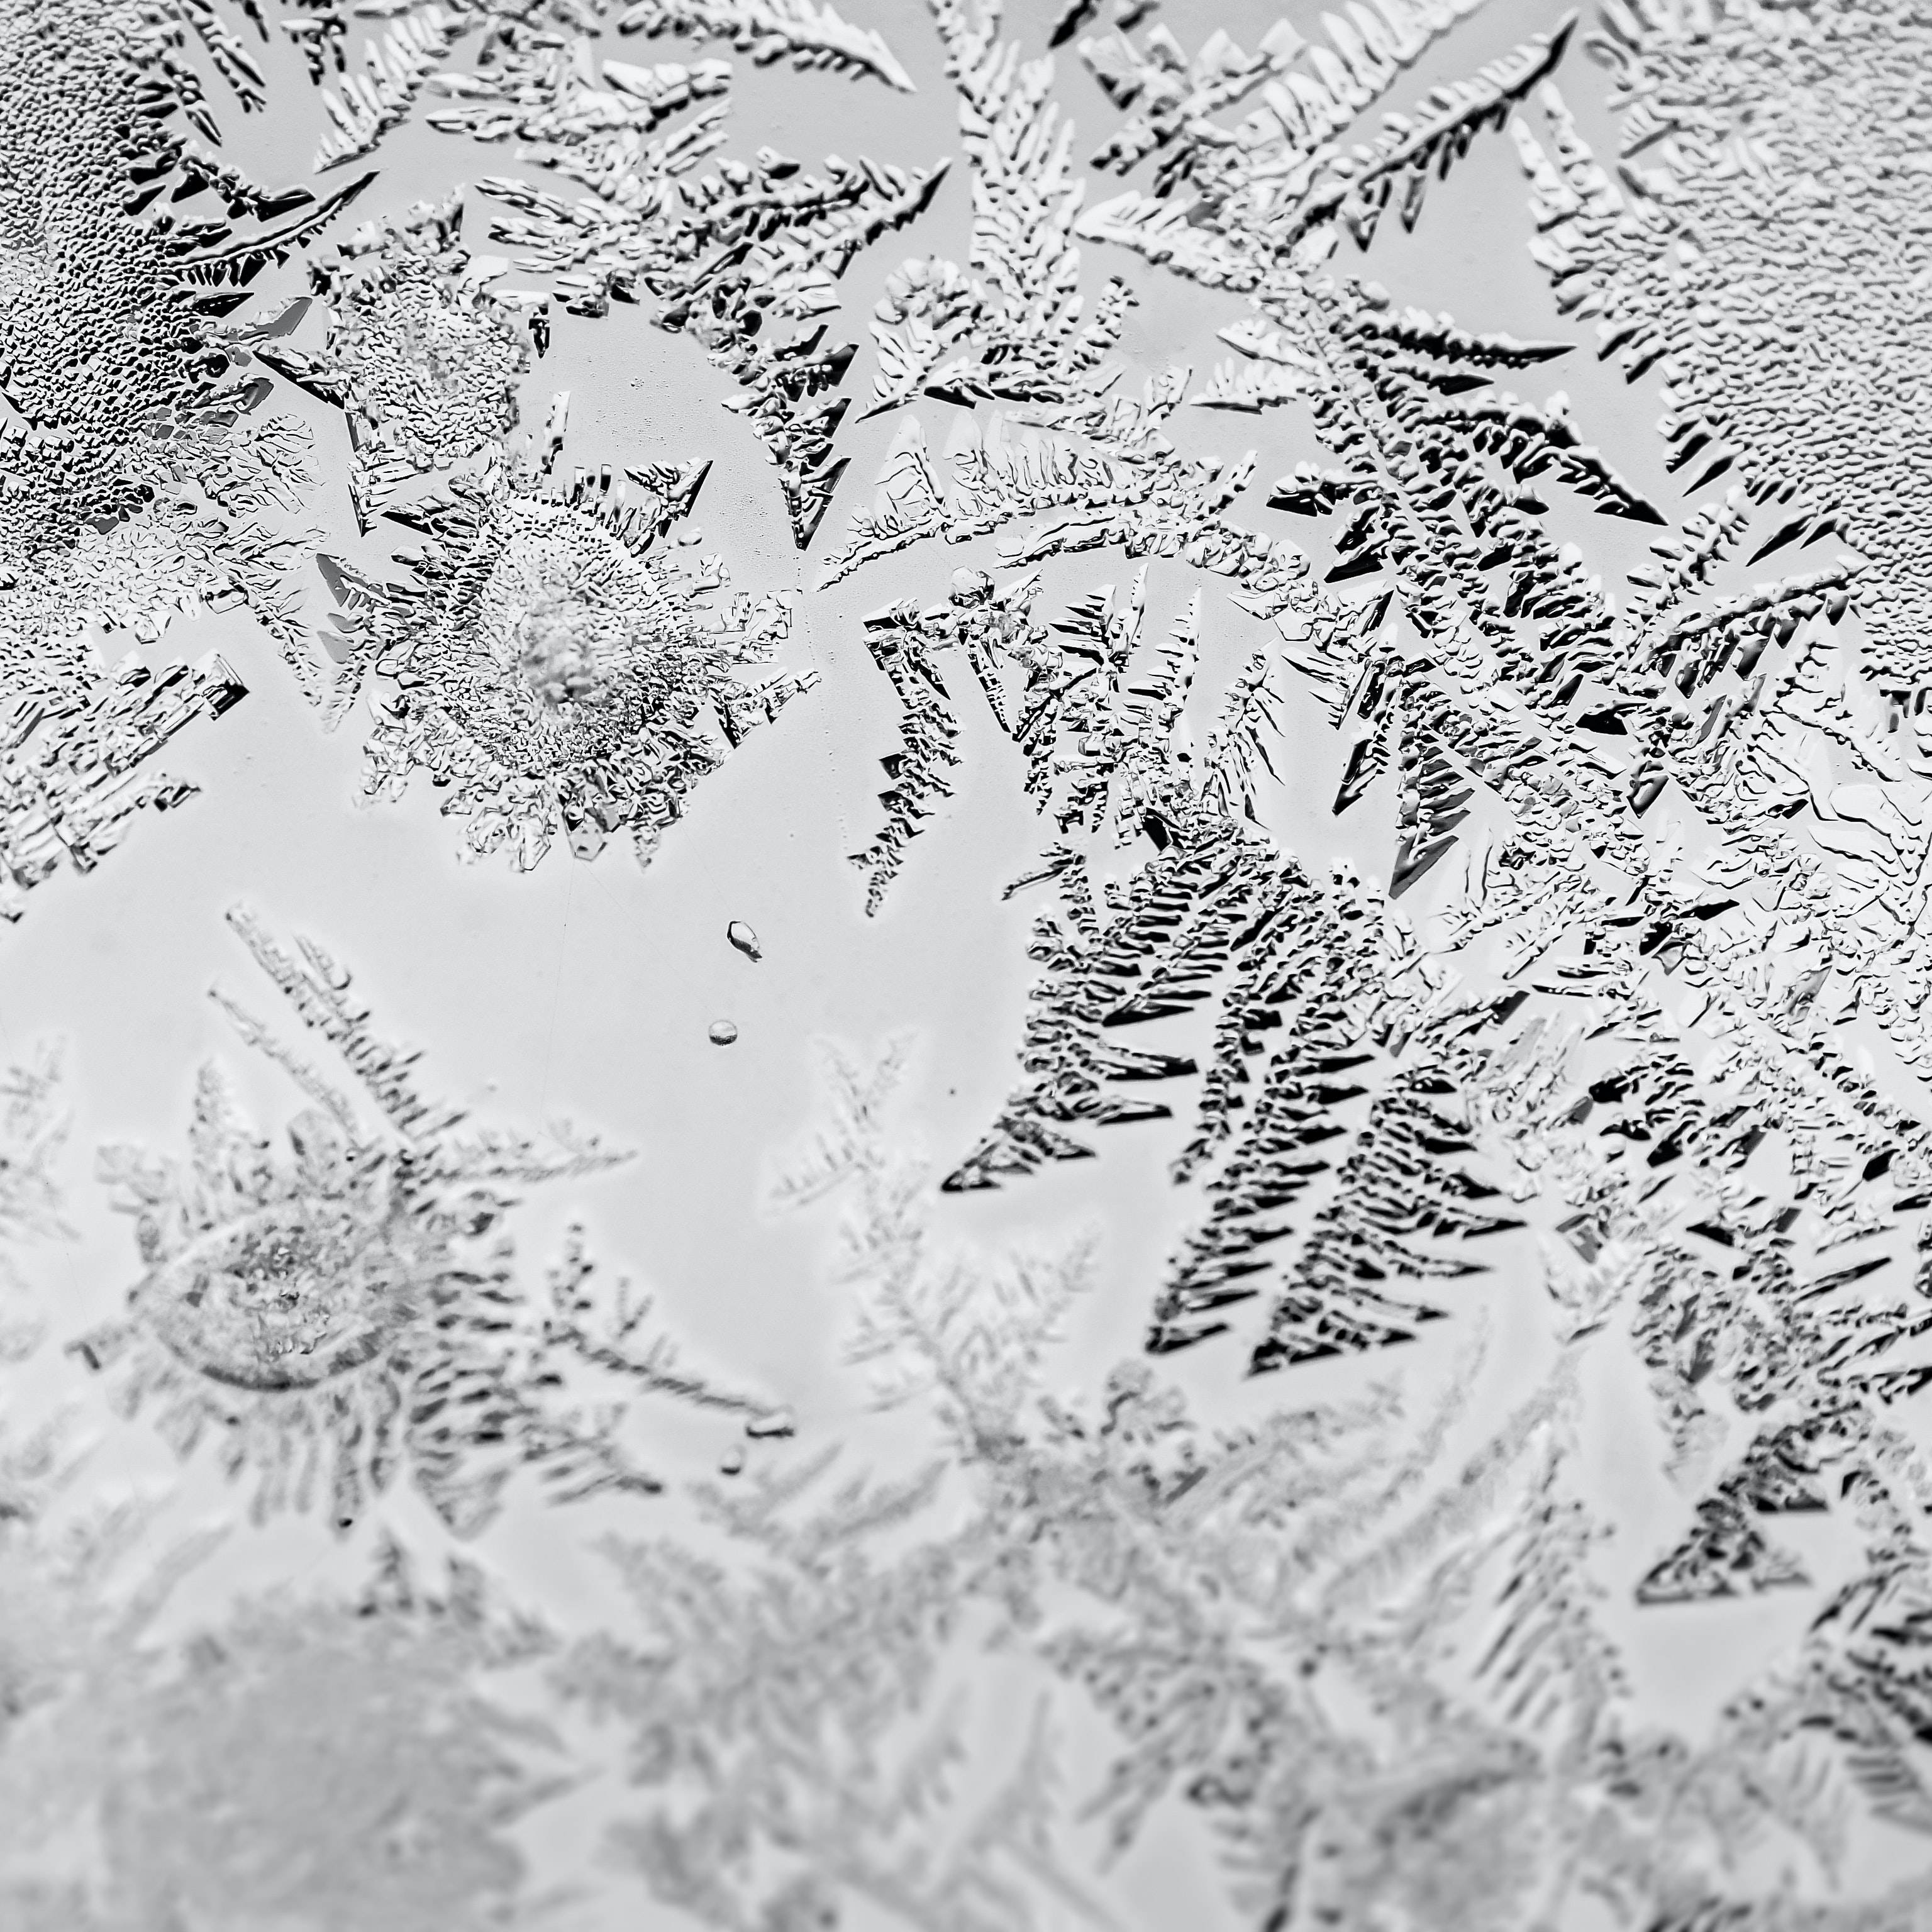
Frostbite
An injury to the body that is caused by freezing, which most often affects the nose, ears, cheeks, chin, fingers, or toes
Notes:
F: Frostbite: An injury to the body that is caused by freezing, which most often affects the nose, ears, cheeks, chin, fingers, or toes.

Slide 12
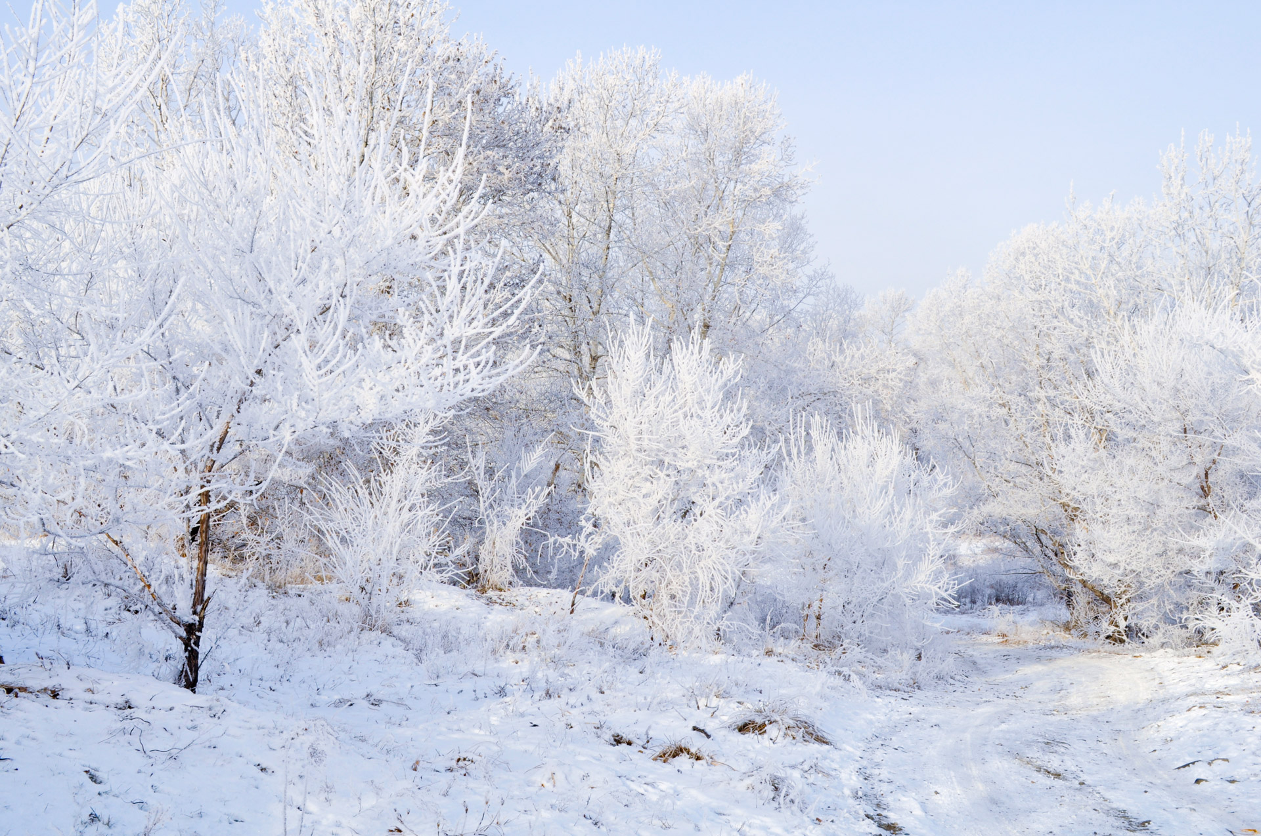
Frostbite Symptoms
Reduced blood flow
Numbness
Aching
Tingling or stinging
Bluish or pale
Notes:
F: Symptoms of Frostbite:
Reduced blood flow
Numbness
Aching
Tingling or stinging
Bluish or pale

Slide 13
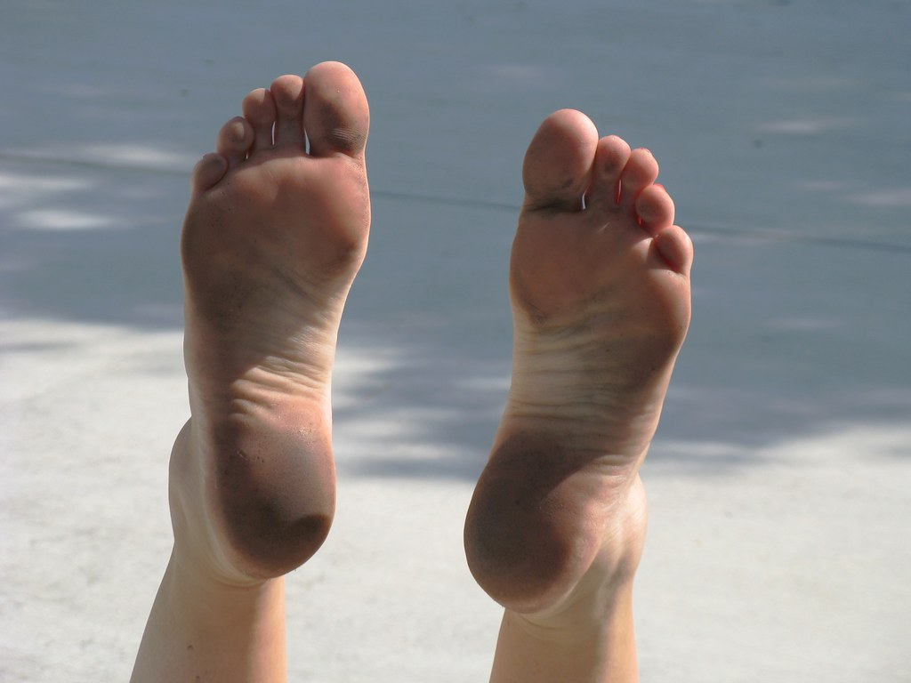
Trench Foot
An injury of the feet resulting from prolonged exposure to wet and cold conditions that can occur at temperatures as high as 60 degrees if the feet are constantly wet.
Notes:
F: Trench Foot: An injury of the feet resulting from prolonged exposure to wet and cold conditions that can occur at temperatures as high as 60 degrees if the feet are constantly wet.
F: Here are a few pictures of what mild and severe Trench Foot Looks like.
F: Trench Foot is also known as Immersion Foot

Slide 14
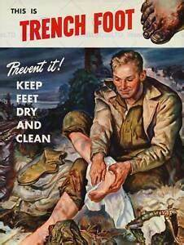
Trench Foot Symptoms
Reddening of skin
Leg Cramps
Swelling
Blisters/Ulcers
Bleeding Under Skin
Gangrene
Notes:
F: Trench Foot Symptoms:
Reddening of skin
Leg Cramps
Swelling
Blisters/Ulcers
Bleeding Under Skin
Gangrene
F: Protect your feet — clean and dry your feet; wear clean, dry socks; and soak affected feet in warm water for 5 minutes. It’s also recommended to elevate bare feet when sleeping. Seek medical attention right away if you suspect someone has trench foot.

Slide 15
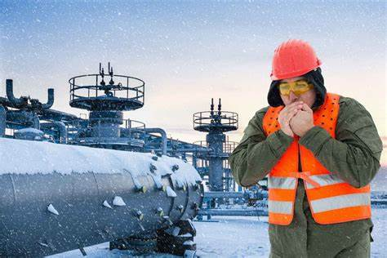
Chilblains
Ulcers formed by damaged small blood vessels in the skin, caused by the repeated exposure of skin to temperatures just above freezing to as high as 60 degrees.
Notes:
F: Chilblains: Ulcers formed by damaged small blood vessels in the skin, caused by the repeated exposure of skin to temperatures just above freezing to as high as 60 degrees.

Slide 16
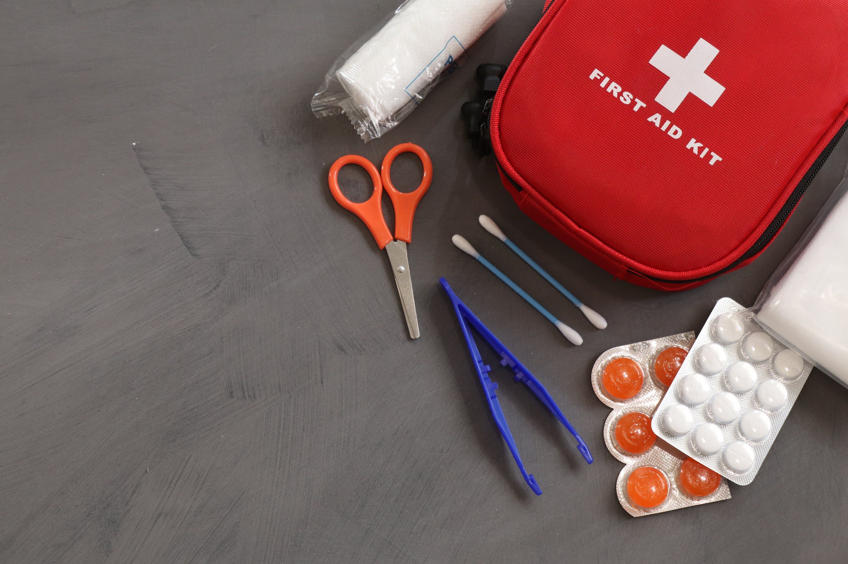
Chilblain Symptoms
Redness
Itching
Blistering
Inflammation
Possible Ulceration
Notes:
F: Chilblain Symptoms
Redness
Itching
Blistering
Inflammation
Possible Ulceration

Slide 17
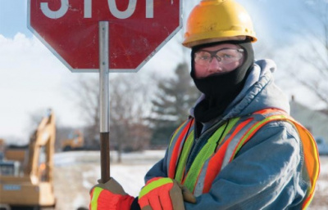
How to Protect Yourself
  Monitor your physical condition and that of your coworkers.
  Wear appropriate clothing.
  Wear several layers of loose clothing for insulation.
  Boots should be waterproof and insulated.
  Carry extra socks, gloves, hats, jacket, and thermos of hot liquid.
  Move into warm locations during breaks; limit the amount of time outside.
  Avoid touching cold metal surfaces with bare skin.
Notes:
F: How do we prevent Cold weather injuries?? {Smile and nod as they participate}
F: Although OSHA does not have a specific standard that covers working in cold environments, under the Occupational Safety and Health Act (OSH Act) of 1970, employers have a duty to protect workers from recognized hazards, including cold stress hazards, that are causing or likely to cause death or serious physical harm in the workplace.
(Click mouse to trigger animation)
Monitor your physical condition and that of your coworkers.
Wear appropriate clothing.
Wear several layers of loose clothing for insulation.
Boots should be waterproof and insulated.
Carry extra socks, gloves, hats, jacket, and thermos of hot liquid.
Move into warm locations during breaks; limit the amount of time outside.
Avoid touching cold metal surfaces with bare skin.

Slide 18
Check On Learning
  Fill in the blank:
  In 2017, there were over ______ occupational injuries related to ice, sleet and snow.
      20,000
      30,000
      40,000
Notes:
Check On Learning

Slide 19
Check On Learning
  Fill in the blank:
  In 2017, there were over ______ occupational injuries related to ice, sleet and snow.
      20,000
      30,000
      40,000
Notes:
Check On Learning

Slide 20
Check On Learning
  According to OSHA, what are the MOST common cold induced injuries?
      Hyperthermia, Frostbite, and Chilblains
      Hyperthermia, Frostbite, Trench Foot & Chilblains
      Hypothermia, Frostbite, and Trench Foot
Notes:
Check On Learning

Slide 21
Check On Learning
  According to OSHA, what are the MOST common cold induced injuries?
      Hyperthermia, Frostbite, and Chilblains
      Hyperthermia, Frostbite, Trench Foot & Chilblains
      Hypothermia, Frostbite, and Trench Foot
Notes:
Check On Learning

Slide 22
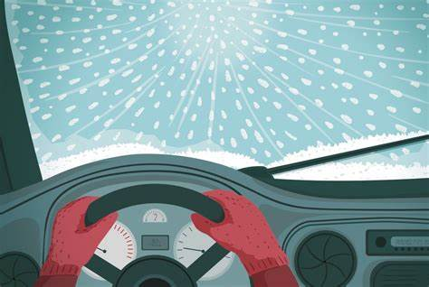
Winter Weather Preparedness
WINTER DRIVING
Notes:
Introduction to Winter Driving

Slide 23
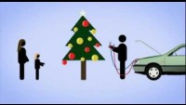
Winter Weather Driving
Notes:
VIDEO – 2:13 Min

Slide 24
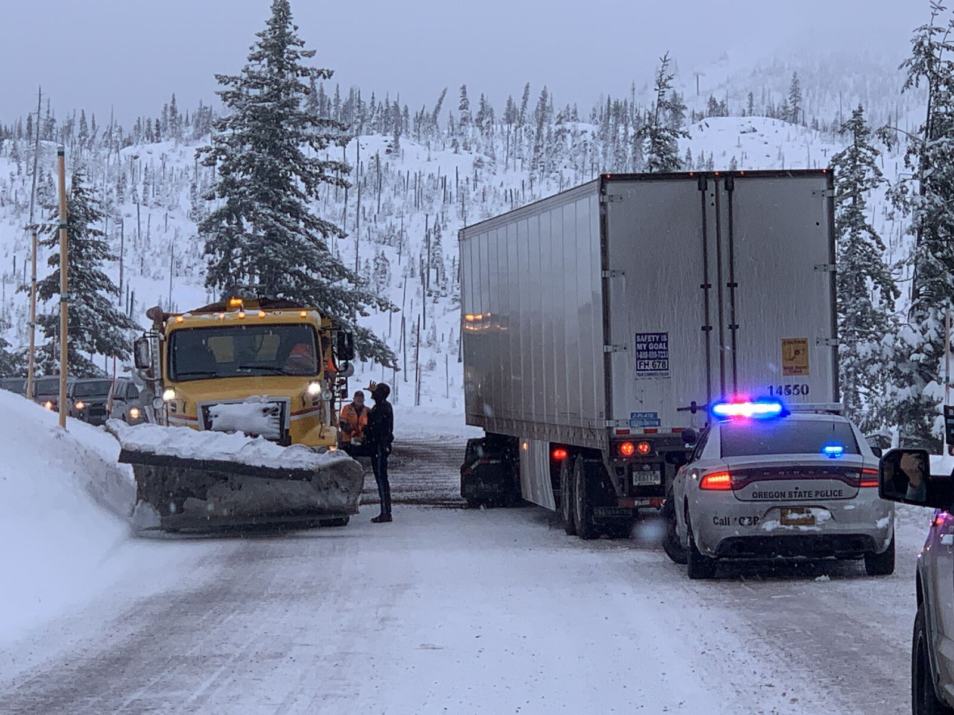
Prepare for Your Drive
Keep an eye on not only your local weather
Inspect your vehicle to determine that your systems are working properly:
  Brakes
  Cooling System
  Electrical System
  Engine
  Exhaust system
  Tires
  Oil
  Visibility systems
Notes:
F: Keep an eye on not only your local weather, but the weather of your destination when making a trip. Inspect your vehicle to determine that your systems are working properly.
PREPARE: (Click mouse to trigger animation)
Brakes: Brakes should provide even and balanced braking. Also check that brake fluid is at the proper level.
Cooling system: Ensure a proper mixture of 50/50 antifreeze and water in the cooling system at the proper level.
Electrical system: Check the ignition system and make sure that the battery is fully charged and that the connections are clean. Check that the alternator belt is in good condition with proper tension.
Engine: Inspect all engine systems.
Exhaust system: Check exhaust for leaks and that all clamps and hangers are snug.
Tires: Check for proper tread depth and no signs of damage or uneven wear. Check for proper tire inflation.
Oil: Check that oil is at proper level.
Visibility systems: Inspect all exterior lights, defrosters (windshield and rear window), and wipers. Install winter windshield wipers.

Slide 25
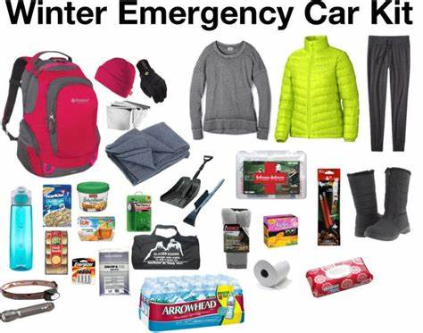
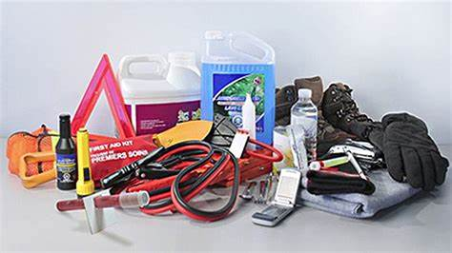
Emergency Kit
  Create an emergency kit containing a cell phone or two-way radio, flashlight, jumper cables, abrasive material (sand, kitty litter, etc.), shovel, snow brush and ice scraper, emergency flares, and blankets. For longer trips, add food, water, and any medications.
Notes:
F: Emergency Kits: Create an emergency kit containing a cell phone or two-way radio, flashlight, jumper cables, abrasive material (sand, kitty litter, etc.), shovel, snow brush and ice scraper, emergency flares, and blankets. For longer trips, add food, water, and any medications.
F: Here are a few more Items you can add to your kits (bring attention to pictures at the bottom of the slide)

Slide 26
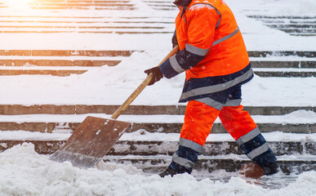
Shoveling Snow
Shoveling snow can be a strenuous activity, particularly because cold weather can be taxing on the body. There is a potential for:
  Exhaustion
  Dehydration
  Back injuries
  Heart attacks
Notes:
Shoveling Snow:
F: Shoveling snow can be a strenuous activity, particularly because cold weather can be taxing on the body.
There is a potential for:
Exhaustion
Dehydration
Back injuries
Heart attacks.

Slide 27
Shoveling Snow Cont.
During snow removal in addition to following the tips for avoiding cold stress, there are other precautions workers can take to avoid injuries:
Workers should warm-up before the activity
Scoop small amounts of snow at a time and where possible, push the snow instead of lifting it.
The use of proper lifting technique is necessary to avoid back and other injuries when shoveling snow (keep the back straight, lift with the legs and do not turn or twist the body).
Notes:
Shoveling Snow:
F: During snow removal in addition to following the tips for avoiding cold stress, there are other precautions workers can take to avoid injuries:
- Workers should warm-up before the activity
- Scoop small amounts of snow at a time and where possible, push the snow instead of lifting it.
- The use of proper lifting technique is necessary to avoid back and other injuries when shoveling snow (keep the back straight, lift with the legs and do not turn or twist the body).

Slide 28
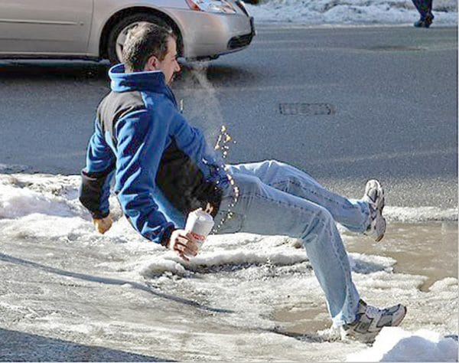
Preventing Slips on Snow and Ice
Clear walking surfaces of snow and ice, spread deicer, as quickly as possible after a winter storm.
Wear proper footwear when walking on snow or ice.
Take short steps and walk at a slower pace so you can react quickly to a change in traction, when walking on an icy or snow-covered walkway.
Notes:
F: To prevent slips, trips, and falls, be sure to:
Clear walking surfaces of snow and ice, spread deicer, as quickly as possible after a winter storm.
Wear proper footwear when walking on snow or ice.
(A pair of insulated and water-resistant boots with good rubber treads is a must for walking during or after a winter storm. Keeping a pair of rubber over-shoes with good treads which fit over your street shoes is a good idea during the winter months).
Take short steps and walk at a slower pace so you can react quickly to a change in traction, when walking on an icy or snow-covered walkway.
F: In 2014, there were 42,480 workplace injuries and illnesses involving ice, sleet, or snow that required at least one day away from work to recuperate. These resulted from falls, slips or trips; overexertion and bodily reaction; and contact with objects and equipment. Among these injuries and illnesses were 34,860, or 82 percent, that were due to falls on the same level (that is, not from falls from heights or through surfaces).” – U.S. Bureau of Labor Statistics

Slide 29
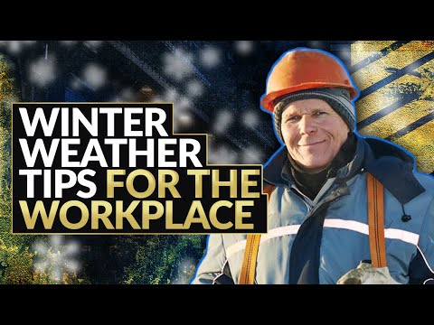
Message from Safety Spiel
Notes:
VIDEO - 3:18

Slide 30

One Team
QUESTIONS?

