Slide 1
Stop Work Authority
SWA
July 2024
Notes:
KLP: You set the tone. If you believe safety is important, the audience will believe safety is important.
The facilitator opens the session by welcoming everybody to the training and noting the monthly focus – Stop Work Authority (SWA).
F: Today’s task is to attend Stop Work Authority (SWA). Cell phones should be turned off or silenced during this training. If you need to take a call, please go to (designated area), take the call and return as soon as possible. {Address any other important announcements or business now.}

Slide 2
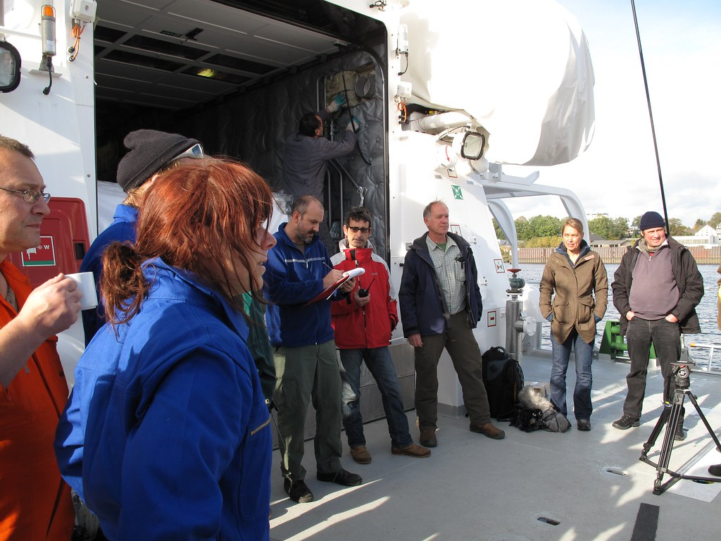
Housekeeping
Muster Point
Notes:
Prior to training, determine if any fire drills are planned and the response expected from the facility and muster points if alarms should go off. It is important to remind employees that should they need to leave the location at any time, they should inform the Facilitator because, in the event of a fire incident, we need to know their whereabouts. This is an opportunity right at the start of the day to brief the employees on HSE procedures in general for the running of the training course. [If your job site is outdoors, don’t overlook this safety moment. Adjust the plan in the event of a job site fire.]
F: Hello Team, I have verified with the HSE department and have confirmed that there are no Fire Drills or Emergency Drills scheduled for today. If we hear an alarm, we will follow site protocol for emergency response.
F: {Point out the fire exits and muster point}
F: Once we are at the muster points, we will do a role call to account for all attendees.

Slide 3

Presenter & Introductions
Safety begins with me!
Notes:
F: {This is your moment! This is a chance to visibly “Walk the Talk”}
Share:
Your personal experience of safety and impact on the company
Importance of making the most of this opportunity to think about the importance of HSE and discuss with employees
Appreciate that you are a leader and that you make an impact
Importance of taking personal responsibility to make a positive impact
You get out of this training what you put into it
HSE matters to our company
The safety program is going to help people feel empowered and take the initiative to improve their own HSE performance through proactive attitudes and behaviors.
You may wish to share:
A story of your experience in the safety program and how it is has changed the way in which you behave.
Some lessons learned from an incident when you have been involved in the investigation, highlighting the devastating impact that accidents have on people’s lives, or you can describe your experience of being involved in an environmental incident. How did this affect the company, and more importantly, affect the lives of others not working for the company.
F: Go around the room and ask everyone to give their name and what their position is. {Wait for their responses, smile, and nod as they participate. Be careful about timing here---if you ask an additional intro question of the participants and give a long-winded answer yourself, your participants will follow with long stories/explanations, and you can accidentally take up a lot of time.}

Slide 4

Why am I here?
You are the KEY to SAFETY!
Notes:
F: Each one of us is the last line of defense to protect workers from injury or the environment from damage, should management systems and collective protections fail. Supervisors and workers are the KEY to HSE. We can promote or destroy the HSE climate through our own behavior and how other workers perceive it.
Supervisors and workers are responsible for enforcing safety rules. Regardless of our position, employment status, or background, everyone is responsible for HSE, and everyone can be a HSE leader by demonstrating positive attitudes and behavior.

Slide 5

What is Stop Work Authority?
Stop Work Authority empowers any employee to stop work without fear of retaliation if they observe an action or activity they believe to be unsafe. It is the link between psychological safety and physical safety, allowing employees to share their perspectives in a respectful and inclusive environment without fear of negative consequences.
For Stop Work Authority to be effective, employees must understand this enables them to speak up, and it is their responsibility to do so.
Notes:
F: Stop work is the authority and obligation to suspend work when health, safety, and environmental risks are not understood or have not been clearly established.
F: Stop Work Authority empowers any employee to stop work without fear of retaliation if they observe an action or activity they believe to be unsafe. It is the link between psychological safety and physical safety, allowing employees to share their perspectives in a respectful and inclusive environment without fear of negative consequences. For Stop Work Authority to be effective, employees must understand this enables them to speak up, and it is their responsibility to do so.
F: It is designed to provide employees and contract workers with the responsibility and obligation to stop work when a perceived unsafe condition or behavior may result in an unwanted event.
F: Workers have the right to refuse to perform dangerous work and, if they do so, are protected against employer retaliation.

Slide 6
Management Support
Senior Management Role:
  Create a culture that promotes SWA, establishes clear expectations and responsibilities.
  Demonstrates support for using SWA without the potential for retribution.
  Resolves SWA conflicts when they arise.
  Holds employees and contractors accountable for full compliance with the SWA program.
Supervisors and Managers:
  Promotes a culture where SWA is freely exercised, SWA requests are honored and resolved before resuming operations. Ensures necessary stop work follow-up is completed.
HSE Department:
  Provides training, support, documentation, and monitors compliance of the SWA program.
Company employees and contractors:
  Initiate stop work (in good faith) and support stop work initiated by others.
Notes:
F: The OSHA general duty clause, Section 5(a)(1) of the Occupational Safety and Health Act, requires that each employer furnish to each of its employees a workplace that is free from recognized hazards that are causing or likely to cause death or serious physical harm.
F: Senior Management is responsible for creating a culture that promotes Stop Work Authority and for establishing clear expectations and responsibilities. They are also responsible for demonstrating support for using Stop Work Authority without the potential for retribution. They should resolve Stop Work Authority conflicts when they arise and hold employees and contractors accountable for full compliance with the Stop Work Authority program.
F: Supervisors and Managers should promote a culture where Stop Worth Authority is freely exercised - where Stop Work Authority requests are honored and resolved before resuming operations. They should also ensure the necessary stop work follow-up is completed.
F: The Safety Department is responsible for providing training, support, documentation, and monitoring compliance of the Stop Work Authority program.
F: Company employees and contractors are responsible for initiating stop work (in good faith) and support stop work initiated by others.

Slide 7
Stop Work Authority Process
STOP
NOTIFY
DISCUSS
CORRECT
RESUME
FOLLOW UP
Notes:
F: Stop Work Authority should be initiated for conditions or behaviors that threaten danger or imminent danger to workers, equipment or the environment.
F: Situations that warrant a Stop Wok Authority may include, but are not limited to the following:
Alarms
Change in conditions
Changes to scope of work or work plan
Emergency
Equipment used improperly
Lack of knowledge, understanding or information
Near-miss incident
Unsafe conditions

Slide 8

Step 1
STOP
NOTIFY
DISCUSS
CORRECT
RESUME
FOLLOW UP
Notes:
F: When an employee or contractor perceives conditions or behaviors that pose an imminent danger to workers, equipment, or environment he or she must immediately initiate a stop work intervention with the workers potentially at risk.
F: If the supervisor is readily available and the affected workers, equipment, or environment is not in imminent danger, coordinate the stop-work action through the supervisor. The stop work action should be clearly identified as a stop work action and initiated in a non-combative manner.

Slide 9

Step 2
STOP
NOTIFY
DISCUSS
CORRECT
RESUME
FOLLOW UP
https://www.flickr.com/photos/garryknight/7267898092
Notes:
F: Notify affected personnel and supervision of the stop work action.
F: If necessary, make the area(s) as safe as possible by removing personnel and stabilizing the situation.

Slide 10

Step 3
STOP
NOTIFY
DISCUSS
CORRECT
RESUME
FOLLOW UP
Notes:
F: Affected personnel will discuss the situation and come to an agreement on the appropriate stop-work action.
F: If all parties come to an agreement the condition or behavior is safe to go ahead without modifications, (e.g., the initiator was unaware of certain information or circumstances), the affected persons should show appreciation to the Stop Worth Authority initiator for their concern and then resume work. The Stop Worth Authority is complete at this point and no further steps are needed.
F: If it is decided and agreed the Stop Worth Authority is valid, A Stop Work Issuance Form will be completed. The conditions or behaviors that pose threats or imminent danger to person(s), equipment or the environment must be completely resolved before restarting work.

Slide 11

Step 4
STOP
NOTIFY
DISCUSS
CORRECT
RESUME
FOLLOW UP
Notes:
F: Modifications to the affected area(s) will be made according to the corrections outlined in the Stop Work Issuance Form. The affected area(s) will then be inspected by qualified experts to verify completeness of the modifications and to verify all safety issues have been properly resolved.
F: The completion of modifications will then be noted on the Stop Work Issuance Form.

Slide 12

Step 5
STOP
NOTIFY
DISCUSS
CORRECT
RESUME
FOLLOW UP
This Photo by Unknown Author is licensed under CC BY-NC
Notes:
F: The affected area(s) will be reopened for work by personnel with restart authority. All affected employees and contractors will be notified of what corrective actions were implemented and that work will recommence.
F: In the event an employee still believes it is unsafe, they will be assigned to another job with absolutely no retribution.

Slide 13

Step 6
STOP
NOTIFY
DISCUSS
CORRECT
RESUME
FOLLOW UP
Notes:
F: Managers will provide the root cause analysis to the stop-work action and identify any potential opportunities for improvement. The Safety Manager will publish the incident details regarding the stop-work action to all Managers and employees outlining the issue, corrective action, and lessons learned. Management will promptly review all stop work reports to identify any additional investigation or required follow-up.
F: All stop-work interventions should be documented using a Stop Work Issuance Form for lessons learned and corrective measures to be put into place and should be reviewed by a supervisor or manager to determine quality of interventions and follow-up, trend common issues, identify opportunities for improvement, and facilitate sharing of learnings.

Slide 14
Intervention
Incidents more likely to be prevented
Work is stopped without hesitation
Hazards less likely to be overlooked
SO THAT…
Positive HSE climate achieved
HSE performance enhanced
We get closer to becoming an accident-free workplace
Notes:
F: When we have a safety climate where intervention is expected, accepted, and even welcomed, there are several benefits for all of us as follows:
When we all look out for each other, we increase the likelihood of incidents being prevented.
When we feel empowered to stop work if a safety risk exists, we are less likely to hesitate to intervene
Similarly, hazards are less likely to be overlooked
And when all the above is happening, we cannot help but create a positive impact on the safety climate, leading to enhanced safety performance and ultimately, our goal of becoming a 100 percent accident-free workplace!

Slide 15
Intervention – Challenging Hazardous Situations
Choose the right moment
Be specific and discreet
Ask the right question, in the right way
Summarize the agreed solution
Notes:
F: If you see something hazardous or someone doing something unsafe, intervene, but make sure you do so in the right way.
Choose the right moment – choosing the wrong moment when the worker is in the middle of a hazardous part of the job or distracted may increase rather than reduce the risk. Don’t wait for the next day either, as it would be too late.
Be specific and discreet – being specific avoids misunderstandings which may reduce the effectiveness of your intervention. Being discreet avoids embarrassment to the worker and confrontation and resistance due to loss of pride. Don’t scream at the top of your lungs.
Ask the right question in the right way (with the right amount of respect: don’t assume but be inquisitive) – some questions will open the conversation and make the worker feel valued rather than threatened. People will understand you just want to help them.
Summarize – When you reach an agreement on a solution, ask the worker to summarize it to indicate their commitment to a change in behavior. This will be easy to achieve if steps 1-3 above are done well. In this case, you know you left a product of intervention behind.

Slide 16
Intervention – The Right Question
Opens the conversation and is non-threatening
Begins with “How” or “What” rather than “Why” or “Do”
Asks for an opinion
Can change behavior instantly
Notes:
F: If we involve each other in finding answers or solutions to safety problems, we will be more likely to achieve positive behavioral change. The right question will get the worker involved in the solution and make behavioral change more likely.
F: Open questions are best, such as ‘Can you tell me what's involved with this task’ or ‘Can you describe how this task is carried out’. Open questions identify triggers for unsafe behavior and allow safety issues to be resolved before any loss has occurred. Open questions neither blame nor finger point the person. We are not safety policemen, and we don’t want people to run away.
F: Avoid closed questions such as “Are you doing this job correctly”? Closed questions elicit a simple yes or no answer and finish the conversation before it even starts. Similarly, “Why” and ‘’Do’’ questions for intervention may seem threatening. ‘’What about trying…’’ is softer.

Slide 17
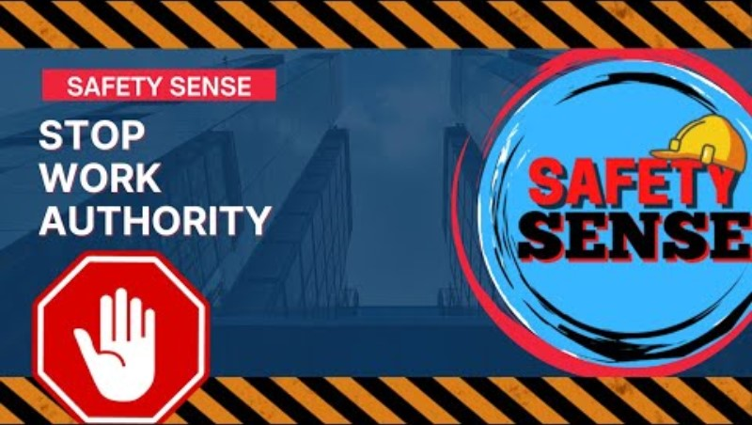
Stop Work Authority - Video
Notes:
VIDEO – 3:16 Min​
​
(Click play to play clip)​

Slide 18

Effective Communication
For effective communication, we need to recognize others’ body language and be self-aware of our own body language.
Notes:
F: Effective communication doesn’t just depend on the words we say. The information you display through tone of voice and body language will have a large impact on how the other person perceives the communication.
F: People will make an observation and form a perception in the first few seconds of an interaction. How the person perceives the conversation can have a direct impact on how the person responds to the communication.
F: For effective communication, we need to recognize others’ body language and be self-aware of our own body language.

Slide 19

One Team
QUESTIONS?
Notes:
F: Safety is everyone’s responsibility; our challenge is to get to an Interdependent state, looking out for each other and protecting the environment.
F: The importance of teamwork for HSE is paramount and respect and equality are important to us all. Teamwork is as powerful with and between the other workgroups on site. We must make efforts to team up for safety/
F: Any questions?

