Slide 1
Hot Work, Welding, and Cutting
March 2024
Notes:
KLP: You set the tone. If you believe safety is important, the audience will believe safety is important.
The facilitator opens the session by welcoming everybody to the training and noting the monthly focus – Hot Work, Welding, and Cutting.
F: Today’s task is to attend training on Hot Work, Welding, and Cutting. Cell phones should be turned off or silenced during this training. If you need to take a call, please go to (designated area), take the call and return as soon as possible. {Address any other important announcements or business now.}

Slide 2
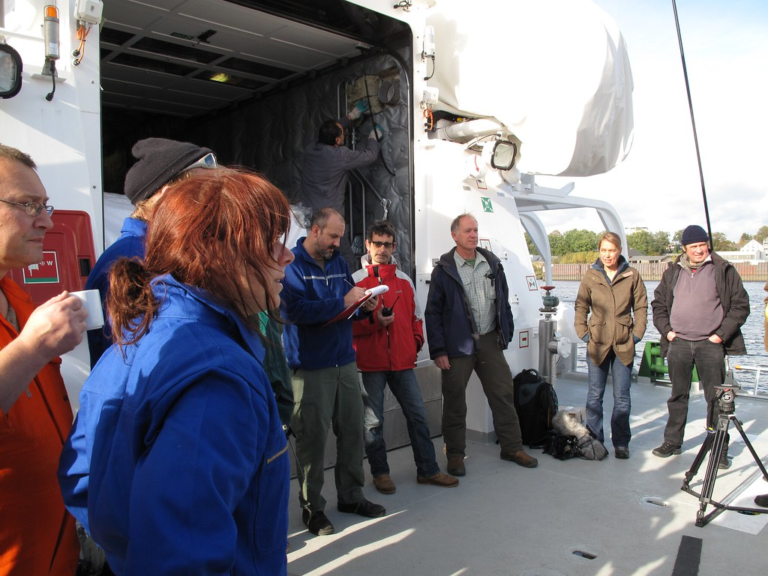
Housekeeping
Muster Point
Notes:
Prior to training, determine if any fire drills are planned and the response expected from the facility and muster points if alarms should go off. It is important to remind employees that should they need to leave the location at any time, they should inform the Facilitator because, in the event of a fire incident, we need to know their whereabouts. This is an opportunity right at the start of the day to brief the employees on HSE procedures in general for the running of the training course. [If your job site is outdoors, don’t overlook this safety moment. Adjust the plan in the event of a job site fire.]
F: Hello Team, I have verified with the HSE department and have confirmed that there are no Fire Drills or Emergency Drills scheduled for today. If we hear an alarm, we will follow site protocol for emergency response.
F: {Point out the fire exits and muster point}
F: Once we are at the muster points, we will do a role call to account for all attendees.

Slide 3

Presenter & Introductions
Safety begins with me!
Notes:
F: {This is your moment! This is a chance to visibly “Walk the Talk”}
Share:
Your personal experience of safety and impact on the company
Importance of making the most of this opportunity to think about the importance of HSE and discuss with employees
Appreciate that you are a leader and that you make an impact
Importance of taking personal responsibility to make a positive impact
You get out of this training what you put into it
HSE matters to our company
The safety program is going to help people feel empowered and take the initiative to improve their own HSE performance through proactive attitudes and behaviors.
You may wish to share:
A story of your experience in the safety program and how it is has changed the way in which you behave.
Some lessons learned from an incident when you have been involved in the investigation, highlighting the devastating impact that accidents have on people’s lives, or you can describe your experience of being involved in an environmental incident. How did this affect the company, and more importantly, affect the lives of others not working for the company.
F: Go around the room and ask everyone to give their name and what their position is. {Wait for their responses, smile, and nod as they participate. Be careful about timing here---if you ask an additional intro question of the participants and give a long-winded answer yourself, your participants will follow with long stories/explanations, and you can accidentally take up a lot of time.}

Slide 4
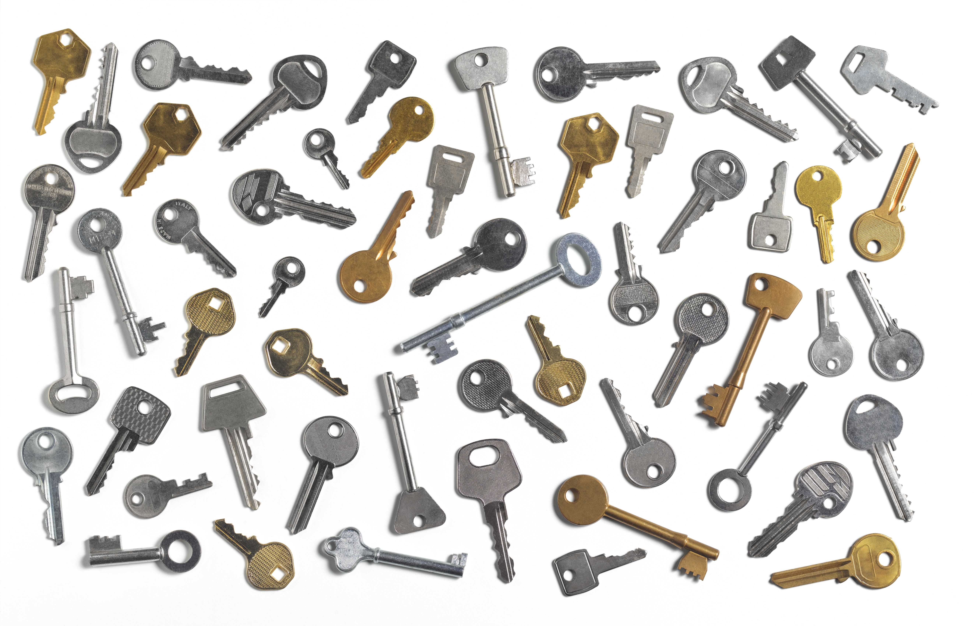
Why am I here?
You are the KEY to SAFETY!
Notes:
F: Each one of us is the last line of defense to protect workers from injury or the environment from damage, should management systems and collective protections fail. Supervisors and workers are the KEY to HSE. We can promote or destroy the HSE climate through our own behavior and how other workers perceive it.
Supervisors and workers are responsible for enforcing safety rules. Regardless of our position, employment status, or background, everyone is responsible for HSE, and everyone can be a HSE leader by demonstrating positive attitudes and behavior.

Slide 5
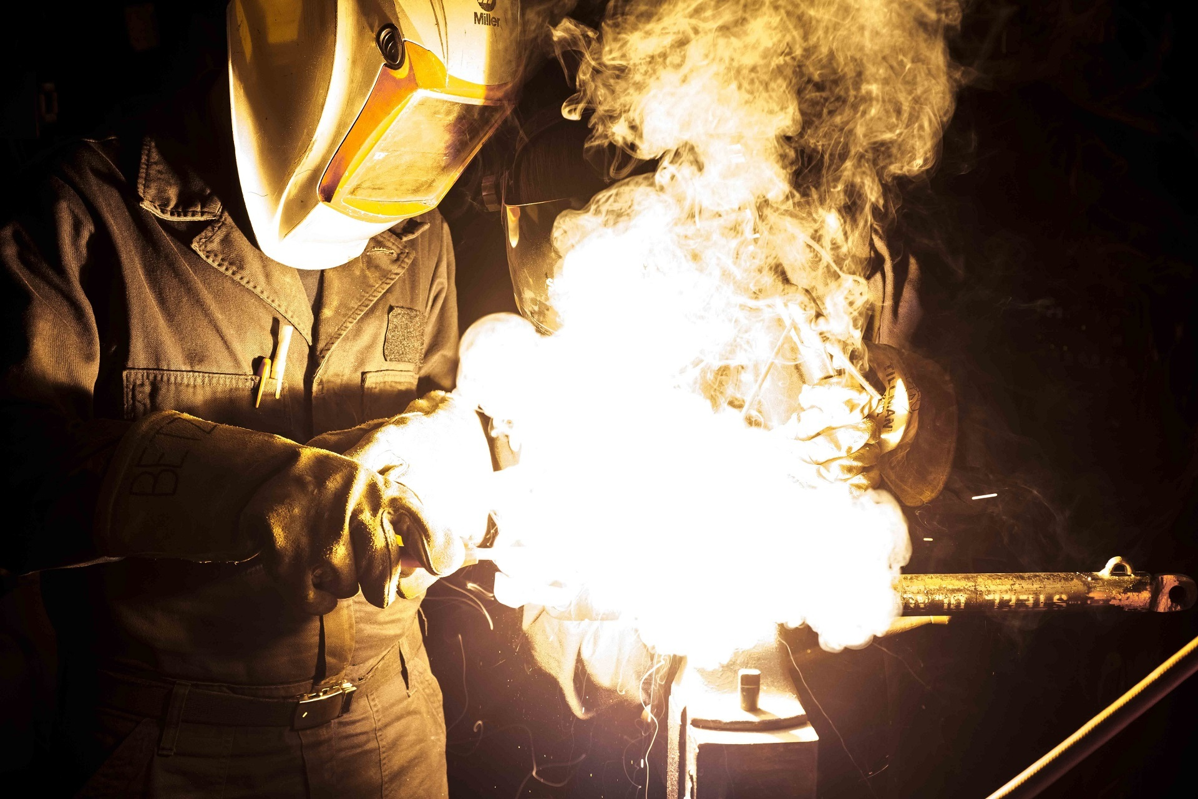
Hot Work, Welding, and Cutting Hazards
  Fires
  Burns
  Electric Shock
  Flammable Gases
  Arc Flash
  Intense Light
Notes:
F: Hot work means work involving electric or gas welding, cutting, brazing, or similar flame or spark-producing operations. Hot work can present a variety of hazards.
F: Some of the most common hazards associated with hot work are:
Fires - Intense heat, sparks, or metal splatter produced during hot work can create fire hazards.
Electric shock - If you touch two metal objects containing voltage, you will become a part of the electrical circuit. Higher voltages increase the risk of injury or death.
Arc flash - Arc flash occurs when an electric current leaves its intended path and travels through the air from one conductor to another or to the ground.
Burns - Radiant energy, sparks, or metal splatter can cause serious burns.
Flammable gases - If allowed to accumulate, flammable gases can flash or explode with catastrophic results.
Intense light - The incredibly bright light of arc welding can cause serious eye damage.

Slide 6
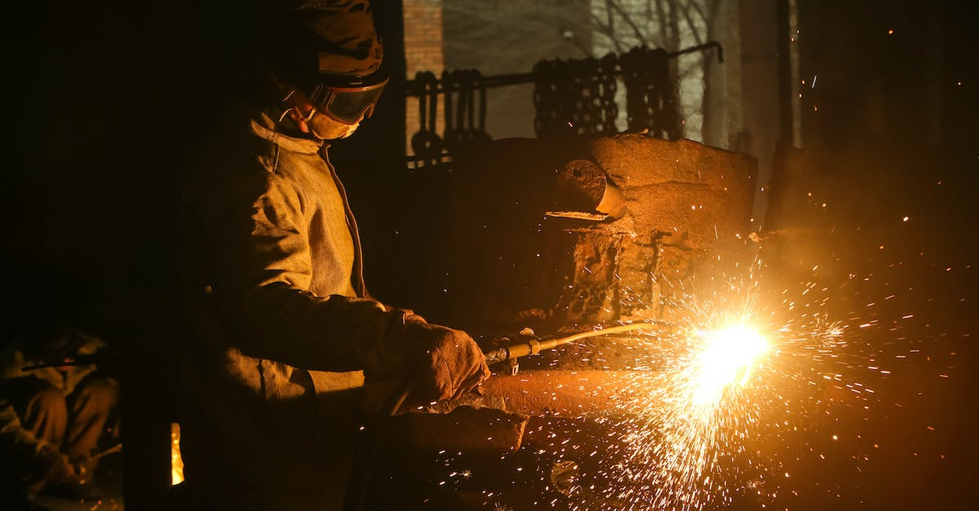
Fire Prevention and Protection
Notes:
F: Fires are one of the most common hazards when performing hot work. To prevent fires caused by heat, sparks, and slag, when welding, cutting, or brazing needs to be performed:
Fire Hazards should be removed if the welded object cannot be readily moved.
Guards should be used to confine the heat, sparks, and slag if removing fire hazards is not possible.
If none of the above is possible, restrictions apply, and no cutting or welding is allowed to be performed.
(https://www.osha.gov/laws-regs/regulations/standardnumber/1910/1910.252)

Slide 7
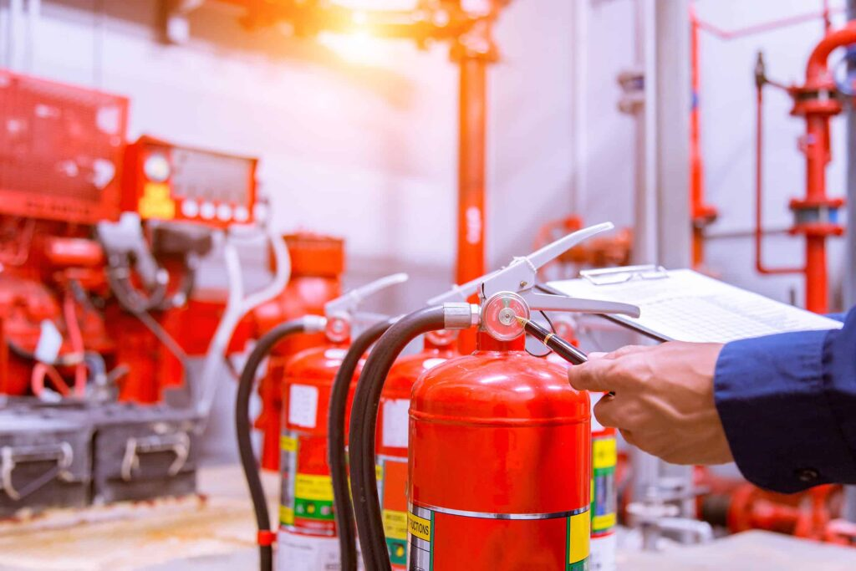
Fire Watch
Notes:
F: A fire watch is the person or persons responsible for continuously observing hot work activity for the detection of, and response to, fires during hot work operations. A fire watch has the authority to stop work if necessary and conduct essential steps for restoring safe conditions within the hot work area.
F: It is required to have fire watchers in welding or cutting locations where:
A large fire could develop
Appreciable combustible materials are closer than 35 ft to the point of operation
Appreciable combustibles are more than 35 ft away but are easily ignited by sparks
Materials on opposite metal walls and roof could catch fire from conduction or radiation
F: A person acting as a “fire watch” must have fire extinguishing equipment readily available and be trained in their use. They should also be familiar with facilities for sounding an alarm in the event of a fire. Fire watchers are responsible for watching for fires in all exposed areas and to extinguish them only when they are obviously in the capacity of the equipment available. If they determine the fire is too large to extinguish with the available equipment, they are to sound the alarm.
F: Fire watch should be maintained for a minimum of a half hour after completion of welding or cutting operations to detect and extinguish possible smoldering fires.
(https://www.osha.gov/laws-regs/regulations/standardnumber/1910/1910.252)

Slide 8
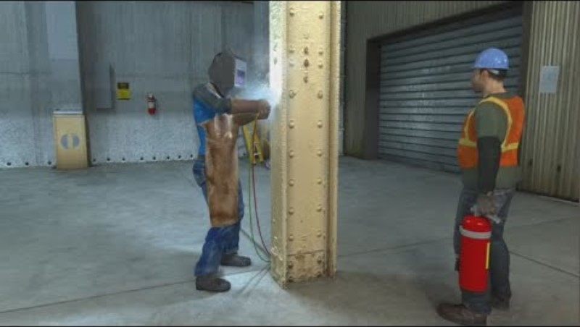
Hot Work Safety – Firewatch
Notes:
VIDEO – 1:42 Min​
​
(Click play to play clip)​

Slide 9
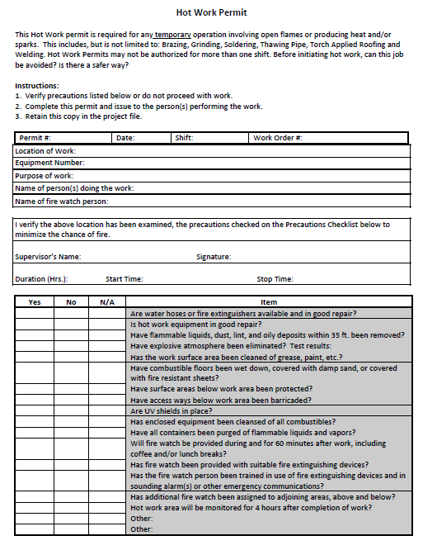
Hot Work Permits
Typically used when working in an area that is not specifically designated for hot work activities.
Reduces the likelihood that a worker will start a fire in an uncontrolled or hazardous workspace.
Though not “required” under OSHA standards, they are considered a “best practice” and are recommended to be used.
Notes:
F: Hot work permits are typically needed when working in an area that is not specifically designated for hot work activities. This reduces the likelihood that a worker will start a fire in an uncontrolled or hazardous workspace.
F: Hot work permits list details like the name of the worker performing the hot work, the location of the worksite where the work is being performed, the types of hot work activities being performed, and hazard prevention checks that must be done before starting hot work.
F: Though hot work permits are not “required” under OSHA standards, they are considered “best practice” and are recommended to be used.

Slide 10
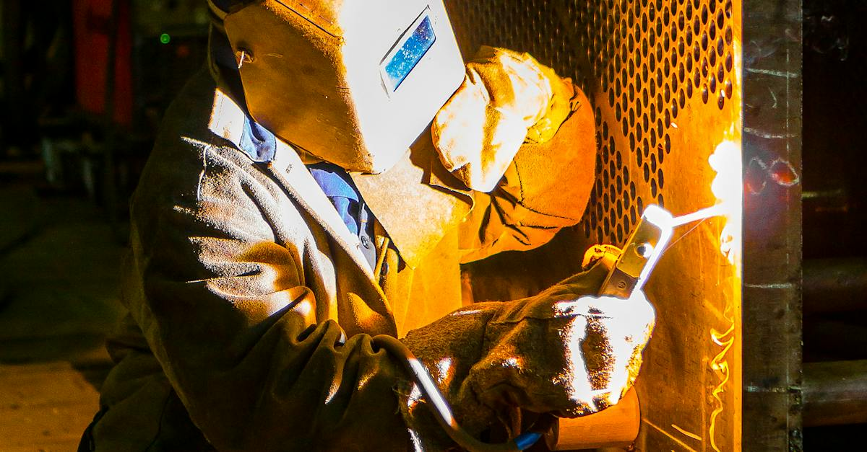
Oxygen-Fuel Gas Welding and Cutting
Notes:
F: Gas welding, or oxy/fuel welding as it is commonly referred to, is slower and easier to control than arc welding. This method unites metals by heating - the heat source being a flame produced by the combustion of a fuel gas. Temperatures can reach up to 6,000 degrees Fahrenheit. This process sometimes includes the use of pressure and filler material.
F: Gases commonly used are oxygen and either acetylene, hydrogen, propane, or propylene. These gases are commonly supplied in compressed gas cylinders, which can pose additional handling and transport hazards.
F: Where gas welding procedures are performed, flammable mixtures of fuel gases and air or oxygen must be guarded against. At no time should any device or attachment facilitating or permitting mixtures of air or oxygen with flammable gases, except at the burner or in a standard torch, be allowed unless it is approved for that purpose.
F: Under no condition should acetylene be utilized at a pressure in excess of 15 psi, except with certain rare exceptions, and the use of liquid acetylene is prohibited.

Slide 11
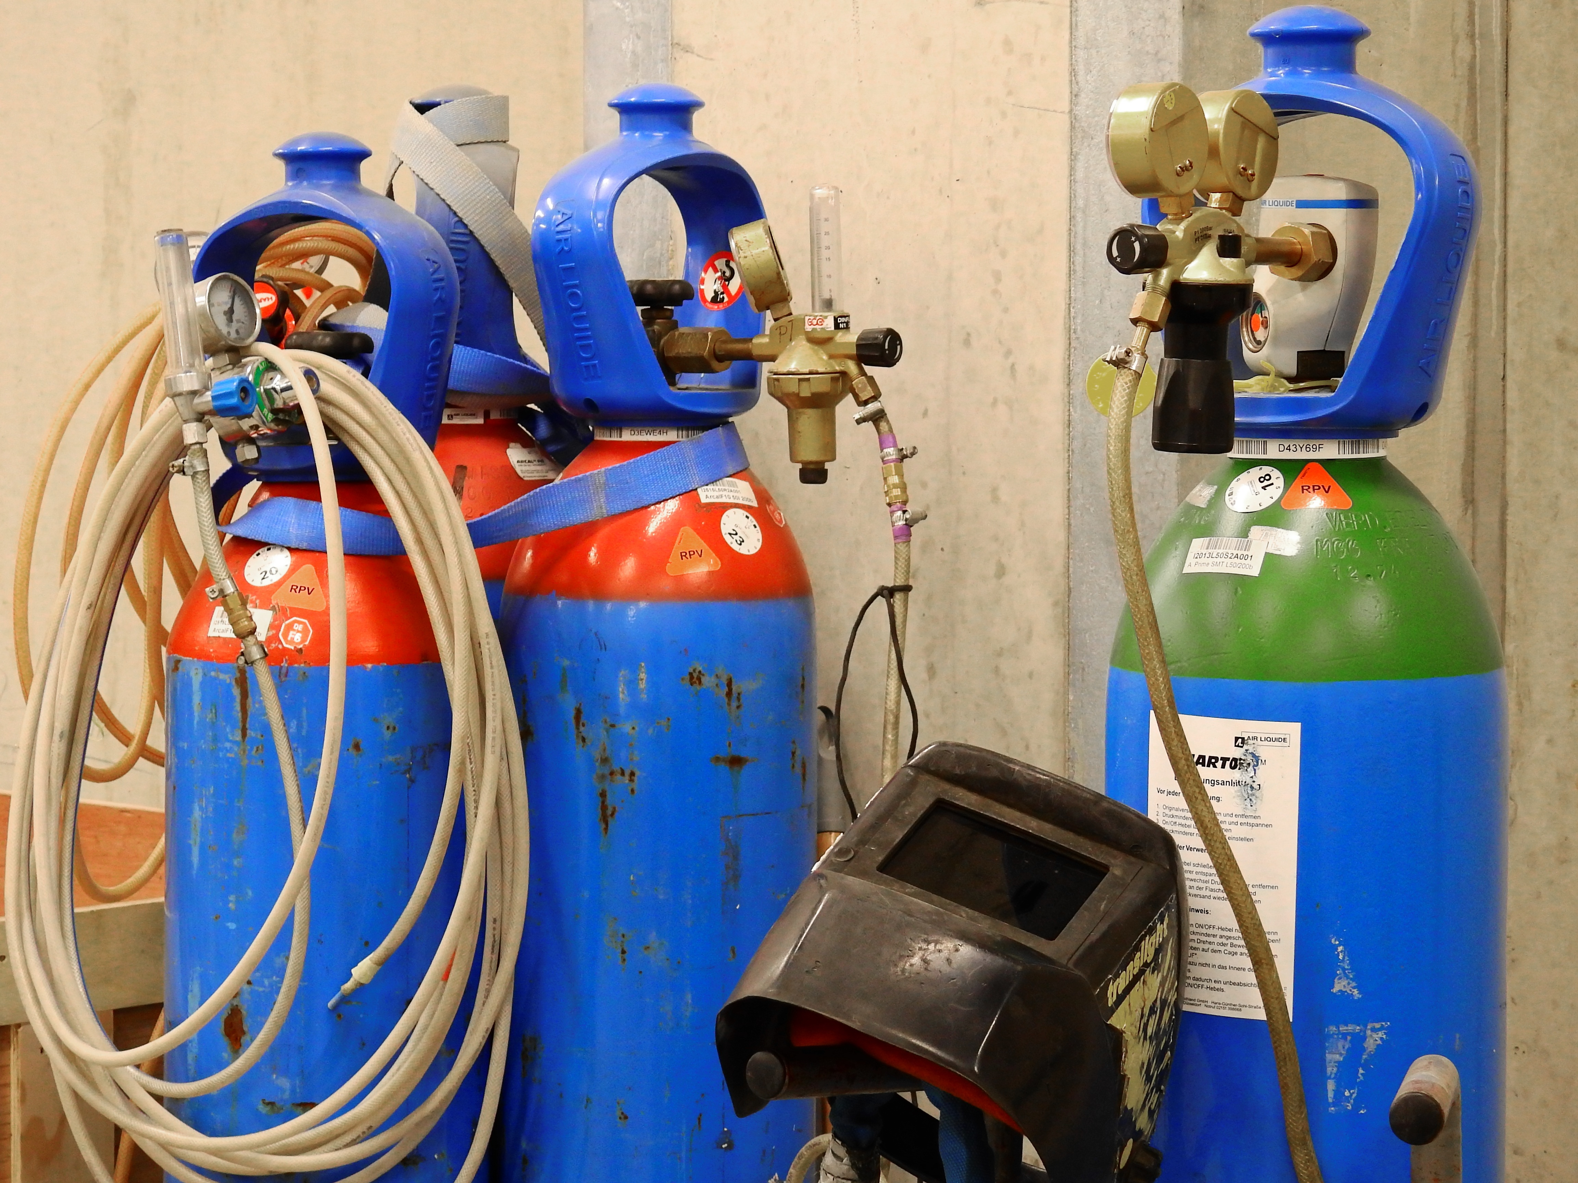
Cylinder Identification, Handling, and Storage
Notes:
F: Compressed gas cylinders can pose a variety of hazards if handled, used, stored, or transported in an unsafe manner.
F: Compressed gas cylinders must be legibly marked, for the purpose of identifying the gas content, with either the chemical or the trade name of the gas. These markings can be stenciled, stamped, or as a label, and should not be readily removable. The markings should be located on the shoulder of the cylinder.
F: Cylinders should be stored:
Away from any sources of heat, such as radiators.
In a well-protected, well-ventilated, dry location, at least 20 feet from highly combustible materials such as oil or excelsior.
Away from elevators, stairs, or gangways.
F: Assigned storage spaces should be located where cylinders will not be knocked over or damaged by passing or falling objects, or subject to tampering by unauthorized persons. Cylinders should not be kept in unventilated enclosures such as lockers and cupboards.
F: Cylinders, except those in actual use or attached ready for use, should be limited to a total gas capacity of 2,000 cubic feet, or 300 pounds, of liquefied petroleum gas.
F: Valve protection caps should always be in place, hand-tight, except when cylinders are in use or connected for use. Empty cylinders should have their valves closed.

Slide 12
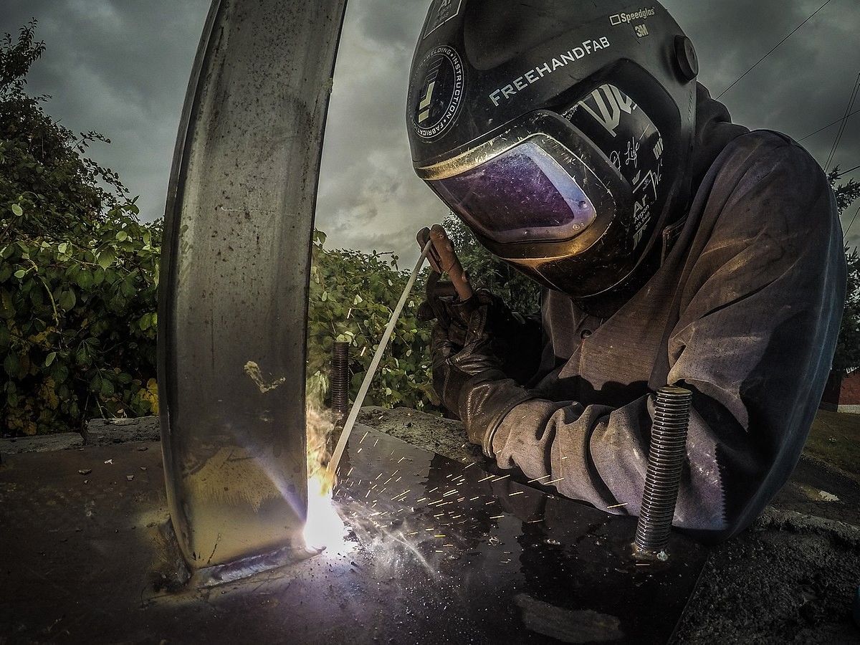
Arc Welding and Cutting
Notes:
F: In arc welding, the intense heat needed to melt metal is produced by an electric arc. The arc is formed between the actual work piece and an electrode (stick or wire) that is manually or mechanically guided along the joint. The electrode can either be a rod, with the purpose of simply carrying the current between the tip and the work, or it may be a specially prepared rod or wire that not only conducts current but also melts and supplies filler metal to the joint.
F: Prior to conducting arc welding or cutting operations, it should be ensured that the appropriate equipment is chosen for safe application to the work to the done and that the welding equipment is installed safely.
F: Welding equipment should be specifically designed to prevent damage in the case of exposure to:
Unusually corrosive fumes
Steam or excess humidity
Excessive oil vapor
Flammable gas
Abnormal vibration or shock
Excessive dust
Weather
Or unusual marine conditions
F: Voltage limits for both alternating- & direct-current machines should not be exceeded, unless special welding or cutting process are required. When special welding or cutting processes require open circuit voltages higher than the recommended limit, protections must be provided to prevent the worker from making accidental contact with the high voltage. This can be through adequate insulation or other means.
(https://www.osha.gov/laws-regs/regulations/standardnumber/1910/1910.254)

Slide 13
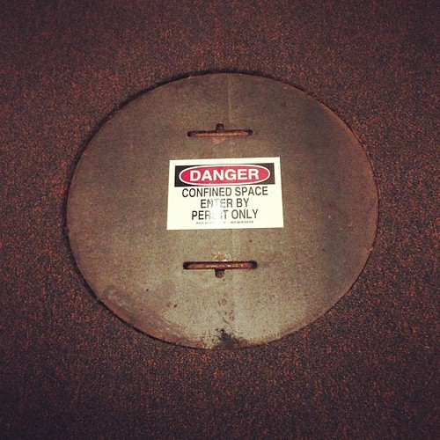
Confined Space
Notes:
F: OSHA defines confined spaces generally as “a relatively small or restricted space such as a tank, boiler, pressure vessel, or small compartment of a ship.”
F: Before starting any work in a confined space, proper ventilation is required to prevent the accumulation of toxic materials or possible oxygen deficiency. In circumstances in which it is impossible to provide proper ventilation, National Institute for Occupational Safety and Health (NIOSH) approved airline respirators or hose masks should be used. In areas immediately hazardous to life, a full-facepiece, pressure-demand, self-contained breathing apparatus or a combination full-facepiece, pressure-demand supplied-air respirator with an auxiliary, self-contained air supply approved by NIOSH must be used.
F: When performing gas welding operations in a confined space, gas cylinders and welding machines must be left on the outside of the enclosed area. All equipment should be securely blocked to prevent accidental movement.
F: Employees that are required to enter confined should be provided a safety belt or line-line that is attached to the welder’s body. This can be used to remove the worker from the confined space quickly in the case of an emergency.
F: Gas cylinders should be closed, and lines should be purged prior to leaving the work area for substantial period of time, such as during a lunch break or overnight. This is to prevent the possibility of gas escaping through leaks of improperly closed valves.
(https://www.osha.gov/laws-regs/regulations/standardnumber/1910/1910.252)

Slide 14
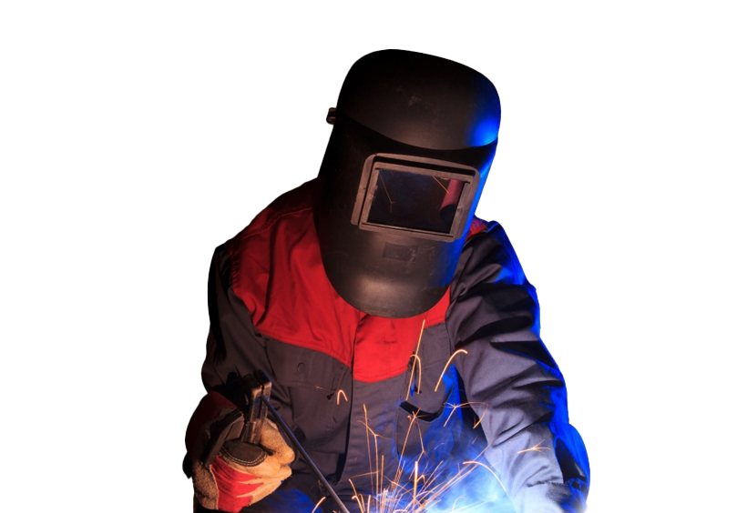
Personal Protective Equipment (PPE)
Cover all exposed flesh by wearing:
A welding hood with adjustable lens filter
Fire resistant gloves
Fire resistant jacket with a buttonable collar. The jacket should hang outside of pants, without open pockets
Fire resistant trousers without cuffs on pant legs
Leather high-top boots with steel toes
This Photo by Unknown Author is licensed under CC BY-NC
Notes:
F: When performing welding and cutting activities, wearing the proper personal protective equipment (PPE) helps to protect from burns, injuries caused by electric shock, and protects the face and eyes from light and radiant energy.
F: To protect against burns, cover all exposed flesh by wearing:
A welding hood with adjustable lens filter
Fire resistant gloves
Fire resistant jacket with a buttonable collar. The jacket should hang outside of pants, without open pockets
Fire resistant trousers without cuffs on pant legs
Leather high-top boots with steel toes
F: Wearing PPE such as insulated gloves and rubber-soled shoes with protect against electric shock.

Slide 15
Eye Protection
Welding operation | Shade No.
Shielded metal-arc welding - 1⁄16-, 3⁄32-, ⅛-, 5⁄32-inch electrodes | 10
Gas-shielded arc welding (nonferrous) - 1⁄16-, 3⁄32-, ⅛-, 5⁄32-inch electrodes | 11
Gas-shielded arc welding (ferrous) - 1⁄16-, 3⁄32-, ⅛-, 5⁄32-inch electrodes | 12
Shielded metal-arc welding:
3⁄16-, 7⁄32-, ¼-inch electrodes | 12
5⁄16-, ⅜-inch electrodes | 14
Atomic hydrogen welding | 10-14
Carbon arc welding | 14
Soldering | 2
Torch brazing | 3 or 4
Light cutting, up to 1 inch | 3 or 4
Medium cutting, 1 inch to 6 inches | 4 or 5
Heavy cutting, 6 inches and over | 5 or 6
Gas welding (light) up to ⅛ inch | 4 or 5
Gas welding (medium) ⅛ inch to ½ inch | 5 or 6
Gas welding (heavy) ½ inch and over | 6 or 8
Notes:
F: Electromagnetic energy given off by an arc or flame can injure workers’ eyes and is commonly referred to as radiant energy or light radiation. Workers must use personal protective equipment, such as safety glasses, goggles, welding helmets, or welding face shields to protect from radiant energy. This equipment must have filter lenses with a shade number that provides the appropriate level of protection. A shade number indicates the intensity of light radiation that is allowed to pass through a filter lens to one’s eyes. Therefore, the higher the shade number, the darker the filter and the less light radiation that will pass through the lens.
F: Excessive exposure to ultraviolet radiation can cause the eyes to feel like they are full of sand and can lead to premature cataracts.
(https://www.osha.gov/laws-regs/regulations/standardnumber/1910/1910.252)
(https://www.osha.gov/sites/default/files/publications/OSHAfactsheet-eyeprotection-during-welding.pdf)

Slide 16
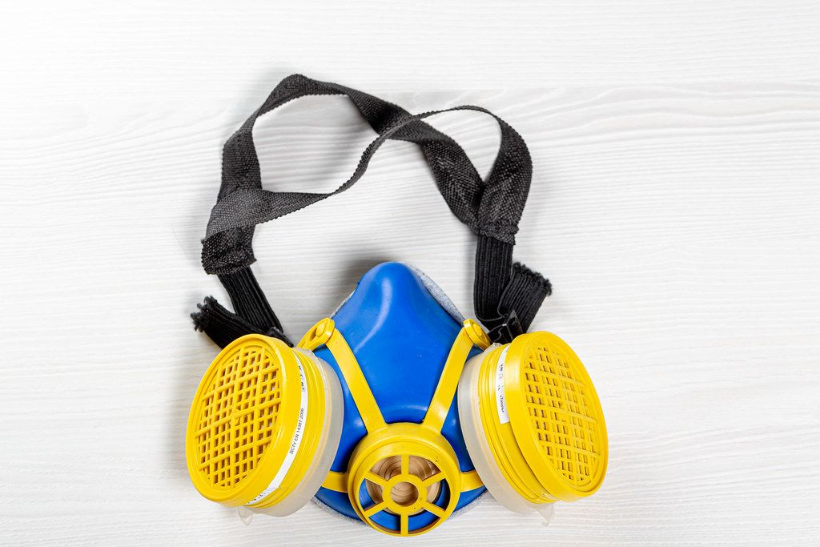
Respiratory Protection
Notes:
F: In many cases, engineering controls, such as ventilation, alone cannot reduce exposure levels adequately. In such cases, it may be appropriate to use respirators.
F: Respirators should be selected based on the Assigned Protection Factor (APF). This is the level of protection a class of respirator can be expected to provide when selected and used properly under real-world conditions.
F: It is important to ensure the respirator chosen is recommended for welding. These respirators are flame and spark resistant while others are not.
F: Employees required to wear respirators should be trained on the proper use, maintenance, cleaning and storage of the equipment. Employees wearing respirators must have a clean-shaven face, as even one-day stubble can cause tight fitting respirators to leak. Additionally, a medical evaluation should be conducted, along with a fit test to ensure a satisfactory fit. Different fit tests are needed for each model of respirator.
F: Respirators should be worn at all times during welding and cutting operations as removing the respirator, even for a short amount of time, significantly increases the likelihood of respiratory injuries.

Slide 17
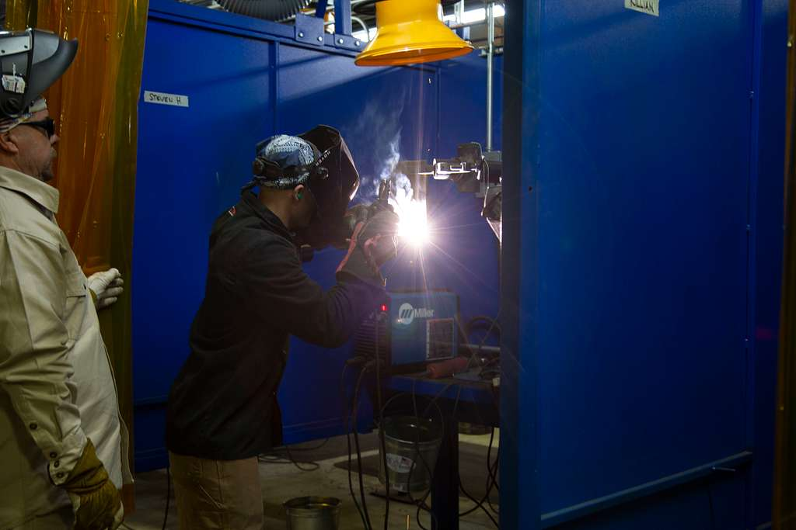
Ventilation
Ventilation has been installed to pull air contaminants away from the workspace.
Notes:
F: Arc welding activities produces an airborne contaminate referred to as welding fume. Welding fume is made up of a mixture of very small particles of metal oxides. These metal oxides come from the type of welding electrode, base metal, surface coatings, and the type of shielding gas for flux.
F: Mechanical ventilation is required in areas where welding and cutting is done on certain metals in spaces of less than 10,000 cubic feet per 1 welder, in a room having a ceiling height of less than 16 feet, in confined spaces, or in welding spaces that contain partitions, balconies, or other structural barriers that they significantly obstruct cross ventilation.
F: Proper ventilation AND respiratory protection is critical when performing hot work on materials containing the following:
Zinc
Chromium
Lead
Cobalt
Cadmium
Mercury
Beryllium

Slide 18
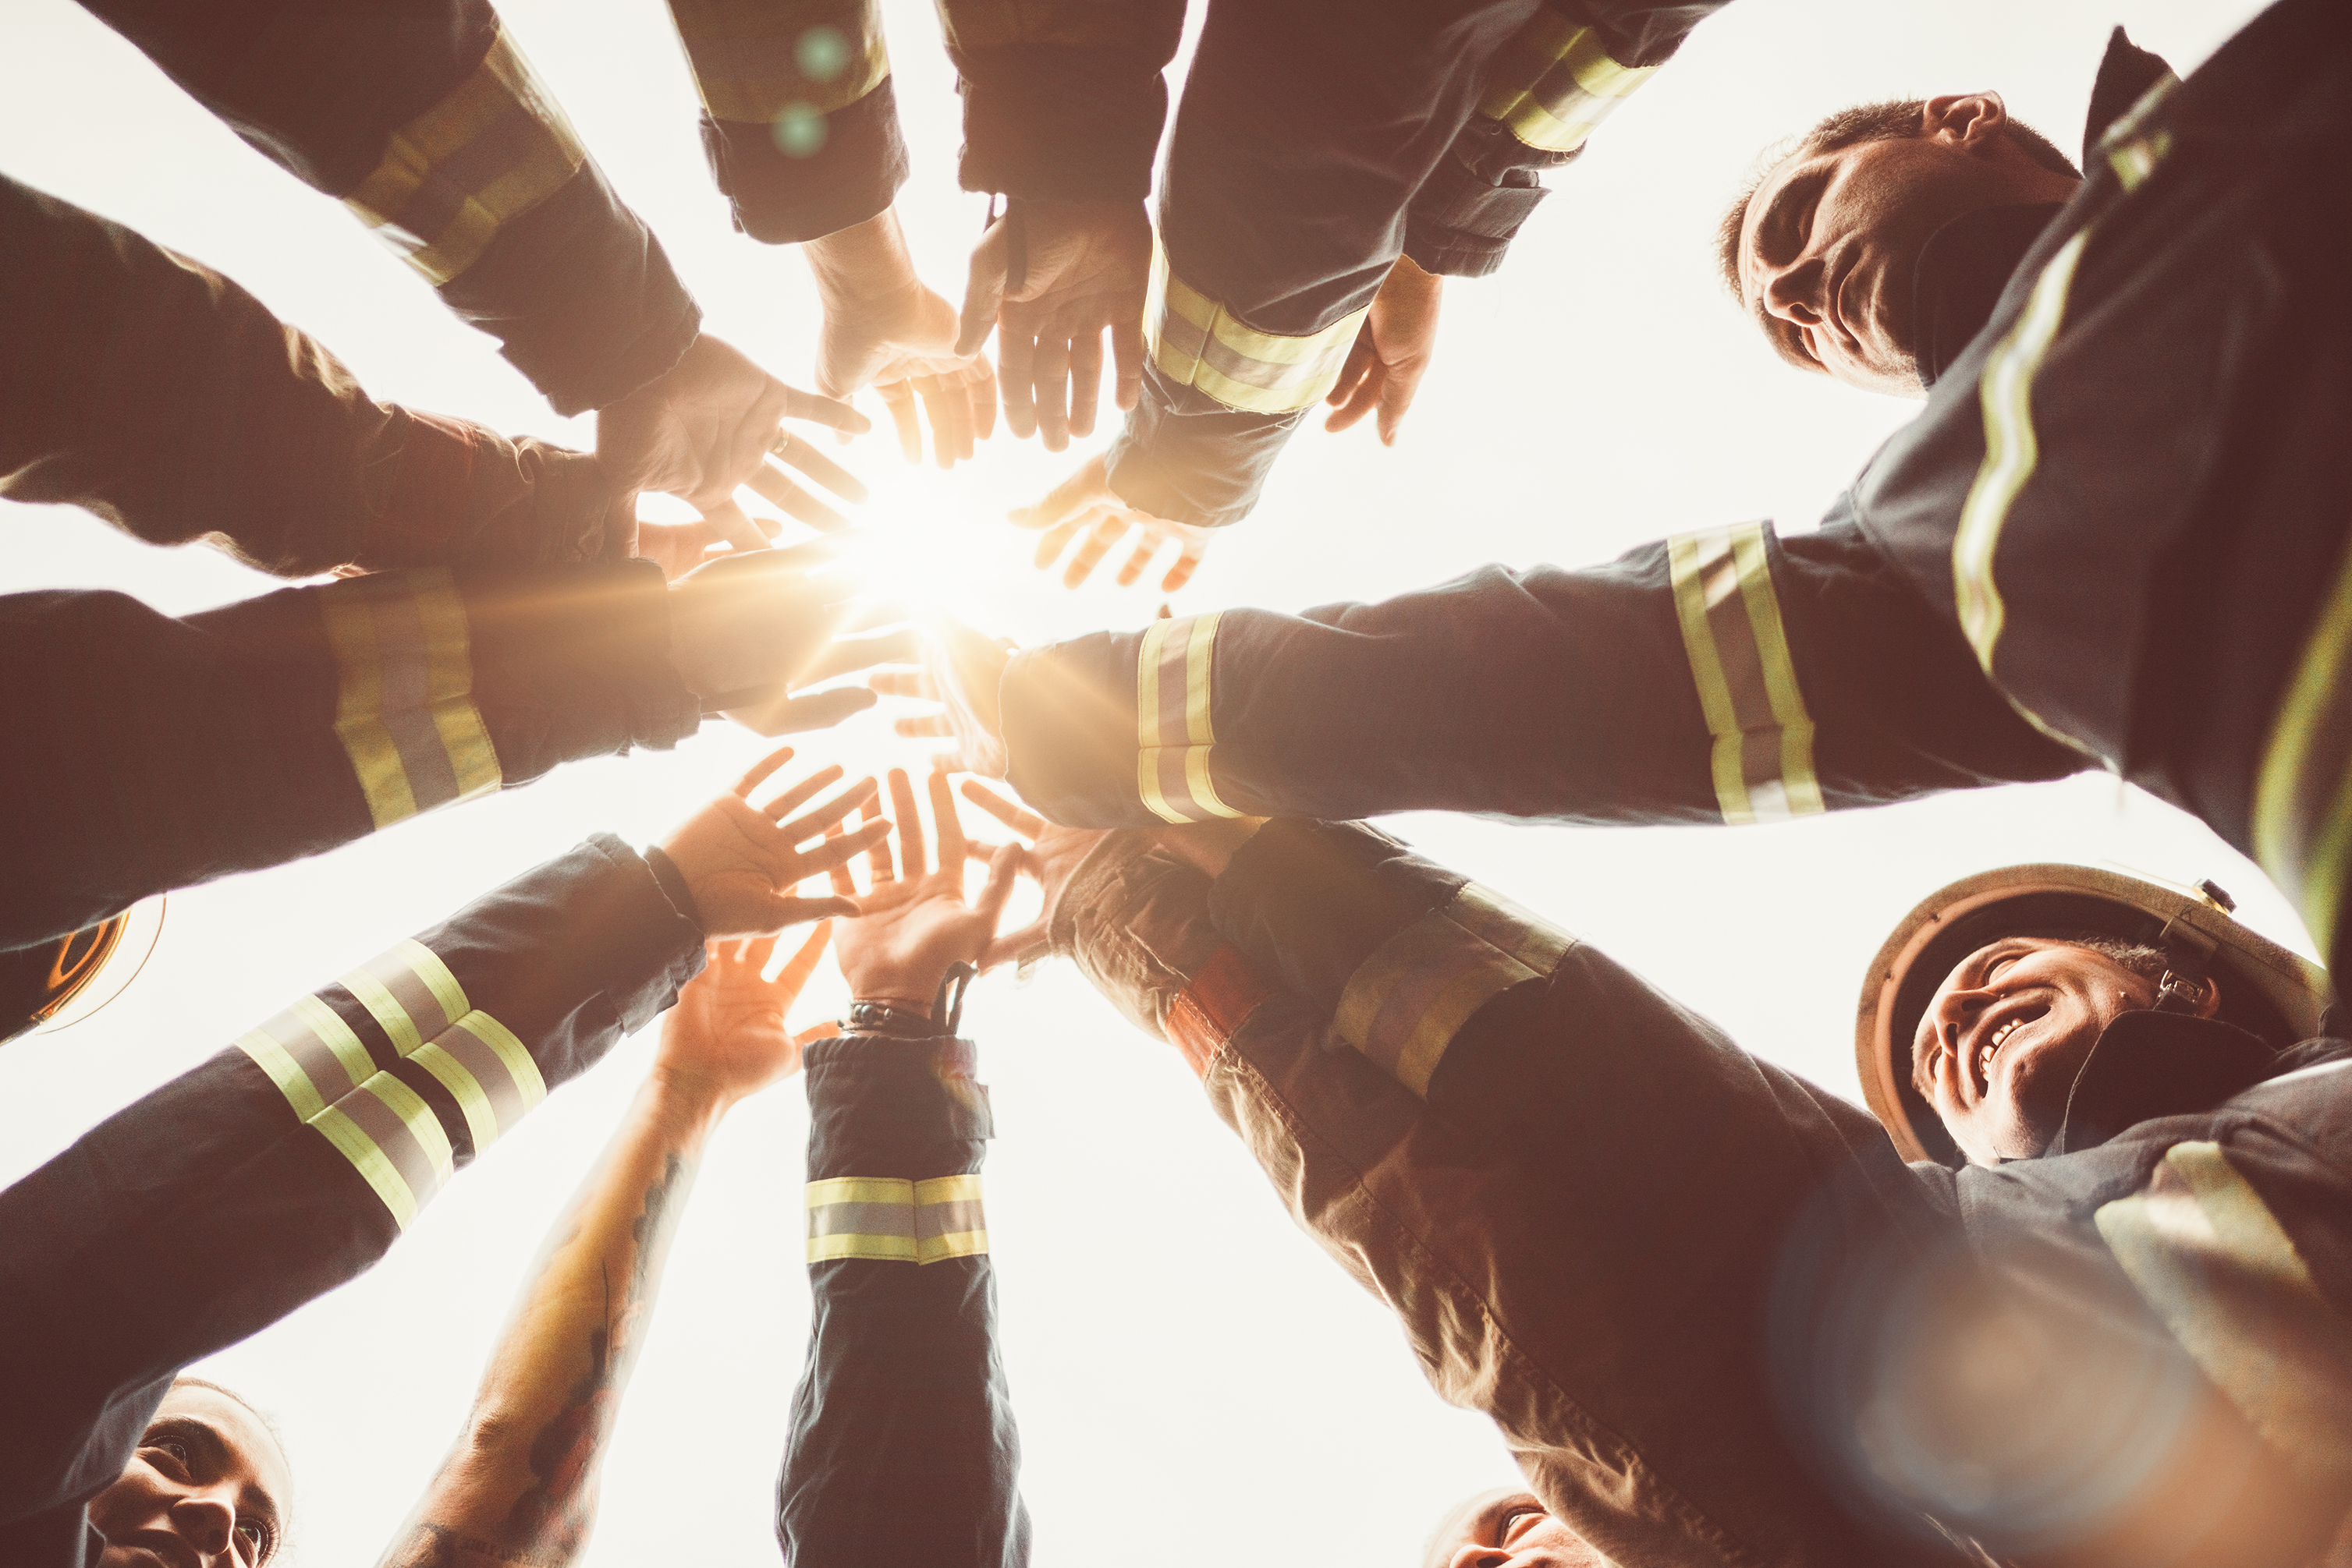
One Team
QUESTIONS?

