Slide 1
Fire Extinguishers
June 2022
Notes:
KLP: You set the tone. If you believe safety is important, the audience will believe safety is important.
The facilitator opens the session by welcoming everybody to the training and noting the monthly focus – Fire Safety.
F: Today’s task is to attend fire safety and extinguisher training. Cell phones should be turned off or silenced during this training. If you need to take a call, please go to (designated area), take the call and return as soon as possible. {Address any other important announcements or business now.}
F: Portable fire extinguishers should only be used for the beginning stage of a fire.
F: If your company wants you to fight fires in the beginning stage, you must receive fire extinguisher training when you are hired and once a year after that.
F: You must be trained on how to:
Figure out how severe a fire is
Choose the correct type of extinguisher
Use an extinguisher in an emergency situation

Slide 2

Housekeeping
Muster Point
Notes:
F: Prior to training, determine if any fire drills are planned and the response expected from the facility and muster points if alarms should go off. It is important to remind employees that should they need to leave the location at any time, they should inform the Facilitator because, in the event of a fire incident, we need to know their whereabouts. This is an opportunity right at the start of the day to brief the employees on HSE procedures in general for the running of the training course. [If your job site is outdoors, don’t overlook this safety moment. Adjust the plan in the event of a job site fire.]
F: Hello Team, I have verified with the HSE department and have confirmed that there are no Fire Drills or Emergency Drills scheduled for today. If we hear an alarm, we will follow site protocol for emergency response.
F: {Point out the fire exits and muster point}
F: Once we are at the muster points, we will do a role call to account for all attendees.

Slide 3

Presenter & Introductions
Safety begins with me!
Notes:
F: {This is your moment! This is a chance to visibly “Walk the Talk”}
Share:
Your personal experience of safety and impact on the company
Importance of making the most of this opportunity to think about the importance of HSE and discuss with employees
Appreciate that you are a leader and that you make an impact
Importance of taking personal responsibility to make a positive impact
You get out of this training what you put into it
HSE matters to our company
The safety program is going to help people feel empowered and take the initiative to improve their own HSE performance through proactive attitudes and behaviors.
You may wish to share:
A story of your experience in the safety program and how it is has changed the way in which you behave.
Some lessons learned from an incident when you have been involved in the investigation, highlighting the devastating impact that accidents have on people’s lives, or you can describe your experience of being involved in an environmental incident. How did this affect the company, and more importantly, affect the lives of others not working for the company.
F: Go around the room and ask everyone to give their name and what their position is. {Wait for their responses, smile, and nod as they participate. Be careful about timing here---if you ask an additional intro question of the participants and give a long-winded answer yourself, your participants will follow with long stories/explanations, and you can accidentally take up a lot of time.}

Slide 4

Why am I here?
You are the KEY to SAFETY!
Notes:
Slide 6: Why am I here? (1 Minute)
F: Each one of us is the last line of defense to protect workers from injury or the environment from damage, should management systems and collective protections fail. Supervisors and workers are the KEY to HSE. We can promote or destroy the HSE climate through our own behavior and how other workers perceive it.
Supervisors and workers are responsible for enforcing safety rules. Regardless of our position, employment status, or background, everyone is responsible for HSE, and everyone can be a HSE leader by demonstrating positive attitudes and behavior.

Slide 5
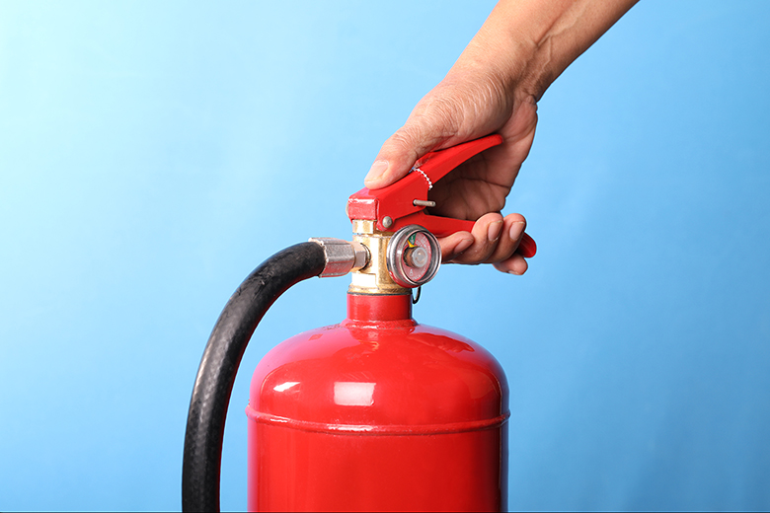
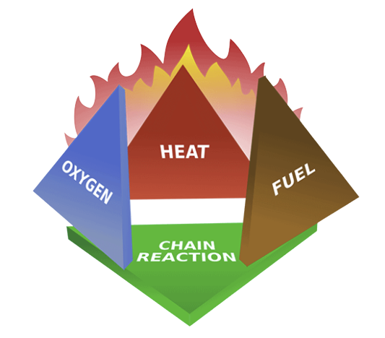
Fire Theory
The basic fire theory says that a fire needs four main elements in order to start: heat, fuel, oxygen, and a chain reaction.
This theory is known as the fire tetrahedron.
Notes:
F: The basic fire theory says that a fire needs four main elements in order to start: heat, fuel, oxygen, and a chain reaction. This theory is known as the fire tetrahedron.
F: There must be Oxygen to sustain combustion, Heat to raise the material to its ignition temperature, Fuel to support the combustion and a Chemical Reaction between the other three elements.
F: The concept of Fire Prevention is based upon keeping these four elements separate.

Slide 6
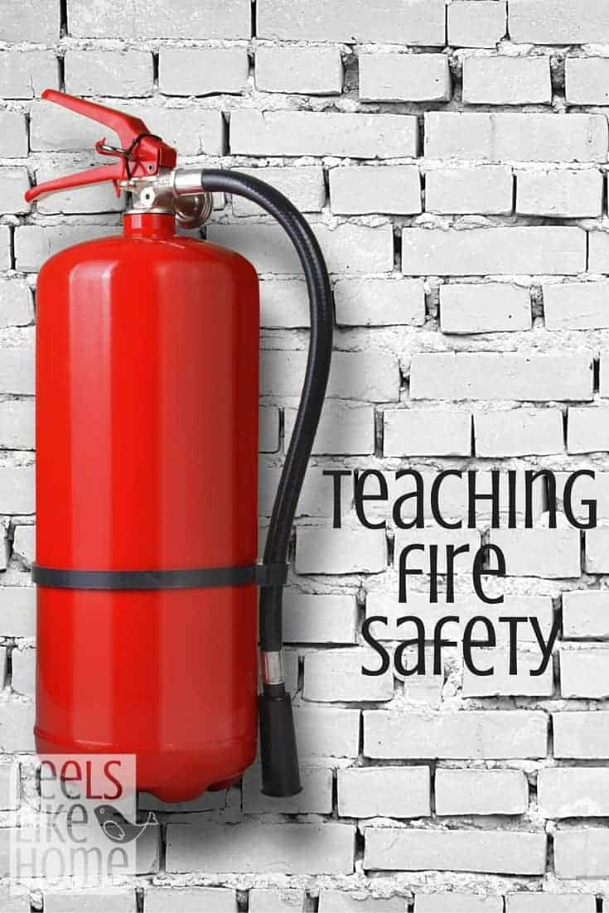
Fire Prevention
Fire prevention stops a fire before it starts. Here are some proactive actions you can take to prevent fires:
Know the hazards of the chemicals you work with.
Keep fire lanes open and unobstructed.
Know where firefighting equipment is located.
Clean up chemical and oil spills immediately.
Notes:
F: Fire prevention stops a fire before it starts. Here are some proactive actions you can take to prevent fires:
Know the hazards of the chemicals you work with.
Keep fire lanes open and unobstructed.
Know where firefighting equipment is located.
Clean up chemical and oil spills immediately.

Slide 7
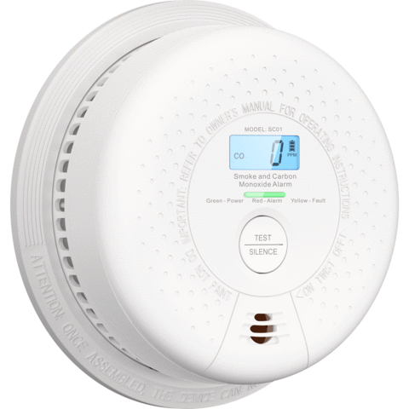
Fire Protection
Fire detection systems are the first line of defense in any fire protection program. Automatic fire detection systems alert you to the presence of heat, smoke, and flames.
Notes:
F: Fire detection systems are the first line of defense in any fire protection program. Automatic fire detection systems alert you to the presence of heat, smoke, and flames.
F: When available automatic sprinkler systems are one of the most dependable ways to fight a fire. They detect a fire, sound an alarm, and spray water toward the fire and heat, they are not necessarily designed to put out fires, but they help keep the flames from spreading and allow workers time to evacuate.
F: Today we will focus on another way to put out fires, portable fire extinguishers. But first, lets talk a little more about the different types of fires.

Slide 8
Fire Classification
Not all fires are the same. Different fuels create different fires and require different types of fire extinguisher agents.
Class A
Class B
Class C
Class D
Class K
Notes:
F: Did you know that there are different types of fires? Fire classification is based on the type of fuel used to feed a fire. Knowing the type of fuel that started the fire will help you choose the correct fire extinguisher.
F: Do you know how many different types of fires there are? {Smile and nod as they participate}
F: There are 5!
F: Who here can list the different classifications? {Smile and nod as they participate}
(Click mouse to trigger animation)
Class A
Class B
Class C
Class D
Class K
F: Fire classification is based on the type of fuel used to feed a fire. Knowing the type of fuel that started the fire will help you choose the correct extinguisher. Some type of fire extinguishing agents can be used on more than one class of fire. Others have warnings where it would be dangerous for the operator to use a particular fire extinguisher agent.

Slide 9
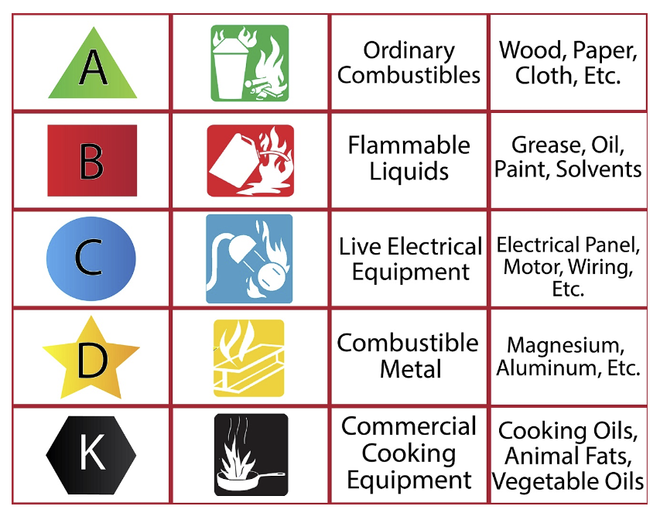
Fire Classification - Continued
Notes:
F: Class A fires are fires in ordinary combustibles such as wood, paper, cloth, trash, and plastics.
F: Class B fires are fires in flammable liquids such as gasoline, petroleum oil and paint. Class B Fires also include flammable gases such as propane and butane, but never include fires involving cooking oils and grease.
F: Class C fires are fires involving energized electrical equipment such as motors, transformers, and appliances. Remove the power and the Class C fire becomes one of the other classes of fire.
F: Class D fires are fires in combustible metals such as potassium, sodium, aluminum and magnesium.
F: Class K fires are fires in cooking oils and greases such as animal fats and vegetable fats.

Slide 10
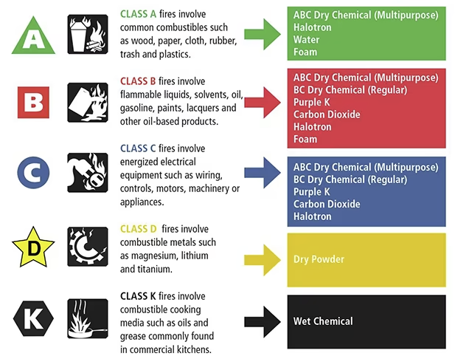
Fire Classification - Continued
Notes:
F: Fire extinguishers are classified using the National Fire Protection Association (NFPA) classification system. The letters A, B, C, D, and K indicate the type of extinguisher.
F: Class A extinguishers cool materials below their ignition temperature and soak fibers to prevent re-ignition. Extinguishers with an A rating are designed to extinguish fires involving these ordinary combustible materials.
F: Class B extinguishers remove oxygen from the fire to stop vapors from reaching the ignition source, stopping the chemical chain reaction. Extinguishers with a B rating are designed to extinguish fires involving flammable and combustible liquids. Do not attempt to extinguish a fire involving flammable gas unless there is reasonable assurance the source of fuel can be promptly shut off.
F: Class C extinguishers use an extinguishing agent that is not capable of conducting electrical currents. Extinguishers with a C rating are designed for use with fires involving energized electrical equipment.
F: Class D fires involve combustible metals, such as magnesium, titanium, and sodium. Extinguishers with a D rating are designed to extinguish fires involving combustible metals. Different metals need different types of extinguishers, although dry sand, sodium chloride, and soda ash are common; these dry powders are not the same as dry chemical extinguishers on other fires.
F: Class K extinguishers Apply sodium bicarbonate dry chemical or potassium bicarbonate dry chemical to burning cooking oil. Extinguishers with a K rating are normally required where deep-fryers and/or griddles are utilized to prepare large quantities of food. An example would be a commercial kitchen similar to those found in restaurants and cafeterias.
{Play video on the next slide}

Slide 11
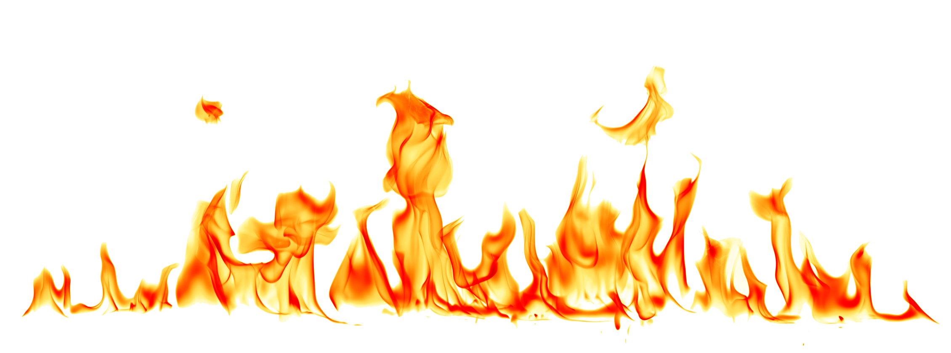

Fire Extinguisher Training Video
Notes:
VIDEO - 6 Min

Slide 12
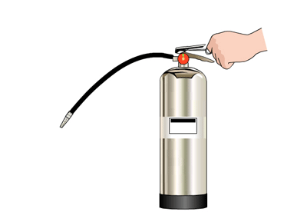
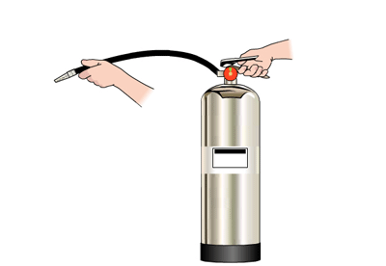

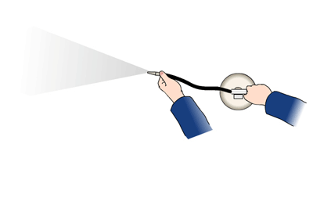
Check your knowledge
30
Extinguishers have a short use period of about seconds.
What is the P.A.S.S. method?
Pull the pin to ready the extinguisher for discharge.
Aim low and point the extinguisher at the base of the fire.
Squeeze the lever to discharge the extinguisher.
Sweep back and forth as you move closer to the fire.
Notes:
{Ask the class the following questions:}
F: Extinguishers have a short use period of about (BLANK) seconds. (Wait for participation, then click mouse to trigger animation)
F: What is the P.A.S.S. method? (Wait for participation, then click mouse to trigger animation)
F: Pull the pin to ready the extinguisher for discharge
F: Aim low and point the extinguisher at the base of the fire
F: Squeeze the lever to discharge the extinguisher
F: Sweep back and forth as you move closer to the fire

Slide 13

Fire Extinguisher Use
Keep the fire extinguisher pointed at the base of the fire until the fire appears to be out.
Never turn your back on a fire even if it appears to be out.
Notes:
F: Remember to keep the fire extinguisher pointed at the base of the fire until the fire appears to be out. Never turn your back on a fire even if it appears to be out.

Slide 14

Should YOU fight the fire?
OSHA Standard 1926.150(a)(1) The employer shall be responsible for the development of a fire protection program to be followed throughout all phases of the construction and demolition work and shall provide for the firefighting equipment.
OSHA Standard 1910.157(g)(1) Where the employer has provided portable fire extinguishers for employee use in the workplace, the employer shall also provide an educational program to familiarize employees with the general principles of fire extinguisher use and the hazards involved with incipient stage fire fighting.
Notes:
F: It is your job to recognize when you should fight a fire and when you should evacuate the area. All workers should have a clear understanding of the organization’s fire safety plan. Guidance to employees should include when it might be appropriate and helpful to fight a small fire with a portable fire extinguisher and when it is the right decision to evacuate immediately.
(Click mouse to trigger animation)
F: OSHA requires that the Employer develop a fire protection program that must be followed throughout all phases of construction and demolition work, and they must also provide firefighting equipment.
F: Portable fire extinguishers are labeled with color-coded letters and/or pictograms that indicate the type of fire they are designed to extinguish. It is critically important that the right type of extinguisher be used on the specific class of fire to avoid personal injury and damage to property. Using the wrong type of fire extinguisher could be ineffective, result in electrical shock, cause an explosion, or even spread the fire. Employees who are trained and authorized to use portable fire extinguishers must know how to conduct a risk assessment to determine whether it is safe to fight a fire or if the best course of action is to evacuate.
(Click mouse to trigger animation)
F: OSHA requires that where the Employer provides portable fire extinguishers, they must also provide an education program, such as this one, to familiarize employees with the general principles of fire extinguisher use and the hazards involved with incipient stage firefighting.
F: Before attempting to extinguish any fire, consider these questions first.
How big is the fire?
Only attempt to put out a fire if it is contained to a small area, is in the early stages of developing, and has not started to spread quickly, also known as an incipient stage fire.
Is the atmosphere safe?
If you can see a lot of smoke, feel hot temperatures, have limited visibility, or know there are hazardous materials in the area, then do not attempt to stay and fight the fire.
Where is the escape route?
If you attempt to fight a fire, an escape route should be behind you. Do not use a fire extinguisher if your means of evacuation is not clear or compromised.
Is the correct fire extinguisher available?
Make sure the fire extinguisher you have on hand matches the type of fuel that is burning.
Are you calm and in control?
If you feel panicked, overwhelmed, or unsure of the situation, do not attempt to fight the fire.
F: After successfully extinguishing any fire:
Maintain a reliable escape route until it is confirmed that the fire is completely out.
Monitor conditions for at least 30 minutes to ensure the fire does not reignite.
Avoid exposure to the extinguishing agent because some fire extinguisher chemicals can irritate your skin or respiratory system.
Once the fire extinguisher is empty, evacuate immediately even if you were unable to put the fire out. If indoors, close the door behind you to help confine the fire. Ensure emergency services has been notified and all other employees have also evacuated the area or the building.
F: If no one on site attempts to extinguish the fire, then all employees should evacuate the area immediately. If indoors, everyone should exit the building, no matter how far away from the fire they are located.
F: Your main responsibility during an emergency is self-rescue. If you are unsure of how to properly fight the fire or if you judge that the fire is beyond the incipient stage:
Evacuate the immediate area of the fire.
Activate the fire alarm system and call 911 or notify emergency services.
Evacuate the building.
Remain outside until notified by the fire department that the building is safe to re-enter.

Slide 15
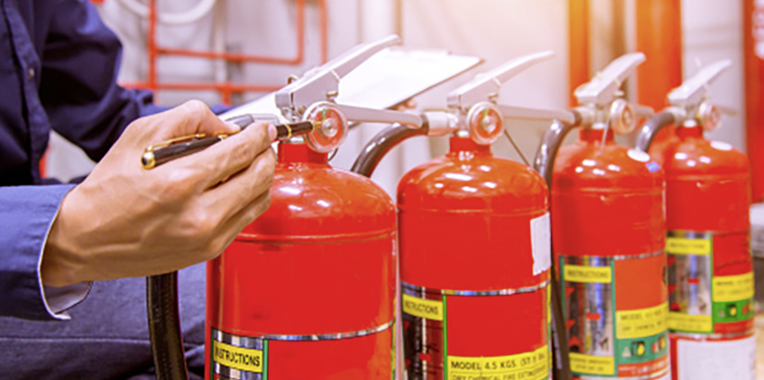
Fire Extinguisher Inspection
Notes:
F: NFPA 10 requires extinguishers be inspected when they are initially installed and once a month after that. You should inspect extinguishers more frequently if they are installed in locations where they are more prone to rust, impact or tampering.
F: Fire extinguishers must be inspected or given a "quick check" every 30 days. For most extinguishers, this is a job that you can easily do by locating the extinguishers in your workplace and check the following:
Make sure it is located in its designated place
Make sure the extinguisher is visible or that there is signage indicating where the extinguisher is located
Make sure you can easily access the extinguisher
Look for obvious signs of physical damage, such as corrosion, leakage, or dents.
Check the pressure gauge to make sure the indicator is in the operating range.
Make sure the pull-pin is not missing and the pull pin seal is intact. Verify the date of the last professional inspection
Ensure the pressure gauge is in the operable range or position
Make sure it is full, this can be done by just lifting the extinguisher or you can weigh it
For wheeled extinguishers, make sure the condition of tires, wheels, carriage, hose, and nozzle are acceptable
For non-rechargeable extinguishers, operate the push-to-test pressure indicators
F: You are not required to be certified in order to perform an inspection; any knowledgeable, competent person should be able to do it.

Slide 16

Fire Extinguisher Inspection Video
Notes:
VIDEO - 2 Min

Slide 17
Fire Extinguisher Maintenance
Notes:
F: Like any mechanical device, fire extinguishers must be maintained on a regular basis to insure their proper operation. You, the owner or occupant of the property where fire extinguishers are located, are responsible for arranging your fire extinguishers' maintenance. This is a thorough examination of the fire extinguisher's mechanical parts; fire extinguishing agent and the expellant gas. Your fire equipment professional is the ideal person to perform the annual maintenance because they have the appropriate servicing manuals, tools, recharge materials, parts, lubricants, and the necessary training and experience.

Slide 18
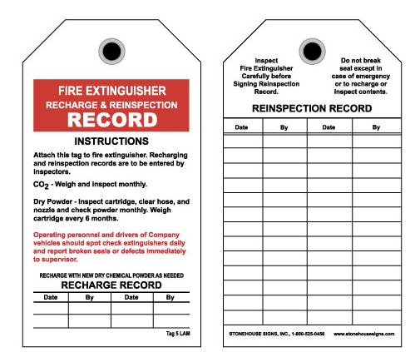
Recordkeeping
Notes:
F: Records of the monthly inspections need to be maintained by either putting a tag or label on the extinguisher or by having it recorded on paper or electronic files.
F: The following items need to be recorded:
The month and year of the inspection
The person conducting the inspection
F: These records need to be maintained for at least 12 months.
F: Each fire extinguisher shall have a tag or label securely attached that indicates that maintenance was performed.
F: The tag or label needs to identify the following:
Month and year maintenance was performed
Person performing the work
Name of the agency performing the work

Slide 19
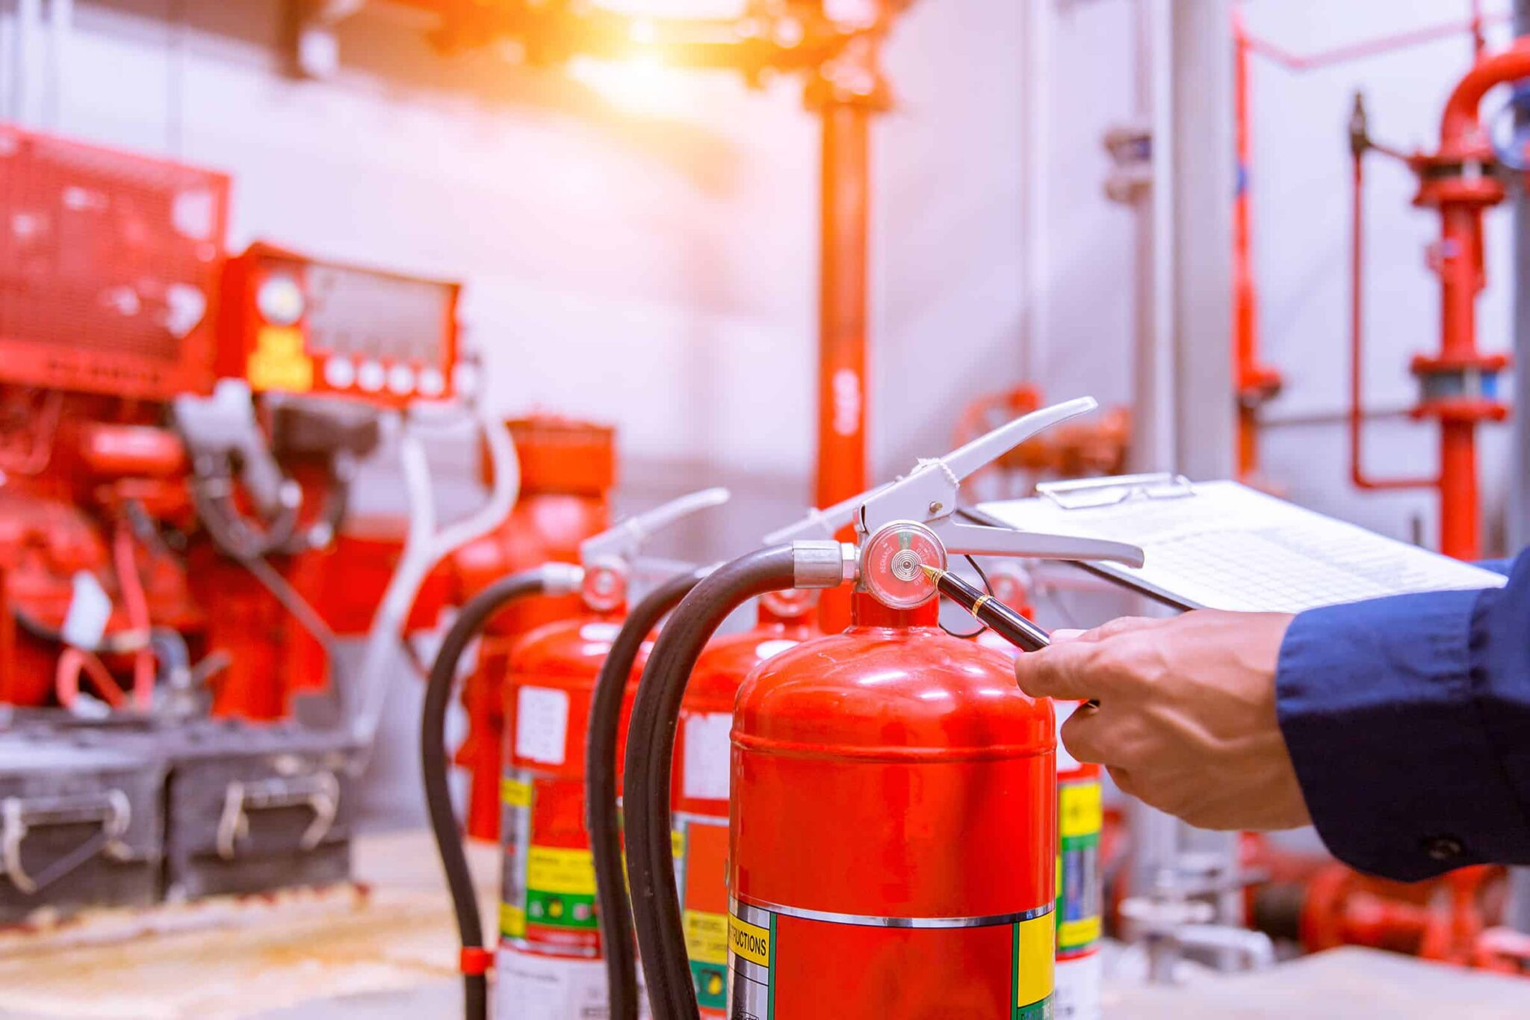
Final Thoughts
Fire extinguishers can be an important tool in preventing a small fire from growing larger. However, they should not be used to combat large or rapidly spreading fires.
The most important thing to do during a fire is to get yourself to safety then call the proper authorities to combat the fire.
A building and the property inside are not worth putting yourself or anyone at risk trying to put it out with a fire extinguisher.
It is important to understand how to use a fire extinguisher and the limitations they have.
Notes:
F: Fire extinguishers can be an important tool in preventing a small fire from growing larger. However, they should not be used to combat large or rapidly spreading fires. The most important thing to do during a fire is to get yourself to safety then call the proper authorities to combat the fire. A building and the property inside are not worth putting yourself or anyone at risk trying to put it out with a fire extinguisher. It is important to understand how to use a fire extinguisher and the limitations they have.

Slide 20
Check your knowledge
How often should a fire extinguisher be inspected?
How often should a fire extinguisher receive maintenance?
Monthly
Annually
Who determines if an employee should fight a fire?
The Employee
Notes:
{Ask the class the following questions:}
F: How often should a fire extinguisher be inspected? (Wait for participation, then click mouse to trigger animation)
Answer: Monthly
F: How often should a fire extinguisher receive maintenance? (Wait for participation, then click mouse to trigger animation)
Answer: Annually
F: Who determines if an employee should fight a fire? (Wait for participation, then click mouse to trigger animation)
Answer: The Employee

Slide 21

One Team
QUESTIONS?

