Slide 1
Workplace Violence and Harassment
June 2024
Notes:
KLP: You set the tone. If you believe safety is important, the audience will believe safety is important.
The facilitator opens the session by welcoming everybody to the training and noting the monthly focus – Workplace Violence and Harassment
F: Today’s task is to attend training on Workplace Violence and Harassment. Cell phones should be turned off or silenced during this training. If you need to take a call, please go to (designated area), take the call and return as soon as possible. {Address any other important announcements or business now.}

Slide 2
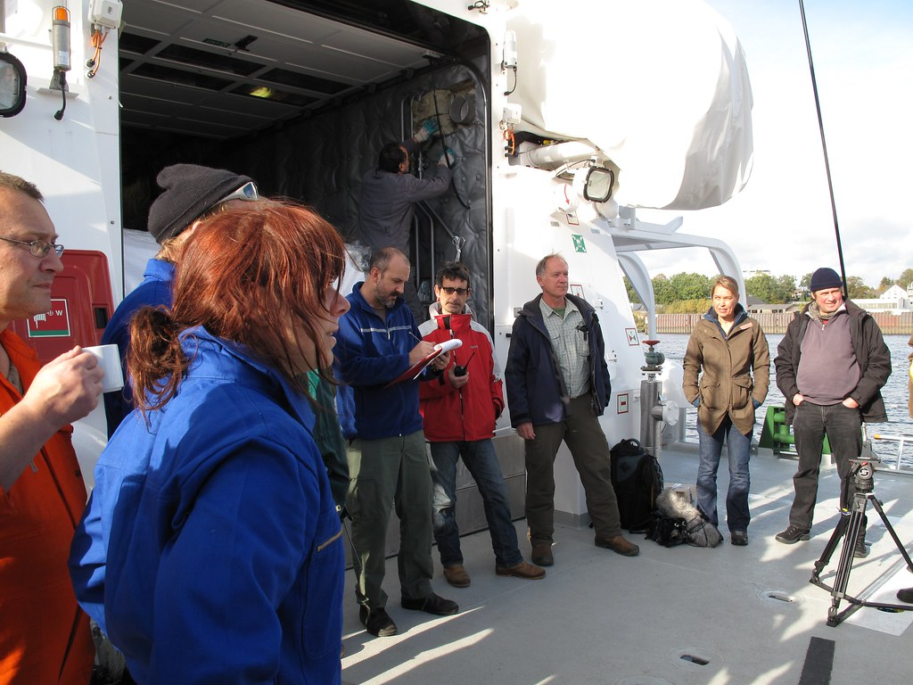
Housekeeping
Muster Point
Notes:
Prior to training, determine if any fire drills are planned and the response expected from the facility and muster points if alarms should go off. It is important to remind employees that should they need to leave the location at any time, they should inform the Facilitator because, in the event of a fire incident, we need to know their whereabouts. This is an opportunity right at the start of the day to brief the employees on HSE procedures in general for the running of the training course. [If your job site is outdoors, don’t overlook this safety moment. Adjust the plan in the event of a job site fire.]
F: Hello Team, I have verified with the HSE department and have confirmed that there are no Fire Drills or Emergency Drills scheduled for today. If we hear an alarm, we will follow site protocol for emergency response.
F: {Point out the fire exits and muster point}
F: Once we are at the muster points, we will do a role call to account for all attendees.

Slide 3

Presenter & Introductions
Safety begins with me!
Notes:
F: {This is your moment! This is a chance to visibly “Walk the Talk”}
Share:
Your personal experience of safety and impact on the company
Importance of making the most of this opportunity to think about the importance of HSE and discuss with employees
Appreciate that you are a leader and that you make an impact
Importance of taking personal responsibility to make a positive impact
You get out of this training what you put into it
HSE matters to our company
The safety program is going to help people feel empowered and take the initiative to improve their own HSE performance through proactive attitudes and behaviors.
You may wish to share:
A story of your experience in the safety program and how it is has changed the way in which you behave.
Some lessons learned from an incident when you have been involved in the investigation, highlighting the devastating impact that accidents have on people’s lives, or you can describe your experience of being involved in an environmental incident. How did this affect the company, and more importantly, affect the lives of others not working for the company.
F: Go around the room and ask everyone to give their name and what their position is. {Wait for their responses, smile, and nod as they participate. Be careful about timing here---if you ask an additional intro question of the participants and give a long-winded answer yourself, your participants will follow with long stories/explanations, and you can accidentally take up a lot of time.}

Slide 4

Why am I here?
You are the KEY to SAFETY!
Notes:
F: Each one of us is the last line of defense to protect workers from injury or the environment from damage, should management systems and collective protections fail. Supervisors and workers are the KEY to HSE. We can promote or destroy the HSE climate through our own behavior and how other workers perceive it.
Supervisors and workers are responsible for enforcing safety rules. Regardless of our position, employment status, or background, everyone is responsible for HSE, and everyone can be a HSE leader by demonstrating positive attitudes and behavior.

Slide 5

Workplace Violence
OSHA defines workplace violence as “any act or threat of physical violence, harassment, intimidation, or other threatening disruptive behavior that occurs at the work site.”
Notes:
F: OSHA defines workplace violence as “any act or threat of physical violence, harassment, intimidation, or other threatening disruptive behavior that occurs at the work site.”
F: Workplace violence can present itself in several ways and can range from threats and verbal abuse to physical assault and even homicide. Workplace violence can include but is not limited to:
Threats or obscene phone calls
Beatings
Shootings
Harassment of any nature
Following others
Shouting and swearing at others
F: The workplace is not just limited to the main work office; it can include parking lots, field locations, and can include while traveling to and from work assignments. For some occupations, it can include the patient or customers’ home that the work is taking place at.
F: According to the Bureau of Labor Statistics Census of Fatal Occupational Injuries (CFOI), of the 5,333 fatal workplace injuries that occurred in the United States in 2019, 761 were cases of intentional injury by another person.
(https://www.osha.gov/workplace-violence)

Slide 6

Workers at Risk
Notes:
F: Workplace violence and harassment is not limited to one occupation or industry. A 2014 Workplace Bullying Institute survey shows that 27% of Americans have suffered serious bullying and abusive conduct at work (defined as repeated abusive conduct that is threatening, intimidating, humiliating, work sabotage or work abuse),”
F: Work factors that can increase the risk of work violence can include:
Exchanging money with the public
Working with volatile, unstable people
Working alone in isolated areas
Providing services and care
Working wear alcohol is served
The time of day and location of the work, such as working late at night or in areas with high crime rates
F: Some occupations with an increased risk of work violence can include delivery drivers, healthcare professionals, public service workers, customer service agents, and law enforcement personnel.
(Beth P. Zoller, legal editor for XpertHR as cited in Workers’ Compensation Report, Vol . 25, No. 10, April 8, 2014.)
(https://www.osha.gov/workplace-violence)

Slide 7

Risk Signals
Notes:
F: There are several risk signals that can lead to violence or harassment that managers, supervisors, and employees alike should be aware of.
F: Some possible risk signals to watch for in the workplace may include:
Verbally expressed anger or frustration
Body language and/or threatening gestures
Signs of alcohol or substance abuse
The presence of a weapon such as a knife or firearm.
F: If any of the above behaviors are witnessed, it is important to report it to your supervisor as soon as possible.

Slide 8
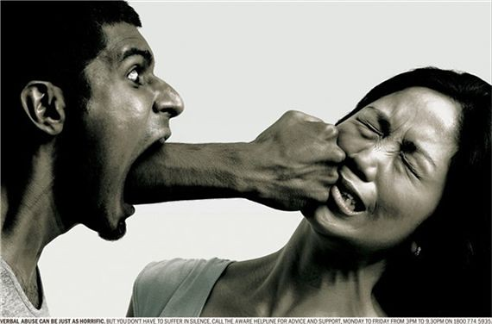
Assault
  Verbal Assault
  Physical Assault
Notes:
F: Assaults can arise in the form of either physical assault or verbal assault.
F: Physical assault is the illegal act of causing physical harm or unwanted physical contact to another person, or, in some legal definitions, the threat or attempt to do so. Physical assault can include actions such as hitting, slapping, punching, pushing, poking, and kicking.
F: Verbal assault involves using threatening language or engaging in verbal conduct that causes the victim to fear imminent bodily harm or physical contact.

Slide 9

Harassment
  Harassment is unwelcome conduct based on race, color, religion, sex (including pregnancy), national origin, age, disability or genetic information.
Notes:
F: Harassment is unwelcome conduct based on race, color, religion, sex (including pregnancy), national origin, age, disability or genetic information.
F: Harassment becomes unlawful where:
enduring the offensive conduct becomes a condition of continued employment, or
the conduct is severe or pervasive enough to create a work environment that a reasonable person would consider intimidating, hostile, or abusive.
F: Harassment takes many forms, some with which we may be familiar and those with which we’re not-so-familiar. Harassment in the workplace can include:
Sexual Harassment
Quid Pro Quo Harassment
Creating a Hostile Work Environment
Third-party Harassment
(https://www.eeoc.gov/harassment)

Slide 10

Types of Harassment
Sexual Harassment
Quid Pro Quo Harassment
Hostile Work Environment
Third-party Harassment
Notes:
F: Let’s take a deeper look at each type of harassment and how it can affect the workplace.
F: Sexual Harassment includes unwelcome sexual advances, requests for sexual favors, and other verbal or physical harassment of a sexual nature.
F: Quid Pro Quo Harassment is based around power dynamics. Examples of Quid Pro Quo harassment can include a supervisor threatening an employee’s integrity or exchanging a favor for a promotion or to prevent from being fired.
F: Third-party Harassment is a type of harassment done by any individual who is not a worker in a company. This can happen when a non-worker harasses an employee in a given work setting. This can include clients, vendors, customers, or independent contractors.
F: A Hostile Work Environment is something that is created either by a boss or coworker, typically by engaging in spreading rumors, lies, and false statements to attack others’ competence, integrity and/or personal life. Hostile work environments also can be contributed to from bullying, degrading comments, sexual propositions or touching, or vulgar language.
F: Offensive conduct can include behaviors such as speaking openly about a subject or topic that can facilitate an offensive environment for others. For example, a group of employees is openly talking with each other about their sex lives in the presence of another employee that feels uncomfortable about the topic.
F: Offensive conduct can also include, but is not limited to:
Offensive jokes
Slurs
Epithets or name calling
Physical assaults or threats
Intimidation
Ridicule or mockery
Insults or put-downs
Offensive objects or pictures
(https://www.eeoc.gov/harassment)
(https://www.eeoc.gov/sexual-harassment)

Slide 11

Impact on Employees
Notes:
F: Violence and harassment in the workplace can have a massively negative impact on workers’ emotional wellbeing and work performance.
F: Hostile work environments cause unnecessary stress to employees and invokes the fear of losing their job or being hurt at work.
F: Hostile work environments lead employees to withdraw from the workplace and avoid interacting with others.

Slide 12

Prevention
Notes:
F: Employers should set clear expectations that workplace violence and harassment are not tolerated.
F: Employers should establish a clear path for reporting violence and harassment, including a process for reporting members of management should the supervisor be accused. When inappropriate behavior is reported, employers should take immediate steps to stop the behavior.
F: Employers should also assess their worksites and identify methods for reducing the likelihood of violence, such as implementing engineering and/or administrative controls.

Slide 13

Engineering Controls
  Installing security cameras in high-risk areas
  Installing alarm systems or other security devices
  Installing metal detectors to pick up on weapons or other metal contraband
  Establish safe rooms to use during emergencies
  Installing bullet-resistant glass around reception area or around cash registers
Notes:
F: Engineering controls are physical changes to the workplace that isolate workers from hazards.
F: Some engineering controls that can be implemented that can reduce injuries caused from workplace violence are:
Installing security cameras in high-risk areas
Installing alarm systems or other security devices
Installing metal detectors to pick up on weapons or other metal contraband
Establish safe rooms to use during emergencies
Installing bullet-resistant glass around reception area or around cash registers

Slide 14

Administrative Controls
Notes:
F: Administrative controls are changes in work procedures to reduce the duration, frequency, and severity of exposure to hazardous situations. These are things like policies and procedure that set expectations for employees and clarity on the company’s processes.
F: Implementing and communicating a Zero-Tolerance Policy that applies to the entire organization, establishing an effective complaint or grievance process, and providing anti-harassment training to managers and employees are effective administrative controls that can help reduce the likelihood of assault from occurring.

Slide 15

One Team
QUESTIONS?

