Slide 1


Rules, Laws, and Investigations in EMS:
Compliance Section Overview
Presented by: Elizabeth Goguet, Compliance Coordinator
Michael Munck, Investigator

Slide 2
On the Agenda
WHAT compliance is and WHY it is important! >> Me talking about my feelings on compliance!
What are the Administrative Rules and New Hampshire State Laws which govern EMS providers?
What happens when a provider or unit has a potential violation?
How investigations are performed / overview of the process / steps of an Administrative Investigation
Criminal History Background Checks / Denials of Provider Applications
Findings (aka Orders) of the Commissioner of Safety (Robert Quinn)
Appeal Process – your rights!
How to Submit a Complaint – we accept anonymous complaints!

Slide 3
“The overall mission of everybody in public safety is the preservation of life and every decision you make has got to focus on the preservation of life”
Gordon Graham, Founder of Lexipol, a company designed to standardize best practices in public safety , and an internationally recognized 33-year veteran (retired) of California law enforcement, and a practicing attorney with a background and formal education as a risk manager.

Slide 4

What is Compliance?
Why do we need it?

Slide 5
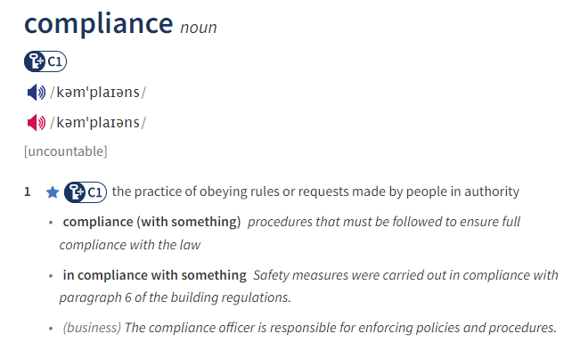

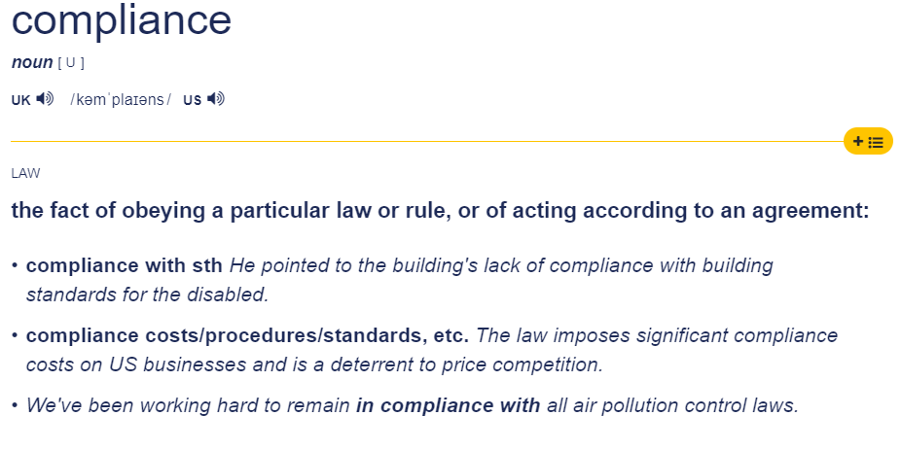


Slide 6
COMPLIANCE IN EMS
Describes a process for developing, implementing and maintaining ongoing monitoring to ensure all EMS providers, and service activities and behaviors, conform to applicable rules, laws, or protocols.

Slide 7

COMPLIANCE WILL DEFINE AND REGULATE AN ORGANIZATION’S “HOW” AND “WHY”

Slide 8
Compliance is part of your organization’s
duties to the community and your stakeholders
If we utilize the resources of others (stakeholders, investors, creditors, donors, tax payer dollars), we need to assure them that we are in compliance with applicable rules, laws, and regulations.
We all benefit from our community and the services provided by EMS and Fire, so we have a duty to comply with the rules and laws which govern EMS providers in the State of New Hampshire.
Compliance will: help mitigate risk, improve educational standards, higher quality of patient care, more job satisfaction.
These are only a few reasons WHY compliance is vital to an organization

Slide 9
WHAT IS THE DIFFERENCE BETWEEN
AN ADMINISTRATIVE RULE AND
LAW (RSA) ?

Slide 10
DOS Administrative Rules (Saf-C 5900)
In the State of New Hampshire, Emergency Medical Services/Units and Providers are ALL governed by laws (RSA 153-A) and Administrative Rules (Saf-C 5900)
Administrative Rules hold the authority of the law, and are authorized by RSAs (laws)
“Saf-C” is the prefix assigned to the Department of Safety (DOS)
The Administrative Rule Saf-C 5900, provides direction regarding the requirements of law or policy in the State of New Hampshire
Each State has their own set of administrative rules, which are passed by the Legislature
You should all become familiar with Saf-C 5900 Emergency Medical Services Rule, updated in May 2019.

Slide 11
Saf-C 5900 EMS Administrative Rules give direction on:
-EMS Operating Standards (Saf-C 5902.01)
-Medical Resource Hospital (Saf-C 5902.02)
-Communications (Saf-C 5902.03)
-Emergency Medical Care Provider Requirements (Saf-C 5902.06)
-Required EMSIR Documentation (Saf-C 5902.08)
-Unit Licensing Standards / Provider Licensing Requirements (Saf-C 5903.01 and Saf-C 5904.04)
-Rules on how to proceed with complaints and Investigations (Saf-C 5922.01)
…. And many more!

Slide 12
RSA – Revised Statutes Annotated (RSA 153-A)
RSA stands for “revised statutes annotated” and is considered State law
A statute is a formal, written enactment of legislative authority which governs the legal entities of a city, state, or country. These laws restrict or permit the functioning of some action and declare a policy
Statutes are sometimes called “acts” (i.e., the Civil Rights Act of 1964)
Statutes are always laws passed by a legislature, whereas Federal Statutes are laws passed by Congress
Every law must go through the legislative process to be enacted, repealed, or changed
Parts of a statute are subdivided into a combination of smaller units, such as:
subsections, chapters, clauses, paragraphs, or items

Slide 13
An easier way to remember the difference between RSA and Administrative Rule(Saf-C):
RSA is State Law: tells us WHAT we can or cannot do
Saf-C is an Administrative Rule: tells us HOW to do the things we do (provides direction).

Slide 14
The most important RSA as an EMS Service Unit or Provider:
NH Title XII, Public Safety and Welfare, Chapter 153-A:13,
Emergency Medical and Trauma Services:
153-A:13, Revocation of License

Slide 15
New Hampshire Title XII, Public Safety and Welfare, Chapter 153-A:13, Emergency Medical and Trauma Services, RSA 153-A:13, I. Revocation of License
I. The commissioner may deny an application for issuance or renewal of a license, or ISSUE A LETTER OF CONCERN, suspend, or revoke
a license, when the commissioner finds that the applicant is guilty of any of the following acts or offenses:
(a) Negligence or incompetency in performing authorized services.
(b) Rendering treatment not authorized under this chapter.
(c) Fraud in procuring a license.
(d) Knowingly making misleading, deceptive, untrue, or fraudulent representations or engaging in unethical conduct
including, but not limited to, conduct likely to deceive, defraud, or harm the public or demonstrating a willful or
careless disregard for the health or safety of a client/patient or practice harmful or detrimental to the public.
Proof of actual injury need not be established.
(e) The illegal use of drugs.
(f) Fraud in representations as to skills or ability.
(g) Willful or repeated violations of this chapter or of rules adopted pursuant to this chapter.
(h) Violating a statute of this state, another state, or the United States, without regard to its designation as either a felony or misdemeanor, which relates to the practice of an
emergency medical care provider. A certified copy of the record of conviction or plea of guilty is prima facie evidence of a violation.
(i) Having a license or registration to practice as an emergency medical care provider revoked or suspended, or
having other disciplinary action taken by a licensing or registering authority of another state, territory, country, or the National Registry of Emergency Medical Technicians. A certified
copy of the record or order of suspension, revocation, or disciplinary action is prima facie evidence of such action.
(j) Negligent, unsafe, or illegal operation of an emergency medical service vehicle, or negligent or unsafe use or maintenance of the safety systems of an emergency medical service vehicle.
(k) Unauthorized disclosure of information regarding an individual who has received care or the services rendered to an individual.
(l) Delivering emergency medical care while drug or alcohol impaired.
II.A determination of mental incompetence by a court of competent jurisdiction automatically suspends a license for the duration of the license, unless the commissioner orders otherwise.
III.A denial, suspension, or revocation under this section shall be in accordance with RSA 541-A.RSA 153-A:13
Amended by 2021, 205:VII-1, eff. 10/9/2021.Amended by 2016, 149:3, eff. 1/1/2017.1999, 345:6, eff. July 1, 1999.

Slide 16
RSA 153-A:13 I. (a) Negligence or incompetency in performing authorized services
NEGLIGENCE arises when there is a duty to act but there is a breach of that duty
That breach of duty causes an effect, leading to damages and/or injury
IN OTHER WORDS: NEGLIGENCE IS A FAILURE TO MEET THE LEGAL DUTY (OR A BREACH OF YOUR STANDARD OF CARE) AND USUALLY INVOLVES A LACK OF PATIENT CARE WITH A RESULT OF INJURY OR SOME TYPE OF DAMAGES.
INCOMPETENCY Performing patient care which is medically inadequate or unsuitable, whether it is a provider’s scope of practice or not.
A provider could have a violation of (a) and have been negligent and incompetent OR just one or the other.
This is why the law has “OR” written in it
Scenario: The wrong dose and type of medication is administered to a patient who has an overdose and
subsequently, an allergic reaction. This would constitute negligence since the provider had a duty to act in the
best interest of the patient by giving them the correct medications; but it is also incompetency, since the wrong
type and dose of medication was given.

Slide 17
Examples of Negligence in EMS
Ambulance got lost/delayed arrival on scene
Broken/malfunctioning/missing medical equipment/supplies
Failure to comply with accepted standard of care for EMS
Medication error – wrong medication or dose
Reckless or dangerous driving

Slide 18
RSA 153-A:13 I. (b) Rendering treatment not authorized
under this chapter
“Rendering Treatment not authorized….” is a violation when a provider performs EMS care which is out of their scope of practice.
“Scope of Practice” is what you are deemed competent to perform
Be familiar with your scope of practice and the State of New Hampshire, Patient Care Protocols, V 8.1 (released, March 24, 2022)
Pursuant to Saf-C 5906.08 Vehicle Equipment and Supplies, all ambulances should have a copy of the most recent Patient Care Protocols.
Scenario: An EMT obtains vascular access (that’s in an AEMT/Paramedic scope, not EMT) This violation
could also impose monetary fines (See Saf-C 5908.02 Schedule of Fines).
Saf-C 5908.02(i) Rendering emergency medical care to any person beyond a provider's level of licensure a fine of $1,000.00 shall be imposed upon the provider.

Slide 19
RSA 153-A:13 I. (c) Fraud in procuring a license
This violation occurs when a provider falsifies documentation as they obtain EMS licensure or when a provider gives deceptive or false information on their application for licensure, to include information on the application itself or documentation for continuing education credits (forged or false certifications).
Fraud: A person or thing intends to deceive others; when someone unjustifiably claims to be something or is credited with accomplishments or qualities that they do not really have.
Procuring: (to procure) which means to obtain.
A Few Tips
-Accuracy and truthfulness always on all official documentation
-Always notice the “fine print”
-Always read the attestation and certification statements carefully
(especially in provider applications)
-Always be sure of what you are signing
Scenario: A provider was not truthful regarding continuing education requirements for their NREMT recertification cycle. OR another example: On a NH Provider License Application, a provider attests that
they do not have any criminal convictions or suspensions/violations, but it turns out that they do!

Slide 20
RSA 153-A:13 I. (d) Knowingly making misleading, deceptive, untrue, or fraudulent representations OR engaging in unethical conduct including, but not limited to, conduct likely to deceive, defraud, OR harm the public OR demonstrating a willful or careless disregard for the health or safety of a client/patient OR practice harmful OR detrimental to the public. Proof of actual injury need not be established
We refer to the violation of RSA 153-A:13 as “Unethical Conduct” which is a blanket statement for many different behaviors or actions which could constitute a violation under this statute.
-A provider could have a violation of ALL of these parts of the statute
OR
-A provider could have only one part of this statute apply to their violation
(i.e., “demonstrating a willful or careless disregard…”)
Discussion: So what is unethical behavior? In our culture and society, being unethical means something is
“morally wrong” OR it could be a practice which is harmful or detrimental to others OR it could be conduct
That is likely to deceive or harm others

Slide 21
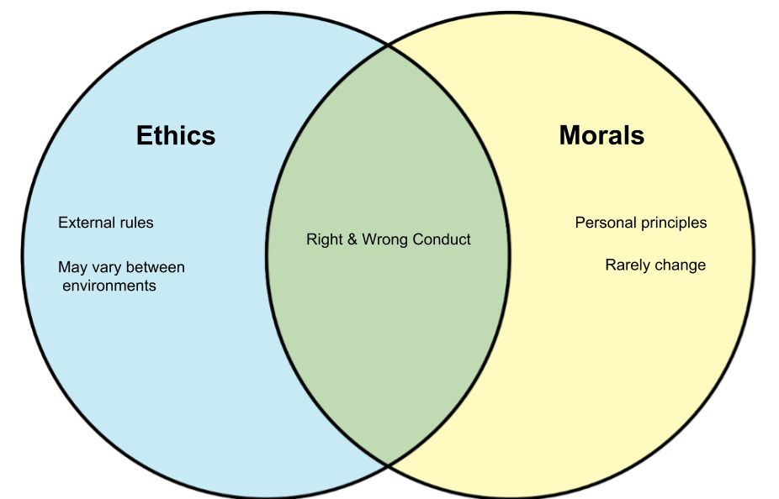
Ethics = a system of moral principles
“moral philosophy”
Ethics are external rules
Ethics affect how people make decisions and lead their lives
Ethics – concern with what is good for individuals and society
What’s the difference?
Ethics and Morals
Morals = a bit more personal
“moral compass”
Morals are what you believe to be right and wrong
People can and will have different morals
Morals rarely change, our
environment and experience will impact our morals and
principles.

Slide 22
Key Points to Acting Ethically
Do no harm;
Act in good faith;
Always act in the patient’s best interest.

Slide 23
RSA 153-A:13 I. (e) The illegal use of drugs
This violation arises when a provider uses a medication incorrectly or out of their scope of practice;
it also applies if a provider steals/diverts medications or inappropriately uses medications
This violation can turn criminal, if an investigation is criminal, we have to notify law enforcement
Scenario: A provider administered a controlled narcotic medication for a patient, but had 1mg left; instead of wasting the leftover narcotic, the provider takes what is remaining of the medication for themselves.
This behavior would also lead to a violation of RSA 153-A:13 I. (l), since a provider cannot practice patient care under the influence of drugs or alcohol, and diverting medications is a criminal act!
*If we have to turn a case over to law enforcement, they would perform their investigation FIRST and based upon their findings, the Division would then take action.

Slide 24
RSA 153-A:13 I. (f) Fraud in representations as to skills or ability
Representing oneself as a licensed provider (when they are not)
Representing licensure level as something you are not (“I’m an AEMT,” but really, you are an EMT)
This violation will turn criminal: representing yourself as a provider when you are not
is illegal (RSA 153-A:21 I.), and it is also “unethical,” RSA 153-A:13 I(d)
RSA 153-A:21 I. “Any person providing emergency medical services who knowingly implies that such person is a licensed emergency medical care provider, or who uses any other term to indicate or imply that the person is a licensed emergency medical care provider, or who acts as an emergency medical care provider…. Shall be guilty of a misdemeanor for the first offense and a class B felony for subsequent offenses”
Scenario: A provider claims to be licensed as an AEMT, when they are in fact a licensed EMT.

Slide 25
Good Samaritan laws exist in most states and are meant to encourage people who witness emergency situations or crimes to help injured parties or victims.
New Hampshire - Good Samaritan Law - RSA 508:12,
Aid at Scene of Emergency or to Victim of Crime.
I. If any person in good faith renders emergency care at the place of the happening of an emergency
or to a victim of a crime or delinquent act or while in transit in an ambulance or rescue vehicle, to a
person who is in urgent need of care as a result of the emergency or crime or a delinquent act, and
if the acts of care are made in good faith and without willful or wanton negligence, the person who
renders the care is not liable in civil damages for his acts or omissions in rendering the care,
as long as he receives no direct compensation for the care from or on behalf of the person
cared for. Any person rendering emergency care shall have the duty to place the injured person under
the care of a physician, nurse, or other person qualified to care for such person as soon as possible
and to obey the instructions of such qualified person.

Slide 26
RSA 153-A:13, I. (g) Willful or repeated violations of this chapter or of rules adopted pursuant to this chapter
This violation occurs when a provider willfully (deliberately) repeats a violation or rule
Scenario: A provider renders patient care with the knowledge that their license expired/lapsed. The provider goes to work anyway and performs 20 patient assessments.
-The provider knew, or should have known, that they were in fact unlicensed
-The behavior is considered “willful” since they deliberately worked without a license
-The behavior is considered “repeated” since they treated 20 patients
** Being in violation of this statute means that your sanction does not allow a SUSPENSION,
but a REVOCATION, which is a much harsher penalty for UP TO 5 years (verses one 1 for suspension)

Slide 27
RSA 153-A:13 I. (h) Violating a statute of this state, another state, or the United States, without regard to its designation as either a felony or misdemeanor, which relates to the practice of an emergency medical care provider. A certified copy of the record of conviction or plea of guilty is prima facie evidence of a violation
This violation may arise from the notification of a provider’s criminal record or convictions.
-We find out about this type of violations a myriad of ways
-Neighboring States sometimes report sanctions/compliance issues or felonious crimes
- If it’s out there, we can find out (internet, social media, or news)
Scenario: You do not have a “duty to report” criminal convictions, (unless there is an apparent threat
to the public), however, this does not mean that if we find out about criminal conviction(s), that we cannot launch an investigation into the matter.

Slide 28
RSA 153-A:13 I. (i) Having a license or registration to practice as an emergency medical care provider revoked or suspended, or having other disciplinary action taken by a licensing or registering authority of another state, territory, country, or the National Registry of Emergency Medical Technicians. A certified copy of the record or order of suspension, revocation, or disciplinary action is prima facie evidence of such action
This statute is regarding having an NREMT Certification revoked/suspended, OR you have had “action taken” on a provider license from another State and have been sanctioned.
The Division has authority to also take action pursuant to this statute,
but not on what the provider was already sanctioned for (the behaviors);
But the fact that a suspension/revocation occurred, is a potential violation
Discussion: We do not look to other states to report because New Hampshire is no longer a “compact state” and it is not a requirement that they report this to the Division.
However, we have to take action under this statute if we are made aware
NREMT DOES NOTIFY US!!!

Slide 29

RSA 153-A:13 I. (j) Negligent, unsafe, or illegal operation of an emergency medical service vehicle, or negligent or unsafe use or maintenance of the safety systems of an emergency medical service vehicle
Operate an ambulance negligently or in a manner which is unsafe, you will be in violation of this statute.
Scenario: No lights and sirens, a community member reports to the Division they were “almost run
over by an ambulance while going through a crosswalk…” They took the service name down, recorded
the date/time/location – street intersection, and reported it compliance.

Slide 30
RSA 153-A:13 I. (k) Unauthorized disclosure of information regarding an individual who has received care or the services rendered to an individual
This violation occurs when a provider gives information for which they are not authorized to give
regarding a patient and their care (even inadvertent disclosure could be a violation).
HIPAA (Health Insurance Portability and Accountability Act) is federal law!
-PHI includes: personal identifiers or other personal health information, past or present
-Never discuss ANY services or care rendered/performed on ANY patient without consent
Scenario: A provider makes a Facebook post about “a woman they treated for a drug overdose…”
Even if the name is not mentioned, this is a violation of this statute, because they have disclosed
her present medical history (drug overdose).
Remember: the internet and social media should not be a place to discuss patient care!

Slide 31
RSA 153-A:13 I. (l) Delivering emergency medical care while drug or alcohol impaired
Under no circumstances should anyone EVER provide patient care while intoxicated, impaired, or under the influence of alcohol and/or drugs.

Slide 32
RSA 153-A: 13, II. A determination of mental incompetence by a court of competent jurisdiction automatically suspends a license for the duration of the license, unless the commissioner orders otherwise
RSA 153-A: 13, III. A denial, suspension, or revocation under this section shall be in accordance with RSA 541-A
Discussion: If you are legally deemed “mentally incompetent” by a court, you will have a suspended license BUT not without an opportunity to appeal that decision.
^ This means you always must have the opportunity for an adjudicative proceeding to try and have the license reinstated. We discuss this further when we talk about Hearings or “Adjudicative Proceedings” in future slides

Slide 33
So, you have a VIOLATION…., now what?
If you have an alleged violation of 153-A:13 I., then you will be placed under investigation.
If you have a “sustained violation,” always remember that each violation has a corresponding “sanction” which is directed via Administrative Rule
A sanction is defined as a penalty for disobeying a law or a rule and are also referred to as: punishment, discipline, or corrective action.
*Sanctions are determined by the Saf-C which gives instructions on how the sanction shall be applied

Slide 34
Saf-C 5922.04 - Suspension of Unit, Provider, PEETE, EMS Instructor Coordinator License, Chair Van Company, or Wheelchair Vans for Hire
(a) Any suspension of a unit, provider, PEETE, EMS Instructor Coordinator's license, chair van company, or wheelchair van for hire shall be assessed for a period of up to one calendar year.
(b) All or any portion of the division's suspension imposed pursuant to (a) above may be deferred for a period of one year, conditioned upon good behavior and the completion of any requirements ordered as part of the suspension. If any misconduct occurs during the period of deferred time or the unit or provider fails to comply with any requirements ordered, a hearing shall be conducted to determine if the deferred suspension shall be imposed, in addition to any further disciplinary action taken on any misconduct that occurred during the deferred period.
(c) The division's period of suspension imposed pursuant to (a) above may be rescinded upon the licensee's correction of the violation(s) that caused the suspension.
(d) Any suspension of a transport unit's license shall also result in the suspension of all vehicle licenses of the unit.
(e) If a licensee's license expires during the suspension period, the unit or provider may apply for a license in accordance with Saf-C 5903.02 following the expiration of the suspension period.
(f) After notice and an opportunity for a hearing pursuant to Saf-C 5903.13, the commissioner shall suspend a unit's license for:
(1) Negligence or incompetence in the provision of emergency medical care as specified in RSA 153-A:13, I(a);
(2) Rendering unauthorized treatment as specified in RSA 153-A:13, I(b);
(3) Unethical conduct as specified in RSA 153-A:13, I(d);
(4) Fraud in representations as to skills or ability of the licensed level as specified in RSA 153-A:13, I …. And more!

Slide 35
If a Service UNIT has a SUSTAINED violation of RSA 153-A:13 I. (a) “negligence or incompetency”
The corresponding Saf-C which provides the sanction penalty assessment that the Commissioner shall order will be listed as such:
Saf-C 5922.04 (f)(1)
A Unit’s license could only be suspended for up to one year.
The Commissioner bases penalties using specific criteria which assists in determining
how a sanction will be imposed →

Slide 36
Saf-C 5922.11 Criteria
In imposing any sanctions under this part, the division shall consider the factors to determine the level of disciplinary sanction imposed and duration of disciplinary sanctions in order to prevent actual or potential harm to the public or any patient, and to deter licensees from engaging in misconduct in the future:
(a) The seriousness of the offense;
(b) The licensee’s prior disciplinary record;
(c) The licensee’s acknowledgement of his or her wrongdoing;
(d) The licensee’s willingness to cooperate with the division;
(e) The potential harm to the public health and safety if the licensee retains his or her license; and
(f) Any mitigating or extenuating circumstances

Slide 37
Saf-C 5901.571 Letter of Concern (LOC)
Adopt Saf-C 5901.571 to read as follows:
Saf-C 5901.571 “Letter of concern” means a disciplinary sanction in lieu of license suspension, imposed by the commissioner in accordance with the criteria provided in Saf-C 5922.11 following a sustained complaint of violation of RSA 153-A:13, I, which does not change the status of a license issued under this chapter or impact the privileges associated with such license, unless otherwise provided in this chapter.
In May of 2022, The Division added into Administrative Rule the “Letter of Concern,” which is
another option for the Commissioner to use as a penalty assessment (Finding/Order)
The LOC is “not reportable” meaning: those issued an LOC do not need to be reported to NREMT, NPDB,
CMS, or listed on the Division Licensing/Compliance Website.
LOC’s can be also be appealed!

Slide 38
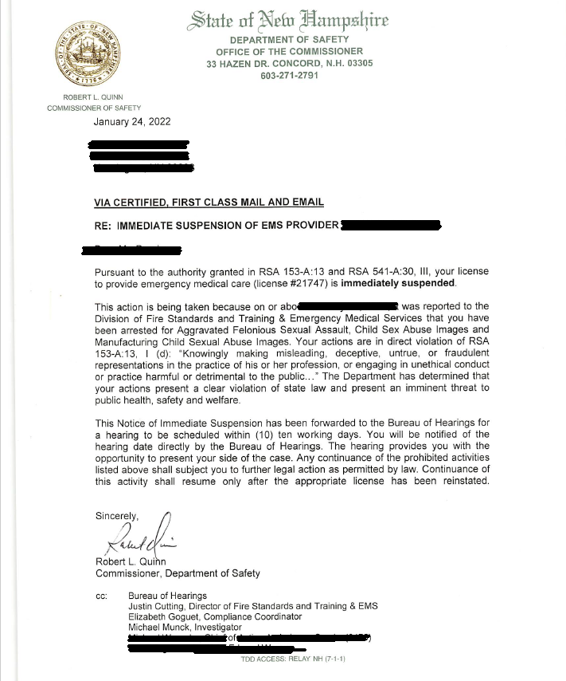
RSA 541-A:30, III. Immediate Suspension
The Commissioner has authority to immediately
suspend a licensee’s license (or Service Unit) if their actions are deemed a threat to public safety.
In order for the 541-A suspension to be upheld, we go before the Bureau of Hearings to state our case.
The Hearings Officer will listen to what we, the State has to provide for evidence, and also the respondent (the
Individual who has been immediately suspended).
Based upon the facts and evidence presented, the Hearing Officer then determines whether or not the suspension shall be upheld.
**Saf-C 5922.10 Immediate Suspension
In accordance with RSA 541-A:30, III, if the division determines that public health, safety, or welfare requires emergency action, an immediate suspension of a license shall be ordered pending an adjudicative hearing…

Slide 39
Evidentiary standard used in a burden of proof analysis – “By a preponderance of the evidence…”
The preponderance of the evidence is one type of evidentiary standard used in a burden of
proof analysis. Under the preponderance standard: the burden of proof is met when the
party with the burden convinces the fact finder that there is a greater than 50% chance
that the claim is true. So, we have to get to at least 51% in order to have a violation!
IN CONTRAST…..
Under US, criminal law, a defendant is considered innocent until proven guilty.
If the judge or jury has a reasonable doubt about the defendant's guilt,
the defendant cannot be convicted.
This is where we get the phrase: “beyond a reasonable doubt.”
Reasonable doubt is the highest standard of proof used in any court of law.

Slide 40

Does anyone have any questions so far?
~ 10 minute break~

Slide 41

State of New Hampshire Administrative Rule
Saf-C 5922.02 Complaints and Investigations

Slide 42
What gives the Division the authority to investigate Providers or Units?
RSA 153-A:14 Investigations
The director shall investigate any complaint regarding the actions of any licensee licensed
under this chapter or when the director has reason to believe that any licensed or unlicensed individual or entity is in violation of this chapter or any rules adopted pursuant to this chapter

Slide 43
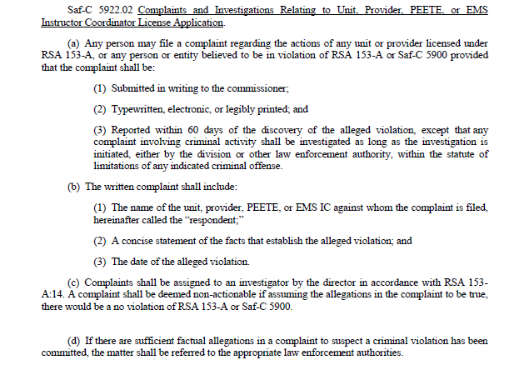
Saf-C 5922.02 – gives all of the instruction we have to follow as fact-finders

Slide 44
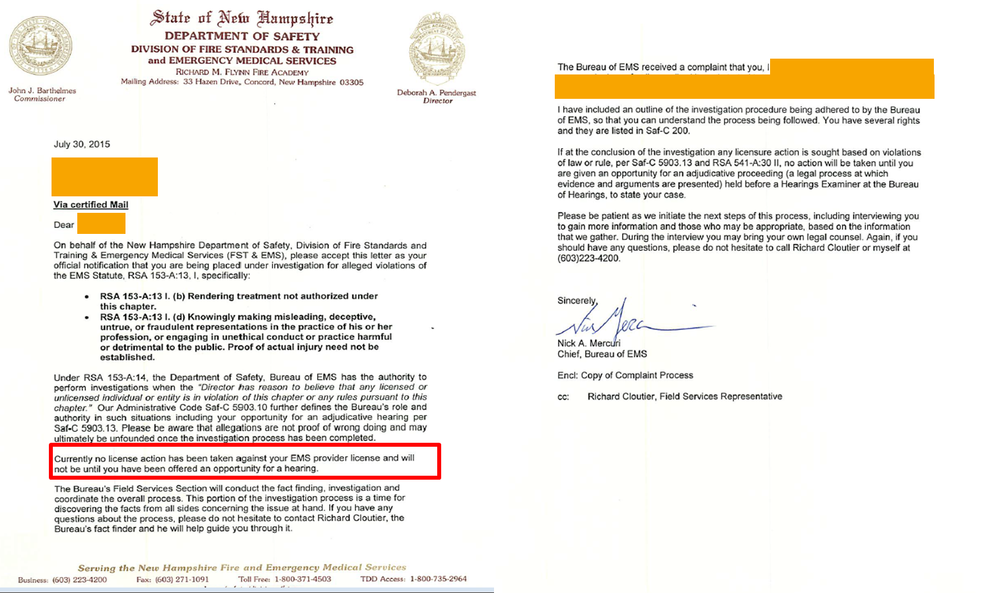
Notice of Investigation (NOI)
NOIs must contain:
Allegations of violation
The date of violation
Investigation process
Information on appeals

Slide 45
CONFIDENTIALITY
Pursuant to 5922.02(k) “Investigation information shall be confidential….”
Investigation information can only be released by a request from:
1. Department of Justice (DOJ);
2. Court order or in adjudicative hearings (appeals);
3. In a case of possible violation affecting public health.

Slide 46
The Investigative Interview…
The interview will be considered “testimony” and New Hampshire is a “two-party-State”
We ALWAYS ask for consent before recording anything!
Why record?
1. To have an accurate record of what the provider/service/investigator states during the investigative interview
2. Nothing can be taken out of context
3. If the case should go to the Bureau of Hearings, we would have an accurate record of what was said
Interviews are “non-custodial” which means we cannot make you speak with us. However, it is usually in your
best interest, since we need all of the facts from all sides.
During the interview, if you need a break, we always allow it
Everyone can bring legal counsel at their own expense; some providers bring union representation.
If there is a sensitive issue being discussed and a provider feels they need moral support, we might allow non-legal
counsel into the room, but that individual cannot be disruptive, or they will be asked to leave
We usually perform interviews at the Fire Academy in Concord OR we go directly to the service or any applicable
or affiliated hospitals

Slide 47
Investigations have 4 possible Findings per Saf-C 5922.01 Definitions.
(a) “Exonerated” any allegation that is true, but was lawful;
(b) “Not Sustained” any allegation for which there is insufficient
evidence to either prove or disprove;
(c) “Sustained” any allegation for which there is sufficient evidence
to prove that it occurred; and
(d) “Unfounded” any allegation that was investigated and found
to have no foundation or basis in fact

Slide 48
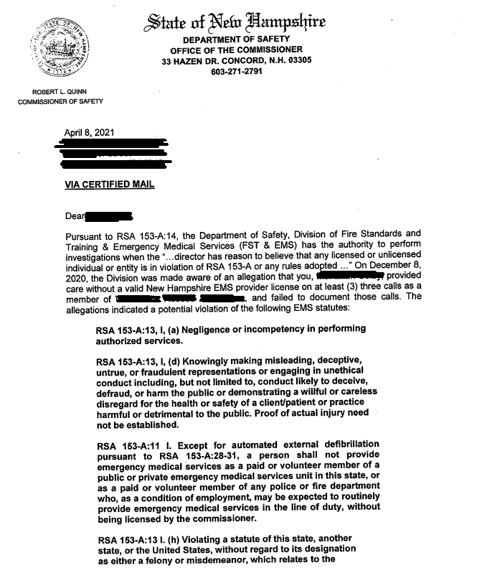
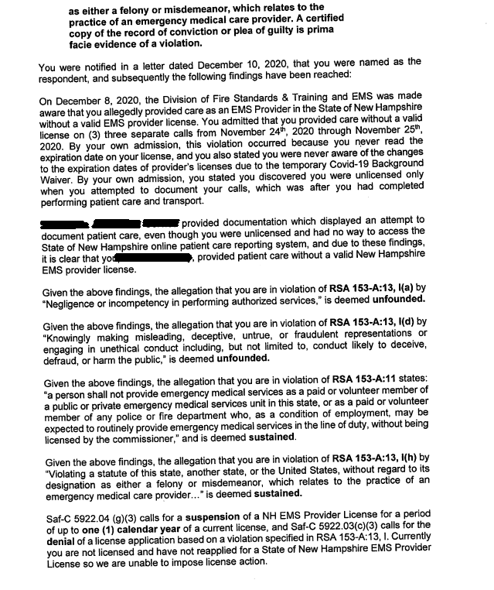
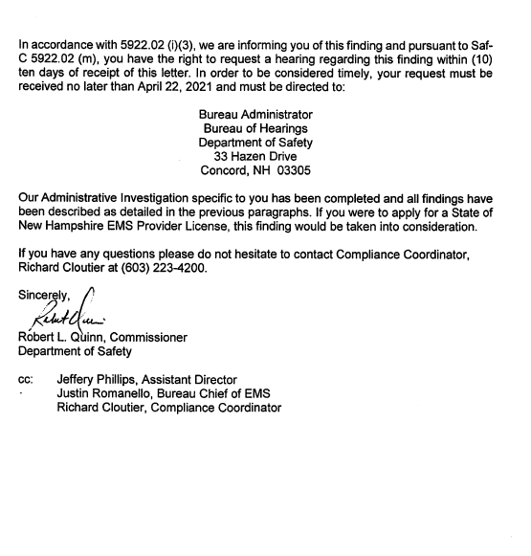
Example of Finding Letter – Order of the Commissioner

Slide 49
Informal Settlements
RSA 541-A:38 Informal Settlements –
Except to the extent precluded by law, informal settlement of matters by
nonadjudicative processes is encouraged. This section does not require any
party or other person to utilize informal procedures or to settle a matter
pursuant to informal procedures.
We encourage settlement – but it is not required!

Slide 50
Bureau of Hearings
There is always the opportunity to appeal any decision that the Commissioner Orders
There are (10) ten business days to appeal an Order, which commences from the date on the order.
The finding will always list the deadline to appeal
The directions to go through this process are given in the finding letter and will look like this:
Department of Safety
Bureau of Hearings
33 Hazen Dr, Concord
(603) 271 – 3486
Safety-Hearings@dos.nh.gov
**Administrative Rules for the Bureau of Hearings: Saf-C 200
Example: If the order is signed March 15, 2023, the last day to appeal will be March 29, 2023.

Slide 51

Let’s talk about criminal background checks…
When applying for licensure – ALL new or lapsed /re-applying EMS provider license applications
must complete a criminal background check!
The law requiring criminal background checks went into effect on January 1, 2017

Slide 52
Statute RSA 153-A:10-a – Criminal History Record Checks for Provider Licensure and Relicensure
The Criminal Background Check includes State Check and FBI / Fingerprints
If an application is denied based upon the criminal record, the applicant will have an opportunity to appeal
that decision at the Bureau of Hearings
Compliance guides providers through the process of completing review of a criminal background check
(if you have any convictions on your criminal record).
In that process we may request: Written Statement / Court Documentation / Letters of Recommendation / and any applicable Arrest Reports.
Having a criminal background record does not mean an individual cannot become licensed

Slide 53
INVESTIGATIVE DOCUMENTATION RETENTION
In accordance with NH Statute, we DO NOT store Background Check Records
All documents concerning investigations are stored for AT LEAST (5) five years
(this includes documents in electronic format)

Slide 54
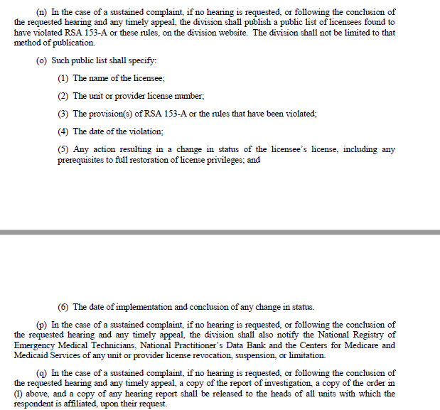
Required Reporting – THE WEBSITE
We are required to report sanctions according to administrative rule:
Saf-C 5922.02(n)(o)
If there is a sustained violation, according to rule, your name and the violation information would appear on the division website…indefinitely!
SUSTAINED sanctions are also reportable to:
NREMT
NPDB
CMS

Slide 55
What is one way to avoid an investigation? Your documentation….
EMSIR Required Documentation Saf-C 5902.08
Saf-C 5902.08(b) A provider from each of the responding EMS units shall complete an EMSIR for each incident, and each
patient originating in this state, in which emergency medical care, transport, response, or transfer was:
(1) Requested;
(2) Rendered;
(3) Refused; or
(4) Canceled

Slide 56
EMSIR Required Documentation Saf-C 5902.08
- Remember: TEMSIS/PCR is a legal document and belongs to the patient
You must effectively document unusual circumstances with great detail;
but also do the same in the cases where you think you do not need to
Have a template – be consistent – use the same process, where applicable
If a patient refuses care, have them sign a refusal, but also document the events clearly and detail the events in your narrative
Please don’t be afraid to use quotations (Yes, even profanity…)
If it is not documented, did it even happen?
If you have questions about how to best document something? Call compliance!

Slide 57
Investigation Statistical Information
2023 so far…(as of March 13, 2023)
Currently, The Division has (21) twenty one active cases in Compliance!
There has been (1) one Immediate Suspension or 541A so far this year.
There are (5) five preliminary investigations – they will likely be
“cleared without a finding” (CWOF) OR they could turn into an
investigation
There have been (0) zero appeals!

Slide 58
How to submit a complaint
You can submit your complaint via the Division of FSTEMS website:
https://nhfa-ems.com/ems-resources/submit-an-ems-complaint/
Email: Elizabeth.a.goguet@dos.nh.gov
Call: 603-223-4251 (Goguet’s Direct phone)
You can submit an anonymous complaint
Finally, just remember, ALL Official Complaints MUST be in
writing, in accordance with Administrative Rule, Saf-C 5922.02

Slide 59

Thank you for attending!
Any questions?

