Slide 1

Assistance to Firefighters Grant Program
Fiscal Year 2022 Application Development Workshop – PPE and Equipment
Notes:
Introduce yourself and support staff. Note the chat, Q&A box and file share.
Welcome to the 2022 version of the assistance to firefighters grant program application development workshop. This workshop will last approximately 1 hour possibly longer depending on questions. This program is designed to provide an overview of Equipment and PPE activities under the operations and safety component of the program.

Slide 2
Application Technical Assistance
Regional Fire Program Specialist
  https://www.fema.gov/grants/preparedness/firefighters/regional-contacts
Assistance to Firefighters Grant (AFG) Program Help Desk
  Monday through Friday, 8:00 AM – 4:30 PM ET
  1-866-274-0960
  FireGrants@fema.dhs.gov
AFG Program Website: https://www.fema.gov/firegrants
Notes:
The first thing we want you to know is that help is available to you through this process. One resource is our regional fire program specialists. There is at least one in each of the ten FEMA regions. The URL here will take to the website to view their contact information.
The next option is the AFG Help-Desk. It is staffed daily by fire service professionals that know the program and the fire service.
The last bullet contains a link to our website where you can download self-help materials to assist you with developing your application and your narrative. We will discuss these later in the presentation.

Slide 3
AFG Newsletter Sign-Up
Receive the latest news from AFG
URL: https://public.govdelivery.com/accounts/USDHSFEMA/subscriber/new?topic_id=USDHSFEMA_153
Notes:
The AFG program sends out program updates as necessary. Ensure you are signed up to receive these critical emails.

Slide 4

Assistance to Firefighters Grant Program
Status Updates
Notes:
Awards are ongoing for the 2021 AFG Programs. Many have received turndown letters at this point with more coming as the remaining funds are depleted. If you’d like more information on why you were not successful, there is a link in your turndown letter to request that additional assistance or simply contact your regional representative.

Slide 5
Fiscal Year (FY) 2022
Assistance to Firefighters Grant Program
Application Period
January 9, 2023, at 8:00 AM ET to
February 10, 2023, at 5:00 PM ET
Notes:
Discuss the dates of the application. That will begin at 8:00 AM on the first day and end at 5:00 PM on the final day. All times are Eastern Time.

Slide 6
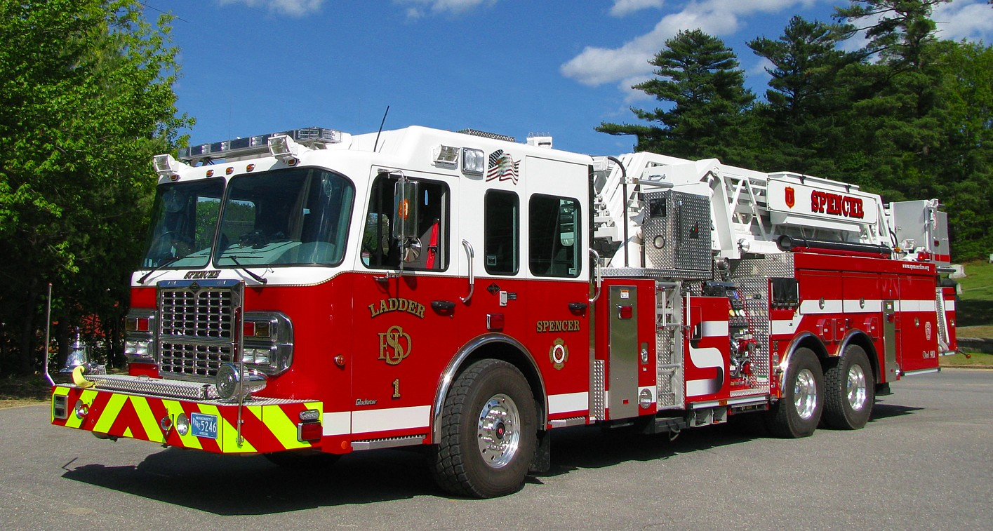
Agenda
What’s New for 2022
PPE and Equipment Application Development
Top Ten Best Practices
Image provided courtesy of Mike Boynton massfiretrucks.com
Notes:
Today's program is primarily comprised of an overview of the PPE and Equipment Activities. We will also cover what is new for 2022 and our top 10 best practices.

Slide 7


Firefighter-Related Grant Programs
AFG
Program
Available FY 2022:
$324,000,000
Staffing for Adequate Fire
and Emergency Response
Program
Available FY 2022:
$360,000,000
Fire Prevention and
Safety
Program
Available FY 2022:
$36,000,000
Notes:
The fire grant programs have three parts.
The Assistance to Firefighters Grant Program, which is what we're discussing today
Staffing for Adequate Fire and Emergency Response – Provides funding to fire departments to increase staffing to meet national standards either through hiring full-time staff or the recruitment and retention of volunteers
Fire Prevention and Safety – Provides funding to bolster fire prevention activities within a municipality. It also has a research and development component to fund studies that could impact the fire service and firefighter safety.
Noted here are the appropriation levels for each.

Slide 8
What’s New for FY 2022
Allow applications to link requests for Air Compressor/Fill Station/Cascade System (Fixed or Mobile) to requests for self-contained breathing apparatus (SCBA)
Allow applicants to link requests for personal protective equipment (PPE) washer/extractor/dryer to requests for PPE by adding the request under additional funding to personal protective equipment (PPE)request
Clarified definitions of front line and reserve vehicles
Applicants should not include permanently out of service vehicles in the application
Notes:
Let’s discuss what is new for 2022 –
For applicants applying for SCBA or PPE you may now add air compressor cascade systems to your SCBA request or PPE washers and dryers to your PPE request. This will need to be justified in the narrative and should be requested using the additional funding line item from the dropdown menu.
Definitions clarifying the difference between frontline and reserve vehicles has been added to the notice of funding opportunity. We will discuss these later.
Applicants requesting vehicles should not include permanently out of service vehicles in their vehicle inventory

Slide 9
What’s New for FY 2022 (continued)
Portable radios may be requested based on seated riding position or number of active members; additional justification will be required if requesting for active members
Virtual reality training simulators are high priority for SFTAs
Vehicle mounted diesel exhaust systems now a high priority under the equipment activity
For SFTAs, repairs and upgrades to props are an eligible expense
Notes:
In the past request for portable radios were limited to the quantity of seated writing positions indicated in the application. Applicants may now request portable radios based on the number of active members in the department. Requests based on active members will have to be justified in the narrative .
Virtual reality training simulators or a high priority only for state fire training academies.
Vehicle mounted diesel exhaust systems are now a high priority within the equipment activity.
For state fire training academies, Repairs and upgrades two existing props are an eligible expense.

Slide 10

System for Award Management (SAM.gov)
Applicants are REQUIRED to have an active account in SAM.gov throughout the entire application and award cycles
  A lapse in SAM.gov registration could result in an applicant not being selected for funding
SAM.gov accounts are FREE
SAM.gov Help
  www.FSD.gov
  866-606-8220
Notes:
We want to remind you that you are required to maintain an active status on your SAM.gov account throughout the application and award cycle. A lapse in your active status could impact your award.
SAM.gov is free so there is no need to pay anyone to register or renew your registration.
If you need assistance, it is available through the federal support desk or at the number listed here on the slide.

Slide 11
Grant Writer Fees – Pre-Award Expenditures
Include fees in the Request Details section
Must be paid 90 days prior to the posting of the NOFO and up to 30 days after the application period closes
Grant writer must be selected based on local procurement policy
Required Documentation:
  A copy of the grant writer’s contract for services
  A copy of the invoice or purchase order
  A copy of the cancelled check (front and back)
  A copy of the local procurement policy (to include evidence that the services were competitively procured, as applicable)
Notes:
You are absolutely allowed to hire a grant writer.
The Assistance to Firefighters Grant Program will reimburse you for the cost of a grant writer up to $1500.
Please note that if you do hire a grant writer you will need to claim those costs in the request detail section of your application.
You must pay your grant writer 90 days prior to the publishing of the NOFO or within 30 days after the application period closes.
Grant writer services must be competitively procured
We strongly recommend following your local procurement policy.
You will be required to submit a copy of the grant writer’s contract, a copy of the invoice or purchase order, a copy, front and back, of the canceled check used to pay the grant writer or other acceptable proof of payment and a copy of your local procurement policy.
If you do not have a local procurement policy, please follow the federal requirements outlined in 2 CFR Part 200; 318-320.

Slide 12
Grant Writer – Important Considerations
Grant writer permissions in FEMA GO
Duplicate or template narratives
Grant writers must be identified in the application even if not requesting reimbursement
The applicant is responsible for the content and validity of all information submitted in the application
Notes:
Some important things to consider when hiring a grant writer are:
Grant writers should be assigned permissions as a grant writer in FEMA GO. Be wary of giving your grant writer permissions as an authorized organization representative in FEMA GO as this gives them the ability to do things like submitting your application or accepting your award.
The application period is short and a busy time for grant writers. Some use templates or somewhat duplicative narratives, which could have significant impacts on your panel review score if the panelists notice the similarities and they will!
If you hire a grant writer, they must be identified as such in the application, even if you are not requesting a reimbursement for the costs of their services.

Slide 13
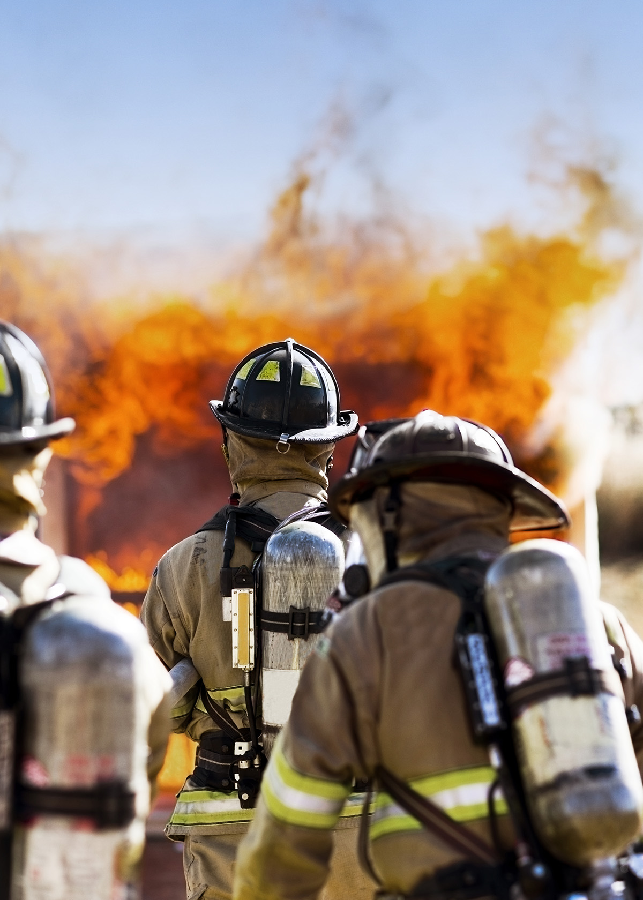
AFG Program Application Types
Operations and Safety
  Training, Equipment, PPE, Wellness and Fitness, Modifications to Facilities
  Micro Grants
Vehicle
Regional (Operations and Safety, Vehicle)
Nonaffiliated EMS organizations
SFTAs
Notes:
The AFG Program consists of 3 separate applications.
The first is operations and safety that consists of five activities equipment, personal protective equipment, training, modifications to facilities, and wellness and fitness.
The second is vehicle acquisition. Eligible applicants can request to replace unsafe fire apparatus and ambulances in their existing fleet.
The third is a regional request where two or more departments combined to request a mutual need.
It's important to note that each of these applications moves through the scoring process separately as do the five activities under operations and safety.
Nonaffiliated EMS and state fire training academies can request many of the same things however they have their own separate and distinct applications.

Slide 14
Equipment
Notes:
We’ll start by talking about the Equipment activity

Slide 15
O&S Equipment: Scoring Considerations
Department type
Community classification
Item Priority
Purpose of request
Age of equipment being replaced
Trained to use
Call volume
Notes:
Scoring factors for equipment include your department type and community classification. These two along with the item or items you are requesting will determine the swim lane you’ll be competing in.
Other factors include:
The priority of the item you are requesting;
The purpose for the request
Age of equipment being replaced
Trained to use
Call volume
We will discuss a few of these more in depth in the coming slides.

Slide 16
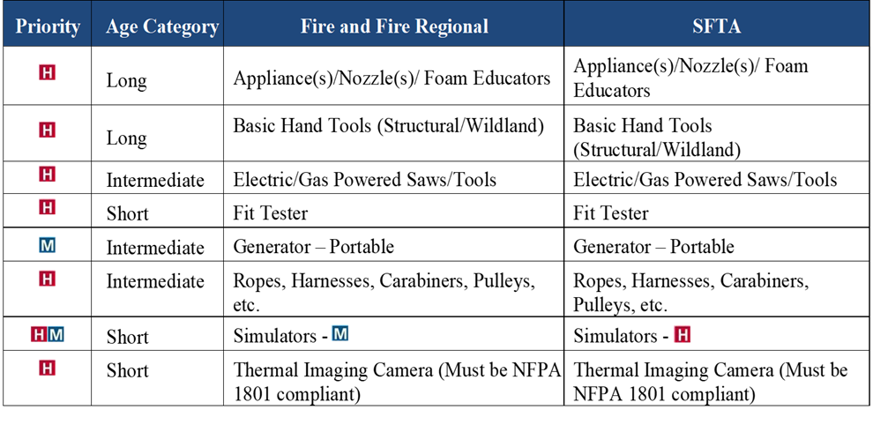
O&S: Equipment
Notes:
The first activity we'll discuss is equipment. Here is a screenshot of the equipment priorities from the NOFO. Notice the Red H, which identifies a high priority item and the blue M notating a medium priority. Notice items like simulators that has both symbols. When you read to the right, you’ll see that simulators are a high priority for fire academies but a medium for fire departments.

Slide 17
O&S: Basic Equipment – High Priority
Hose, Nozzles, and Appliances
Thermal Imaging Cameras
Ladders
Power/Hand Tools
RIT Packs
Personal Accountability Systems
H
Notes:
High priority basic equipment is simply the equipment that you carry on your fire truck every day. Notice that RIT packs are considered equipment if they are being requested alone. If you are requesting SCBA and also need a RIT pack, it should be requested in conjunction with an SCBA request under the PPE activity using the additional funding line item within the PPE activity.

Slide 18
O&S: Communications Equipment – High Priority
Communications equipment must be P-25 Compliant
Base Stations
Mobile Radios
Portable Radios
Mobile Repeaters
Headsets
Pagers – Limited to Rural Only
H
Notes:
Only the basic communications equipment is considered high priority of the program.
Things like mobile radios, portable radios, base stations, pagers, and mobile repeaters are high priority.
Notice that pagers are high priority only for departments that have a rural community classification.
All communications equipment must be certified as project 25 compliant.
You do not want to ask for things like fixed repeaters or microwave antennas as these are ineligible and you will not get your request.

Slide 19
O&S: Rescue Equipment – High Priority
Vehicle Extrication Equipment (Battery Powered or Hydraulic)
Technical Rescue Equipment
  Air Bags
  Struts
  Ropes, harnesses, carabiners,
  pulleys, etc.
H
Notes:
Rescue equipment is a high priority of the program.
All of the equipment that you would associate with vehicle extrication to include battery operated tools are high priority.
All of the equipment you would associate with technical rescue to include air bags, struts, ropes, carabiners are all considered high priority.

Slide 20
O&S: EMS Equipment – High Priority
Applicants MUST have staff trained to Service Level required for EMS Equipment Requested
Automated External Defibrillators
Automatic Chest Compression Device
EMS Training Aids
Cardiac Monitor/Defibrillator
Power Lift Cots/Systems
Pulse Oximeters
Non-Disposable Airway Equipment (e.g., suction)
H
Notes:
EMS equipment is a high priority of the program. All of the equipment that you would associate with the delivery of your EMS program is considered high priority.
In the request detail section for EMS equipment, you will be asked to select the level of service associated with the type of equipment you're requesting. Make sure that the service level corresponds with the item selected.
An example would be a 15 lead monitor, which you would associate with an ALS level of service

Slide 21
O&S: Other Equipment – High Priority
Air Compressor/Fill Station/Cascade System (Fixed or Mobile) for filling SCBA
PPE Washer/Extractor/Dryer
Skid Unit (Brush Truck)
Vehicle Mounted Diesel Exhaust Systems
Training Props and Tow Vehicles
  High Priority for SFTA and Regional Requests
  Regional Requests limited to $50,000 per prop
Training Simulators
  High Priority for SFTA
  Medium Priority for Fire Departments and Nonaffiliated EMS
H
Notes:
Air refill cascade systems, washers and dryers that you would associate with your SCBA or PPE are considered equipment if being purchased outside of a PPE or SCBA request.
Vehicle mounted diesel exhaust systems are now considered high priority
Props are a high priority of the program but only if they are associated with a regional project. Also, props are limited to $50,000 per prop.
In the application it allows you to select props or simulators. If you are doing a regional application for a prop then you will want to select prop. Do not select simulator under any circumstances as it is a low priority.

Slide 22
O&S: Equipment – Medium/Low Priority
Boats
All Terrain Vehicles
Computers for Training
Portable Generators
Mobile Data Terminals
Hazardous Materials Equipment
Portable Pumps
M
L
Notes:
Things that we are often asked about that are medium or low priority items that you should avoid are boats, ATVs, and hazardous materials equipment.

Slide 23
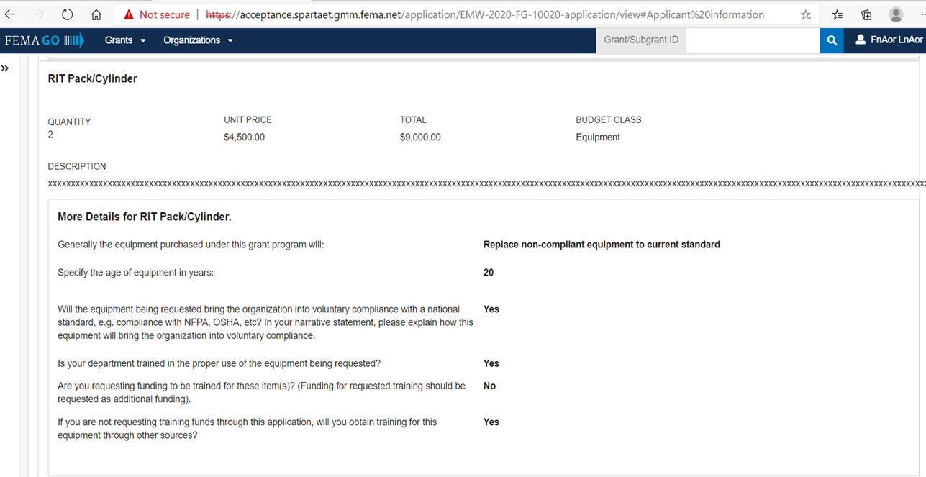
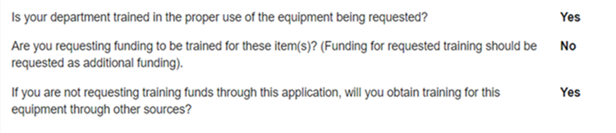
O&S: Training Question
Notes:
The program will not award you equipment that you are not trained to use. For each piece of equipment that you request, you will be asked a series of three questions.
1. Is your department trained in the proper use of the equipment being requested. If you are, just answer yes we believe you
2. If you are requesting funding to train your department on the use of the equipment that you're requesting because you are not currently trained to use it you will want to answer yes to question number 2. If this is the case, you will want to add the costs associated with the training as a new line item under additional funding.
3. If you are not already trained to use the equipment and you are not requesting funding to get the training you must answer yes that you are going to get the training through another source.
The summary of this is you have to answer yes to at least one of these questions. If you do not you will not receive an award for that piece of equipment. Subsequently, a lower score on one piece of equipment could affect the rest of your request.

Slide 24
O&S: Equipment – Other Considerations
Equipment that has a direct effect on firefighters’ health and safety
Age of equipment considered for replacement
Equipment that operationally benefits other jurisdictions
Equipment that brings the department into compliance with a national recommended standard
H
Notes:
Make sure when you are determining what you should ask for that you can explain how receiving that item is going to have a direct effect on firefighter health and safety.
Age is an important part of the scoring process. Older is always better when you're considering what to ask for.
You'll want to make sure to articulate that the equipment that you're purchasing will benefit other organizations likely your mutual aid partners.
You'll also want to make sure that the equipment that you're purchasing we'll bring you into compliance with a national standard as you will be asked that question in the application.

Slide 25
O&S: Equipment – Other Eligible Costs
Extended warranties and service agreements, when offered, are eligible on all items
Request training for specific equipment (add training costs to Additional Funding section)
Installation, Freight Costs, and Taxes
Notes:
Some things to think about as you're considering what to request or putting cost estimates together are extended warranties and service agreements, installation or freight costs, or taxes that might be associated with your purchase are all allowable costs. The program does not award grants to departments that are not trained to use the equipment they are requesting. If you are going to require training and that training will come at a cost, you may request those costs as part of your application. To include costs such as these listed, you’ll want to add another item under the equipment activity, select the additional funding line item from the drop down menu and then you can describe the costs and what they are for.

Slide 26
O&S: Equipment – Product Lifecycle
Age Category | Useful Life | Examples
Short | 5-7 Years Old | Cardiac Monitors Thermal Imaging Camera Gas Monitors | Accountability Sys. Fit Test Systems Computers Tablets
Intermediate | 8-14 Years Old | Washer/Dryer RIT Pack Communications Equipment Extrication Tools | Power Stretchers Ropes, Pulleys, etc. Nozzles Cascade Systems Hose
Long | 15-20 Years Old | Basic Hand Tools Foam Eductors | Appliances Ladders Tow Vehicles
Notes:
Back in 2013 in order for a piece of equipment to be considered high priority it had to be 15 years old or older. In 2014 the program introduced this product lifecycle that was designed to addressed the fact that some equipment becomes obsolete well before that time.
Equipment has been broken out into these three age categories short, intermediate, and long. Notice the useful life associated with these age categories and the examples that are provided for equipment that fits into those age categories. As I mentioned earlier regarding age, the older the better. So, just because you have a cardiac monitor that is 6 years old, it does not mean you should ask to replace that at that point as you will likely be competing against agencies that have equipment that is significantly older. From the standpoint of competition older is always better when considering what you should request.

Slide 27



O&S: Equipment – Purpose Question
    Obtain equipment to achieve minimum operational and deployment standards for existing missions
    Replace non-compliant equipment to current standard
    Obtain equipment for new mission
    Upgrade technology to current standard
Notes:
In the request details section of your application and for each item you are requesting you will be asked the purpose for why you are requesting the equipment.
If you are requesting equipment that you do not currently own, you will want to use the first high priority answer which is: obtain equipment to achieve minimum operational and deployment standards for existing missions.
If you are requesting to replace equipment that is just no longer compliant, you'll want to use the second high priority answer here.
There are two additional options for you to answer this question you want to avoid answering that you are obtaining equipment for a new mission or that you are just upgrading technology to the current standard. That last one is tricky because it has some similar language to the high priority answers above but if you remember that you do not want to upgrade technology or begin a new mission you will be fine.

Slide 28
Personal Protective Equipment
Notes:
The next activity we’ll discuss in personal protective equipment.

Slide 29
O&S: PPE – Scoring Considerations
Department type
Community classification
Item Priority
Purpose of request
Age of PPE being replaced
SCBA and National Fire Protection Association (NFPA) 1981
Trained to use
Call volume
Notes:
Scoring factors for PPE include your department type and community classification. These two along with the item or items you are requesting will determine the swim lane you’ll be competing in.
Other factors include:
The priority of the item you are requesting;
The purpose for the request
Age of PPE being replaced
Edition of NFPA 1981 SCBA being replaced is compliant with
Trained to use
Call volume
We will discuss a few of these more in depth in the coming slides.

Slide 30
PPE Priorities
PPE being REPLACED must be 10 years old or older
SCBA Must be 10 years old or older AND compliant with the 2007 Edition of NFPA 1981 or older editions
Notes:
Now we will move on to the personal protective equipment activity.
When determining if you should ask to replace your PPE or SCBA you'll need to consider its age and the addition of NFPA 1981 that your SCBA is compliant with.
For PPE to be considered high priority it must be 10 years old or older. Again, in order to be competitive, remember the older the better.
For SCBA, it must also be 10 years old or older but also be two cycles out of compliance with NFPA 1981. For fiscal year 2022, SCBA must be compliant with or older than the 2007 edition of NFPA 1981.

Slide 31
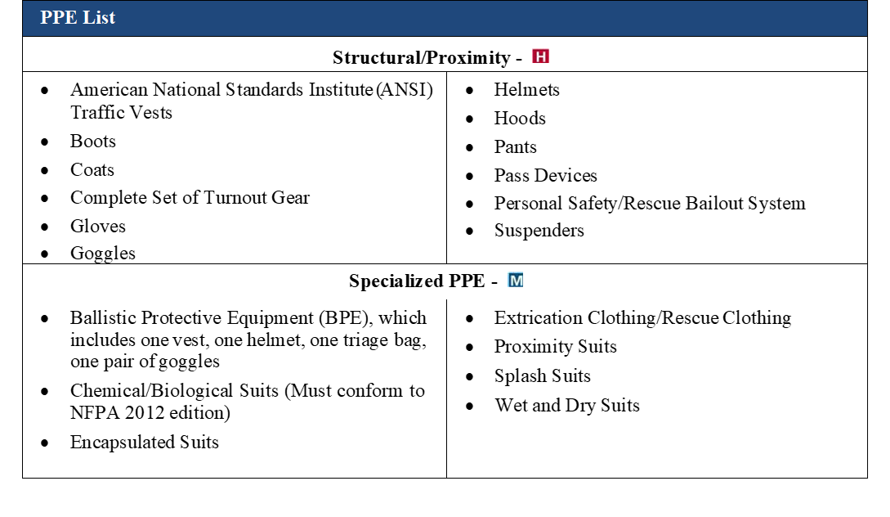
PPE: NOFO
Notes:
Here is a screenshot from the NOFO as it relates to PPE notice the difference in how high priority items are delineated here versus the listing under equipment.

Slide 32
PPE: Structural/Proximity – High Priority
PPE can be requested as a complete set or a la carte
AFG Program funds will NOT award requests for second sets of PPE
Coats
Pants
Boots
Gloves (2 pairs)
Hoods (2)
Helmets
PASS Devices
Goggles
Suspenders
Bail-Out/Personal Escape Device (included in Complete Set if Departmental Policy)
Notes:
Structural PPE may be requested as a complete set or Ala carte. Please consult the notice of funding opportunity to ensure that you are accounting for all of what we consider a complete set of PPE. One item of note is that we consider two sets of gloves and two hoods as part of a complete PPE ensemble.
Bail out kits can be requested as a stand-alone item or as part of a complete PPE ensemble IF departmental policy requires them to be worn with a members PPE at all times.
The program is too competitive at this point to allow for any agency to request a second set of PPE so if you determined that that is your need you will not want to ask for that through this program

Slide 33
PPE: Wildland – High Priority
Can be requested as a complete set or a la carte
Coats
Pants
Boots
Gloves
Jumpsuits/Coveralls
Helmets
Shelters
Goggles
Suspenders
Web Gear/Backpacks
Canteens/Hydration Systems
Notes:
As with turn out gear wildland gear can be requested as a complete set or a la carte.
This slide contains the full list of items identified in the NOFO that make up a complete set of wildland PPE. If you are considering a wildland PPE request, you may want to note this list as there may be some components you may not have considered

Slide 34
PPE: EMS – High Priority
Can be requested as a complete set or a la carte
Coats
Pants
Boots
Gloves
Helmets
Goggles
Suspenders
Notes:
EMS PPE is also a high priority of the program

Slide 35
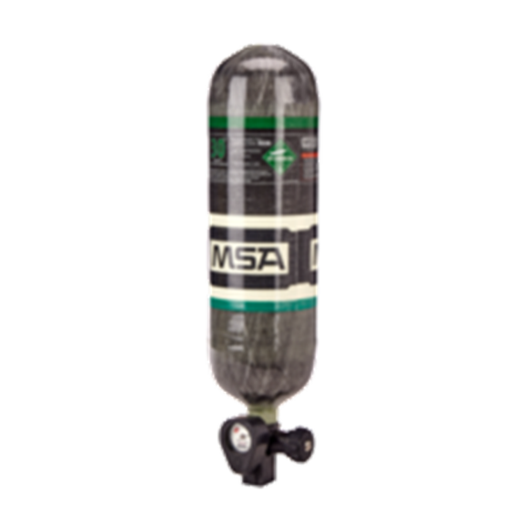
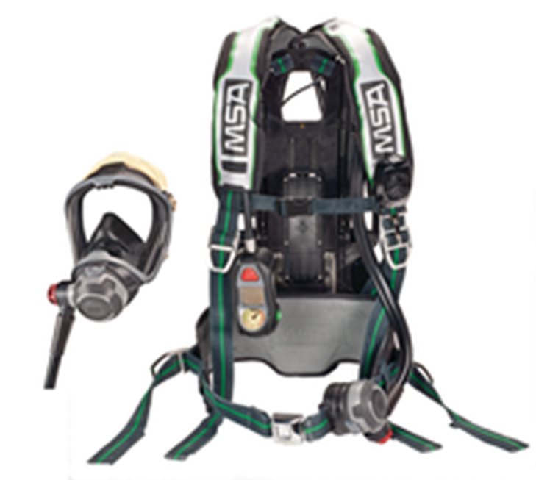
PPE: SCBA – High Priority
SCBA (SCBA Unit includes: Harness/Backpack, Face Piece, and 2 cylinders)
Air-Line Units
Additional Facepieces
Respirators
SCBA Spare Cylinders
Images provided courtesy of MSA
Notes:
For replacement SCBA to be high priority, the equipment has to be 10 years old or older and compliant with the 2007 edition of NFPA 1981 or an older edition.
The program considers and SCBA to consist of a harness a face piece and two cylinders. You'll want to ensure when you are requesting cost estimates from vendors that you ensure they are considering all of these components.
You may also request additional face pieces to ensure that all of your firefighters have their own facepiece. If you require 20 SCBA and have 40 firefighters you can request twenty additional face pieces to augment the 20 face pieces that will come with the 20 SCBA.
If you need just cylinders there is an item in the dropdown specifically for those. The same goes if you just need face pieces. If you are just requesting the harnesses then you will have to use the regular SCBA item in the dropdown menu and then note in the product description that you are just purchasing harnesses. Your cost estimate should also be reflective of this.
Another thing to consider with SCBA is cost estimates that are received from vendors. Often times these cost estimates are based on manufacturers suggested retail prices and do not reflect the cost that generally comes from a competitive procurement process. If you decide to use an estimate that you've received from a vendor keep in mind it is likely inflated and will be reduced as part of the technical review process to the cost that has been determined through market research

Slide 36
PPE: Medium/Low Priority
Ballistic PPE
Extrication/Rescue PPE
Wet/Dry Suits
Hazardous Materials PPE (all levels)
Proximity Suits
M
L
Notes:
Some items of PPE you will want to avoid requesting are hazardous materials PPE, PPE for ice or water rescue , or ballistic PPE. These are all medium or low priorities of the program.

Slide 37
PPE: Purpose Question
Increase supply for new hire/existing firefighters that do not have one set of turnout gear (PPE) or allocated seated position (SCBA); this includes replacing out of service PPE and SCBA
Replace in-service/in-use/damaged/unsafe/ unrepairable PPE or SCBA to meet current standard
Replace in-service/in-use/expired/ noncompliant PPE or SCBA to current standard
Replace PPE to upgrade technology to current standard
Notes:
As we discussed in the equipment activity, there is a similar question in the PPE activity as it pertains to the purpose for requesting PPE.
If you are requesting turn out gear for firefighters that do not have it or if you have riding positions on your apparatus that do not have SCBA assigned to them, you want to use the first high priority answer, which is increased supply for new hires and/or existing fire effect turn out gear or allocated seated position.
If you are requesting SCBA or turn out gear that is damaged, unusable or unrepairable but still in service, you will want to use the second high priority answer which is Replace in-service/in-use/damaged/unsafe/unrepairable PPE or SCBA to meet current standard.
If you are simply replacing your SCBA or turn out gear to meet the current standard, you will want to use the final high priority answer which is Replace in-service/in-use/expired/noncompliant PPE or SCBA to current standard.
The fourth bullet is a low priority reason that suggests that you are going to Replace PPE to upgrade technology to current standard. If you have compliant gear and are simply upgrading technology, you’ll want to consider asking for something different.

Slide 38
PPE: Other Considerations
Applicants are required to provide the age of PPE being replaced
Priority of the requested PPE is a factor
Call volume can contribute to the justification for new risk
Applicants with the oldest PPE and/or trying to bring the department into 100% NFPA compliance, or increase the percent of active members who will have compliant gear to 100%
SCBA Integrated Thermal Imaging Cameras are ineligible as they are not yet NFPA compliant
H
Notes:
You will be asked to provide a complete inventory of your PPE and the ages. Call volume is also considered when PPE applications are scored. The program also wants to ensure that all of your members or all of your seated riding positions that require SCBA have compliant gear associated with them.
The thermal imaging cameras that are sometimes associated with SCBA are not eligible to be purchased through the program as they are not yet NFPA compliant.

Slide 39
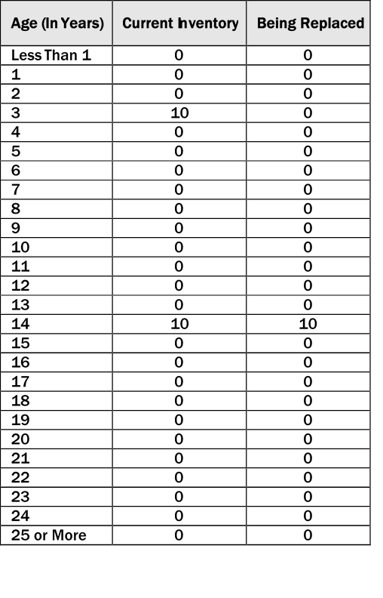
PPE: Inventory
Notes:
There are two matrices that will show up in your request detail for each item as it pertains to turn out gear or PPE. If you are asking to replace PPE, you will see an inventory matrix similar to what is here. This is where you will tell us about your PPE as it relates to its age. And then in the being replaced column you will tell us which of those sets of turn out gear you are replacing. In order to be high priority, you should only be asking to replace PPE that is 10 years old or older. In the example this department has twenty sets of turn out gear. Ten of which are three years old and ten that are 14 years old, as you can see, they are only asking to replace those ten sets that are 14 years old and not the three-year-old equipment.

Slide 40
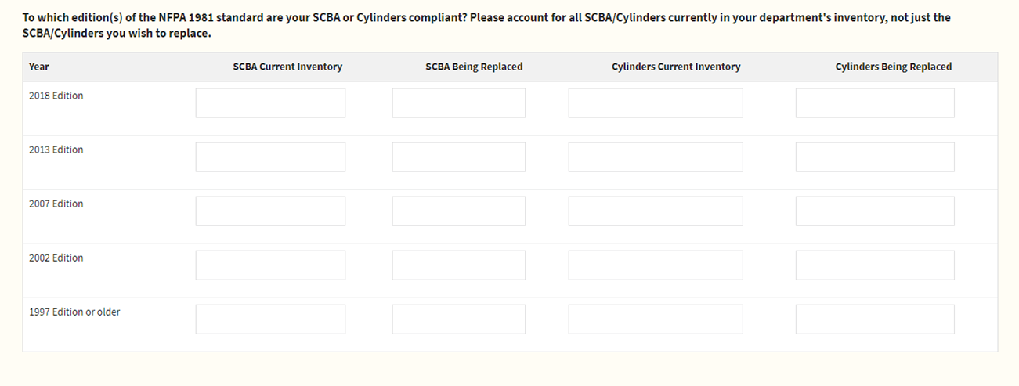
PPE: SCBA Inventory
Notes:
If you are requesting SCBA, you will see a matrix similar to what is here. Instead of reporting your equipment based on age, you will be asked to inventory your SCBA based on the edition of NFPA 1981 that it is compliant with.

Slide 41
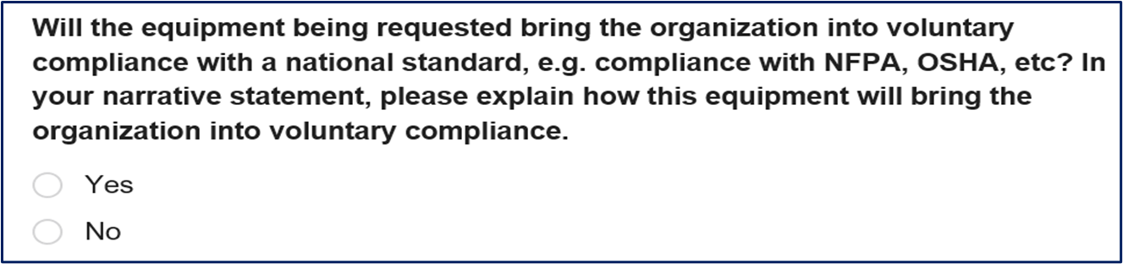
PPE: Compliance/Coverage Application
  How many of your on-duty active members currently have PPE that meets applicable NFPA and Occupational Safety and Health Administration Standards?
  How many of your seated riding positions currently have compliant SCBA assigned to it?
Notes:
Within the request details section for each item of SCBA or PPE that you are requesting, you will be asked if the equipment will bring you into compliance with some national standard this question is scored and should be yes.
Depending on whether you are asking for SCBA or PPE you will be asked to answer one of these next two questions, respectively. For PPE, it asks how many of your on-duty active members currently have PPE that meets applicable NFPA and OSHA standards. If you are asking to replace your full inventory of PPE, the answer to this question should be 0 since none of your members have compliant turn out gear. The same applies to the question as it relates to SCBA and see their riding positions if you were asking to replace all of your SCBA then none of your seated writing positions have compliant SCBA associated with them, and the answer should be 0. There may be situations where you do have some compliant gear and are only asking to replace the equipment that is not compliant. In this situation you should only answer this question by providing the quantity of gear that you have that is currently compliant.
It is important to note that neither of these questions are scored but will likely be viewed by panelists at peer review which could impact their scoring of your application.

Slide 42
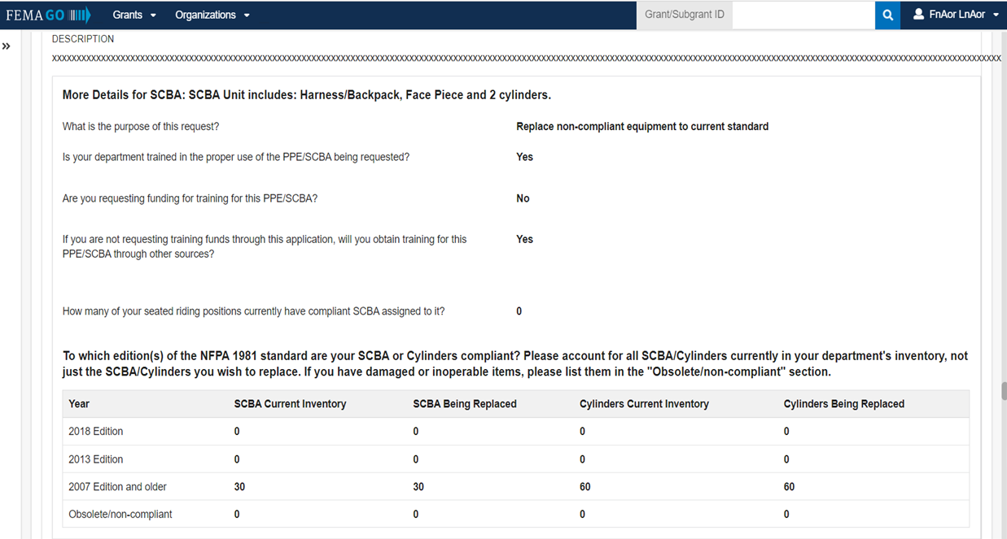
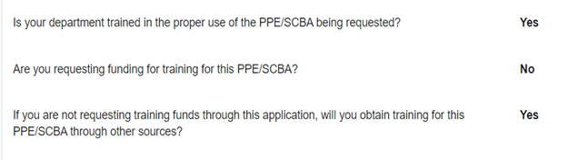
PPE: Training Question
Notes:
As was discussed with equipment there will be the same training questions asked in each item request for SCBA or PPE. The program will not award equipment that you were not trained to use so it is critical that the answer to one of these questions be YES.

Slide 43
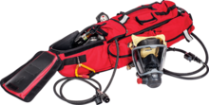
PPE: Non-PPE Equipment
If the item is to be worn, it is considered PPE; if an item is used or carried, it is considered Equipment
Items below are the exception to this if requested in conjunction with PPE or SCBA:
  Air-Refill/Cascade
  PPE Washer/Dryer
  RIT Pack
Image provided courtesy of MSA
Notes:
In order to effectively separate equipment from PPE, the Program had to create some delineation between the two. That delineation is PPE is worn and equipment is used or carried.
Items such as rapid intervention packs, gear washers/dryers and air refill cascade systems that you may associate with your PPE request can requested in conjunction with a PPE or SCBA request and should be added under the PPE activity as a line item under additional funding.
This will need to be justified in your narrative.

Slide 44
PPE: Seated-Riding Positions
SCBA and Portable Radio awards are made based on the number of Seated-Riding Positions identified in the application
Portable radios can also be requested based on number active members, but this must be justified in the narrative
Notes:
The program awards portable radios and SCBA‘s based on the amount of seated riding positions you identify in the application. However, you are now allowed to base the quantities of portable radios you are requesting on the number of active members in your agency. If you use this methodology for your request, you will have to justify that need in your narrative.

Slide 45
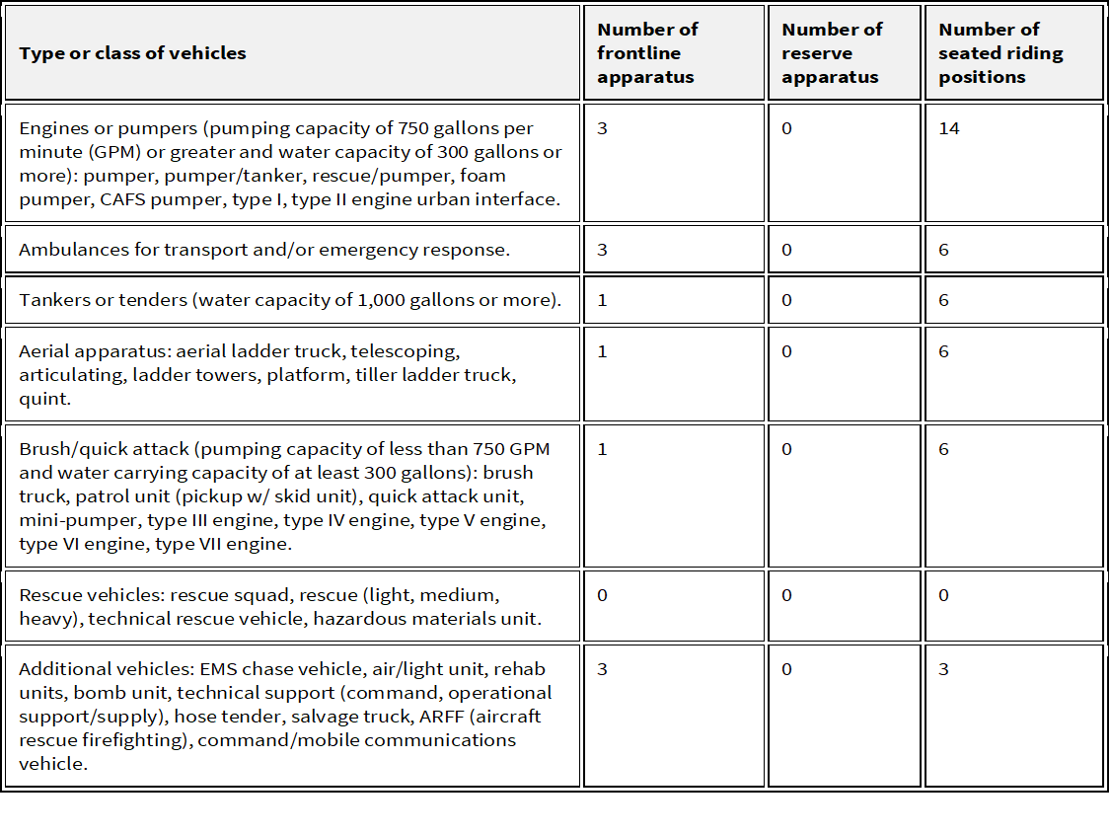
PPE: Seated Riding Positions
Notes:
This is an example of the form you will have to fill out in the application where you will tell us about the vehicles in your fleet and on the far-right side, you'll associate the total number of seated riding positions with the total number of apparatus you have in each class.
So, for example, if you are asking to replace 20 SCBA you will want to ensure that you are showing that you have at least 20 seated riding positions.

Slide 46
PPE: Seated Riding Positions (continued)
Apparatus Type | Number of Seated Riding Positions
Engines | Minimum of 4
Ambulances | 2
Tankers | Minimum of 4
Aerials/Quints | Minimum of 4
Brush/Quick Attack | 2
Rescue/Haz-Mat | Minimum of 4
Command/Support | 1
Notes:
Here is an example of what we would expect as far as the minimum amount of seated riding positions that you might associate with the vehicles in your fleet. The minimum of four associated with engines, tankers, aerials, and rescue apparatus are based on the requirements of NFPA 1901.

Slide 47
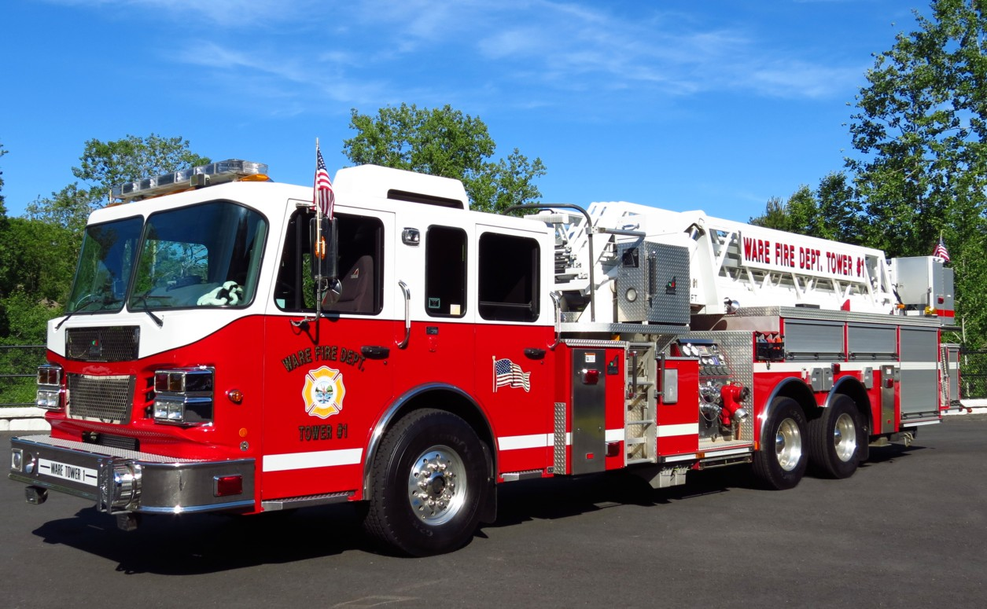
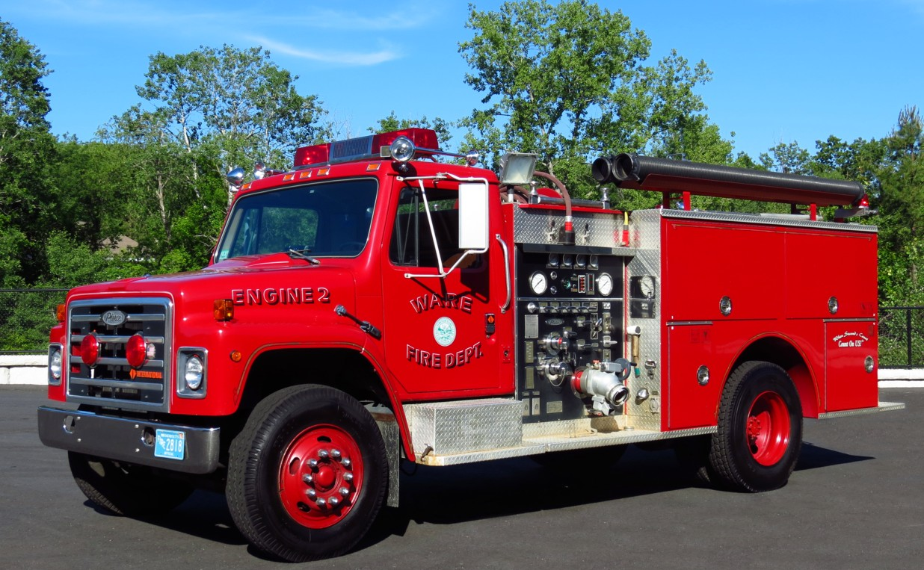
PPE: Seated Riding Positions – Commercial/Custom Cabs
Image provided courtesy of Mike Boynton massfiretrucks.com
Image provided courtesy of Mike Boynton massfiretrucks.com
Notes:
We often get questions about how many seated riding positions should be associated with different types of apparatus. Specifically, as it pertains to custom and commercial cabs. For your custom cabs it is just the amount of SCBA that are mounted in the seats and possibly one in a compartment for your driver. For commercial cabs that normally only have two seats the SCBA are mounted in a side compartment for the purposes of the application the amount of SCBA that you carry on that commercial cab apparatus is the amount of seated riding positions you will want to associate with that truck. So, if your truck only has two seats and you carry 6 SCBA in a side compartment you should be associating six seated riding positions with that vehicle.

Slide 48
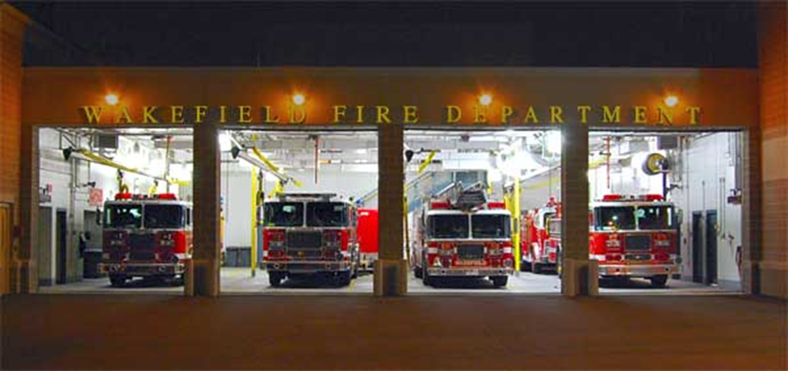
PPE: Seated Riding Positions – Front-Line/Reserve
Front Line Vehicle: a vehicle that is fully equipped and ready to respond to emergency calls (first due, second due, ready-reserve vehicle)
Reserve Vehicle: a vehicle that is not fully equipped and not ready to respond. Reserve apparatus is used when the frontline vehicle is out-of-service (repairs/maintenance). Equipment is removed from the front-line vehicle and moved to the reserve vehicle for emergency response
Image provided courtesy of Dave Parr
Notes:
It is important to make the distinction between frontline and reserve apparatus as it is seen by the assistance to firefighters grant program. Looking at this picture of a fire station there are certainly apparatus here that the department in question likely considers their frontline or first due pieces and those that are considered reserve. In many cases department consider reserve apparatus as a fully equipped apparatus that is ready to respond if needed. In other words, it has hose, tools, SCBA, radios , etc. assigned to it. The program has added definitions to clarify the difference between frontline and reserve. They are:
Front Line Vehicle: a vehicle that is fully equipped and ready to respond to emergency calls (first due, second due, ready-reserve vehicle).
Reserve Vehicle: a vehicle that is not fully equipped and not ready to respond. Reserve apparatus is used when the frontline vehicle is out-of-service (repairs/maintenance). Equipment is removed from the front-line vehicle and moved to the reserve vehicle for emergency response.

Slide 49
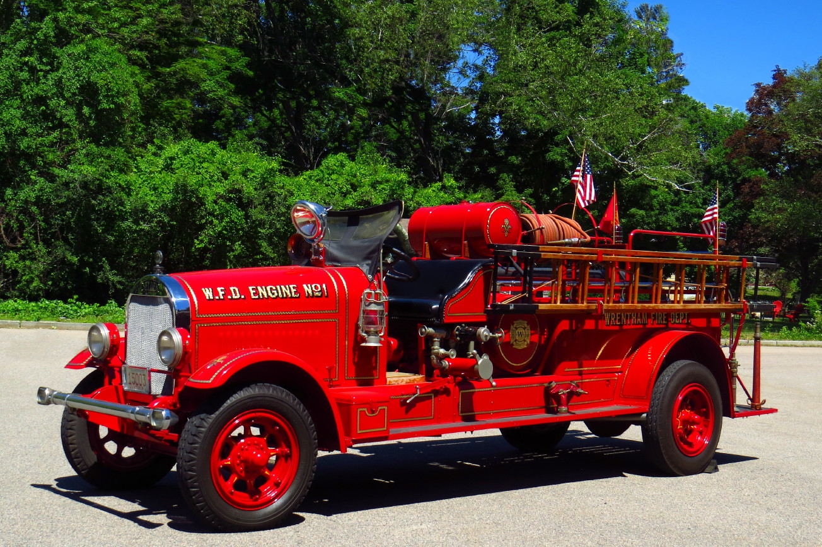
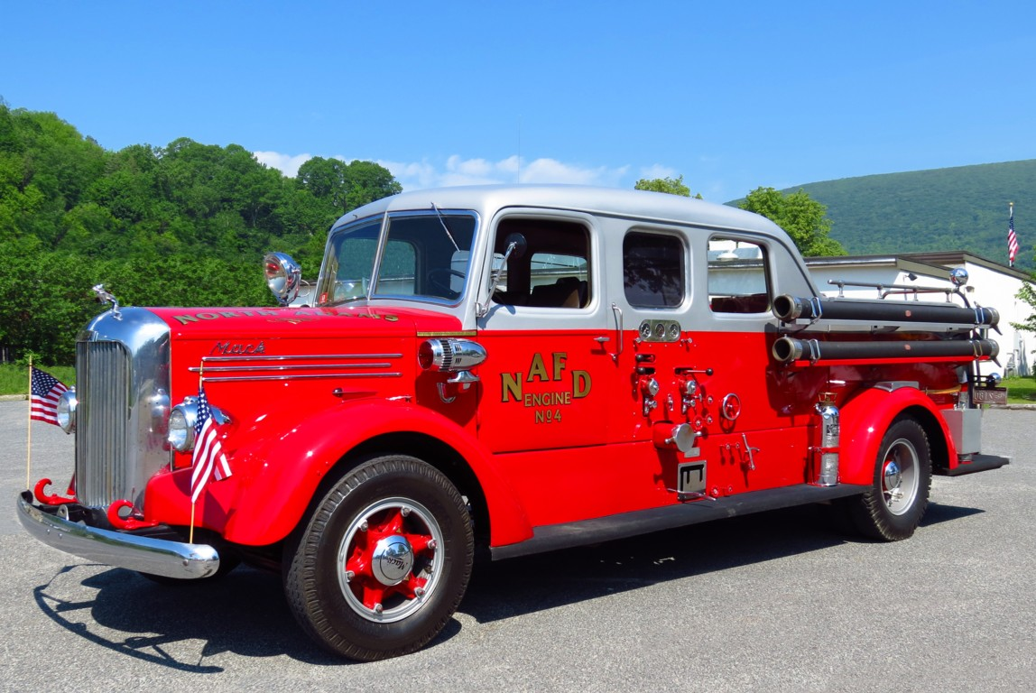
PPE: Seated Riding Positions – Front-Line/Reserve
Permanently out-of-service vehicles should not be listed in the application
Images provided courtesy of Mike Boynton massfiretrucks.com
Notes:
Permanently out-of-service vehicles should not be listed in the application. An example of a permanently out of service vehicle could be this parade piece or that old apparatus out behind the station that does not have any equipment on it.

Slide 50
Operations and Safety – Micro-Grants
Grants of $50,000 or less (Federal share)
Eligibility:
  Fire Departments and Nonaffiliated EMS Agencies
  All five of the O&S Activities are Eligible
    Equipment
    PPE
    Training
    Wellness and Fitness (Priority I only)
    Modifications to Facilities
Applicants that have been unsuccessful in the past may receive up to three additional points in the electronic scoring process
Micro-Grants will only compete against other Micro-Grant applications
Notes:
Another item to consider is microgrants. Microgrants are an option under your operations and safety application. A microgrant is a request that is less than $50,000 federal share and can be for any one of the five activities listed.
It's important to note that microgrants are an option if you apply for a microgrant for something that is less than $50,000 under any of these activities that becomes your operations and safety application. You cannot apply for a microgrant for a PPE washer and do a second application to request SCBAs.
Micro grants are intended to help applicants that have not been successful. For each micro grant application, the system will look back over the past five years to determine if the applicant has been successful or not. If not, they applicant may receive up to 3 additional points toward their pre-score depending on how many times they have applied and not received an award.
Micro grants only compete against micro grants. Micro grants have their own set aside allowing the program to use up to 25% of the appropriation to fund micro grant applications.

Slide 51
Regional Applications
Notes:
On the next few slides, we’ll discuss regional applications. You can partner with other departments that have similar needs within the equipment and PPE activities.

Slide 52
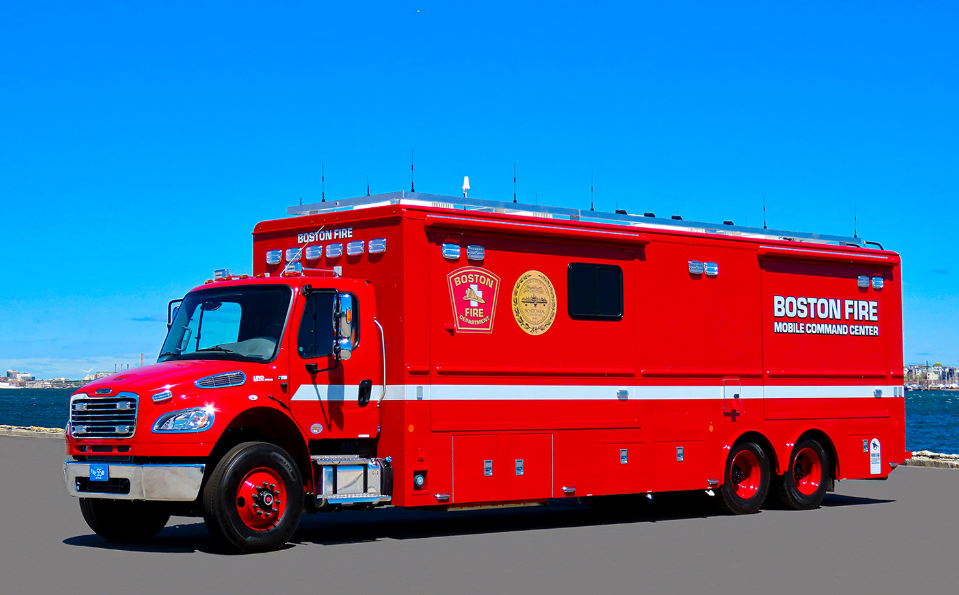
Regional Applications: Overview
A regional application is one in which multiple organizations serving more than one local jurisdiction benefit directly from the activities implemented with the grant funds
Eligible projects:
  Operations and Safety
    Training
    Equipment
    PPE
    Wellness and Fitness
  Vehicle acquisition
Image provided courtesy of Mike Boynton massfiretrucks.com
Notes:
A regional request is where one or more agencies combined their application efforts to request a common need.
Regional projects can be in the areas of training, equipment, PPE, or Wellness and fitness.
Two or more departments may also request to replace or acquire a vehicle that will benefit all departments involved.

Slide 53
Regional Applications: Overview (continued)
An eligible department must act as the Host of a regional application:
Host Department Type determines the set-aside category where funds will be awarded from
All partners need to be listed in the application
Include statistics of partners
Memorandum of Understanding required
Regional purchases must be made from same vendor
Notes:
Regional requests require that an eligible department be the host or the primary applicant in the application. Please note that the type of department whether career, combination or volunteer determines what bucket of funds the award will be made from. This is referring to the 25% set aside for each department type.
The host will have to ensure that all regional partners are listed in the application and that a memorandum of understanding is executed and attached to the application. This memorandum of understanding should include the signatures of all regional partners as well as determine how the funds will be distributed and how the match will be allocated.
Regional applications require that these statistics of the application be aggregated from the totals for all the departments involved. This means that the total population, call volume and other statistics represent the totals for all involved. One option to make this easier would be to download the application checklist from our website and share with each of your regional partners. Once they return them completed, you can easily add up things like numbers of firefighters, stations, response area, population, etc. to be incorporated into the application.
Keep in mind that regional purchases must be made from the same vendor

Slide 54
Regional Applications: Regional Vehicle Priorities
Notes:
For planning purposes here is a list of high priority regional vehicles from the NOFO. Notice the difference between these and what was considered high priority for single department vehicle acquisition.

Slide 55
Program Resources
Documents Resources
AFG FireGrants Help-Desk
Cost Share Calculator
Self Evaluation Sheets
Application Checklist
Narrative Development Guide
Application Workshop PowerPoint
AFG Program Help Desk: 1-866-274-0960
Email: firegrants@fema.dhs.gov
AFG Program Website: https://www.fema.gov/grants/preparedness/firefighters
Notes:
Here's a list of resources that can be found on our website.
Some what you'll want to consider for the purposes of planning and preparation are the application checklist that provides you with all of the information that you'll need to compile to complete a large majority of the application.
The next valuable resource is a self evaluation sheets. There are two of these one for a regular operations and safety request and a second for a vehicle acquisition request. The self evaluation sheets provide you with the exact criteria that the panelists will be reviewing your narrative based on. We recommend providing anyone that is going to review your narrative with a copy of the self-evaluation sheets so that they can review it based on that same criteria and provide you with feedback as to whether you have touched on all of the items necessary.
Our latest resource is the Narrative Development Guide. This document builds off of the criteria outlined on the self-evaluation sheets and provides you with tips on how you can meet that criteria. There are even sample narratives included to help you get a feel for how your narratives should flow.
In addition to printed documents, technical assistance is also available through the help desk and the regional fire program specialists.

Slide 56
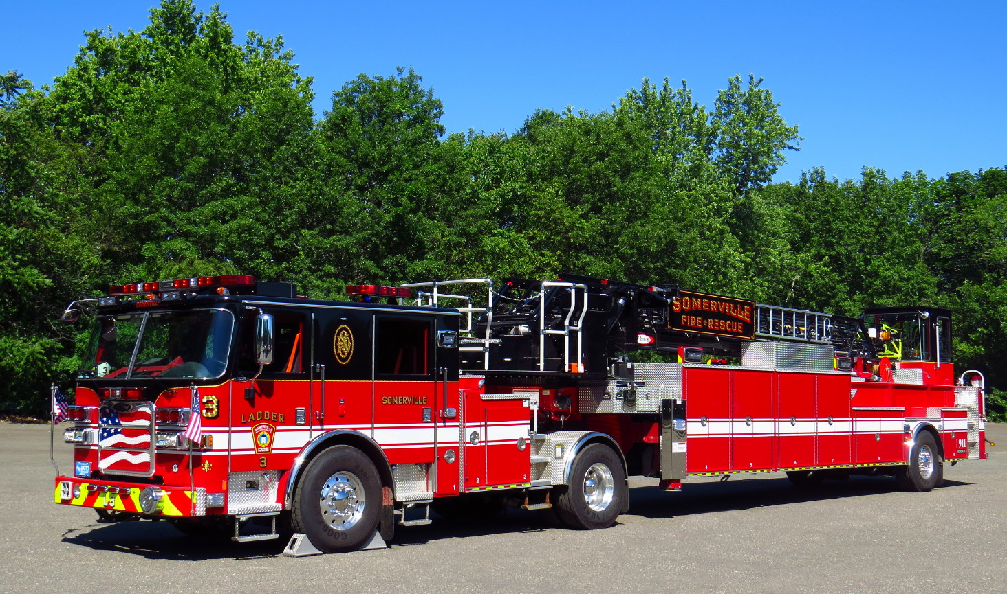
Top 10 Best Practices
Start preparing now and read the NOFO/Program Guidance
Use the application checklist to gather as much information as possible in advance
Align your department’s risk assessment with the FY 2022 AFG Program high funding priorities
Tell your department’s unique story – avoid vendor/ template/copying other
organizations’ narratives
Read each question carefully, then
answer
Image provided courtesy of Mike Boynton massfiretrucks.com
Notes:
Here are the top 10 best practices.
Start preparing now read the notice of funding opportunity.
Use the application checklist and any other resources available to gather as much information as possible in advance of the application opening.
Conduct your risk assessment and then a line your request with the highest priorities of the program.
Make sure when developing your narrative to tell your department's story and the unique reasons for your request stay away from vendor narratives, templates or copying other department's narratives.
Read each question carefully then answer it carefully. If you were not sure what a question is asking for reach out to your regional fire program specialist.

Slide 57
Top 10 Best Practices (continued)
Have your entire application/narratives reviewed by someone else before submitting
Make sure you gather and include all eligible costs as part of your application:
  Training
  Service/extended warranties
  Vehicle performance bonds
Make sure your project can be completed within the grant’s period of performance
Ensure you have support from your local government leaders
Print your application (CTRL/CMD-P) before submitting
Notes:
Make sure that someone else is reviewing your entire application to include your narrative before you submit your application. Make sure that your authorized organization representative has submitted your application.
Make sure to account for all eligible costs that you can associate with your request these include training costs service agreements extended warranties and possibly performance bonds in the case of vehicle acquisition.
Ensure that your project can be completed within your grants 2-year period of performance and articulate that in your narrative.
Ensure that you have support from your community's decision-making authority and that they understand that there is a match requirement with this grant.
Print your application using control P before you submit it.

Slide 58
Questions
Notes:
We will now open up the floor for questions.

Slide 59
Application Technical Assistance
Regional Fire Program Specialist
  https://www.fema.gov/grants/preparedness/firefighters/regional-contacts
AFG Program Help Desk
  Monday through Friday, 8:00 AM – 4:30 PM ET
  1-866-274-0960
  firegrants@fema.dhs.gov
AFG Program Website: https://www.fema.gov/firegrants

