Slide 1

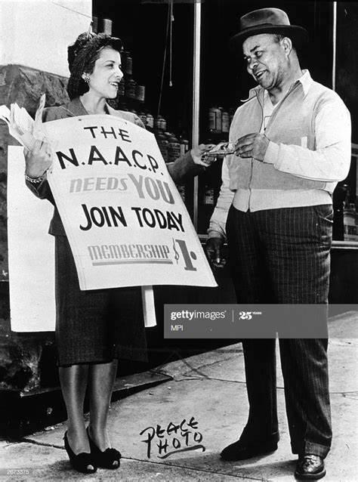
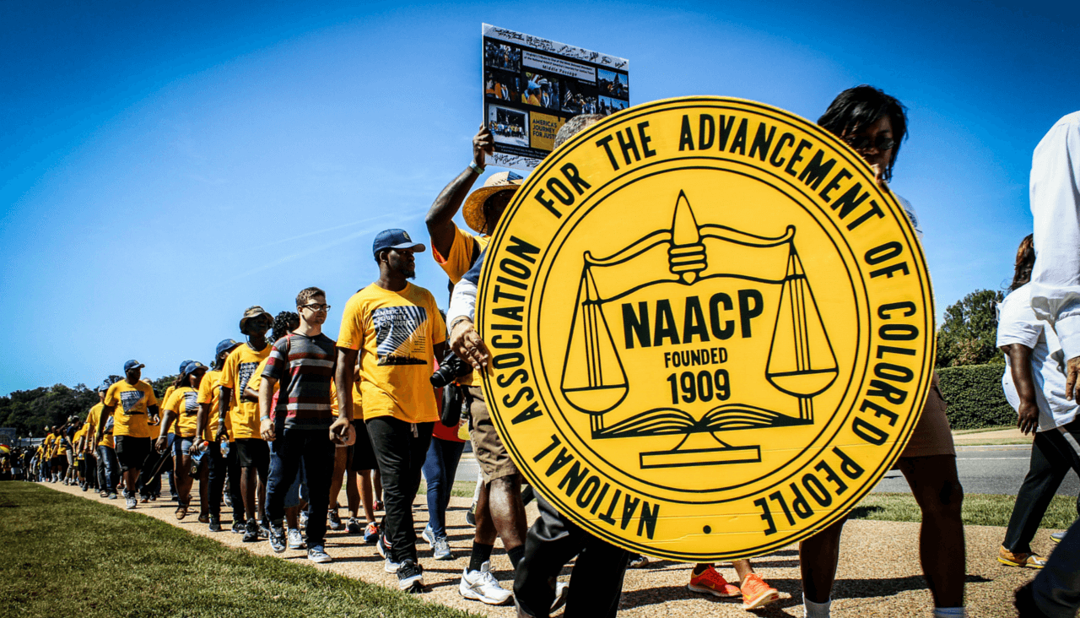
Arlington Branch NAACP Scholarship Class of 2021
Contact Information:
E-mail: 7047@arlingtonnaacp.com

Slide 2
SCHOLARSHIP PROGRAM OVERVIEW
Three award types for 2021
  Willard Woodson Brittain, Jr. Foundation – Renewable $5,000
  Arlington Branch NAACP Future Leaders Scholarship – Renewable $10,000
  Arlington Branch NAACP One Time Scholarships - $1,500
Three levels of review: Community, Scholarship Committee and Executive Committee
The students were selected based on a combination of the community and scholarship committee review, their strong academic achievements, heavy involvement in their schools and community, leadership potential and their commitment to the ideals of the NAACP. The Future Leaders scholars also were reviewed for financial need.

Slide 3
2021 Scholarship Program By the Numbers

Slide 4
Willard Woodson Brittain, Jr. Foundation Scholarship Award
  This award is granted to high school seniors who are residents of Arlington or active members of a civic institution/organization, or faith-based organization in Arlington.
  Recipients displayed high academic achievement, extensive school and community involvement, leadership potential and a commitment to the mission and values of the NAACP.
  Minimum GPA 2.5 and must maintain a 2.5 in college to continue to qualify for the award.
  Funded by the Brittain Foundation, this award provides an annual, renewable scholarship based on funding availability.
  For the Scholarship Class of 2021 we awarded two Brittain Foundation Scholars.

Slide 5
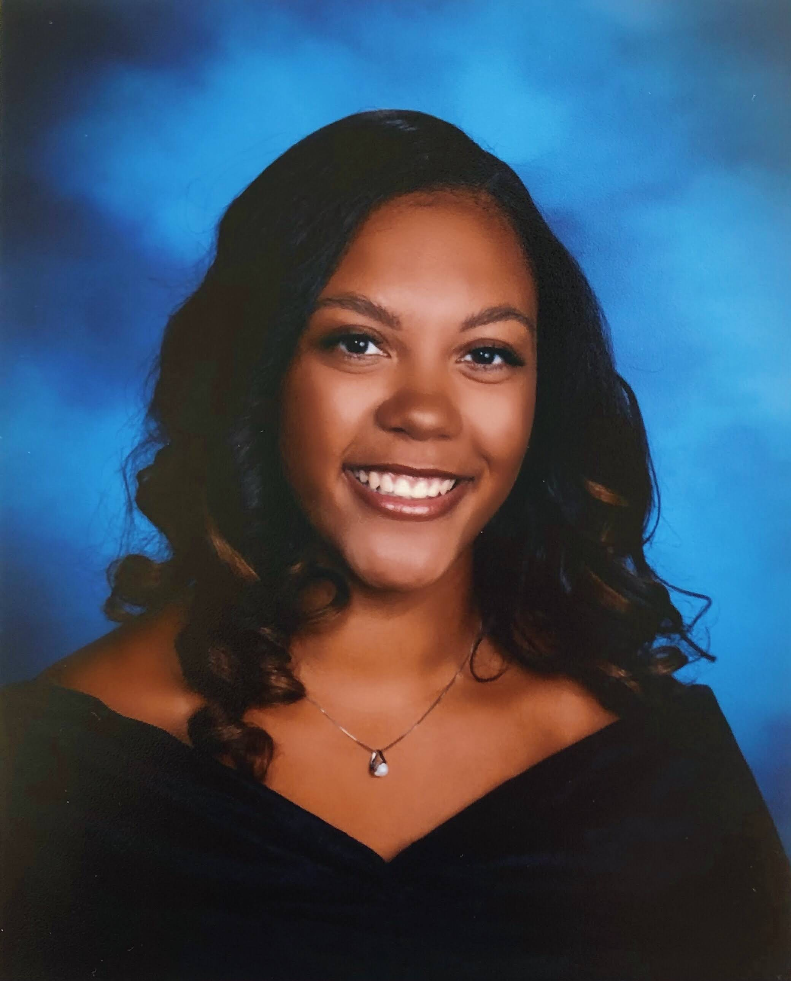
RYLEI PORTER
HIGH SCHOOL- Yorktown
Principal’s Board Member, Choir section leader, All-State VA Choir, National Honor Society, Music Honor Society, A Capella Section Leader, Swim and Dive athlete.
Volunteer for Sources of Strength, Teen Angel Project (Vocal Captain), Innovation Academy, Worship Team Leader at McLean Bible Church
COLLEGE- Belmont University, Nashville TN
Plans to study Music Business and Public Relations
FUTURE GOALS
Rylei hopes to pursue a career in the Artists and Repertoire (A&R) department of a music label to help spread the joy of music.
FAVORITE QUOTE: "Success is not about the money you make, but the difference you make in somebody's life.” - Michelle Obama

Slide 6
Arlington Branch NAACP Future Leaders Scholarship
  This need-based award is granted to graduating HS seniors who are Arlington residents.
  Recipients displayed high academic achievement, extensive school and community involvement, leadership potential and a commitment to the mission and values of the NAACP.
  Minimum GPA 2.75 and must maintain a 3.0 in college to continue to qualify for the award.
  Funded by a generous donation from Amazon, this award provides a $10,000 annual, renewable scholarship.
  For the Scholarship Class of 2021 we awarded five Future Leaders Scholars

Slide 7
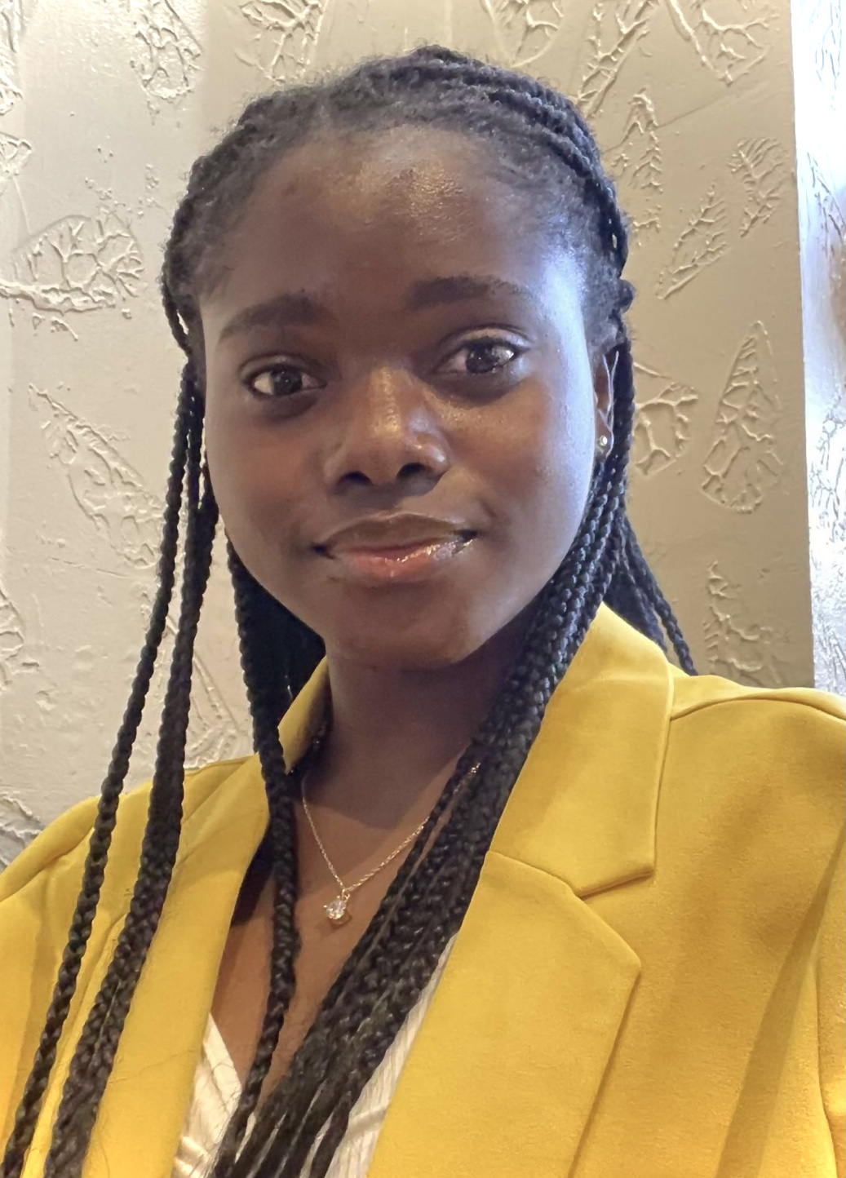
JOANA AGBOKA
HIGH SCHOOL- HB WOODLAWN PROGRAM
Founder of Young People of Color, Produced HB’s Annual Black History Month Talent Show, Peer leader for Sources of Strength, Excellence and Equity Cohort
Air Force Junior ROTC, involved several hours of varied community service
COLLEGE- Virginia Commonwealth University, Richmond VA
Plans to study nursing
FUTURE GOALS
Joana hopes to attend graduate school for a Nursing specialization or master’s in Public Health/Health management, with a dream of starting a free clinic that provides quality healthcare for the underrepresented.
FAVORITE QUOTE: “Nothing will work unless you do.” - Maya Angelou

Slide 8
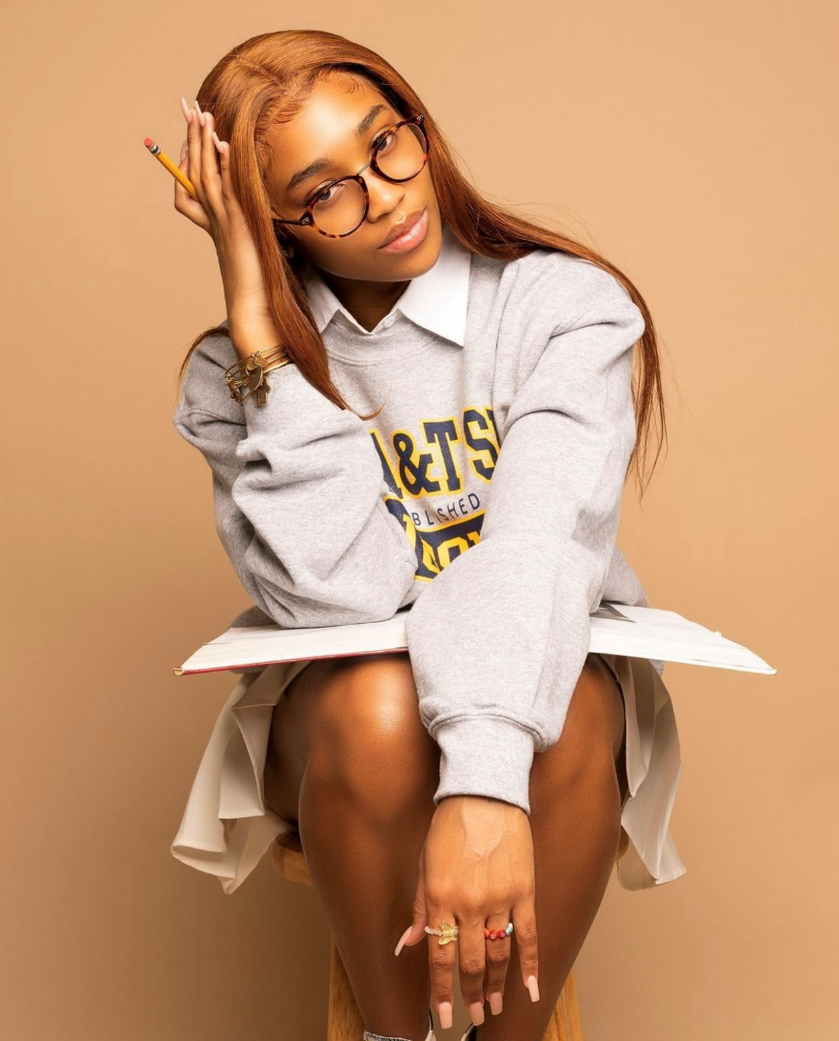
CHELSEA FIGARO
HIGH SCHOOL- Wakefield
Student Government Association, Black Student Union leader
Track and field athlete, and two year co-captain
GMU Early Identification Program participant
COLLEGE- North Carolina A&T University, Greensboro NC
Plans to study Political Science with a minor in African History
FUTURE GOALS
Chelsea aspires to pursue further studies including global relations to widen her knowledge. She plans to use her education to better help her community to prosper and grow.
FAVORITE QUOTE: “Education is the passport to the future, for tomorrow belongs to those who prepare for it today.” - Malcolm X

Slide 9
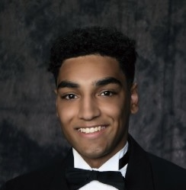
ALEXANDER HALL
HIGH SCHOOL- Wakefield
Wakefield Cohort member, Young Dems, Tennis, Swim and Track Athlete
Published Article in Our Daily Planet
Color of Justice Essay winner
3rd Chair Saxophonist
Volunteer with AFAC, Westover library, Aspire! Interact Club (Officer)
COLLEGE- University of Virginia, Charlottesville VA
Major is undecided, but wants to use his education to address injustice and inequity
FUTURE GOALS
Alex aspires to advance the NAACP’s vision of a society in which all individuals have equal rights without discrimination based on race.
FAVORITE QUOTE: “If you want to go fast, go alone. If you want to go far, go together.” - African proverb

Slide 10
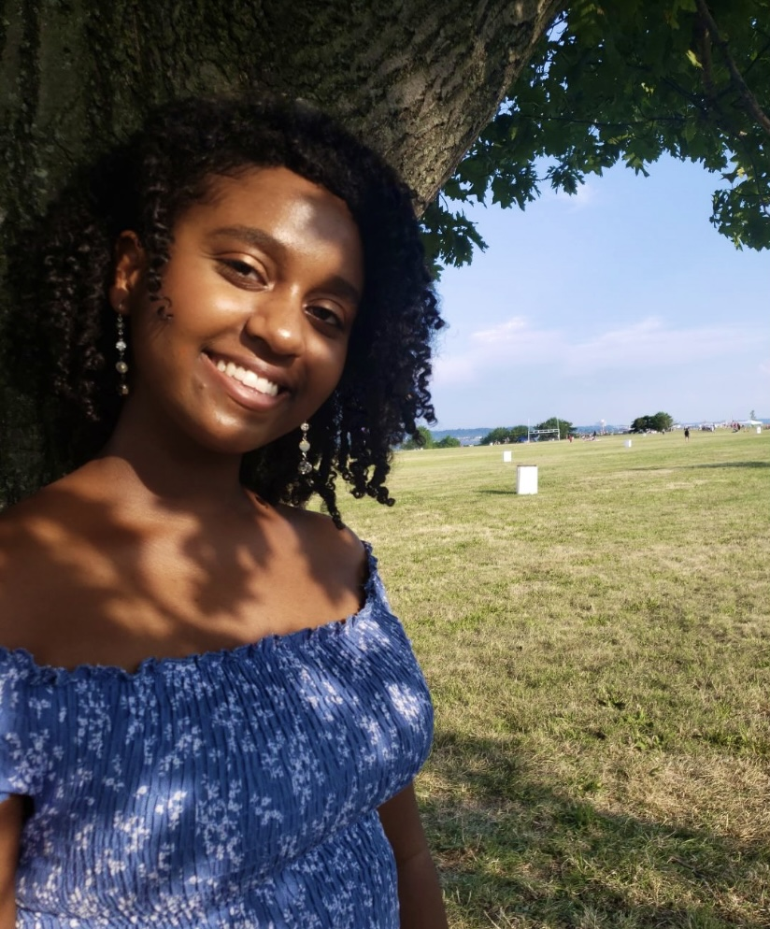
ELENA OGBE
HIGH SCHOOL- Wakefield
AP Seminar/Research Certificate
National Honor Society, Math Honor Society, Vice President Club Africa, Wakefield rep for Students For Mental Health Reform
COLLEGE- James Madison University, Harrisonburg VA
Plans to study nursing
FUTURE GOALS
Elena aspires to become a nurse, working in communities with vulnerable populations, with a goal of helping to eradicate disparities in health care (especially among women of color).
FAVORITE QUOTE: "The future belongs to those who believe in the beauty of their dreams." - Eleanor Roosevelt

Slide 11
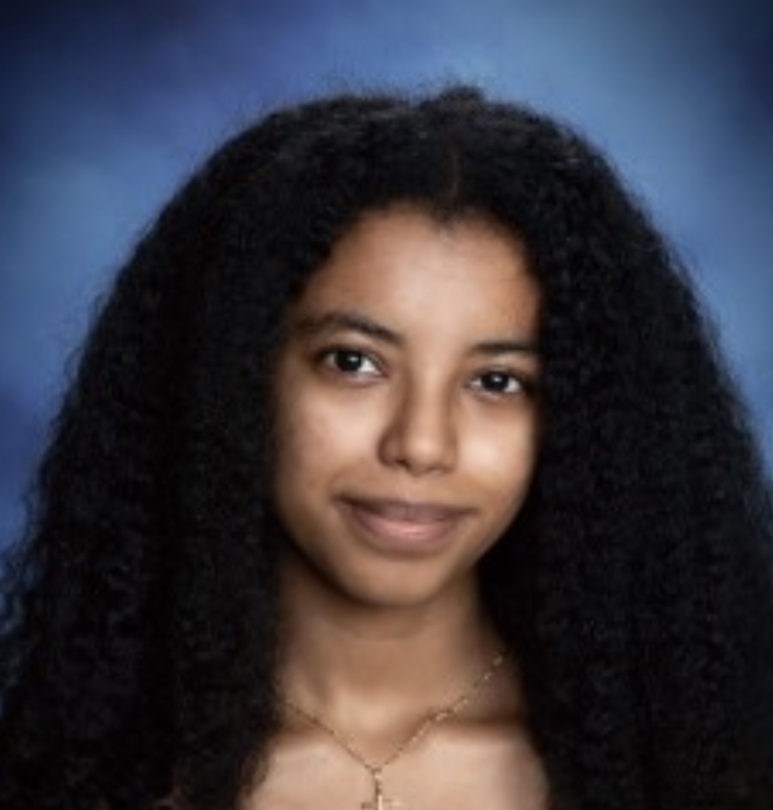
BELEN TESFAYE
HIGH SCHOOL- Washington-Liberty
IB Student with
Co-Founder of the Equity and Excellence club which was formed to create a safe space for students of color at W-L.
Track and field athlete
Volunteer with Hour of Code, AFAC, and Goodwin House
COLLEGE- Northeastern University, Boston MA
Plans to study Health Science and minor in Global Health and Computer Science
FUTURE GOALS
Belen is an aspiring neuro or general surgeon and hopes to continue to medical school.
FAVORITE QUOTE: “The skill of physicians makes them distinguished, and in the presence of the great they are admired.” - Ben Sira

Slide 12
Arlington Branch NAACP One-Time
Scholarship Awards
  Special one-year awards provided by donations to the Branch.
  Recipients displayed high academic achievement, extensive school and community involvement, leadership potential and a commitment to the mission and values of the NAACP.
  Minimum GPA 2.5
  Funded by scholarship donations to the branch, this merit-based award provides $1,500 to the student.
  For the Scholarship Class of 2021 we granted one One-Time Award

Slide 13
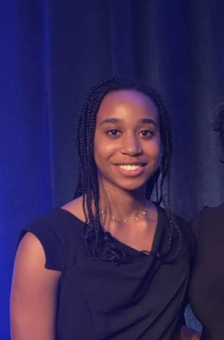
KIRA HARRISON
HIGH SCHOOL- Washington-Liberty
IB Student, Advisory Board Member
Founder of the Change for Climate Club
Volleyball Team
Volunteer with Calloway United Methodist Church, AFAC, AWLA and advocate for environmental justice/sustainable improvements in low-income communities
COLLEGE- Virginia Polytechnic Institute and State University, Blacksburg VA
Plans to study Landscape Horticulture & Design and minor in Environmental Science
FUTURE GOALS
Kira plans to use her education to build sustainable domains and communities that are in harmony with nature.
FAVORITE QUOTE: “There are no mistakes, just happy accidents.” - Bob Ross

