Slide 1
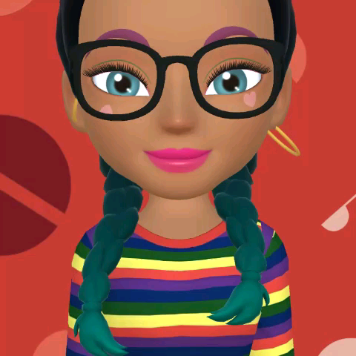

Slide 2
Let’s Take a look at How to Use Zones
Students will stand at waiting zones Until it is clear and they get the okay from a facilitator to start recess.
Student must go to a zone and stay at that zone for entire recess or unless re-directed by facilitator.
Students must not to run on the blacktop, unless in a Basket Ball group game. ( Must be facilitated at all times.
There should only be 6-8 students at a game or activity.

