Slide 1
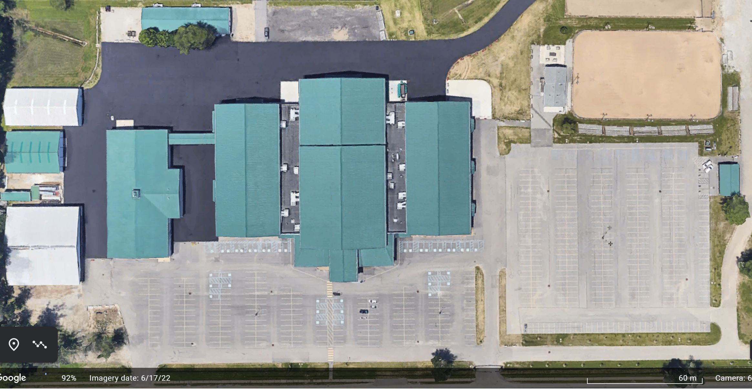
NORTH WING
WEST PAVILION
WEST
WING
COLISEUM
EAST
WING
GALLERY
DOOR #7
WEST WING ENTRANCE
DOOR #5 EAST WING ENTRANCE
WEST PAVILION ENTRANCE
DOOR #6
MAIN ENTRANCE

Slide 2
HIATT DRIVE
VENDOR & STAFF PARKING
VENDOR & STAFF PARKING
DOOR #15
DOOR #21
NORTH WING
DOOR #2
DOOR #3
WEST PAVILION
WEST
WING
COLISEUM
EAST
WING
DOOR #4
GALLERY
DOOR #7
WEST WING ENTRANCE
DOOR #5 EAST WING ENTRANCE
WEST PAVILION ENTRANCE
DOOR #6
MAIN ENTRANCE
TEAL ROAD

