Slide 1
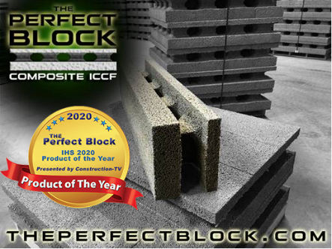
ECO BUILDING SYSTEMS CORP
Rick Tindal
11/27/2023

Slide 2
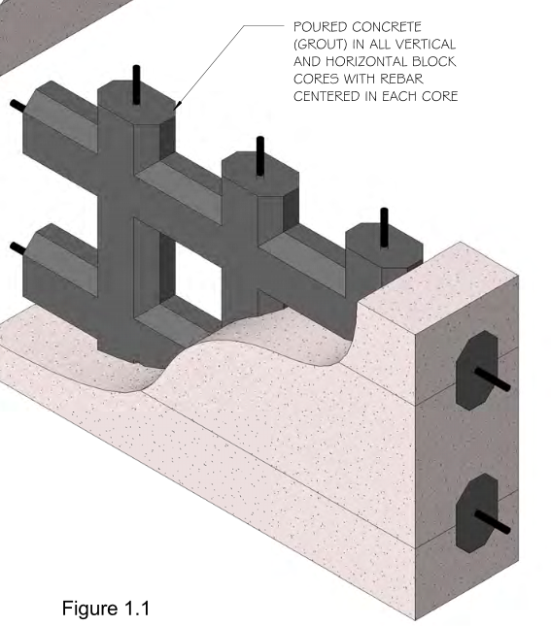
Agenda
Welcome to Eco Building Systems
Who is Eco Building Systems
The Perfect Block Family of ICCF Building Elements
Benefits
What’s the difference between ICF and ICCF?
Strength and Composition
IRC
Excerpt from 2018 IRC, Chapter 6, Wall Construction
Not an Alternative
What is the “Big Five”?
Testing
Walls built to full height
Walls built to a stage (half wall)
Corner Construction
Ledger Construction

Slide 3
Welcome to Eco Building Systems Corp
Manufacturers of The Perfect Block
Insulated Concrete Form (ICF)
Insulated Composite Concrete Forms (ICCF)

Slide 4
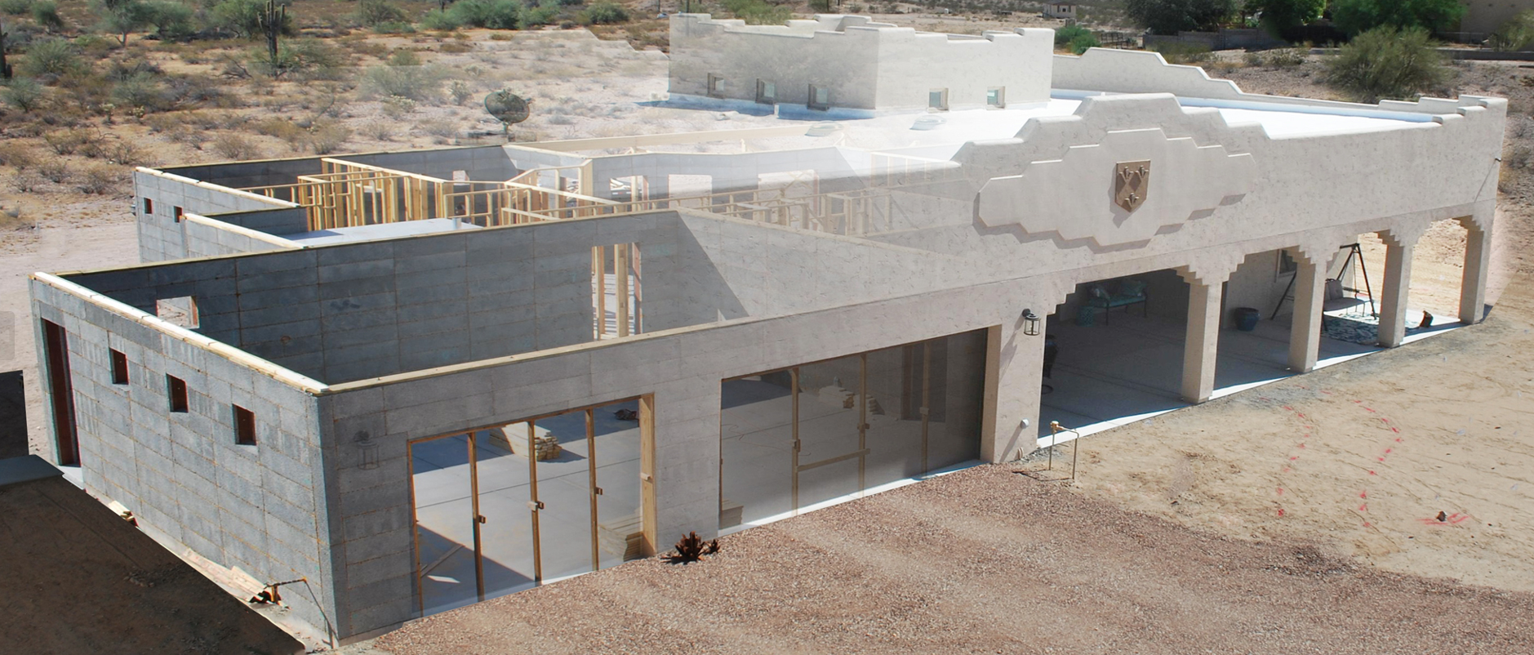
Who is Eco Building Systems (EBS)?
We have been manufacturing ICCF block since 2008
Since the mid nineties, we were builders of ICCF walls and we are still builders
We manufacture “gray block” ICCF and sell block nationwide and overseas
Currently, we are also sub-contractors for ICCF wall construction
We train contractors and owner/builders on ICCF construction and consult on all things ICCF for free

Slide 5
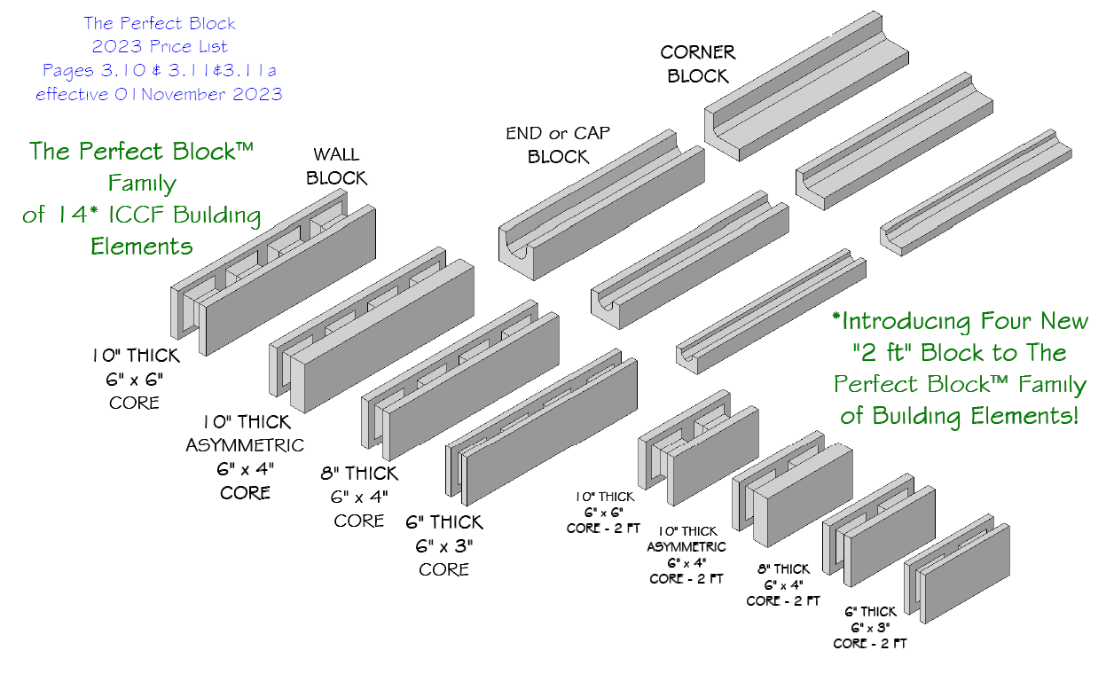
The Perfect Block Family of ICCF Building Elements
The Perfect Block is the name given the to the family of “gray block” ICF/ICCF building elements we manufacture

Slide 6
Benefits
4-hour Fire Rating ASTM E119 Tested
Can withstand 250 MPH winds E-330 E-1886 -E1996 ICC-500 Tested
Can be engineered to hold a seismic 8 earthquake
Super insulated
Noise reduction
Easy to build with
Minimal to no bracing
Perfect for any climate
Termite resistant
Green building

Slide 7
What’s the difference between ICF and ICCF? The Perfect Block (TPB) is an ICF in the eyes of the International Residential Code (IRC) building code But, we are a “gray block” ICF (a mix of cement and expanded polystyrene), and the acronym, ICCF, better describes TPB as a composite (mix) ICF. Either acronym will describe us as a Exterior Concrete Wall Construction (IRC, Chapter 6) building element

Slide 8
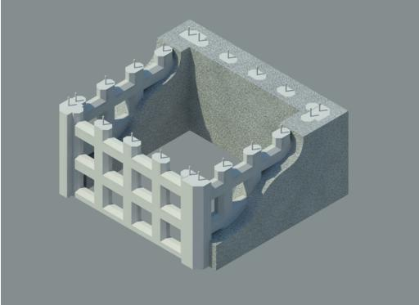
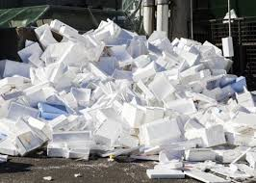
Strength and Composition
"The Perfect Block" is a stay-in-place form made of a mixture of ground-up clean post-industrial, post-consumer expanded polystyrene (EPS), cement, and proprietary admixtures and water.
100% of the EPS in an ICCF block is recycled EPS that was destined to be dumped in a landfill. We are using a modern era waste product that would be filling the world's landfills to create a much-needed energy-efficient building block.

Slide 9
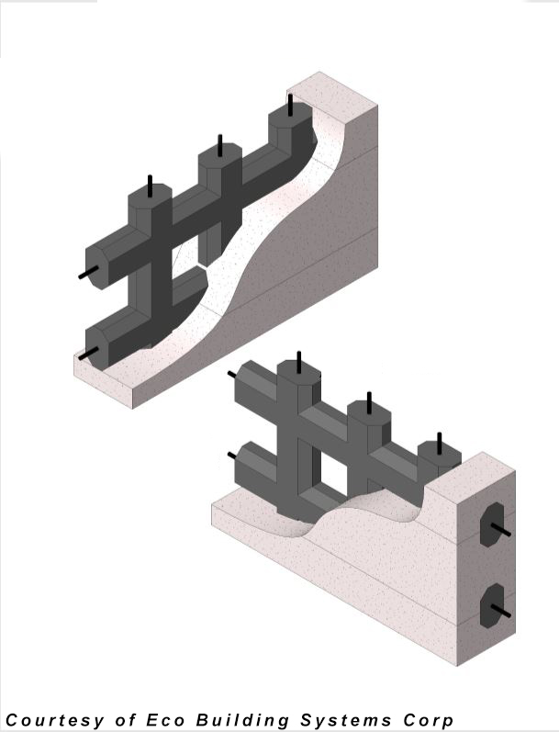
When the cores of assembled ICCF blocks are filled (grouted) with concrete and reinforcement steel (rebar), …..
….. the cured structure provides a permanent framework for a "screen-grid" of reinforced concrete to form highly insulated stem walls, load-bearing walls, shear walls, non-load bearing walls, sound attenuation walls, lintels, perimeter walls, retaining walls, and many other components of a building.

Slide 10
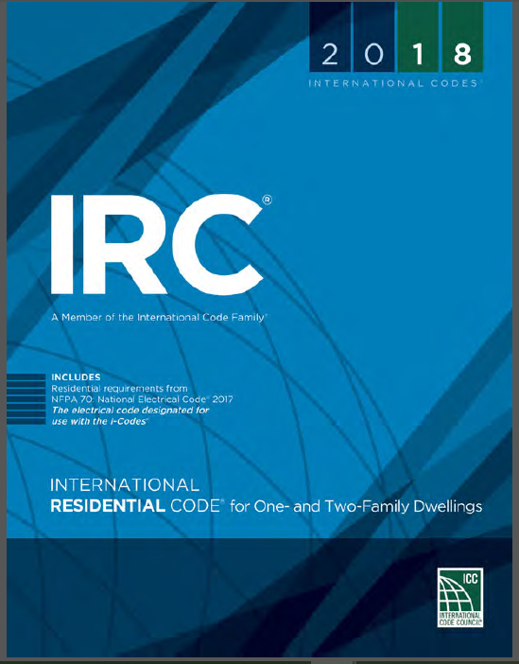
IRC
Provisions for the control of design and construction of ICF/ICCF walls are provided in the 2018 International Residential Code (IRC) and previous and future editions

Slide 11
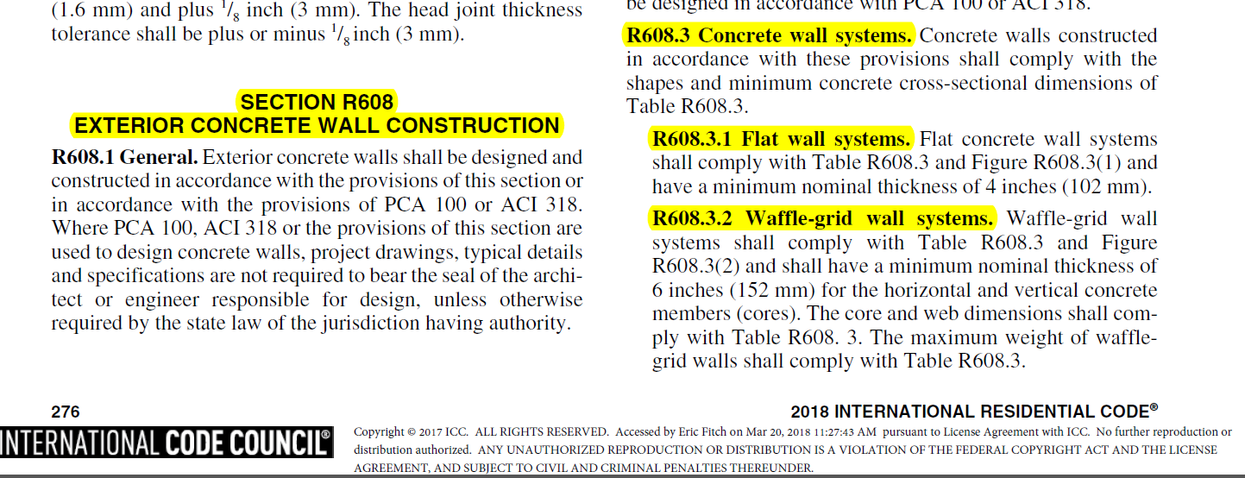
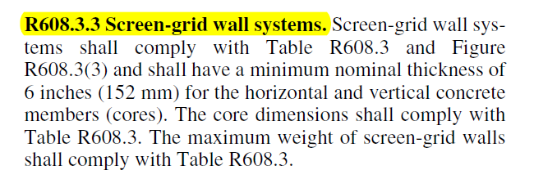
Excerpt from 2018 IRC, Chapter 6, Wall Construction

Slide 12
Not an Alternative
The Perfect Block (TPB), “Screen-grid” Wall System, is not an “alternative” building material.
It is one the “Big Five” of building materials listed and described in the International Residential Code (IRC), Chapter 6, Wall Construction.

Slide 13
What is the “Big Five”?
The Big Five -as described in Chapter 6 of the IRC
Wood Wall Framing
Cold-Formed Metal Wall Framing
Masonry
Exterior Concrete Wall Construction
Concrete Wall Systems
Flat Wall Systems (white block)
Waffle-grid Wall Systems (white block)
Screen-grid Wall Systems (gray block/ICCF)
5. Structural Insulated Panels (SIPS)

Slide 14
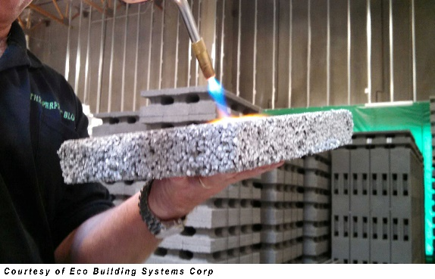
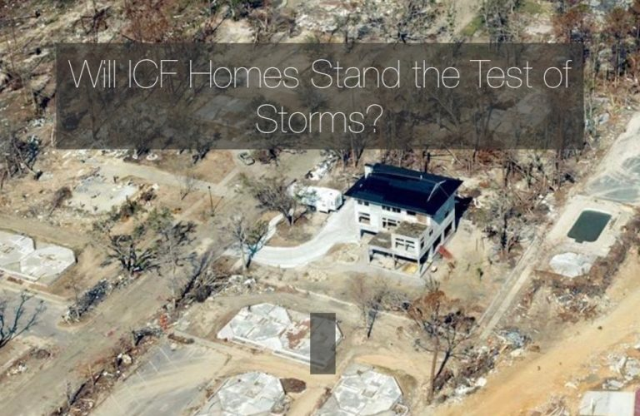
Testing
The Perfect Block has a successful 4 Hour Fire Rating: American Society for Testing and Materials, ASTM E-119, ASTM E119 / UL263, ASTM E119-16a, ASTM E226-5ba
A 250-mph wind rating, Structural Wind Load, Impact and Cycling (Hurricane) and Tornado Impact Testing: ASTM E330, ASTM E1886, E1196, ICC-500 / E1996
Both from Intertek Testing Services

Slide 15
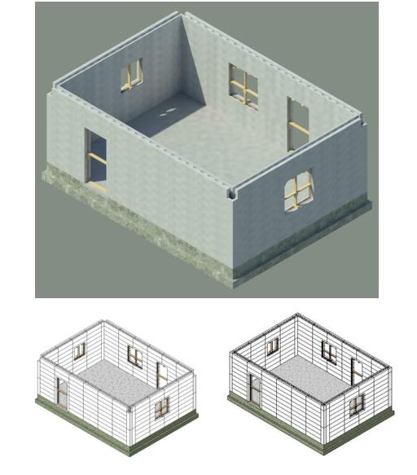
Walls built to full height

Slide 16
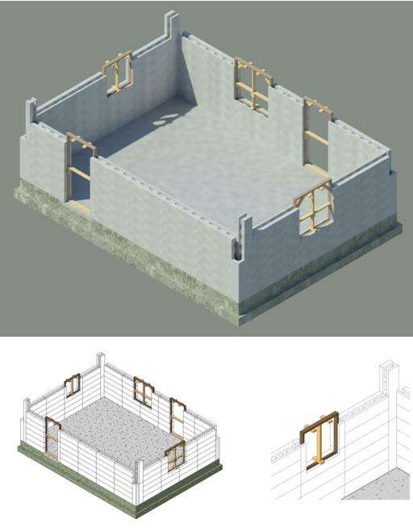
Walls built to a stage (half wall)

Slide 17
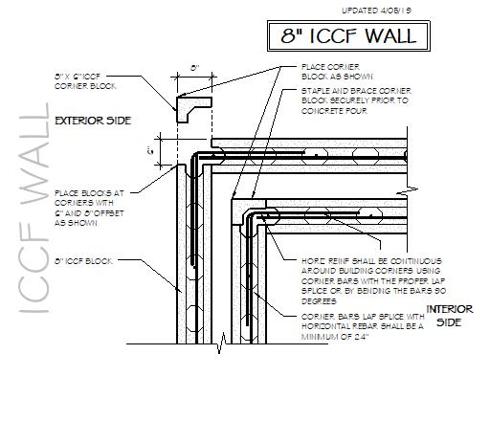
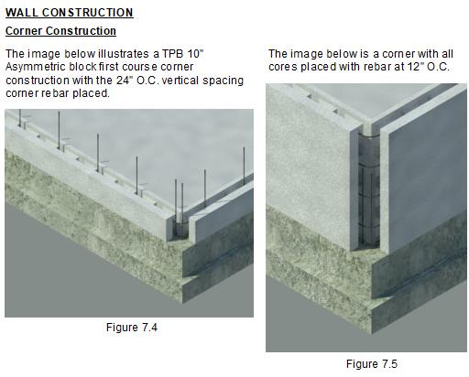
Corner Construction

Slide 18
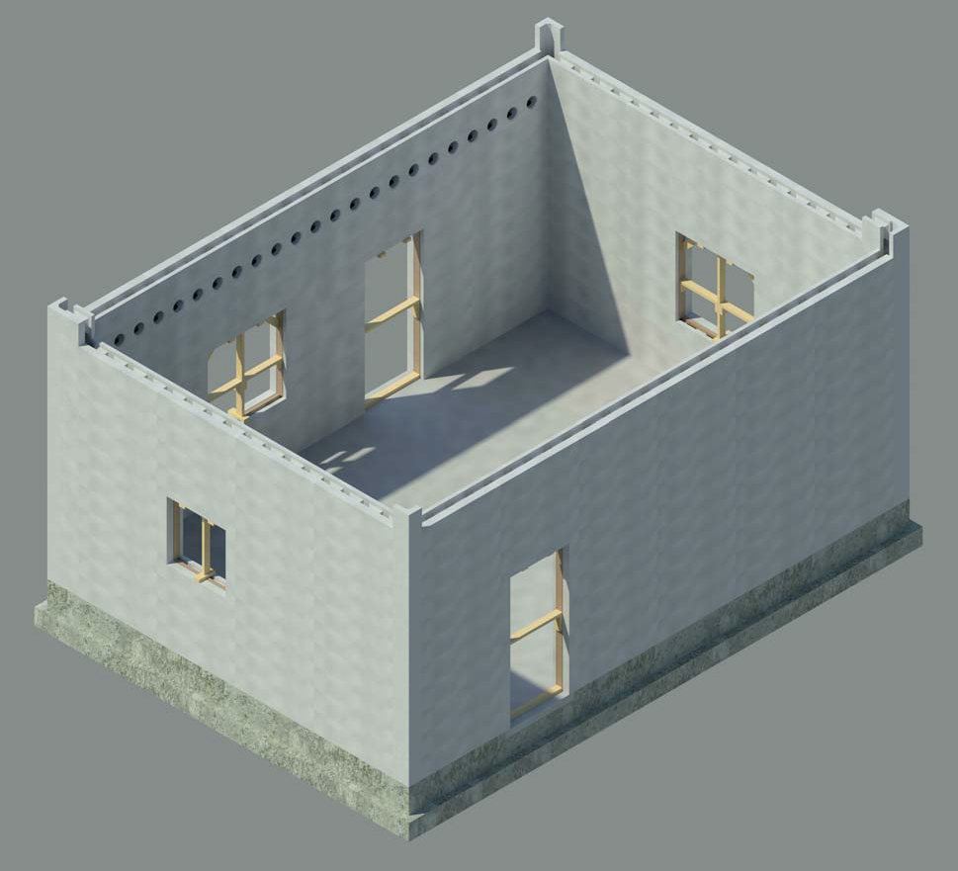
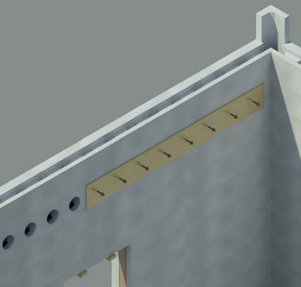
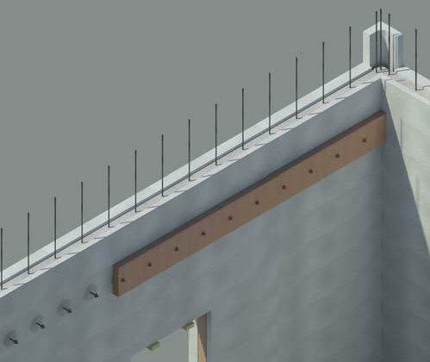
Ledger Construction

Slide 19
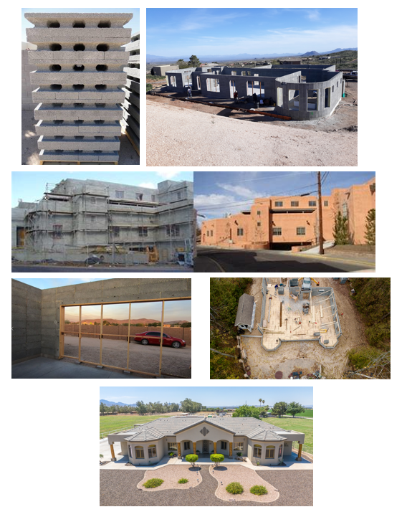
Questions

