Slide 1
EASY BEES
By Vuong Hong, PE

Slide 2
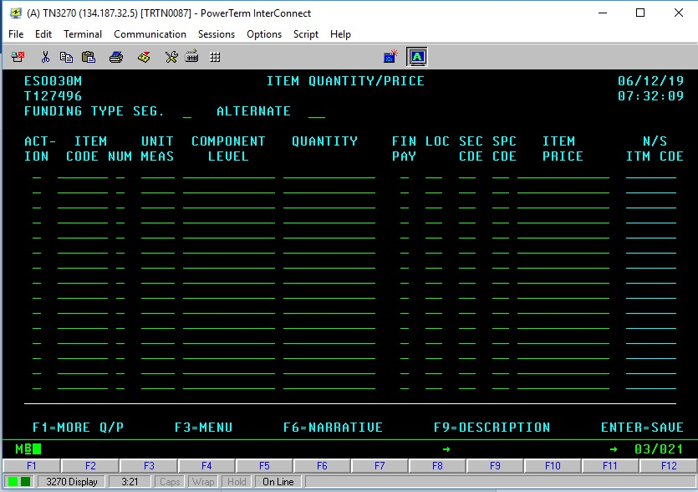
Do BEES by menu

Slide 3
Using tables to establish or modify the BEES, we have to enter the item codes of all the items. It takes time to enter the item codes and if you make a mistake, it is very difficult to debug and fix the error(s). Sometimes we have to delete the file and enter the whole item codes again.
BEES does not give warnings or errors. It just does not give the estimating results.

Slide 4
Different way to do BEES
Copy and reuse the BEES codes from former completed similar project. We do not have to enter all item codes.
Change the quantity and unit price of the item codes we want to keep.
Delete the item codes we do not need.
The copied codes are errors freed because they are from a completed project.
Because the copied codes from a similar project, the item codes are almost the same so the changes are minimal.
Remind the users of the item codes he or she might forget.
Easy to debug and fix the errors.

Slide 5
OPEN BEES MENU

Slide 6
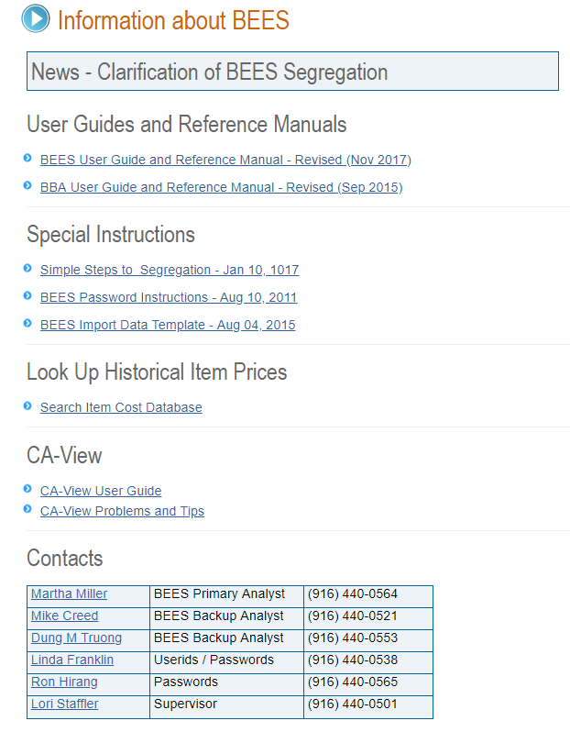
Link for BEES info
https://it.onramp.dot.ca.gov/information-about-bees

Slide 7
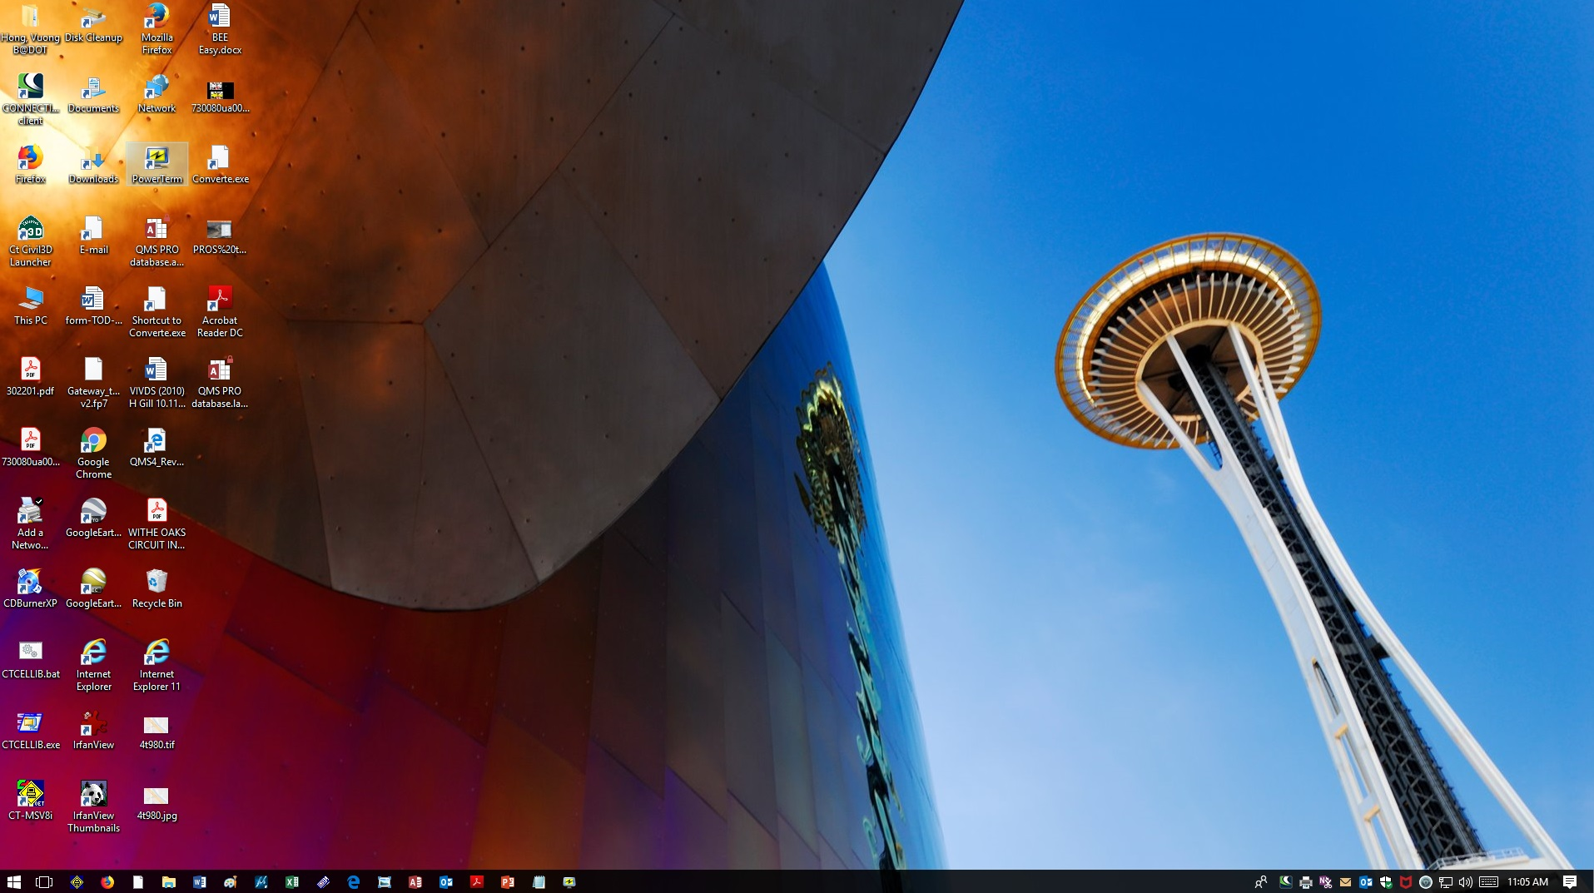
To open BEES menu
Double click icon “PowerTerm”

Slide 8
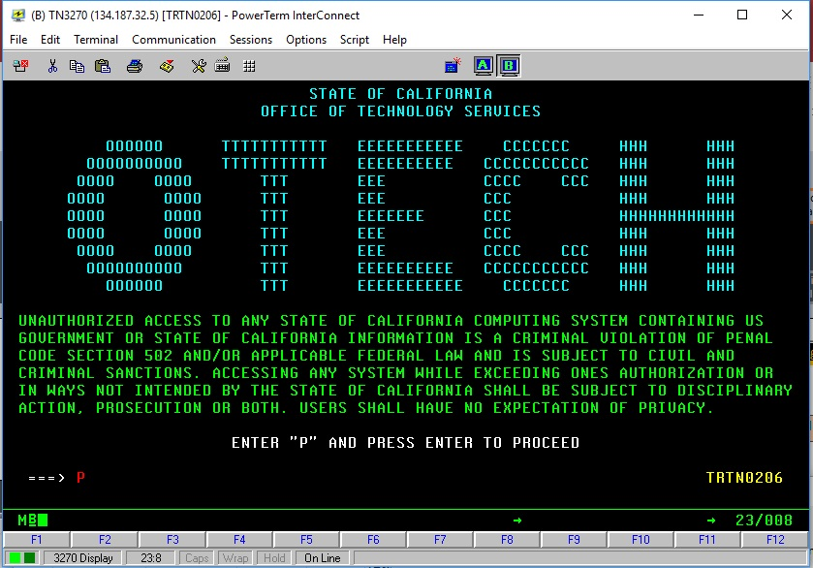
Enter “p” and then hit “Enter”.

Slide 9
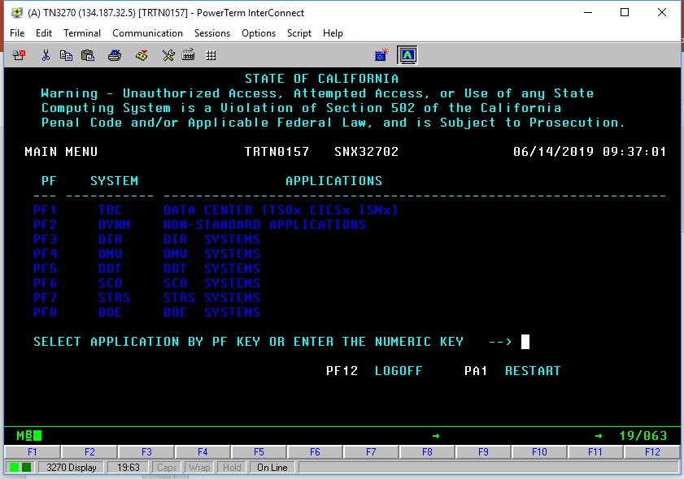
Hit F5 and then F1

Slide 10
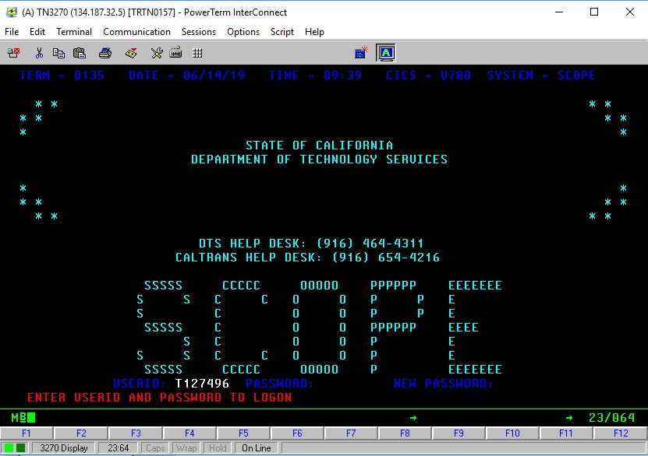
Enter ID and Password
Enter ID and Password and then hit Enter.

Slide 11
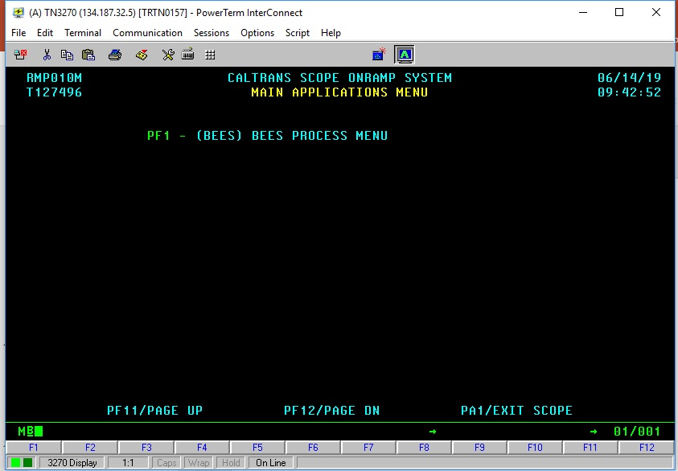
Hit F1 key.
Hit F1 key.

Slide 12
ESTIMATES

Slide 13
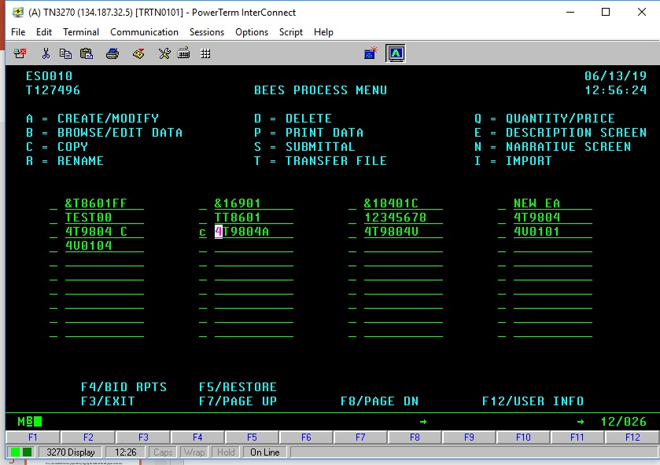
Example: We want to copy
Former project 4T9804A to new project TEST04.
Enter “c” at the command and then change the file name.

Slide 14
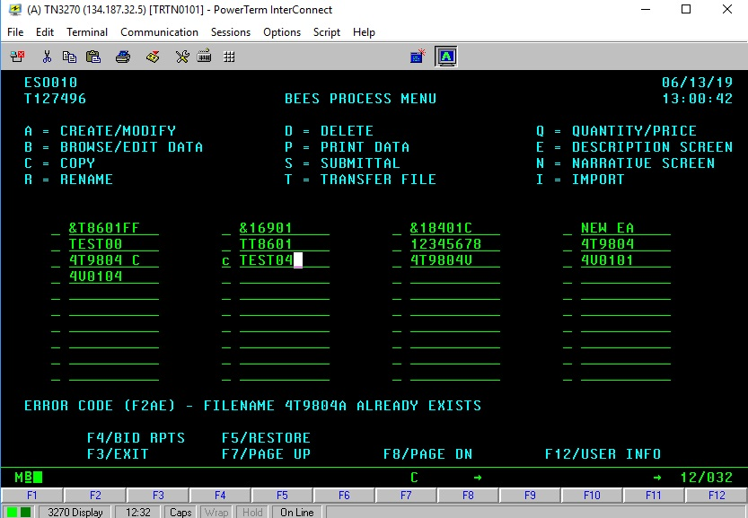
Type in “c” and new filename. Hit “Enter”.

Slide 15
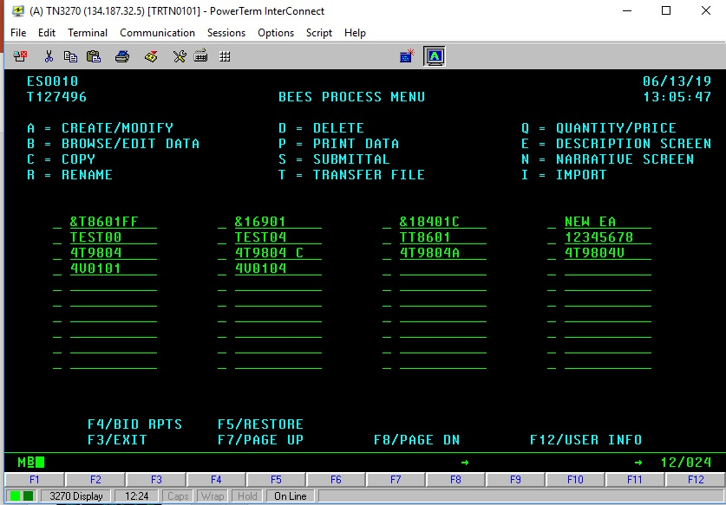
New EA ready to use

Slide 16
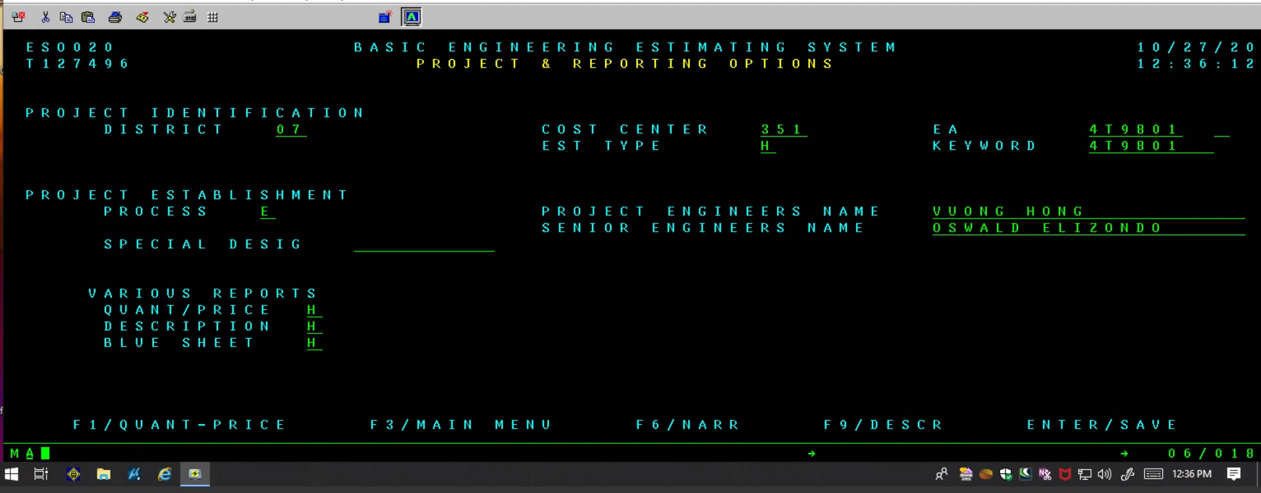
Use create/modify menu to create and enter the info’s of the new project

Slide 17
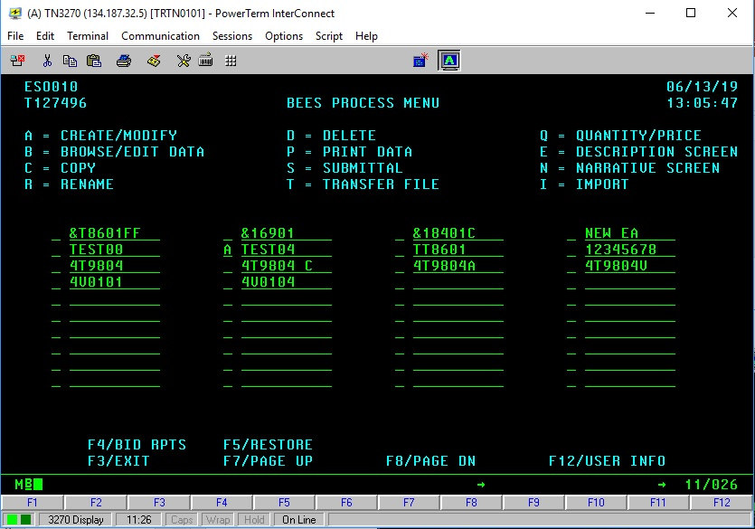
Use create/modify menu to change the info’s of copied project to match the info’s of the new project

Slide 18
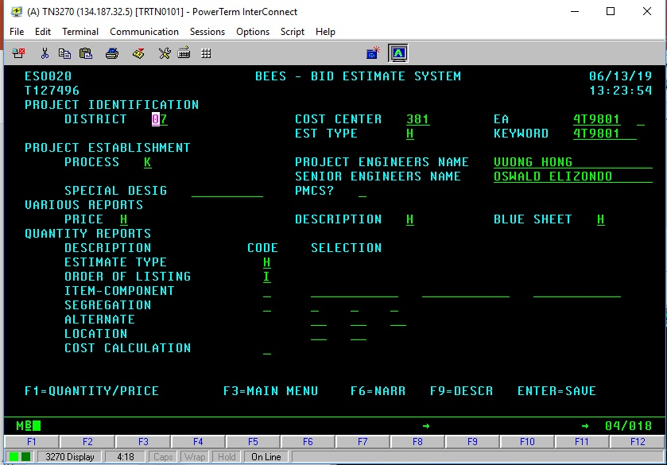
Update all necessary info’s.

Slide 19
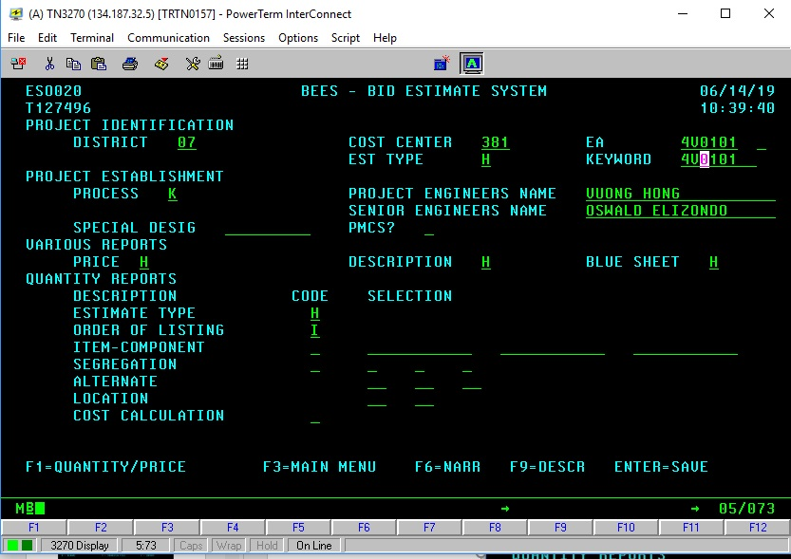
Enter “K” for modify
Edit the info’s
New EA

Slide 20
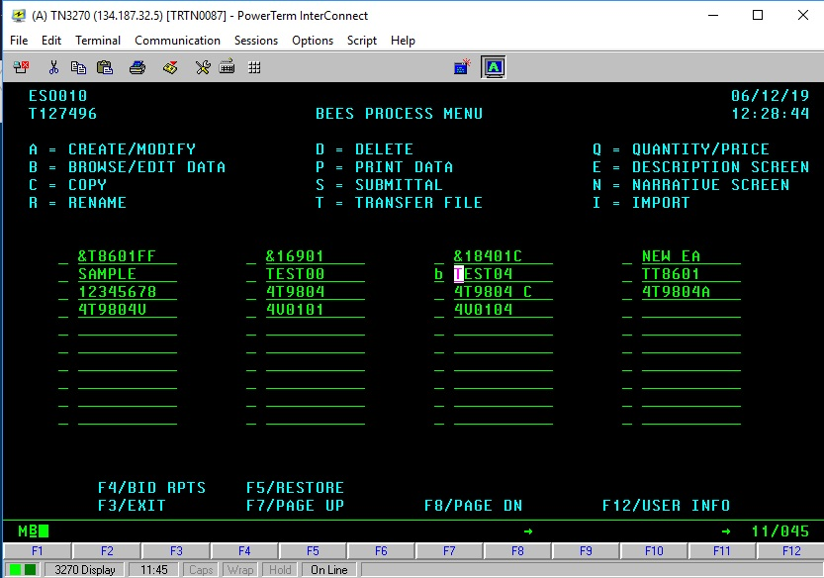
Enter “b” to edit data

Slide 21
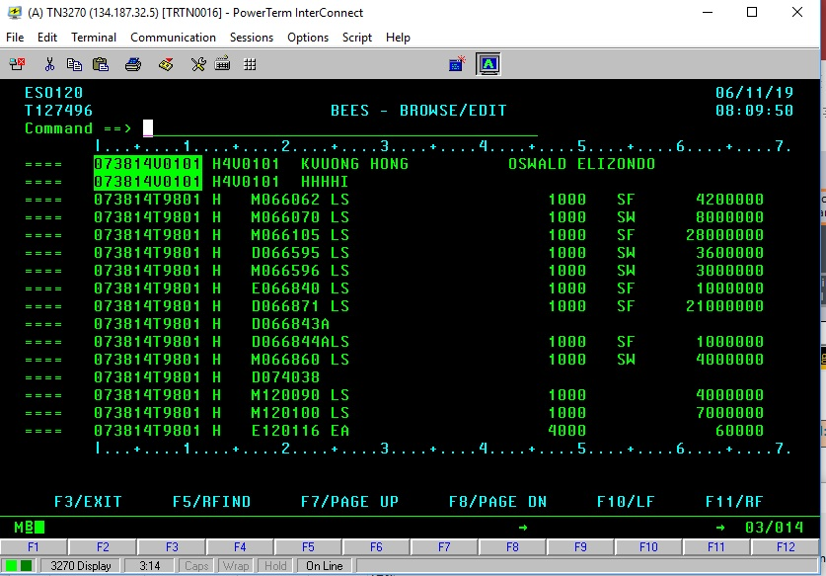
New EA
Still old EA.
We need to update those.
Highlight new control number then hit ctrl +c to copy to clipboard.
High light new EA numbers and then hit ctrl + C

Slide 22
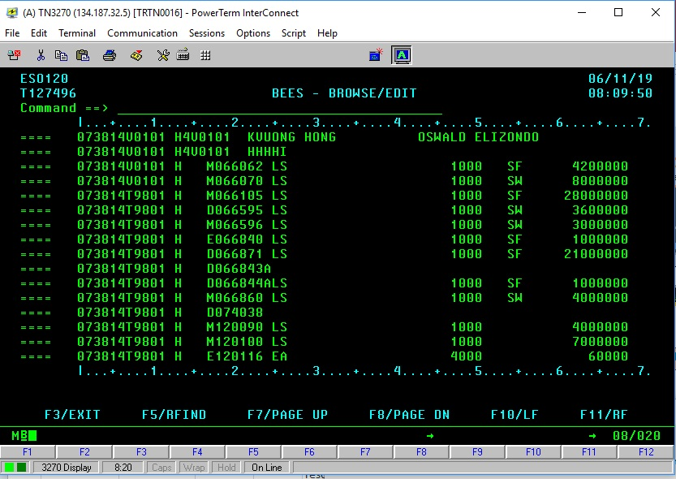
Click here and then hit ctrl + v. The highlighted will be copied down from here.
Click on the top left corner of the lines we want to copy to. Hit Ctrl + V to paste the copied portion down.

Slide 23
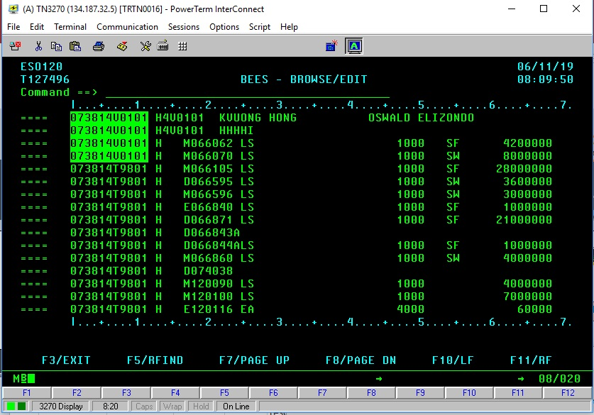
1. Drag to highlight.
2. Ctrl + c (copy)
3.Click here
4. Ctrl + v (paste)

Slide 24
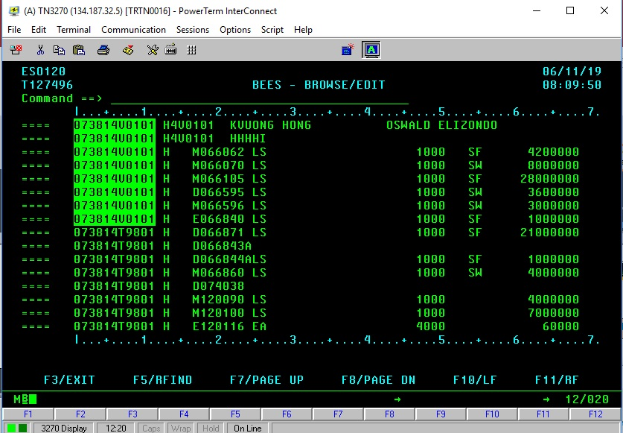
Four lines were copied down.
Repeat these steps until we fill out the whole project.

Slide 25
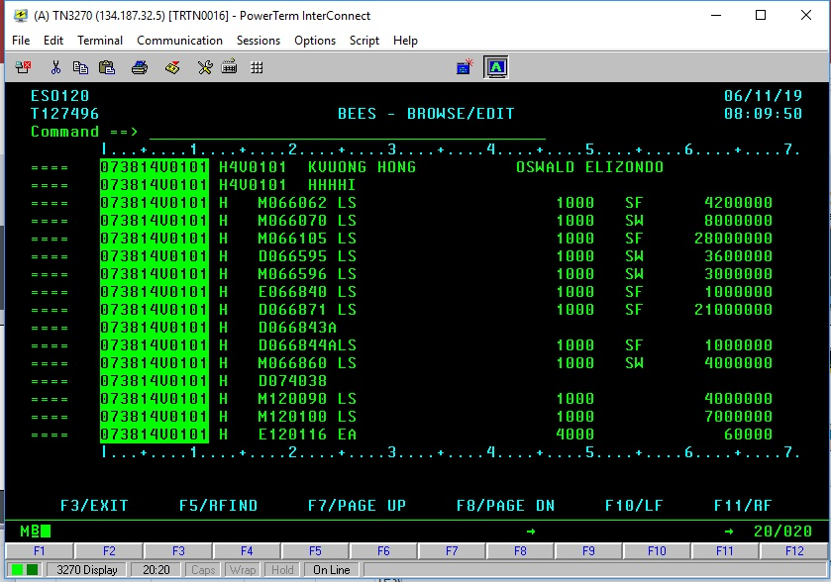
Repeat the steps until all are updated.
We also can use excel to do this steps with ctrl+c and ctrl+v.

Slide 26
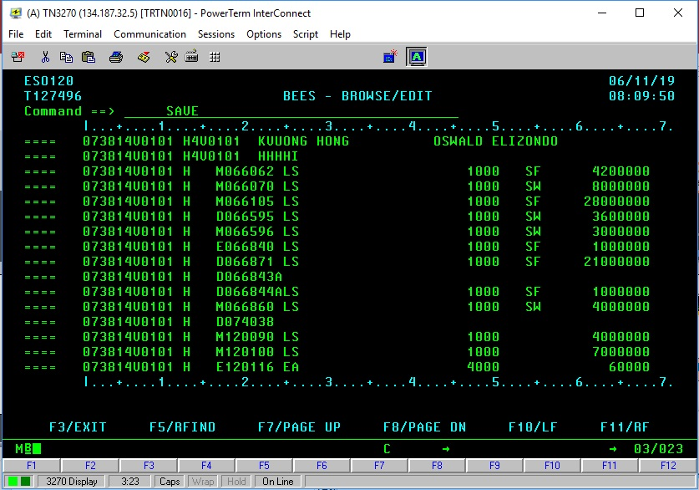
To save the work,
Enter “save” and hit Enter key.

Slide 27
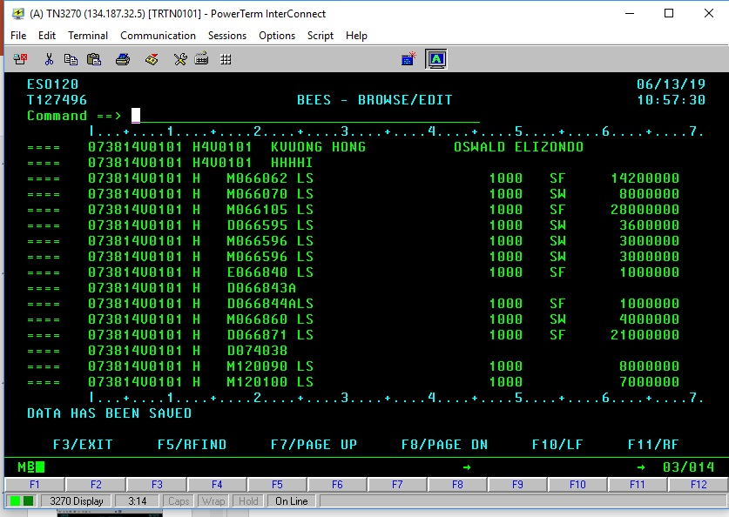
Message if save successful.

Slide 28
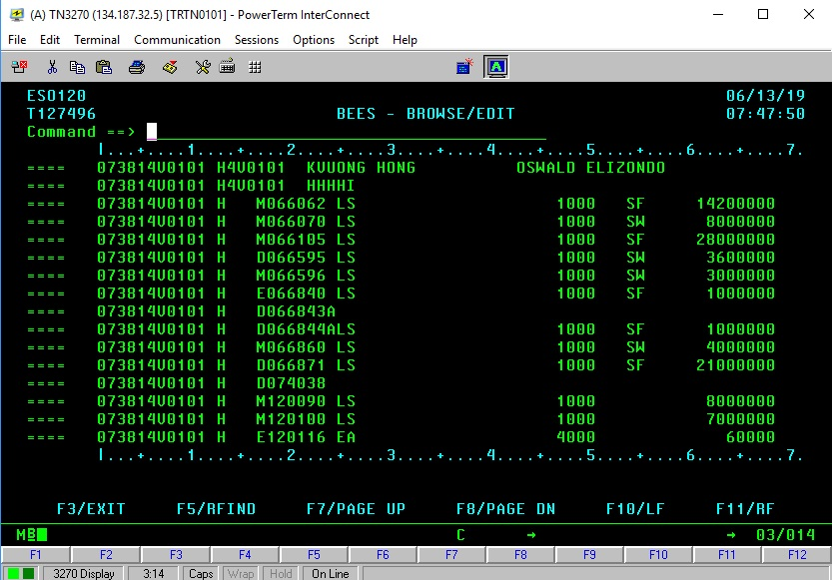
Three decimal numbers
Click and enter
“E” for establish new item
“M” for modify
“D” for delete
For “M”, make necessary changes to unit, qty, section, cost.
For “E”, copy a line than enter Item code, unit, qty, sec, and cost

Slide 29
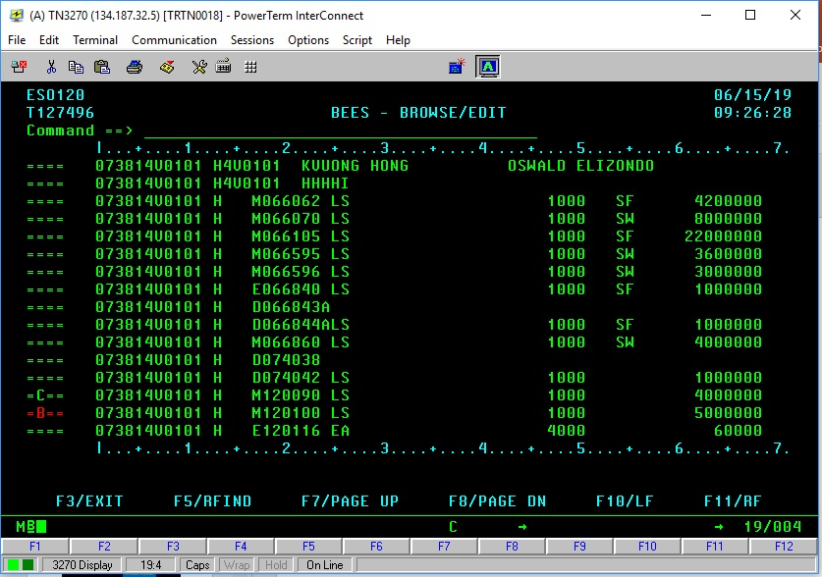
To copy one line at “C” to line above line “B”.

Slide 30
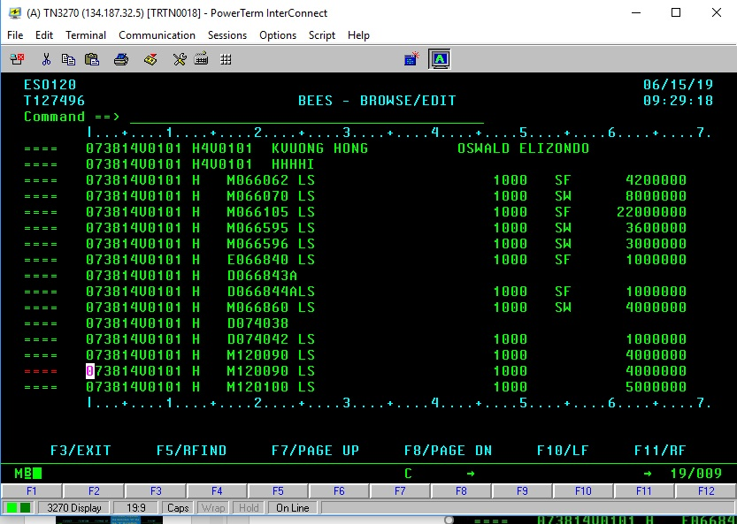
Lines are duplicated

Slide 31
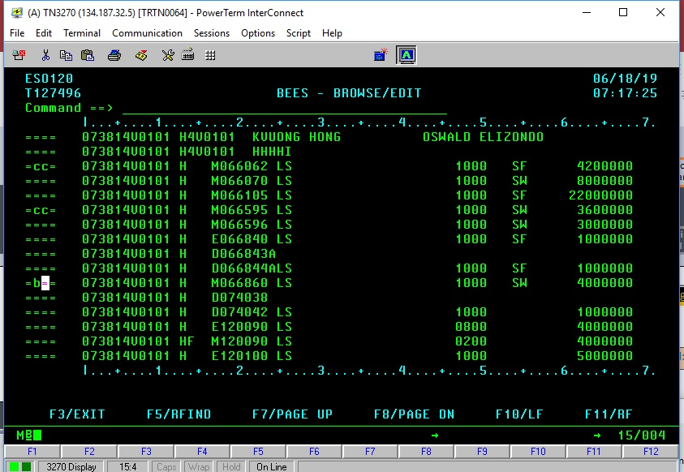
To copy group between “cc” to above line “B”.

Slide 32
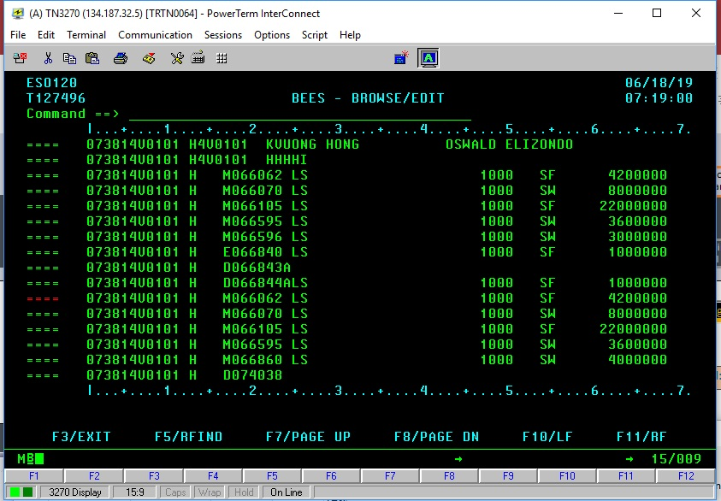
Results of “cc” copy

Slide 33
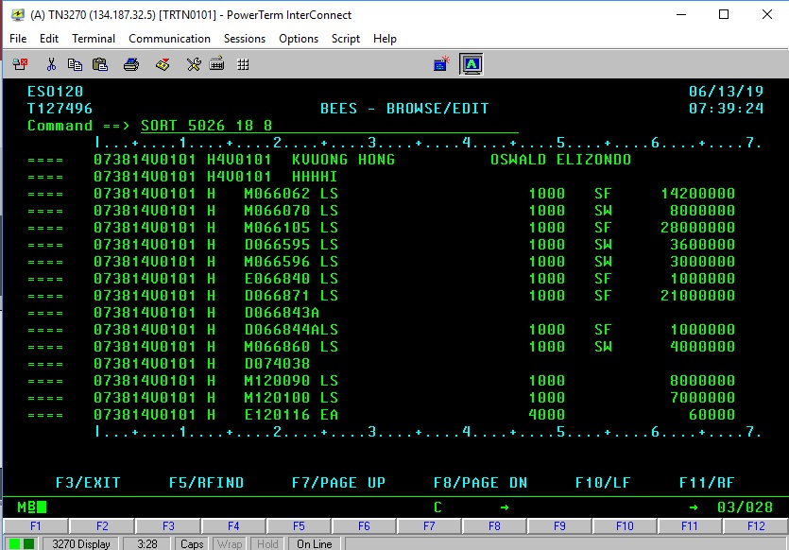
To sort the item codes,
Enter “SORT 5026 18 8” and hit Enter key.

Slide 34
Sorted item codes
We can debug and fix the errors from the sorted list.
For the same item code, only E then M,
E then D
M then D
D then E are accepted.
D then D no change
If in doubt, duplicate the item then “D” the top, “E” the bottom.
Remember to save the changes.

Slide 35
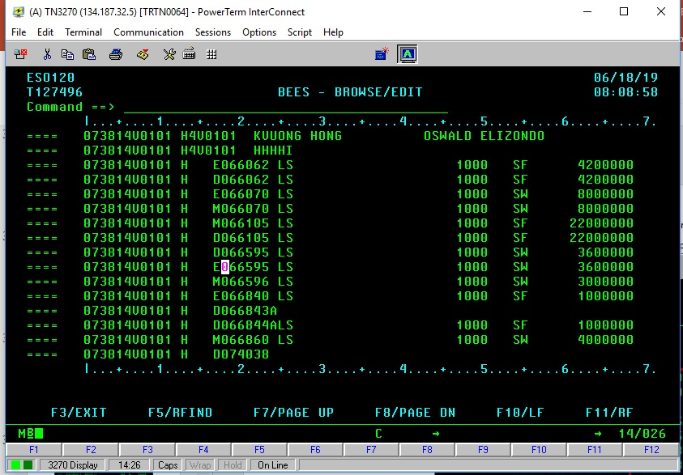
First, sort the item codes by enter (sort 5026 18 8) on the command line.
We can debug and fix the errors from the sorted list.
For the same item code, only E then M,
E then D
M then D
D then E are accepted.
D then D no change
If in doubt, duplicate the item then “D” the top, “E” the bottom.
Remember to save the changes.

Slide 36
REPORT

Slide 37
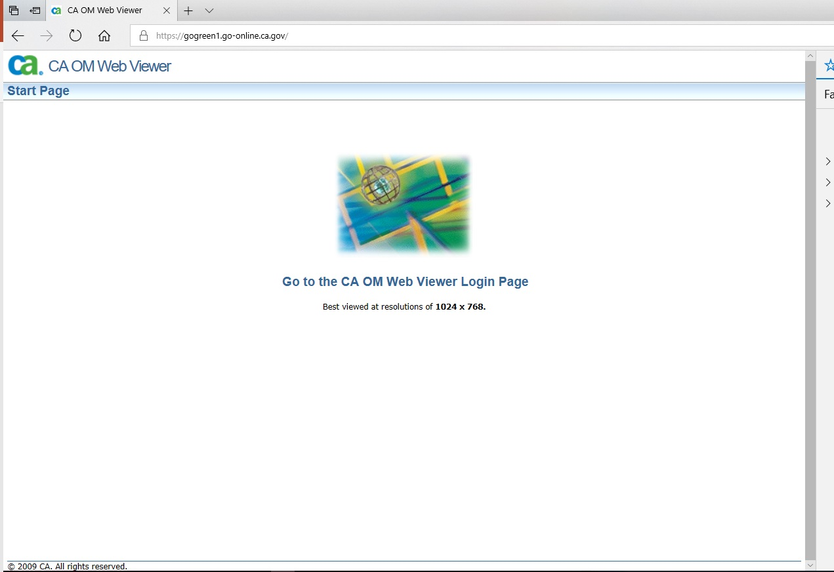
Click here.
https://gogreen1.go-online.ca.gov/
Link to this screen.

Slide 38
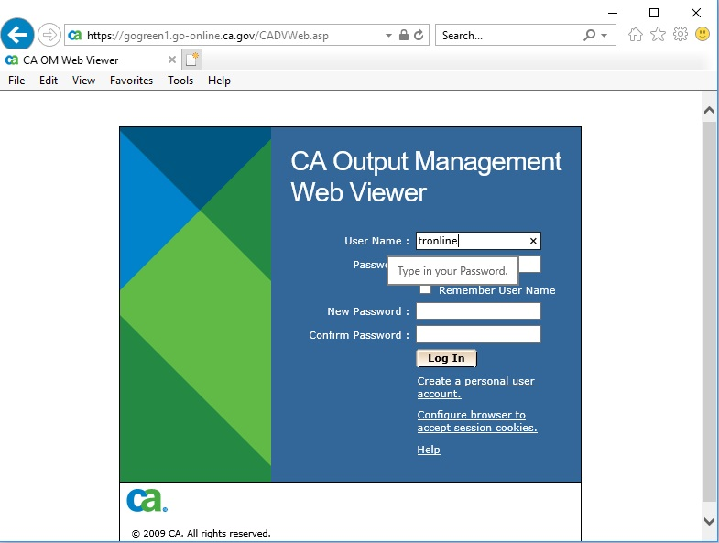
Enter “tronline “ for User Name and hit “Enter” key.

Slide 39
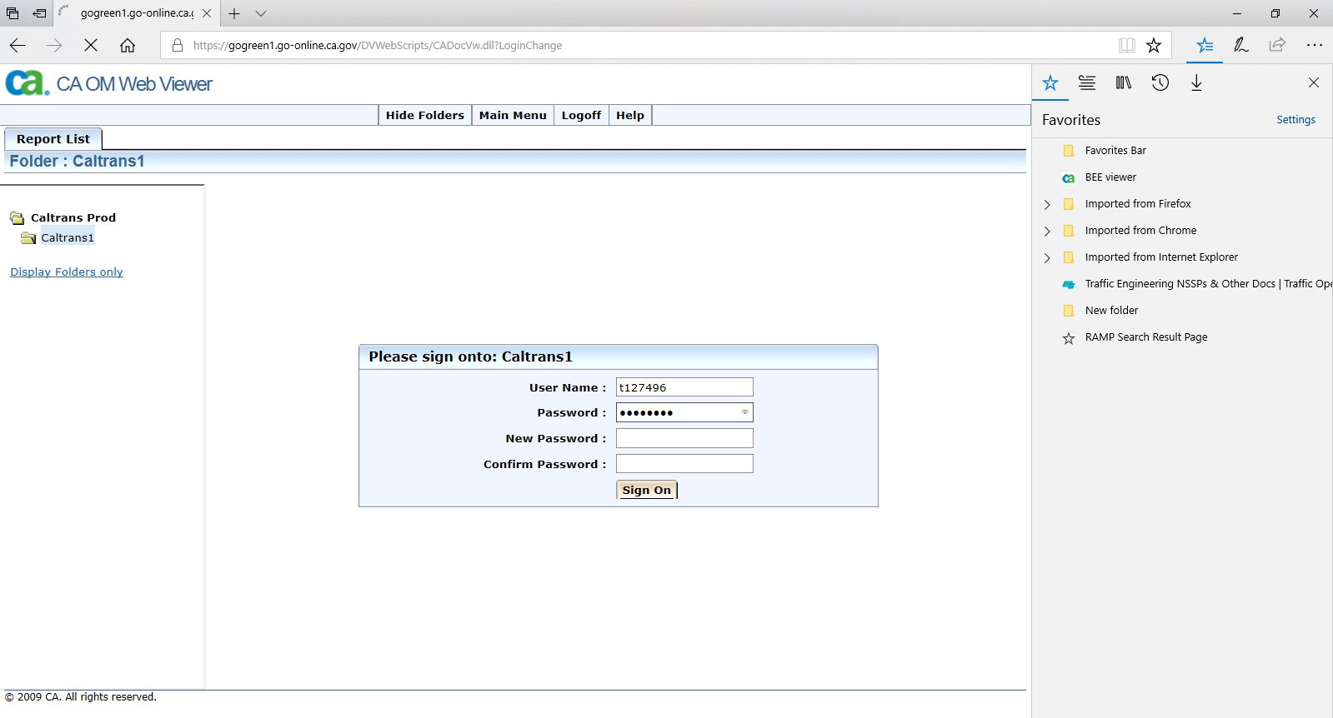
Enter BEES ID and password and hit “Enter” key.

Slide 40
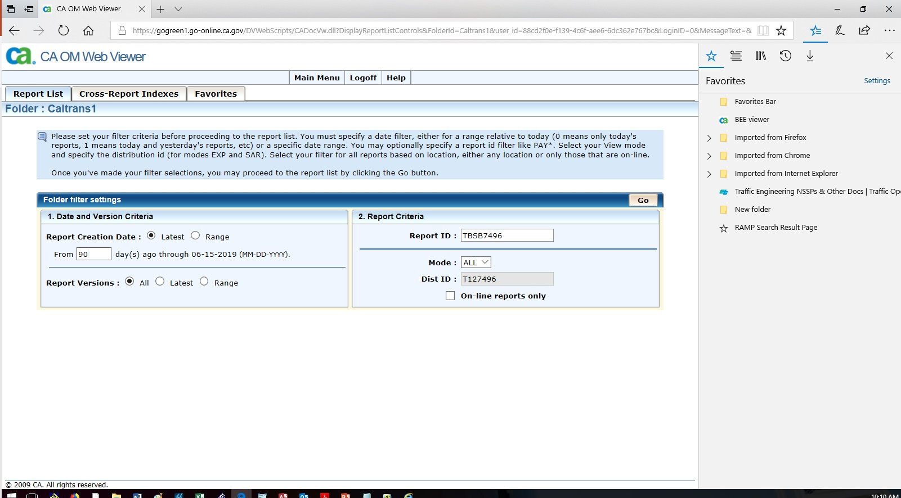
Click on “Go” button

Slide 41
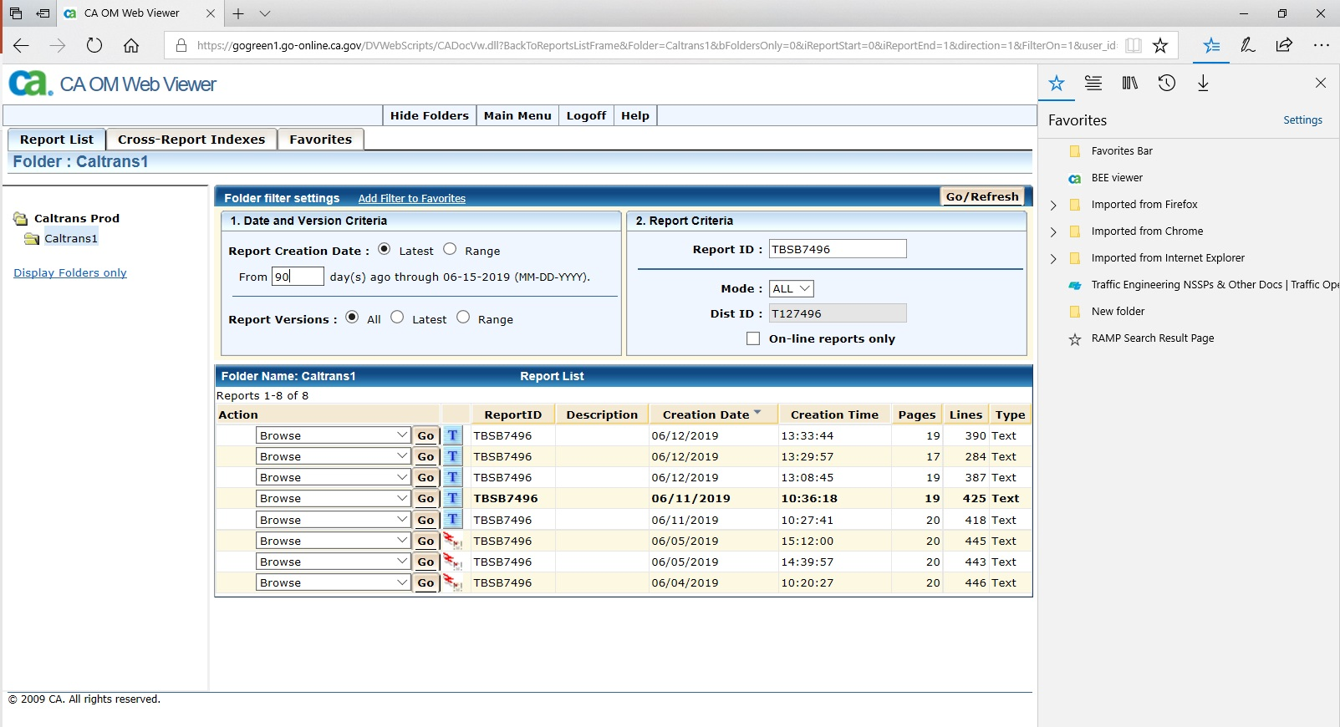
Click on “Go” button

Slide 42
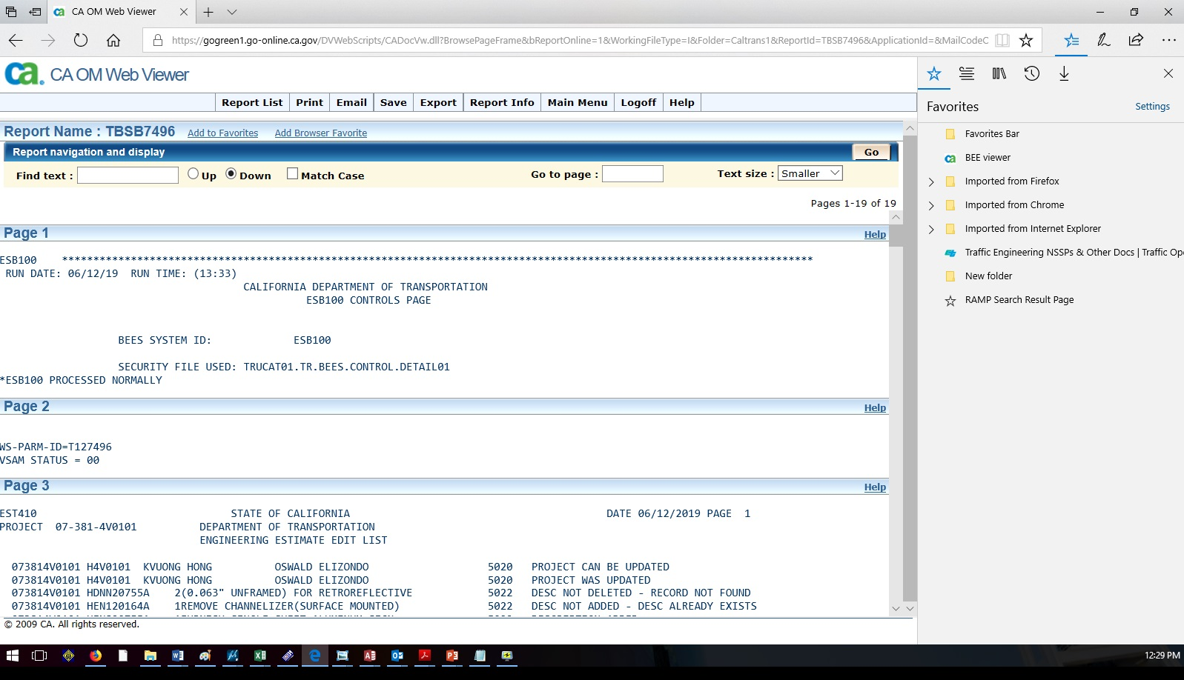
Click on “Save” button

Slide 43
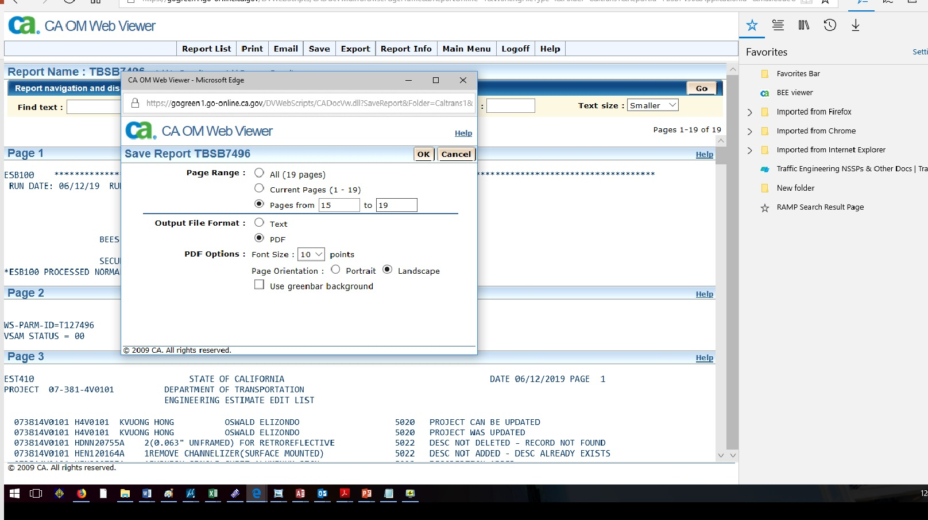
Enter:
Pages range
PDF file type
Landscape format
Click OK button

Slide 44
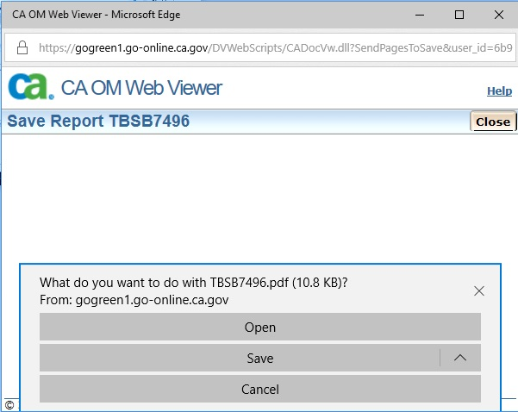
Click “Open” to see the result
Or click “Save” to save the result.

Slide 45
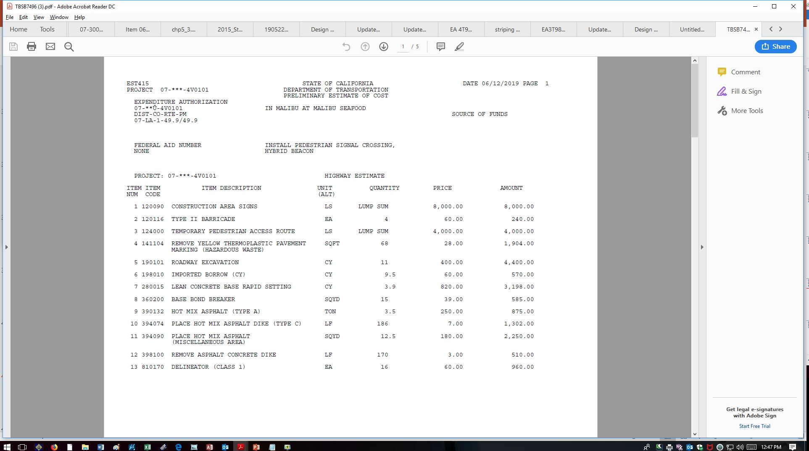

Slide 46
SEGREGATION

Slide 47
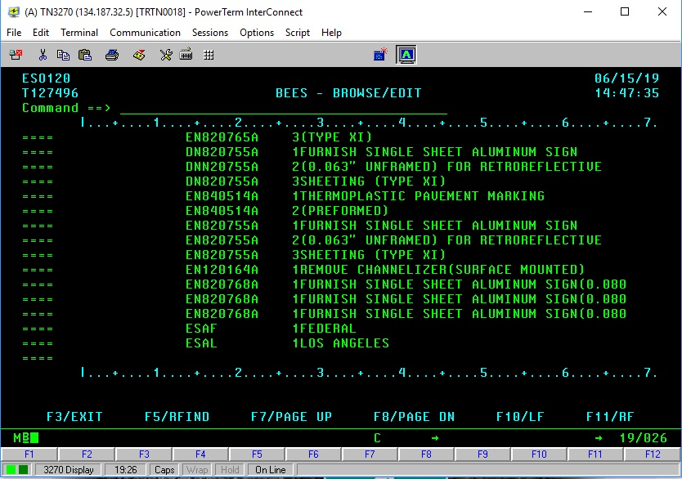
Create description for segregation
ESAF: Establish Segregation A (system required) F (name of the segregation)

Slide 48
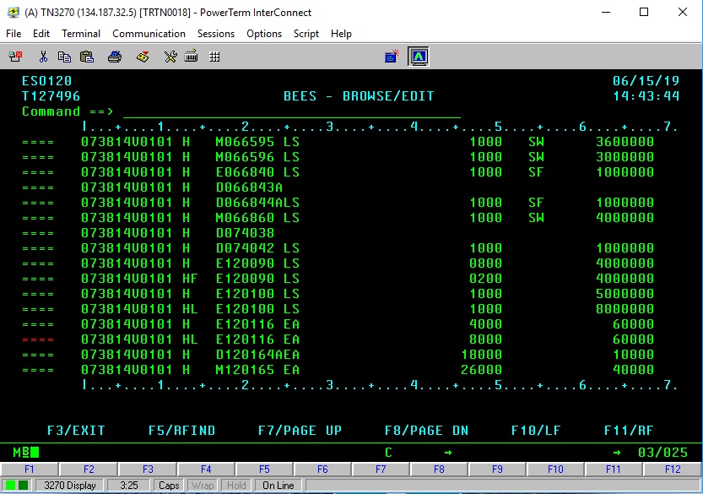
Segregation by percent
F for Federal
L for Los Angeles
Blank for state fund
Segregation by cost
Segregation by Quantity

Slide 49
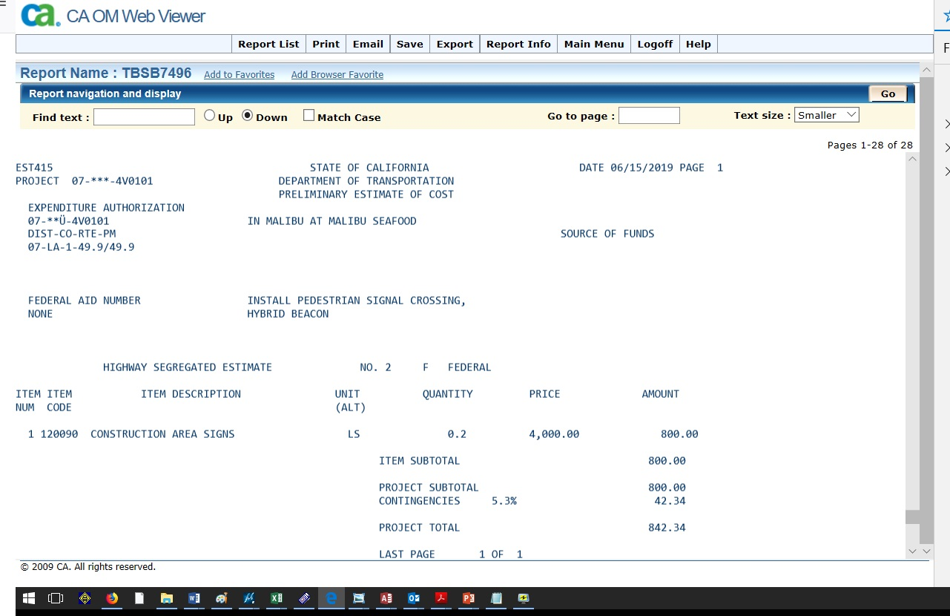
Segregation by percent
Federal portion

Slide 50
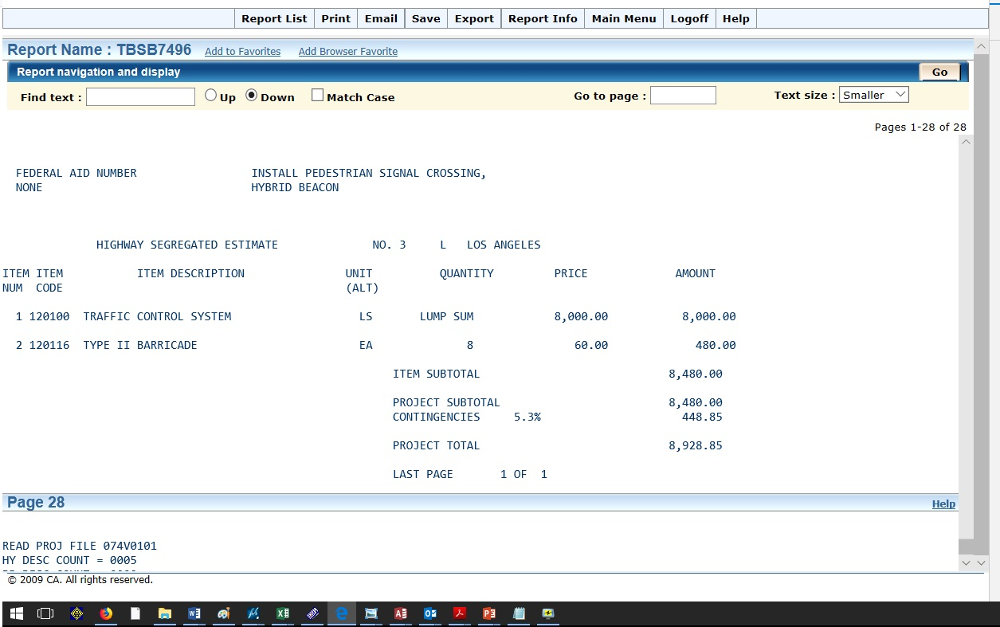
Segregation by Cost
City portion
Segregation by Quantity
City portion

Slide 51
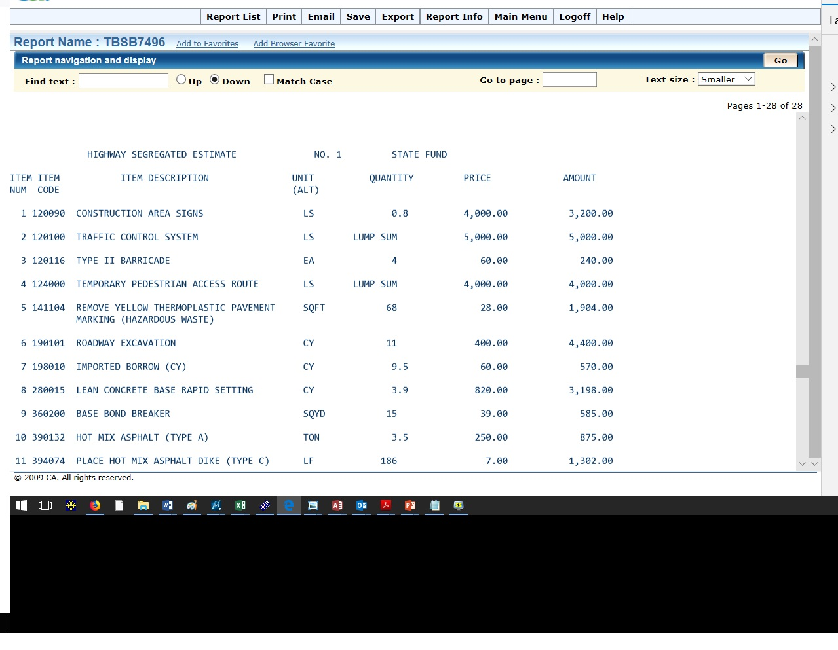
Segregation by %, Cost & Qty
State Fund

Slide 52
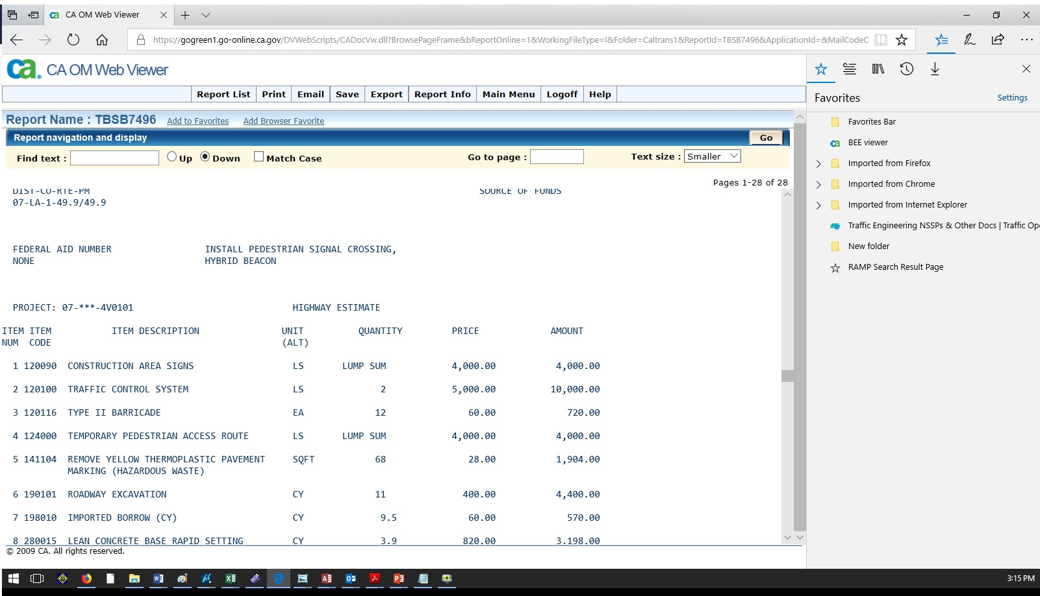
Segregation Combined results

Slide 53
https://it.onramp.dot.ca.gov/information-about-bees

