Slide 1


AASHTOWare Project Preconstruction Implementation
PPM & OE, Division of Engineering Services

Slide 2
Why AASHTOWare Project Preconstruction
Legacy Mainframe Systems
Critical legacy mainframe systems lack flexibility to implement changes
Systems are in critical path of the contract development process and continued use of these systems have significant risk to project delivery
Legacy system is not sustainable
40+ years system, difficult to maintain
AASHTOWare Project Modules
Modern cloud based enterprise system that provides web-based access
Systems are sustainable with regular updates & enhancement. Used by 40 other DOTs.
AASHTOWare Preconstruction offers similar functionality to BEES & Bid
AASHTOWare Preconstruction integrates with existing AASHTOWare systems BIDS, and BAMS/DSS
Systems warrantied by AASHTO’s vendor/ software designer (InfoTech)
vs

Slide 3
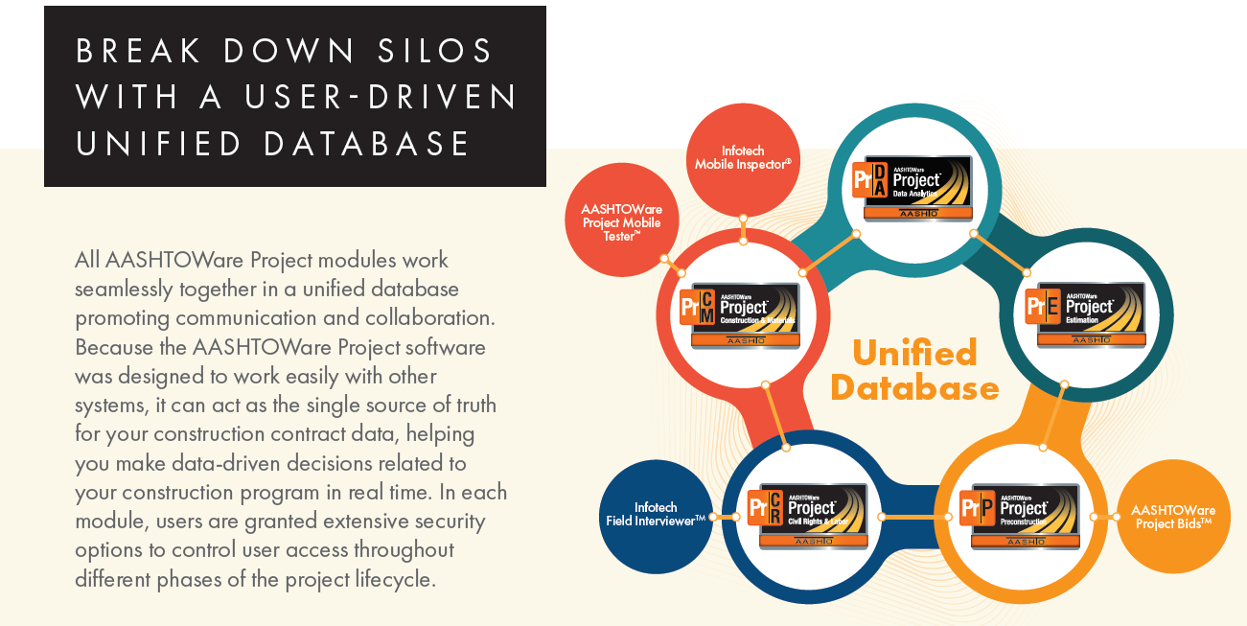
AASHTOWare Projects Enterprise System

Slide 4

Video: AASHTOWare Project Executive Summary
https://www.youtube.com/watch?v=c0SEPg-j6B4

Slide 5
Guiding Principles for implementing AASHTOWare Preconstruction
  AASHTOWare Core Team – cross functional team bringing together the resources and skills from different programs and divisions (North Region, District 4, Central Region, District 8, Structure Office Engineer, DES Office Engineer, Office of Civil Rights, HQ Division of Construction, HQ Information Technology)
  Minimize changes to off the shelf software – configure software for Caltrans requirements, with limited customization. Must ensure long-term system sustainability.
  Implement in phases with DES OE leading Core Team

Slide 6
Preconstruction Training
Report Date: 9/9/2022
District | Total Trained
1 | 45
2 | 56
3 | 178
4 | 250
5 | 31
6 | 187
7 | 177
8 | 88
9 | 27
10 | 37
11 | 110
12 | 93
Totals: | 1279
LMS Course Code: 102338
How to use AASHTOWare

Slide 7
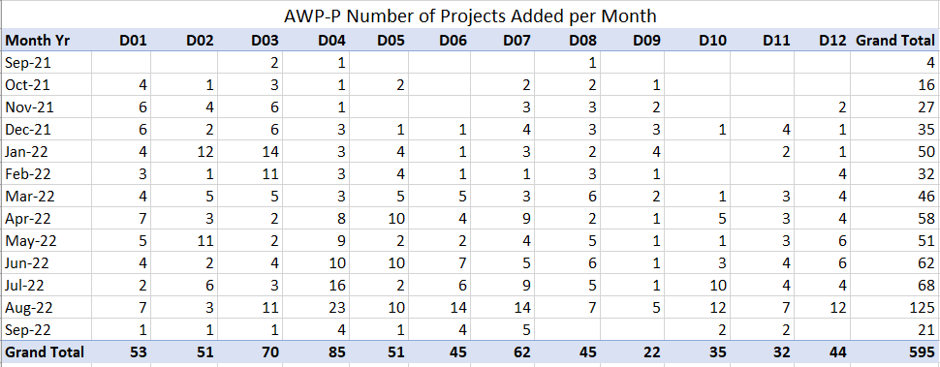
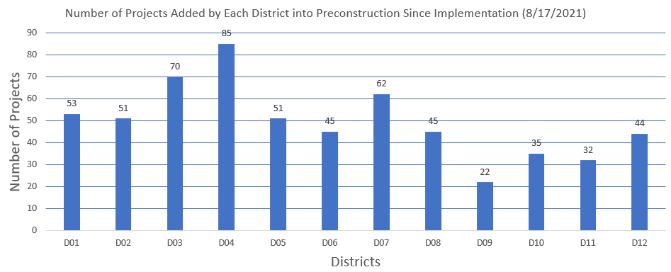
Number of Project Added in AWPP by Each District

Slide 8
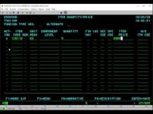
Demonstration of Legacy system (BEES)
https://youtu.be/L5J5a78STKo
Notes:
Now we have another video. This video shows how our current BEES system work. This video is about 2 minutes long.

Slide 9

Demonstration of AASHTOWare Project Preconstruction
https://www.youtube.com/watch?v=3C8mQrUmOo0

Slide 10
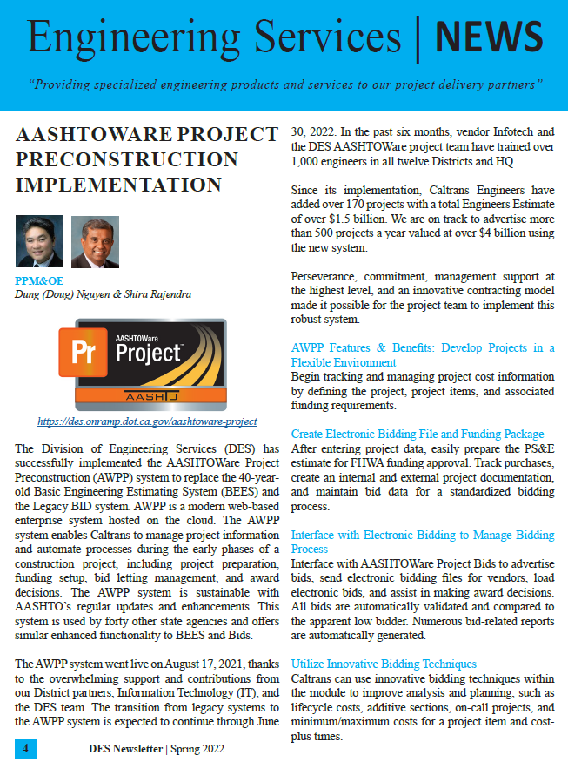
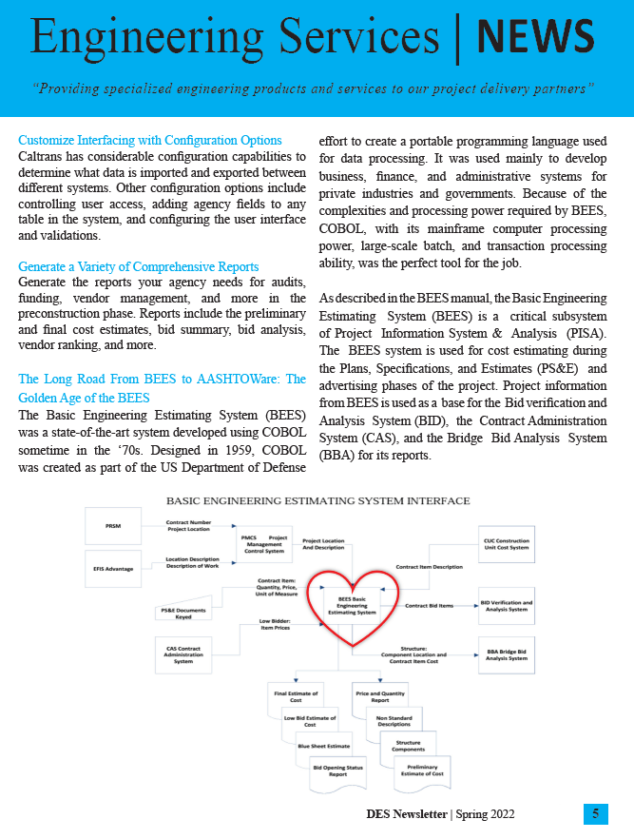

Slide 11
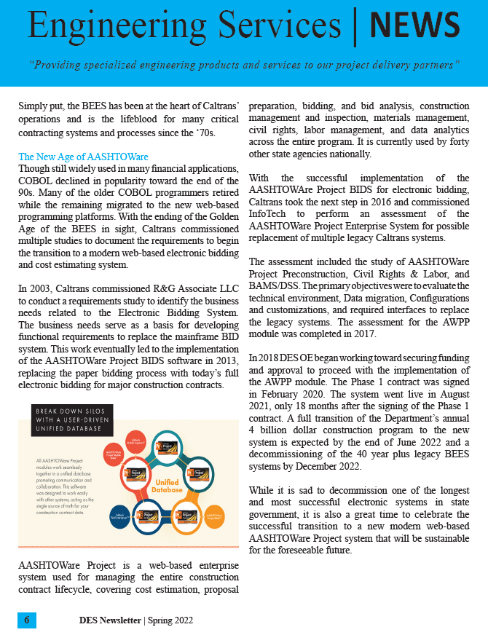
Thank You

