Slide 1

E Record with SECURE
Government to Government Recording

Slide 2
Problem:Recording in person
SOLUTION: G2G E RECORD
Covid Changes
  Delayed Recordings
  No counter service at recorder
  Weeks long mail process to record.
  Contracts/fees for Title Company Service
Recording in person
  Timely
  Coordination with buyer
  Errors need another trip to record
Electronic Recordings from district office.
Free Service
*Available in 20 California counties
  *next slide
Turnaround 14 days or less
Available for all District Recordings

Slide 3
https://www.secure-recording.com/g2g.html
Contra Costa County
Fresno County
Los Angeles County
Marin County
Merced County
Nevada County
Orange County
Riverside County
Sacramento County
San Benito County
San Bernardino County
San Diego County
San Joaquin County
San Mateo County
Santa Barbara County
Santa Clara County
Shasta County
Solano County
Tulare County
Ventura County

Slide 4

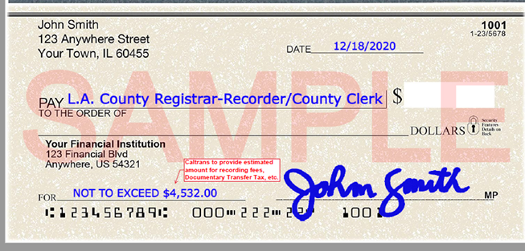
Tips to get started
Sign MOU with SECURE and individual counties
Dedicated work station needed.
Invoiced monthly in arrears
Deed jacket and confirmation delivered electronically.
*Buyer can write check directly to County as follows:

