Slide 1
Resource Check Pivot Table
A solution to promote the Open-Data Mindset
Cameron Muir
Transportation Engineer and GIS Specialist, District 1
11/16/2020

Slide 2
Disclaimer
This presentation is designed to be a detailed walkthrough of the process to use the Resource Check Pivot Table. A copy of the file template is located on the last slide

Slide 3
Background
Problem:
Resources to complete a project are measured by hours of work. Before projects make it to the K phase, the resources for each functional unit are allocated in PRSM. During the K phase, functional units use their allocated resources to complete their contribution to the PID. The Advance Planning Senior is tasked with managing the resources for all the projects in the K phase, and often there are many projects. The Advance Planning Senior relies on the PE’s to verify functional units have not overspent their resources for their projects. This resource check consists of comparing the current usage of resources to the original allocated amount. To complete this comparison, the PE needs the current usage, which is provided in PRSM. The current usage is compared with the allocated amount, which is logged in a local spreadsheet. Once the comparison is made, it is sent to the Advance Planning Senior for them to review and make decisions about resource allocation for the remainder of the K phase. This process is completed on a monthly basis.
3

Slide 4
Solution
Best Solution
The best solution would be one that is able to automatically query and pull resource data from the PRSM database and compare it to the original allocated amount. This comparison would be in the form of a chart, graph, or other visualization.
Workaround
Due to the restrictive nature of PRSM, data is required to be manually downloaded. Once the data is downloaded, it can be pasted into a solution that performs the resource check comparison automatically.
4

Slide 5
Workaround Solution
The workaround solution consists of an excel pivot table. Data is downloaded from PRSM for a specific project. The data is then pasted into the excel spreadsheet. The data is parsed to fit the data format required by the pivot table. Data is automatically pulled from a original allocation spreadsheet, and the pivot table is updated to complete the resource comparison. The resource check pivot table spreadsheet is then sent each month to the Advance Planning Senior for each project.
5

Slide 6
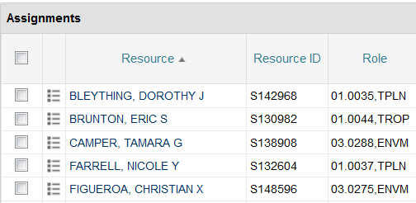
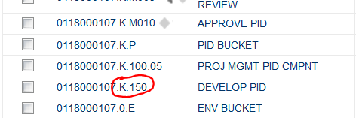
Workaround Steps
Open PRSM
Go to the Project
Expand the Task Tab
In the Task Column (not the check box) Click on task K.150
Wait for the view to change
6

Slide 7
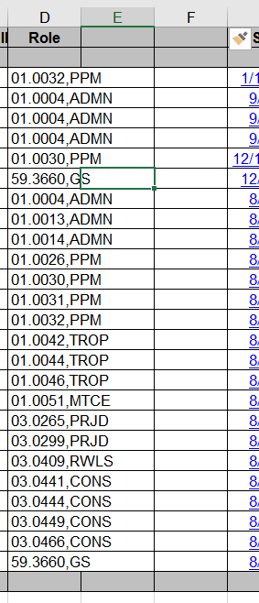
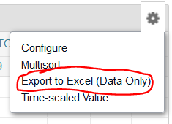
Workaround Steps
Click on the wee gear near the upper right of the view and export to excel. The excel file will contain resource data for the K.150 task
Repeat steps 4-6 for task K.100.05.
Open the Resource Check Pivot Table Excel file
In the K.150 excel file highlight the “E” and “F” columns (i.e. “Start” and “Finish” columns) and right click to “Insert” new columns. Two new columns should show up to the right of the “Role” column. (see image on right)
7

Slide 8
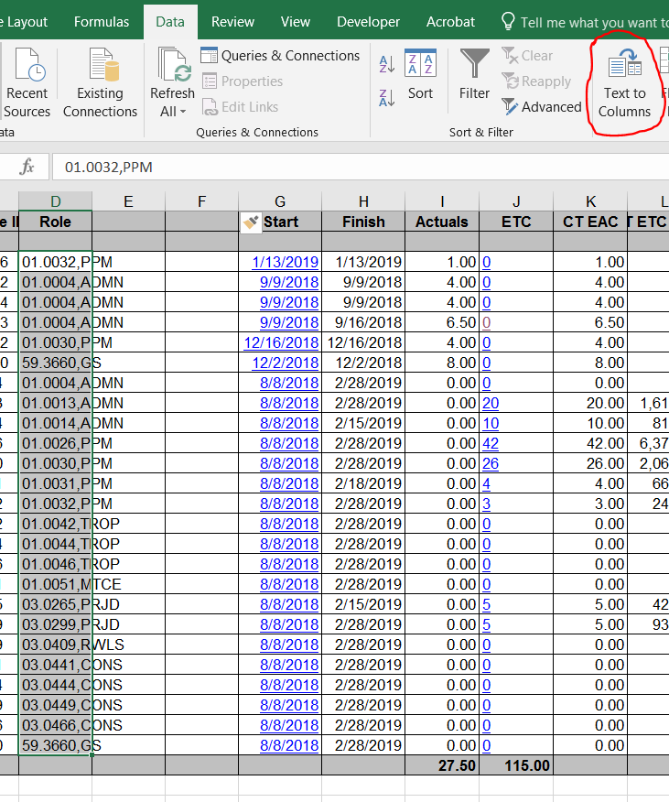
Workaround Steps
Highlight the data in the “Role” column (not the headings but the data in the white cells)
At the top of excel, click on the “Data” Tab then click on “Text to Columns.” (see image on right)
8

Slide 9
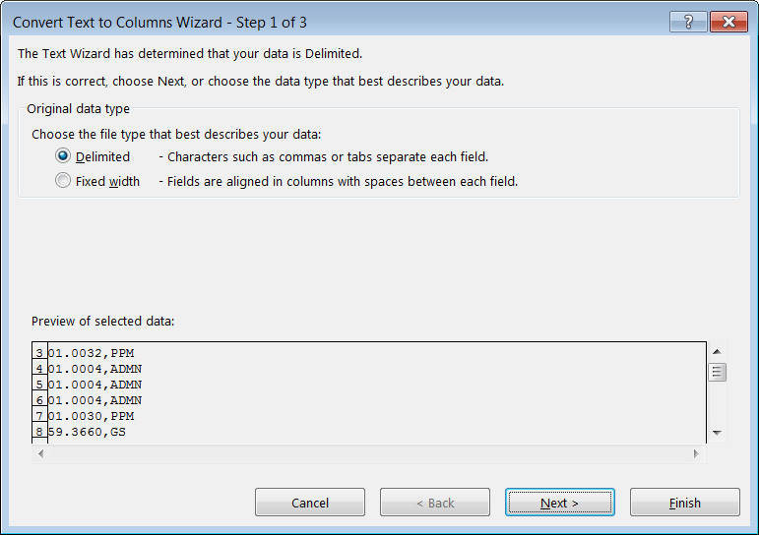
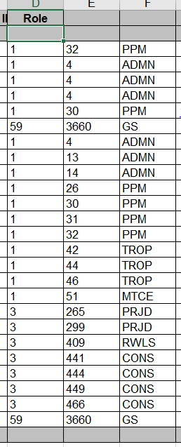
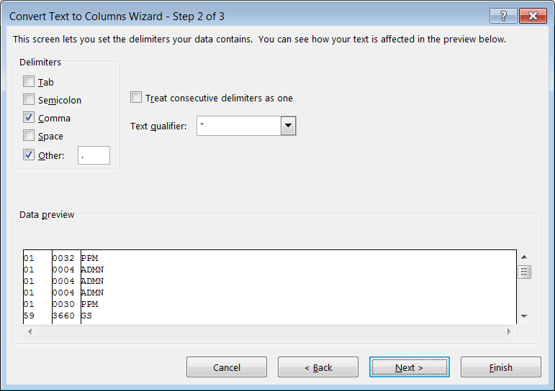
Workaround Steps
When prompted, select “Delimited” then “Next” then select “Comma” and “Other.” In the Other box put a period “.” and hit “Finish.” Hit “yes” for the warning box. The data from the “Role” column should be parsed into the three columns (see images to the right).
9

Slide 10
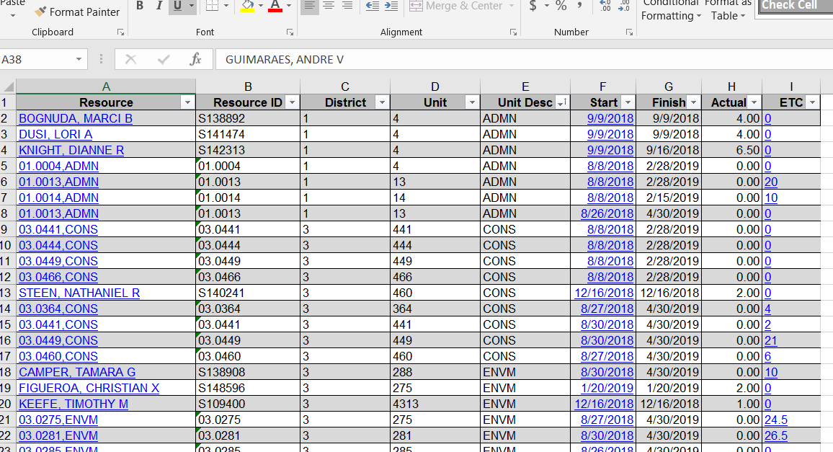
Workaround Steps
Copy the data (white cells) from the “Resource” column to the “ETC” column, and Paste the data into the “PRSM Data” worksheet located in the Resource Pivot Check file. Paste the data into cell A2 so as to not overwrite the table headings (see image to the right for an example of successful pasting of data)
Repeat steps 9-13 for the K.100.05 excel file and paste data below the K.150 data.
10

Slide 11
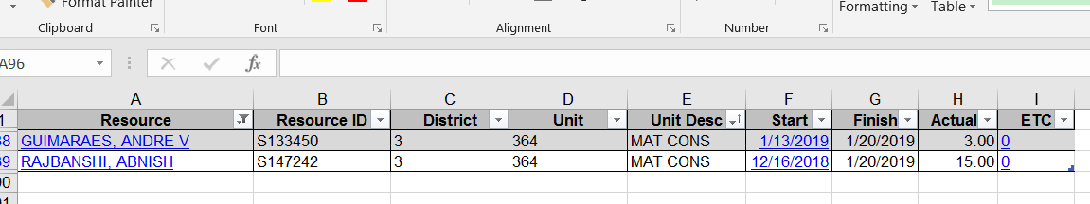
Workaround Steps
Note: Steps 15 and 16 are unique to District 1, because resources used in the Materials Functional Unit are specifically monitored. These steps can be adapted to the names of the materials employees in other districts
In the “Resource” Column on the “PRSM Data” worksheet, filter for the Materials folks (currently GUIMARAES, ANDRE V and RAJBANSHI, ABNISH).
Enter “MAT CONS” in the “Unit Desc” column (see image below)
11

Slide 12
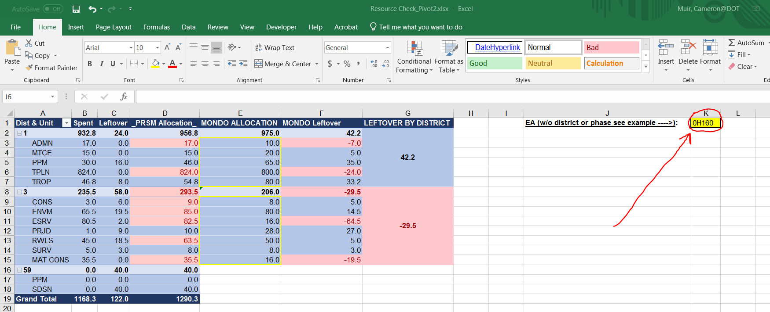
Workaround Steps
On the "Resource Check" worksheet, fill in the yellow highlighted cell (K1) with your project 5-digit EA. Be sure to not include the district prefix or phase. E.g. for 01-0H160K, you would enter "0H160“
This will populate the "MONDO ALLOCATION" cells with the allocated resource hours for each District and Unit (see image below)
12

Slide 13
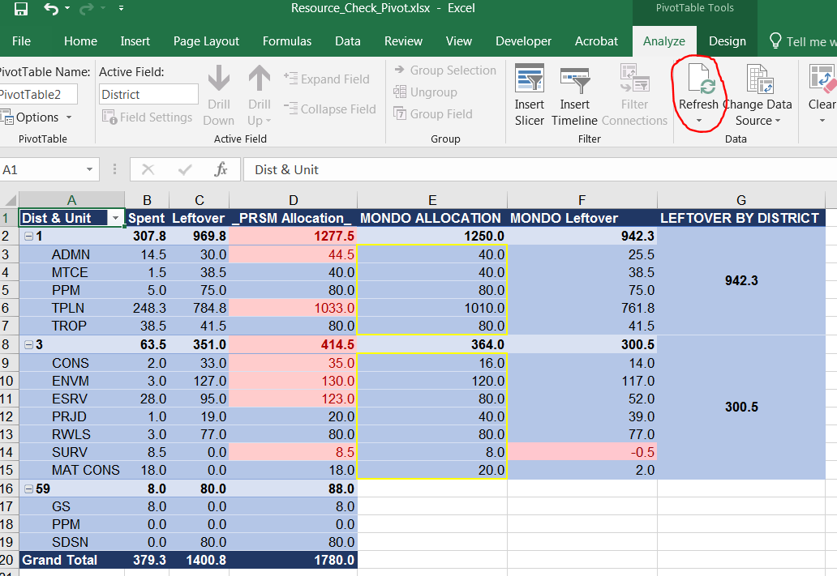
Workaround Steps
Click on “Dist & Unit” (cell “A1”) in the Pivot Table.
At the top of excel click on “Analyze” Tab. Then click the “Refresh” button on the tab (see image to the right)
Once the Pivot Table has refreshed, some values will be shown in red. These values indicate: overspending, resource budget reached, or PRSM discrepancies with original allocation spreadsheet.
13

Slide 14
Workaround Steps
Lastly, if any hours were reallocated (i.e. removed or added to your project) in your project, then provide the number of hours in the Adjustments (+/-) column. If hours were added to your project, then insert the positive number of hours in the row that corresponds to the unit (e.g. TPLN, CONS, PRJD, etc.) that received the hours. If hours were removed from your project, then insert the negative number of hours in the row that corresponds to the unit that hours were removed from.
14

Slide 15
Workaround Solution File
Double click the image below to edit the file. You can save a copy for yourself to configure.
Note: Formulas in the yellow bordered cells reference to the original resource allocation spreadsheet for District 1. You can configure these cells to pull data from your own original allocation spreadsheet for your district. Alternatively, you can manually enter the values into the cells.
15

