Slide 1
District 11 Traffic Monitoring Dashboard

Slide 2
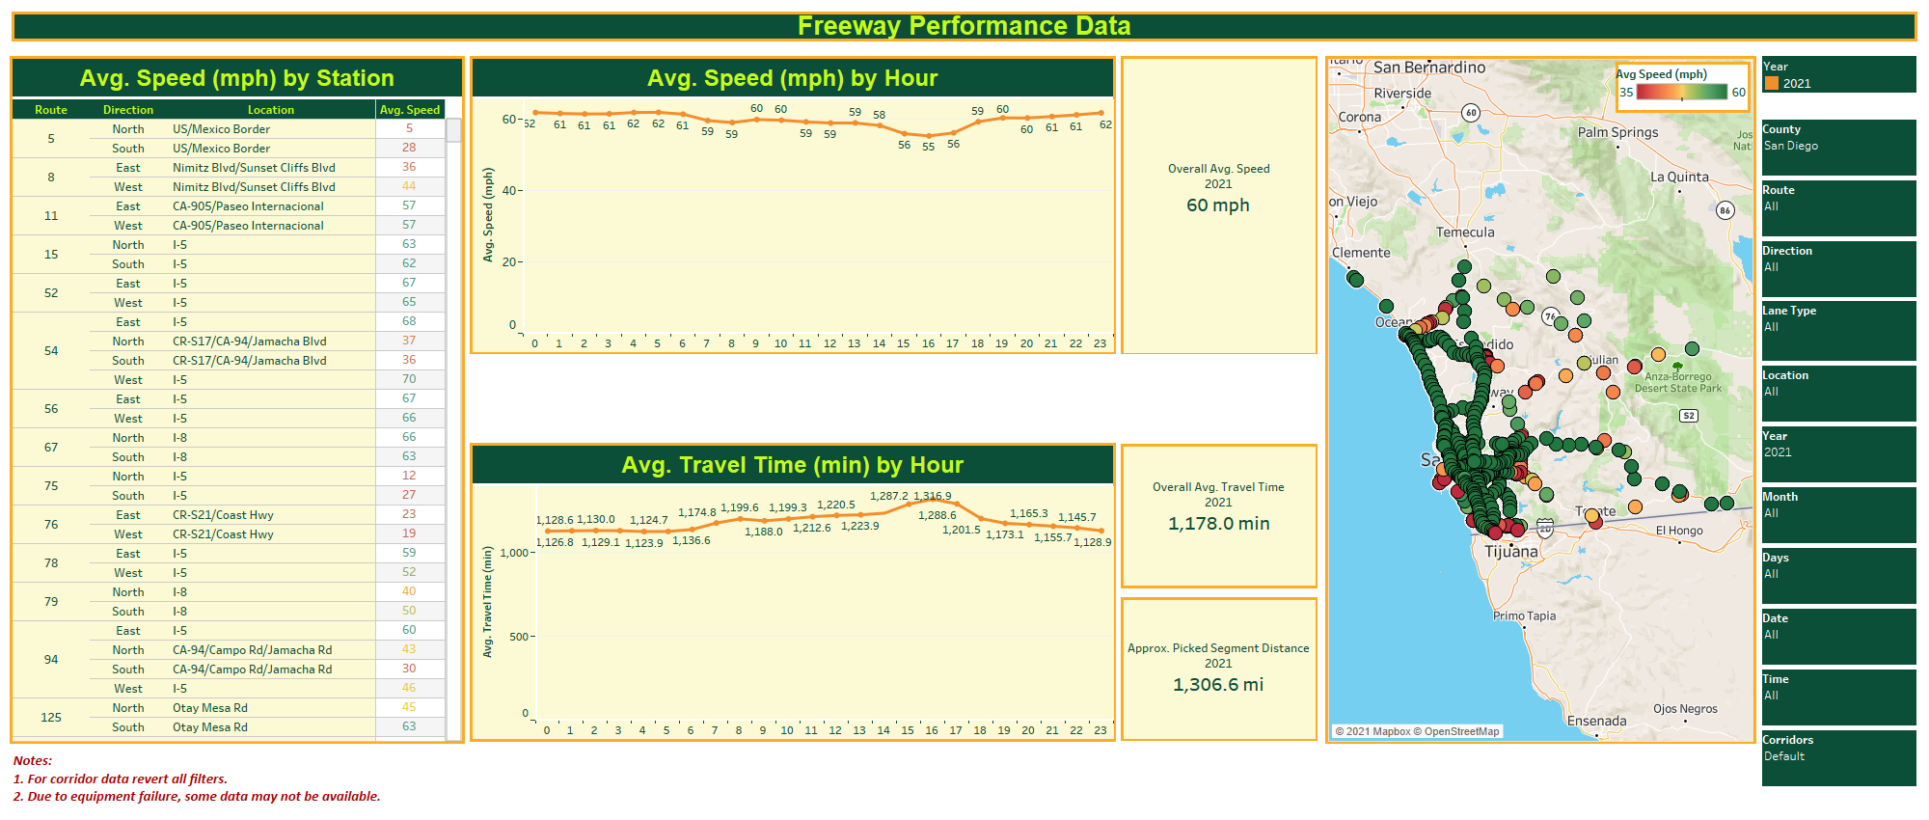
Instructions for use
Step 01: Select the desired filters which are located to the right of the dashboard. Please do not forget to hit the “Apply” button where it applies.

Slide 3
Video
This dashboard is dynamic, and it is being modified as needed to meet current needs. The Dashboard looks different since the last time this video was recoded, but the concept of use is the same.

Slide 4
Instructions for use
Step 02: To reset the filters please click on the “Revert” option which is located on the bottom left corner of the screen to reset the view.

Slide 5
Instructions for use
Step 03: To download the data please select the “Download” option located on the bottom right corner of the screen.

Slide 6
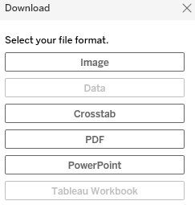
Instructions for use
Step 04: On the download screen please select your file format as “Crosstab”.

Slide 7
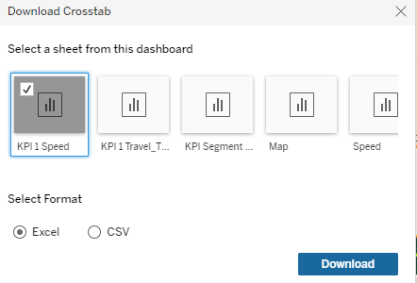
Instructions for use
Step 05: On the “Download Crosstab” screen please select the sheet and click on the “Download” button.

