Slide 1
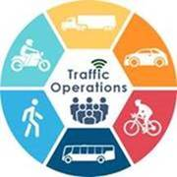

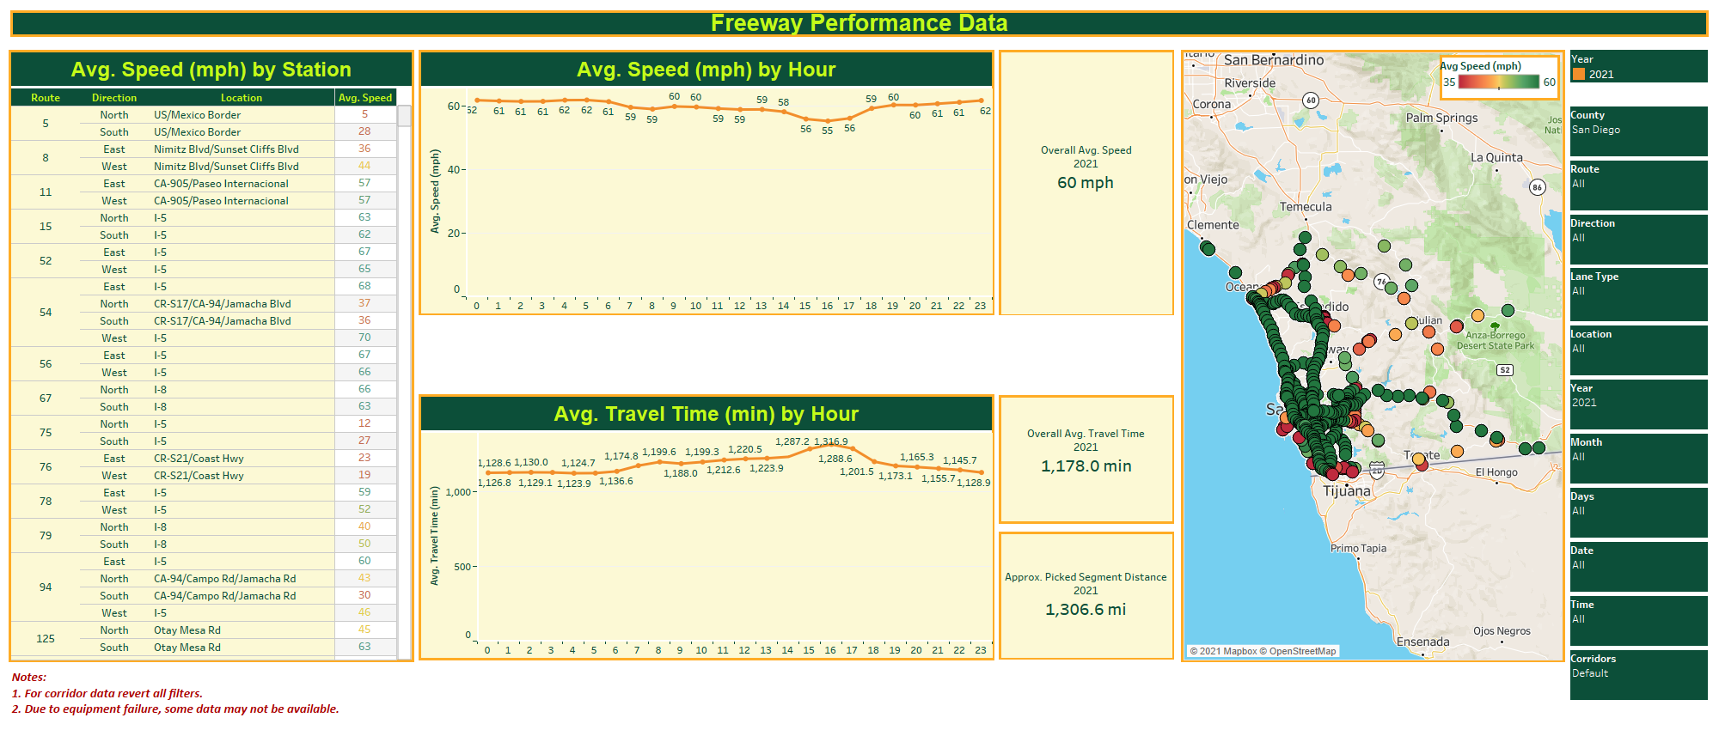
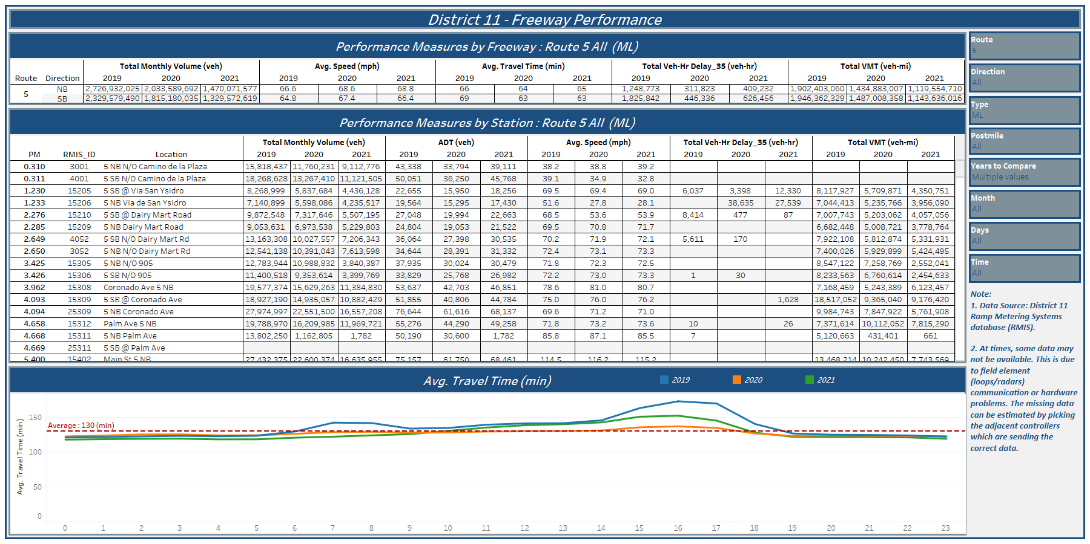
DISTRICT 11 TMC Traffic Performance Measuring System
Cell-Phone Traffic Data DASHBOARD
By collecting Speed Data from Cellphones and field detectors we were able to create Performance Measure DASHBORDS.
This allows other divisions to use this data in order to plan, design and operate existing and future projects.
District 11 field detection data DASHBOARD
Cellphone cloud
TMC
Field Detectors

