Slide 1
Improving Student Retention through Critical Thinking Application Activities
C. McMullen, MSN, RN
Northwest MS Community College

Slide 2

Objectives
Identify
Assess
Discuss
An innovative teaching strategy you’d like to use!
for barriers to implementing innovative teaching strategies!
ways to overcome these barriers!

Slide 3


Reference: (Gracious Quotes, 2021)

Slide 4

What is Critical Thinking Application (CTA) ?
Method of applying the information learned in lectures
Accommodates visual and kinesthetic learners
Reiterates hard skills (assessment and procedures)
Reinforces soft skills (communication, empathy, teamwork)

Slide 5
How has NWCC Nsg used CTA?
Reinforcement tool
Builds critical thinking skills
Encourages student engagement
Prepares students for upcoming exams
Preparation for clinical
  Incorporation of pertinent clinical documents
*For CTAs to be effective, content should be meaningful (pertinent to testing/evaluation).

Slide 6
CTA: When?
The last class day before the exam is typically CTA day.
Nsg I is front-loaded.
  Theory content is taught before check-offs and clinical.
Students have all lecture content for the upcoming exam before CTA day.
Usually weekly or every other week until the Final Exam

Slide 7
CTA: How?
Determine how many stations are needed based on lecture topics.
Divide students into small groups.
Prepare each station the day before.
Can be modified to the needs of the course
  Other courses: groups have ½ day to rotate through fewer stations
  Computer stations for practice quizzes may be self-led if no instructor is available.

Slide 8

Nsg I CTA Set-Up
Location | Instructor | Skill | Group (by last name)
Station 1: Basement Classroom (side 1) | McMullen | TPR (Vital Signs) | A-C
Station 2: Basement Classroom (side 2) | Beaver | BP, Apical HR (Vital Signs) | D-G
Station 3: Basement Sunroom | Coey | Intro to Nsg/ Maslow Activity | H-M
Station 4: Computer Lab 138 | Evans | Demographic Survey/ F. A. Davis Quiz | N-R
Station 5: Freshman Skills Lab | Clemons | Bed Bath/ Making occupied bed | S-Z

Slide 9
Nsg I CTA Set-Up
Schedule
Station 1: 0810- 0910
Station 2: 0920-1020
Station 3: 1030-1130
LUNCH 1130-1230
Station 4: 1240-1340
Station 5: 1350-1450

Slide 10
“I’m not creative. How can I apply CTA?”
Hard Skills | Soft Skills
Vital Signs, Ht/Wt, Handwashing | Maslow’s Hierarchy- Prioritization Game
Health Assessment | Nursing Process Puzzle
NG/ enema | Communication Case Study
Medication Administration | Teaching/ Learning Activity
Foley Catheter | Concept Mapping Scenarios w/ manikins
PPE | Documentation Practice
Transfers/ Range of Motion | Dosage Calc Practice
Combination on Final Day: Escape Room | Surveys/ Evals
*Any concept or skill that needs more reinforcement can be made into a CTA activity!

Slide 11
“I’m not creative. How can I apply CTA?”
Hard Skills | Theoretical Content
IV skills | Jeopardy
In and Out Catheter Insertion | Kahoot!
Tracheostomy | Menti-Meter
Port-a-Cath | Socratic Questioning
Safety Scenarios | Hurst Next Gen Scenarios
*Any concept or skill that needs more reinforcement can be made into a CTA activity!

Slide 12

Benefits of CTA
For Students:
Smaller groups!
Opportunities to make connections with concepts and people!
Makes learning fun!
Increases confidence in critical thinking!
Allows students to reflect on their “muddy points”
For Faculty:
FLEXIBLE/ADAPTABLE to your needs!
Once created, very easy to implement!
Interactive Learning vs. Critical Thinking Application Hours

Slide 13
Supporting Data
Critical thinking is a component of nursing judgment that is essential for new graduate nurses’ competency (Patterson et al., 2017).
“Nursing education is experiencing the challenges of a nurse faculty shortage, increasingly sophisticated technologies, and the stimulation of a diverse student population” (Christensen & Simmons, 2020, p. 25).

Slide 14
Supporting Data
To stimulate critical thinking development, students must be allowed to ask meaningful questions and find the answers by themselves. The educator’s role is to facilitate this experience while challenging, stimulating and supporting students in the search for the answers to their own questions (Urcula-Pardo et al., 2018).
“Integrating concepts of active learning and self-direction while aligning expectations and creating overlap between classroom and clinical domains can assist in addressing the challenges faced by new faculty and students” (Barrett et al., 2018), p. 359).

Slide 17
Student Feedback:
“I really appreciated how the instructors incorporated CTA days, as it helped with check-offs and exams.”
“CTA days are AMAZING! Please keep them!”
“You have given us all the resources and exposure you could possibly give, especially with CTA days.”
-Nsg I Evals

Slide 18

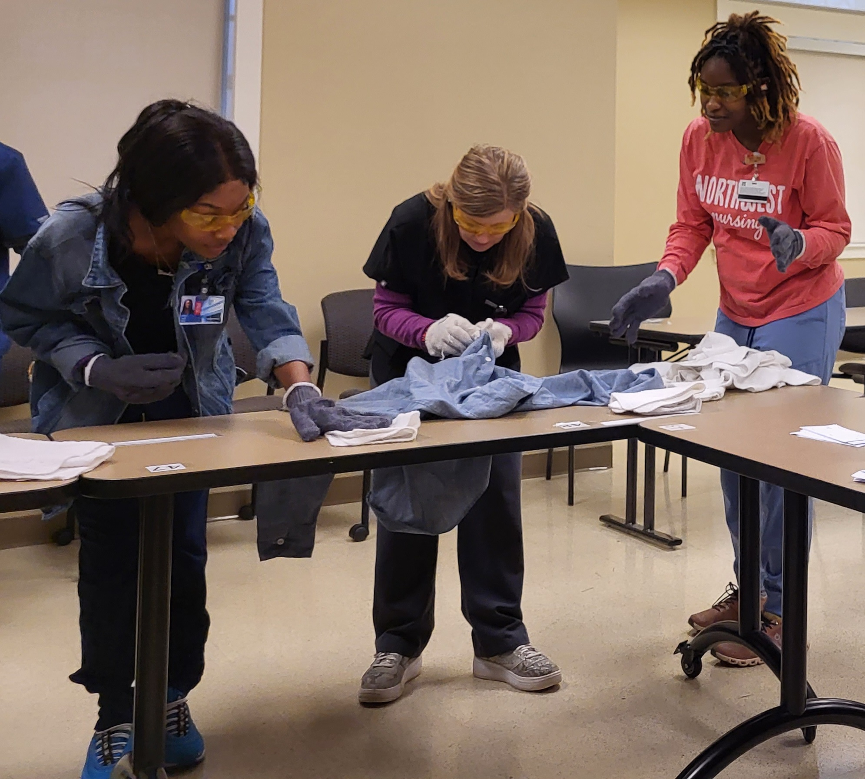
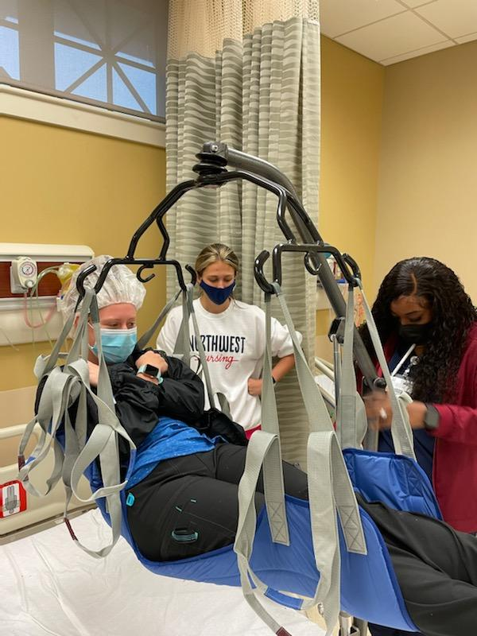
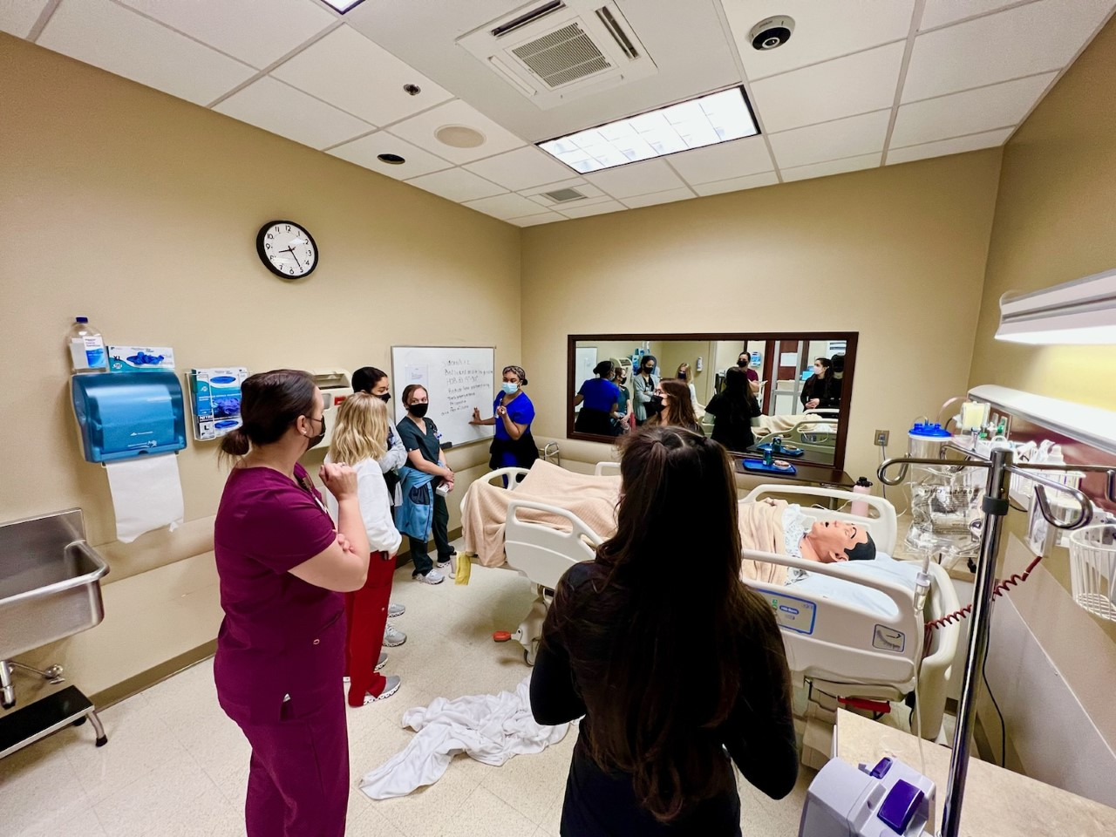

Reference: Nsg I Faculty (2021-2023)

Slide 19
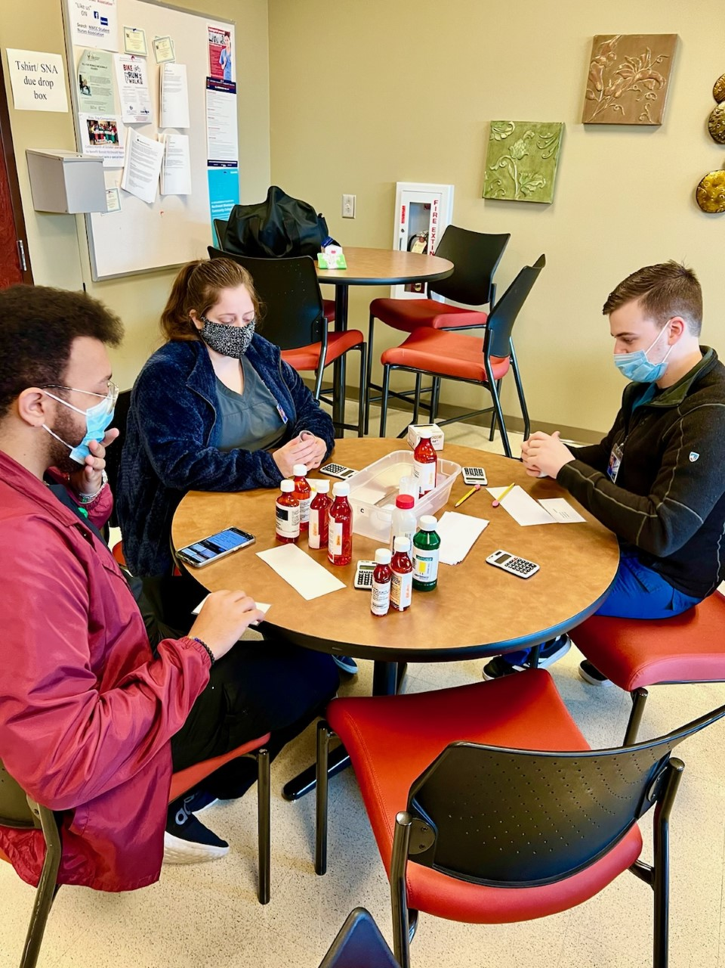
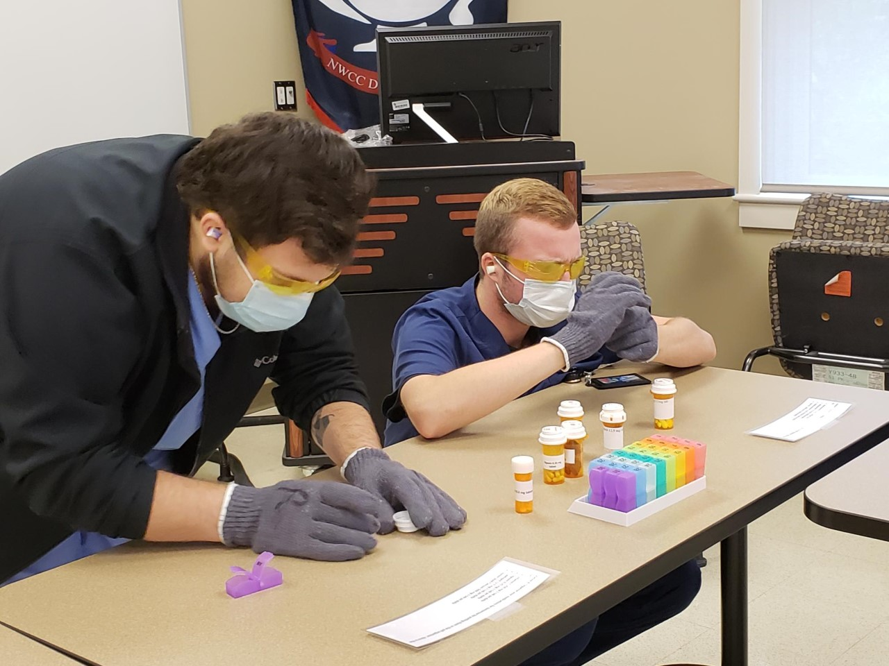


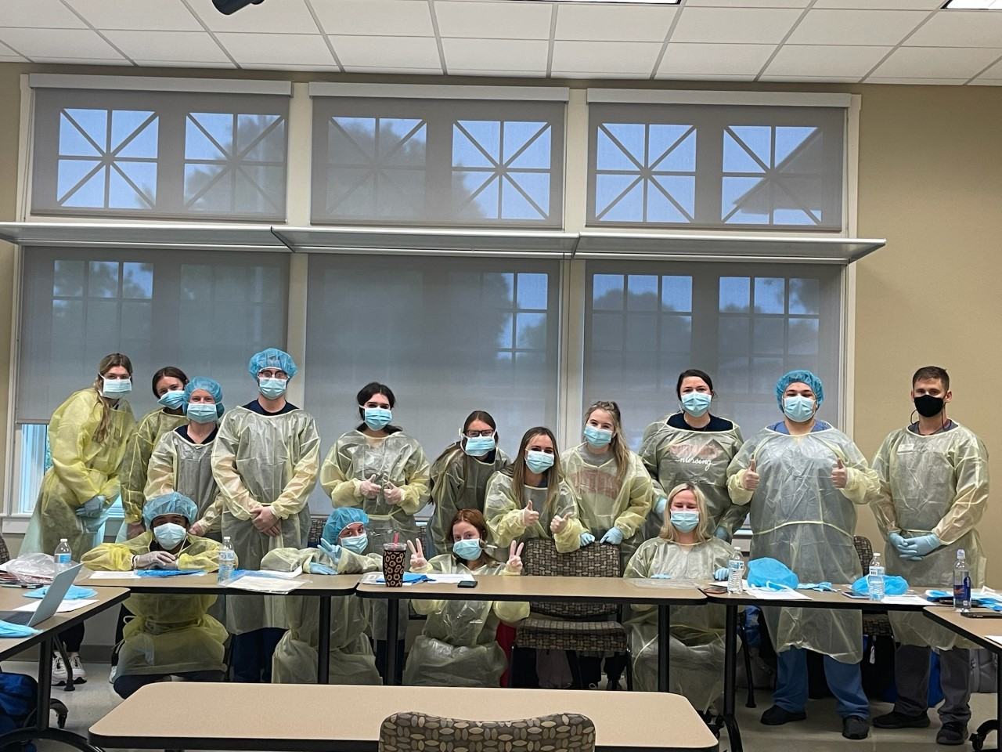
Reference: Nsg I Faculty (2021-2022)

Slide 20
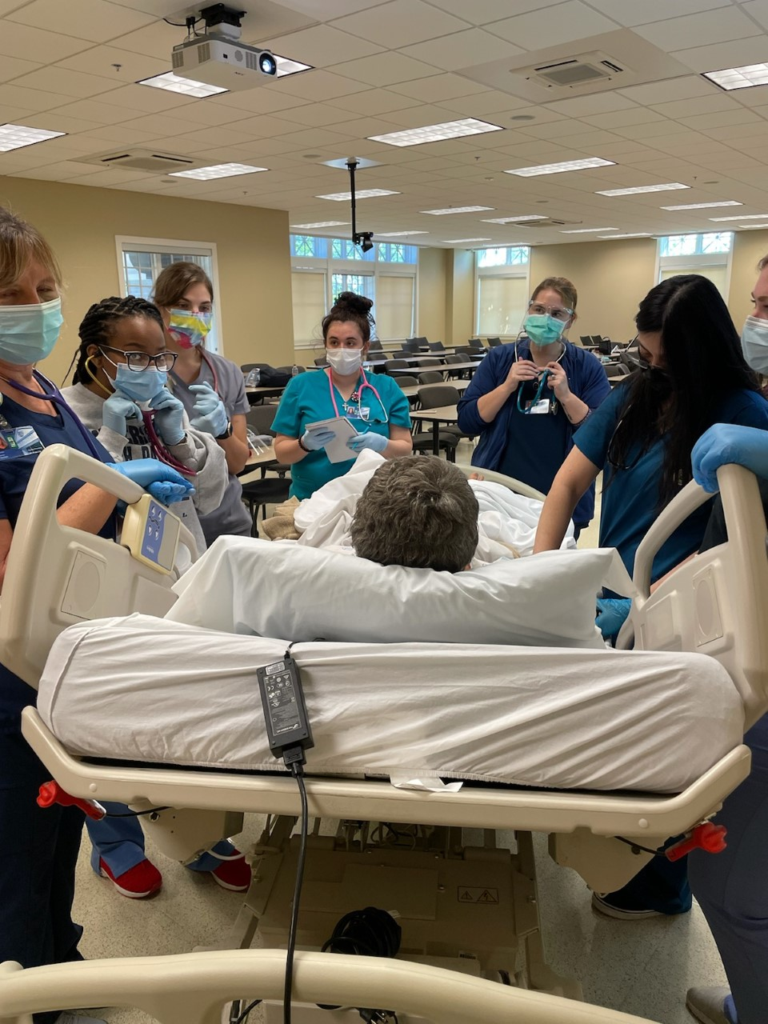
Take-Aways
Critical Thinking Application (CTA) activities increase one’s ability to apply theoretical information to practice.
CTA increases student retention, competence, and confidence.
CTA is a fun way to bring “real-world” scenarios to the classroom setting before exposure to clinical.
Reference: Nsg I Faculty (2021)

Slide 21
Where we are…
Where we’re going!
All levels are now implementing CTA activities in their courses!
Overall Program Retention Rate of 84.9% after Fall 2022!
Increased program retention!
Increase in nursing graduates!

Slide 22
MOADN Faculty Challenge
10 Minute Group Discussion
  What content areas do students have the most difficulty with on exams? How can you incorporate CTA activities into these content areas?
  Is there a critical thinking application activity you’d like to use?
  What are the barriers to implementing CTA activities? How can you overcome those barriers?
  Nominate one spokesperson per table to share responses at the end of the discussion.

Slide 23
Share Time!
Listeners:
What recommendations can you offer?

Slide 24

Questions?

Slide 25
Special Thanks
Ms. Stacy Taylor: for the idea!
Nursing I Team: for your support, for your creativity, and for your acceptance of this endeavor!
Mrs. Monica Williams & Dr. Erin Harrington: for adjusting your schedules to make the plan work!
Mrs. Lacey Gentry: for supporting new, creative ideas!
Nsg II-IV: for your buy-in!
Thank you all for listening!

Slide 26
Thank You!
Courtney McMullen, MSN, RN
Course Coordinator for Nursing I
Northwest MS Community College
GLS SON Building, Office 109
cmcmullen@northwestms.edu
662-560-5208

Slide 27
References
Barrett, J. L., Denegar, C. R., & Mazzerole, S. M. (2018). Challenges facing new educators: Expanding teaching strategies for clinical reasoning and evidence-based medicine. Athletic Training Education Journal, 13(4), 359-366. DOI: 10.4085/1304359
Christensen, L. S., & Simmons, L. E. (2020). The scope of practice for academic nurse educators and academic clinical nurse educators (3rd Ed.). Wolters Kluwer.
Gracious Quotes. (2021, Dec. 9). 35 motivational dare-to-try quotes. Graciousquotes.com. https://graciousquotes.com/dare-to-try/
Patterson, E. E. B., Boyd, L., & Mnatzaganian, G. (2017). The impact of undergraduate clinical teaching models on the perceptions of work-readiness among new graduate nurses: A cross-sectional study. Nurse Education Today, 55(Aug. 2017), pp. 101-106. http://dx.doi.org/10.1016/j.nedt.2017.05.010

Slide 28
References
Unpublished CTA Photos (2021-2023). Nsg I faculty (with permission from students).
Urcola-Pardo, F., Blazquez-Ornat, I., Anguas-Gracia, A., Gasch-Gallen, A., & German-Bes, C. (2018). Perceptions of nursing students after performing an individual activity designed to develop their critical thinking: The “critical card” tool. Nursing Education in Practice, 29(2018), 35-40. https://doi.org/10.1016/j.nepr.2017.11.005

