Slide 1
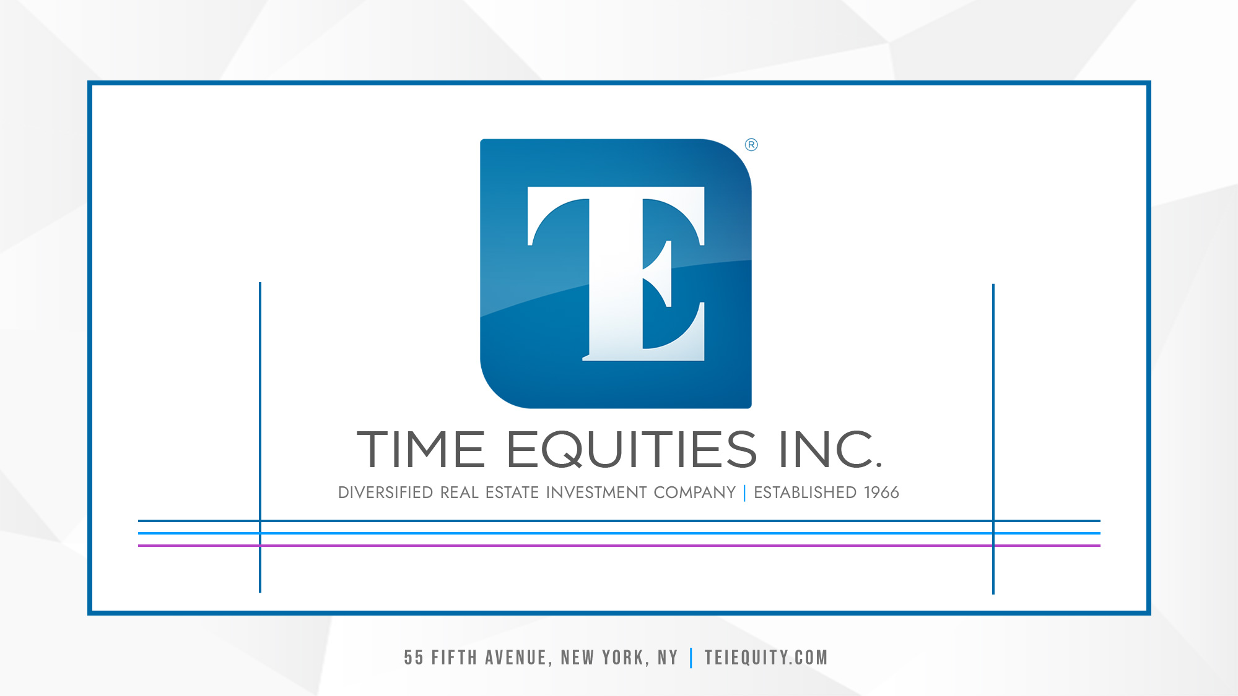

Slide 2
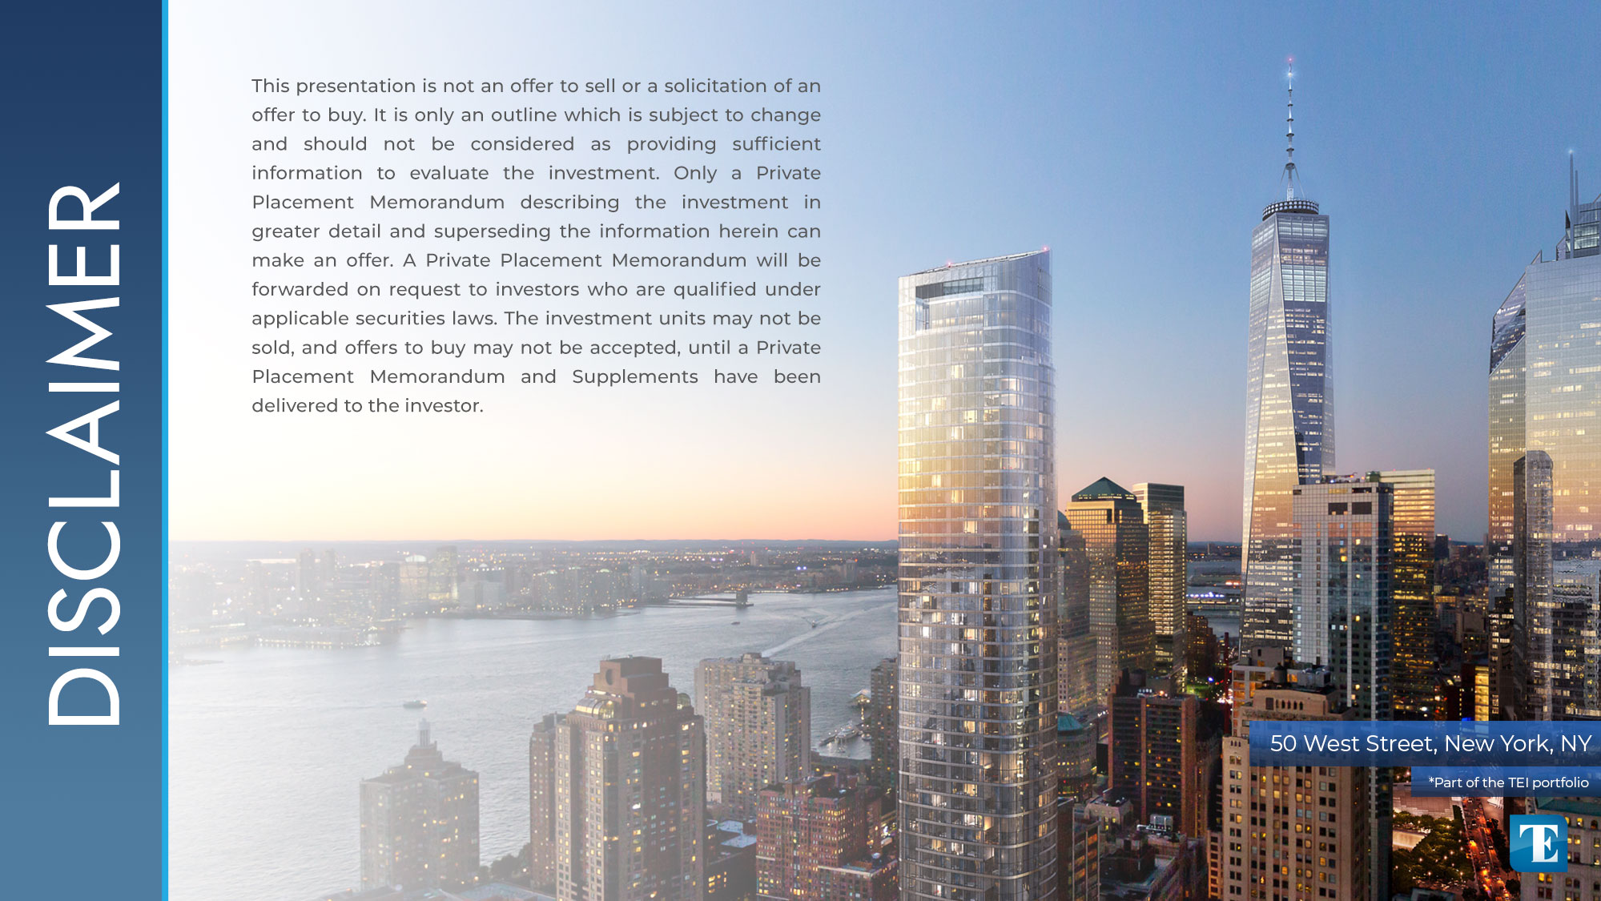

Slide 3
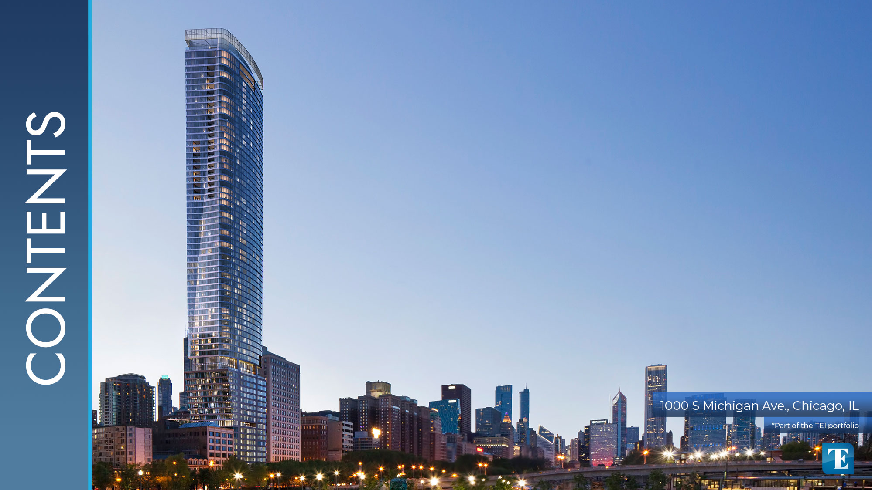
1...............................WHO WE ARE
2...............................OUR STRATEGY
3...............................DIVERSIFIED FUND PERFORMANCE
4...............................CURRENT OFFERINGS
5………………………….TEXCHANGE 1031
6...............................MEET THE TEAM
7………………………….QUESTIONS/FEEDBACK

Slide 4


Slide 5


Slide 6
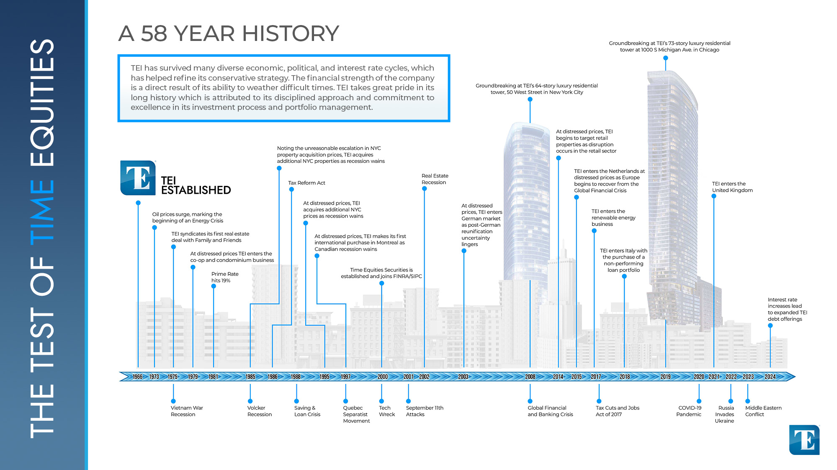

Slide 7
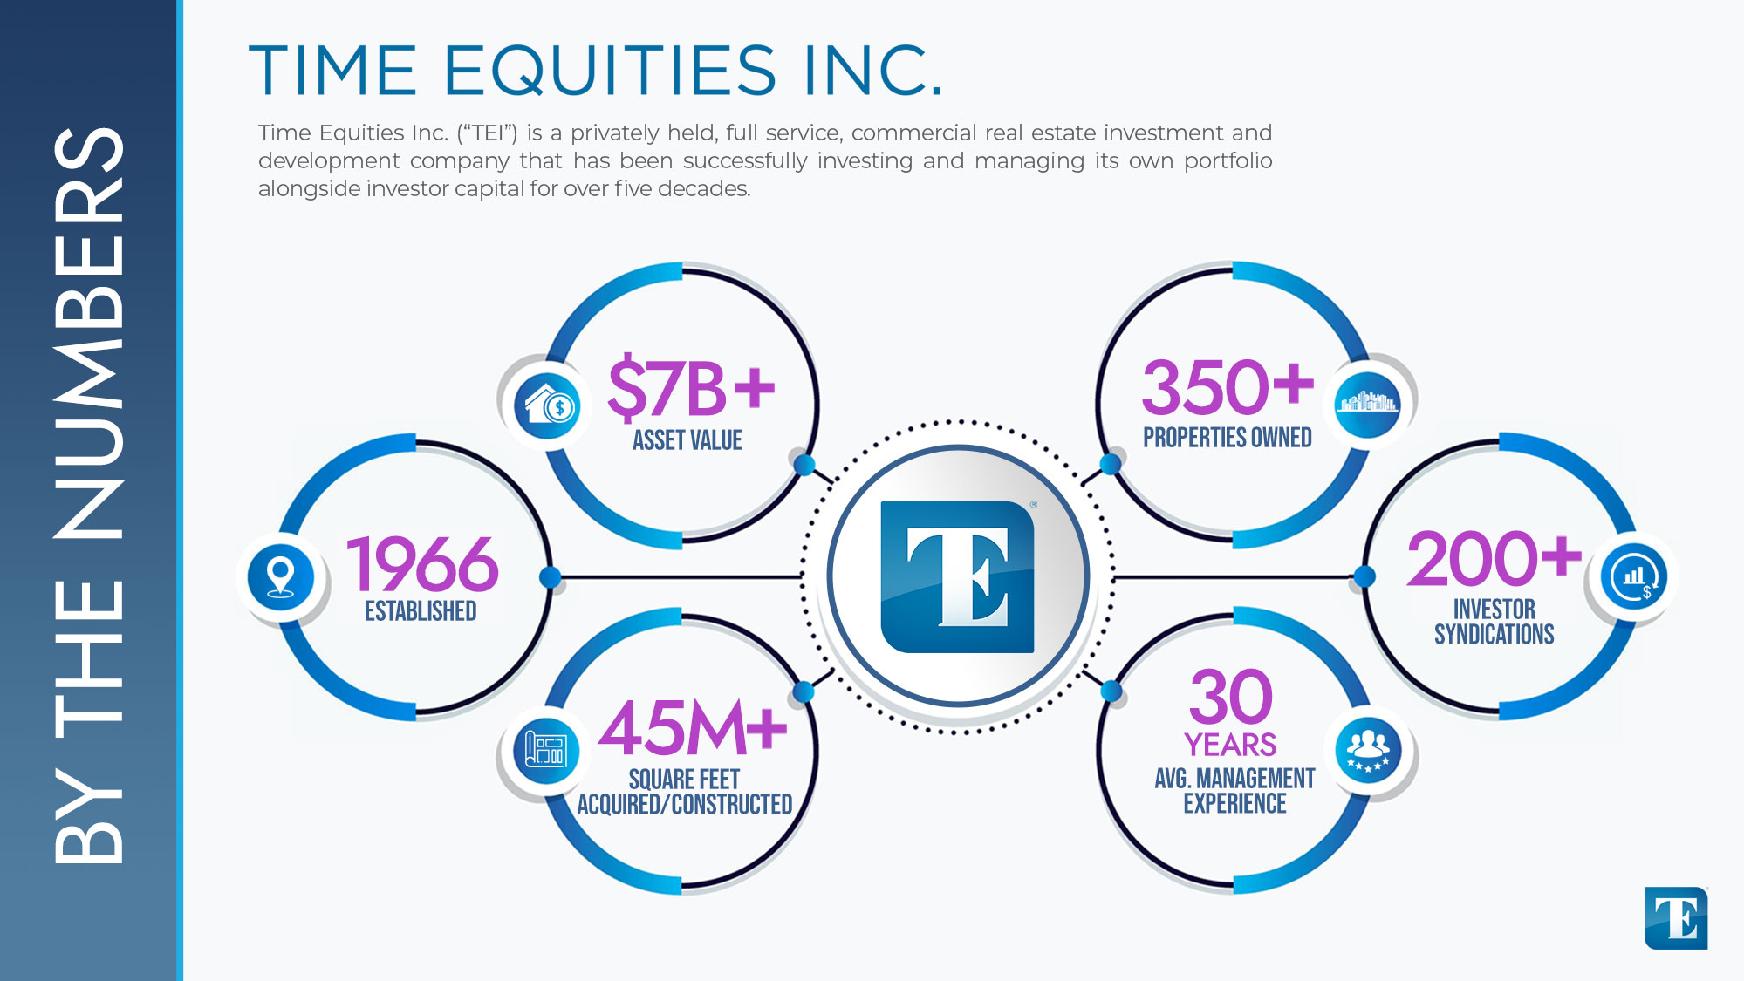

Slide 8
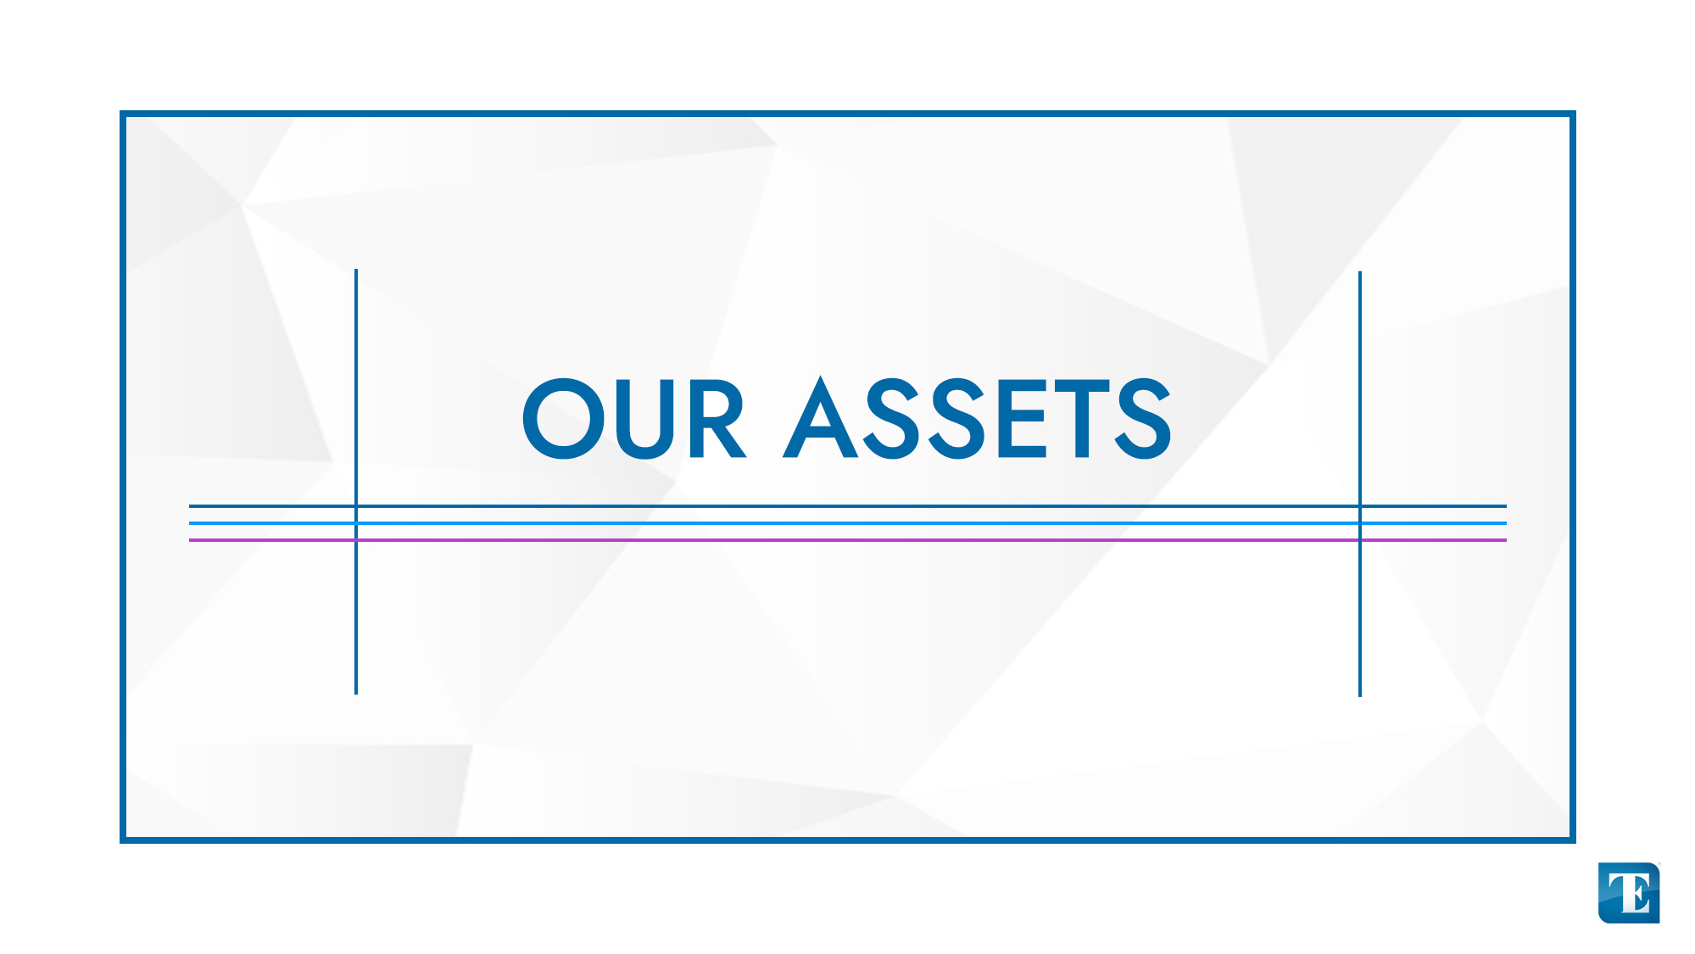

Slide 9
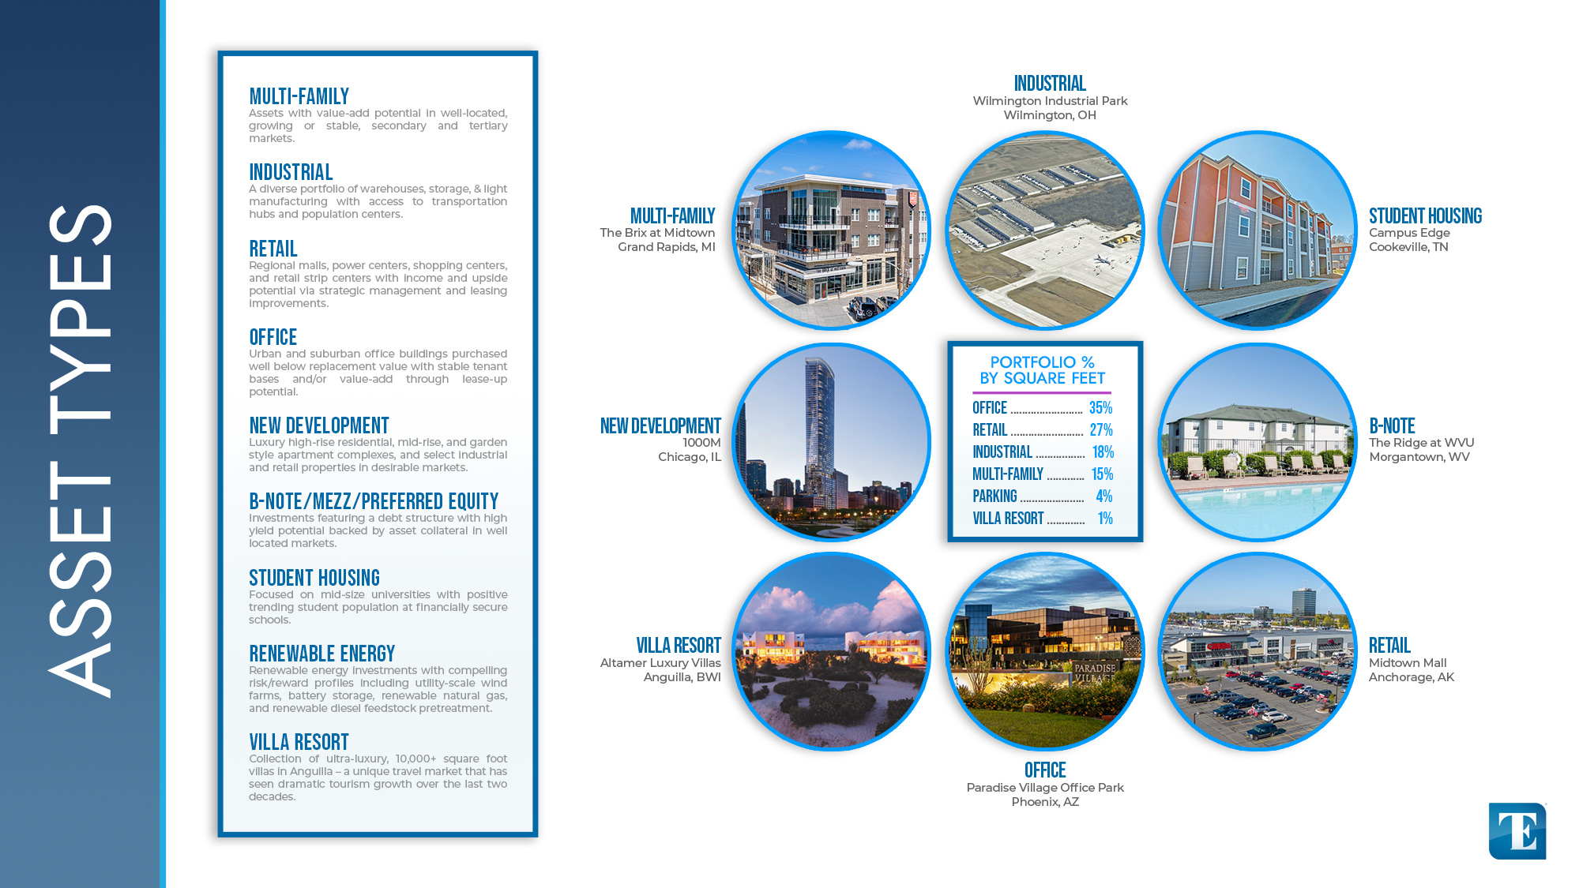
*These properties are owned or operated by Time Equities and its affiliates.

Slide 10
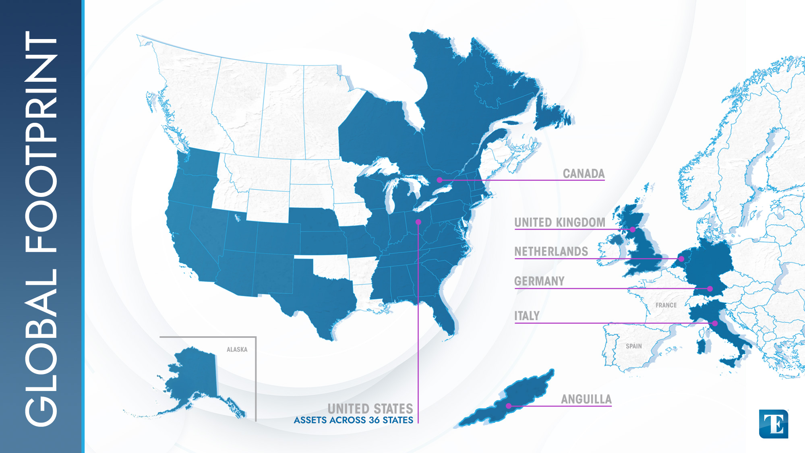

Slide 11
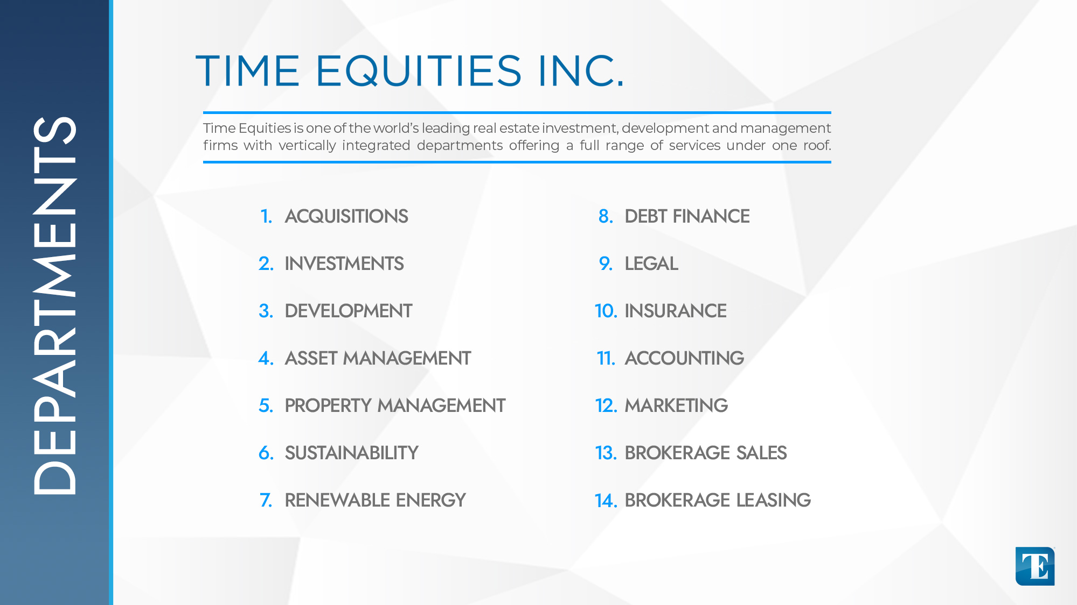

Slide 12
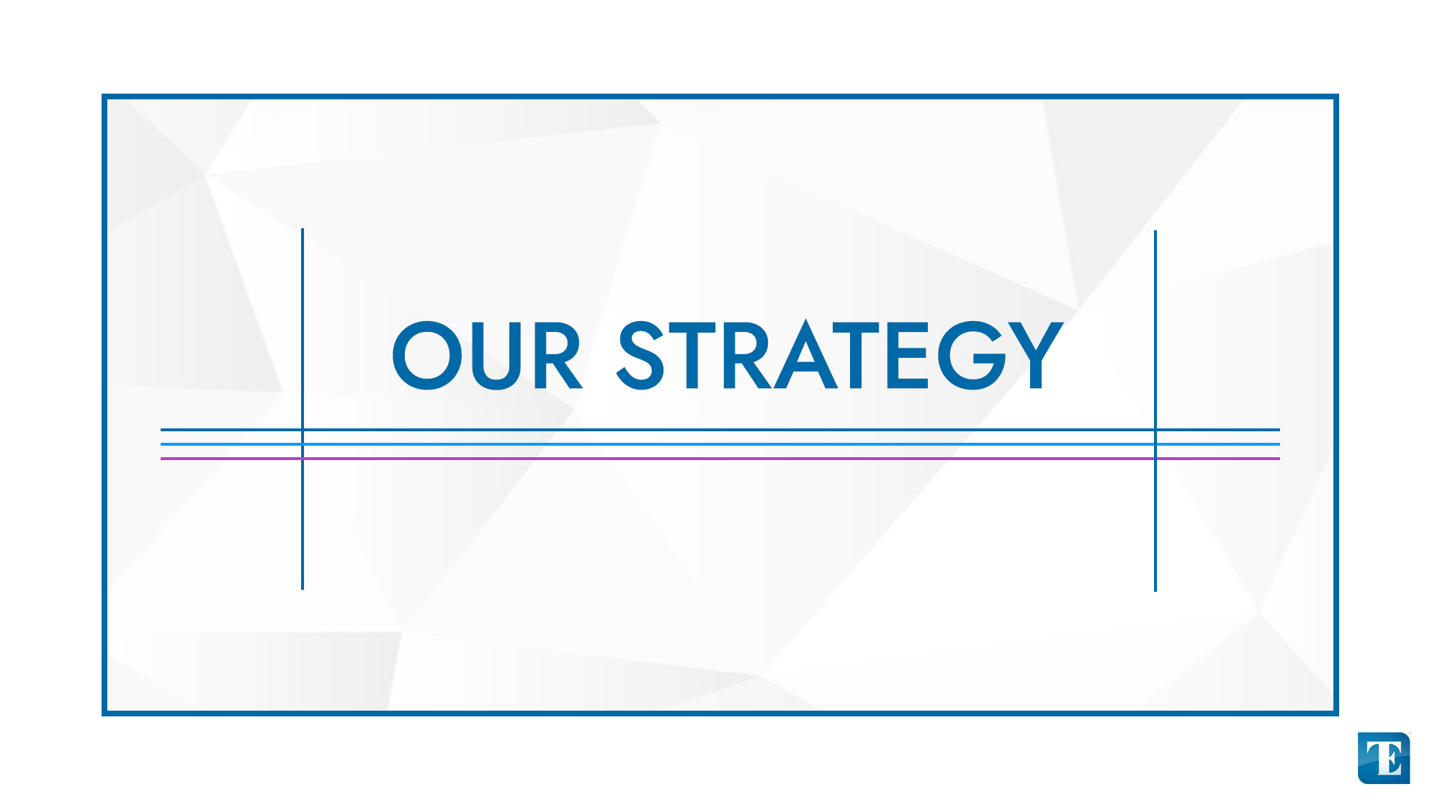

Slide 13
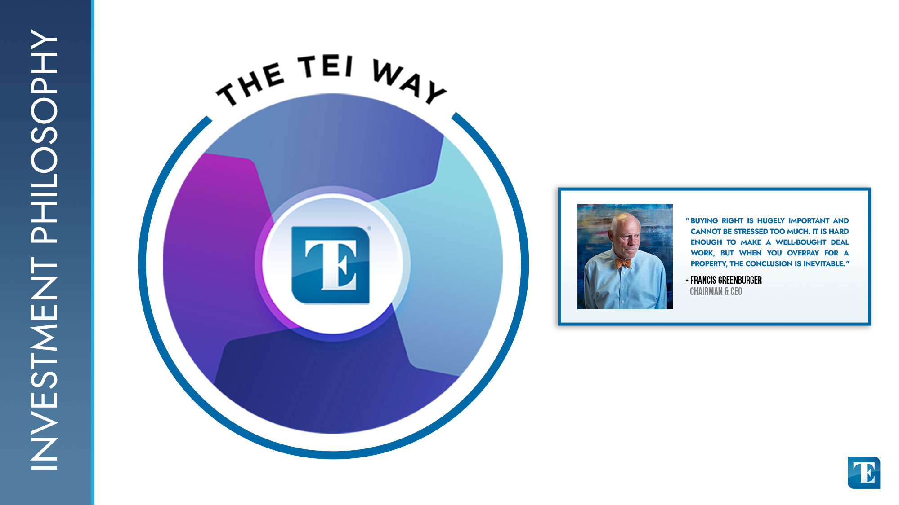
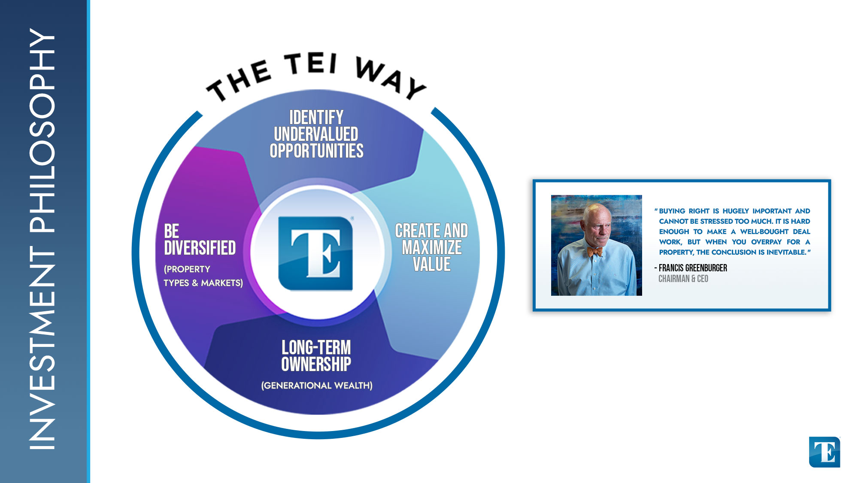

Slide 14
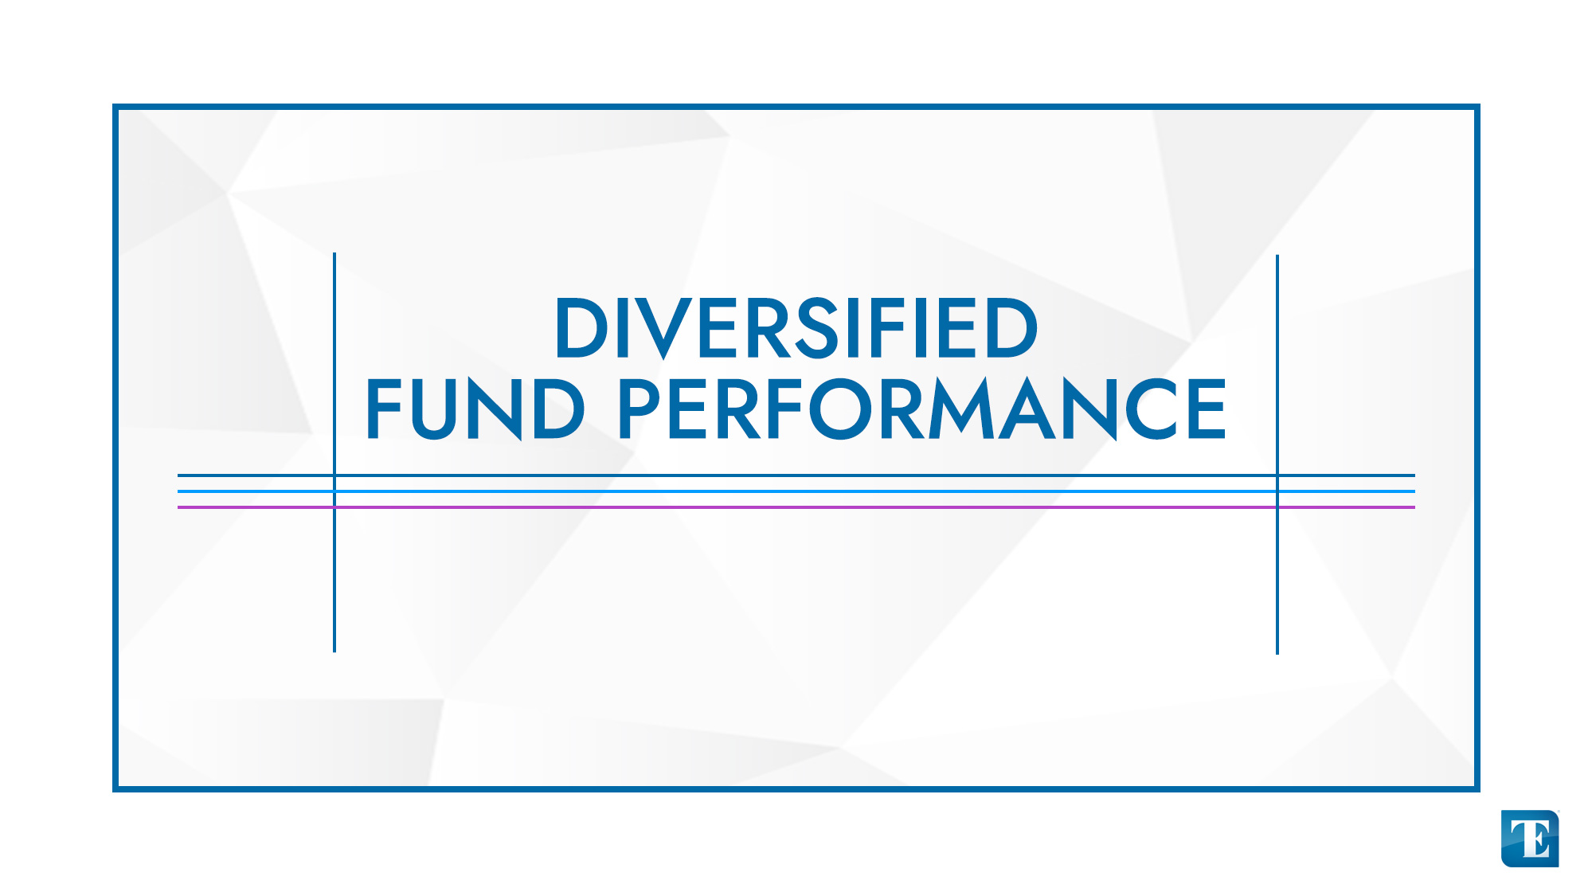

Slide 15
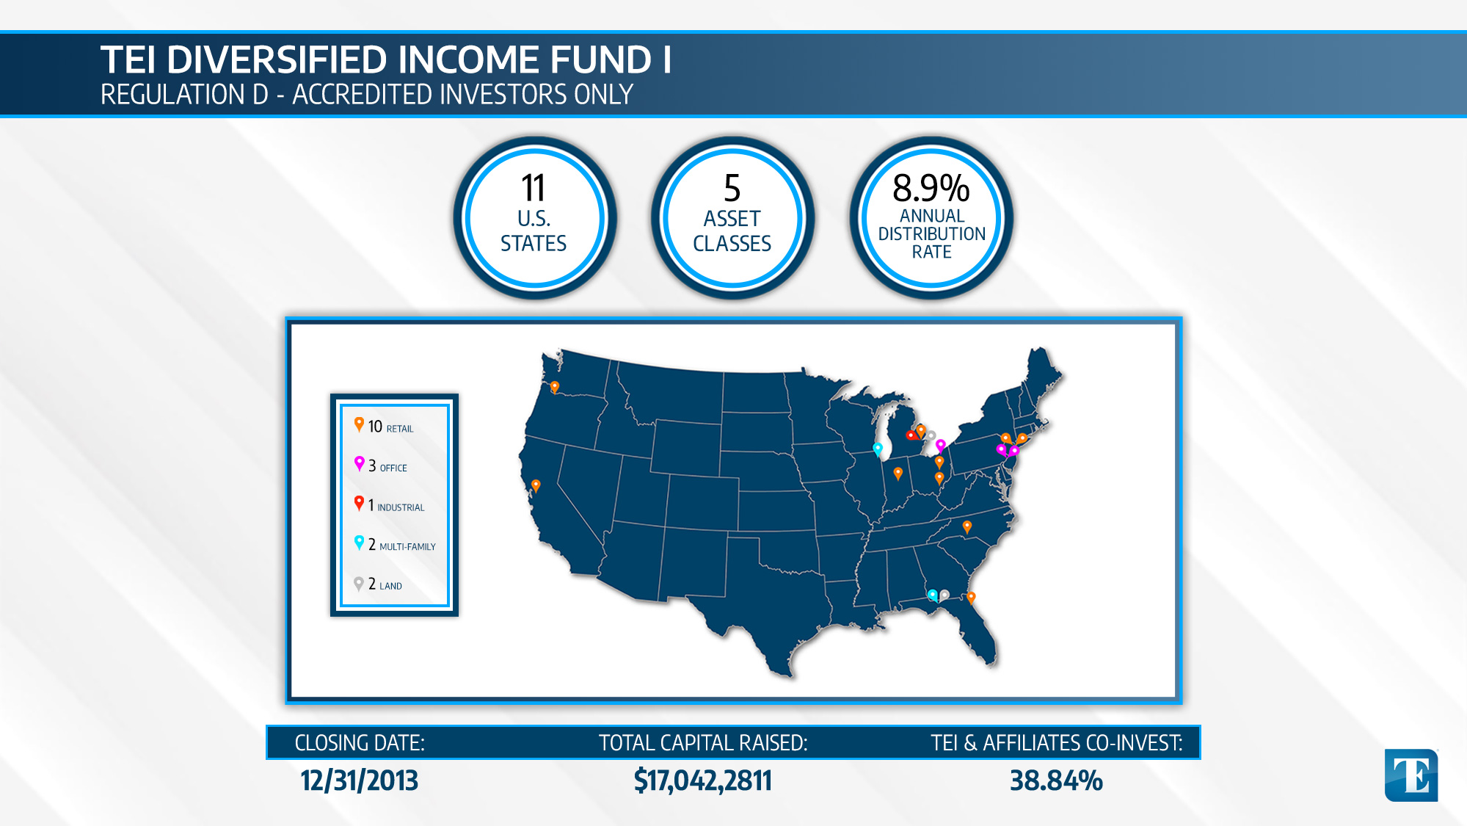

Slide 16
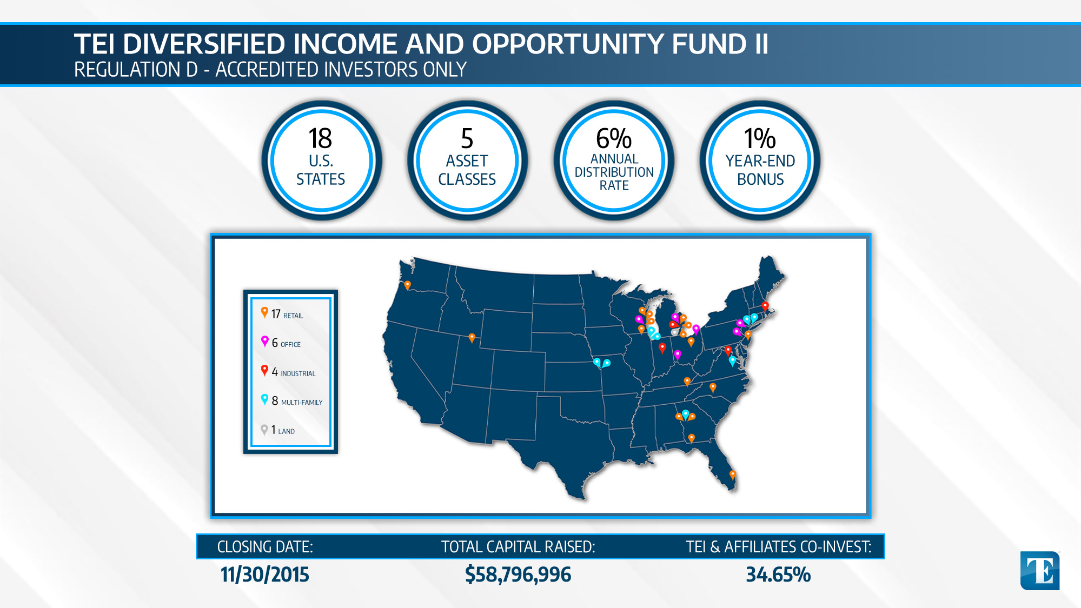

Slide 17
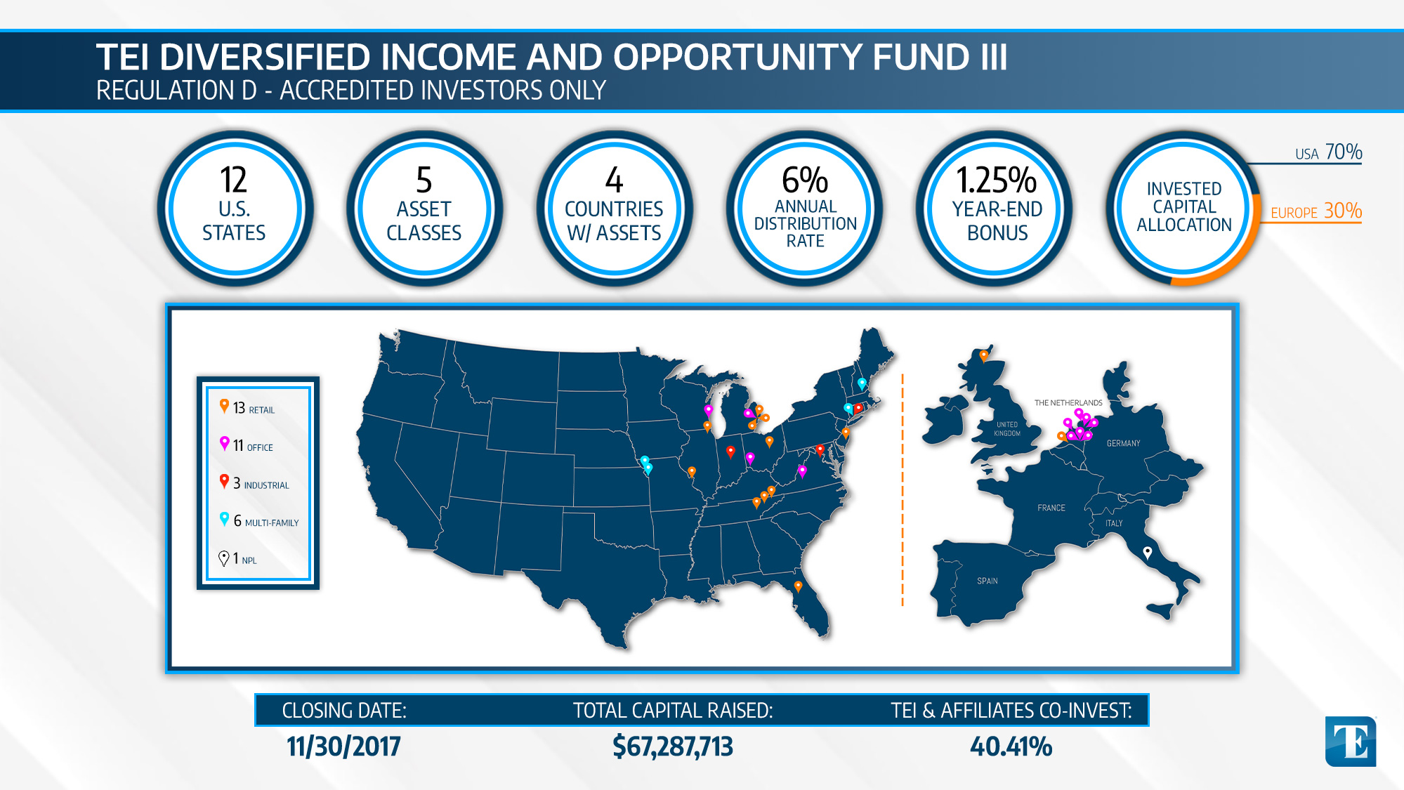

Slide 18
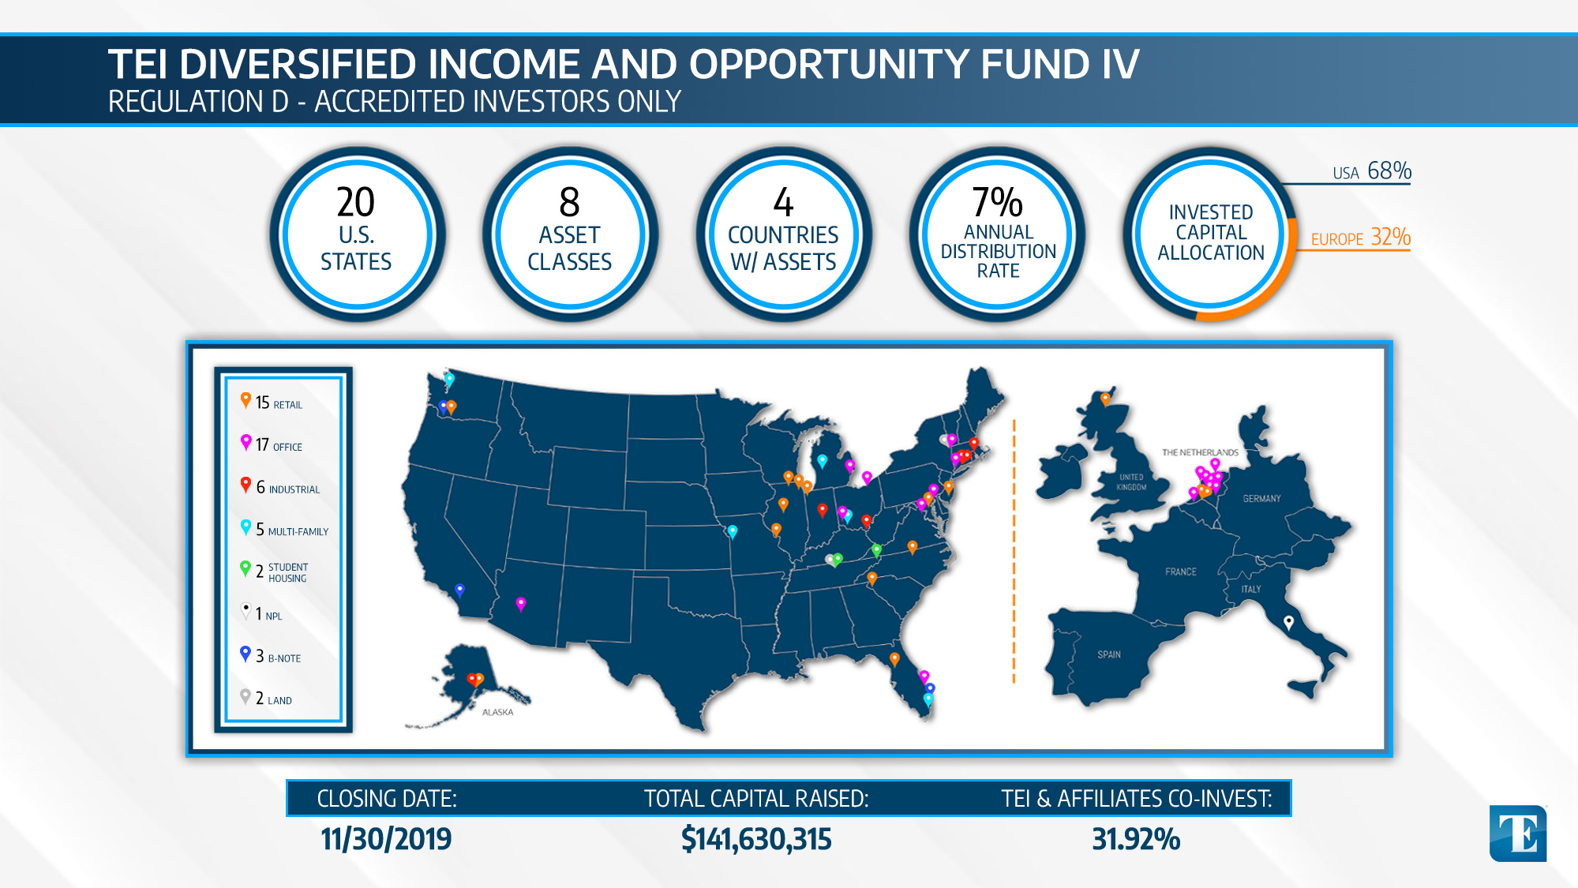

Slide 19


Slide 20
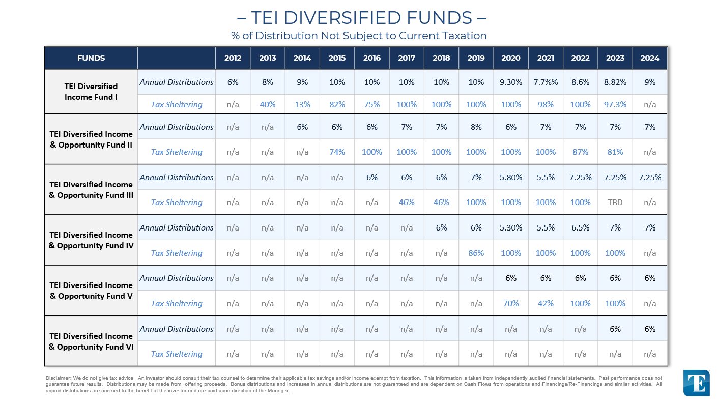

– TEI DIVERSIFIED FUNDS –
% of Distribution Not Subject to Current Taxation
FUNDS |  | 2012 | 2013 | 2014 | 2015 | 2016 | 2017 | 2018 | 2019 | 2020 | 2021 | 2022 | 2023 | 2024
TEI Diversified Income Fund I | Annual Distributions | 6% | 8% | 9% | 10% | 10% | 10% | 10% | 10% | 9.30% | 7.7%% | 8.6% | 8.82% | 9%
 | Tax Sheltering | n/a | 40% | 13% | 82% | 75% | 100% | 100% | 100% | 100% | 98% | 100% | 97.3% | n/a
TEI Diversified Income & Opportunity Fund II | Annual Distributions | n/a | n/a | 6% | 6% | 6% | 7% | 7% | 8% | 6% | 7% | 7% | 7% | 7%
 | Tax Sheltering | n/a | n/a | n/a | 74% | 100% | 100% | 100% | 100% | 100% | 100% | 87% | 81% | n/a
TEI Diversified Income & Opportunity Fund III | Annual Distributions | n/a | n/a | n/a | n/a | 6% | 6% | 6% | 7% | 5.80% | 5.5% | 7.25% | 7.25% | 7.25%
 | Tax Sheltering | n/a | n/a | n/a | n/a | n/a | 46% | 46% | 100% | 100% | 100% | 100% | TBD | n/a
TEI Diversified Income & Opportunity Fund IV | Annual Distributions | n/a | n/a | n/a | n/a | n/a | n/a | 6% | 6% | 5.30% | 5.5% | 6.5% | 7% | 7%
 | Tax Sheltering | n/a | n/a | n/a | n/a | n/a | n/a | n/a | 86% | 100% | 100% | 100% | 100% | n/a
TEI Diversified Income & Opportunity Fund V | Annual Distributions | n/a | n/a | n/a | n/a | n/a | n/a | n/a | n/a | 6% | 6% | 6% | 6% | 6%
 | Tax Sheltering | n/a | n/a | n/a | n/a | n/a | n/a | n/a | n/a | 70% | 42% | 100% | 100% | n/a
TEI Diversified Income & Opportunity Fund VI | Annual Distributions | n/a | n/a | n/a | n/a | n/a | n/a | n/a | n/a | n/a | n/a | n/a | 6% | 6%
 | Tax Sheltering | n/a | n/a | n/a | n/a | n/a | n/a | n/a | n/a | n/a | n/a | n/a | n/a | n/a
Disclaimer: We do not give tax advice. An investor should consult their tax counsel to determine their applicable tax savings and/or income exempt from taxation. This information is taken from independently audited financial statements. Past performance does not guarantee future results. Distributions may be made from offering proceeds. Bonus distributions and increases in annual distributions are not guaranteed and are dependent on Cash Flows from operations and Financings/Re-Financings and similar activities. All unpaid distributions are accrued to the benefit of the investor and are paid upon direction of the Manager.

Slide 21

TEI DIOF VI
CURRENT OFFERINGS

Slide 22


TEI DIOF VI
TEI DIVERSIFIED INCOME & OPPORTUNITY FUND VI, LLC
REG. D PRIVATE PLACEMENT 506(b) – ACCREDITED INVESTORS ONLY
SIZE OF OFFERING: Up to $100,000,000 (option to increase to $150,000,000).
INVESTMENT STRATEGY: Acquire a balanced, diversified portfolio of income producing commercial real estate asset and debt across the United States and internationally that provide stable, current income with upside potential.
MINIMUM INVESTMENT: $50,000 (lesser amounts accepted at sole discretion of the Sponsor).
TEI & AFFILIATES CO-INVEST: Minimum 15% of total offering proceeds (cash contributions and property level co-ownership).
PREFERRED RETURN: 6.0% (distributed quarterly) with potential for year-end bonus distribution.
HOLD PERIOD: 10 or more years. Invested capital returned from capital events (financings and sales proceeds).
DISTRIBUTIONS FROM NET CASH FLOW:
1. 100% until the Members have received a cumulative 6% Return on their unreturned Invested Capital;
2. 60% to the members and 40% to the Manager.
DISTRIBUTIONS FROM CAPITAL EVENTS:
1. 100% until the members have received a cumulative 6% Return on their unreturned Invested Capital;
2. 100% until all of the members have received a return of 100% of their Invested Capital;
3. 60% to the members and 40% to the Manager.
REDEMPTION POLICY: Up to 5% of the outstanding units each year (excluding death and substantial disability).
EMERGENCY FACILITY LOAN: Members may borrow up to 25% of their unreturned capital.

Slide 23
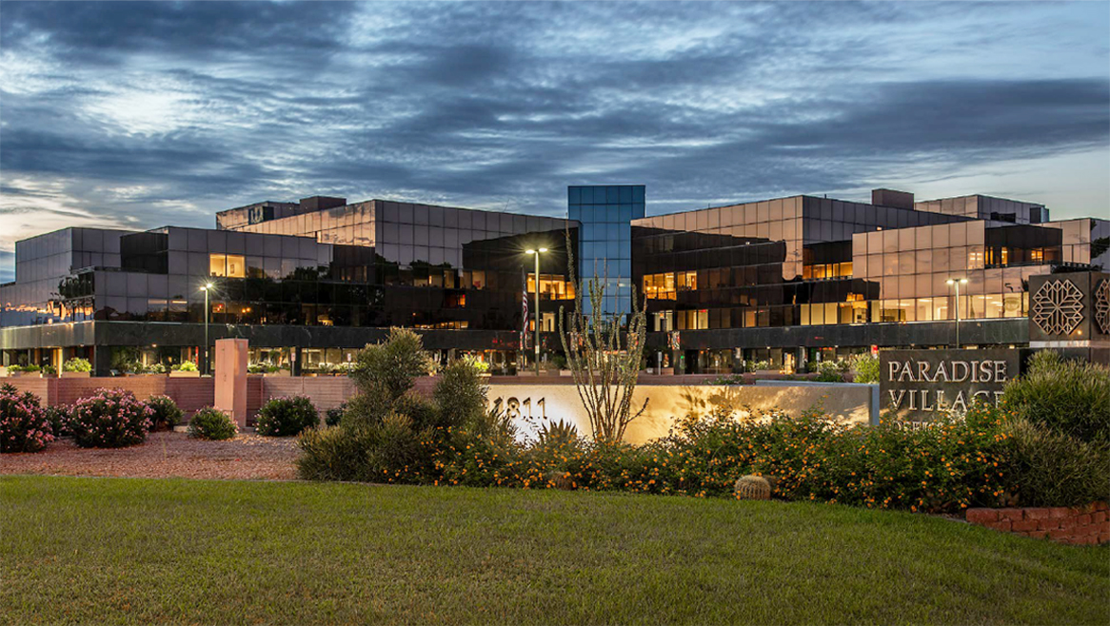
FUND VI ACQUISITIONS
TEI DIVERSIFIED INCOME & OPPORTUNITY FUND VI, LLC
REG. D PRIVATE PLACEMENT 506(b) – ACCREDITED INVESTORS ONLY
Paradise village office park
U.S. OFFICE | CLOSED MAY 2022
PURCHASE PRICE:
FINANCING:
PROPERTY SIZE:
ACQ. OCCUPANCY:
ACQ. CAP RATE:
FUND VI OWNERSHIP:
$43,000,000
$29,000,000
268,516 SF ($160 PSF)
75%
5.91%
6.13%
PHOENIX, AZ

Slide 24
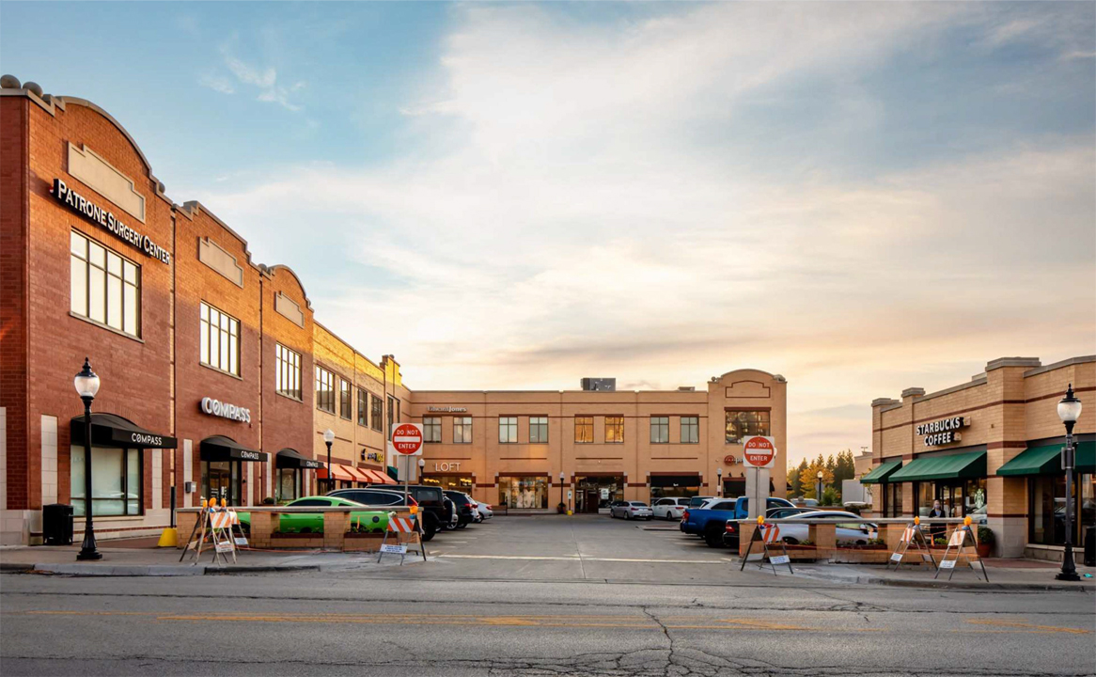
FUND VI ACQUISITIONS
TEI DIVERSIFIED INCOME & OPPORTUNITY FUND VI, LLC
REG. D PRIVATE PLACEMENT 506(b) – ACCREDITED INVESTORS ONLY
ARLINGTON TOWN SQUARE
MIXED USE | CLOSED NOVEMBER 2022
PURCHASE PRICE:
FINANCING:
PROPERTY SIZE:
ACQ. OCCUPANCY:
ACQ. CAP RATE:
FUND VI OWNERSHIP:
$16,983,898
$10,350,000
102,533 SF ($166 PSF)
98%
8%
13.75%
ARLINGTON HEIGHTS, IL

Slide 25
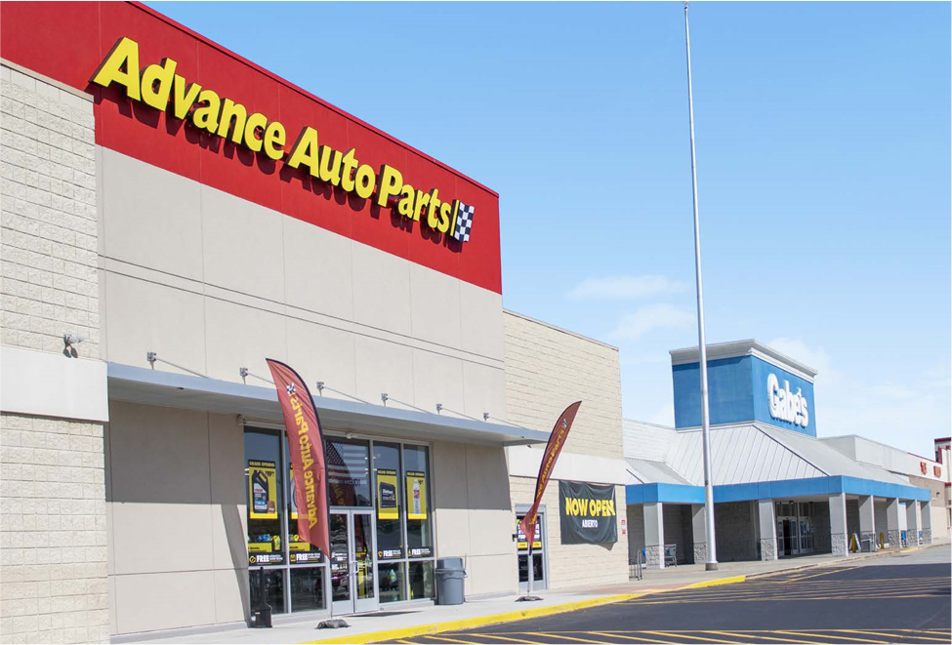
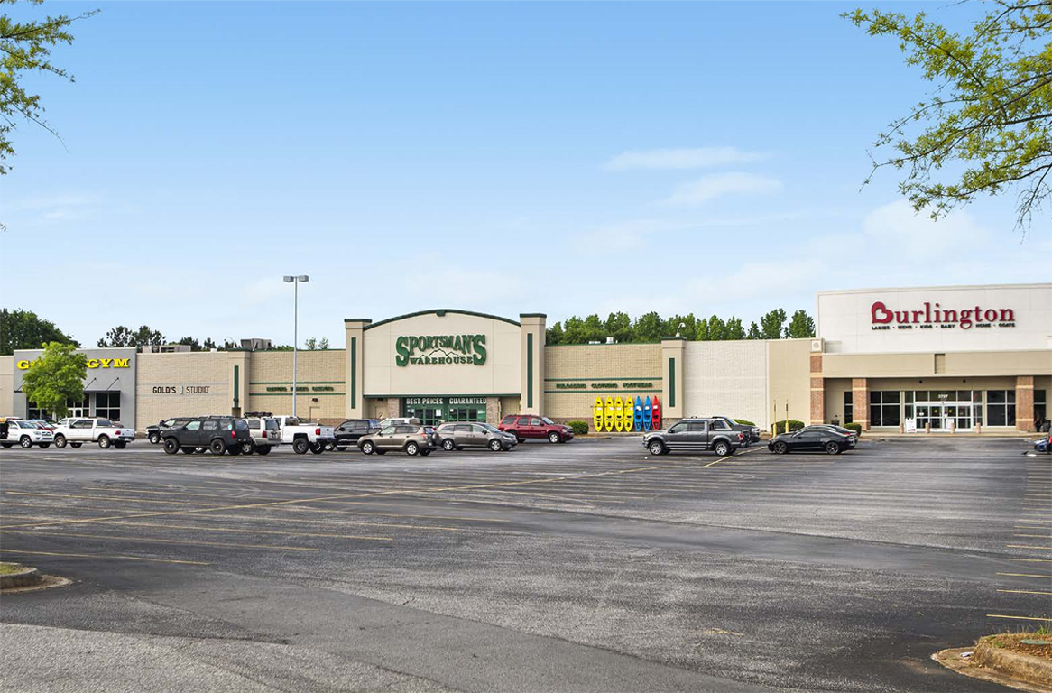
FUND VI ACQUISITIONS
TEI DIVERSIFIED INCOME & OPPORTUNITY FUND VI, LLC
REG. D PRIVATE PLACEMENT 506(b) – ACCREDITED INVESTORS ONLY
SERITAGE PORTFOLIO
U.S. RETAIL | CLOSED DECEMBER 2022
PURCHASE PRICE:
FINANCING:
PROPERTY SIZE:
ACQ. OCCUPANCY:
ACQ. CAP RATE:
FUND VI OWNERSHIP:
$23,500,000
$15,000,000
295,602 SF ($79.50 PSF)
96.5%
7.3%
LANDMARK CENTER = 7.4%
BOULEVARD MARKET FAIR = 16.7%
LANDMARK CENTER, ANDERSON, SC
BOULEVARD MARKET FAIR, GREENSBORO, NC

Slide 26
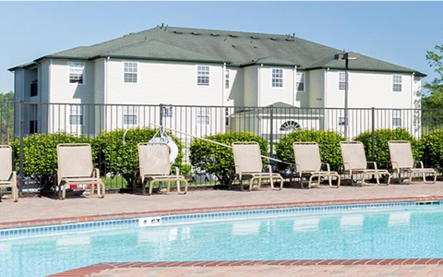
FUND VI ACQUISITIONS
TEI DIVERSIFIED INCOME & OPPORTUNITY FUND VI, LLC
REG. D PRIVATE PLACEMENT 506(b) – ACCREDITED INVESTORS ONLY
THE RIDE AT WVU
B-NOTE PARTICIPATION | CLOSED MARCH 2023
$2,000,000 B-Piece interest in a $11,660,000 first mortgage loan
82.5% leased (at time of closing)
16.25% per annum
36-month loan term with an initial maturity date of April 1, 2026
50%
Loan is collateralized by a 640-bed, approximately 200,000 SF, primarily student housing property located less than one mile from West Virginia University (“WVU”). The Property includes a swimming pool, hot tub, volleyball and basketball courts, club house, gaming area, and fitness center.
PURCHASE PRICE: COLLATERAL OCCUPANCY:
CURRENT B-NOTE YIELD:
TERM:
FUND VI OWNERSHIP:
DESCRIPTION:
MORGANTOWN, WV – West Virginia University

Slide 27
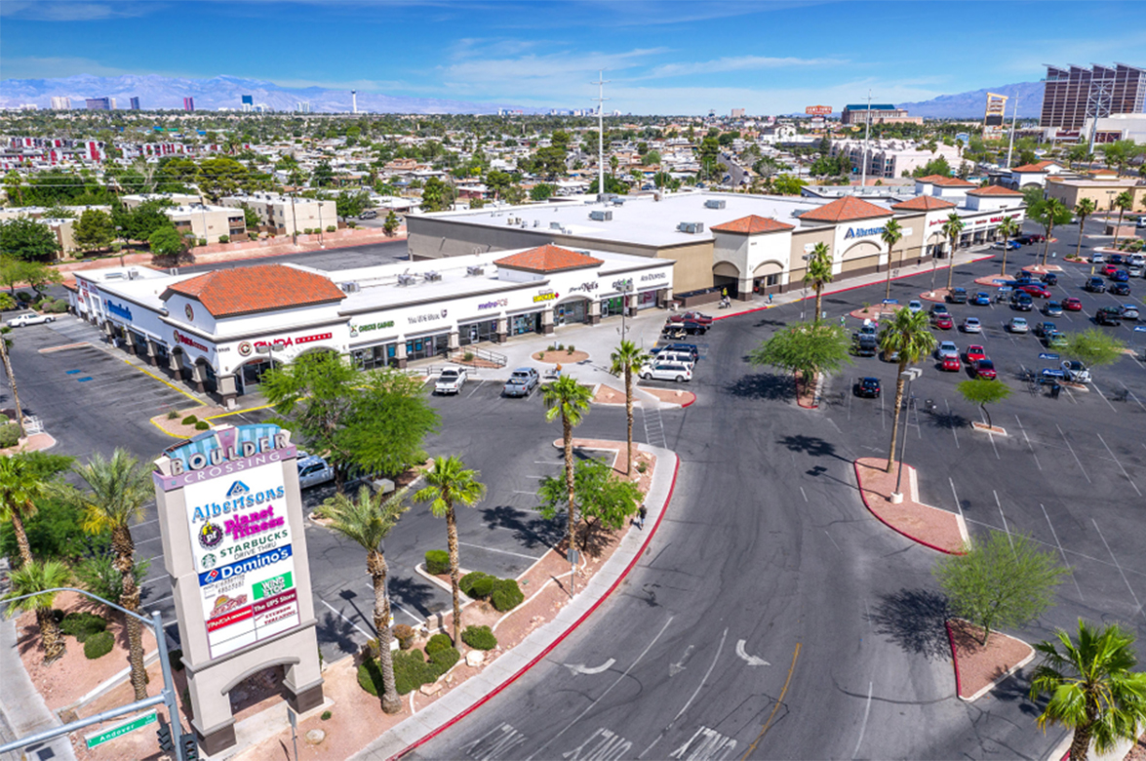
FUND VI ACQUISITIONS
TEI DIVERSIFIED INCOME & OPPORTUNITY FUND VI, LLC
REG. D PRIVATE PLACEMENT 506(b) – ACCREDITED INVESTORS ONLY
Boulder crossing
RETAIL | CLOSED NOVEMBER 2023
PURCHASE PRICE:
PROPERTY SIZE:
ACQ. OCCUPANCY:
ACQ. CAP RATE:
FUND VI OWNERSHIP:
$10,375,000 (all-cash)
48,160 SF ($215 PSF)
91.8%
8%
16.15%
LAS VEGAS, NV

Slide 28
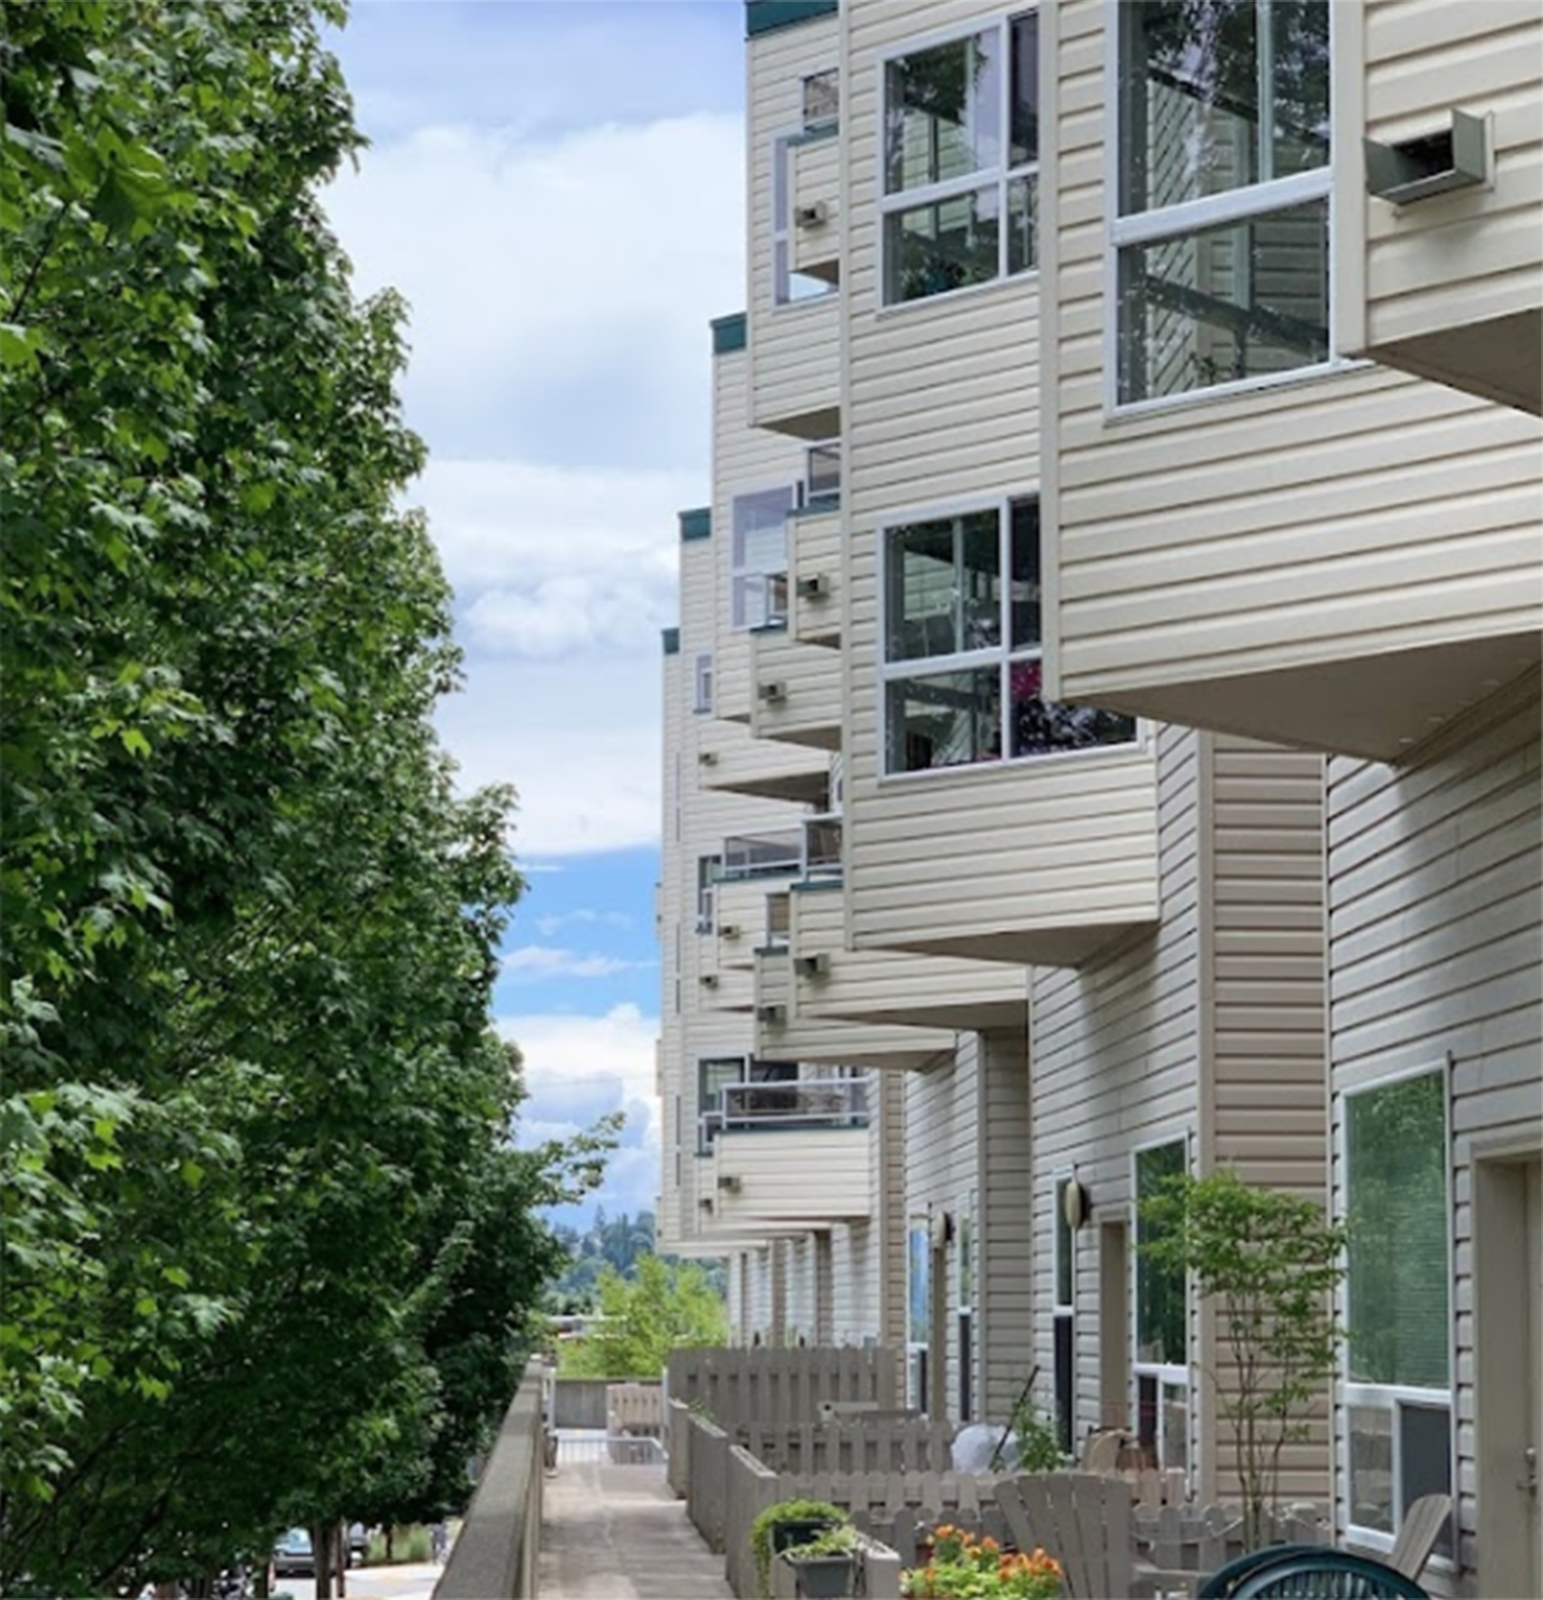
FUND VI ACQUISITIONS
TEI DIVERSIFIED INCOME & OPPORTUNITY FUND VI, LLC
REG. D PRIVATE PLACEMENT 506(b) – ACCREDITED INVESTORS ONLY
MIRABELLA APARTMENTS
MULTI-FAMILY | CLOSED NOVEMBER 2023
PURCHASE PRICE:
PROPERTY SIZE:
ACQ. OCCUPANCY:
ACQ. CAP RATE:
FUND VI OWNERSHIP:
$12,064,000
40,400 SF
95%
8%
8.46%
SEATTLE, WA

Slide 29
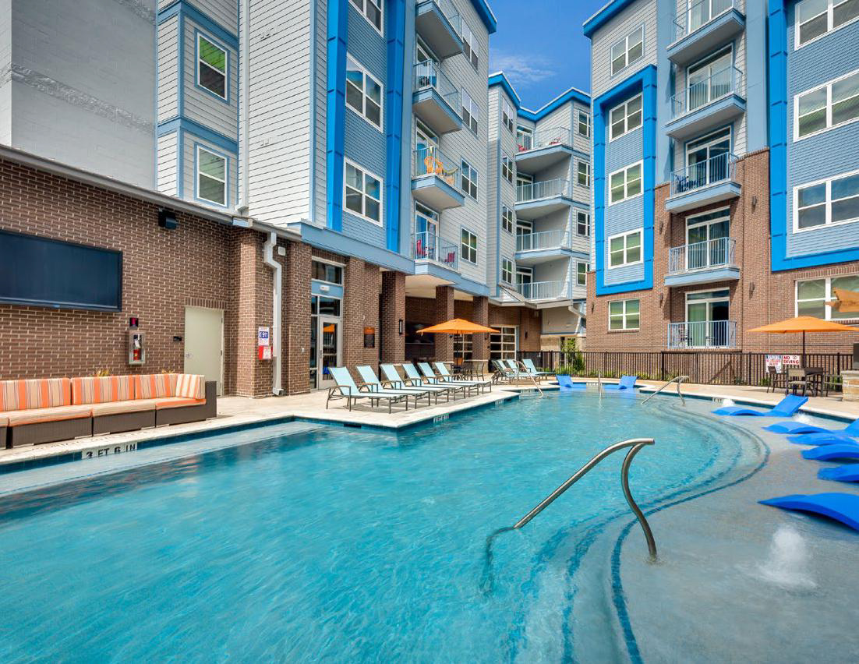
FUND VI ACQUISITIONS
TEI DIVERSIFIED INCOME & OPPORTUNITY FUND VI, LLC
REG. D PRIVATE PLACEMENT 506(b) – ACCREDITED INVESTORS ONLY
The armory
STUDENT HOUSING | CLOSED APRIL 2024
PURCHASE PRICE:
FINANCING:
PROPERTY SIZE:
ACQ. OCCUPANCY:
ACQ. CAP RATE:
FUND VI OWNERSHIP:
$25,750,000
$17,500,000
145 Units/502 Beds
95%
8.11%
10.48%
HUNSTVILLE, TX – Sam Houston State University

Slide 30
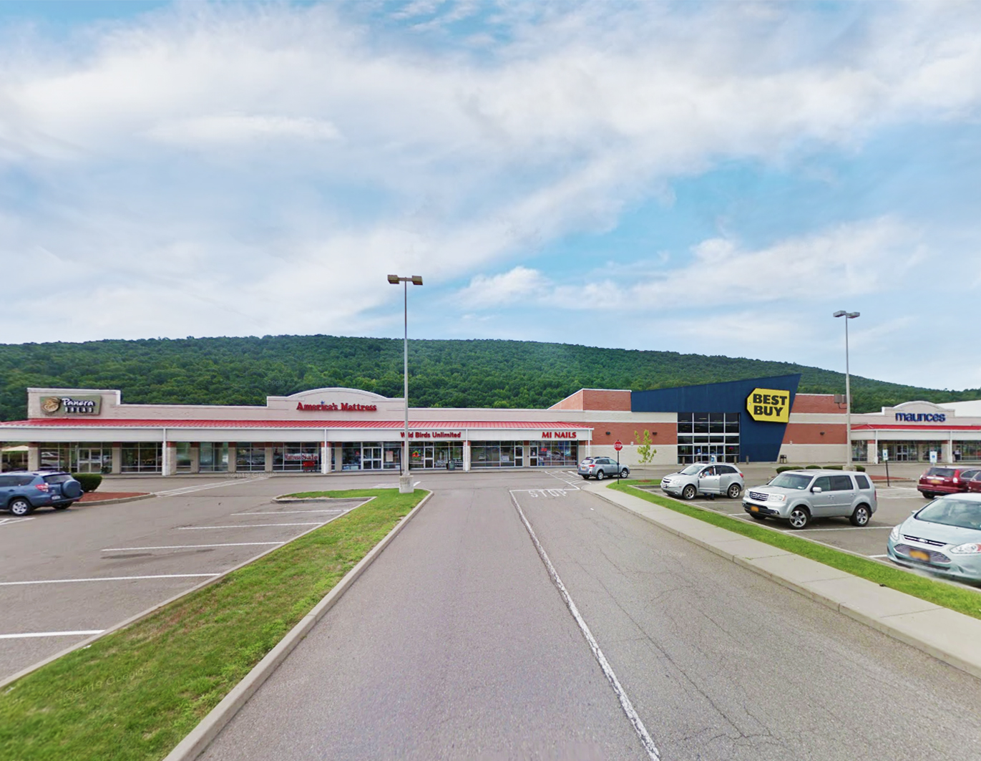
FUND VI ACQUISITIONS
TEI DIVERSIFIED INCOME & OPPORTUNITY FUND VI, LLC
REG. D PRIVATE PLACEMENT 506(b) – ACCREDITED INVESTORS ONLY
Big flats commons
RETAIL | CLOSED JUNE 2024
PURCHASE PRICE:
PROPERTY SIZE:
ACQ. OCCUPANCY:
ACQ. CAP RATE:
FUND VI OWNERSHIP:
$6,500,000 (all-cash)
44,590 SF ($146 PSF)
90.5%
8.10%
15.33%
ELMIRA, NY

Slide 31
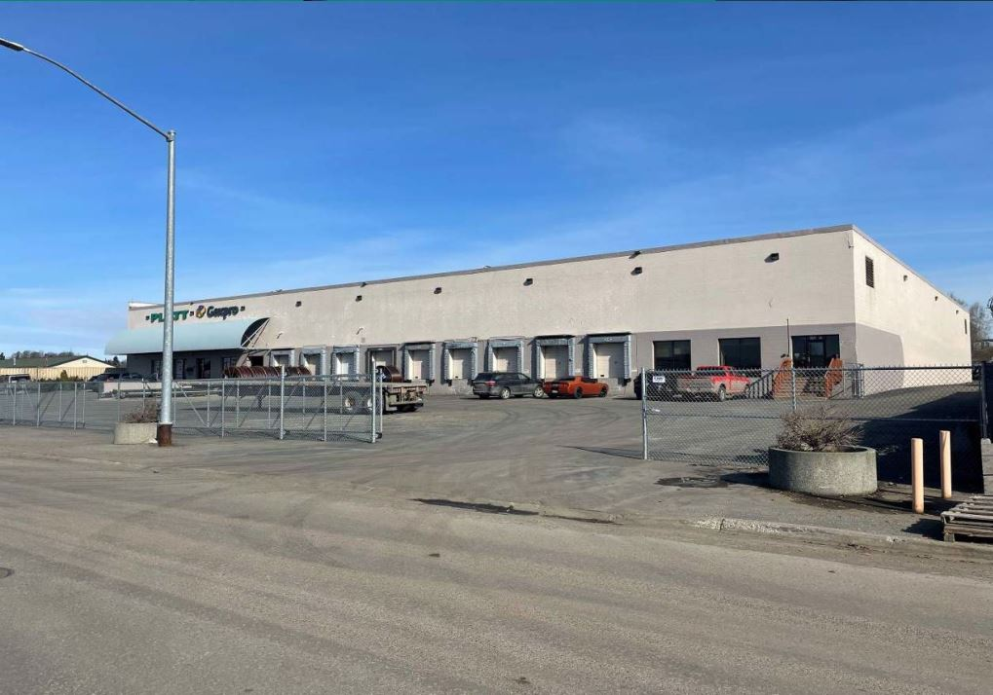
FUND VI ACQUISITIONS
TEI DIVERSIFIED INCOME & OPPORTUNITY FUND VI, LLC
REG. D PRIVATE PLACEMENT 506(b) – ACCREDITED INVESTORS ONLY
501 west 58th avenue
INDUSTRIAL | CLOSED JUNE 2024
PURCHASE PRICE:
FINANCING:
PROPERTY SIZE:
ACQ. OCCUPANCY:
ACQ. CAP RATE:
FUND VI OWNERSHIP:
$9,100,000
$5,400,000
48,826 SF ($186 PSF)
100%
6.50%
8.15%
ANCHORAGE, AK

Slide 32
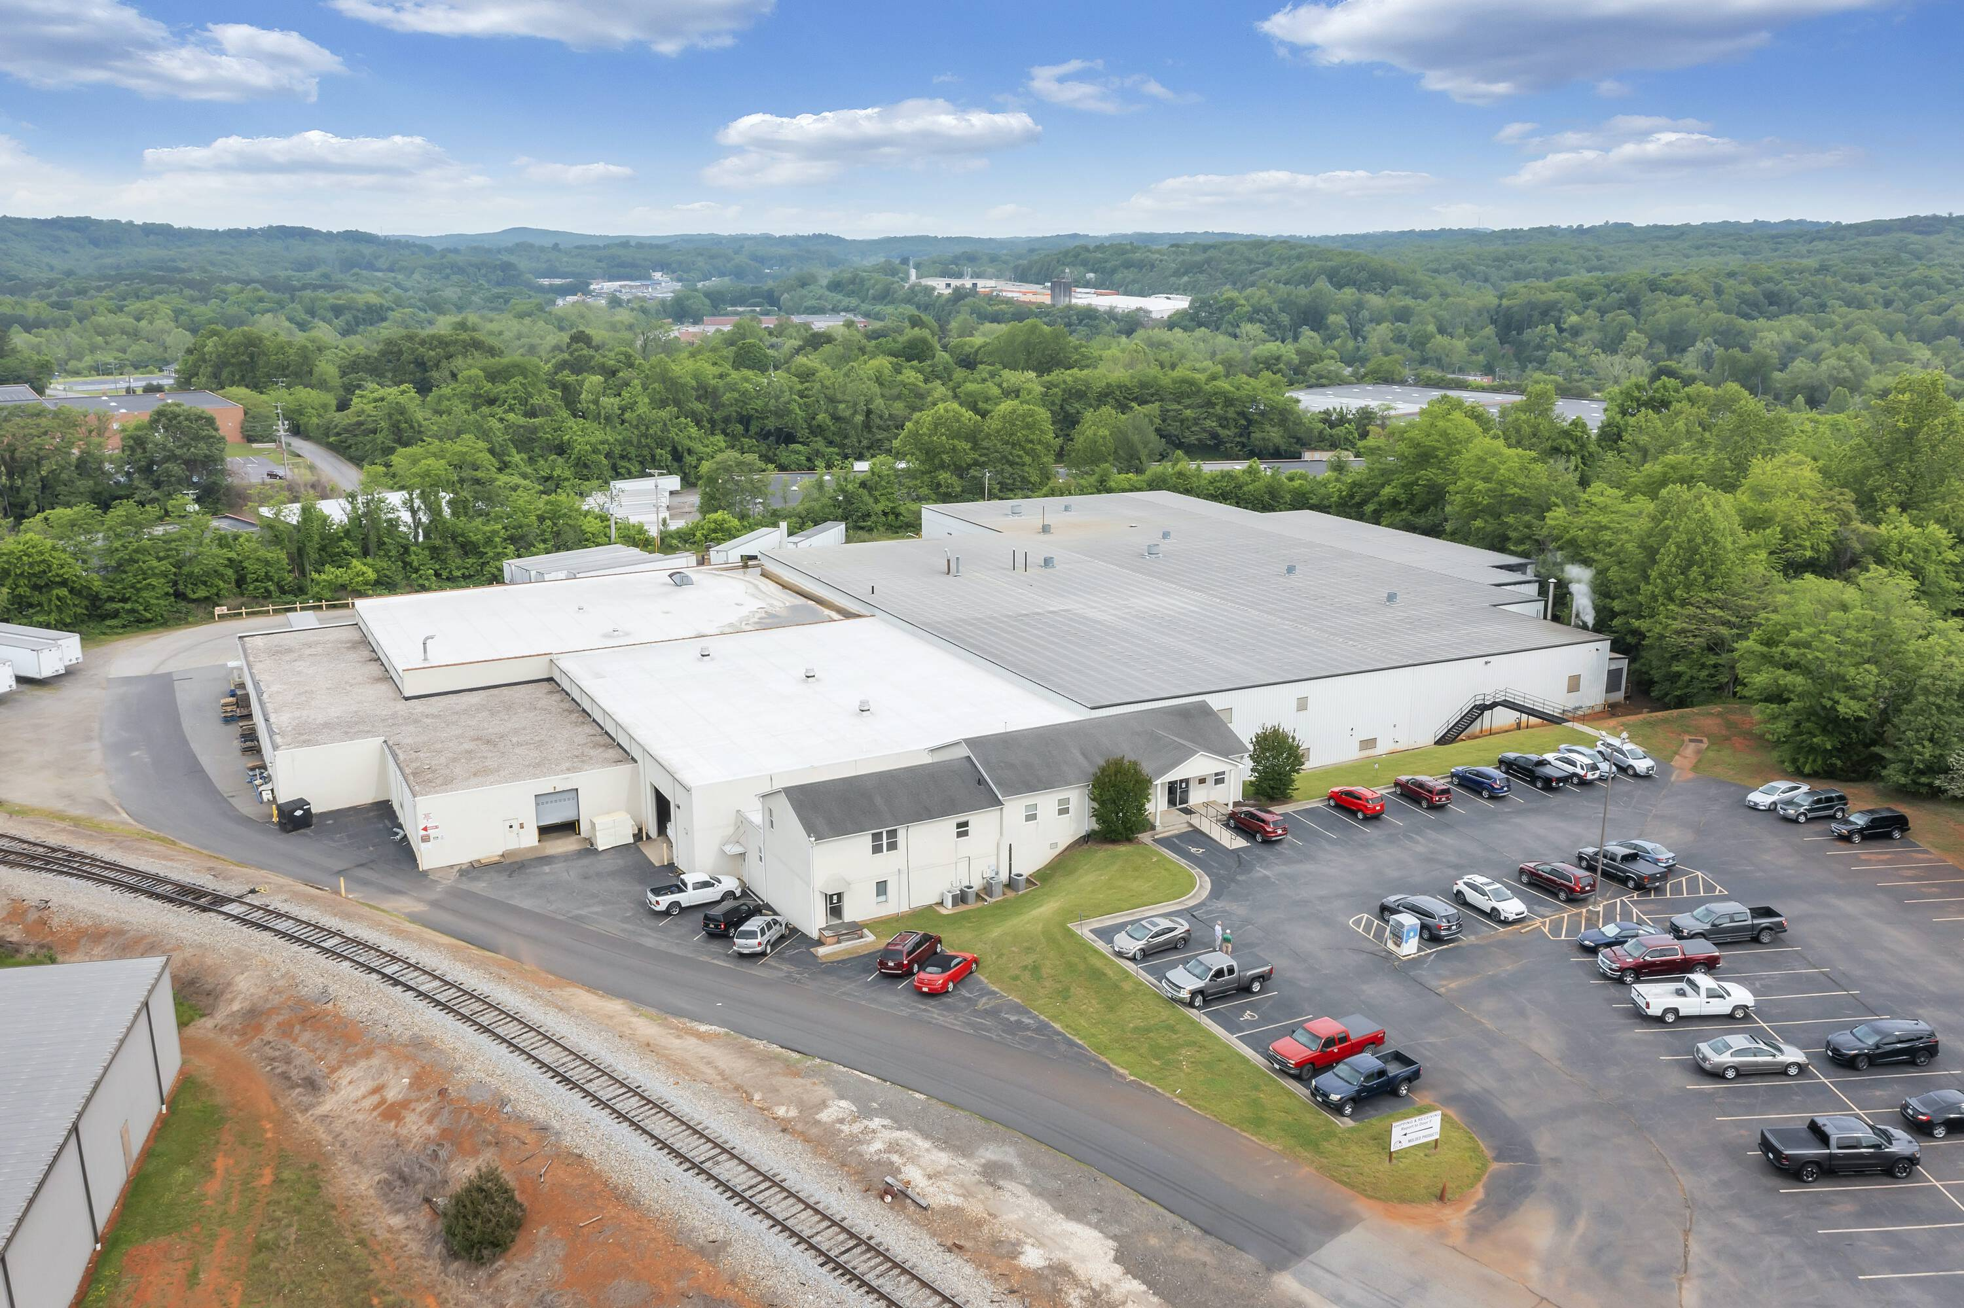
FUND VI ACQUISITIONS
TEI DIVERSIFIED INCOME & OPPORTUNITY FUND VI, LLC
REG. D PRIVATE PLACEMENT 506(b) – ACCREDITED INVESTORS ONLY
445 industrial park
INDUSTRIAL | CLOSED AUGUST 2024
PURCHASE PRICE:
PROPERTY SIZE:
ACQ. OCCUPANCY:
ACQ. CAP RATE:
FUND VI OWNERSHIP:
$2,350,000 (all-cash)
44,590 SF ($146 PSF)
100%
6.75%
25%
RIDGEWAY, VA

Slide 33
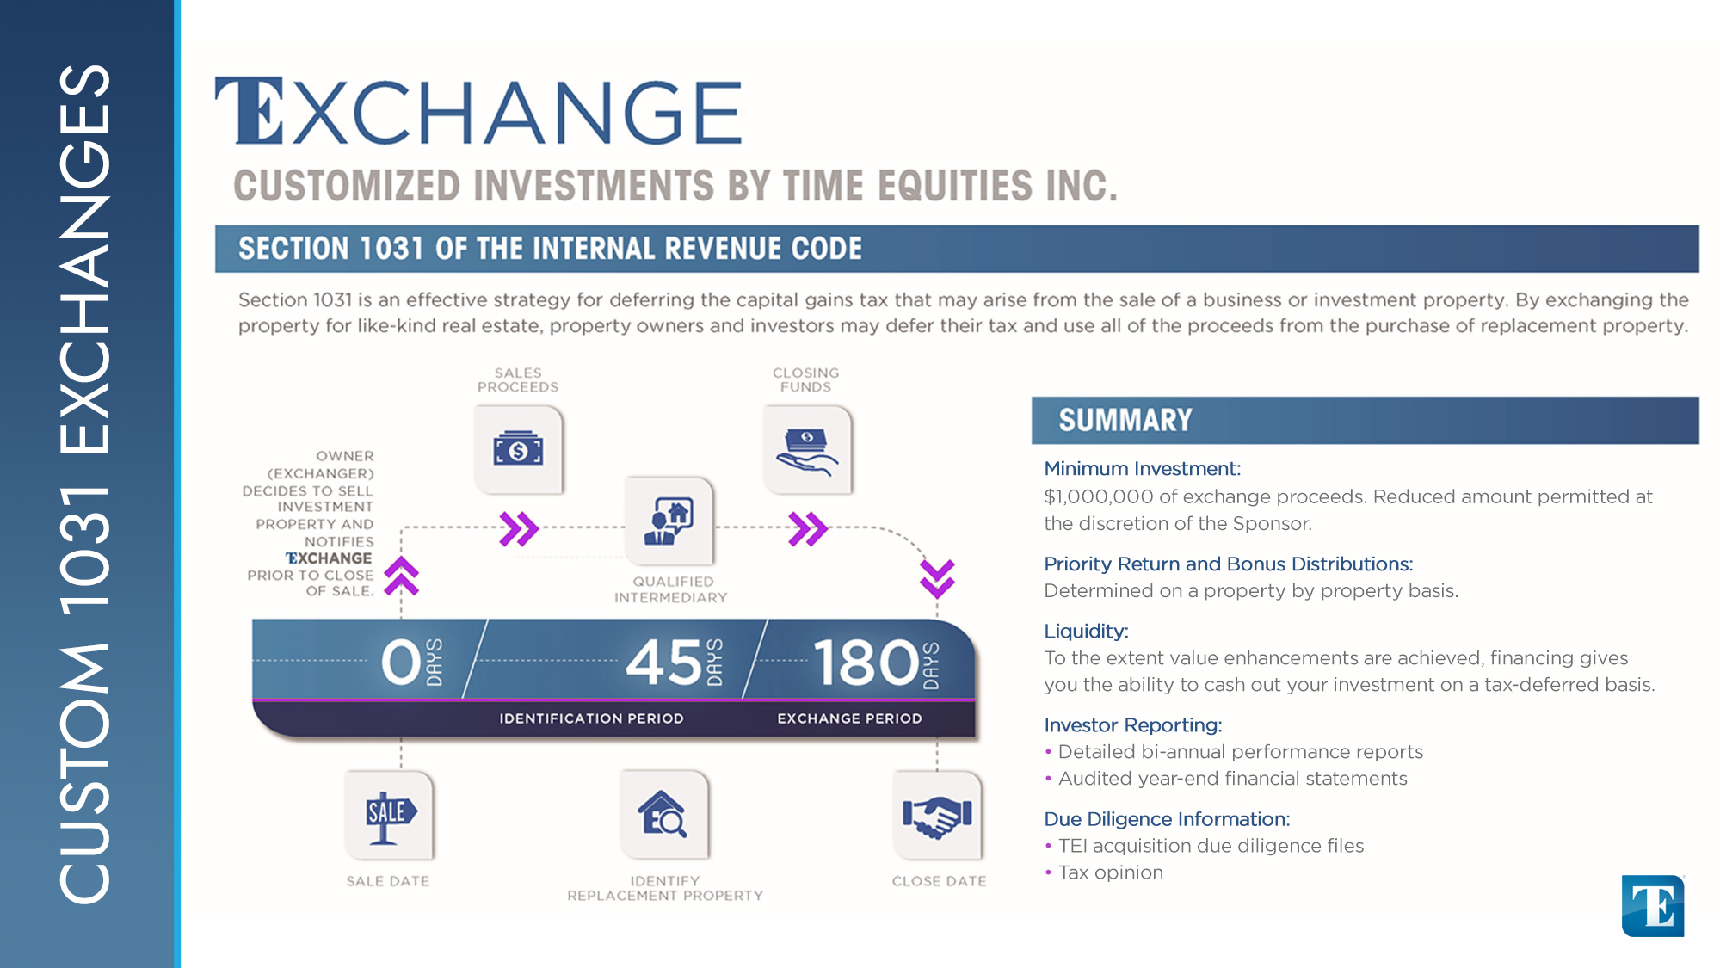

Slide 34


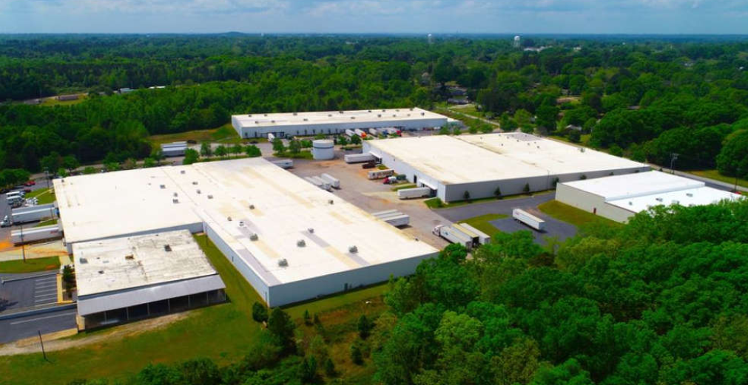
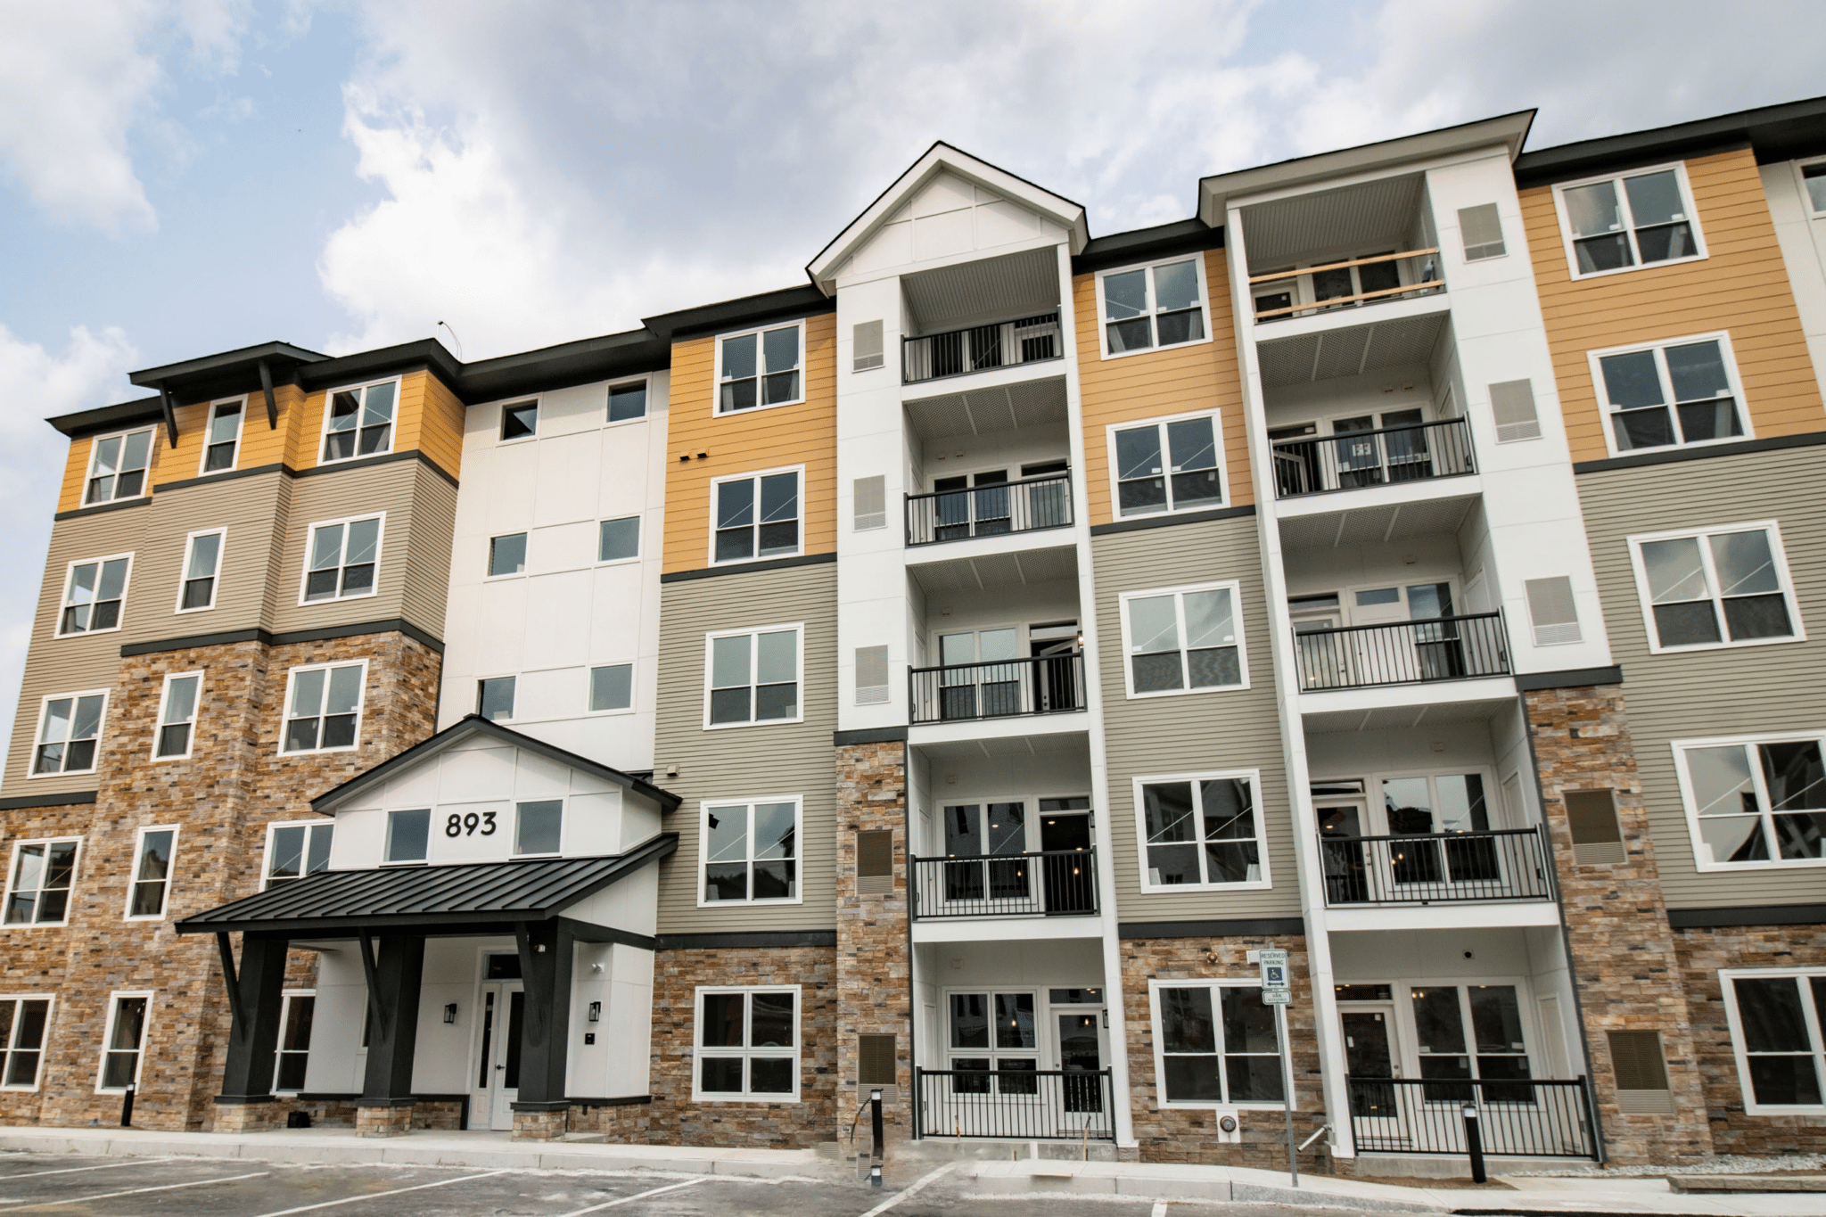
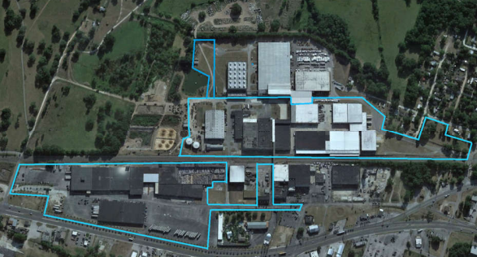
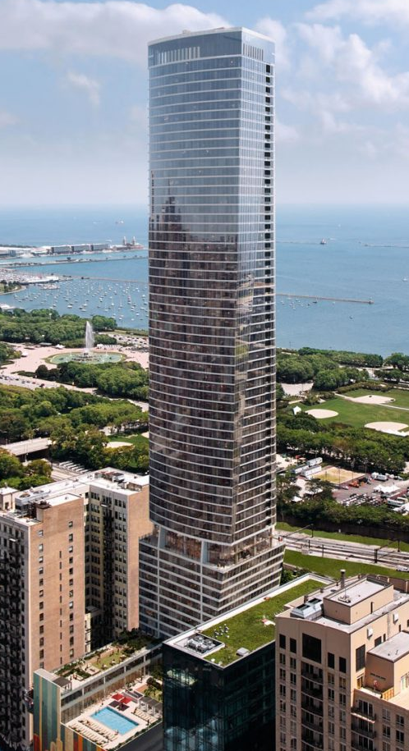
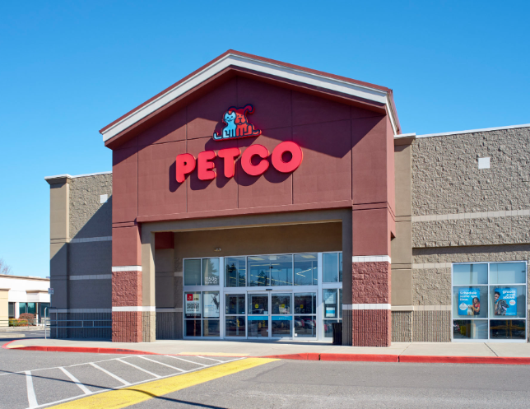
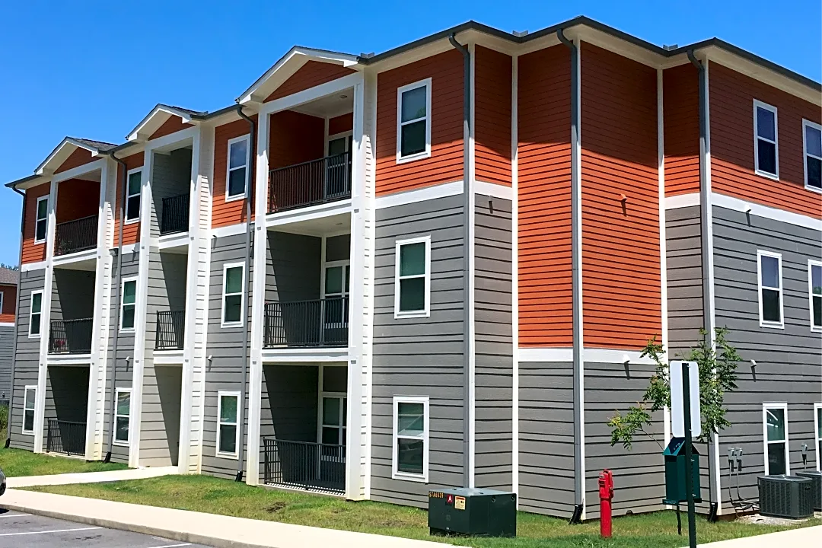
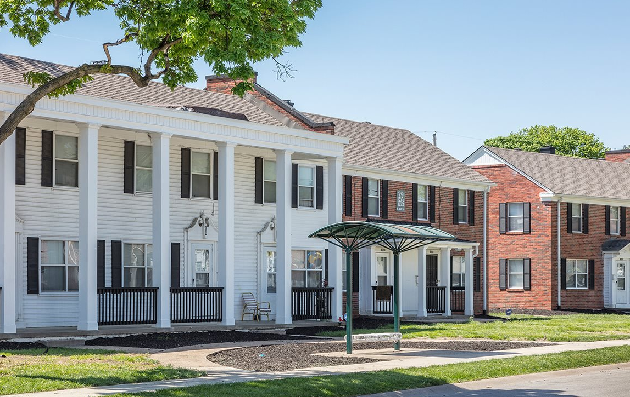
CUSTOM 1031 EXCHANGES
A Decade of 1031 Exchanges with Arete Wealth | 2014-2024
Schmid Plaza Industrial
Haverhill Development
Dade City Industrial
1000M TIC
ANDERSON, SC
2023/2024
HAVERHILL, MA
2023
DADE CITY, FL
2022
Orchards Market Center
Campus Edge Student Housing
Plaza East Apartments
VANCOUVER, WA
2019
COOKEVILLE, TN
2019
KANSAS CITY, MO
2018
CHICAGO, IL
2021/2023

Slide 35
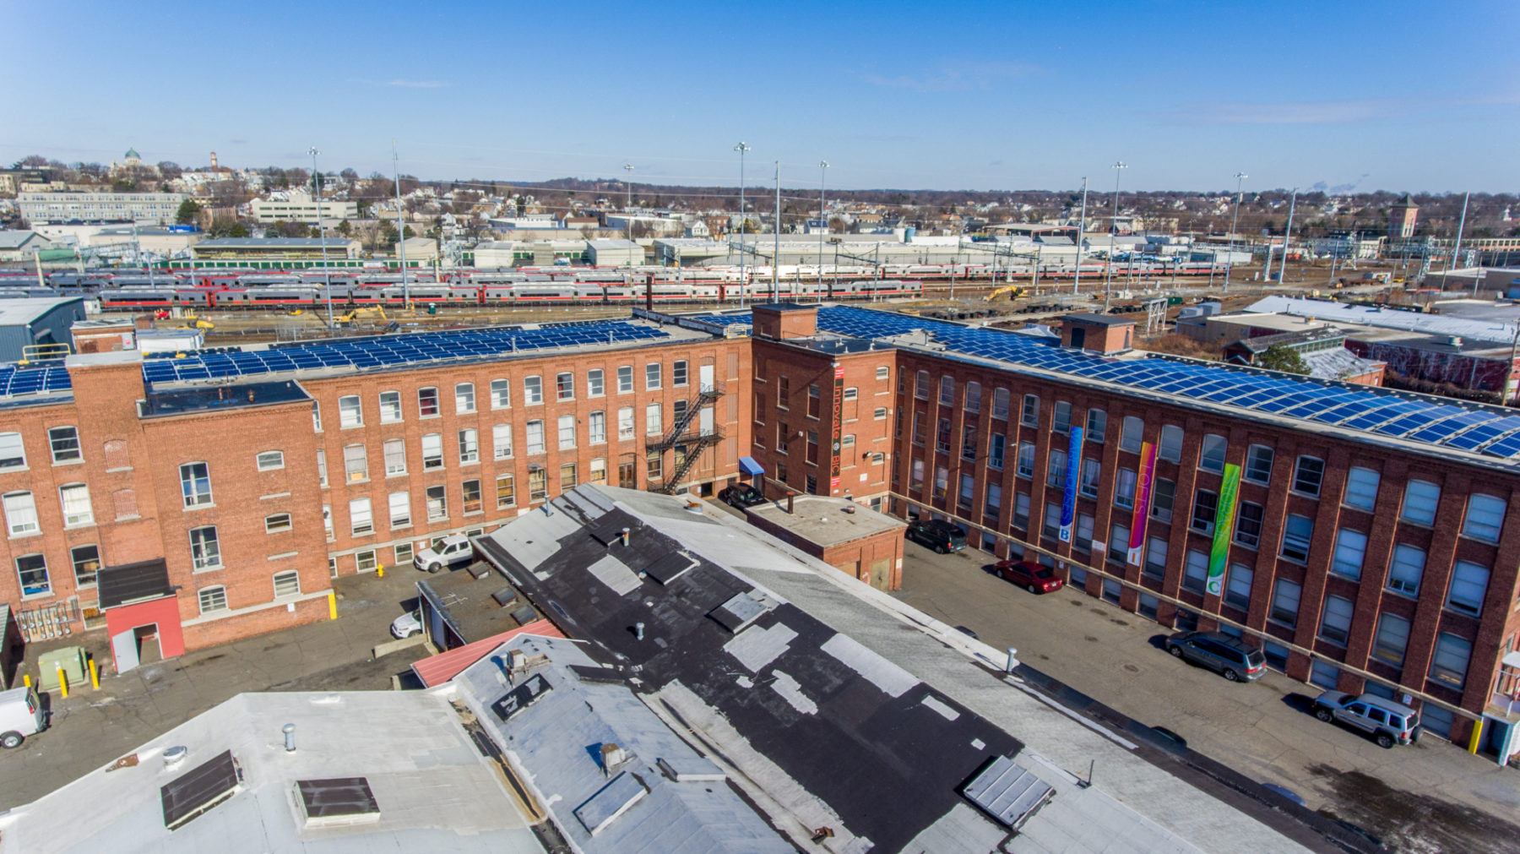
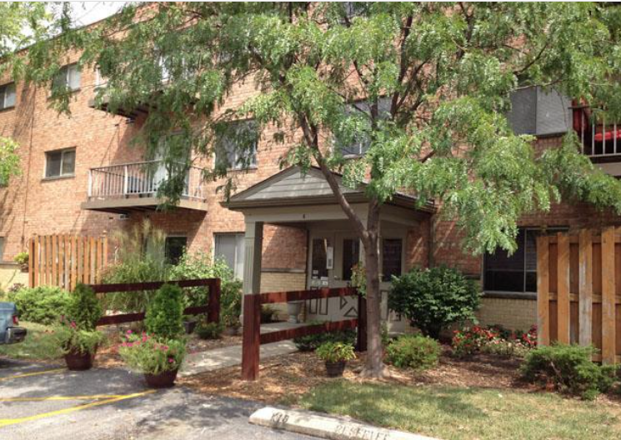
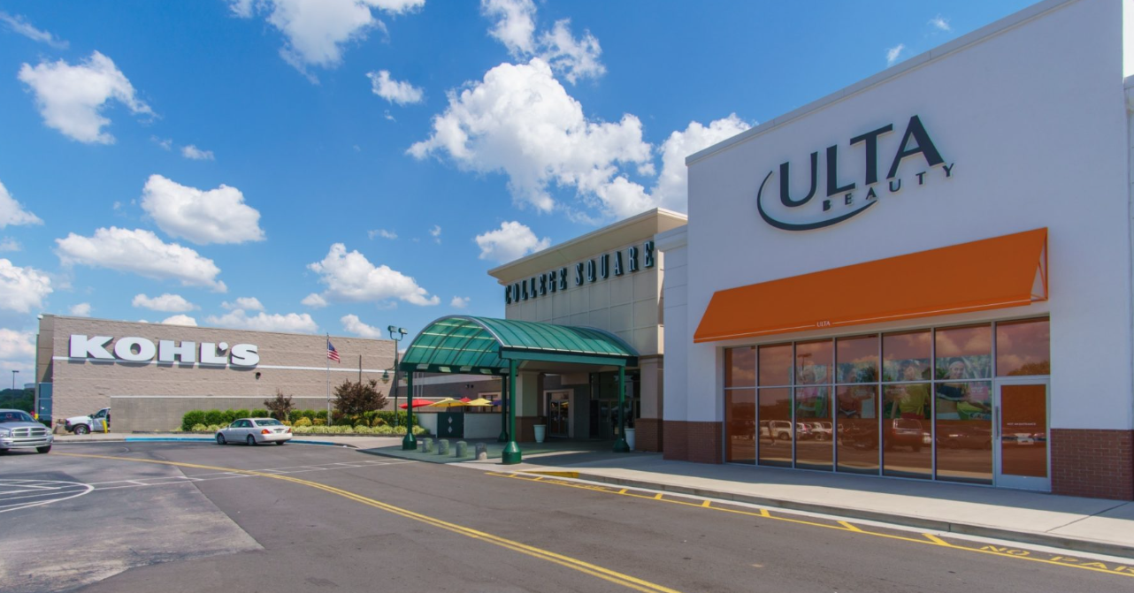
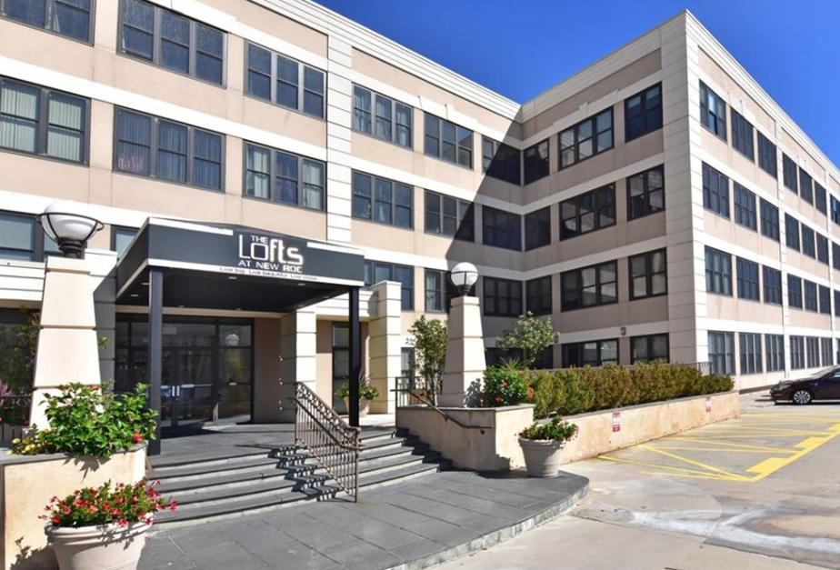
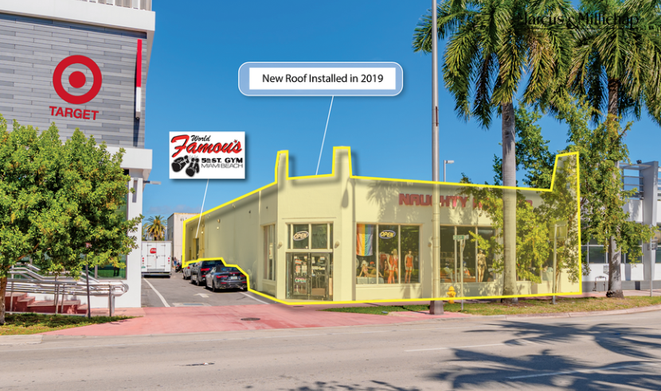
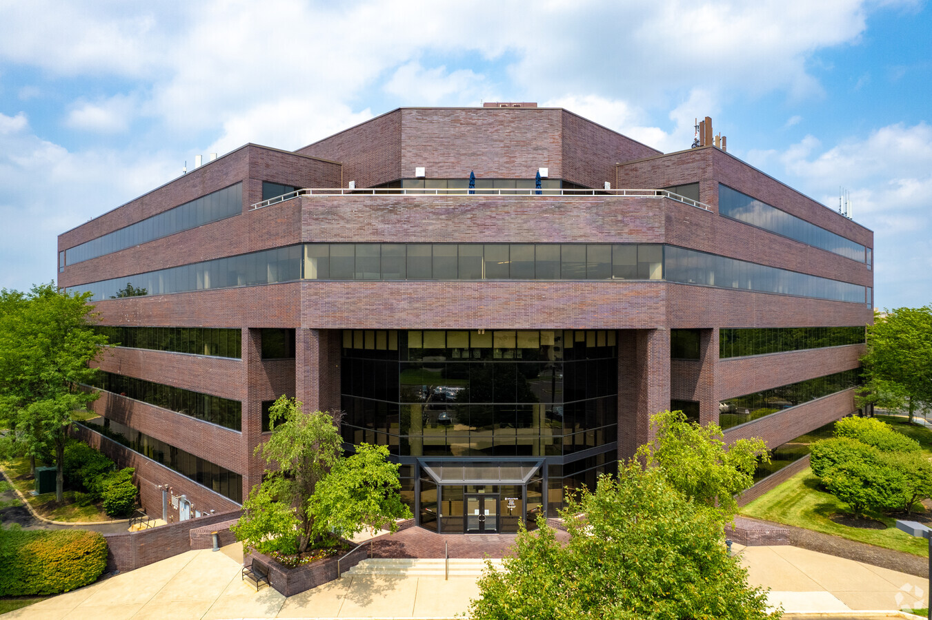
CUSTOM 1031 EXCHANGES
A Decade of 1031 Exchanges with Arete Wealth | 2014-2024
Bridgeport Innovation Center
Arbor at Montana Apartments
Foothills Mall
BRIDGEPORT, CT
2018
CINCINNATI, OH
2018
MARYVILLE, TN
2017
The Lofts at New Rochelle
Miami Beach Retail Condo
Glenview Corporate Center
NEW ROCHELLE, NY
2015
MIAMI BEACH, FL
2015
BENSALEM, PA
2014

Slide 36


Slide 37
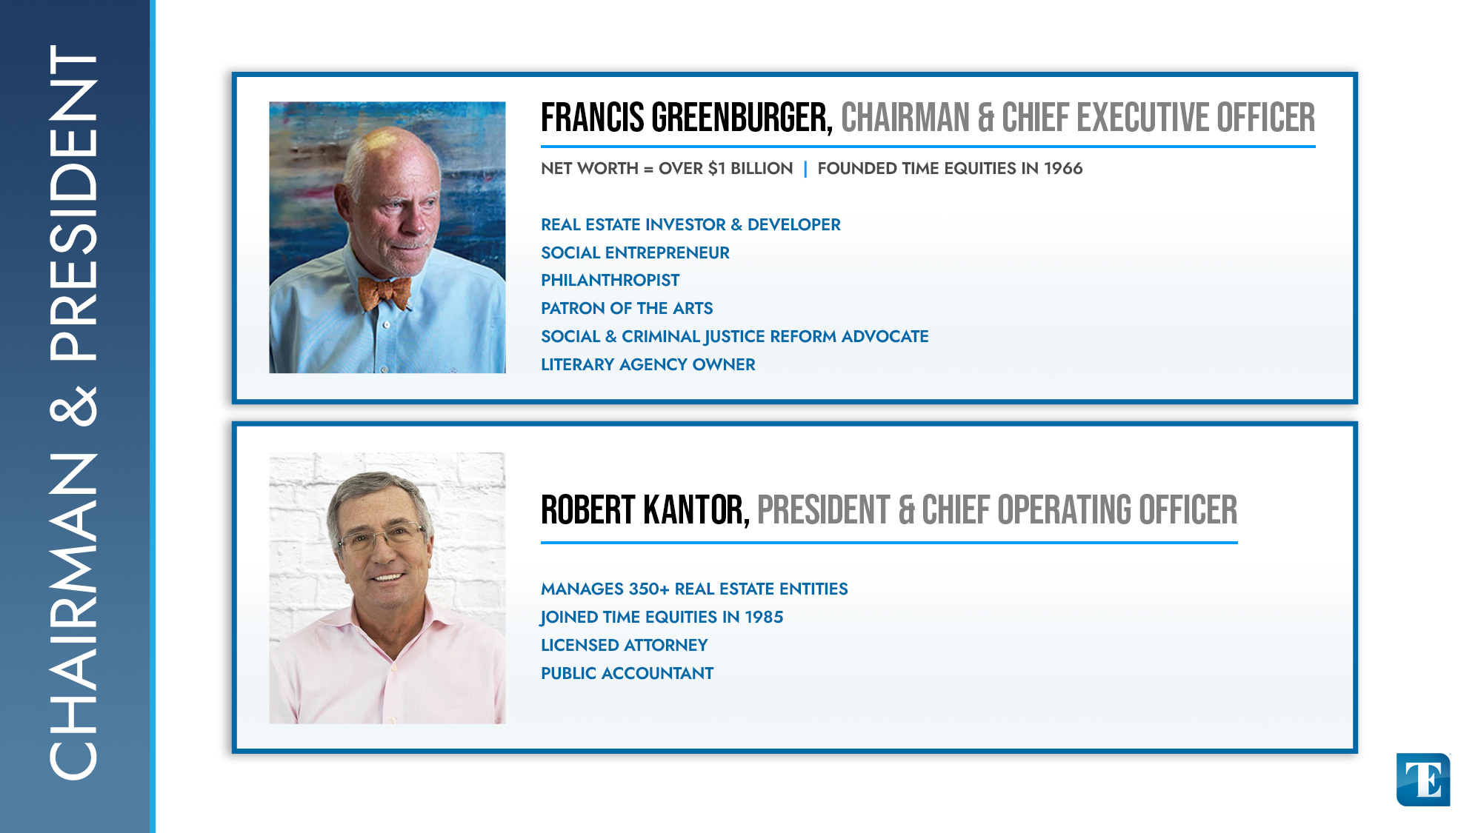

Slide 38
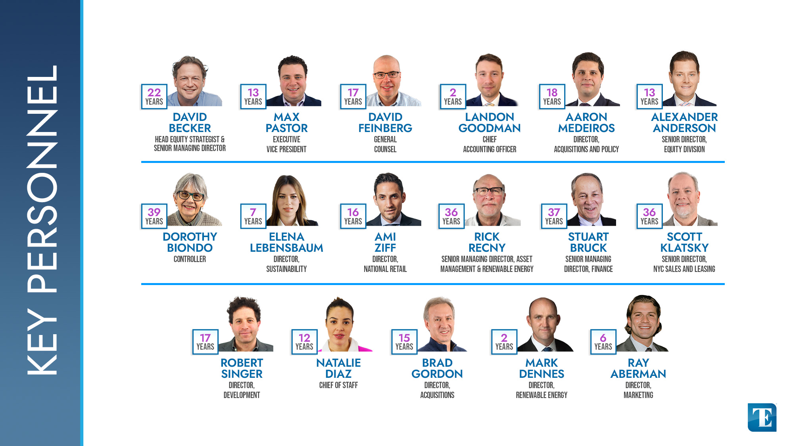

Slide 39
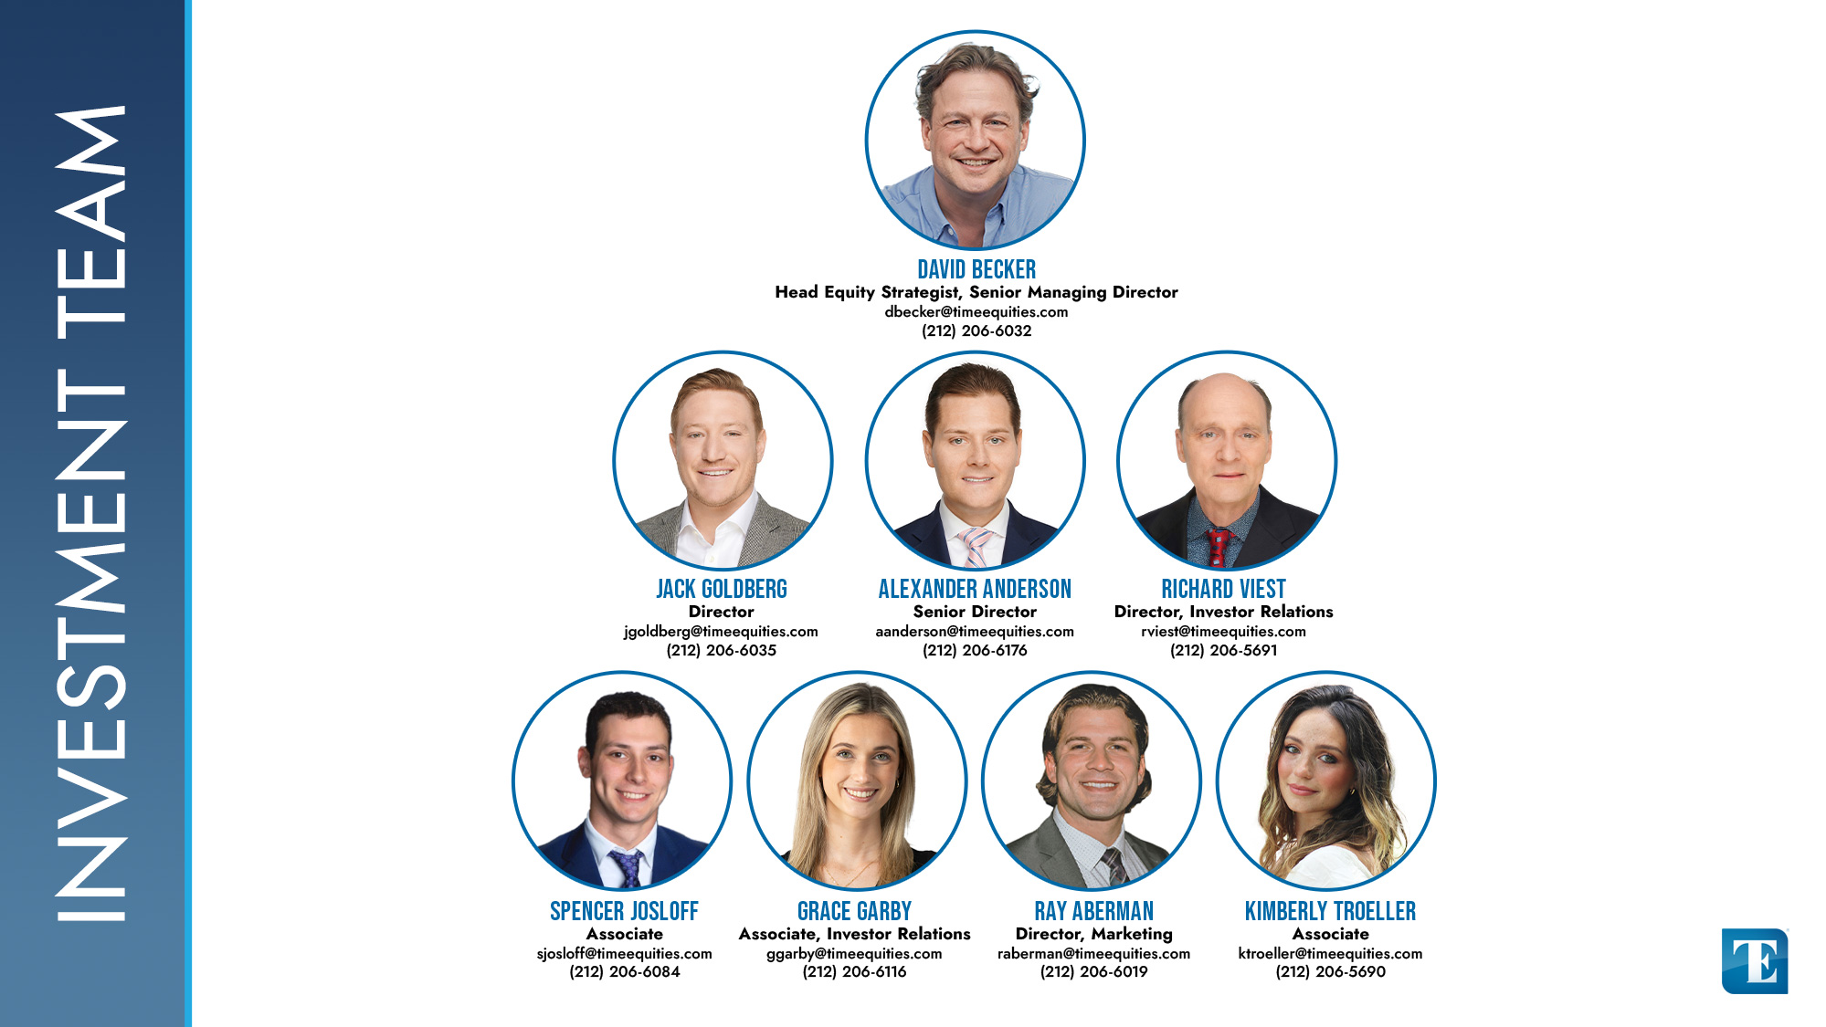

Slide 40
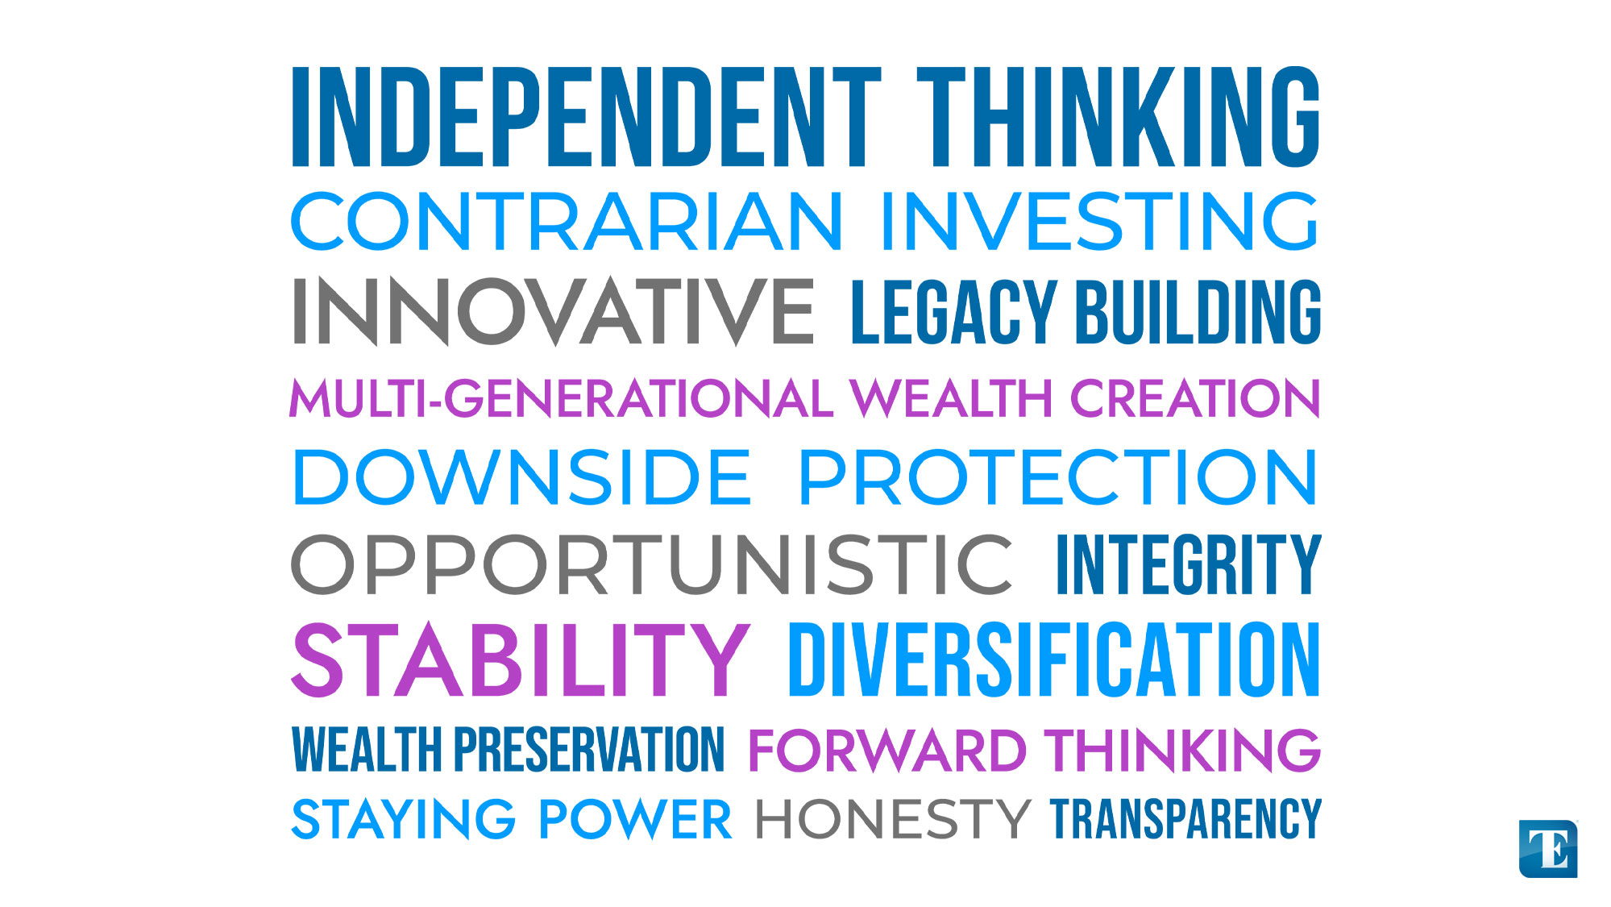

Slide 41
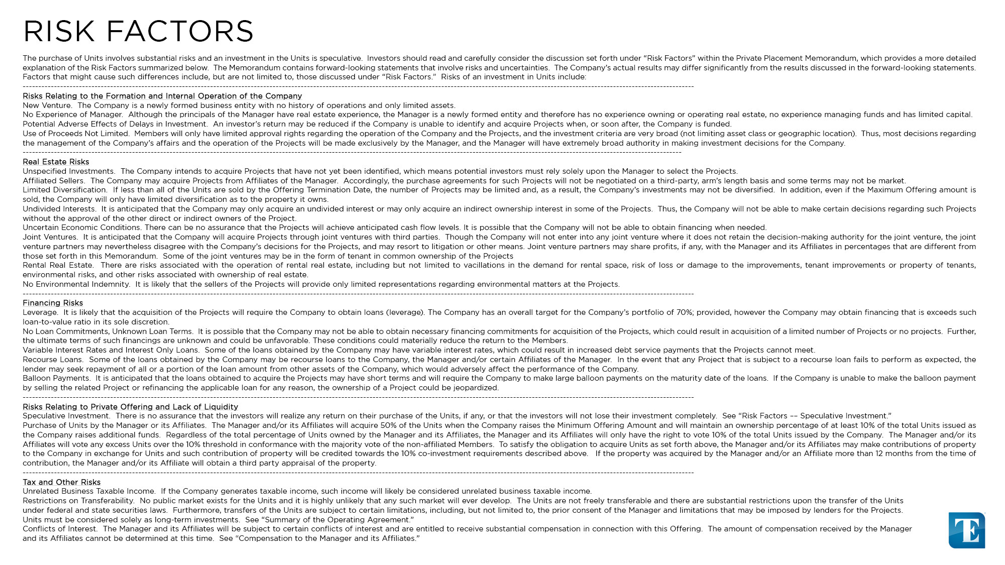

Slide 43


