Slide 1

MacKenzie Capital Management
Arete Wealth Management-Chicago

Slide 2
Disclosures
The following information contains, or may be deemed to contain, “forward-looking statements” within the meaning of Section 27A of the Securities Act of 1933, as amended (“1933 Act”). These forward-looking statements include all statements regarding the current intent or expectations regarding matters covered and all statements which are not statements of fact. By their nature, forward-looking statements involve risks and uncertainties because they relate to events and depend on circumstances that may or may not occur in the future. The future results of MacKenzie Realty Capital, Inc. (the “Company”) may vary from the results expressed in, or implied by, forward-looking statements, possibly to a material degree. Since these factors can cause results, performance and achievements to differ materially from those discussed in this presentation, you are cautioned not to place undue reliance on the forward-looking statements. The Company will update these forward-looking statements to reflect any material changes occurring prior to the completion of the offering. For a discussion of some of the important factors that could cause results to differ from those expressed in, or implied by, the forward-looking statements contained herein, please refer to the Company’s Offering Circular, in particular, the “Risk Factors” section, and the summary of risks below. The forward-looking statements in this document are excluded from the safe harbor protection of Section 27A of the 1933 Act.
The Company has elected to be taxed as a REIT, but if it fails to meet the requirements, there may be adverse tax consequences.

Slide 3
Disclosures
NEITHER THIS PRESENTATION NOR THE CONTENT HEREIN CONSTITUTES AN OFFER TO SELL OR A SOLICITATION OF AN OFFER TO BUY THE COMPANY’S SHARES (WHICH MAY ONLY BE DONE THROUGH THE OFFERING CIRCULAR) AND IS NOT INCORPORATED BY REFERENCE INTO THE Offering Circular.
Prospective investors in the Company should carefully consider the Company’s investment objectives, risks, charges and expenses, which are discussed in the Offering Circular, before investing. The Offering Circular, which contains this and other information about the Company, is available and should be read carefully before investing.
Securities products and services are offered through Arete Wealth Management, LLC. Arete is a member of the Financial Industry Regulatory Authority and the Securities Investor Protection Corporation. Arete is not affiliated with the Company, MacKenzie or MCM-GP, Inc.
Arete Wealth Management, LLC is a registered broker dealer that may sell the Company in North Carolina.
This is not an offering, which may be made only by Offering Circular. A copy of the Offering Circular may be obtained from the Company by calling 800-854-8357 or writing to 89 Davis Road, Orinda CA 94563 or by visiting our website at www.mackenzierealty.com.

Slide 4

Track Record
MacKenzie Capital Management has actively managed portfolios of real estate and deeply discounted real estate securities for over 35 years and launched over 80 funds.

Slide 5

MacKenzie Realty Capital
MacKenzie Realty Capital, Inc. is a West Coast focused REIT that intends to invest its property portfolio approximately 50% in multiple-family and 50% in Class A suburban offices.
We intend to further differentiate ourselves by allocating up to 20% of our portfolio to deeply discounted real estate securities that will supplement our current cash flow and dividends.

Slide 6
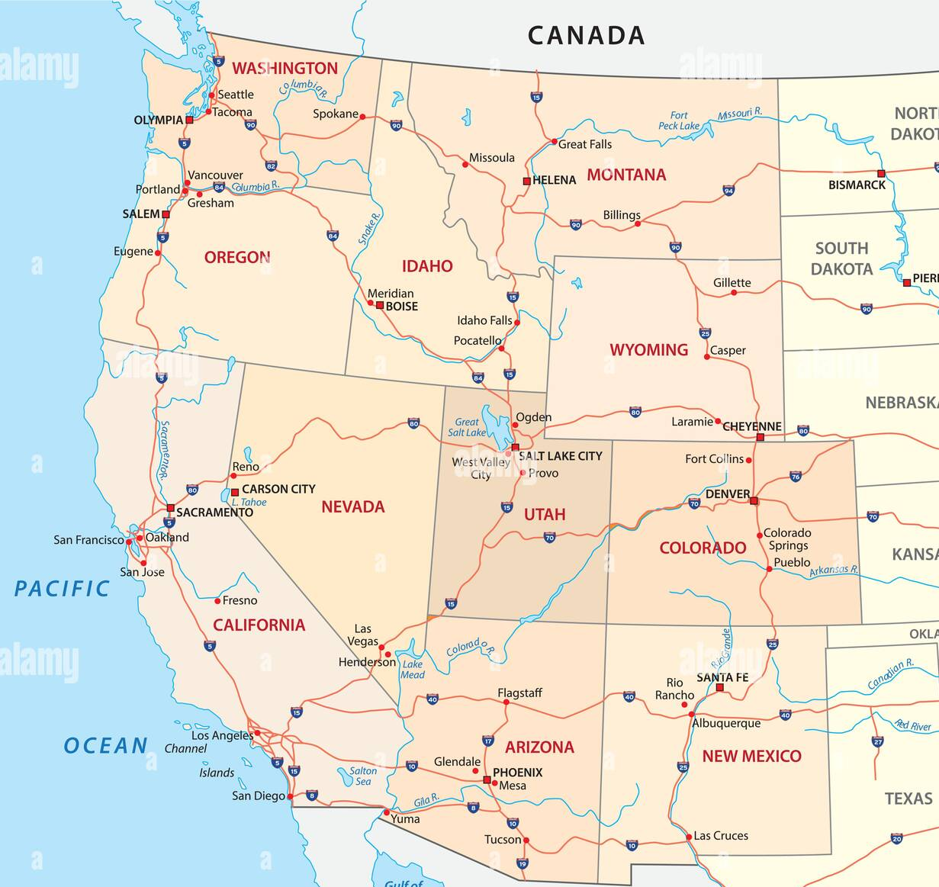
80%- Core Portfolio Locations
Mayfield
(Capitol Hill)
Wiseman
(8 Properties)
Lakeview
(4 Properties)
True USA
(Hillview)

Slide 7
20% -Non-Traded REITs
Full Cycle Tenders
NAME | PURCHASE PRICE PER SHARE | AMOUNT REALIZED AT EXIT PER SHARE (NAV) | TOTAL RETURN (Discount to NAV) | Holding Period
Phillips Edison & Co. | $16.50 | $32.00 | 194% | 6 Months
Franklin BSP Realty Trust (F) | $10.50 | $15.70 | 153% | 25 Months
Highlands REIT | $0.05 | $0.14 | 280% | 10 Months
Highlands REIT | $0.04 | $0.14 | 350% | 4 Months

Slide 8
MacKenzie Realty Capital Preferred – Series A 6%-7.15%
Adviser | MCM Advisers, LP and MacKenzie Realty Advisers, LP
Corporate Structure | Real Estate Investment Trust ("REIT")
Registration | Regulation A
Maximum Offering Size | $75,000,000
Minimum Investment | $5,000
Initial Offering Price | Brokerage: $25.00 / Advisory: $23.25 / RIA: $22.975
 | Client account statements reflect $25.00 Stated Value
Annualized Dividend Rate | Brokerage: 6% / Advisory: 6.45% / RIA: 6.53%
Tax Reporting | 1099
Dividend Reinvestment Plan | $22.50/share (10% discount to $25.00/share offer price)
Share Repurchase Option | Upon issuance, for Stated Value, less a 12% repurchase fee; After 1 year, for Stated Value, less a 9% repurchase fee;
 | After 2 years, for Stated Value, less a 6% repurchase fee; After 3 years, for Stated Value, less a 3% repurchase fee;
 | After 4 years, for Stated Value.
Company Redemption Option | Company may, at its option, redeem shares of Series A Preferred Stock, in whole or in part from time to time, for cash during the Early Redemption Period (which begins on January 1, 2023) at a price per share equal to the Purchase Price plus an amount equal to all accrued and unpaid dividends thereon to, and including, the date on which the Preferred Shares are redeemed (the “Early Redemption Date”).
Conversion Feature | If a shareholder requests redemption, such redemption may be paid, at the shareholder’s request, in shares of common stock at an issuance price of $10.25 per share, subject to availability of an exemption from registration or an effective registration statement. In addition, if the Company elects to redeem preferred shares, holders may elect to receive for each share (a) $25.00 plus all accrued and unpaid dividends (the “Conversion Amount”), or (b) the number of shares of common stock equal to the Conversion Amount divided by $10.25.

Slide 9
MacKenzie Realty Capital
Preferred – Series B 12%+
Adviser | MCM Advisers, LP and MacKenzie Realty Advisers, LP
Corporate Structure | Real Estate Investment Trust ("REIT")
Registration | Regulation A
Maximum Offering Size | $75,000,000
Minimum Investment | $5,000
Initial Offering Price | Brokerage: $25.00 / Advisory: $23.25 / RIA: $22.975
 | Client account statements reflect $25.00 Stated Value
Annualized Dividend Rate Dividend Frequency | 12% (9% Accrued/3% Paid) Quarterly
Tax Reporting | 1099
Dividend Reinvestment Plan | $22.50/share (10% discount to $25.00/share offer price)
Share Repurchase Option | (i) Beginning on the third anniversary of the Acquisition Date and continuing for a one-year period, the purchase price for the repurchased preferred shares will be equal to 97% of the Liquidation Preference for the preferred shares; and
 | (ii) Beginning on the fourth anniversary of the Acquisition Date and thereafter, the purchase price for the repurchased shares will be equal to 100% of the Liquidation Preference for the preferred shares
Company Redemption Option | Company may, at its option, redeem shares of Series B Preferred Stock, in whole or in part from time to time, for cash during the Early Redemption Option Period (which begins on January 1, 2025) at a price per share equal to the Purchase Price plus an amount equal to all accrued and unpaid dividends thereon to, and including, the date on which the Preferred Shares are redeemed (the “Early Redemption Date”).
Conversion Feature | At the option of the holder of any shares of Series B Preferred Stock as to which the Board approves such a repurchase request (or at the option of the Board if the common stock is then listed on a national securities exchange or an over-the-counter market as reported by OTC Markets Group, Inc.), the applicable repurchase consideration may be paid – subject to the availability of an exemption from registration or an effective registration statement – by issuing a number of shares of common stock determined by dividing such amount (A) by the lower of a price of $10.25 per share of common stock or at the Board’s most recent estimated net asset value per share of common stock, if the common stock is not then listed as described above or (B) by the lower of $10.25 per share or a 20-day volume weighted average trading price, if the common stock is then so listed. Additionally – and again subject to the availability of an exemption from registration or an effective registration statement – a holder of Series B Preferred shares will have the right from and after the third anniversary of the applicable Series B Acquisition Date, in the event the Board declines such a requested cash redemption, to require the Company to exchange such shares of Series B Preferred Stock for shares of common stock in accordance with the timing and valuation criteria described above.

Slide 10

Aurora at Green Valley
72-Unit Multi-family community located in Fairfield, California; 15 miles from the renowned Napa Valley.

Slide 11
Aurora at Green Valley
Preferred Membership Interests 14% Preferred Return
Adviser | Wiseman Company Management, LLC and Wiseman Commercial, Inc., along with MacKenzie Real Estate Advisers, LP
Manager | MacKenzie Realty Capital, Inc.
Registration | Regulation D – Accredited Investors
Maximum Offering Size | $10,000,000
Minimum Investment | $50,000
Annualized Dividend Rate | 14% Preferred Return / 50/50 Split Thereafter
Repurchase Schedule | 24 Months
Investment Objectives | Develop, construct, lease and manage 72 residential apartments

Slide 12
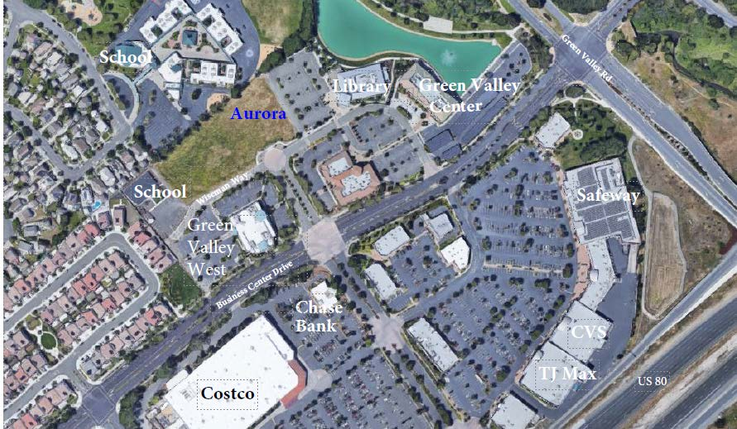
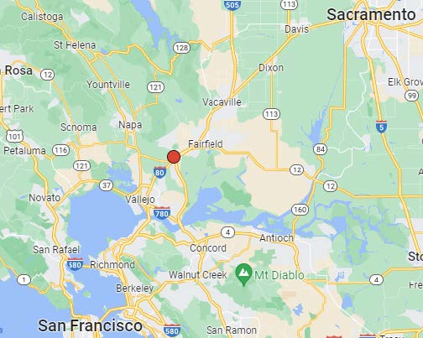
Market Snapshot
  The area of Fairfield is growing rapidly and vacancy rates are a low 3.1%
  REIS data indicates the market will remain stable with vacancy rates at or near 3.0% over the five-year extended forecast.
  City has an increasing demand for housing due to its pro-growth initiatives.
  Asking rent growth is anticipated to continue in 2024 and 2025 with a five-year forecast growth rate near 3.56%
*According to a REIS.com Performance Monitor report for the 16,717-unit Vallejo-Fairfield market third quarter 2023 information.

Slide 13
Key Highlights of
Aurora at Green Valley
  Highly sought-after location:
    Aurora at Green Valley is strategically located in the heart of Fairfield, just 15 miles from the renowned Napa Valley and 10 miles from Travis Air Force Base.
  Family-Oriented Community:
    The development is nestled near top-rated schools, parks, and a variety of shops and services, making it an ideal choice for families.
  Outdoor Recreation:
    Residents will enjoy easy access to biking and hiking trails, nature parks, and the picturesque Napa Valley vineyards.
  Nearby Entertainment:
    Just minutes away from entertainment, dining, and shopping options, Aurora at Green Valley ensures a well-rounded lifestyle for its residents.
  Premier Class-A Residential Multi-Family Complex:
    Designed with meticulous attention to detail, Aurora at Green Valley comprises three buildings with a total of 72 units, organized into three 24-plexes.

Slide 14
Distributions of Disposition Proceeds or Upon Liquidation
Final distribution or liquidation will be allocated in the following order:
  First, 100% to the Preferred Members for the payment of their accrued but undistributed Preferred Return;
  Second, to the Preferred Members as a return of capital;
  Third, to the Manager as the Common Member as a return of capital; and
  Thereafter, 50% to the Preferred Members and 50% to the Manager as the Common Member.

Slide 15
Exit Strategy:
Upon completion and stabilization (approximately 90% leased), a sale of the Project or a refinance of the Property and redemption of Units from Investors using the lender’s appraised value as a hypothetical sale price
Investors in the Company will also have the right, at any time after the second anniversary of the Final Closing Date, to elect to convert their holdings into common shares of the Manager (or, at their election, common OP units of the Manager’s operating partnership if a tax-free contribution is desired) at a conversion ratio that will provide a 14% simple annual return, using the volume weighted average trading price per share of common stock for the twenty (20) trading days prior to the date of the conversion (with a 5% discount for assumed transaction costs) or, if MRC’s shares are not listed,
the most recently published net asset value of the shares.

Slide 16
Contact Information
Brooke Buckley 415-994-5755 brooke@mackenziecapital.com
Art Miller 347-545-1039 art@mackenziecapital.com

