Slide 1

Generational, Value-Add Real Estate Investors
An investment in Sovereign Fund IV is speculative, illiquid and involves a high degree of risk, including the loss of principal invested.
Past Performance is no guarantee of future results. All investing is subject to risk, including the possible loss of the money you invest. Diversification does not ensure profit or protect against a loss.Securities offered through Orchard Securities, LLC, member FINRA/SIPC. Orchard Securities, LLC and Sovereign Partners are not affiliated.
For Financial Professional Use Only

Slide 2
DISCLOSURES
For Financial Professional Use OnlyUse Only
An interest in the Fund is an interest in a private investment vehicle (a “Private Fund”). Private Funds are unregistered private investment funds, which are speculative, illiquid investments. There are substantial risks in investing in Private Funds including the loss of principal invested. You should note carefully the following:
Private Funds represent speculative investments and involve a high degree of risk. An investor could lose all or a substantial portion of his/her investment. Investors must have the financial ability, sophistication/experience and willingness to bear the risks of an investment in a Private Fund.
The Fund’s distress-oriented investment strategy involves significant risks. The Fund intends to invest in CRE Debt that is subject to risks of delinquency, taking title to collateral, loss and bankruptcy of the borrower. If the borrower defaults, it may result in losses to the Fund.
Investments made by the Fund will be subject to the risks associated with owning, financing, managing and disposing of real estate, which include, but are not limited to, market conditions, tenants, environmental issues, tax considerations, and other risks.
The Fund will seek to acquire distress-oriented assets which may have weak financial conditions, poor operating result, substantial financial needs, negative net worth, special competitive or regulatory problems, involvement in bankruptcy or reorganization proceeds, and other difficulties, which may adversely impact investments made by the Fund.
An investment in a Private Fund should be discretionary capital set aside strictly for speculative purposes.
An investment in a Private Fund is not suitable or desirable for all investors. Only qualified eligible investors may invest in Private Funds.
Private Fund offering documents are not reviewed or approved by any governmental authority, including U.S. federal or state regulators.
Private Funds may be leveraged (including highly leveraged) and a Private Fund’s performance may be volatile.
An investment in a Private Fund is illiquid, there may be very limited or no voluntary withdrawals of interests in a Private Fund, and there may be significant restrictions on transferring interests in a Private Fund. There is no secondary market for an investor’s investment in a Private Fund and none is expected to develop.
A Private Fund may involve a complex tax structure, which should be reviewed carefully, and may involve structures or strategies that may cause delays in important tax information being sent to investors.
Private Funds are not required to provide periodic pricing or valuation information to investors.
Private Funds and their managers/advisors may be subject to various conflicts of interest.
The above summary is not a complete list of the risks and other important disclosures involved in investing in the Fund and is subject to he more complete disclosures contained in the Fund’s confidential offering documents, which must be reviewed carefully.

Slide 3

INTRODUCING SOVEREIGN PARTNERS
3rd generation family-run investment firm
Founded in 2002
Targets high-quality
value-add, distressed and opportunistic investments
Vertically-integrated, national real estate operator
*The photo featured is not and will not be owned Sovereign Partners
For Financial Professional Use Only

Slide 4
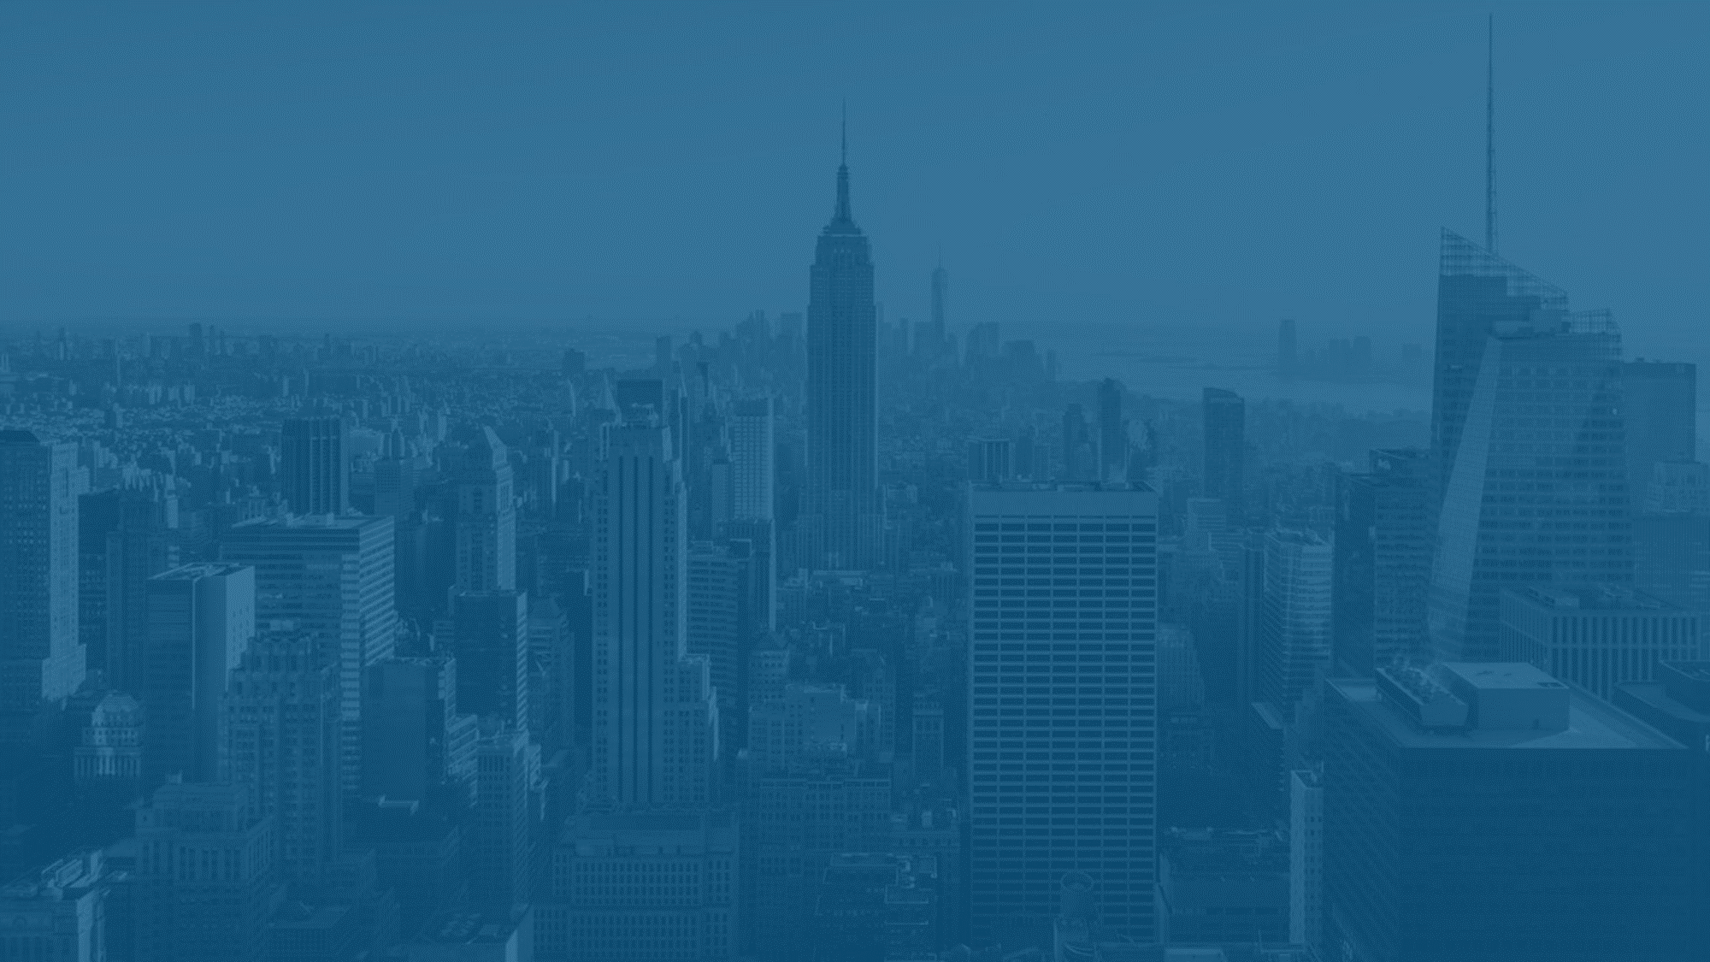



PURCHASE*
Loan-to-own
Increase occupancy
Financial restructurings
Resolve liquidity issues
Improve performance
Opportunistic sales
Enhance operating efficiencies
Targeted capital expenditure
*These objectives may not be achieved
For Financial Professional Use Only

Slide 5
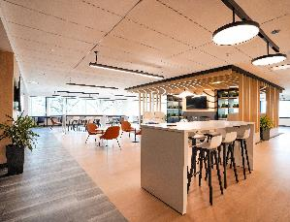
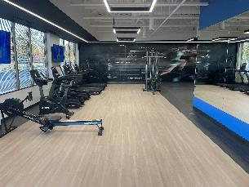
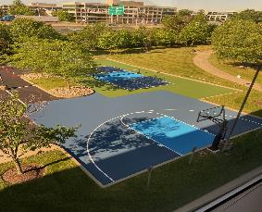
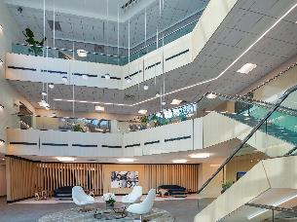
REPOSITION
Seek to amenitize asset to create a Class A+ experience; includes adding golf simulator, pickleball court, fitness center, lobby renovations and more.
Work to drive cash flow by the ability to undercut market area rents, while still being accretive to our position.
Seek to increase cash flow by finding operational inefficiencies created by previous ownership.
The images above represent currently and previous owned Sovereign assets. Past performance is not indicative of future performance.
For Financial Professional Use Only
5

Slide 6
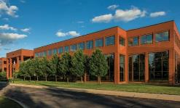
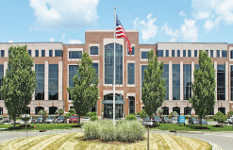
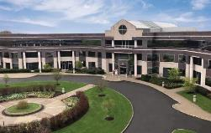
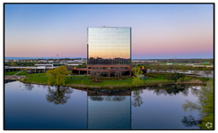

DISPOSITION
Long Lake Crossing – Fund I
300 Kimball – Fund I
Pond View – Fund I
Purchased: Sept. 2018 - $20.5M
Sold: Feb. 2022 - $26.5M
Purchased: Mar. 2019 - $66.0M
Sold: Dec. 2022 - $88.0M
Purchased: June 2019 - $19.95M
Refinance & Special Distribution: Sept. 2021
Adjacent Land Sale & Special Distribution: Mar. 2023
Sold: Aug. 2023 - $29.75M
One Park Plaza – Fund II
Liberty One – Fund II
Purchased: January 2020 - $6.75M
Refinance & Special Distribution: July 2021
Sold: July 2022 - $21.85M
Purchased: April 2020 - $1.6M
Sold: July 2022 - $4.4M
* Past performance is not indicative of future performance
For Financial Professional Use Only

Slide 7
OUR TRACK RECORD
Through five decades and five recessions, our co-founders have focused on indentifying high-quality assets at discounts to historic values.¹
40 years
as real estate
investors
~$800M
capital deployed across real estate and distressed debt
38%
weighted average gross IRR^{1,3}
Interests in over
7M SF
of real estate nationwide²
61%
weighted average gross IRR on all debt-related investments⁴
2.3x
weighted average gross multiple^{1,5}
1. Prior performance is not indicative of future performance. 2. Includes limited partnerships and other non-controlling interests. 3. Represents transactions since Sovereign inception in 2002. Represents both realized transactions and unrealized transactions using management exit valuations as of Q2 2022. Exit valuations may not be indicative of actual sale values, in which event realized Gross IRR may be lower, or substantially lower, than the hybrid realized/unrealized Gross IRR figure provided herein. Note, Gross IRR represents the average Gross IRR across Sovereign transactions weighted by transaction size. This includes Sovereign’s worst performing transaction, which realized a -6% Gross IRR. Gross IRR does not take into account fees and expenses charged by affiliates of the Sponsor. Net IRR is necessarily lower than Gross IRR. The above returns do not include the sales load associated with the Fund. IRR is calculated using a methodology that is compliant with global investment performance standards (GIPS). 4. These returns represent all 8 debt-related investments made from 2008-2012 ranging from 10% to 183% Gross IRR; previous downturn performance numbers are not available. Note, Gross IRR represents the average Gross IRR across Sovereign transactions weighted by transaction size. Net IRR is necessarily lower than Gross IRR. Historical information relates to portfolios held outside any existing fund and are not indicative of expected results of any existing fund or investment. The above returns do not include the sales load associated with the Fund. 5. Represents realized transactions since Sovereign inception in 2002. Note, Gross Multiple represents the average Gross Multiple across Sovereign transactions weighted by transaction size. This includes Sovereign’s worst performing transaction, which realized a 0.93 Gross Multiple. Gross Multiple does not take into account fees and expenses charged by affiliates of the Sponsor. Net Multiple is necessarily lower than Gross Multiple. The above returns do not include the sales load associated with the Fund. Represents numbers of Q4 2022.
For Financial Professional Use Only

Slide 8
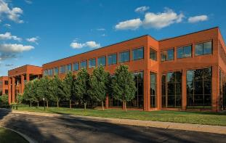
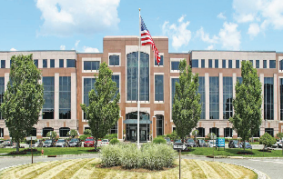
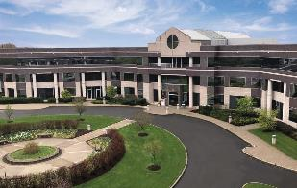
FUND I – FULL CYCLE
Investor Net IRR : ~14.9%¹
Investor Net Multiple : 1.6x²
GOLF SIMULATOR
Troy, MI
Parsippany, NJ
Farmington, CT
Purchased: Sept. 2018 - $20.5M
Sold: Feb. 2022 - $26.5M
Hold: ~3.5 years
Purchased: Mar. 2019 - $66.0M
Sold: Dec. 2022 - $88.0M
Hold: ~3.75 years
Purchased: Mar. 2019 - $19.95M
Refinance & Special Distribution: Sept. 2021
Adjacent Land Sale & Special Distribution: Mar. 2023
Sold: Aug. 2023 - $29.75M
Hold: ~4 years
(1) Average net IRR is net of all sponsor fees and is calculated by considering the IRR earned by investor in the fund and dividing by the total number of investors in the fund. Please note that the internal rate of return in an investment vehicle may differ greatly on an individual investor basis depending on the timing of an investor’s entrance and exit from the vehicle and whether the investor invested net of any up-front commissions and fees. IRR is calculated using a methodology that is compliant with global investment performance standards (GIPS).
(2) Average net Multiple is net of all sponsor fees and is calculated by considering the multiple earned by investor in the fund and dividing by the total number of investors in the fund. Please note that the multiple of return in an investment vehicle may differ greatly on an individual investor basis depending on the timing of an investor’s entrance and exit from the vehicle and whether the investor invested net of any up-front commissions and fees. Past performance is no guarantee of future results.

Slide 9
FUND II – CASH FLOW
ONE PARK PLAZA
Milwaukee, WI
LIBERTY ONE
Milwaukee, WI
FERNCROFT
Boston, MA
PENN ON PARKWAY
Indianapolis, IN
SAN FELIPE PLAZA
Houston, TX
Acquisition | 1.9.20 | 4.24.20 | 1.21.22 | 2.15.22 | 2.21.2023
Price | $5.8M | $1.6M | $25.5M | $29.8M | $104.5M
U/W NOI⁽¹⁾ | ~$400k | ~$141k | ~$2.4M | ~$400k | ~$8.5
U/W Occupancy⁽¹⁾ | 55% | 28% | 73% | 38% | 60%
Going-In Cap Rate⁽¹⁾⁽³⁾ | 7.12% | 8.85% | 9.45% | 1.3% | 8.2%
Current Status⁽⁵⁾ as of
7.1.2024
NOI⁽¹⁾ |  |  | ~$2.7M | ~$3.8M | ~$15.2M
Occupancy⁽¹⁾ |  |  | 75% | 73% | 66%
Cap Rate⁽²⁾ |  |  | 10.6% | 12.8% | 14.5%
 | One Park Plaza was sold on 7.27.22 for $22.0M, generating a gross asset level IRR⁽⁴⁾ of ~58% and a multiple of 2.21x. | Liberty One was sold on 7.27.22 for $4.4M, generating a gross asset level IRR⁽⁴⁾ of ~47% and a multiple⁽⁴⁾ of 2.32x. . | Completed the full renovation at the end of Q1 2024; which included tenant lounge, fitness center, golf simulator. Food service is expected to begin this fall. We have recently signed two new leases. Touring has picked up velocity with the amenity package being completed. | Construction on the conference facilities, tenant lounge, fitness center, and the pickleball court are complete. Two new leases are signed totaling ~30k SF. We are in active negotiations with two tenants for an additional ~30k SF. | Construction on the amenity package is near completion; the pickleball court, basketball court, and fitness center were completed in Q1 2024. We signed a ~32k SF tenant at the beginning of the year, and have a handshake with another ~60k SF. NOI⁽¹⁾ has increased to ~$15.2M since the asset’s acquisition while occupancy⁽¹⁾ has risen to 66%.
S
O
L
D
S
O
L
D
1. There can be no assurance that the Net Operating Income, Cap Rate, Occupancy or Weighted Average Lease Term will remain as outlined, and may increase or decrease.
2. Capiliazation rate calculated based on acquisition price
3. Cap rate is calculated as NOI divided by purchase price
4. Gross IRR does not take into account fees and expenses charged by affiliates of the Sponsor. Past performance is no guarantee of future results
5. As of 7.1.2024

Slide 10
.
FUND III – CASH FLOW
CALEB’S CREEK
Winston-Salem, NC
TWO PEIRCE PLACE
Itasca, IL
SAN FELIPE PLAZA
Houston, TX
TOWER 56
New York, NY
100 FIFTH AVE
New York, NY
Acquisition | 10.29.21 | 1.25.22 | 2.21.23 | 4.4.23 | 10.23.2023
Price | $4.9M | $24.0M | $104.5M | $113.0M | $126.5M
U/W NOI⁽¹⁾ | N/A | ~$1.0M | ~$8.5M | ~$4.7M | ~$8.3
U/W Occupancy⁽¹⁾ | N/A | 37% | 60% | 70% | 64%
Going-In Cap Rate⁽¹⁾⁽³⁾ | N/A | 4.2% | 8.2% | 4.2% | 6.6%
Current Status⁽⁴⁾ as of
7.1.2024
NOI⁽¹⁾ | N/A | ~$6.2M | ~$15.2M | ~$8.0M | ~$15.5M
Occupancy⁽¹⁾ | N/A | 70% | 66% | 87% | 97%
Cap Rate⁽²⁾ | N/A | 25.8% | 14.5% | 7.0% | 12.3%
 | Our first mortgage loan on Caleb's Creek continues to perform as intended. The borrower is currently under contract to sell the project. We will know more in the fall regarding timing. The sale will result in full repayment of the loan | At Two Pierce Place, robust leasing momentum continues. We have executed ~200k SF of new leasing since acquisition, and ~100k SF of renewals with 8 years of WALT⁽¹⁾. Two Pierce continues to capitalize on the prevalent office trend – flight to quality | Construction on the amenity package is near completion; the pickleball court, basketball court, and fitness center were completed in Q1 2024. We signed a ~32k SF tenant at the beginning of the year, and have a handshake with another ~60k SF. NOI⁽¹⁾ has increased to ~$15.2M since the asset’s acquisition while occupancy⁽¹⁾ has risen to 66%. | An elite amenity package that caters to the sophisticated clientele of the building is currently under construction. We anticipate completion in Q4 2024. Since acquisition, we have signed 14 new leases. The discounted acquisition basis, combined with the elite location, has proven to be accretive in a short period of time. | Sovereign underwrote 100 Fifth Avenue at 64% occupancy⁽¹⁾ with the assumption of Apple vacating the asset. Apple renewed their lease prior to closing the deal. The day after close, Sovereign signs new tenant bringing occupancy⁽¹⁾ to 96% with an underwritten NOI⁽¹⁾ of ~$15.5M
1. There can be no assurance that the Net Operating Income, Cap Rate, Occupancy or Weighted Average Lease Term will remain as outlined, and may increase or decrease.
2. Capiliazation rate calculated based on acquisition price
3. Cap rate is calculated as NOI divided by purchase price
4. As of 7.1.2024
For Financial Professional Use Only

Slide 11
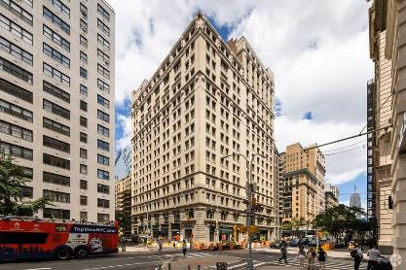
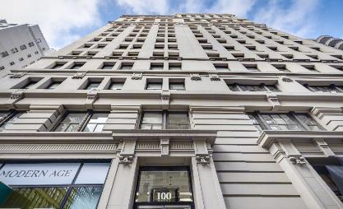
INVESTMENT HIGHLIGHT:
100 Fifth Avenue– Distressed Fund Sale
.
New York Office
10.23.2023 Acquisition Date
Summary:
Size: 277,509 square feet
Purchase Price: $126.5M¹ ($456¹ PSF)
U/W NOI: ~$8.3M²
U/W Occupancy: 64%²
U/W Going-In Cap Rate: 6.6%²
Previous Owner paid approximately $230.0M³ (45% discount to previous purchase)
Ideally positioned within Manhattan’s Midtown South submarket
One Park Plaza, currently owned by Fund 2.
1. Based on $126.5M purchase price
2. There can be no assurance that the Net Operating Income, Cap Rate, Occupancy or Weighted Average Lease Term will remain as outlined and may increase or decrease. Cap Rate = NOI/Purchase price. Does not reflect Fund return. Information presented as of 10.23.2023.
3. Based on $126.5M purchase price compared to previous purchase price of $230.0M (Per The Real Deal 10.4.23).
For Financial Professional Use Only

Slide 12
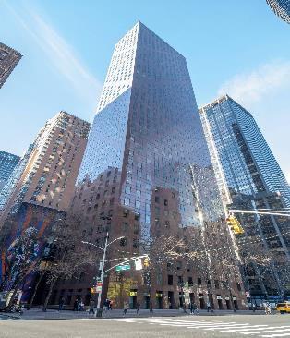
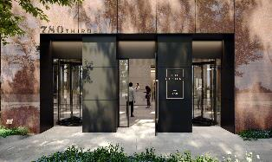
INVESTMENT HIGHLIGHT:
780 Third Avenue – Distressed Loan Sale
.
New York Office
6.25.2024 Acquisition Date
Summary:
Size: 510,940 square feet
Purchase Price: $177M¹ ($346¹ PSF)
U/W NOI: ~$5.9M²
Occupancy: 57%²
Previous owner peak FMV: $427M ($839) PSF
WALT: 5.5 years², with no tenant larger than 4% of rent roll
Two blocks from Grand Central; direct access to Subway, LIRR, and Metro North
Previous owner completed a $40M renovation of lobby, and 20k SF of amenities in 2022
One Park Plaza, currently owned by Fund 2.
1. Based on $177 purchase price
2. There can be no assurance that the Net Operating Income, Cap Rate, Occupancy or Weighted Average Lease Term will remain as outlined and may increase or decrease. 3. Per EastDil Secured Sales & Marketing
4. Based on FMV per TIAA 10Q (3/31/2018)
For Financial Professional Use Only

Slide 13

SOVEREIGN FUND IV:
OBJECTIVE:
To provide opportunistic total returns through targeted distressed investments throughout the capital stack
in the United States
There is no assurance that the total return of the fund will be achieved.
For Financial Professional Use Only
Securities offered through Orchard Securities, LLC, member FINRA/SIPC

Slide 14
SOVEREIGN FUND IV
Offering Size
Sovereign Investment
Minimum Investment ⁽¹⁾
Investor Suitability ⁽²⁾
Property Focus ⁽³⁾
Redemptions ⁽⁴⁾
$75,000,000
Asset Management Fee⁽⁵⁾
Acquisition Fee
Promote⁽⁶⁾
1.0% of the aggregate contract purchase prices
$1,500,000
1.0% of Purchase Price
$25,000
Return of Investor Capital
8% Annual Preferred Return⁽⁷⁾
  72.5% Investor / 27.5% Sponsor
Accredited – Reg D,
Rule 506(b)
Distressed Real Estate
1. Manager may permit investments in lesser amounts in certain limited circumstances. 2. There are additional suitability standards set forth in the Memorandum which investors must meet in order to invest. 3. These assets may include office, industrial, retail and hospitality properties, single-tenant properties, multifamily properties and other real estate-related assets.
4. See PPM for full detail regarding redemptions | Note: The Fund will reimburse manager for O&O up to 1% of the gross offering proceeds; Fund will pay manager up to 4% property management fee on assets in which the Sponsor operates, Fund will pay 3rd party managers a reasonable, customary and competitive fee related to operating assets (i.e. hospitality, multifamily) and construction. 5. The Asset Management Fee is 1.00% of the aggregate contract purchase price for any equity investment. The Debt Administration Fee is 1.00% of the aggregate amount advanced for loan assets. 6. Represents sub-distribution from available cash; see PPM for further description of sub-listing and merger distribution process. 7. There is no assurance that the 8% return hurdle will be reached. The 8% preferred returns are a metric used in determining the Manager’s entitlement to subordinated distributions, as set forth in the funds Operating Agreement and as described in more detail in the Memorandum.
Available
For Financial Professional Use Only

Slide 15
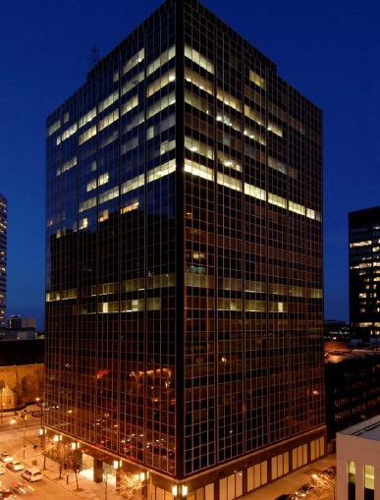
PAST CASE STUDY
Cleveland Office
OPPORTUNISTIC EQUITY
Summary:
Location: Cleveland, OH
Size: ~358K square feet
Date: 2006
UW NOI¹: N/A
Purchase Price: ~$13.0M
(all cash)
Sale Price: ~$13.0M
0.93x Equity Multiple
-2% Gross IRR^{1,2}
UW Net Operating Income calculated as UW Revenues less UW Expenses. Cap Rate calculated as NOI divided by Purchased Price. The internal rate of return in an investment vehicle may differ on an individual investor basis depending on the timing of an investor’s entrance and exit from the vehicle and whether the investor invested net of any up-front commissions and fees Note: This transaction is not representative of all realized transactions by the Sponsor but is an example of an unsuccessful one in a previous investment made by an affiliate. 2. Past performance is not indicative of future performance.
IRR is calculated using a methodology that is compliant with global investment performance standards (GIPS).
For Financial Professional Use Only

Slide 16

PAST CASE STUDY
Cleveland Office
$
Purchase
Reposition
Disposition¹
In 2006, Sovereign purchased a 358K square foot office tower in Cleveland, OH
The asset was acquired for $36/SF, a comfortable basis for a Class-A asset in a central location
Capital Improvements: ~$500,000 in targeted renovations
Leasing: Vacated 57,000 square feet (~16% of building) to 0% occupancy
Expenses: Lowered expenses by 50%
Fully vacated building for anticipated multifamily conversion
Low leverage allowed hold during the downturn
Disposed of asset at approximately same price of purchase, navigating downturn successfully to avoid a large loss of principal investment
Note: Worst realized investment since Sovereign inception.
1. Past performance is not indicative of future performance.
For Financial Professional Use Only

Slide 17
SOVEREIGN PARTNERS
www.sovpartners.com
747 Third Avenue, 37th Floor | New York, NY 10017
212.319.5800
For more information contact:
Jeff Young
720.371.0688
jyoung@sovpartners.com
Sam Kinzeler
303.916.4850
skinzeler@sovpartners.com
For Financial Professional Use Only
Securities offered through Orchard Securities, LLC, member FINRA/SIPC

