Slide 1



AIR LEGAL FINANCE FUND
ARETE WEALTH
airassetmanagement.com

Slide 2


EXECUTIVE SUMMARY
Kerberos Capital Management
Award-Winning
Private Credit Platform
Proven
Performance
Differentiated platform and investment team have received mainstream recognition
  Investment Team is comprised of former principals of the nation’s leading law firms and a finance professional of a multi-billion-dollar private credit fund
  Kerberos named a Top 3 Global Newcomer among private debt funds worldwide by Private Debt International*
  CIO Magazine recognized Kerberos as the “Very Best of Institutional Investing” in naming Kerberos a finalist for its annual “Innovation Awards”*
Kerberos has managed $270M of AUM in the Law Firm Lending sector since inception
  Full recourse loans with personal guaranty and attractive yields
  Funds I and II capitalized by institutional credit investors
    Net IRRs of 16.4% and 18.6% respectively
  Realized principal and interest to date of $220M across all transactions
1
1
As of 3/31/24. Figures provided by Kerberos Capital Management. 1: Refer to the disclosure section for details. *Please refer to the “Awards” section in the disclosures for important information.

Slide 3
FIRM HISTORY
Milestone
OVERALL STATS
$340M
1
Capital Deployed
28 Loans
1
Named CIO Innovation Award Finalist 2
Launched ESG-
Linked Debt
Product for
Borrowers
Funded
$270M
2
Current AUM
Named Top 3 Global New comer of the Year by Private Debt Investor
$220M
2
Operations & Investment Team Scales to 8
*
P&I Realized
8
Team Members
SMA Platform
Fund 2
Launch of Kerberos Capital Management
Fund I
$340M
DEPLOYED
$1M
DEPLOYED
$34M
DEPLOYED
$198M
DEPLOYED
$289M
DEPLOYED
$309M
DEPLOYED
$150M+
PIPELINE
1
2018
2019
2020
2021
2022
2023
Please refer to Important Notices and Disclosure for additional important information on the figures displayed here. 1: “Deployed” throughout this slide refers to the principal deployed since inception. “Funded” refers to the total number of borrowers (law firms) funded since inception. 2: Refer to disclosure for important information. *Refer to the disclosure for important information on the awards.

Slide 4
AIR ASSET MANAGEMENT & KERBEROS CAPITAL MANAGEMENT
Strategic Partnership
PURPOSE OF PARTNERSHIP
KEY BENEFITS
ADVANTAGES OF LAW FIRM LENDING THROUGH
AIR ASSET MANAGEMENT
OBJECTIVE
PROVEN EXPERTISE
To offer an open-ended vehicle for accessing attractive risk-adjusted, uncorrelated returns through legal financing.
Kerberos specializes in originating and underwriting law firm loans, with $340M capital deployed in the law firm lending and AUM of $270M .
LOWER COST TO ENTRY
Provides an attractive entry point for qualified investors through an open-end structure.
1
DIVERSIFICATION AND SECURITY
  Loans are backed by perfected liens on all revenues and cross-collateralized across diverse case inventories.
  Personal guarantees from equity partners ensure additional security.
  Loan-to-value (LTV) typically <30% on collateral value of seasoned cases.
BETTER LIQUIDITY TERMS
PARTNER SELECTION
  Open-ended structure offers enhanced liquidity terms compared to closed-end funds structure.
  2-year lock-up period with quarterly withdrawals upon 180 days' notice.
Kerberos is a proven leader in the space with an established track record.
ATTRACTIVE RETURNS
Historical net IRR of 16.4% for Kerberos Capital I and 18.6% for Kerberos Capital Fund II.
1: “Deployed” throughout this slide refers to principal deployed since inception. Please refer to Important Notices and Disclosure for additional important information on the figures displayed here.

Slide 5
LOWER RISK APPROACH
Legal Funding Landscape
Accelerated Settlement Monetization
Post- Settlement
Low Risk
Multi-Case/Portfolio Funding
Legal Lending
RISK
Single Case Funding
CASE MATURITY
High Risk
Law Firm-JV Financing
Early
1
100+
NUMBER OF CASES IN COLLATERAL

Slide 6
AIR LEGAL FINANCE STRATEGY
Compelling Risk-adjusted Returns
AIR Legal Finance Fund, LP - Class A Performance (%)*
AS OF 6/30/24
 | JAN | FEB | MAR | APR | MAY | JUN | JUL | AUG | SEP | OCT | NOV | DEC | YTD
2024 | 1.37 | 1.31 | 1.25 | 1.13 | 1.17 | 1.12 |  |  |  |  |  |  | 7.56
2023 | 1.14 | 1.30 | 1.56 | 1.38 | 1.34 | 1.28 | 1.32 | 1.30 | 1.21 | 1.28 | 1.24 | 1.41 | 16.95
2022 | 1.34 | 0.99 | 1.18 | 1.12 | 0.96 | 1.07 | 1.11 | 1.20 | 1.02 | 1.04 | 1.26 | 1.11 | 14.24
*Data as of 6/30/24. See disclaimers for important information.

Slide 7
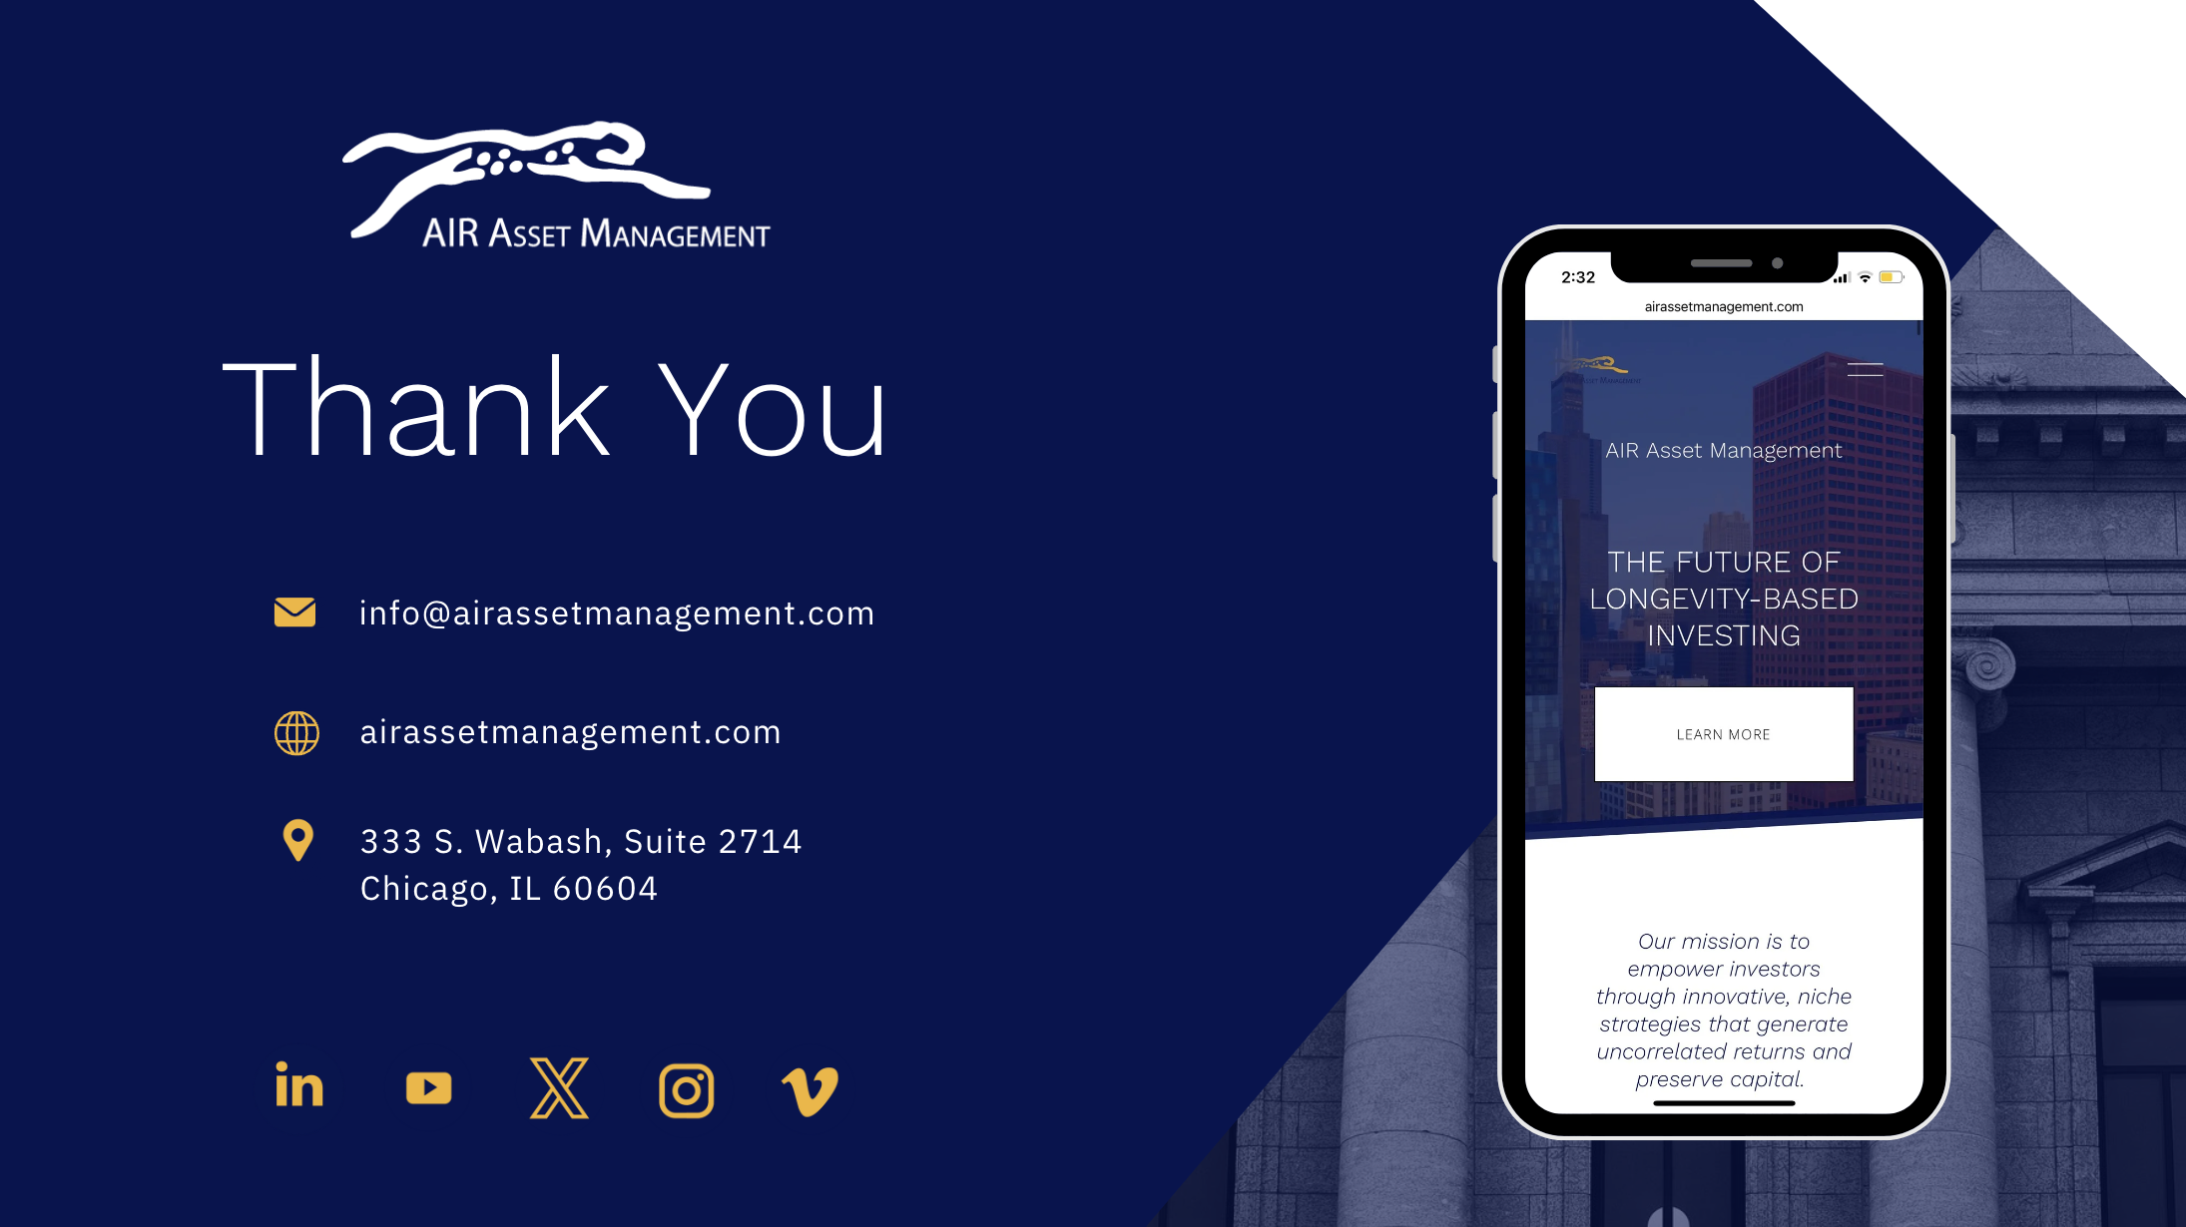

Slide 8
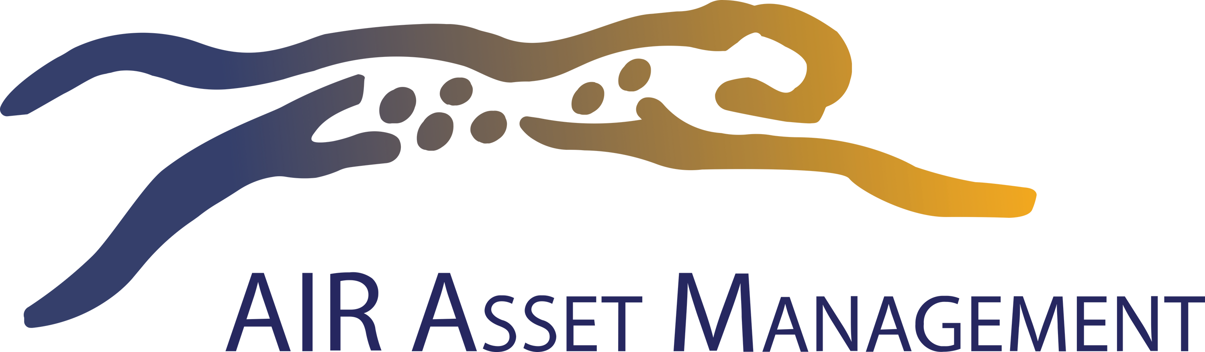
DISCLAIMERS
General
The information and any disclosures in this presentation are in summary form and have been prepared solely for informational purposes only. This document does not constitute an offer to sell or the solicitation of an offer to buy interests in AIR Legal Finance Fund, LP (the “Fund”). An offering of interests will be made only using a definitive confidential private offering memorandum or other definitive legal documentation prepared by the Fund, including any supplements thereto (collectively, the “Offering Document”), and only in those jurisdictions where permitted by law. In the case of any inconsistency between the information and disclosures contained herein and the information and disclosures contained in the Fund’s Offering Document, the Fund’s Offering Document will control. Any purchase made by you based on information and any disclosures not included in or consistent with the Fund’s Offering Document will be solely at your own risk. Please see additional disclaimers below.
Rainmaker Securities
AIR Asset Management’s Richard Beleutz, Chief Executive Officer; Amy Boyet Besse, the Chief Compliance Officer; and Alex Ochoa, the Senior Associate of Business Development, are agents of RainMaker Securities, LLC. Member FINRA / SIPC. Please find information about Rainmaker Securities and its agents onBrokerCheck.
investment Performance
*The Fund’s inception is in January 2022. Monthly returns are calculated using a Valued Added Monthly Index (VAMI), which assumes monthly compounding of returns. Past performance does not guarantee future results. Please review the following for clarification on the returns reported:
For information on the former terms of the Partnership and/or general performance questions, don't hesitate to contact us at InvestorRelations@airassetmanagement.com.
The performance representations contained herein are not representations that such performance will continue in the future or that any investment scenario or performance will even be similar to such description. Any investment described herein is an example only and does not represent that the same or similar investment scenarios will arise or that investments made will be profitable. No representation is made that any investment will likely achieve profits or losses similar to those shown. There are frequently sharp differences between prior performance results and actual results achieved by a particular trading program. YTD performance assumes an investment has been held since January 1, the relevant year. Because some investors have different fee arrangements and depending upon the timing of a specific investment, net performance for an individual investor may vary from the net performance stated herein. Actual returns will vary among investors following the terms of the pertinent offering documents or investment management agreements. Investment returns and the principal value of an investment will fluctuate and may be quite volatile. In addition to exposure to adverse market conditions, investments may also be exposed to changes in regulations, changes in capital providers, and other service providers. Investors risk the loss of their entire investment.
Speculative Risk
An investment in the Fund is speculative and involves high risk. The Fund may employ certain techniques that may increase the risk of investment loss. Further, investors will have limited withdrawal and transfer rights, and no secondary market for the interests exists or is expected to develop. In addition, the Fund’s fees and expenses offset trading profits. All of the risks, as well as other important risks and information (including, without limitation, information regarding trading objectives and programs, fees, and expenses, tax considerations, and suitability requirements), are strongly urged to review the Fund’s offering documents carefully and consult with their own financial, legal and tax advisors before investing with the Fund. Our investment program involves substantial risk, including the loss of principal, and no assurance can be given that our investment objectives will be achieved.
Forward-Looking Statements
Certain information contained in this material constitutes forward-looking statements, which can be identified by the use of forward-looking terminology, such as “may,” “will,” “should,” “expect,” “anticipate,” “target,” “project,” “estimate,” “intend,” “continue,” or “believe,” or the negatives thereof or other variations thereon or comparable terminology. Such statements are not guarantees of future performance or activities. Due to various risks and uncertainties, actual events or results or the Fund's actual performance may differ materially from those reflected or contemplated in such forward-looking statements.
Illustrative Purposes Only
Examples of our processes and any other ideas presented herein are for illustrative purposes only. There is no guarantee that the Fund will acquire a position in an issuer or industry referenced in such examples or ideas or that
any such position would be profitable.
I, 2: Definitions
“AUM” is the summation of all active loan balances (including accrued interest and as adjusted for impairment) across all investment vehicles, SMAs, and other clients as of March 31, 2024.
“Realized Principal & Interest” is all repaid principal plus paid interest on both fully realized and partially realized loans, including refinancings and secondary sales.
“Net IRR” is calculated from date of funding through the earlier of realization date or March 31, 2024, using the XIRR method, which calculates an internal rate of return after consideration of different-size time periods and which Kerberos believes produces a more prudent and relevant performance measurement for loans that do not have regularly periodic cash flows. Net IRR is calculated across both realized and unrealized loans and based on management fees of 1.5% on invested capital and carried interest of 20% over a preferred return to investors of 12%, with a full general partner catch-up, and estimated expenses such as organizational, administrative, audit, legal, and other related expenses, most of which were not actually incurred but are reflected here on an estimated basis to attempt to replicate a blind pool vehicle. With respect to loan level calculations, management fees are allocated pro rata based on each loan’s deployed capital (without reflecting subsequent repayment or other realization) and performance fees are allocated pro rata based on gross profits, in each case assessed as of March 31, 2024.
*Awards
Sources: https://www.privatedebtinvestor.com/pdi-annual-awards-2020-our-global-winners/ - The Private Debt Investor Awards acknowledge leaders across an array of categories and are the culmination of a broad-based voting process among industry participants, including the private debt, private equity, and institutional limited partner communities. Kerberos did not pay a fee to be considered for the recognition. https://www.ai-cio.com/news/cio-announces-winners-of-innovation-awards/ The Innovation Awards celebrate the “very best of institutional investing” and recognize management firms that have “truly and reliably enhanced the portfolios of their clients” using innovative approaches to asset management, according to CIO. Finalists and winners are chosen by the CIO editorial team in conjunction with an advisory board of chief investment officers. Kerberos did not pay a fee to be considered for the recognition.
Start Date | End Date | Disclosure Applicability | Disclosure
January 1, 2022 | December 31, 2023 | Class A Interests | The Fund's Class A Interests launched on January 1, 2024; thus, returns reported prior to this launch date are reflective of the Class B Interests (the original share class of the Fund).
January 1, 2022 | December 31, 2023 | Class I Interests | The Fund's Class I Interests launched on January 1, 2024; thus, returns reported prior to this launch date are reflective of the Class B Interests (the original share class of the Fund).
January 1, 2022 | December 31, 2023 | All Share Class Interests | Returns are reported for all share class Interests under the former terms of the Partnership, and in alignment with the above disclosures.
January 1, 2024 | To date | All Share Class Interests | Returns are reported for all share class Interests under the current terms of the Partnership.
Alternative Investment Resource LLC (d/b/a AIR Asset Management) (“AIRAM”)
333 South Wabash, Suite 2714, Chicago, IL 60604 | (312) 877-1360 | airassetmanagement.com | info@airassetmanagement.com
©2024 AIR Asset Management. All Rights Reserved. AIR Asset Management® is a registered trademark of Alternative Investment Resource, LLC.

