Slide 1

Direct Investments
In Energy
Notes:
Slide 1:
Good afternoon, my name is __________________ from U.S. Energy Development Corporation. Today I will be reviewing an Introduction to Direct Investments in Energy & Drilling Funds. Please note that an investment opportunities discussed today are for accredited investors and this presentation is intended for informational purposes only. Please reference the Private Placement Memorandum for complete accuracy and for additional details. Past performance is not indicative of future results.
The oil & gas assets shown in this presentation are not owned by the USEDC 2024 Drilling Fund, or previous U.S. Energy partnerships, nor are they targeted for acquisition in any U.S. Energy partnership at this time. All assets pictured are representative of the type of assets the USEDC 2024 Drilling Fund will target unless otherwise noted.

Slide 2

Risk Information:
You should always review the Private Placement Memorandum before investing in any oil & gas partnership sponsored by U.S. Energy Development Corporation. For Accredited Investors Only
• Oil and natural gas partnerships are an inherently speculative activity. An investment in the partnerships involves a high degree of risk and is suitable only if you have substantial financial means and no need of liquidity in your investment. You should carefully consider the following factors and other information in the private placement memorandum before deciding to invest in the partnership.
• Attainment of the partnership’s investment objectives will depend on many factors, including the ability of the managing general partner to select suitable assets which will be productive and produce enough revenue to return the investment made. The success of the partnership depends largely on future economic conditions, especially the future price of natural gas and oil which is volatile and may decrease. There can be no guarantee that the foregoing objectives will be attained.
• There is a risk that you will not recover all of your investment or, if you do recover your investment, that you will not receive a rate of return on your investment which is competitive with other types of investment. You will be able to recover your investment only through the partnership’s distributions of the sales proceeds from the production of its oil and natural gas reserves from productive wells. Oil and natural gas reserves generally deplete over time until the wells are no longer economical to operate. All of these distributions to you may be considered a return of capital until you have received 100% of your investment.
• There is a risk that even if a well is drilled by the partnership and produces oil and natural gas in commercial quantities (that is, revenues from the sale of the oil and/or gas produced from a well exceed the cost of operating such well) it will not produce enough oil and natural gas to pay for the costs of acquiring the well, even if tax benefits are considered. Thus, even if all of the partnership's wells are capable of commercial production there is a risk that your investment will not be returned on a cash-on-cash basis.
• If you invest in the partnership, then you must assume the risks of an illiquid investment. The transferability of the units is limited by state and federal securities laws, tax laws and the partnership agreement. The units cannot be readily liquidated, and there is no market for the sale of the units. Also, a sale of your units could create adverse tax and economic consequences for you.
• An investor may experience a complete loss of their investment.
• Distributions may be reduced or delayed.
• Under certain circumstances as explained in the private placement memorandum, an investor may owe taxes in excess of the cash distributions received from the partnership.
• Borrowing by the managing general partner could reduce funds available for its presentment obligation.
• Substantial conflicts of interest exist between the managing general partner and investors.
This document is for preliminary review purposes only and does not contain much of the information included in the private placement memorandum pursuant to which the offering will be conducted. This presentation does not constitute an offer to any person. Offers will be made only by the private placement memorandum, which should be carefully reviewed by a prospective purchaser prior to making an investment decision.
Notes:
Slide 3:
Disclaimers for today’s presentation. We will take a moment to discuss this important Risk Information.
This document is for preliminary review purposes only and does not contain much of the information included in the private placement memorandum pursuant to which the offering will be conducted. This presentation does not constitute an offer to any person. Offers will be made only by the private placement memorandum, which should be carefully reviewed by a prospective purchaser prior to making an investment decision.
You should always review the Private Placement Memorandum before investing in any oil & gas partnership sponsored by U.S. Energy Development Corporation. For Accredited Investors Only
***Information related to “Risk Factors” (page 1) in the Private Placement Memorandum. The balancing risks above are not intended to suggest these are the only risks that may affect the Program's objectives. It is important to review and understand all "Risk Factors" including those mentioned above. Please see all "Risk Factors" as detailed in the Program Offering documents.***

Slide 3
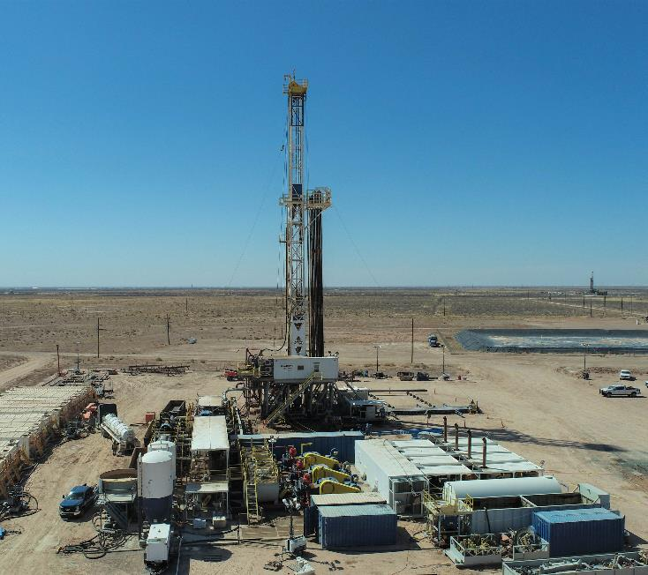

Veteran E&P Operator
Leader in Investment Underwriting
Ownership & Leadership:
44-Year History (Established 1980)
Established Second-Generation Leadership
Corporate Governance:
Majority Independent Board of Directors
Environmental, Social and Governance (ESG) Committee
Operational Excellence:
Over 35 Premier JV Partners Providing Access to High-Quality (Tier 1) Assets
Proven Operations Team
Diversified Areas of Operation: Own & Operate in 13 States & Canada
U.S. Energy’s 2024 Operations
Notes:
***Information related to “Investment Objectives” (page 39), “Prior Activities” (page 59), “Management” (page 69) and “Proposed Activities” (page 74) in the Private Placement Memorandum.

Slide 4
U.S. Energy Financially Strong GP
Projected 2023 Revenue of $143MM vs $97.8MM in the prior year
Projected EBITDA of $88.5MM vs $31.9MM in the prior year
YTD Partnership distributions of $150MM+
12/31/2023 NYMEX reserves of $416MM
Production average ~10,000+ BOE/day
Co-invested $100 million in 2022, $130 million in 2023, and plans to increase in 2024.

Slide 5
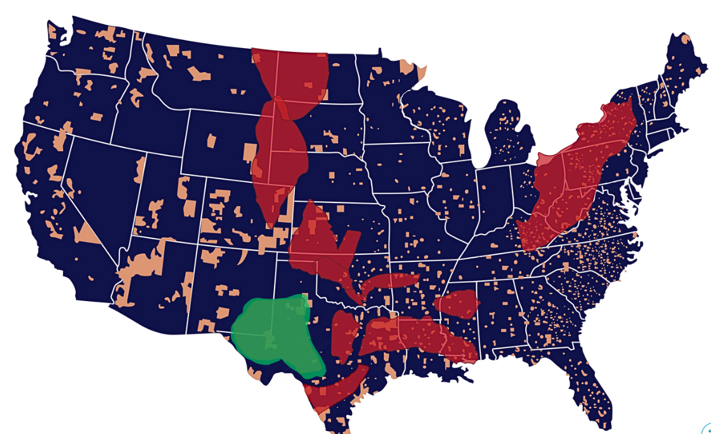
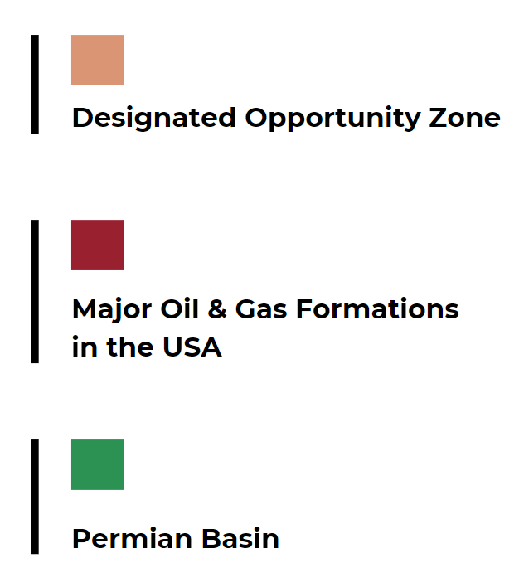
U.S. Energy - Over $3 Billion deployed
Notes:
***Information related to “Investment Objectives” (page 37), “Prior Activities” (page 57), “Management” (page 65) and “Proposed Activities” (page 69) in the Private Placement Memorandum.

Slide 6








Established Joint Venture Partner Network
Notable Partners Include:

Slide 7
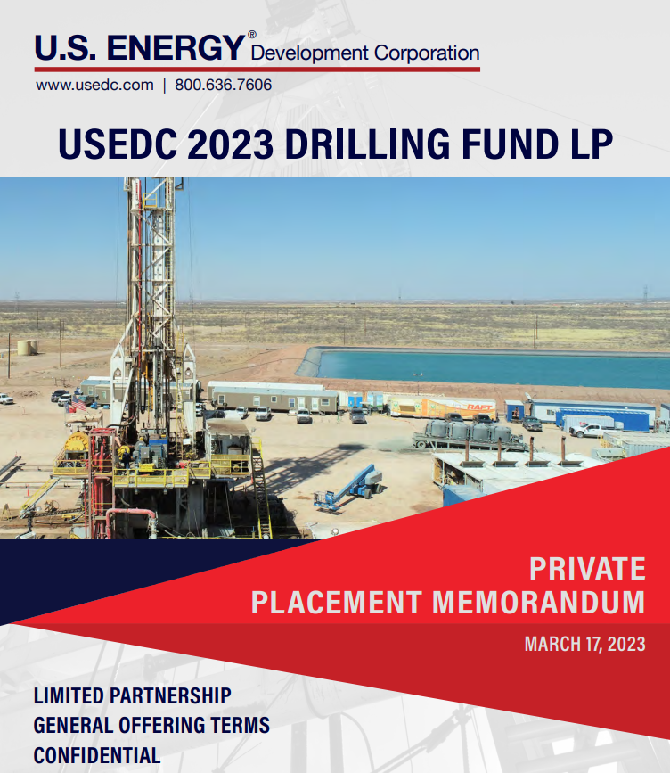



One firm, multiple investment solutions
2024 Drilling Fund
(1st yr. Write off funds)
Mineral Fund
(1031x eligible)
Qualified Opportunity Zone Fund
(Cap gain def + Tax free exit)
Private Capital Fund
(Growth & Income)
Notes:
***Information related to “Investment Objectives” (page 39), “Prior Activities” (page 59), “Management” (page 69) and “Proposed Activities” (page 74) in the Private Placement Memorandum.

Slide 8
USEDC 2023 Capital Summary (MM’s)
Notes:
***Information related to “Investment Objectives” (page 37), “Prior Activities” (page 57), “Management” (page 65) and “Proposed Activities” (page 69) in the Private Placement Memorandum.

Slide 9
Macro
Environment

Slide 10
Oil Consensus 2024 Pricing ($/bbl)
Firm | Q1 2024 | Q2 2024 | Q3 2024 | Q4 2024
Deutsche Bank | $80 | $82 | $88 | $90
RBC | $75 | $80 | $81 | $82
JP Morgan | $75 | $80 | $80 | $81
Notes:
Slide 9:
This chart illustrates 2023 consensus oil pricing among large banks.
Data Source: Bloomberg Terminal
***Information related to regulation, competition and markets, see “Competition, Markets and Regulation” (page 84) and “Risk Factors” (page 5) in the Private Placement Memorandum. Template Slide which will continue to be reviewed and updated as new information becomes available.***

Slide 11
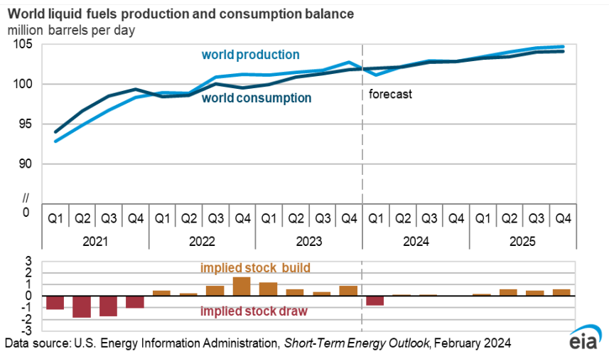
Global Market Outlook
EIA forecasts crude prices in '24 & '25 to remain near the 2023 average.
OPEC+ production cuts will lead to global oil inventory withdrawals in early 2024, putting upward pressure on prices.
Positive macro-outlook for 2024 suggests a balanced and stable oil market.
Increased world production and consumption.
Notes:
Slide 10:
This chart illustrates the EIA 2024 global market outlook.
Data Source: U.S. Energy Information Administration, Short-Term Energy Outlook, February 2024
***Information related to regulation, competition and markets, see “Competition, Markets and Regulation” (page 89) and “Risk Factors” (page 5) in the Private Placement Memorandum. Template Slide which will continue to be reviewed and updated as new information becomes available.***

Slide 12
Tax Planning

Slide 13

Tax Planning Strategies
General Partners – Ordinary Income Tax Deduction
For Illustrative Purposes Only.
Up to 37% Tax Savings on Invested Amount in Year of Investment
Potential State Tax Savings up to 13.3%
As more fully described in the private placement memorandum, there are significant differences between the types of units that are available; including that owners of general partner units potentially have unlimited liability for events occurring during the drilling phase of the partnership’s wells while limited partner unit owners have limited liability and that intangible drilling cost deductions attributable to limited partner unit owners may only be applied to passive income. Potential investors should discuss with their financial advisor which unit type may be most suitable for their financial situation. The minimum subscription is one unit, however, partial units may be accepted in the managing general partner’s discretion. Larger subscriptions will be accepted in $1000 increments. (See terms of the offering in the PPM). See suitability standards in the private placement memorandum. You should review all aspects of the private placement memorandum prior to investing. There is no certainty or guarantee that any or all of the investment objectives will be achieved. The tax benefits of an investment are not guaranteed, tax rates may change in the future which would impact the partnership and investors may be subject to income tax liability in excess of the cash received from the partnership. Distributions are not assured or guaranteed. The oil & gas assets shown in this presentation are not owned by the 2024 drilling fund, nor are they owned by U.S. Energy or any affiliated partnerships, unless otherwise noted. All assets pictured are representative of the types of assets the 2024 drilling fund will target for ownership, unless otherwise noted.
Notes:
Slide 22:
This graphic demonstrates the typical costs of drilling a well in addition to some investment risks associated with the various share classes.
As more fully described in the private placement memorandum, there are significant differences between the types of units that are available. You should review all aspects of the private placement memorandum prior to investing. There is no certainty or guarantee that any or all of the investment objectives will be achieved. The tax benefits of an investment are not guaranteed, tax rates may change in the future which would impact the partnership and investors may be subject to income tax liability in excess of the cash received from the partnership. Distributions are not assured or guaranteed.
Potential investors should discuss with their financial advisor which unit type may be most suitable for their financial situation. The minimum subscription is one unit, however, partial units may be accepted in the managing general partner’s discretion. Larger subscriptions will be accepted in $1000 increments. (See terms of the offering in the PPM). See suitability standards in the private placement memorandum.
***Information related to “Summary of the Offering” (page 1), “Investment Objectives” (page 39), “Proposed Activities” (page 74) and “Tax Aspects” (page 112) in the Private Placement Memorandum. You should review all aspects of the private placement memorandum prior to investing.***

Slide 14
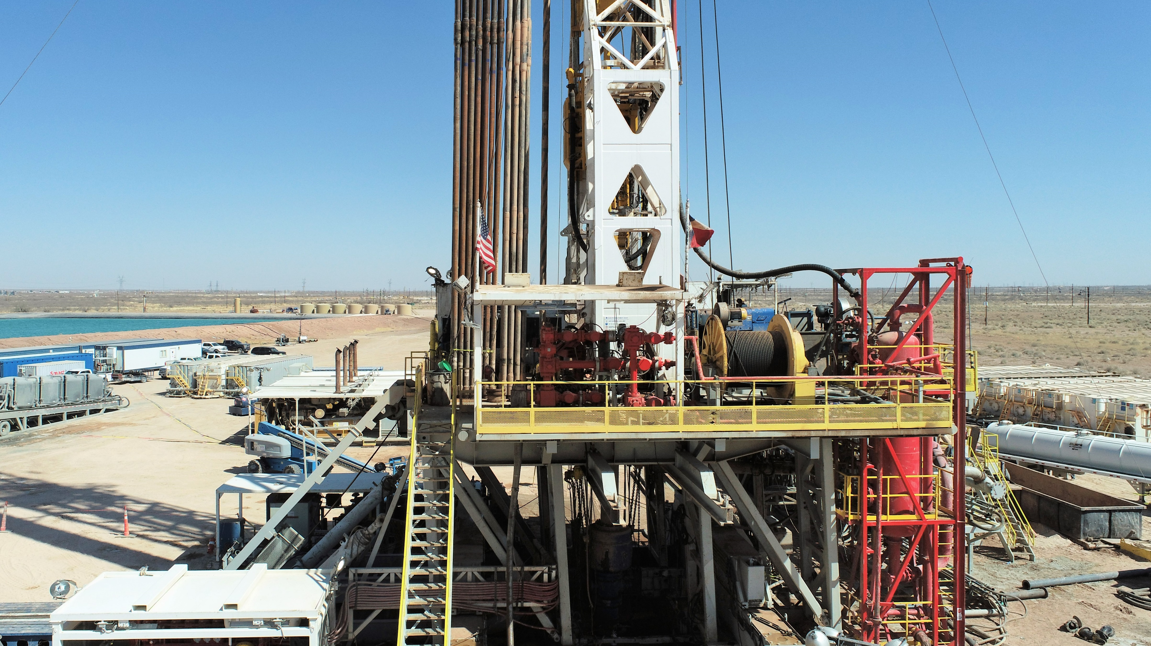

USEDC Drilling Fund LP: Summary
Offering Size | $250,000,000
Closing Date: | December 31, 2024
Unit Size | $100,000 (Partial Units Accepted)
Investor Units: | General Partner (GP) Limited Partner (LP) Limited Liability Company Units (LLC), for Retirement Accounts
Distributions: | Quarterly Distributions U.S. Energy Subordinates to a 12% annualized rate of return for the first five years
Annual Tax Forms: | General & Limited Partners receive a Schedule K-1 LLC Units receive Form 1099 from their Custodian
Investor Reports: | Updates released quarterly via Online Investor Portal
Suitability | Accredited Investors Only
sfdf
Notes:
Slide 19:
Summary of the 2024 Drilling Fund
***Information related to “PPM Cover” (cover page), “Description of Units” (page 1), “Proposed Activities” (page 74), “Subordination of Portion of Managing General Partner’s Net Revenue Share” (page 96) and “Reports to Investors” (page 140) in the Private Placement Memorandum. You should review all aspects of the private placement memorandum prior to investing. Potential investors should review the Private Placement Memorandum for additional information on investor units and discuss with their financial advisor which unit type may be most suitable for their financial situation. The minimum subscription is one unit, however, partial units may be accepted in the managing general partner’s discretion. Larger subscriptions will be accepted in $1000 increments. (See Terms of the Offering in the PPM). See Suitability Standards in the Private Placement Memorandum.***

Slide 15
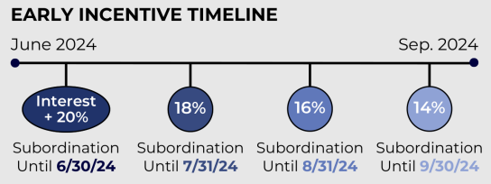
2024 Drilling Fund Early Investor Incentives
Subordination: U.S. Energy Subordinates to a 20% annualized rate of return for the first five years
Interest on Invested Amounts: Payment made in January 2025.
Guaranteed Spot in Fund: Early investors guaranteed a spot in the fund for additional contributions
*See PPM for additional details
Notes:
Slide 21:
Early Participants.
Early Participants admitted to the Partnership will be eligible for the following:
• The Subordination Threshold of the MGP Payment Subordination with respect to each Early Participant shall be 20% rather than 12%.
• At any time on or prior to November 15, 2024, an Early Participant may notify the Partnership of its intent to increase its Subscription by December 15, 2024, which notice shall include the amount of Early Participant’s desired Subscription increase. The Partnership may, in its discretion and without waiving its rights to reject any Subscription, hold such Subscription amount for Early Participant until December 15, 2024.
• Interest will be earned on an Early Participant’s Subscription Proceeds and credited to the Account of an Early Participant for the actual days elapsed from the time such Subscription Proceeds were accepted until the December 31, 2024, regardless of when such Subscription Proceeds were utilized to operations of the Partnership. The interest rate payable to Early Participant will be the rate paid by Washington Federal, National Association with respect to such funds.
***Information related to “Summary of the Offering” (page 1), “Investment Objectives” (page 39), “Proposed Activities” (page 74) and “Tax Aspects” (page 112) in the Private Placement Memorandum. You should review all aspects of the private placement memorandum prior to investing.***

Slide 16





Drilling fund highlights
First-Year Tax Deduction of up to 90%+ on Invested Amount for General Partners
Quarterly Cash Distributions
U.S. Energy subordinates up to 100% of our working interest to a 12% annualized rate of return for the first 5 years
Tax Advantaged Income
Potential for JV partnerships with Major E&P Firms
As more fully described in the private placement memorandum, there are significant differences between the types of units that are available; including that owners of general partner units potentially have unlimited liability for events occurring during the drilling phase of the partnership’s wells while limited partner unit owners have limited liability and that intangible drilling cost deductions attributable to limited partner unit owners may only be applied to passive income. Potential investors should discuss with their financial advisor which unit type may be most suitable for their financial situation. The minimum subscription is one unit, however, partial units may be accepted in the managing general partner’s discretion. Larger subscriptions will be accepted in $1000 increments. (See terms of the offering in the PPM). See suitability standards in the private placement memorandum. You should review all aspects of the private placement memorandum prior to investing. There is no certainty or guarantee that any or all of the investment objectives will be achieved. The tax benefits of an investment are not guaranteed, tax rates may change in the future which would impact the partnership and investors may be subject to income tax liability in excess of the cash received from the partnership. Distributions are not assured or guaranteed. The oil & gas assets shown in this presentation are not owned by the 2024 drilling fund, nor are they owned by U.S. Energy or any affiliated partnerships, unless otherwise noted. All assets pictured are representative of the types of assets the 2023 drilling fund will target for ownership, unless otherwise noted.
Notes:
Slide 20:
Investment Objectives for the 2024 Drilling Fund:
The Partnership’s principal investment objectives are to invest its subscription proceeds in wells
which will:
• Cash Distributions. Provide quarterly cash distributions to you beginning approximately twelve months after the closing of the Partnership (which may be delayed in the discretion of the Managing General Partner until sufficient Partnership revenues are received) until the wells are depleted with a preferred average annual cash flow of 12% during the first five years of distributions after 75% of the Partnership’s wells are generating production revenues, based on cumulative distributions and your original subscription amount. The preferred return and its calculation are described in Section 5.01(b)(4) of the Amended and Restated Certificate and Agreement of Limited Partnership that is attached as Exhibit (A) to this Memorandum. You should review that Section for a more complete explanation of this feature.
• Tax Deductions. A primary benefit to participants in the Partnership will be the tax deductions arising from their investments. Accordingly, the Partnership will prepay funds attributable to intangible drilling costs on or before December 31, 2024 to obtain tax deductions in 2024, for GP Investors, from intangible drilling costs to offset a portion of their taxable income and for participants who invest as limited partners and elect to have their net subscription proceeds treated in the same manner as the GP Investors, to offset a portion of their passive income. If the drilling of all of the Partnership’s wells is begun by March 31, 2025, or completed by within 3 ½ months of the date of prepayment, one Unit will produce a 2024 tax deduction for intangible drilling costs of from approximately $69,000 to up to $92,000 (if 100% of the investor’s net subscription proceeds are applied to the payment of intangible drilling costs), against ordinary income if you invest as an investor general partner. If 100% of your net subscription proceeds are applied to the payment of intangible drilling costs and you are in the 37%, 35% or 32% tax bracket for 2024, then one Unit will save you up to approximately $34,040, $32,200 or $29,440 per Unit, respectively, in federal taxes this year. Most states also allow this type of deduction against the state income tax. For wells for which drilling has not commenced by March 31, 2025, and/or is not continuously drilled until completed, if warranted, or abandoned, the deduction for intangible drilling costs with respect to any such services that are not reasonably expected to be completed within 3 ½ months of the date of prepayment (i.e. April 15, 2025 if prepayment is made on December 31, 2024) will be deferred to the 2025 tax year. (For LP Investors intangible drilling cost deductions will only offset passive income.)
Additional tax deductions attributable to the accelerated depreciation of tangible equipment costs for those portions of net subscription proceeds applied to the purchase of equipment constituting “qualified property”, will be obtained for the year in which such equipment is placed into service, which is anticipated to primarily be in 2024.
• Depletion Allowance. Offset a portion of gross production income generated by the Partnership with tax deductions from percentage depletion which currently is 15%. However, for wells that produce 15 barrels or less of oil per day or 90 mcf or less of natural gas per day, this rate fluctuates from year to year depending on the price of oil, but will not be less than 15% nor more than 25%. Depletion will be allocated among the investors based upon their interest in Partnership revenues.
Additional Notes on Depletion:
Current Tax Laws allow for Depletion Deductions of 15-25% of oil and gas sale revenues. Depletion allows an owner or operator to account for the reduction of oil and/or gas well reserves. Depletion Deductions are calculated at 15-25% of gross revenue. Every year, investors receive the GREATER of cost or percentage depletion.
Cost Depletion
Calculated as a deduction, based upon units of well production and remaining reserves, of the original cost of developing a natural resource that is consumed over a period of time.
Percentage Depletion
Calculated as a set percentage, by which one may reduce their gross income from oil and gas production, independent of cost. Percentage Depletion is based on the reference price of oil. As the price of oil increases, Percentage Depletion decreases to a minimum of 15% of gross income. As the price of oil decreases, Percentage Depletion increases to a maximum of 25%.
Attainment of the partnership’s investment objectives will depend on many factors, including the ability of the managing general partner to select suitable wells which will be productive and produce enough revenue to return the investment made. The success of the partnership depends largely on future economic conditions, especially the future price of natural gas and oil which is volatile and may decrease. There can be no guarantee that the foregoing objectives will be attained.
***Information related to “Summary of the Offering” (page 1), “Investment Objectives” (page 39), “Proposed Activities” (page 74) and “Tax Aspects” (page 112) in the Private Placement Memorandum. You should review all aspects of the private placement memorandum prior to investing.***
Potential investors should review the Private Placement Memorandum for additional information on investor units and discuss with their financial advisor which unit type may be most suitable for their financial situation. The minimum subscription is one unit, however, partial units may be accepted in the managing general partner’s discretion. Larger subscriptions will be accepted in $1000 increments. (See Terms of the Offering in the PPM). See Suitability Standards in the Private Placement Memorandum.

Slide 17
USEDC Private Capital II LP
Notes:
Slide 1:
Good afternoon, my name is __________________ from U.S. Energy Development Corporation. Today I will be reviewing an Introduction to Direct Investments in Energy & Drilling Funds. Please note that an investment opportunities discussed today are for accredited investors and this presentation is intended for informational purposes only. Please reference the Private Placement Memorandum for complete accuracy and for additional details. Past performance is not indicative of future results.
The oil & gas assets shown in this presentation are not owned by the USEDC 2023 Drilling Fund, or previous U.S. Energy partnerships, nor are they targeted for acquisition in any U.S. Energy partnership at this time. All assets pictured are representative of the type of assets the USEDC 2023 Drilling Fund will target unless otherwise noted.

Slide 18

Distribution Reinvestment Program
Distribution Re-Investment Program
Investors may elect to have their quarterly distribution of up to 12% applied to the purchase of additional units to increase their ownership in the fund.
No sales commissions, fees or other amounts will be paid on units purchased through the Distribution Re-Investment Program (DRIP).
Partnership Reinvestment
Cash flow in excess of funds required for operations and investor distributions may be invested in the acquisition of, or investment in, additional assets.
No sales commissions, fees or other amounts will be paid on amounts that are reinvested.
Notes:
Slide 25:
Distribution Reinvestment Program of the USEDC Private Capital II LP Fund
*** “Investment Objectives” (page 34) and “Proposed Activities” (page 56) in the Private Placement Memorandum.
You should review all aspects of the private placement memorandum prior to investing. There is no certainty or guarantee that any or all of the investment objectives will be achieved. The tax benefits of an investment are not guaranteed, tax rates may change in the future which would impact the partnership and investors may be subject to income tax liability in excess of the cash received from the partnership. Distributions are not assured or guaranteed. Information herein is provided as of March 2024 and we undertake no responsibility to provide updated information after this date. See “Risk Factors,” in the Private Placement Memorandum.

Slide 19
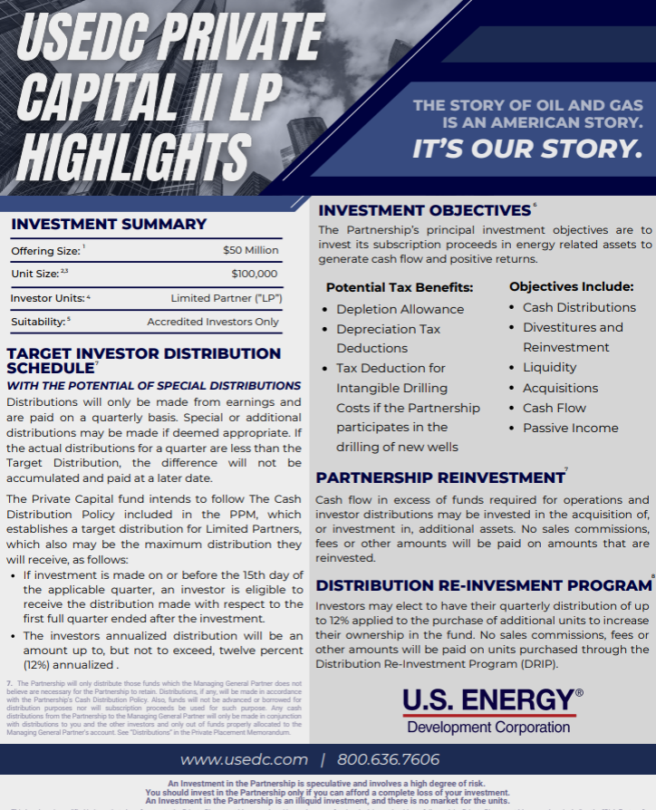
USEDC Private Capital II LP
2024 Structural Evolutions:
Compounded Returns (DRIP)
Passive Income
Tax Advantaged Income
Choose your yield (up to 12% annualized)
1
2
3
4
Notes:
Slide 23:
Investment Objectives of the USEDC Private Capital II LP Fund
***Information related to “PPM Cover” (cover page), “Description of Units” (page 1), “Investment Objectives” (page 34), “Proposed Activities” (page 56) and “Reports to Investors” (page 100) in the Private Placement Memorandum.
You should review all aspects of the private placement memorandum prior to investing. There is no certainty or guarantee that any or all of the investment objectives will be achieved. The tax benefits of an investment are not guaranteed, tax rates may change in the future which would impact the partnership and investors may be subject to income tax liability in excess of the cash received from the partnership. Distributions are not assured or guaranteed. Information herein is provided as of March 2024 and we undertake no responsibility to provide updated information after this date. See “Risk Factors,” in the Private Placement Memorandum.

Slide 20
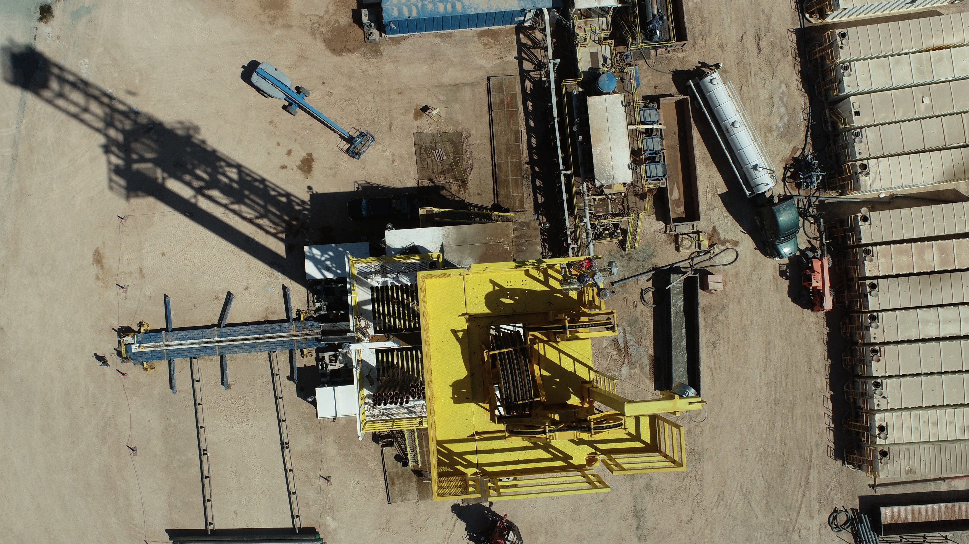

2024 Acquisitions
UNDERWRITING BROKER DEALER: WESTMORELAND CAPITAL CORPORATION
The oil & gas assets shown in this presentation are not owned by the USEDC 2024 Drilling Fund LP, nor are they owned by U.S. Energy or any affiliated partnerships, unless otherwise noted. All assets pictured are representative of the types of assets the USEDC 2024 Drilling Fund LP will target for ownership, unless otherwise noted.
Notes:
Slide 27:
Transition to specific discussion on 2023 Acquisitions
***Template Slide. This slide will continue to be reviewed and updated as new information becomes available.***

Slide 21
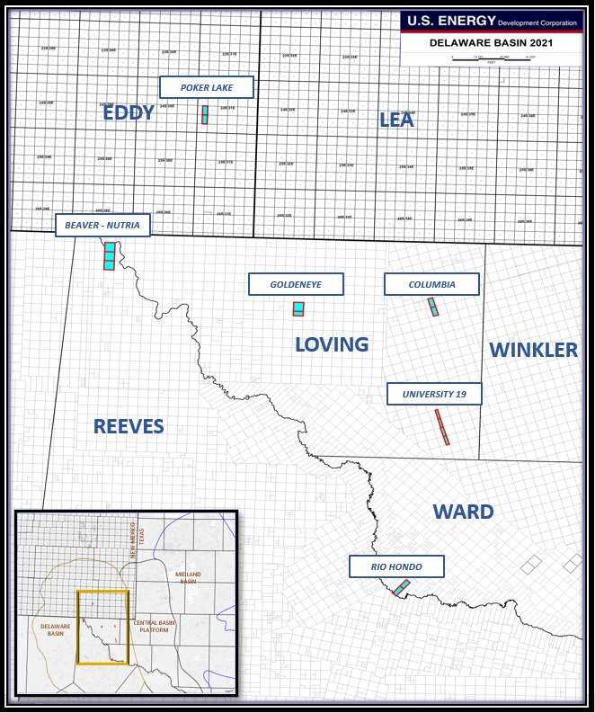
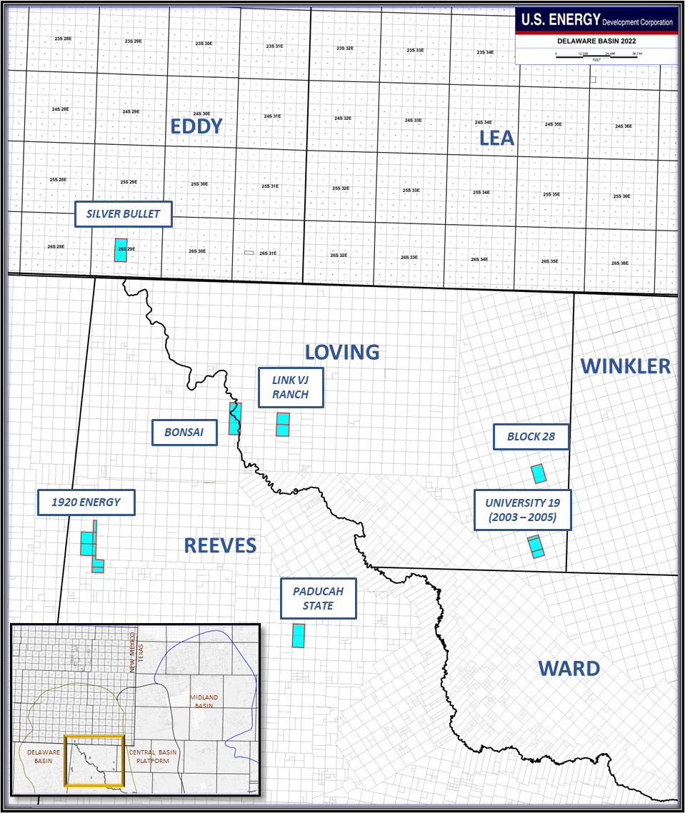
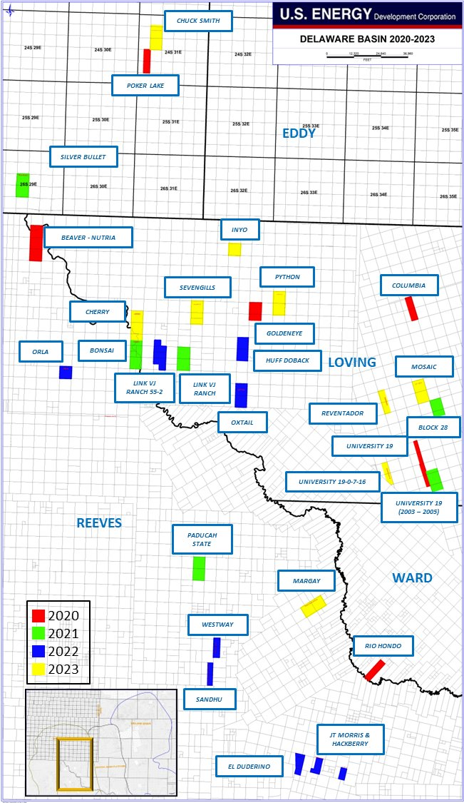
Expanding Permian Footprint
2020
2021
2020 - 2023
  Industry changes have allowed USEDC to gain unprecedented access to projects in Tier 1 acreage​
  Non-Operated: Continue to participate in projects operated by blue-chip E&Ps, many of which deliver immediate cash flow​
Notes:
Slide 31:
U.S. Energy’s Expanding Permian Footprint
The information above depicts U.S. Energy’s growth in activity in the Permian Basin. The prior performance shown is not from wells that will be included in the current offering. Past performance is not a guarantee of future results.
***Information related to “Investment Objectives” (page 34), “Prior Activities” (Page 49) and “Proposed Activities” (page 56) in the Private Placement Memorandum, Template Slide reflecting current operations. This slide will continue to be reviewed and updated as new information becomes available.***

Slide 22
Drilling Fund: Potential investment strategies
General Partners
Limited Partners
High W2 or Bonus Offset
Sale of Business
Roth Conversion Tax Offset
Maximize Qualified Business Income (QBI) Deduction
Required Minimum Distributions (RMDs) Offset
Reduced Valuations for Gifting
Offset Lost Deductions from the TCJA
Offset Self Employment Taxes
Stock Options
Client in Alternative Minimum Tax (AMT)
Net Unrealized Appreciation (NUA)
Offset Medicare Surplus / Net Investment Income Tax
Opportunity Zone Fund Benefits:
    Reduced (potentially eliminated) back-end tax liability
    Higher-Yielding Cash Flow Potential
  Passive Losses / Passive Income Potential
LLC Members
Potential Dividends for Qualified Accounts
Discounting/Roth Conversion Opportunities
The information provided is not tax advice and you should consult your own advisor and/or CPA for specific information. As more fully described in the private placement memorandum, there are significant differences between the types of units that are available; including that owners of general partner units potentially have unlimited liability for events occurring during the drilling phase of the partnership’s wells while limited partner unit owners have limited liability and that intangible drilling cost deductions attributable to limited partner unit owners may only be applied to passive income.
You should review all aspects of the private placement memorandum prior to investing. There is no certainty or guarantee that any or all of the investment objectives will be achieved. The tax benefits of an investment are not guaranteed, tax rates may change in the future which would impact the partnership and investors may be subject to income tax liability in excess of the cash received from the partnership. Distributions are not assured or guaranteed. The amount of an investor general partner’s deduction will be dependent upon the final capital raise from limited partner and limited liability company investors and/or a separate investment entity which will pay some or all of the lease acquisition and/or tangible equipment costs and that all partnership wells are begun by March 31, 2024 and diligently pursued. For limited partners, net subscription proceeds will first be applied to the payment of equipment and lease acquisition costs and accordingly there may be no intangible drilling cost deductions for limited partner investors.
Notes:
Slide 24:
Summary of potential Investment Strategies for different Investment Units.
***Information related to “Summary of the Offering” (page 1), “Investment Objectives” (page 39), “Proposed Activities” (page 74) and “Tax Aspects” (page 112) in the Private Placement Memorandum. You should review all aspects of the private placement memorandum prior to investing. When considering an investment in and oil & natural gas partnership, there are several important features to review. The list above is not intended to review all investment features. Investment features will differ from program to program and sponsor to sponsor and you should review all aspects of the private placement memorandum. Past performance is not indicative of future results. Template Slide reflecting current information. This slide will continue to be reviewed and updated as new information becomes available.***
The information provided is not tax advice and you should consult your own advisor and/or CPA for specific information. As more fully described in the private placement memorandum, there are significant differences between the types of units that are available; including that owners of general partner units potentially have unlimited liability for events occurring during the drilling phase of the partnership’s wells while limited partner unit owners have limited liability and that intangible drilling cost deductions attributable to limited partner unit owners may only be applied to passive income.
You should review all aspects of the private placement memorandum prior to investing. There is no certainty or guarantee that any or all of the investment objectives will be achieved. The tax benefits of an investment are not guaranteed, tax rates may change in the future which would impact the partnership and investors may be subject to income tax liability in excess of the cash received from the partnership. Distributions are not assured or guaranteed. The amount of an investor general partner’s deduction will be dependent upon the final capital raise from limited partner and limited liability company investors and/or a separate investment entity which will pay some or all of the lease acquisition and/or tangible equipment costs and that all partnership wells are begun by March 31, 2025 and diligently pursued. For Limited Partners, net subscription proceeds will first be applied to the payment of equipment and lease acquisition costs and accordingly there may be no intangible drilling cost deductions for Limited Partner investors.

Slide 23
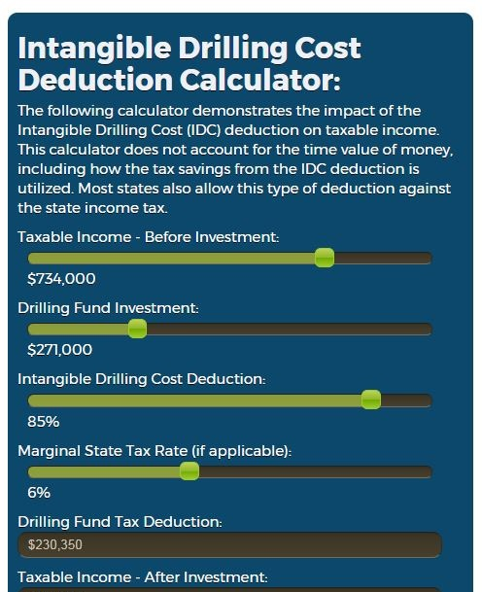
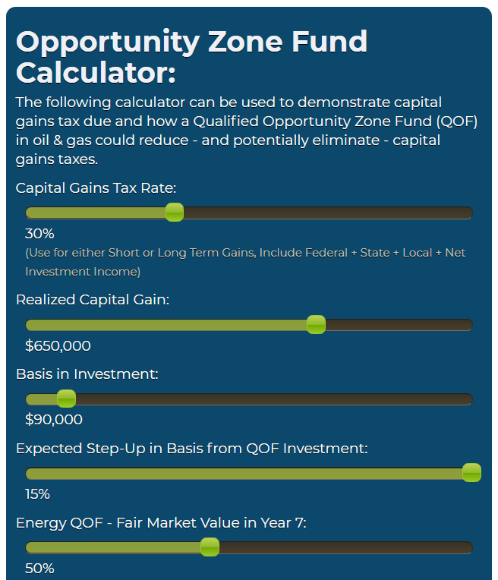
U.S. Energy Resources
Visit U.S. Energy’s Website:
www.usedc.com
(mobile compatible)

Slide 24
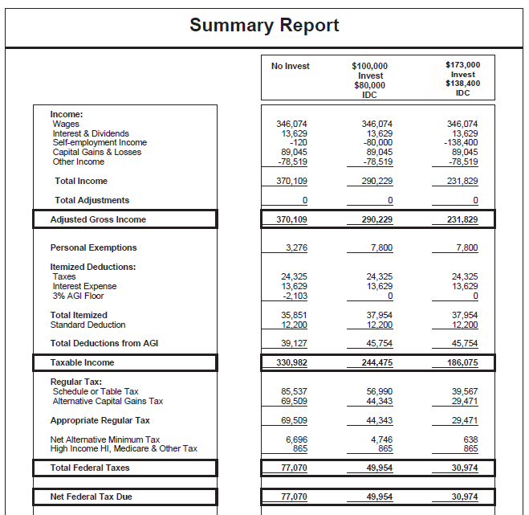
U.S. Energy Resources – 3rd party tax analysis!
Notes:
Slide 32: 3rd Party Tax Analysis Available
***Information related to “Summary of the Offering” (page 1), “Investment Objectives” (page 39), “Proposed Activities” (page 74) and “Tax Aspects” (page 112) in the Private Placement Memorandum. You should review all aspects of the private placement memorandum prior to investing.***

Slide 25

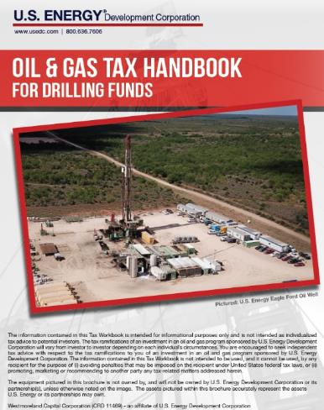
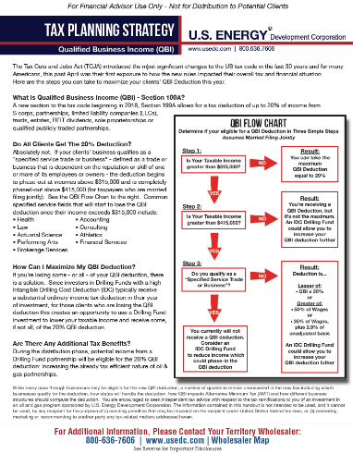
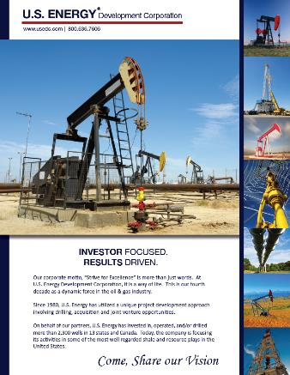
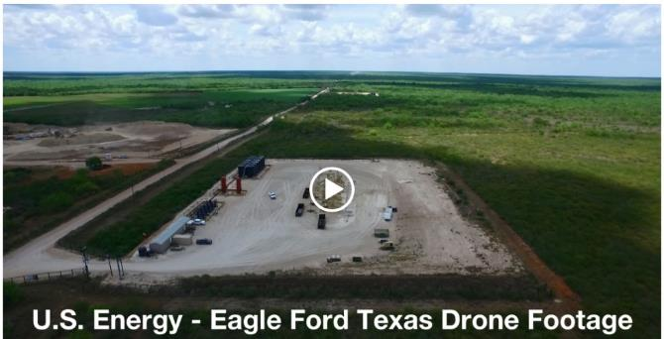

  Oil & Gas Tax Handbook:
  Tax Planning Resources & Whitepapers:
  Investor Materials:
  Online
  Educational
  Videos:

