Slide 1
Cubesat-based Infrared Lunar Astronomy: Water-ice Signatures
Ronald H. Freeman, PhD
Chair, Space Operations & Support Technical Committee, AIAA
Editor-in-Chief, Journal of Space Operations Communicator

Slide 2
Analyses of infrared absorption spectra have identified water and hydroxyl (–OH) absorption bands at ∼3 μm within the lunar surface. Spatial distribution of the –OH signal suggests that water is formed by the interaction of the regolith-embedded solar wind with silicates and other oxides in the lunar regolith. Solar wind H and He are released from grains of the molten lunar-produced glass, after partly reducing the contained FeO to produce water.
Purpose
To explore different water-ice signatures on the moon and the infrared technologies employed in their investigation by prospective cubesat-intended Artemis payloads in the near future ---
1. Lunar Flashlight
2. Lunar IceCube
3. Lunar-H Mapper.
Method
A literature review of infrared findings of lunar characteristics was summarized to include challenges of their respective data collection. Inferences from the findings were elaborated, suggesting additional objectives for further investigation into lunar water-ice signatures. Infrared technologies being developed were described as payloads for prospective cubesat or rover deployment on the moon were described.

Slide 3
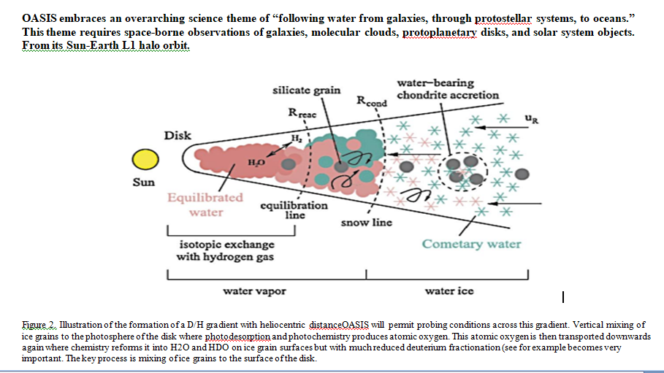
Notes:
Orbiting Astronomical Satellite for Investigating Stellar Systems (OASIS) is a mission concept being developed in preparation for the 2021 MidEX Announcement of Opportunity

Slide 4
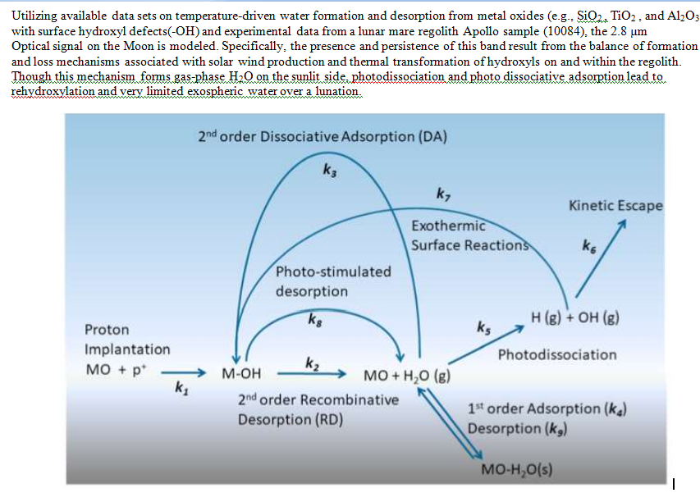
Chemical Kinetics Model: Solar Wind-induced Water Cycle

Slide 5
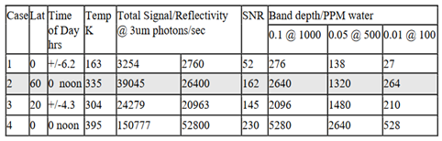
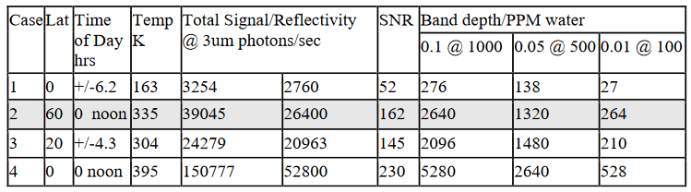

Slide 6
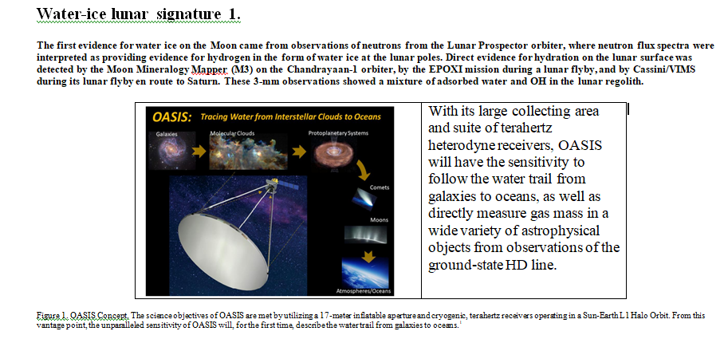

Slide 7
Measuring H₂ Abundance on Lunar Surface to Infer H₂ O Presence
Inversing water ice from neutron data (Neutron Spectrometer)
The cosmic rays of the Milky Way interact with the surface of the moon to generate a stream of neutrons.
After a series of elastic or inelastic collisions with the nucleus of lunar surface agglutinates, neutrons form a balanced energy spectrum on the lunar surface distribution.
Hydrogen atoms and neutrons have the same mass, so the superthermal neutrons are the most sensitive to the existence of hydrogen. If the hydrogen abundance in a certain area is high, the hyperthermal / fast neutrons (0.5eV< Energy <0.5 MeV) loses energy and becomes thermal neutrons (< 0.5eV). So,
Neutron spectrometer determines H₂ Abundance by measuring the decrease in the flux of superthermal neutrons and the increase in the flux of thermal neutrons.
The superheated neutron flux is inversely proportional to the hydrogen content in the region. Scientists rely on this to determine the hydrogen abundance on the moon's surface, and then use the hydrogen abundance to vaguely judge the water ice content in the region.

Slide 8
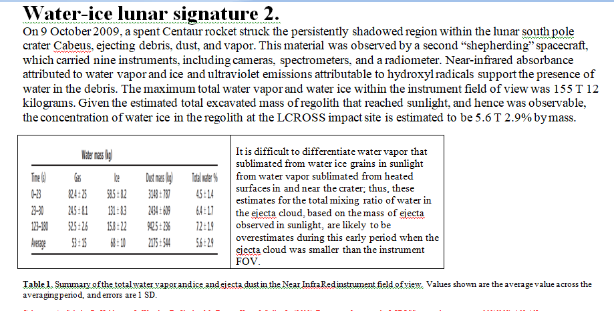

Slide 9
Lunar Polar Hydrogen Mapper (LunaH-Map) | To produce a high-resolution map of the Moon’s bulk water deposits, unveiling new details about the spatial and depth distribution of potential ice previously identified during a variety of missions. | The Miniature Neutron Spectrometer (Mini-NS) uses a set of CLYC scintillators to detect neutrons and has a gadolinium shield to provide sensitivity primarily to neutrons above 0.5 eV.
Lunar InfraRed Imaging (LunIR) | To collect data about the lunar surface: --material composition --thermal signatures -- presence of water. LunIR’s infrared sensor will map the Moon during both day and night and can collect data at much higher temperatures than similar sensors per innovative micro-cryocooler technology (t0 -234 degrees F).. | Minerals such as pyroxene, plagioclase, olivine, and ilmenite, in different sizes and shapes, constitute most of the lunar surface rocks. They have distinctive spectral characteristics in the Visible and Near-infrared (VIS/NIR) wavebands.
Lunar IceCube | To prospect, locate, and estimate amount and composition of water ice deposits on the Moon | BIRCHES, Broadband InfraRed Compact, High-resolution Exploration Spectrometer to characterize and distinguish important volatiles (water, H2S, NH3, CO2, CH4, OH, organics) and mineral bands, BIRCHES has the high spectral resolution (5nm) and wavelength range (1 to 4μm) needed to distinguish phase states of water.
Lunar Flashlight | To explore, locate, and estimate size and composition of water ice deposits on the Moon | To carry an active multi-band reflectometer to measure the reflectance of the lunar surface from orbit near water ice absorption peaks.
OMOTENASHI (Outstanding MOon exploration TEchnologies demonstrated by NAno Semi-Hard Impactor) | Small spacecraft and semi-hard lander of the 6U cubesat format that will demonstrate low-cost technology to land and explore the lunar surface.
Lunar Compact Infrared Imaging System (L-CIRiS) | Includes a radiometer determining the thermal stability of volatiles based on temperature measurements. | To determine the presence and abundance of water ice and other volatiles on lunar surface and subsurface.

Slide 10
CLPS Payloads for 2022
Company
Payload Instruments
Peregrine and Griffin Landers (Astrobotic Technologies)
Nova - C lander (Lockheed Martin Space)
XL-1 lander (Masten Space Systems)
Genesis/ Blue Ghost lander (Firefly Aerospace)
Linear Energy Transfer Spectrometer, to monitor the lunar surface radiation.
Magnetometer, to measure the surface magnetic field.
Low-frequency Radio Observations from the Near Side Lunar Surface, a radio experiment to measure photoelectron sheath density near the surface.
A set of three instruments to collect data during entry, descent and landing on the lunar surface to help develop future crewed landers.
Stereo Cameras for Lunar Plume-Surface Studies is a set of cameras for monitoring the interaction between the lander engine plume and the lunar surface.
Surface and Exosphere Alterations by Landers, another landing monitor to study the effects of spacecraft on the lunar exosphere.
Navigation Doppler Lidar for Precise Velocity and Range Sensing is a velocity and ranging lidar instrument designed to make lunar landings more precise.
Near-Infrared Volatile Spectrometer System, is an imaging spectrometer to analyze the composition of the lunar surface.
Neutron Spectrometer System and Advanced Neutron Measurements at the Lunar Surface, are a pair of neutron detectors to quantify the hydrogen -and therefore water near the surface.
Ion-Trap Mass Spectrometer for Lunar Surface Volatiles, is a mass spectrometer for measuring volatiles on the surface and in the exosphere.
Solar Cell Demonstration Platform for Enabling Long-Term Lunar Surface Power, a next-generation solar array for long-term missions.
Lunar Node 1 Navigation Demonstrator, a navigation beacon for providing geolocation for orbiters and landing craft.

Slide 11
Thank you,
ronald horacefreeman@gmail.com

