Slide 1
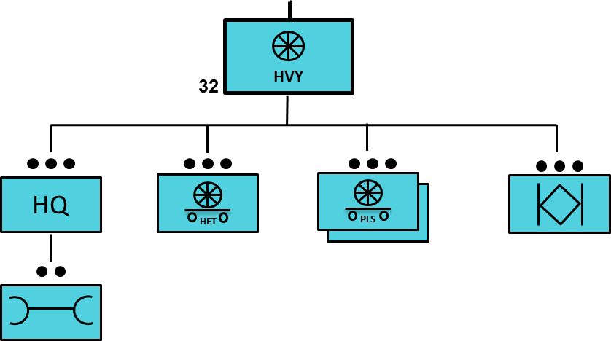
32 CTC(H) Capabilities
Manning (FY20)
 | Auth.
Officer | 6
Warrant | 1
NCO | 108
Soldier | 151
Total | 266
Mission Statement: Perform Transportation and convoy security support to Sustainment Brigade operations for a Heavy Division. Provides transportation assets for the movement and distribution of dry and refrigerated containerized cargo, general non-containerized cargo, ammunition, bottled water, bulk water (when equipped with tank racks/hippos), heavy equipment, tanks and oversized loads. Performs unit moves, transports personnel, and provides escort services for contracted trucks.
Headquarters / Operations Section: Provides C2 for units operations and implement specialized operations to include: HR support, communications, unit supply and CBRN. Coordinates, dispatches, maintains visibility and forecasts requirements in support of installation support.
Maintenance Section: Provides supervision, and technical guidance to maintenance teams performing field maintenance. Provides personnel and equipment to perform field maintenance on wheeled vehicles and utilities equipment organic to the unit, maintain records, reports, prescribed load lists, logbooks, and provide internal refueling and recovery support for vehicles and equipment organic to the company.
HET Platoon: 18 x M1070 w/ M1000. The Heavy Equipment Transporter System (HETS) can load 140,000lbs can support single push capacity of 18 x armored tank/vehicles.
PLS Platoon: 40 x M1075 w/ M1076. Provides transportation assets for the movement and distribution of dry and refrigerated containerized cargo, general non-containerized cargo, ammunition, bottled water, and bulk water/fuel (when equipped with hippos/modular fuel system tank racks).
MATV Platoon: 20 x MATVs with 6x CROW Systems provide convoy protection for internal transportation support missions. Annual requirement for Sustainment Gunnery through Table VI is required for certification.
Total Unit Capability: 494.4 break-bulk general STON, 1,097.2 break-bulk AMMO STON, 1,040 Pallets, 200 463L Pallets, 80 TEU, 160,000 Bulk Water GAL, 200,000 Bulk Fuel GAL, and 18 x armored tank/vehicles.
Notes:
Utting, Jacob 2LT in July 2020
Designed to support armored divisions the CTC (Heavy) consists of 40 PLS trucks and 40 PLS trailers, 18 HET systems, 20 MTV Cargo trucks and 20 trailers and 20 Mine Resistant Ambush Protection Vehicles.
This company performs transportation and convoy security support to sustainment brigade operations for a heavy division.
It provides transportation assets for the movement and distribution of dry and refrigerated containerized cargo, general non-containerized cargo, ammunition, bottled water, and bulk water (when equipped with tank racks/hippos).
The CTC assists with unit moves and transports heavy equipment, tanks, and oversized loads. It may also provide security escort for contracted trucks.
This company is employed in the brigade and division area of operations. It is capable of conducting both line haul and local haul missions in all threat environments.

