Slide 1
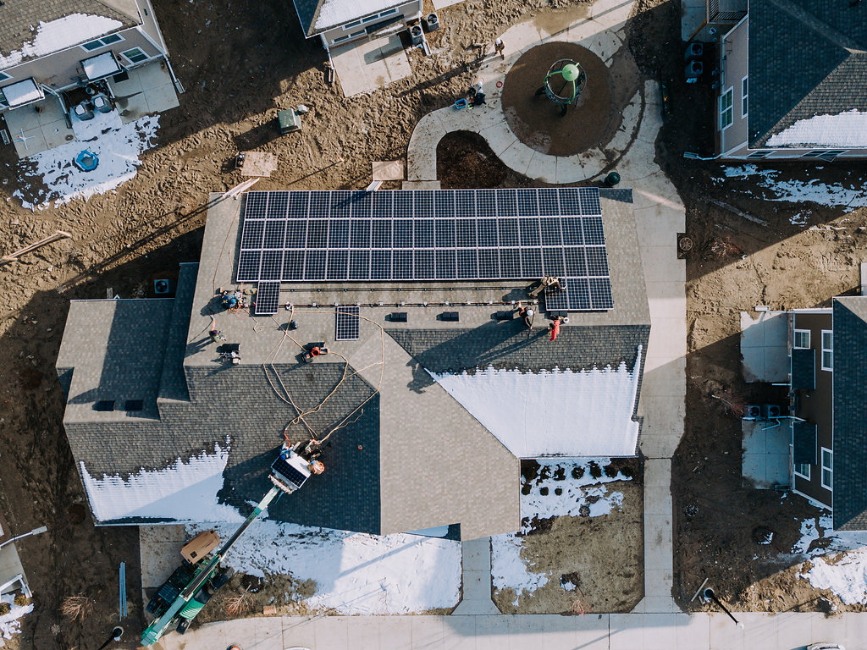
Notes:
Steve
So cool to see so many old friends and new friends on the call tonight.
I’m Steve Mulder. MI Regional Organizer for the Climate Witness Project and Officer and Board member of the Solar Faithful
Here to
Tell you a little about who Solar Faithful is, and how we cam to be.
Understand the offering at a high-level (there are many ways to finance and install a solar project. Ours is one way for you to consider
This is our first webinar. We plan to do these on a regular basis. Bear with us if everything doesn’t flow perfectly.
1 hour
40 minutes of presentation
20 minutes Q&A
Type questions into the chat or hold to the end for the QA
Stay muted
We will mute anyone as needed (Barking Dogs, etc)
My email address is in the chat and will be on the last slide. Feel free to email me and will send you the recording of this webinar, the slides, example spreadsheets, and answer or direct follow up questions.
Link to interest form is in the chat

Slide 2
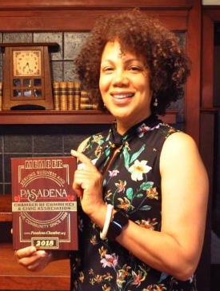
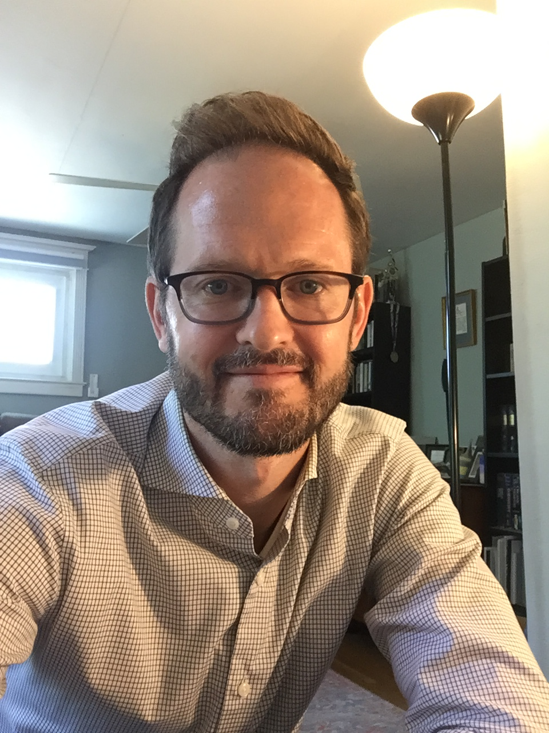
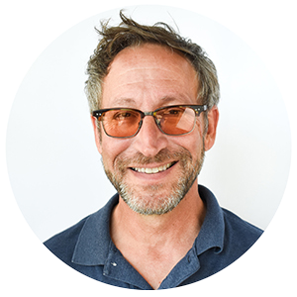
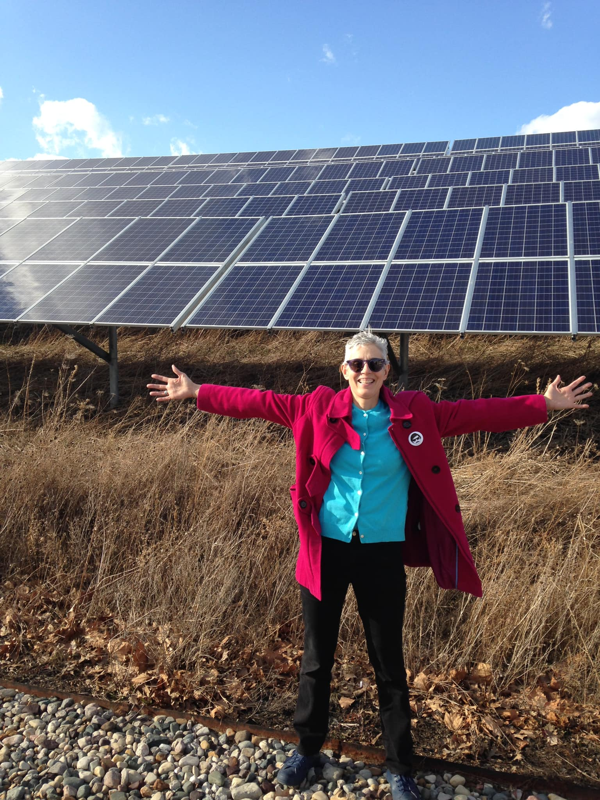
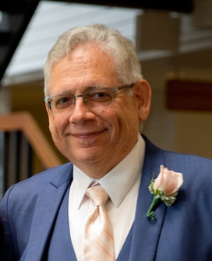
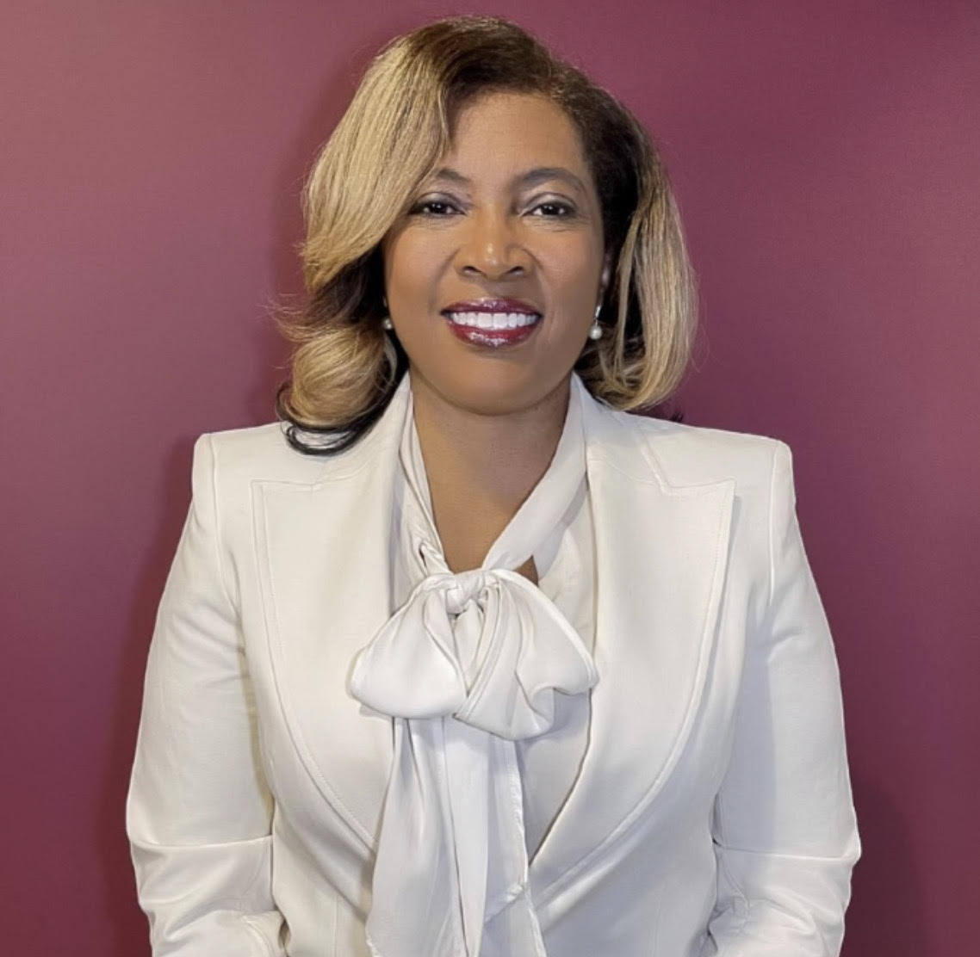
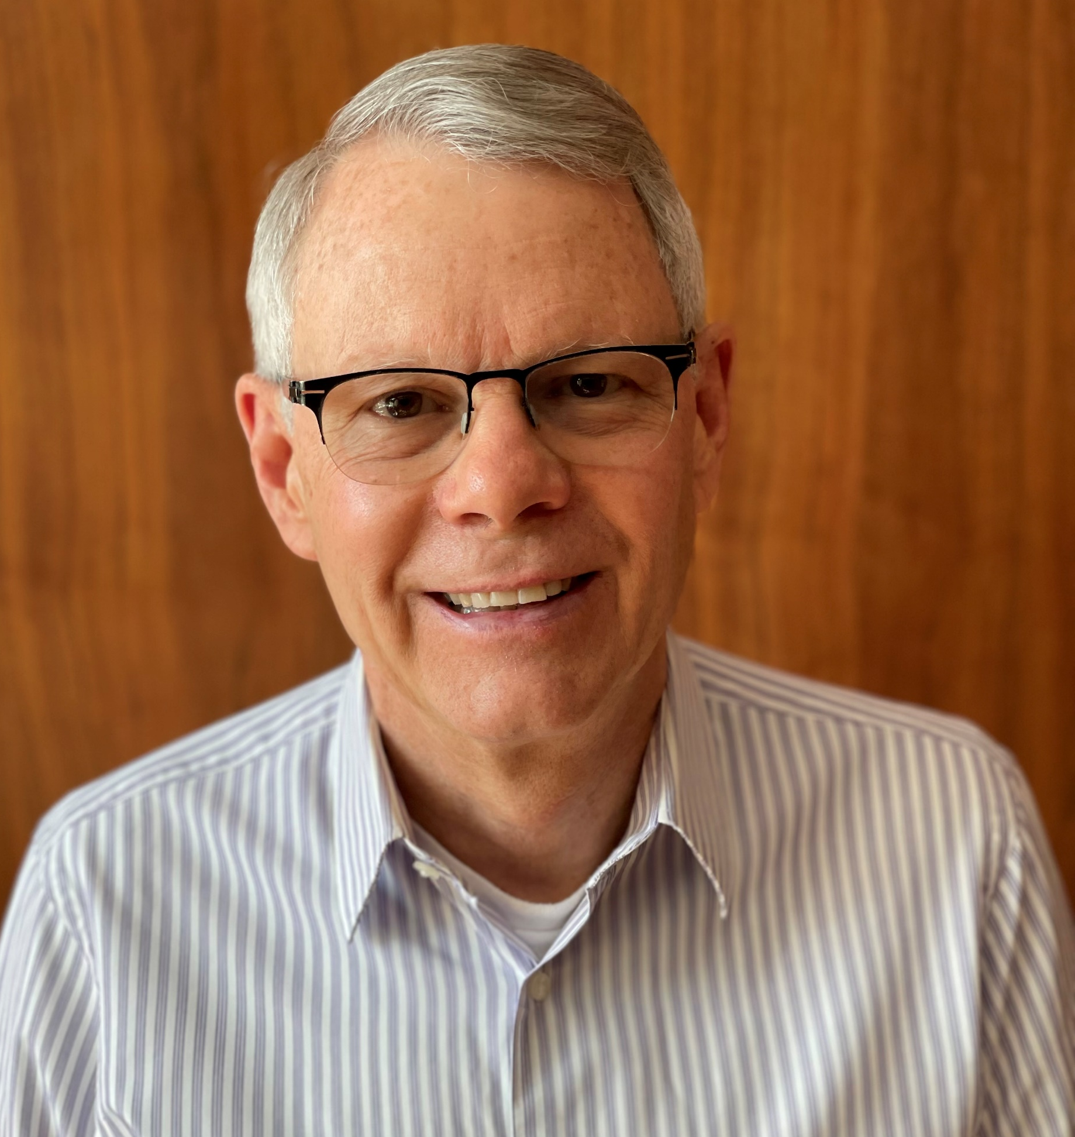
Who we are
Donna Lee
Steve Mulder
Rob Rafson
Allen Drew
Diane Cheklich
Murray Rosenthal
Pamela Pugh
Jennifer Young
John Mirsky
Notes:
Steve
Solar Faithful is a 501©(3) created and supported by 3 non-profits, one solar developer and an impact investor
These are the Board Members
On this call are: Allen Drew (Philadelphia), Donna Lee (Los Angeles), Jennifer Young (Ferndale), John Mirsky (Ann Arbor), Murray Rosenthal (Ann Arbor), Rob Rafson (Muskegon), Steve Mulder (Grand Rapids), Not on the call: Diane Cheklich (?), Diane Van Buren (?)
We come from different organizations, backgrounds, faith traditions, and communities, with many years experience in different aspects of renewable energy
First we will tell you a little about these organizations, and how and why we came together to create Solar Faithful

Slide 3
The “original” Solar Faithful
Notes:
Steve
Our organizations are located in different parts of the state of Michigan.
SunWealth is located in Massachusetts
Let’s look a little closer at these organizations that stand behind Solar Faithful…

Slide 4
A project of the CRCNA and World Renew
Engage with congregations working to mitigate the worst impacts of Climate Change working in 4 areas:
Worship
Education
Energy Stewardship
Advocacy
US and Canada
1,500 Partners
350 Congregations
25 denominations
Bethany CRC, Gallup, NM
Notes:
STEVE
CWP Representative:
Introduces CWP
Half a dozen CWP congregations have run capital campaigns and installed solar
tells story of Bethany
Search for collaborators started with meeting with CHE in 2017 ending with MIPL Conference where Steve learned about Solar Faithful
Introduced MIPL Rep (Jennifer Young)
Put link to Partner sign up in the chat

Slide 5
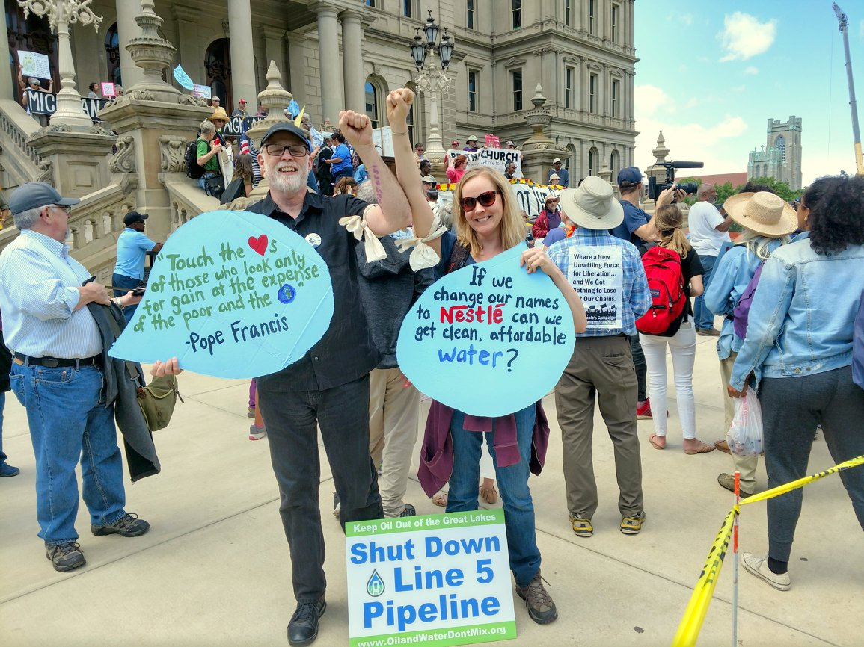
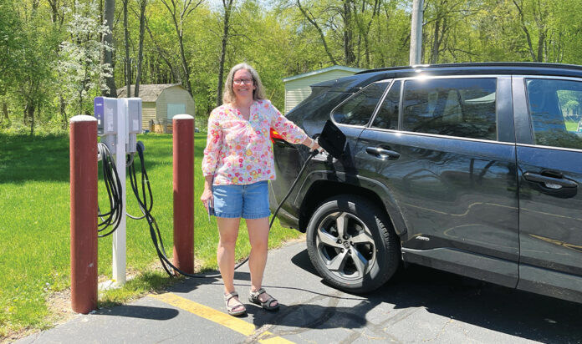
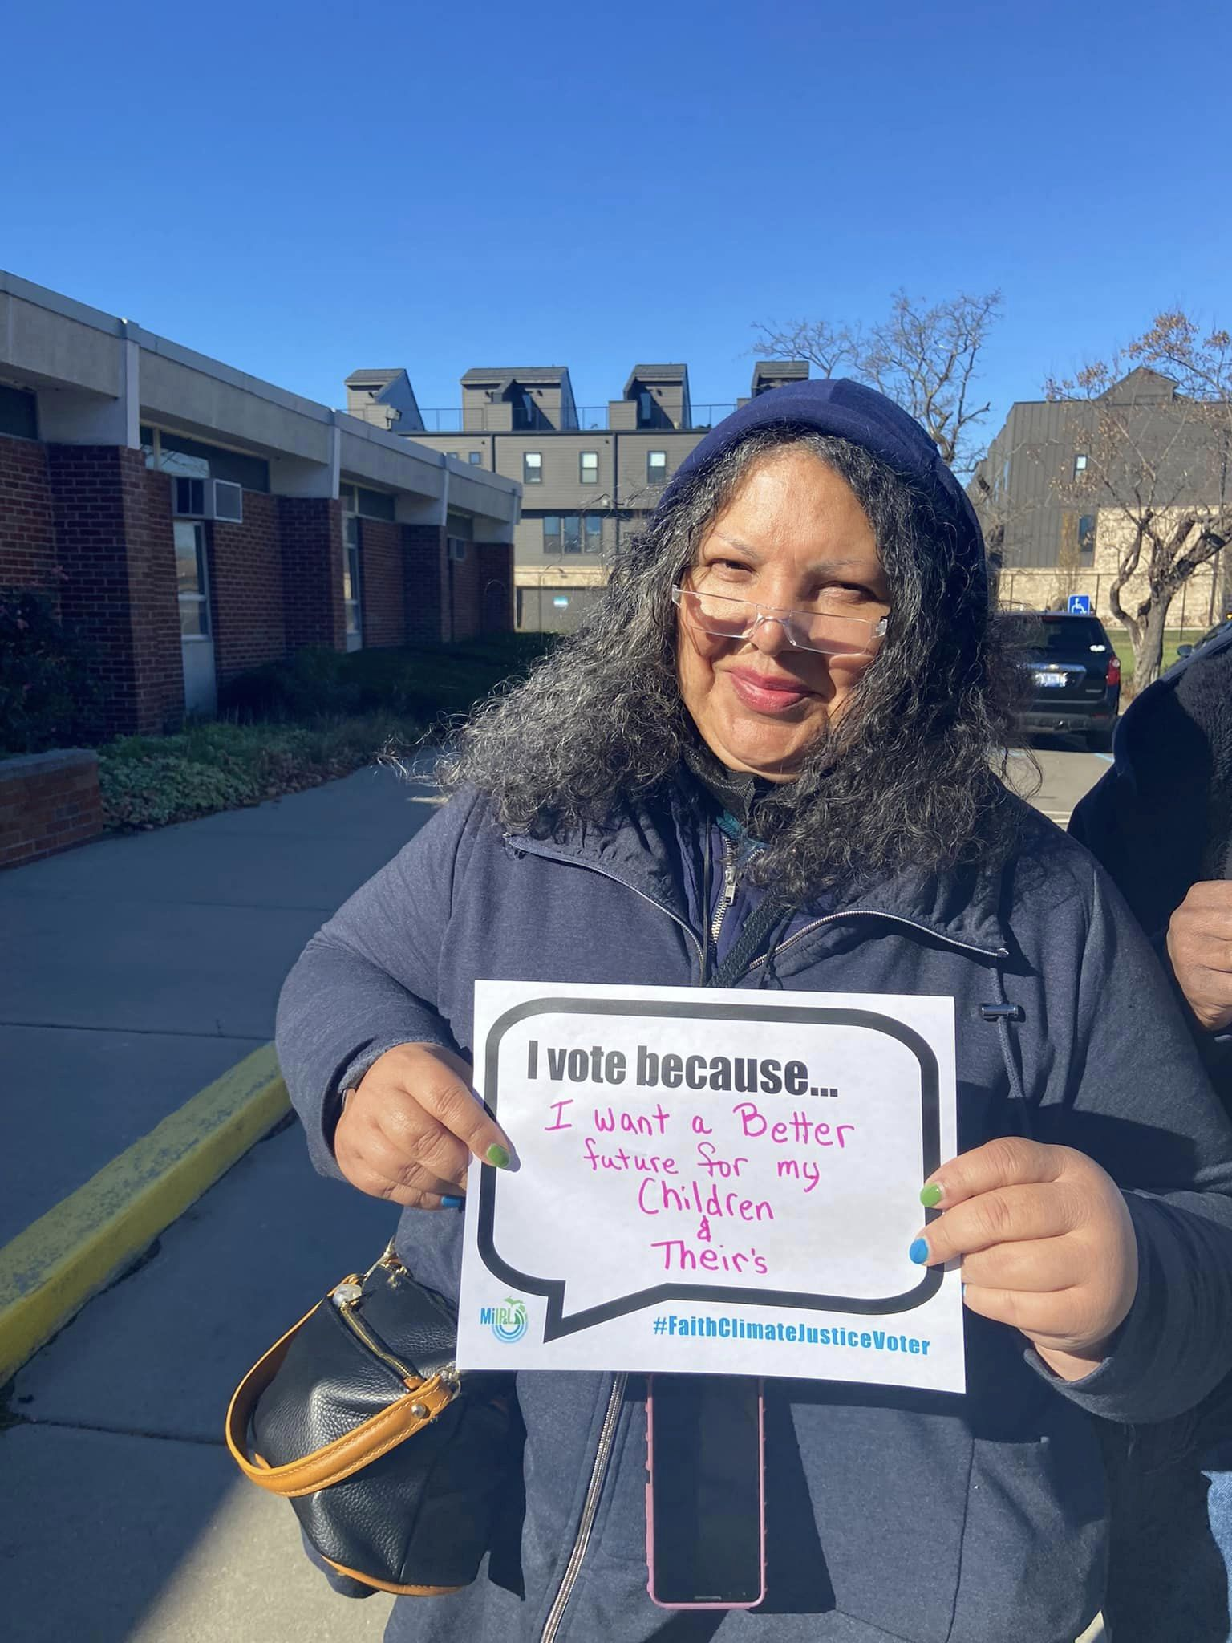
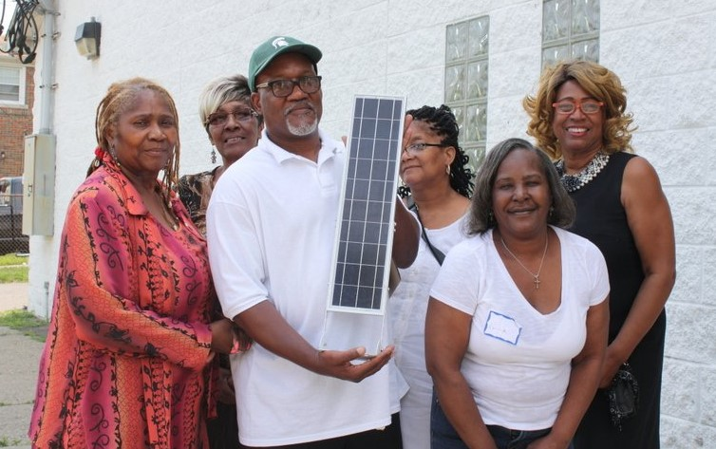
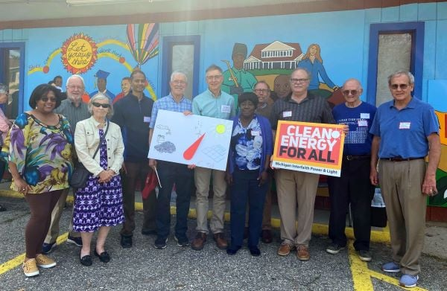
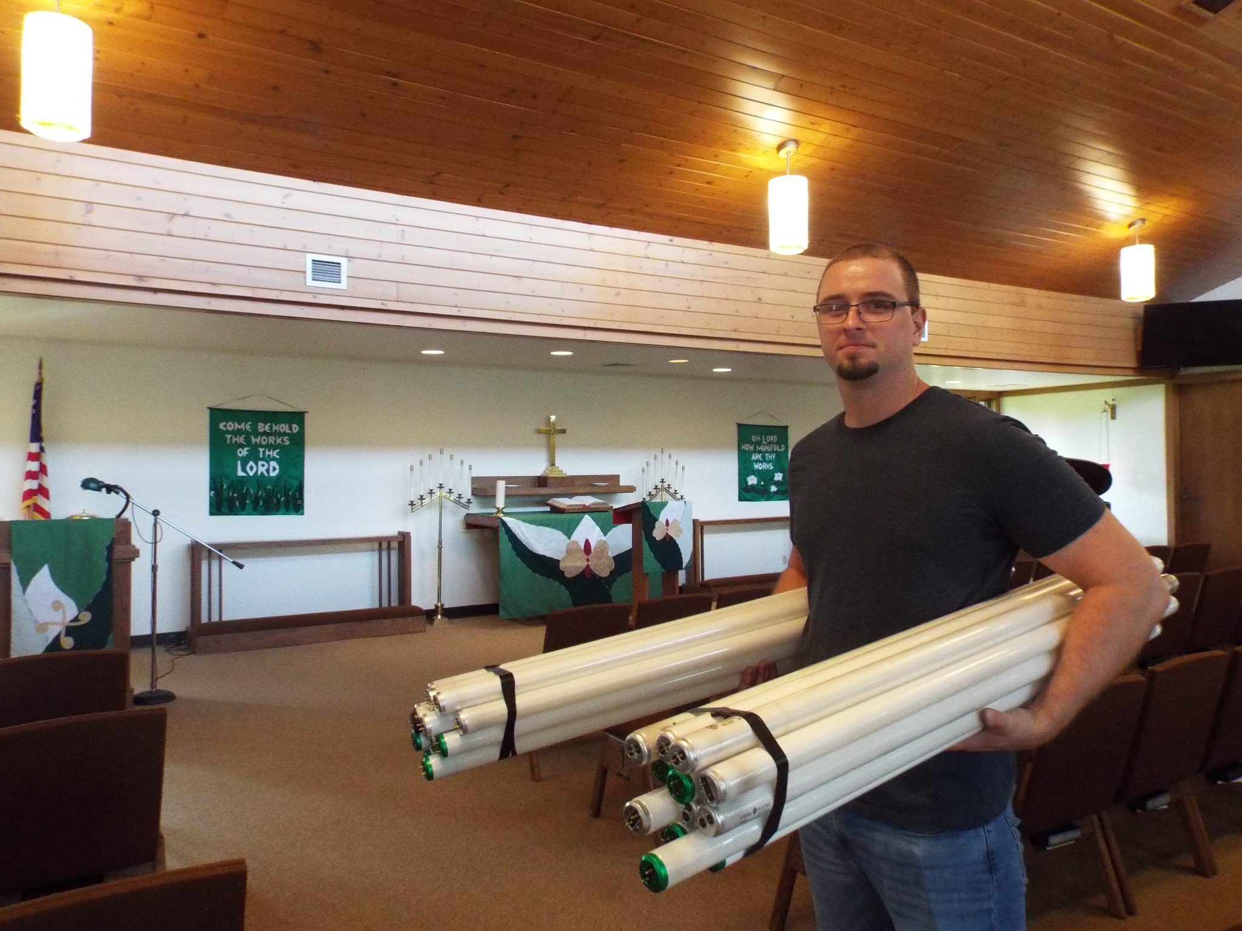
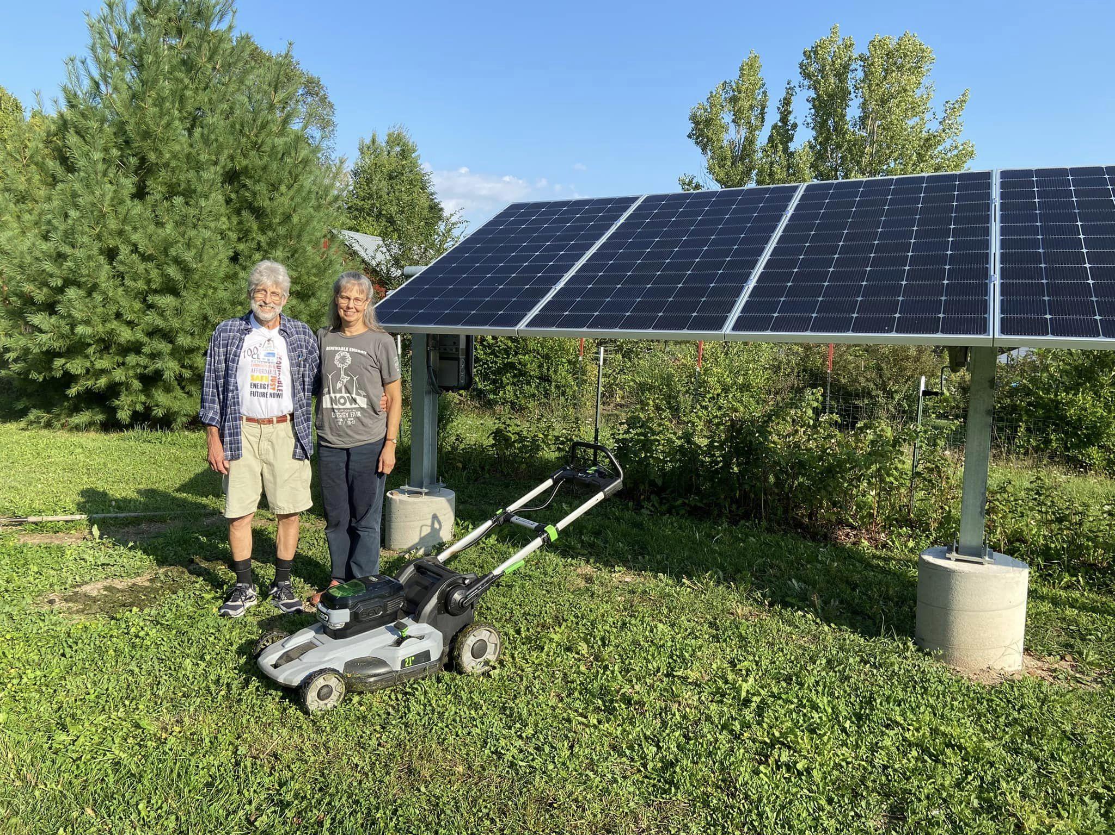
Notes:
Jennifer

Slide 6
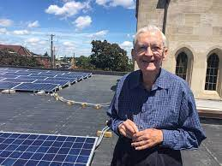
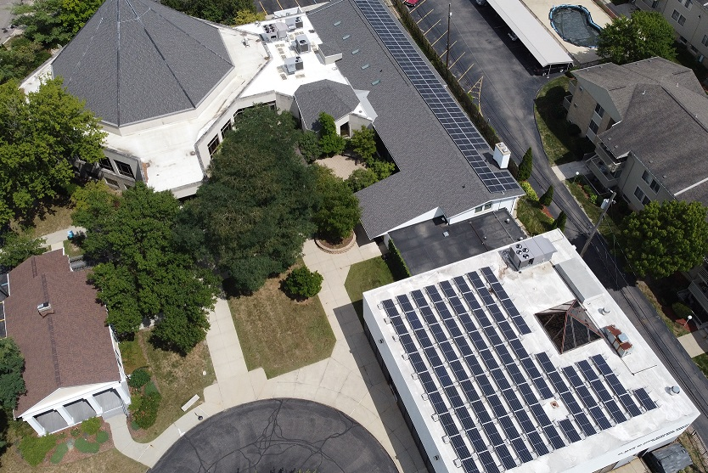
The “original” Solar Faithful
First UMC Ferndale, MI
“Genesis”, Ann Arbor, MI
Notes:
Murray
Original SF Representative:
Introduces Original SF
tells a solar story
Introduces CHE Rep
Solar Faithful was launched in late 2017 (by Jane Vogel) as a partnership between Ann Arbor and Michigan IPL with a small Department of Energy (DOE) grant. The goal was to come up with a scalable model for solar among houses-of-worship (HoW’s). A number of (eight) solar installations have been completed in the southeast Michigan area primarily using an ‘investor model’ (PPA),

Slide 7
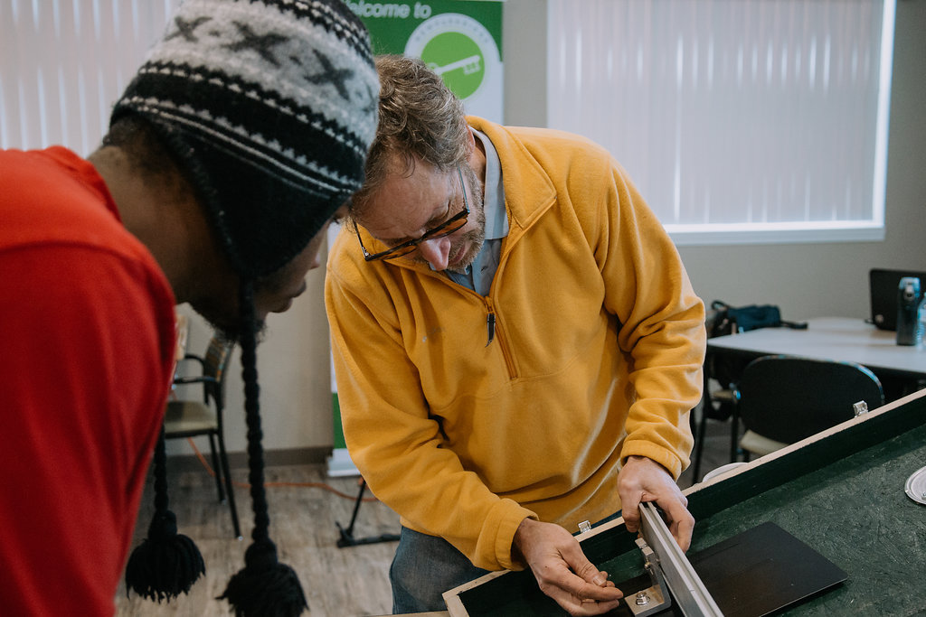
Solar Developer honest, respectful service since 2009
Help low-income to participate in energy transition
Job training
Low-income and non-profit projects
US made, local components and labor
Develop projects as if we will own every system
Notes:
Rob
CHE Representative:
Introduces CHE
tells a Solar Story
Tells of the 4 organizations coming together
Birth of SF 501c3

Slide 8
The “original” Solar Faithful
Notes:
Rob

Slide 9
Our Mission: Solar Faithful aims to increase solar access among houses of worship and faith-based nonprofits by offering multiple clean energy adoption models to equitably and faithfully lead the clean energy revolution. Striving to build a more inclusive movement for climate justice, Solar Faithful offers green job training in the trades by creating economic opportunities in communities where solar arrays are installed.
Notes:
Rob
Summarize our Mission. Do not read word for word
Introduce John

Slide 10
Why Solar with
Notes:
John
Why should your HoW or religious nonprofit consider installing solar though Solar Faithful?
We think there are seven compelling reasons.

Slide 11
The Moral Imperative
All faith traditions call us to care for the creation, future generations, and the world’s most vulnerable.
When your congregation installs solar you help:
Decrease greenhouse gas emissions (GHG)
Reduce acid rain
Reduce particulate pollution*
Reduce health impacts
Promote environmental justice
* EPA Criteria Air Pollutants including particulate pollution and harmful gases
Notes:
John
First and foremost, we think there is a moral imperative for action.
As we all know, solar power replaces so-called “gray power” which includes electricity generated by the burning of fossil fuels. That combustion generates pollutants which frankly is atmospheric sewage.
One component of that sewage is greenhouse gases, like CO2 and methane. GHGs are the primary driver of climate change.
The other pollutant group is known as “EPA Criteria Pollutants” such as Sulphur oxides, Nitrogen oxides and fine particulates, which is the soot you see coming from power plant (and other sources like diesel trucks). These pollutants negatively impact human and ecological heath, and also contribute to acid rain.
Reducing these pollutants is a moral imperative and environmental and climate justice issues because power plants are generally located near BIPOC and low-income neighborhoods.

Slide 12
Commitment to Inclusion and Environmental Justice
We are helping to “write a new story” that includes all faith traditions, economic levels, and ethnic/racial groups in a just energy transition
50% of participants will be predominantly BIPOC, other than Christian, and/or low income
We do business only with ”B Corporations” and others that share our values and practices
We pay prevailing wages to installers and repair persons
Notes:
John
Second, Solar Faithful is committed to inclusion and environmental justice.
We are focused on serving all faith traditions and ethnic and racial groups in a just and equitable way as a part of the energy transition. Indeed, our objective is half of our installations will benefit entities serving BIPOC or low-income populations.
For example, we have been deliberate about doing business with “B Corporations” otherwise known as Benefit Corporations which balance profits, people and the planet and entities that share our values and practices.
We are also committed to pay prevailing wages to installers and maintenance personnel.
Finally, we are actively seeking a more diverse board of directors.
We fundamentally believe in win-win outcomes for all stakeholders.

Slide 13
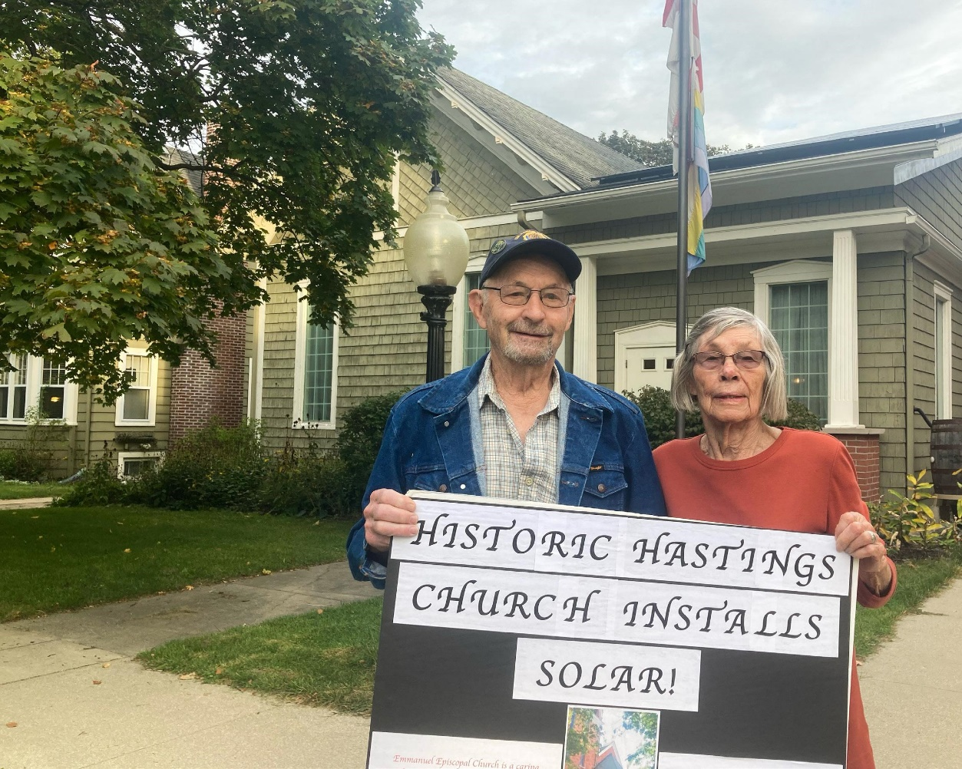
Bearing Witness
You action will inspire your members, neighbors and other congregations
Notes:
John
The third reason to install solar though Solar Faithful is that you action will bear witness. Indeed, we know from the social sciences and research that installing solar inspires members, neighbors and other congregations to do the same.
This multiples the benefits to human health and the environment and helps mitigate climate change.

Slide 14
It’s Easy!
Solar Faithful provides a turnkey system. No need for:
Technical expertise
Financial resources or
expertise
Maintenance
Notes:
John
Fourth, it’s easy!
If your organization has the resources to go it alone, that’s great!
However, if you don’t have:
Technical expertise
The time vet installers
The time to gather multiple quotes or
The ability to raise money or carry the financial risk …
… then install solar though Solar Faithful!
Why go it alone when Solar Faithful has all of those resources and our team has long individual track records of serving local communities, being trustworthy and not motivated by profits.

Slide 15
Save Money
Your congregation will free up money for activities that support your mission:
$0 up-front cost and thus no fundraising
Start with 10% off your utility bills
Notes:
John
Fifth, your HoW or nonprofit will save money. That frees up funds for activities that more directly support your core mission.
While we recognize your primary motivation may not be cost savings, no one like to spend more money on utilities than is needed. Moreover, why provide revenue to investor-own utilities’ whose sole fiduciary responsibility is to maximize profits for its share holders?
The Solar Faithful program:
Requires no up-front investment and
The energy produced on the panel Solar Faithful installs will be provided at a 10% discount to the rate you are paying your utility.
Later in the presentation, we’ll tall you how this savings is expected to increase through the life of the contract.

Slide 16
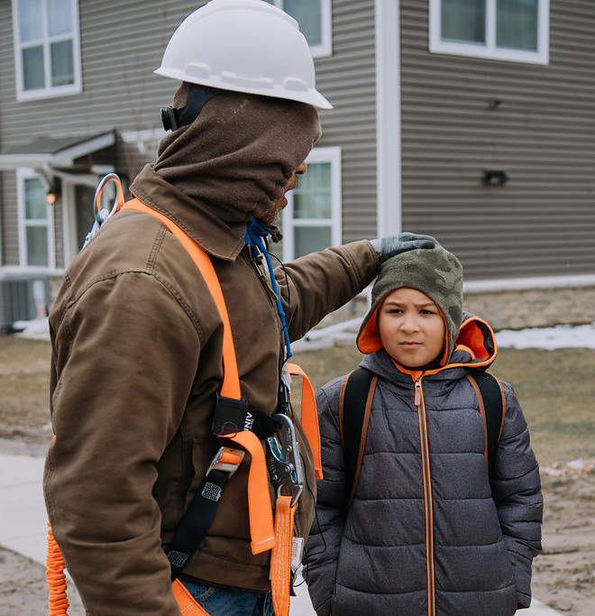
Career Training
Job training will help underserved communities participate in a just energy transition
Notes:
John
Sixth, the Solar Faithful model provides career training targeted at members of underserved communities enabling those workers to participate in a just energy transition and secure a brighter future for their families and neighbors.

Slide 17
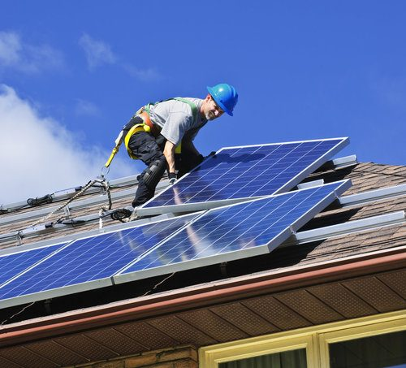
Address Roof Concerns
The panels can be removed and reinstalled one time at no cost to the congregation during the life of the contract.
Notes:
John
Finally, Solar Faithful will inspect your roof.; if it needs repair or replacement now, we will point that out and help you work through your options and how to access potential incentives.
Moreover, if your roof needs to be repaired or replaced during the 25-year contract period, the Solar Faithful contracts provides for one-time removal and reinstallation of the panels and racking. That provides real peace of mind.
We hope that all or at least some of the seven reasons I just outlined resonated with you and that you will seriously consider exploring next steps with Solar Faithful.
I’m now going to hand things off to Rob Rafson who will outline in detail how our program works.

Slide 18
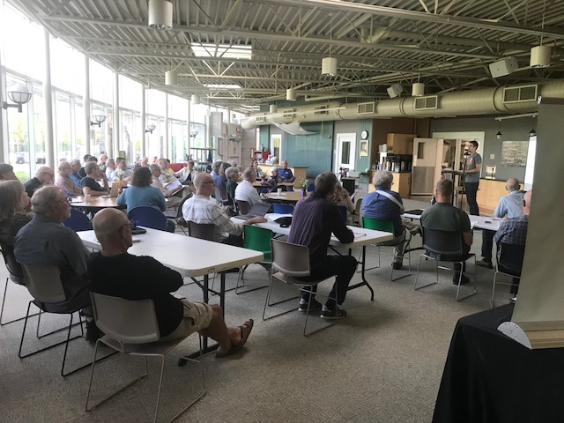
Join the Solar Faithful Community
We Look Forward to:
Webinars
Newsletter
Learning from each other
Celebrating together
On-site meetings/ presentations
Notes:
John
Introduce Rob

Slide 19
Coming Soon!
Renewable Energy and Efficiency/Electrification
Notes:
John
Back to Rob…

Slide 20
How it Works
Notes:
Rob

Slide 21
Two options:
1) Direct Purchase:
Parties sign purchase agreement
Parties sign loan agreement with Michigan Saves or other lender
Chart House Energy installs array
Congregation realizes savings from power produced
Congregation uses savings and federal incentives to pay off loan
Notes:
Rob

Slide 22
2) Power Purchase Agreement (PPA):
Congregation signs PPA
Chart House Energy installs array
Congregation starts producing clean solar power
Solar Faithful guarantees that power purchase will not exceed savings
Congregation pays 10% less than the utility rate for the power produced and expected to increase over time
Solar Faithful maintains equipment
Congregation can buy the panels at “fair market value” during the contract period
At the end of the contract, the congregation:
Renews the contract,
Assumes ownership of the array at no cost, or,
Requests that the panels be removed at Solar Faithful’s expense
Notes:
Rob
Re Introduce Steve

Slide 23
Typical HoW Power Situation
$
Utility
Notes:
Steve
I can’t understand anything, unless I can draw a picture of it. Here is the picture that was helpful to me. It may be helpfue to you.
Most congregations simply buy electricity from the utility that serve their area. At the price set by the utility.
One result is high cost and high levels of emissions

Slide 24
Solar Faithful PPA
$
$
$
Utility
Notes:
Steve
When you sign a PPA contract with SF:
SunWealth Pays Chart House to install Solar Array
Capacity will be ~ 75% of current usage (don’t want to produce excess energy as it sold into grid for fraction of what you pay when you “buy it back”
You will pay two utility bills
The rate for the energy produced by the panels starts at 10% discount
The discount is expected to grow and is guaranteed to never go above the Utility's rate
You will decrease your contribution to GHG, Particulate, Acid Rain, Environmental injustice and save money
The additional “Burden” on the congregation is:
Sign a PPA
Pay 2 utility bills/month

Slide 25
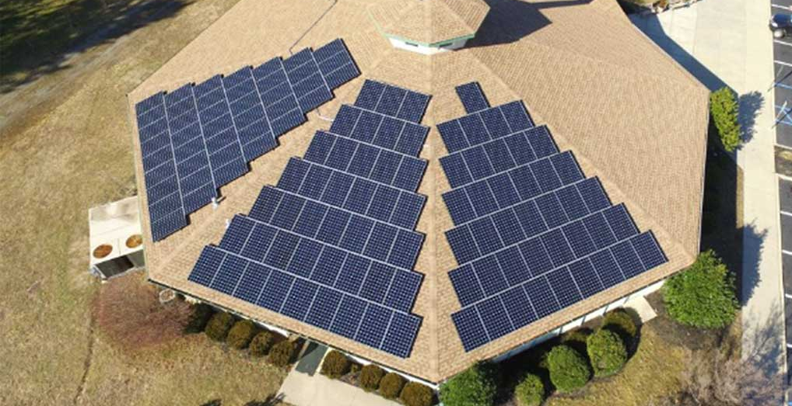
25 kW System Example
Monthly electric bill = $600 ($7,200 annually) paid to utility @ $.18 /kWh (~ 3,333 kWh/Month / 40,000 kWh/Year)
CHE installs a 25kW system expected to provide 75% of the congregation’s electrical needs from about 50 panels
25% of the congregation’s power will continue to come from the utility
Start with 10% discount for energy produced by panels. PPA rate increases 1.5% annually. (Historically, utility rate increases 3.5% annually)
Notes:
Steve
Just an example
All round numbers

Slide 26
Year | Utility Rate (3.5% Annually) | Usage (kW) | Annual Cost
Solar Faithful rate starting @ 90% (+1.5% annually) | Usage (kW) 75% of Need | Annual Cost
Utility Rate (3.5% Annually) | Usage (kW) 25% of Need | Annual Cost
PPA Total Annual Cost
1 | $0.180 | 40,000 | $7,200 |  | $0.162 | 30,000 | $4,860 |  | $0.180 | 10,000 | $1,800 |  | $6,660
2 | $0.186 | 40,000 | $7,452 |  | $0.164 | 30,000 | $4,933 |  | $0.186 | 10,000 | $1,863 |  | $6,796
3 | $0.193 | 40,000 | $7,713 |  | $0.167 | 30,000 | $5,007 |  | $0.193 | 10,000 | $1,928 |  | $6,935
4 | $0.200 | 40,000 | $7,983 |  | $0.169 | 30,000 | $5,082 |  | $0.200 | 10,000 | $1,996 |  | $7,078
5 | $0.207 | 40,000 | $8,262 |  | $0.172 | 30,000 | $5,158 |  | $0.207 | 10,000 | $2,066 |  | $7,224
6 | $0.214 | 40,000 | $8,551 |  | $0.175 | 30,000 | $5,236 |  | $0.214 | 10,000 | $2,138 |  | $7,373
7 | $0.221 | 40,000 | $8,851 |  | $0.177 | 30,000 | $5,314 |  | $0.221 | 10,000 | $2,213 |  | $7,527
8 | $0.229 | 40,000 | $9,160 |  | $0.180 | 30,000 | $5,394 |  | $0.229 | 10,000 | $2,290 |  | $7,684
9 | $0.237 | 40,000 | $9,481 |  | $0.182 | 30,000 | $5,475 |  | $0.237 | 10,000 | $2,370 |  | $7,845
10 | $0.245 | 40,000 | $9,813 |  | $0.185 | 30,000 | $5,557 |  | $0.245 | 10,000 | $2,453 |  | $8,010
11 | $0.254 | 40,000 | $10,156 |  | $0.188 | 30,000 | $5,640 |  | $0.254 | 10,000 | $2,539 |  | $8,179
12 | $0.263 | 40,000 | $10,512 |  | $0.191 | 30,000 | $5,725 |  | $0.263 | 10,000 | $2,628 |  | $8,353
13 | $0.272 | 40,000 | $10,880 |  | $0.194 | 30,000 | $5,811 |  | $0.272 | 10,000 | $2,720 |  | $8,531
14 | $0.282 | 40,000 | $11,260 |  | $0.197 | 30,000 | $5,898 |  | $0.282 | 10,000 | $2,815 |  | $8,713
15 | $0.291 | 40,000 | $11,655 |  | $0.200 | 30,000 | $5,986 |  | $0.291 | 10,000 | $2,914 |  | $8,900
16 | $0.302 | 40,000 | $12,063 |  | $0.203 | 30,000 | $6,076 |  | $0.302 | 10,000 | $3,016 |  | $9,092
17 | $0.312 | 40,000 | $12,485 |  | $0.206 | 30,000 | $6,167 |  | $0.312 | 10,000 | $3,121 |  | $9,288
18 | $0.323 | 40,000 | $12,922 |  | $0.209 | 30,000 | $6,260 |  | $0.323 | 10,000 | $3,230 |  | $9,490
19 | $0.334 | 40,000 | $13,374 |  | $0.212 | 30,000 | $6,354 |  | $0.334 | 10,000 | $3,343 |  | $9,697
20 | $0.346 | 40,000 | $13,842 |  | $0.215 | 30,000 | $6,449 |  | $0.346 | 10,000 | $3,461 |  | $9,909
21 | $0.358 | 40,000 | $14,326 |  | $0.218 | 30,000 | $6,546 |  | $0.358 | 10,000 | $3,582 |  | $10,127
22 | $0.371 | 40,000 | $14,828 |  | $0.221 | 30,000 | $6,644 |  | $0.371 | 10,000 | $3,707 |  | $10,351
23 | $0.384 | 40,000 | $15,347 |  | $0.225 | 30,000 | $6,744 |  | $0.384 | 10,000 | $3,837 |  | $10,580
24 | $0.397 | 40,000 | $15,884 |  | $0.228 | 30,000 | $6,845 |  | $0.397 | 10,000 | $3,971 |  | $10,816
25 | $0.411 | 40,000 | $16,440 |  | $0.232 | 30,000 | $6,947 |  | $0.411 | 10,000 | $4,110 |  | $11,057
 |  |  | $280,439 |  |  |  | $146,106 |  |  |  | $70,110 |  | $216,216
PPA
Total Cost of Electricity BAU | $280,439
Total Cost of Electricity SF PPA | $216,216
25 Year Savings | $64,223
Average Annual Savings | $2,569
Notes:
Steve
Business as Usual in Brown
SF in the light of the sun

Slide 27
Year | Utility Rate (3.5% Annually) | Usage (kW) | Annual Cost
Michigan Save’s Financing Option | Interest 7.5% | Annual Cost
Utility Rate (3.5% Annually) | Usage (kW) 25% of Need | Annual Cost
PPA Total Annual Cost
Cost
1 | $0.180 | 40,000 | $7,200 |  | $100,000 | 7.5% | $7,284 |  | $0.180 | 10,000 | $1,800 |  | $9,084
2 | $0.186 | 40,000 | $7,452 |  | -$50,000 | 7.5% | $7,284 |  | $0.186 | 10,000 | $1,863 |  | $9,147
3 | $0.193 | 40,000 | $7,713 |  | $0 | 7.5% | $7,284 |  | $0.193 | 10,000 | $1,928 |  | $9,213
4 | $0.200 | 40,000 | $7,983 |  | $0 | 7.5% | $7,284 |  | $0.200 | 10,000 | $1,996 |  | $9,280
5 | $0.207 | 40,000 | $8,262 |  | $0 | 7.5% | $7,284 |  | $0.207 | 10,000 | $2,066 |  | $9,350
6 | $0.214 | 40,000 | $8,551 |  | $0 | 7.5% | $7,284 |  | $0.214 | 10,000 | $2,138 |  | $9,422
7 | $0.221 | 40,000 | $8,851 |  | $0 | 7.5% | $7,284 |  | $0.221 | 10,000 | $2,213 |  | $9,497
8 | $0.229 | 40,000 | $9,160 |  | $0 | 7.5% | $7,284 |  | $0.229 | 10,000 | $2,290 |  | $9,574
9 | $0.237 | 40,000 | $9,481 |  | $0 | 7.5% | $7,284 |  | $0.237 | 10,000 | $2,370 |  | $9,655
10 | $0.245 | 40,000 | $9,813 |  | $0 | 7.5% | $7,284 |  | $0.245 | 10,000 | $2,453 |  | $9,783
11 | $0.254 | 40,000 | $10,156 |  | $0 |  | $0 |  | $0.254 | 10,000 | $2,539 |  | $2,539
12 | $0.263 | 40,000 | $10,512 |  | $0 |  | $0 |  | $0.263 | 10,000 | $2,628 |  | $2,628
13 | $0.272 | 40,000 | $10,880 |  | $0 |  | $0 |  | $0.272 | 10,000 | $2,720 |  | $2,720
14 | $0.282 | 40,000 | $11,260 |  | $0 |  | $0 |  | $0.282 | 10,000 | $2,815 |  | $2,815
15 | $0.291 | 40,000 | $11,655 |  | $0 |  | $0 |  | $0.291 | 10,000 | $2,914 |  | $2,914
16 | $0.302 | 40,000 | $12,063 |  | $0 |  | $0 |  | $0.302 | 10,000 | $3,016 |  | $3,016
17 | $0.312 | 40,000 | $12,485 |  | $0 |  | $0 |  | $0.312 | 10,000 | $3,121 |  | $3,121
18 | $0.323 | 40,000 | $12,922 |  | $0 |  | $0 |  | $0.323 | 10,000 | $3,230 |  | $3,230
19 | $0.334 | 40,000 | $13,374 |  | $0 |  | $0 |  | $0.334 | 10,000 | $3,343 |  | $3,343
20 | $0.346 | 40,000 | $13,842 |  | $0 |  | $0 |  | $0.346 | 10,000 | $3,461 |  | $3,461
21 | $0.358 | 40,000 | $14,326 |  | $0 |  | $0 |  | $0.358 | 10,000 | $3,582 |  | $3,582
22 | $0.371 | 40,000 | $14,828 |  | $0 |  | $0 |  | $0.371 | 10,000 | $3,707 |  | $3,707
23 | $0.384 | 40,000 | $15,347 |  | $0 |  | $0 |  | $0.384 | 10,000 | $3,837 |  | $3,837
24 | $0.397 | 40,000 | $15,884 |  | $0 |  | $0 |  | $0.397 | 10,000 | $3,971 |  | $3,971
25 | $0.411 | 40,000 | $16,440 |  | $0 |  | $0 |  | $0.411 | 10,000 | $4,110 |  | $4,110
 |  |  | $280,439 |  |  |  | $72,843 |  |  |  | $70,110 |  | $142,953
Incentives
Direct Purchase
Total Cost of Electricity BAU | $280,439
Total Cost vis SF Direct Purchase | $142,953
25 Year Savings | $137,486
Average Annual Savings | $5,599
Notes:
Steve
Business as Usual in Brown
SF in the light of the sun
Reintroduce Jennifer

Slide 28
The PPA Process
Notes:
Jennifer

Slide 29
1) Congregation submits Solar Faithful Interest Form and electric bill
2) Chart House Energy drafts proposal
3) Congregation submits 2 years of financials
4) SunWealth approves application
5) Congregation obtains internal approval for PPA
6) Parties sign Contract
7) Congregation enjoys watching the array being installed
8) We all celebrate!!
1
2
3
4
5
6
7
8
As little as a month or two
https://bit.ly/SolarFaithfulInterestForm
Notes:
Jennifer

Slide 30
Some early Participants
Notes:
Jennifer

Slide 31
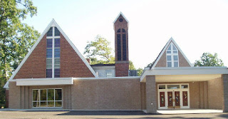
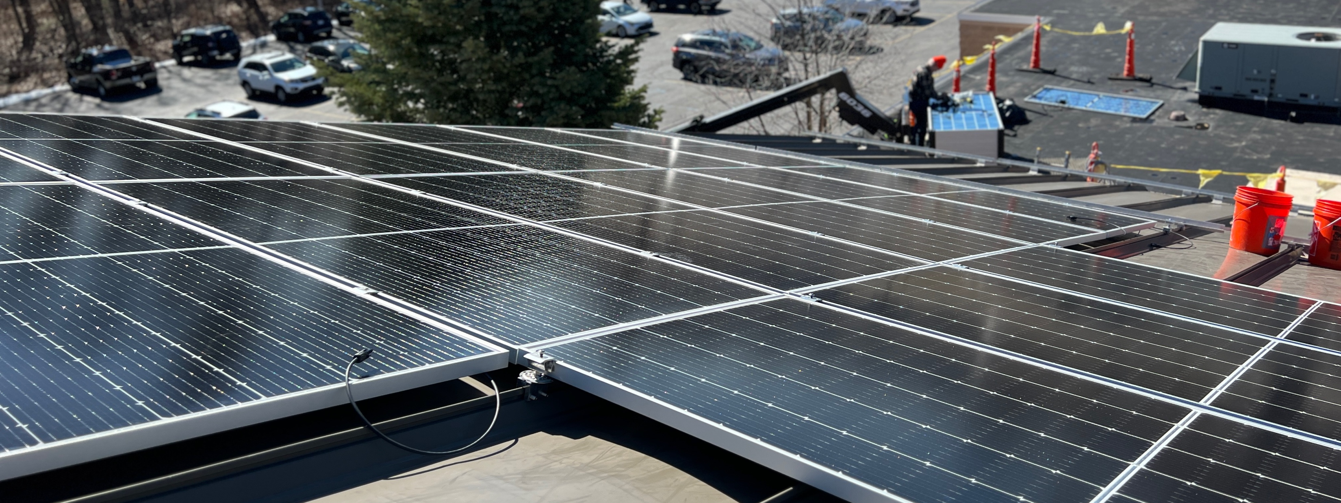
First Lutheran – North Muskegon (PPA)
Notes:
Jennifer

Slide 32
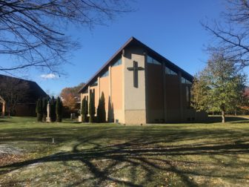
Faith Lutheran – Okemos (PPA)
Notes:
Jennifer

Slide 33
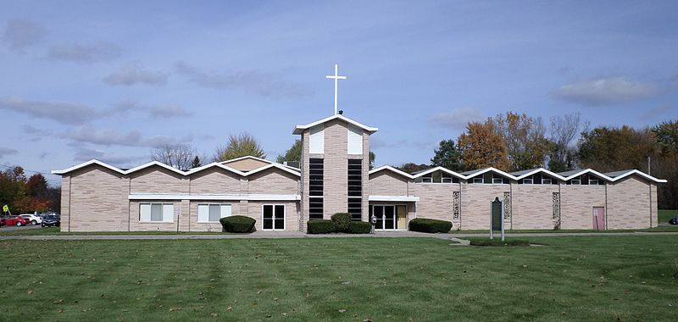
Trinity (AME) – Lansing (PPA)
Notes:
Jennifer

Slide 34
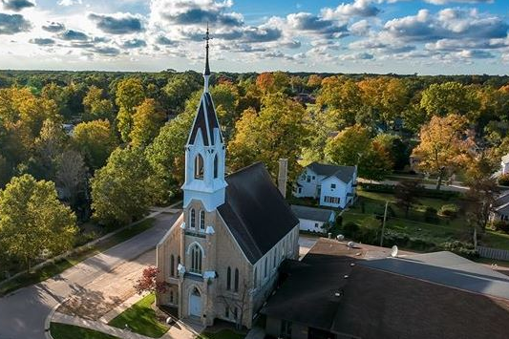
Ferry Memorial (RCA) – Montague (Direct Purchase)
Notes:
Jennifer
Direct Purchase
Introduce Gerry

Slide 35
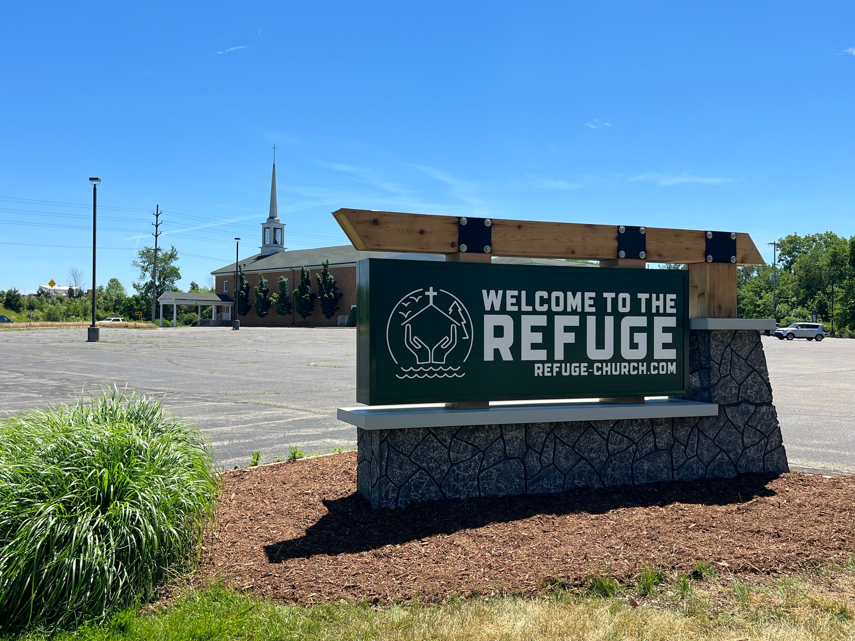
The Refuge (CRC) – Grandville (PPA) Rev. Gerry Koning
Notes:
Gerry
Rev, Gerry Koning will share experience of the Refuge
Then introduce Donna Lee

Slide 36
Our Vision
Notes:
Donna

Slide 37
Today: 5 congregations under contract in the state of Michigan
End of 2023: 55 Michigan congregations and faith-based nonprofits participating
In 10 years:
Scaled to national level (starting with Pennsylvania/New Jersey and California)
Thousands of organizations participating
Inclusive of all faith traditions, ethnic/racial groups, income levels
Expansive educational program for congregations and communities
Notes:
Donna
I am Donna Lee Regional California Regional Organizer for the Climate Witness Project and a member of the Solar Faithful Board of Director
We are currently in conversation with well over 100 congregations and faith-based non-profits
Introduce Allen Drew

Slide 38
Q&A
https://bit.ly/SolarFaithfulInterestForm
steve@solarfaithful.org
Notes:
Allen
I am Allen Drew East Coast Regional Organizer for the Climate Witness Project and a member of Solar Faithful Board of Directors
Most of the questions will probably be answered by Rob Rafson, the president of Solar Faithful, but its fine if you have a question for one of the other presenters.
We will answer as many questions as we are able, and encourage you complete the interest form. That will start a direct conversation and we can answer any specific questions you have. Steve Mulder’s email is also on the screen and in the chat. Feel free to send him any follow-up questions or comments
We have a number of questions in the Chat. I have tried to synthesize these and will ask X# questions to get us started.
Then I will ask you raise your hand. I will recognize you. Take yourself off mute and ask your question. You can direct to a specific board member if you like

