Slide 1

Inflation Recovery Act – Non-Profit Benefits
Murray Rosenthal

Slide 2



Agenda
Introduction
Source of Information
Example of Solar Tax Credit
Details

Slide 3
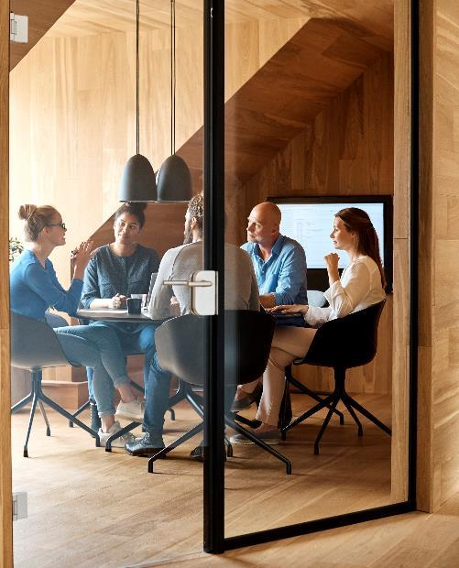



Introduction
Typically, taxpayers can only claim federal income tax credits if they pay federal income tax. Because non-profits do not pay taxes, they could not get this credit until now.

Slide 4
Introduction
The Inflation Reduction Act (“IRA”) was signed on 16 AUG 2022. Beginning 2023, it allows tax exempt entities to use certain tax credits created or expanded by the IRA, and for them effectively to be refundable.

Slide 5
Introduction
There are many ways this benefits non-profits (e.g., purchase of an electric vehicle via the Clean Commercial Vehicle Tax Credit and the Energy Efficient Commercial Buildings Deduction) but we will focus on: The Renewable Electricity Investment Tax Credit for wind, solar, etc.

Slide 6
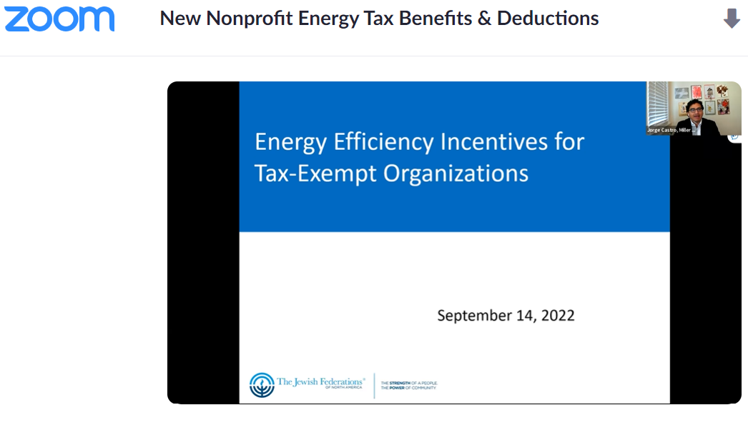
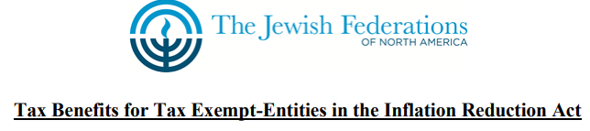
Source: Webinar Sept 14, 2022
New Nonprofit Energy Tax Benefits & Deductions - Zoom

Slide 7

Still up in the air. Waiting for IRS Guidance on How to Apply for payment.

Slide 8
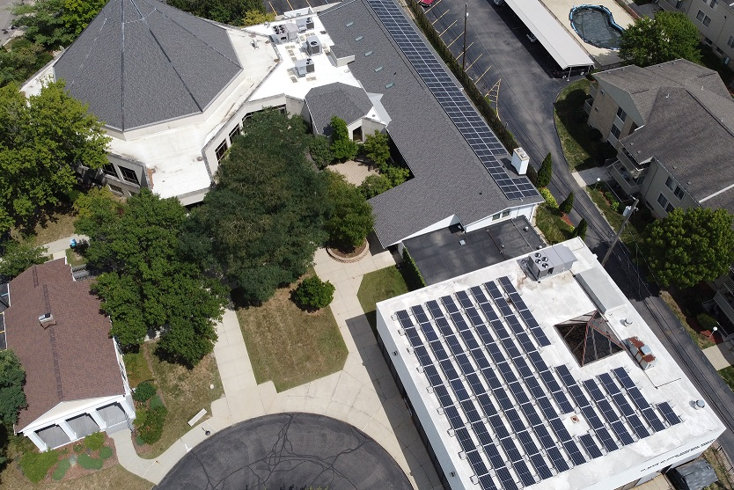

Example
A House of Worship (HoW) accepts a contract to purchase a qualifying 12 kW capacity solar panel system for its office on November 1, 2022, for $35,000. The system is installed on January 7, 2023. The HoW is entitled to a Renewable Energy Investment Tax Credit of 30 percent, or $10,500, which it can receive as a cash payment. Guidance will need to be issued by the IRS on how to claim this credit.

Slide 9
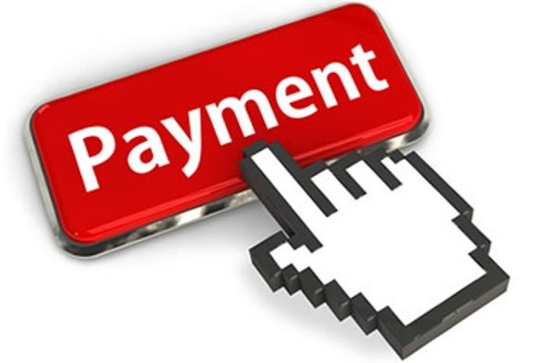
Not a Credit
It’s a payment!

Slide 10

Timing
Construction must start after 01-JAN-2023
Construction must start before 01-JAN-2025

Slide 11
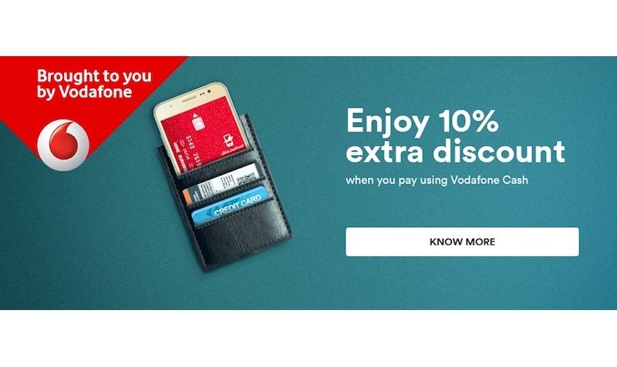
Additional Payments
10% more $$ if mostly domestically manufactured materials are used and if installers are paid appropriate wages.

Slide 12
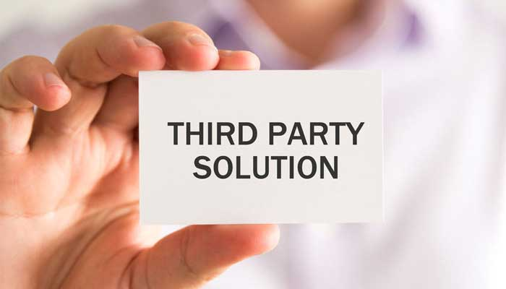
How can a non-profit take advantage of payments and get solar?
Buy the installation (have funds already, fund-raise, capital campaign, deep-pocket donor, borrow)
Set up PPA with Installer or LLC made up of congregants or altruistic investors (investor model)
PPA via a third-party

Slide 13

The way to get started is to quit talking and begin doing.
Walt Disney

Slide 14

Summary
Solar panels cost money
30% Tax Credit that turns into a payment for non-profits
10% Additional payment if certain conditions are met
Start construction in 2023

Slide 15


Questions?
Murray Rosenthal
scibridge0@gmail.com

