Slide 1
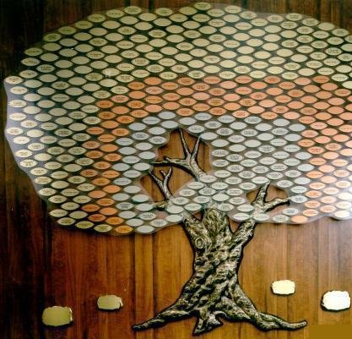
Genesis Decarbonization Plan
Murray Rosenthal

Slide 2
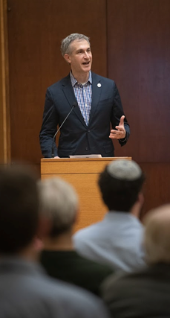
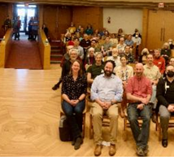

A2 Climate Teach-in
226 Attendees!!

Slide 3
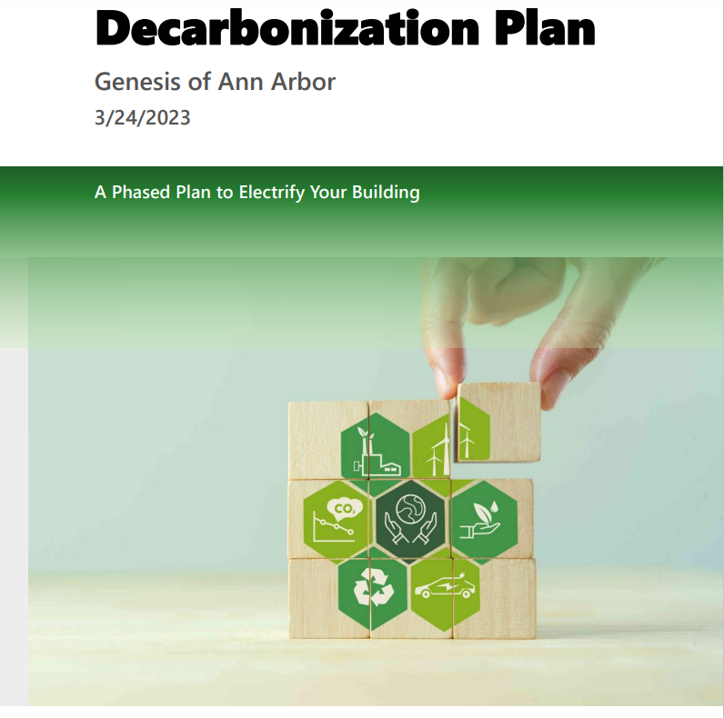
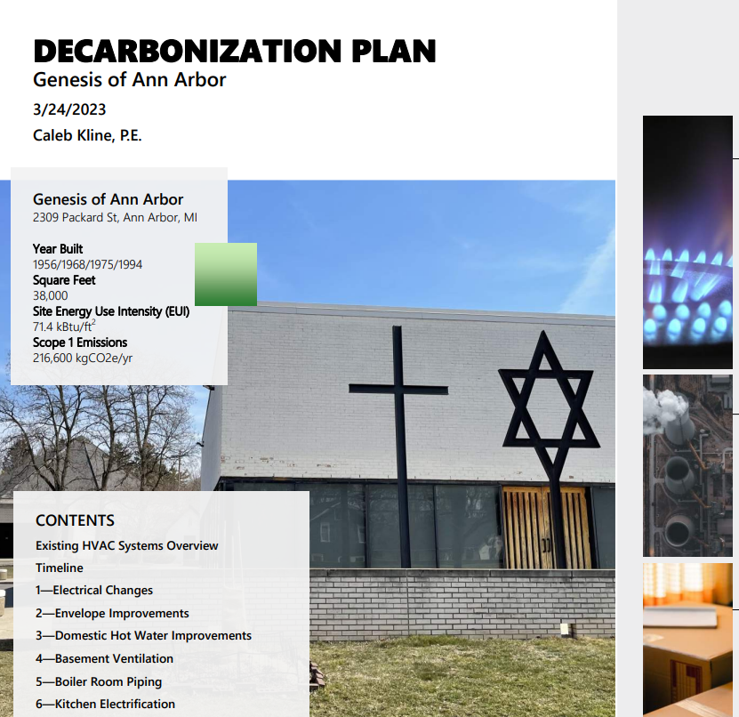
Genesis has a decarbonization plan!

Slide 4
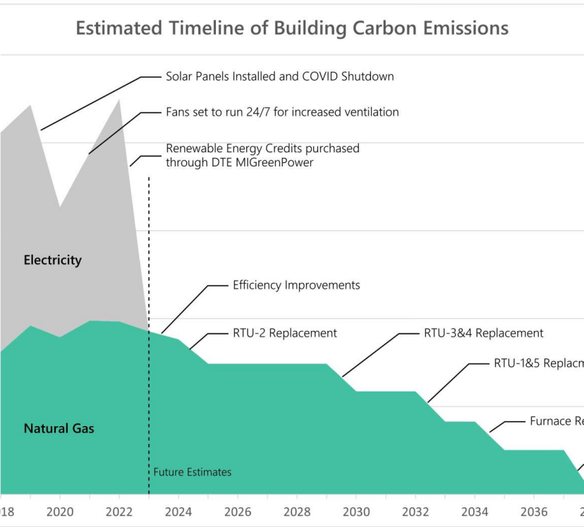
What is a decarbonization plan?
Building decarbonization is achieved by switching to energy sources or materials that emit less carbon, from high carbon-emitting fossil fuels, and by counteracting any carbon that is emitted. The goal of our decarbonization plan for is to eliminate carbon dioxide emissions related to the energy use by our building.

Slide 5
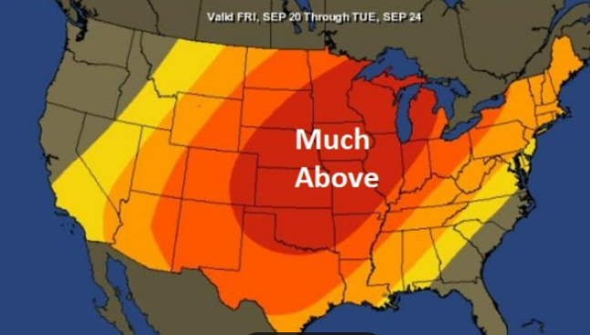
Why?
Do our part to prevent climate volatility by reducing the use of fossil fuel to power our building.
City of Ann Arbor will require it.

Slide 6

A2 Zero
Adopted on Ju​ne 1, 2020, A2ZERO​​ is the City of Ann Arbor's plan for achieving a ju​​st transition to community-wide carbon neutrality by 2030.

Slide 7

A2 Zero
Eliminate the use of natural gas and substitute electricity

Slide 8
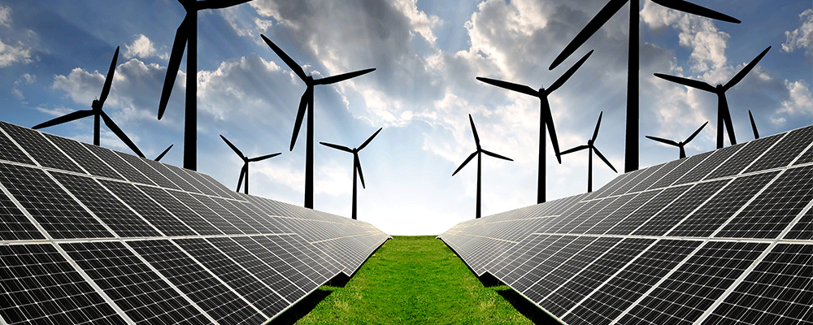
A2 Zero
Generate / purchase electricity only from renewable sources

Slide 9



How?
Cost: $7800
Minus: -$5000 (grant from 2030 District)

Slide 10
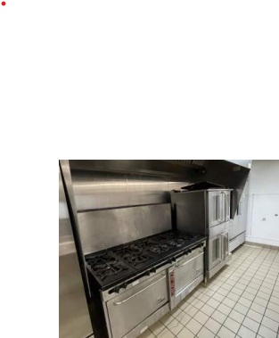
Obsolete, redundant, broken systems
Stove and oven is 29 years old
Makeup air unit is broken

Slide 11
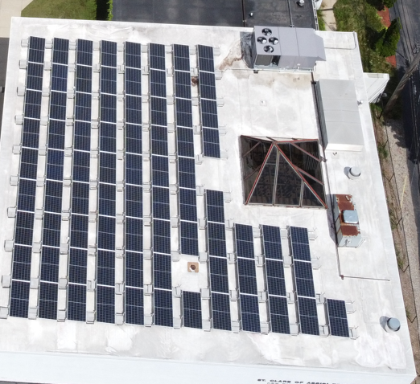
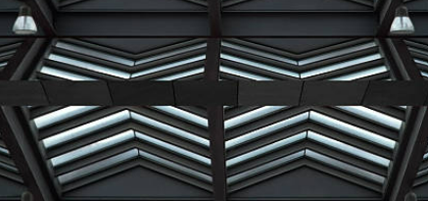
Obsolete, redundant, broken systems
Abandoned roof louver on Social Hall – light can be seen, which likely means we have holes in our roof
Four other smaller holes were found (e.g., non working fans)

Slide 12
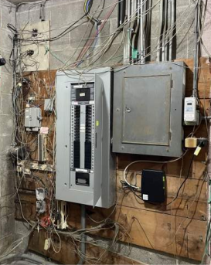
Obsolete, redundant, broken systems
Electrical panels need updating

Slide 13
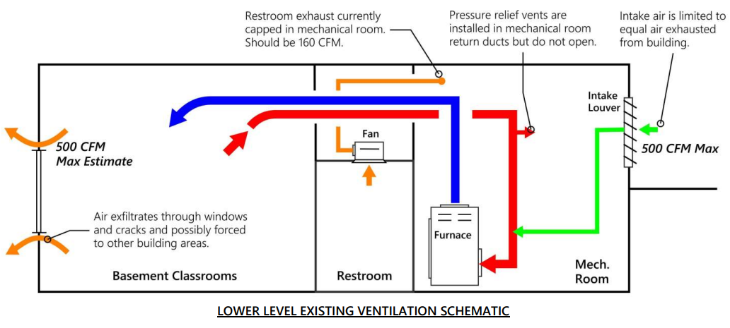
Obsolete, redundant, broken systems
No air is exhausted
from the basement classrooms

Slide 14

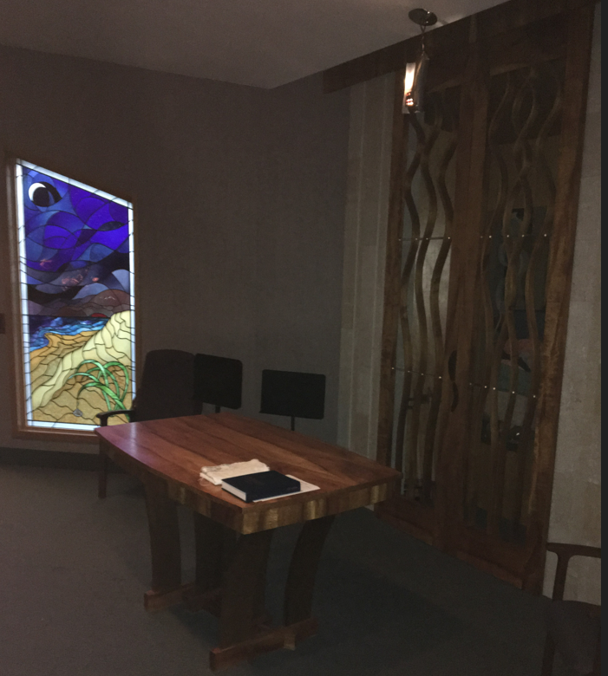
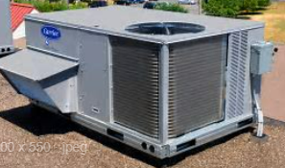
Obsolete, redundant, broken systems
Adult Lounge and TBE Chapel are served by both RTUs and mini-splits
Two different systems may lead to simultaneous heating and cooling

Slide 15

What is in the plan?

Slide 16
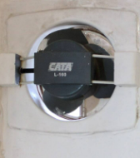
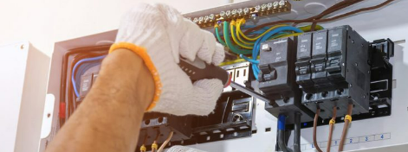
What is in the plan?
Fixing existing deficiencies, sealing holes, updating electrical systems.

Slide 17
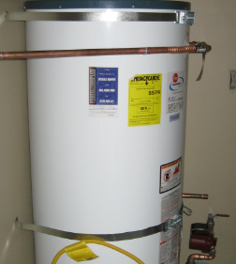
Replacement of current HVAC, Kitchen and Hot Water Equipment
What is in the plan?

Slide 18
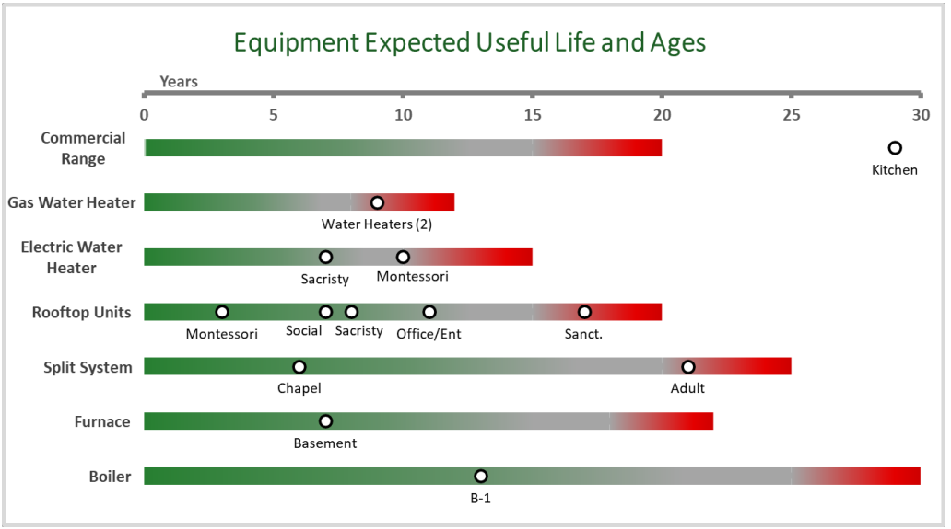

Expected obsolescence (basis of the plan)

Slide 19
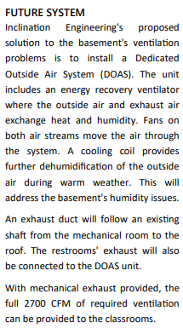
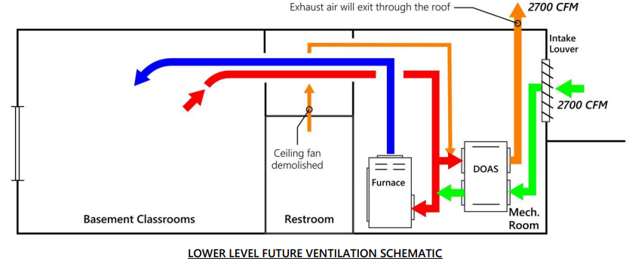
Replacement Example - DOAS
Replacement Example – Dedicated Outside Air System

Slide 20
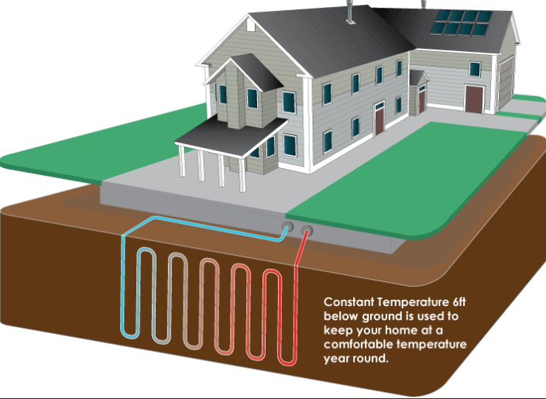
Replacement Example - Geothermal
Estimated savings in operation utility costs are 43%
Replacement Example – Bonus: Switch from natural gas to electricity

Slide 21
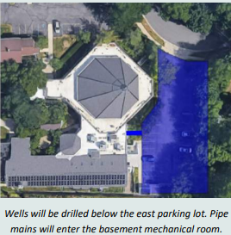
Geothermal System #1

Slide 22
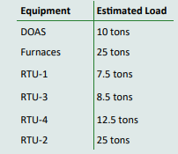

Geothermal System #1
Lower-level DOAS will be linked to the circulating water system, along with RTUs

Slide 23
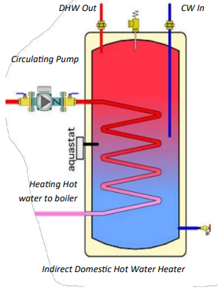
Hot water
Consolidate to single tank in boiler room

Slide 24
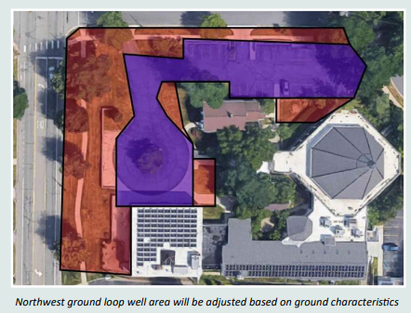
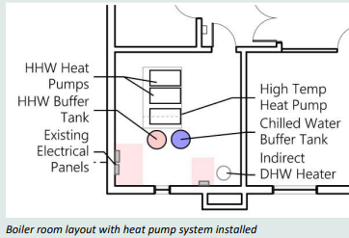
Geothermal System #2
Connects to main boiler

Slide 25

Funding

Slide 26

30% Federal Investment Tax Credit for energy improvements – now directly available to non-profits.

Slide 27
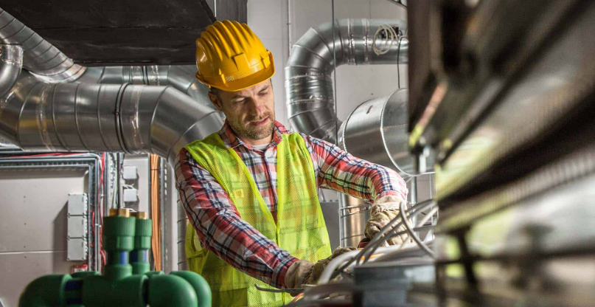
30% Federal Investment Tax Credit + up to an extra 10% for using domestic parts and union labor.

Slide 28

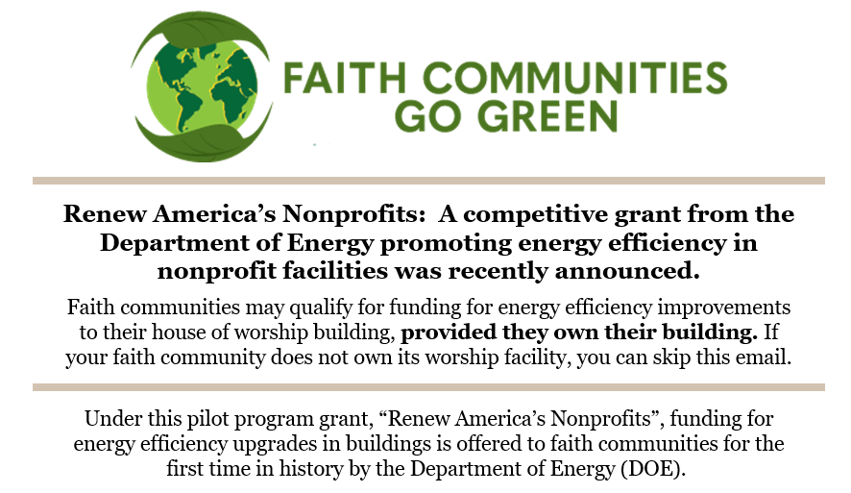


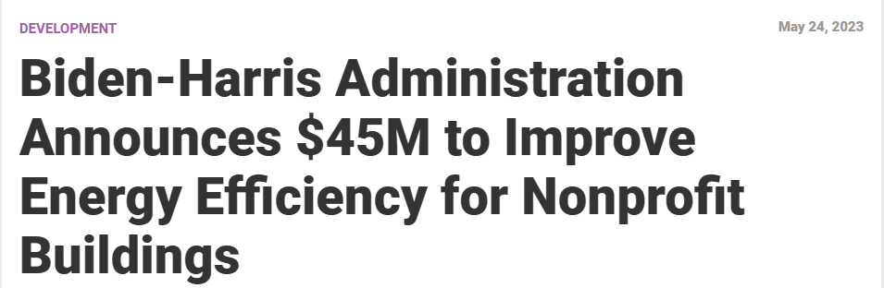
Grants are available for energy improvements

Slide 29
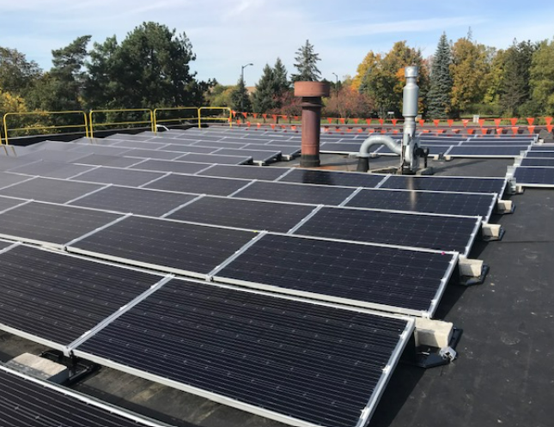
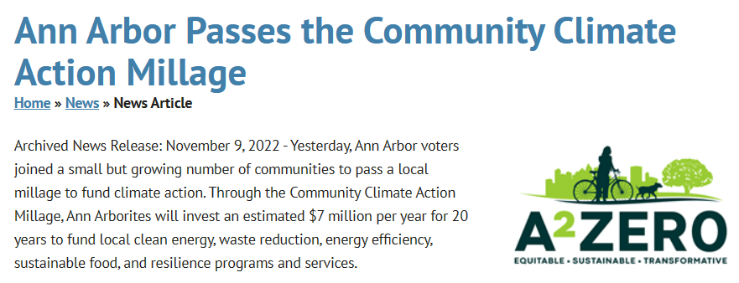
City Funds are available for energy efficiency improvements

Slide 30
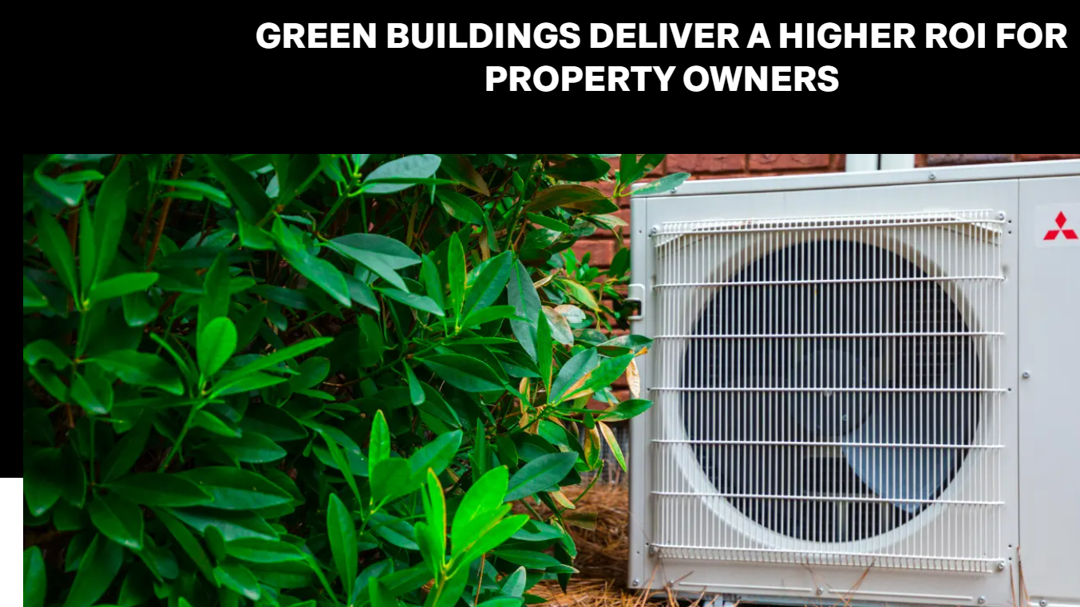
BlocPower – Project Management?
https://www.blocpower.io/home-building-upgrades

Slide 31

Decarbonization Report
15 Ledger pages (17 x 11”)

Slide 32

We are the leaders!

Slide 33
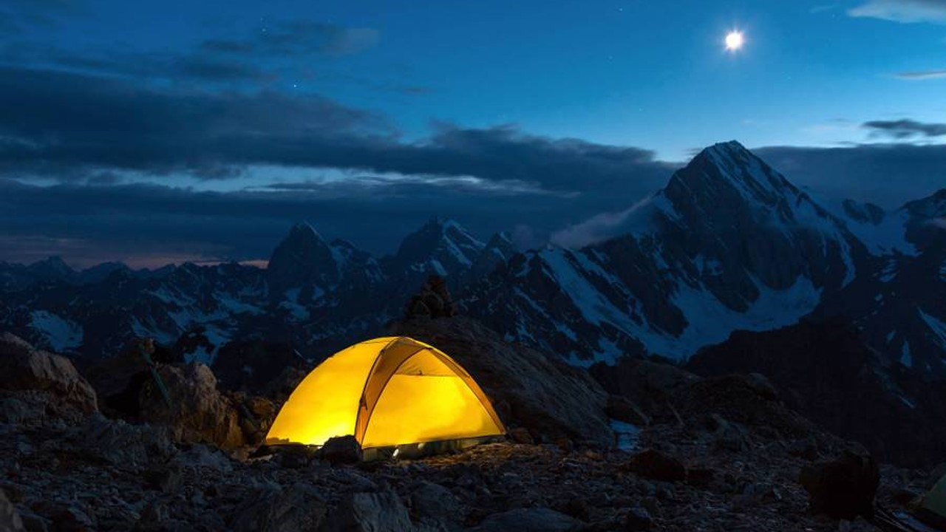
The way to get started is to quit talking and begin doing.
Walt Disney

Slide 34
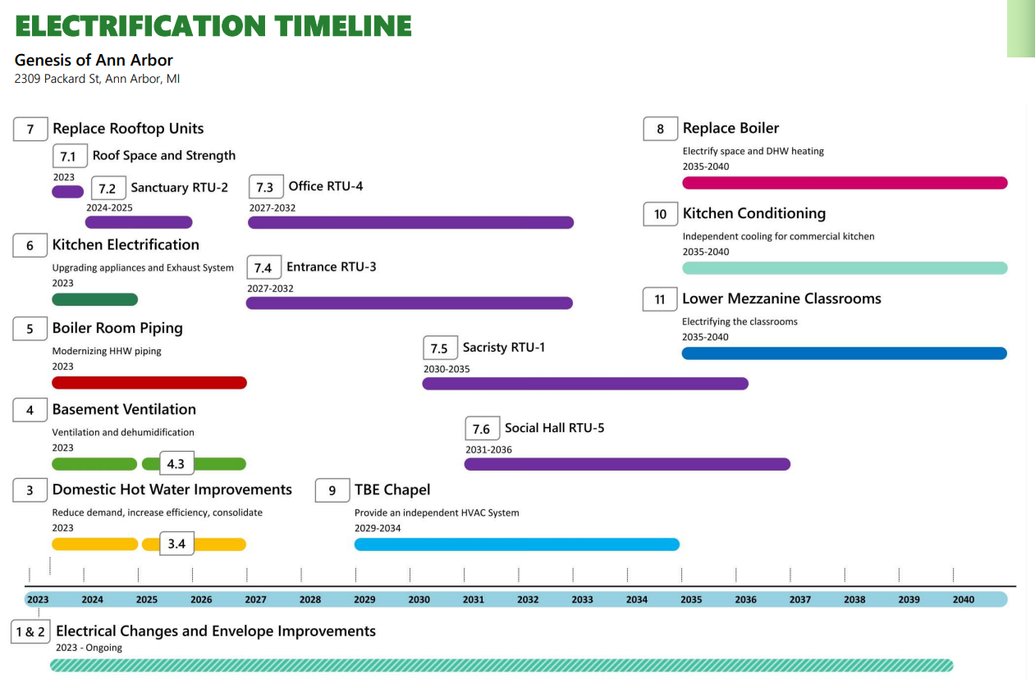

Slide 35

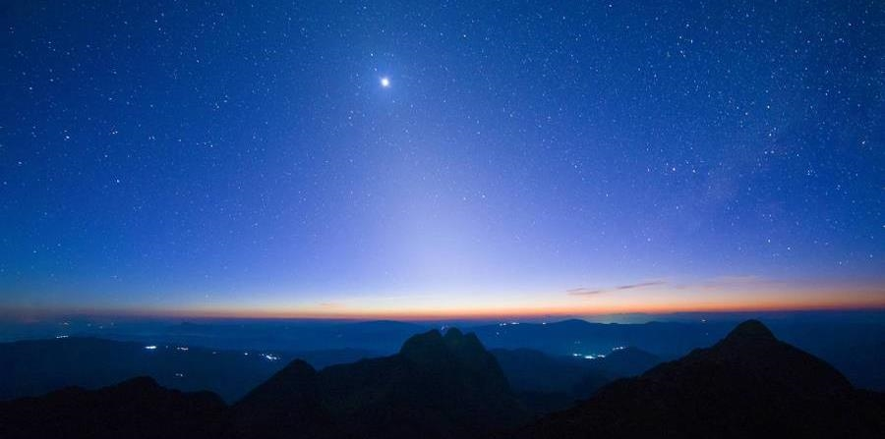
Thank you!
Murray Rosenthal
scibridge0@gmail.com
Genesis Home | Genesis Of Ann Arbor (genesisa2.org)

