Slide 1
Update on the Mural Residency
February 2020

Slide 2
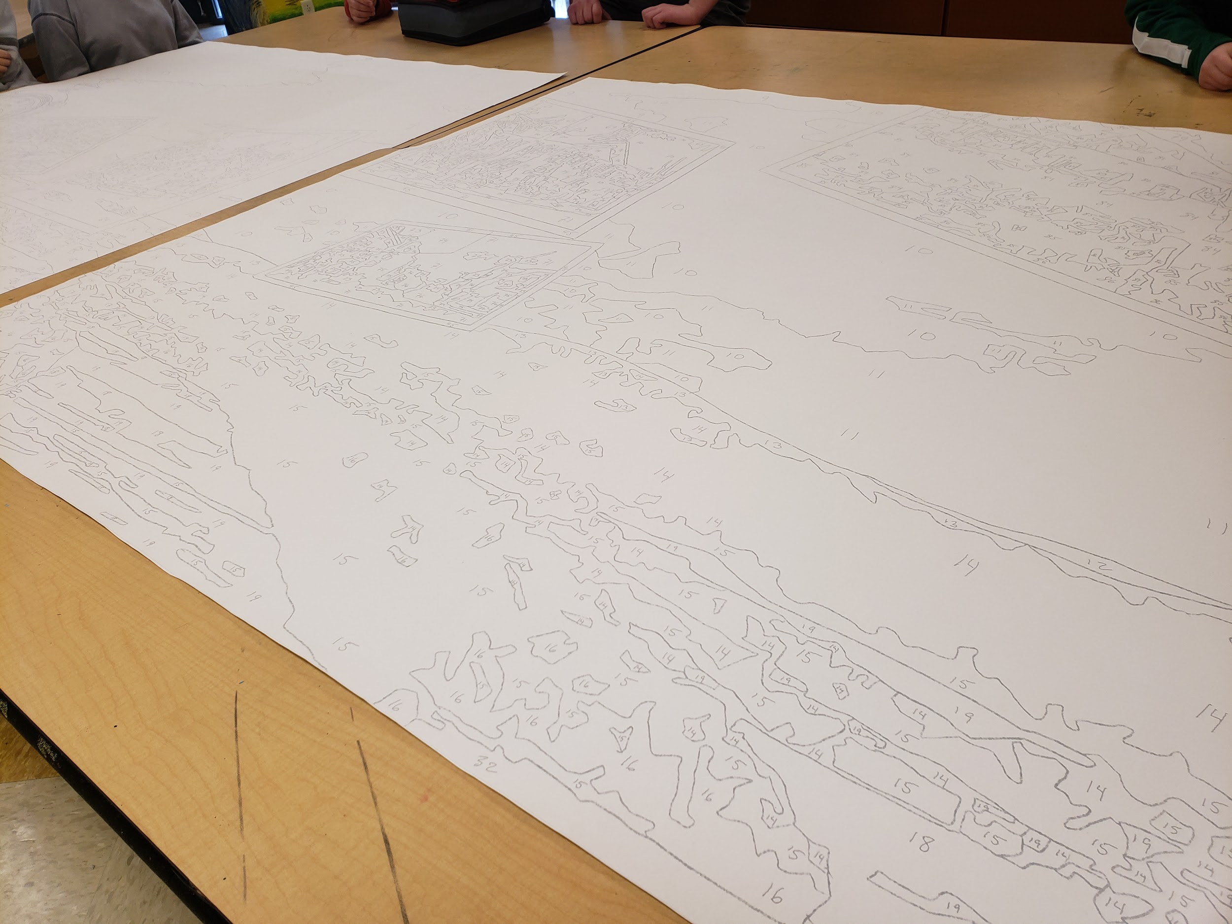
Getting Started - Day 1
Our resident artist, Jon Laidacker, came for ten days in December with 21 sheets for us to paint for the mural. He also brought about 150 colors and each of the 21 panels had the design printed on it with numbers for each color.

Slide 3
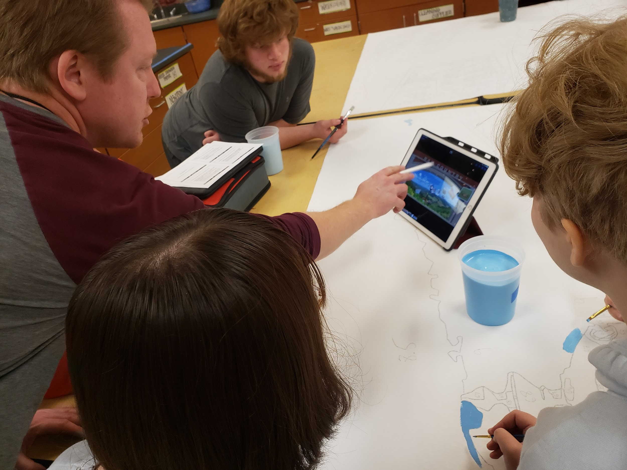
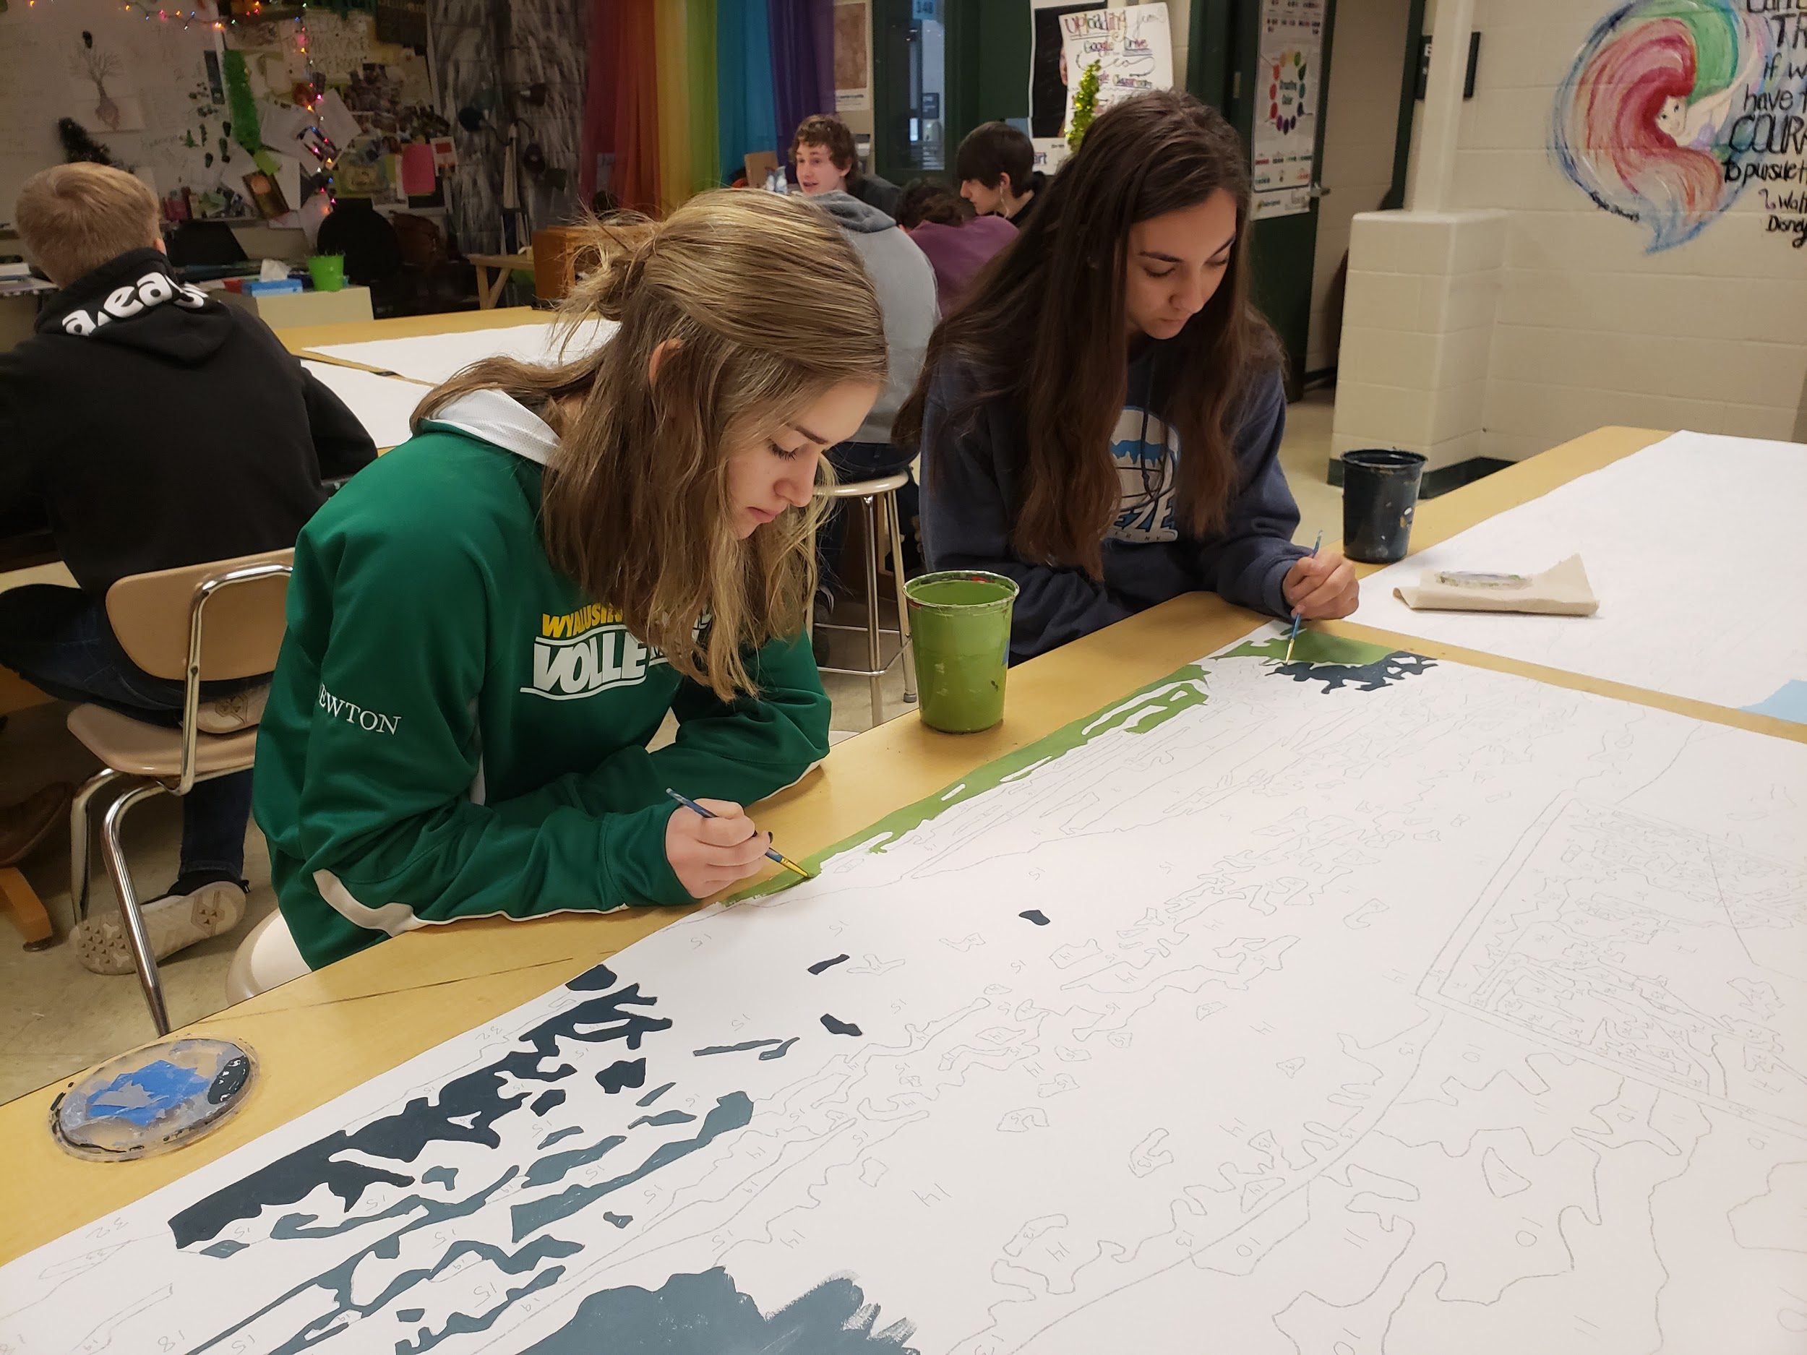

Slide 4
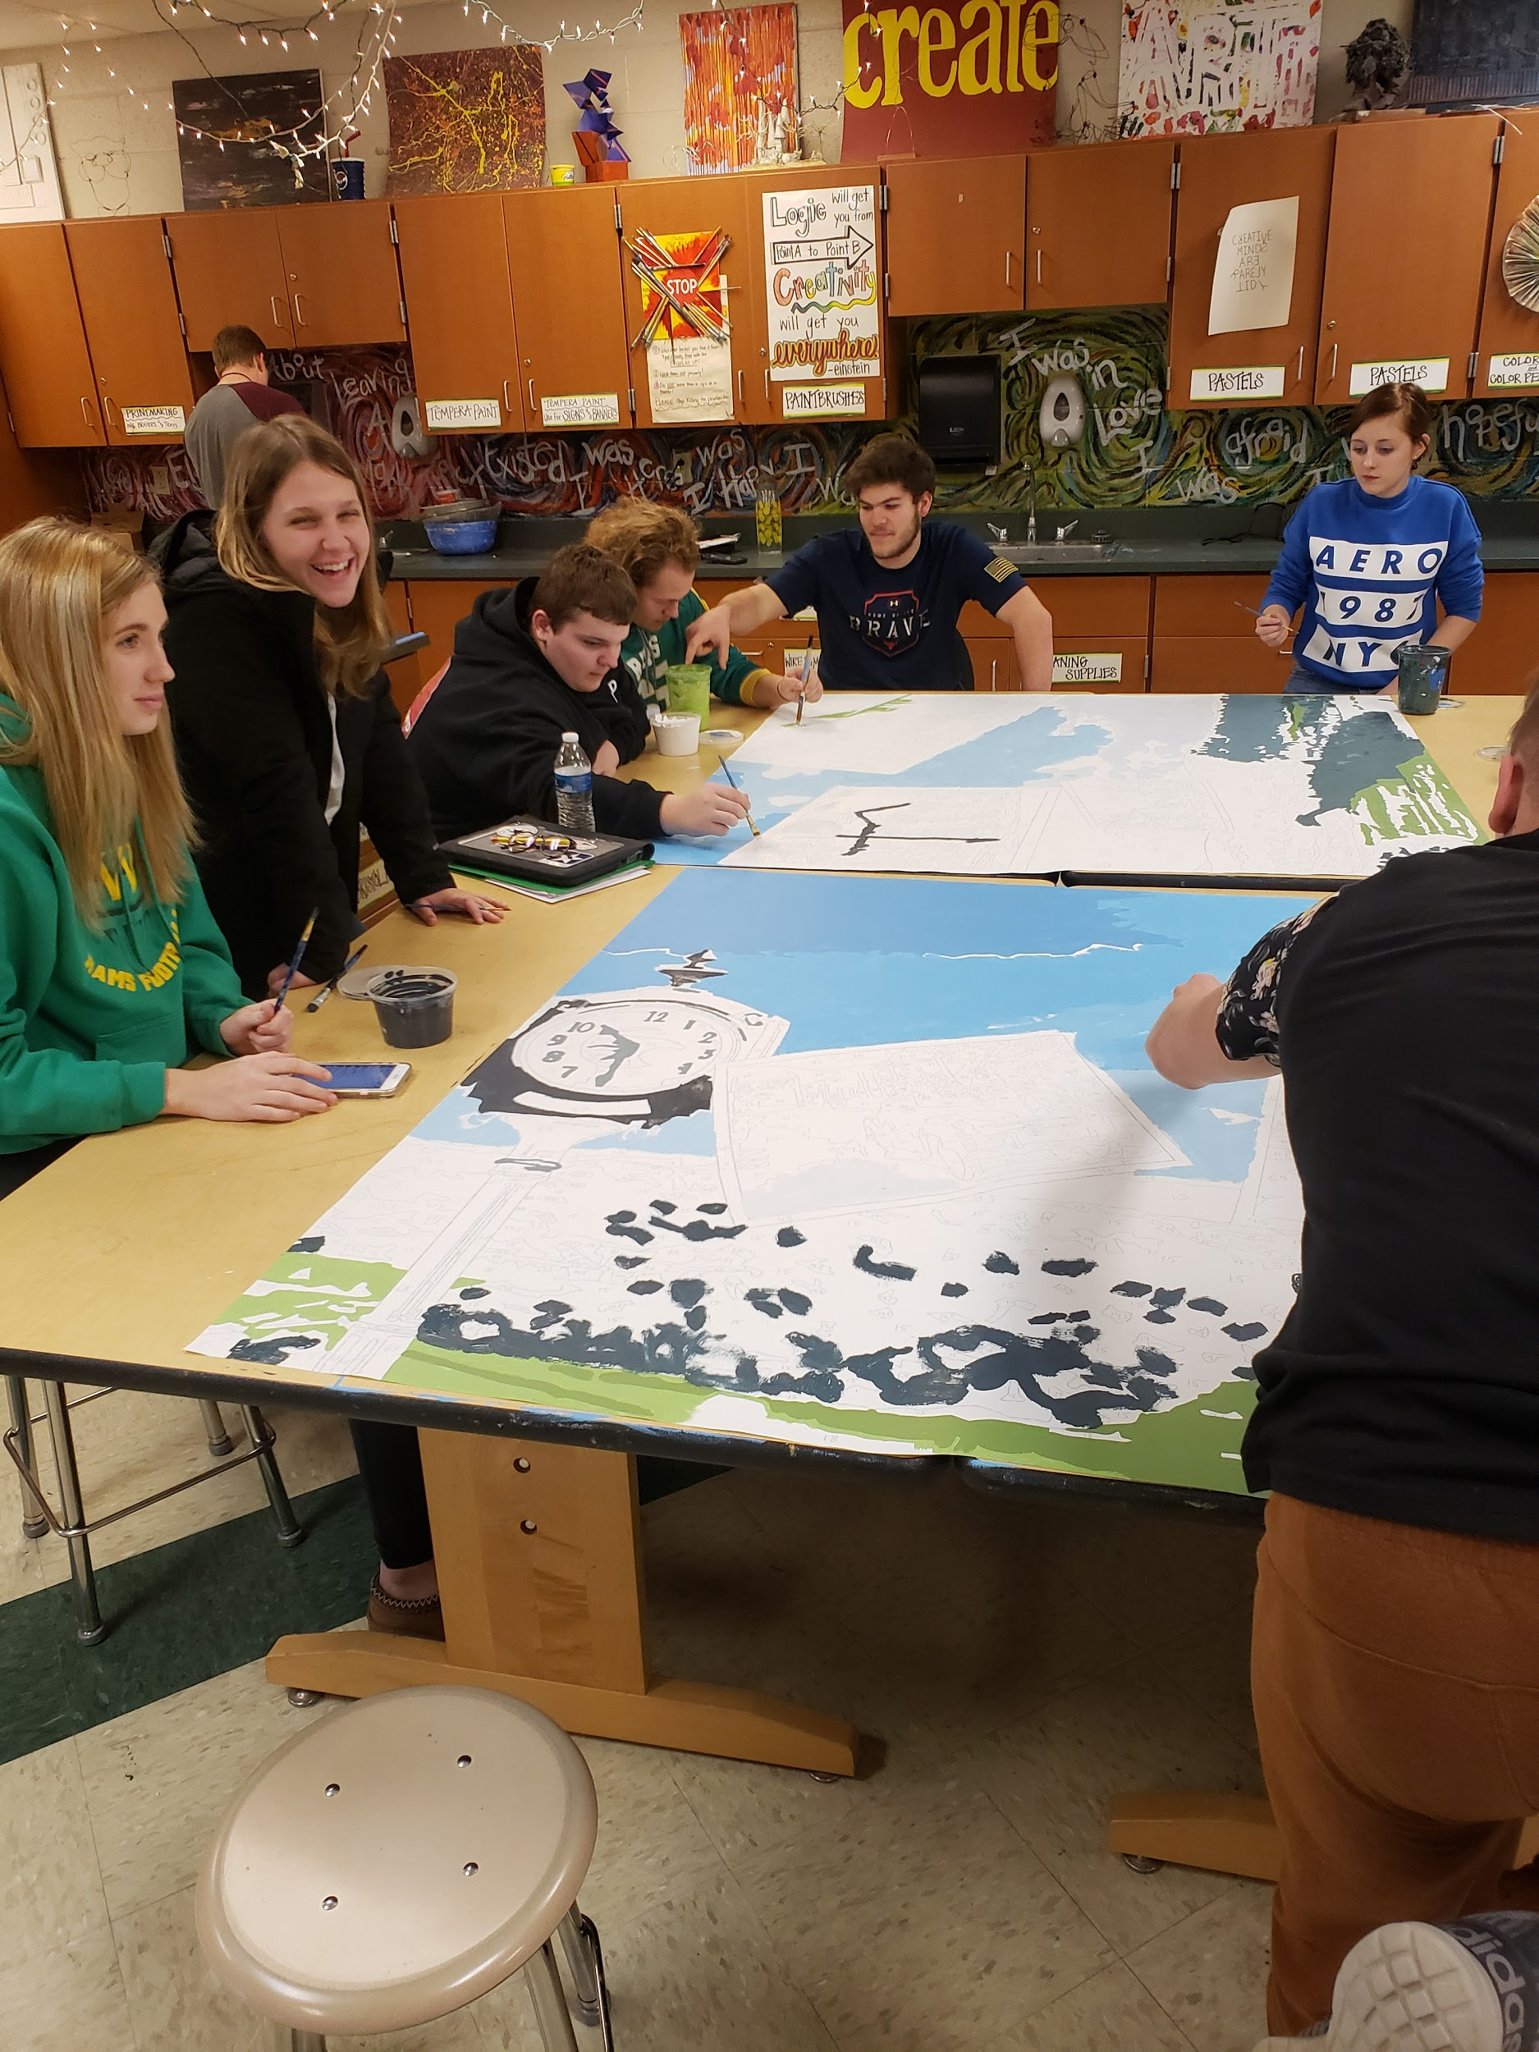
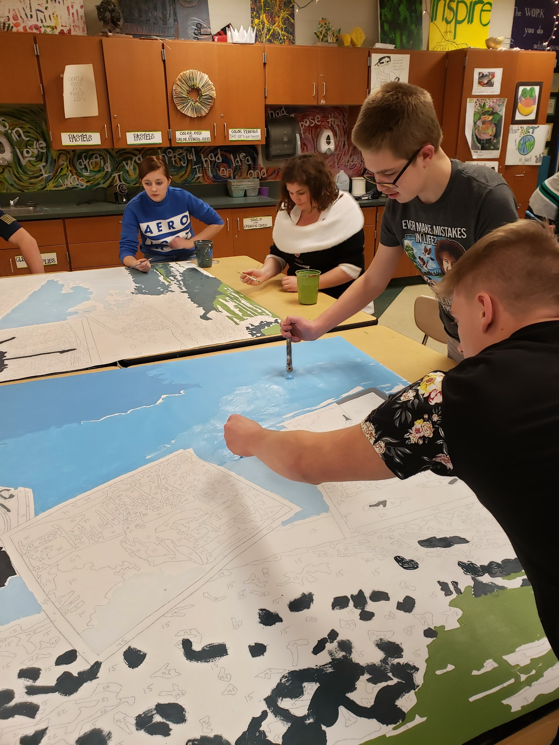

Slide 5
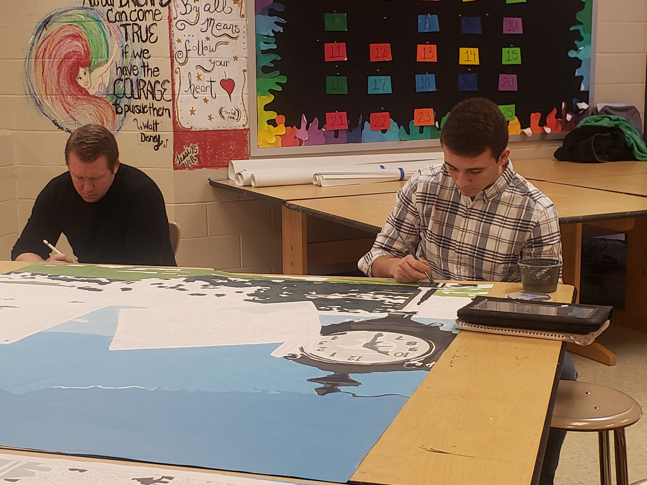
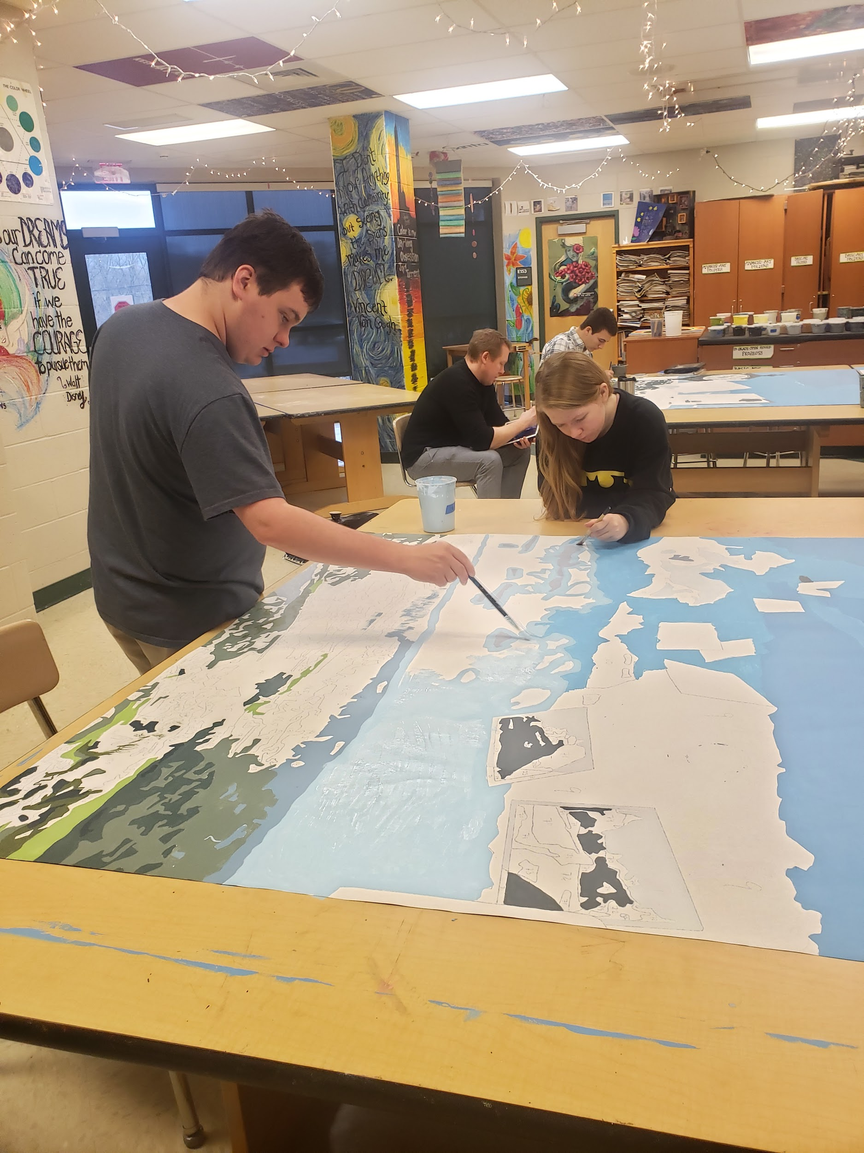
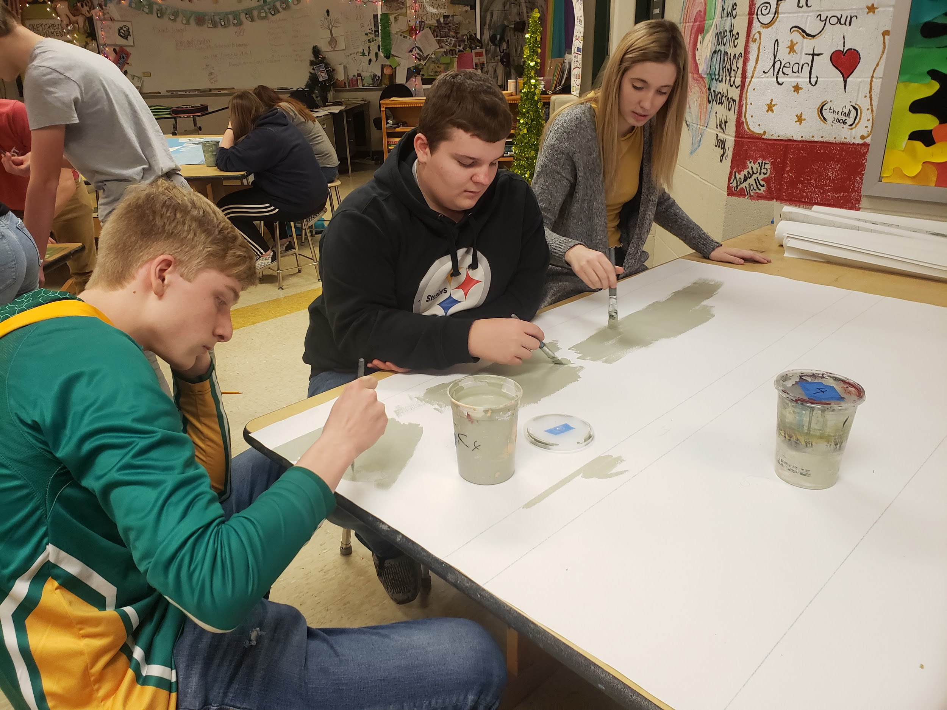
Day 2
The most interesting change between Day 1 and Day 2 was the students’ interest level. On day 1, they looked at the sheets and were overwhelmed and said “this is going to take forever!” However, by day 2, they could see it starting to come together already and saw how therapeutic it could be. Some students were in my room painting during every free moment they had!

Slide 6
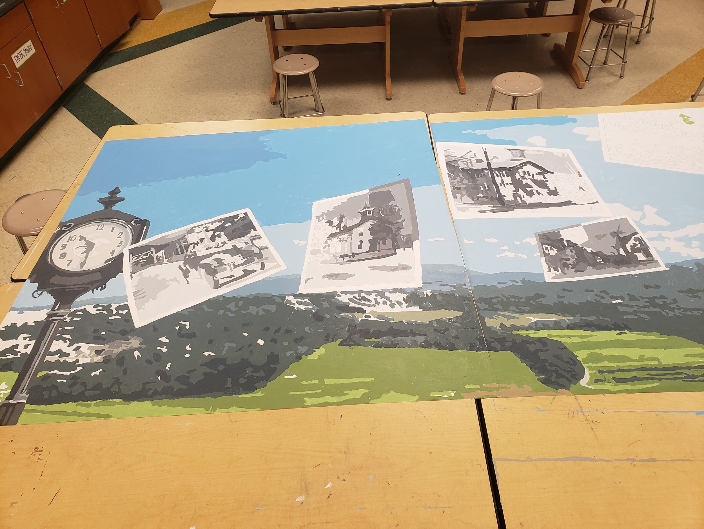

Slide 7
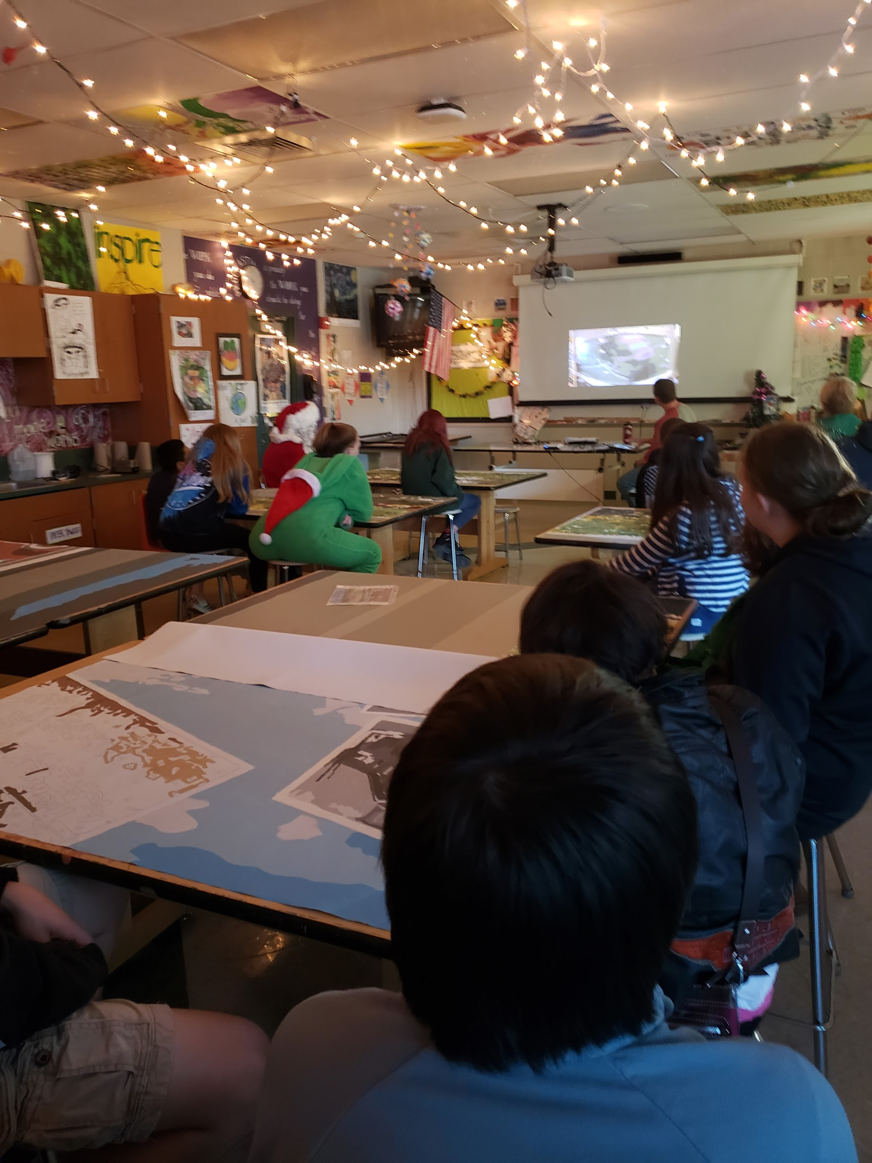
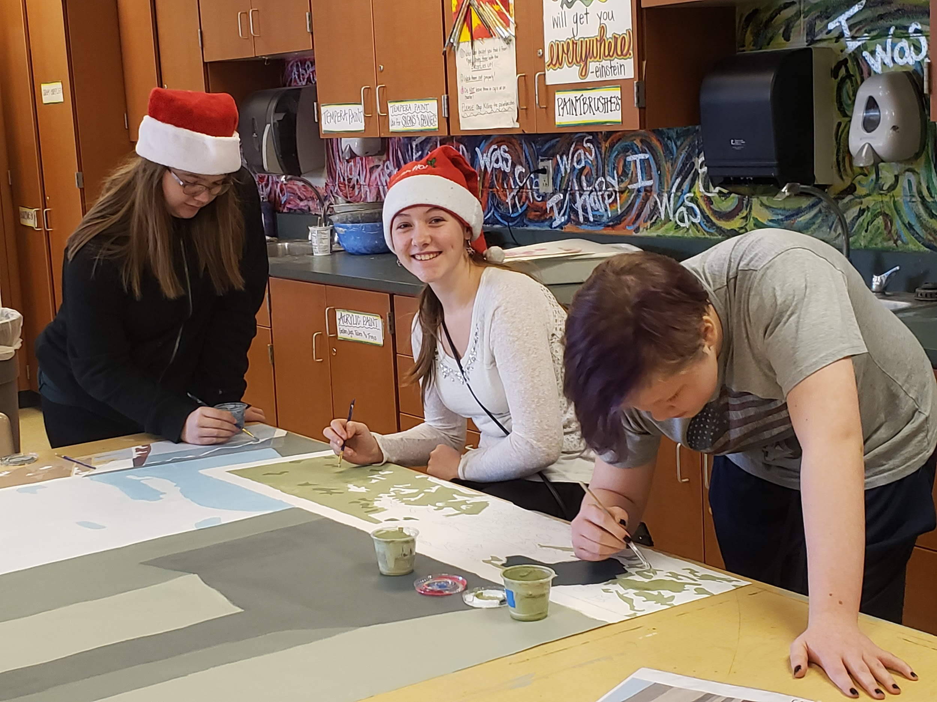
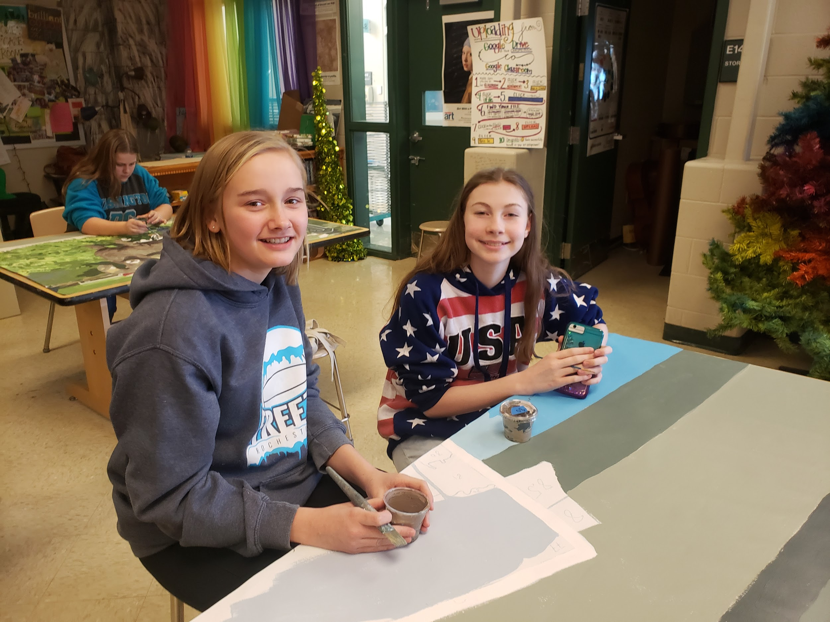
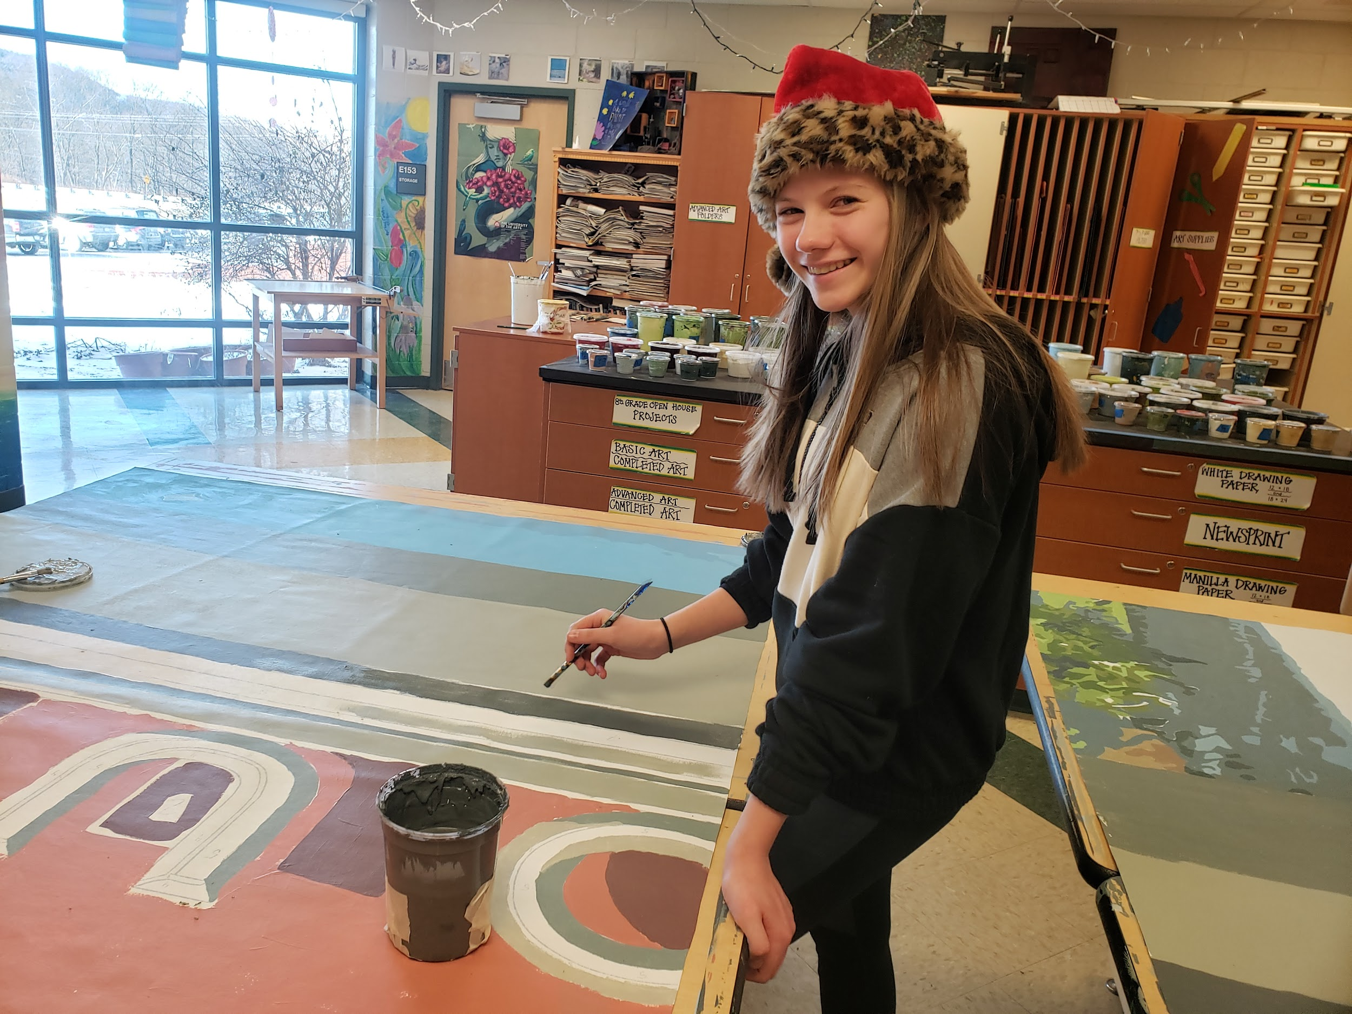
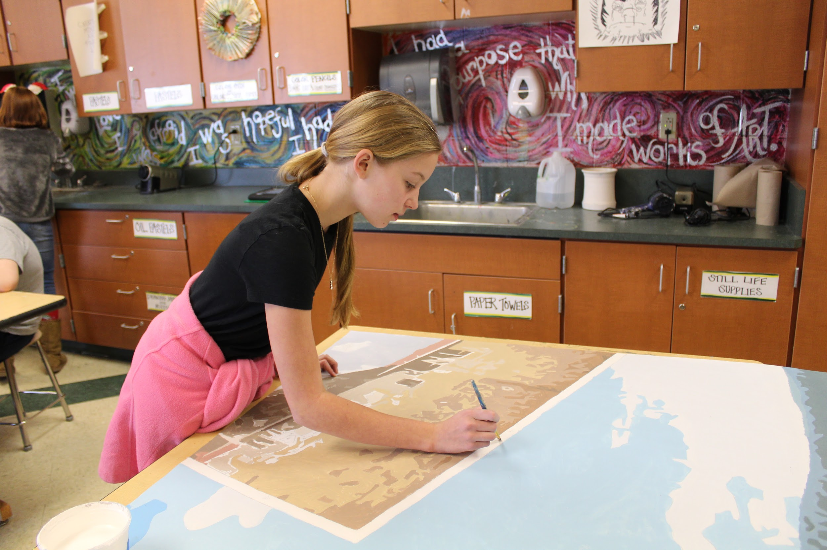
Junior high got to help too!

Slide 8
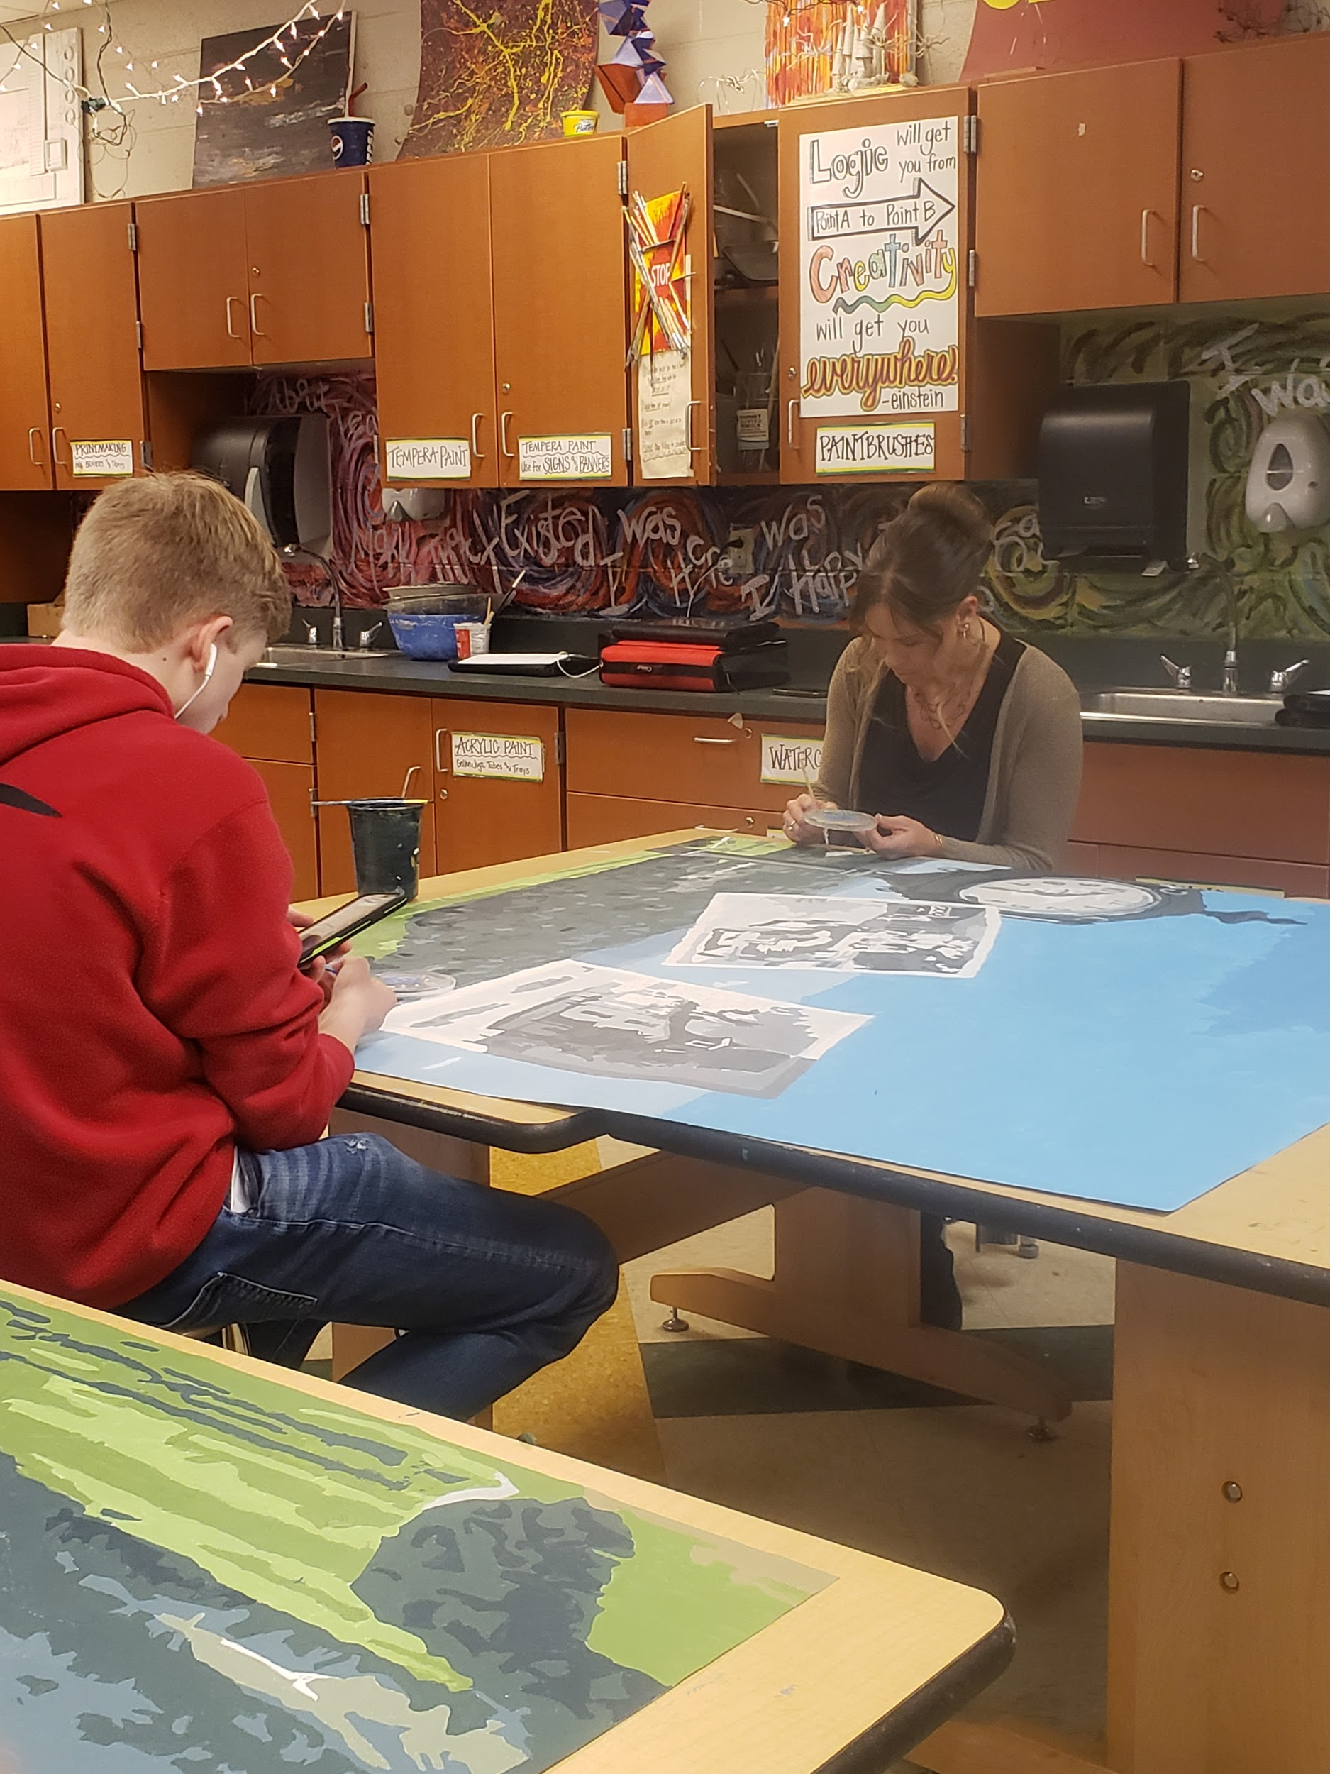
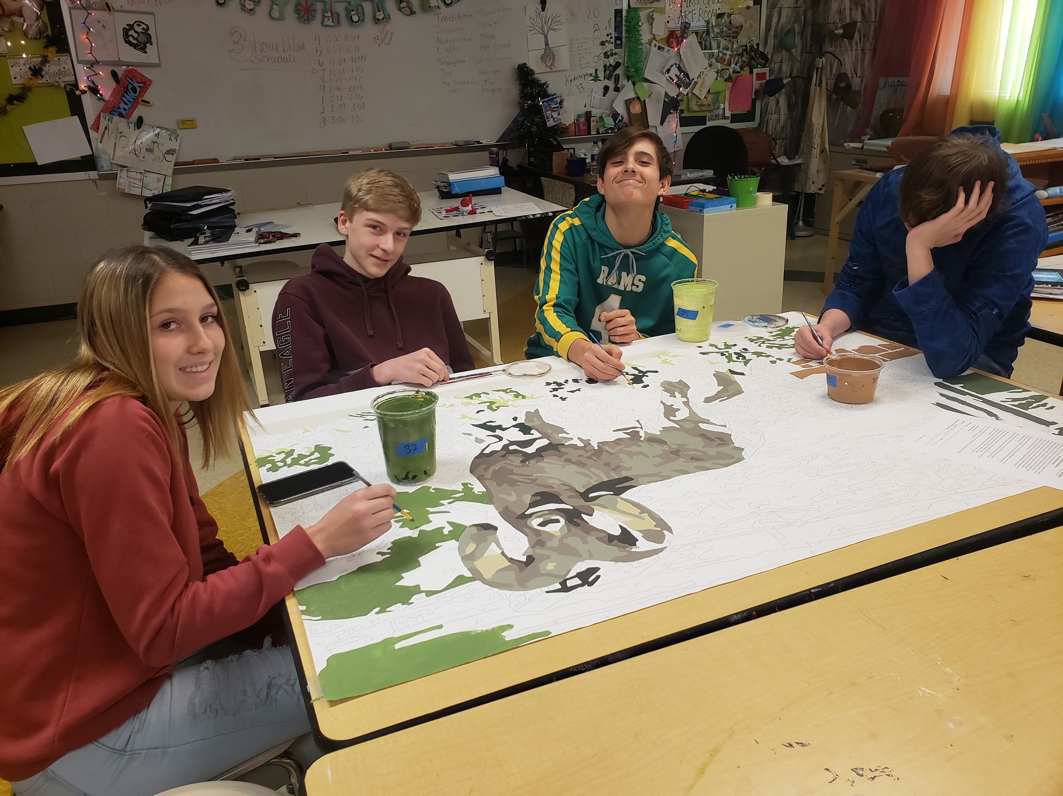
We had lots of people stop in to help! Even other teachers came in to help!

Slide 9
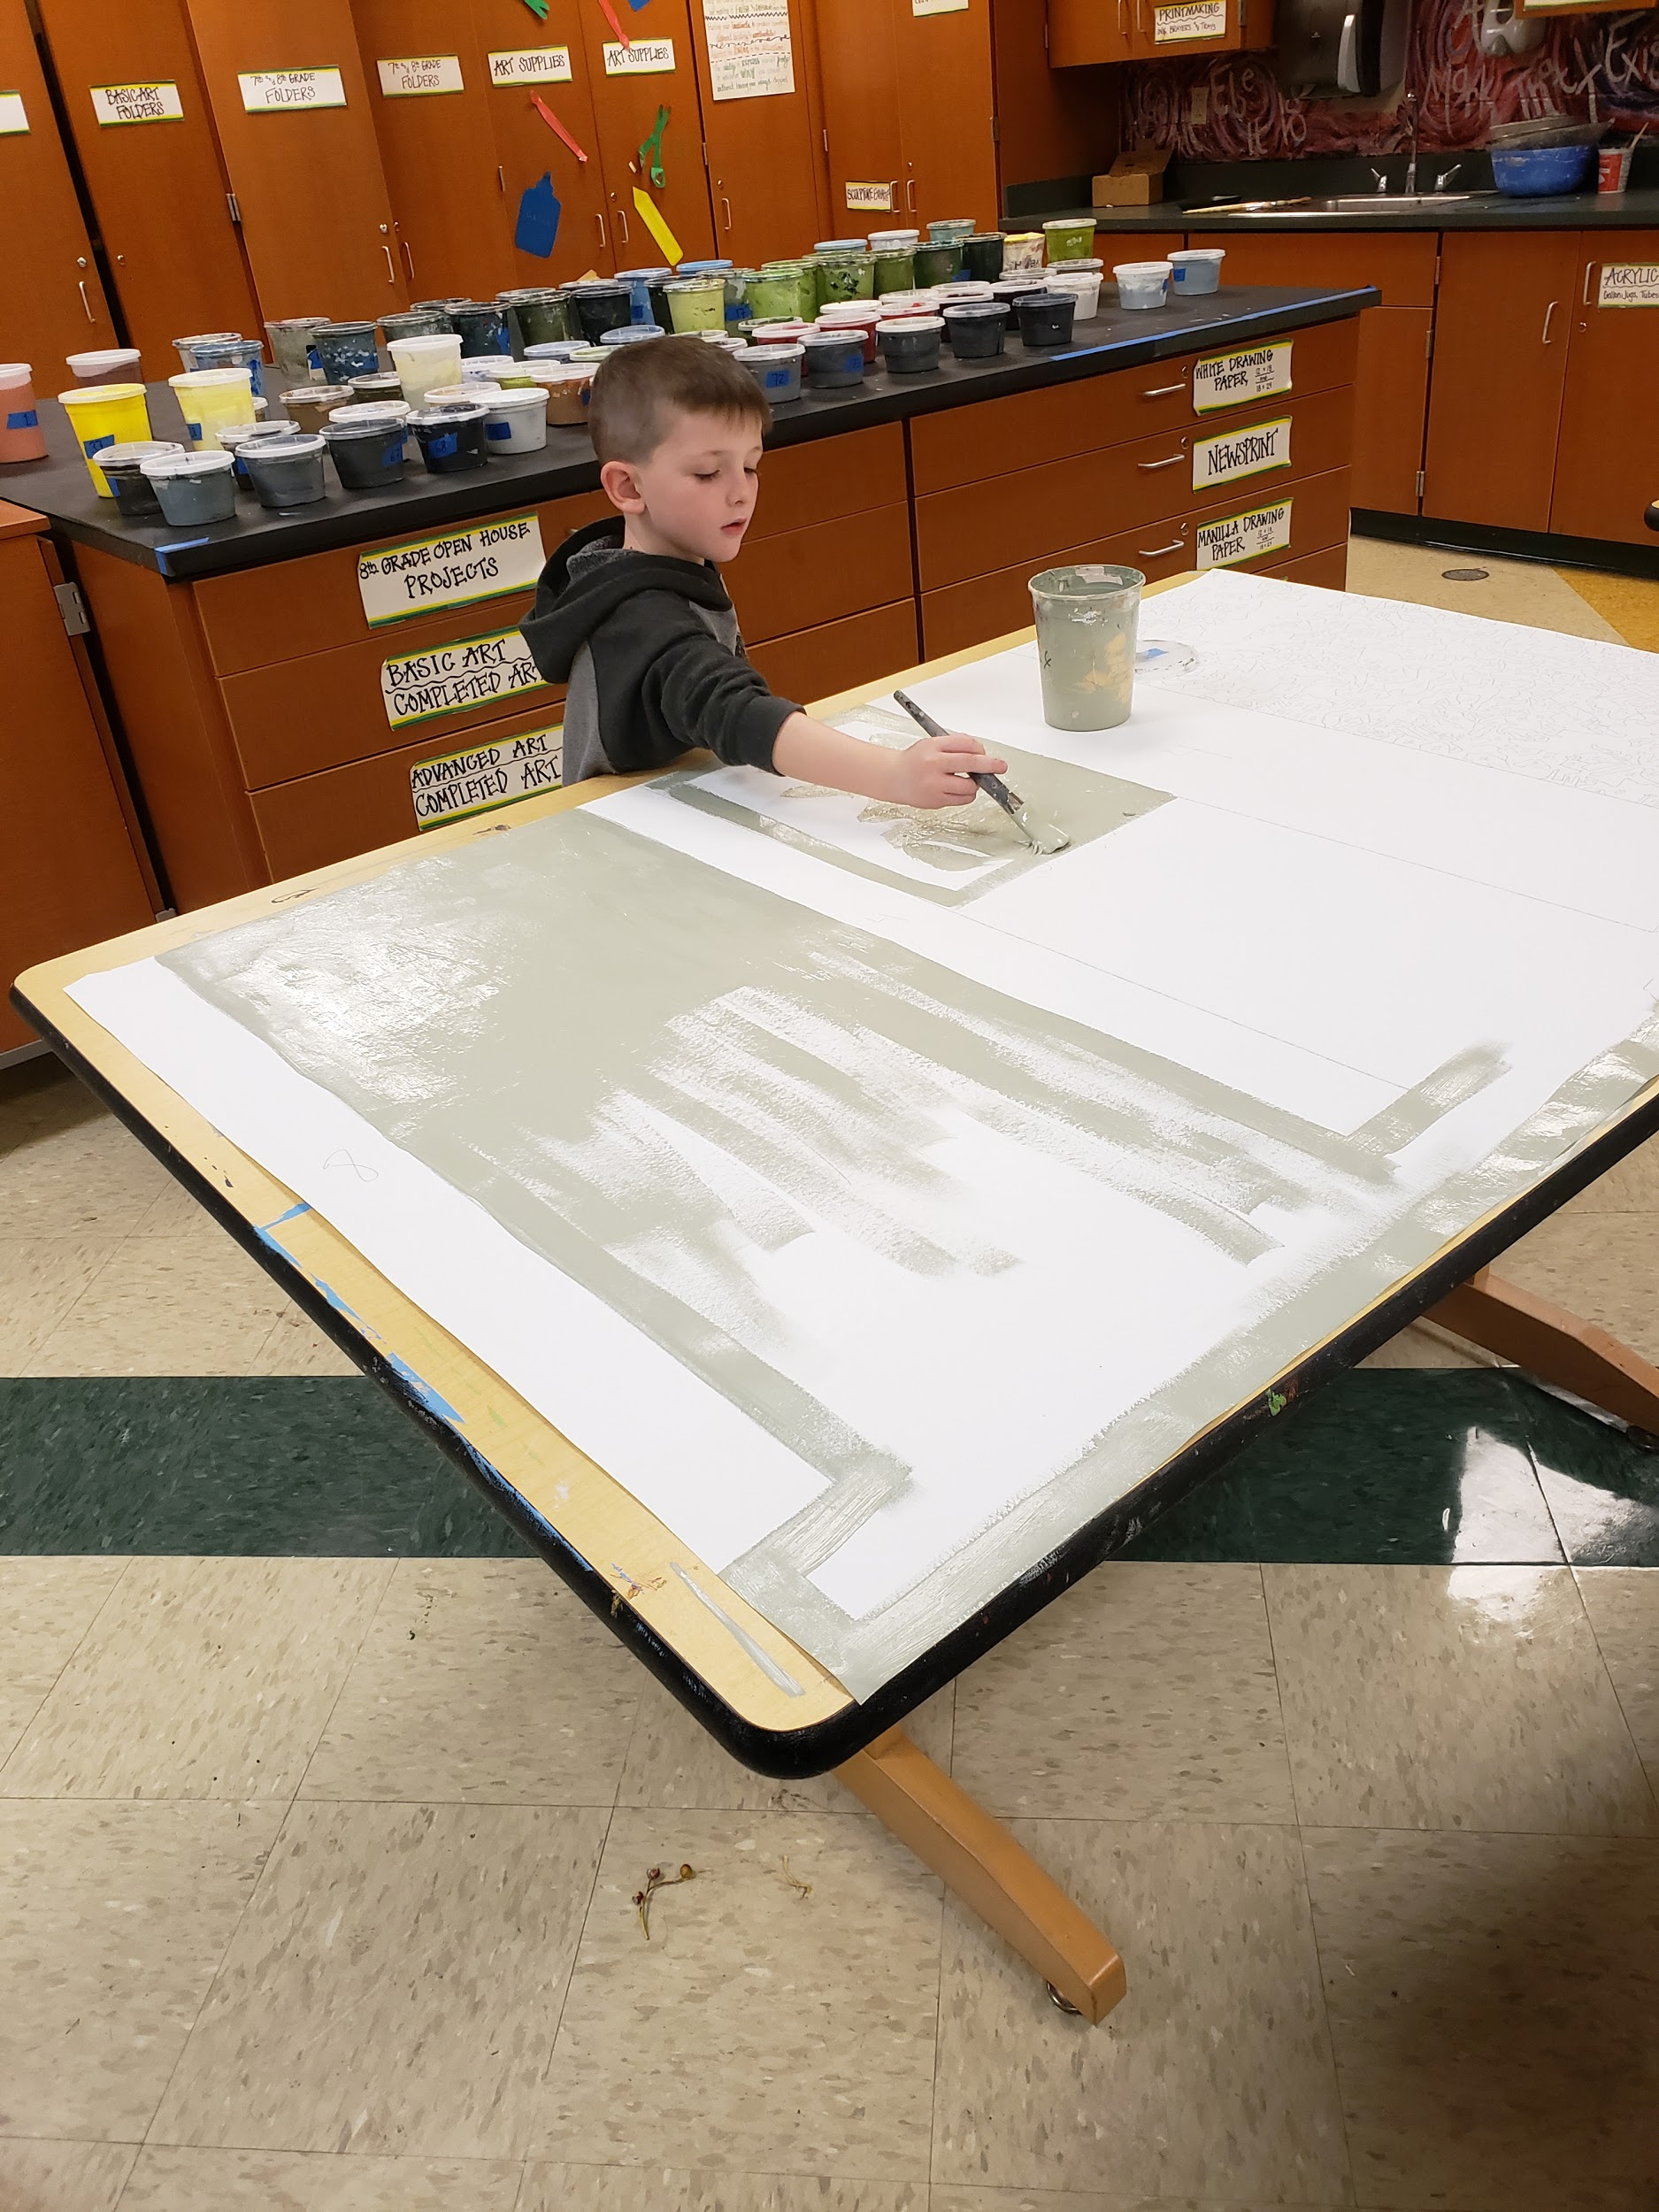
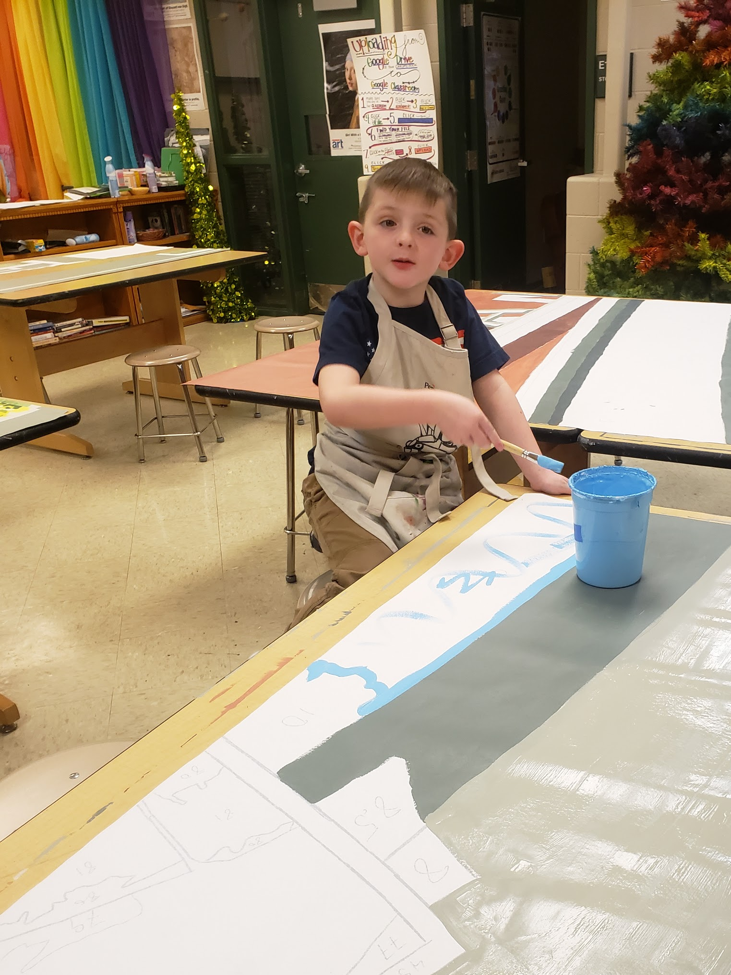
And Jackson got to help too!

Slide 10
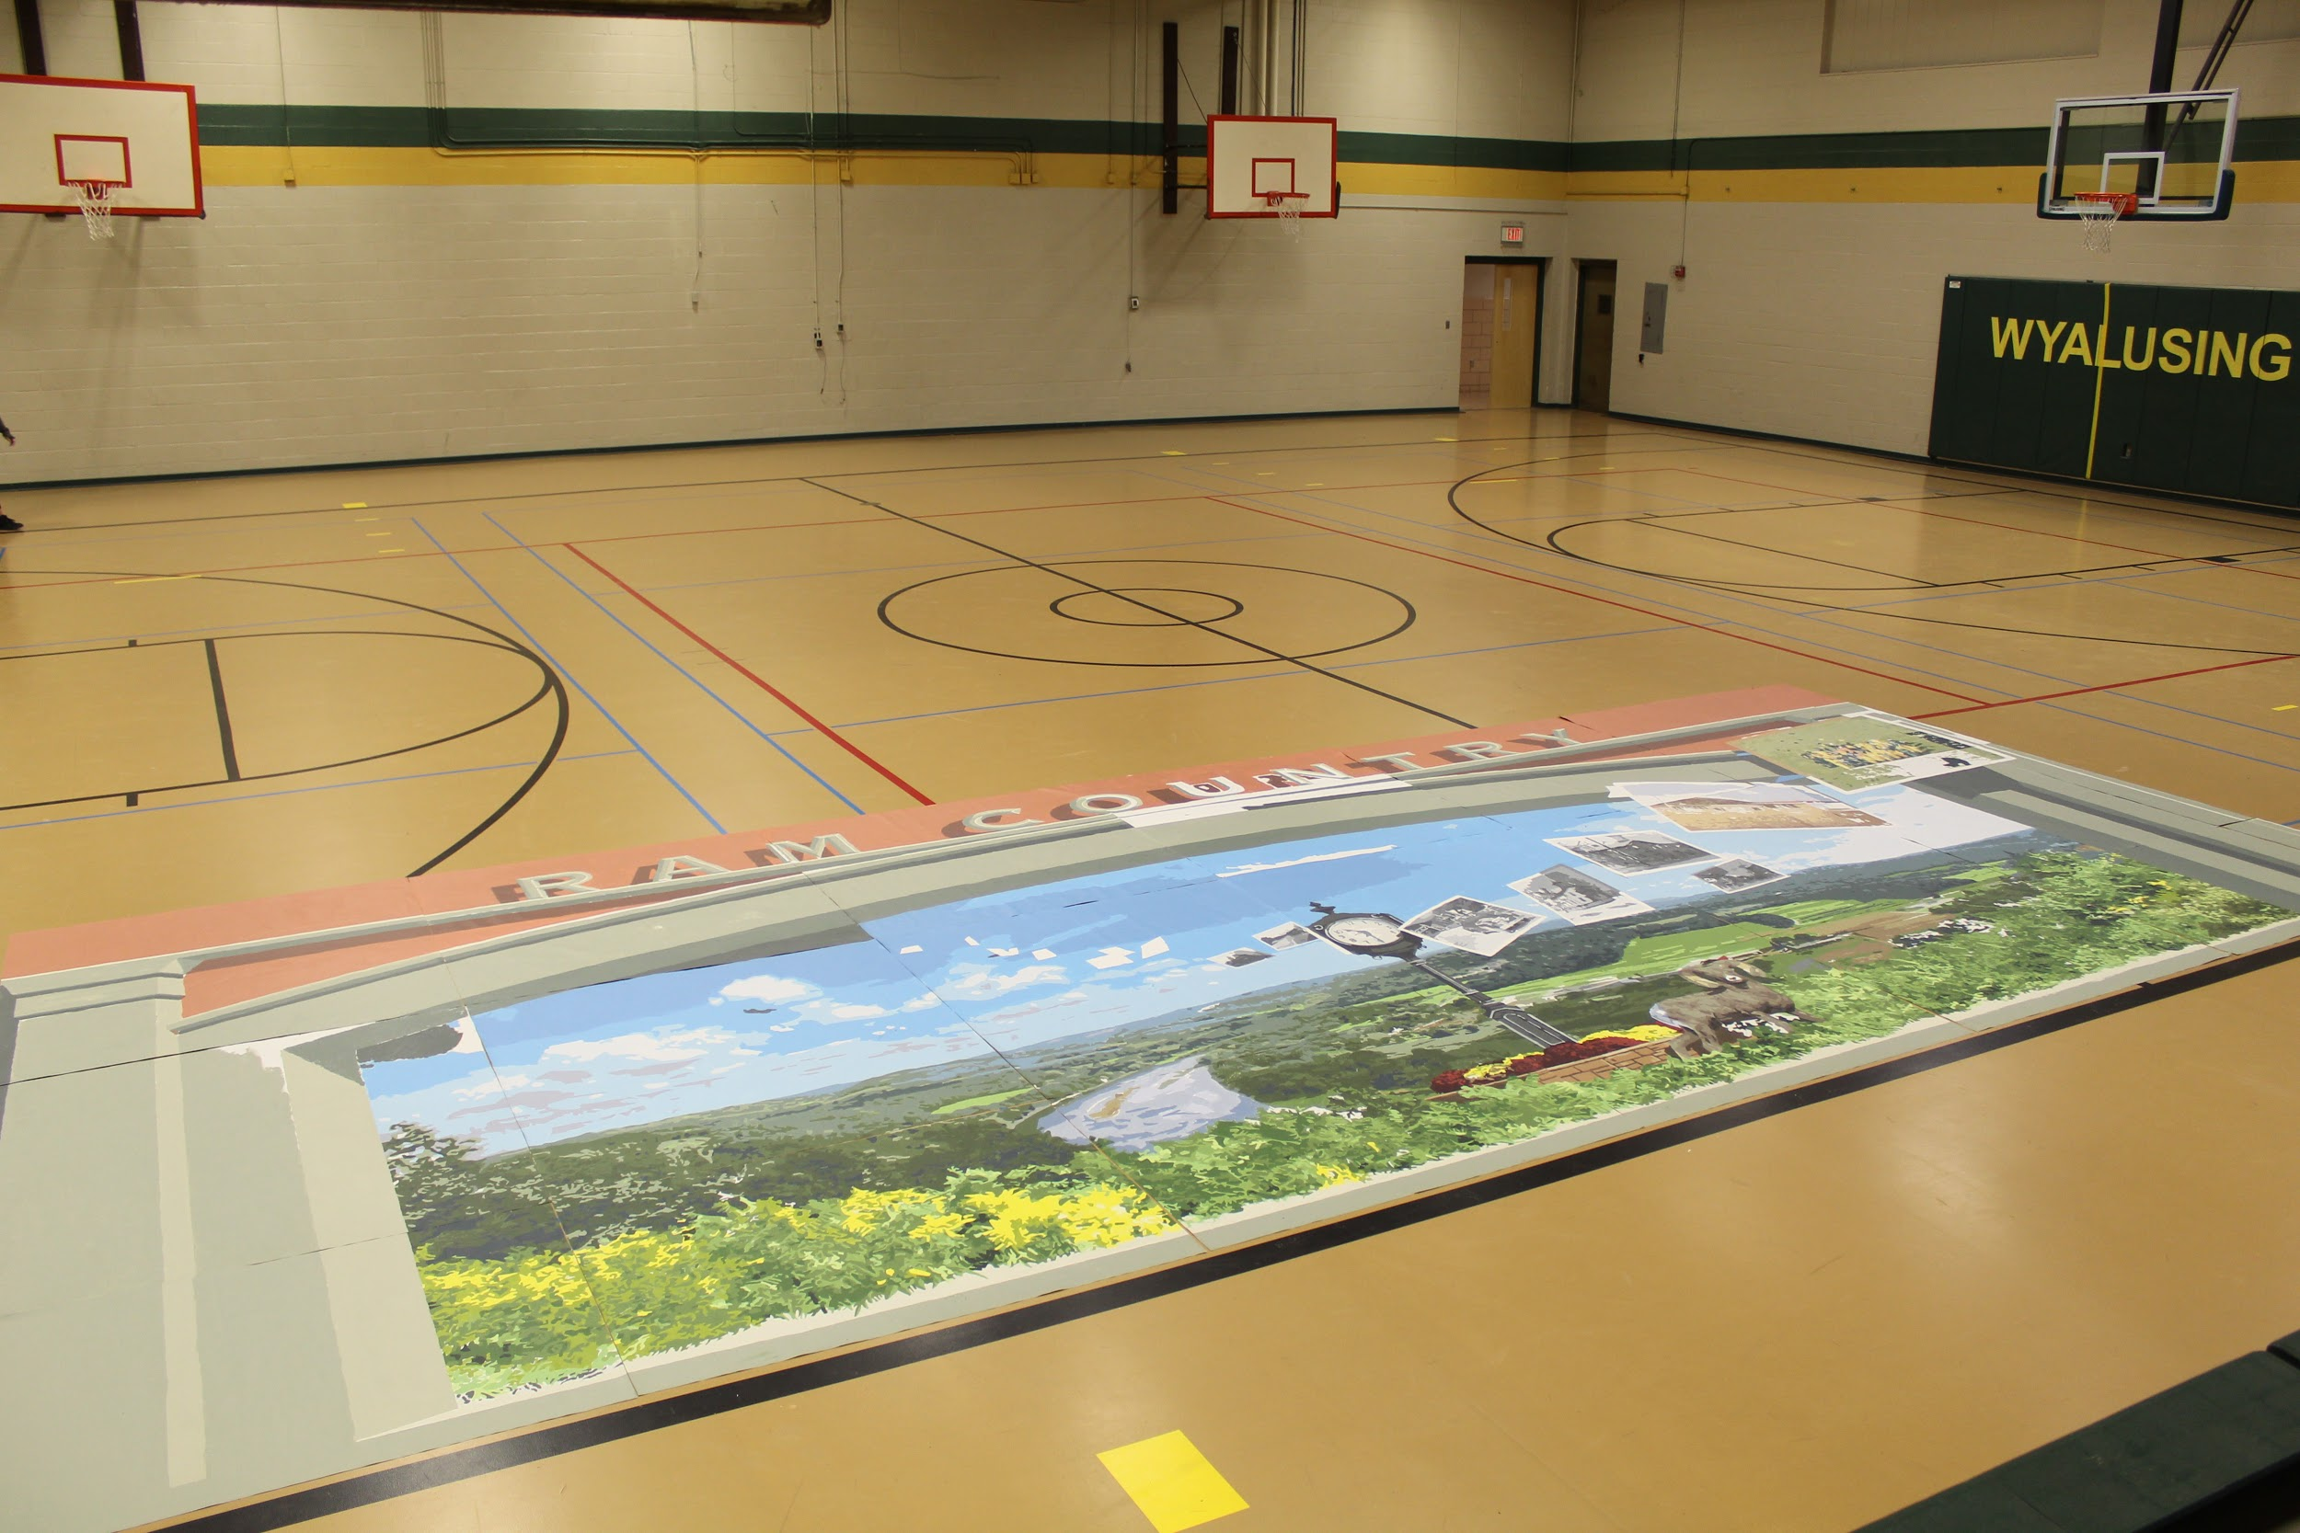
The last day of work in December
The last day Jon was with us in December was so exciting!
First, we had worked much faster than he anticipated and were able to take the panels to the old gym to lay out and see how it would all come together.
He will do a lot more to the panels but it is amazing to see how far we made it in just a few days!

Slide 11
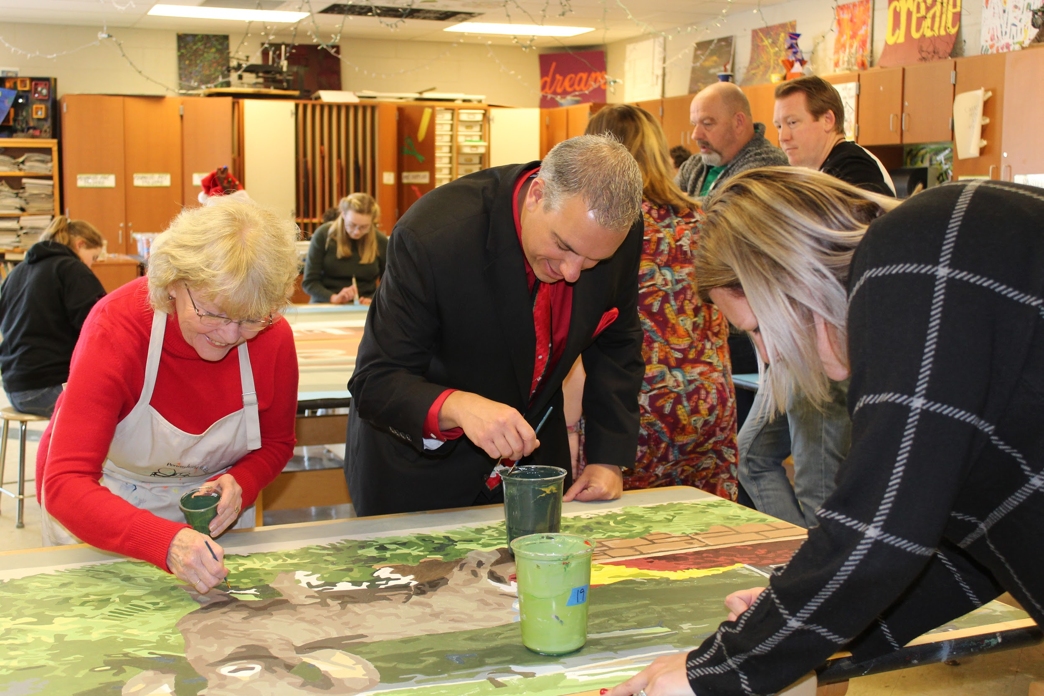
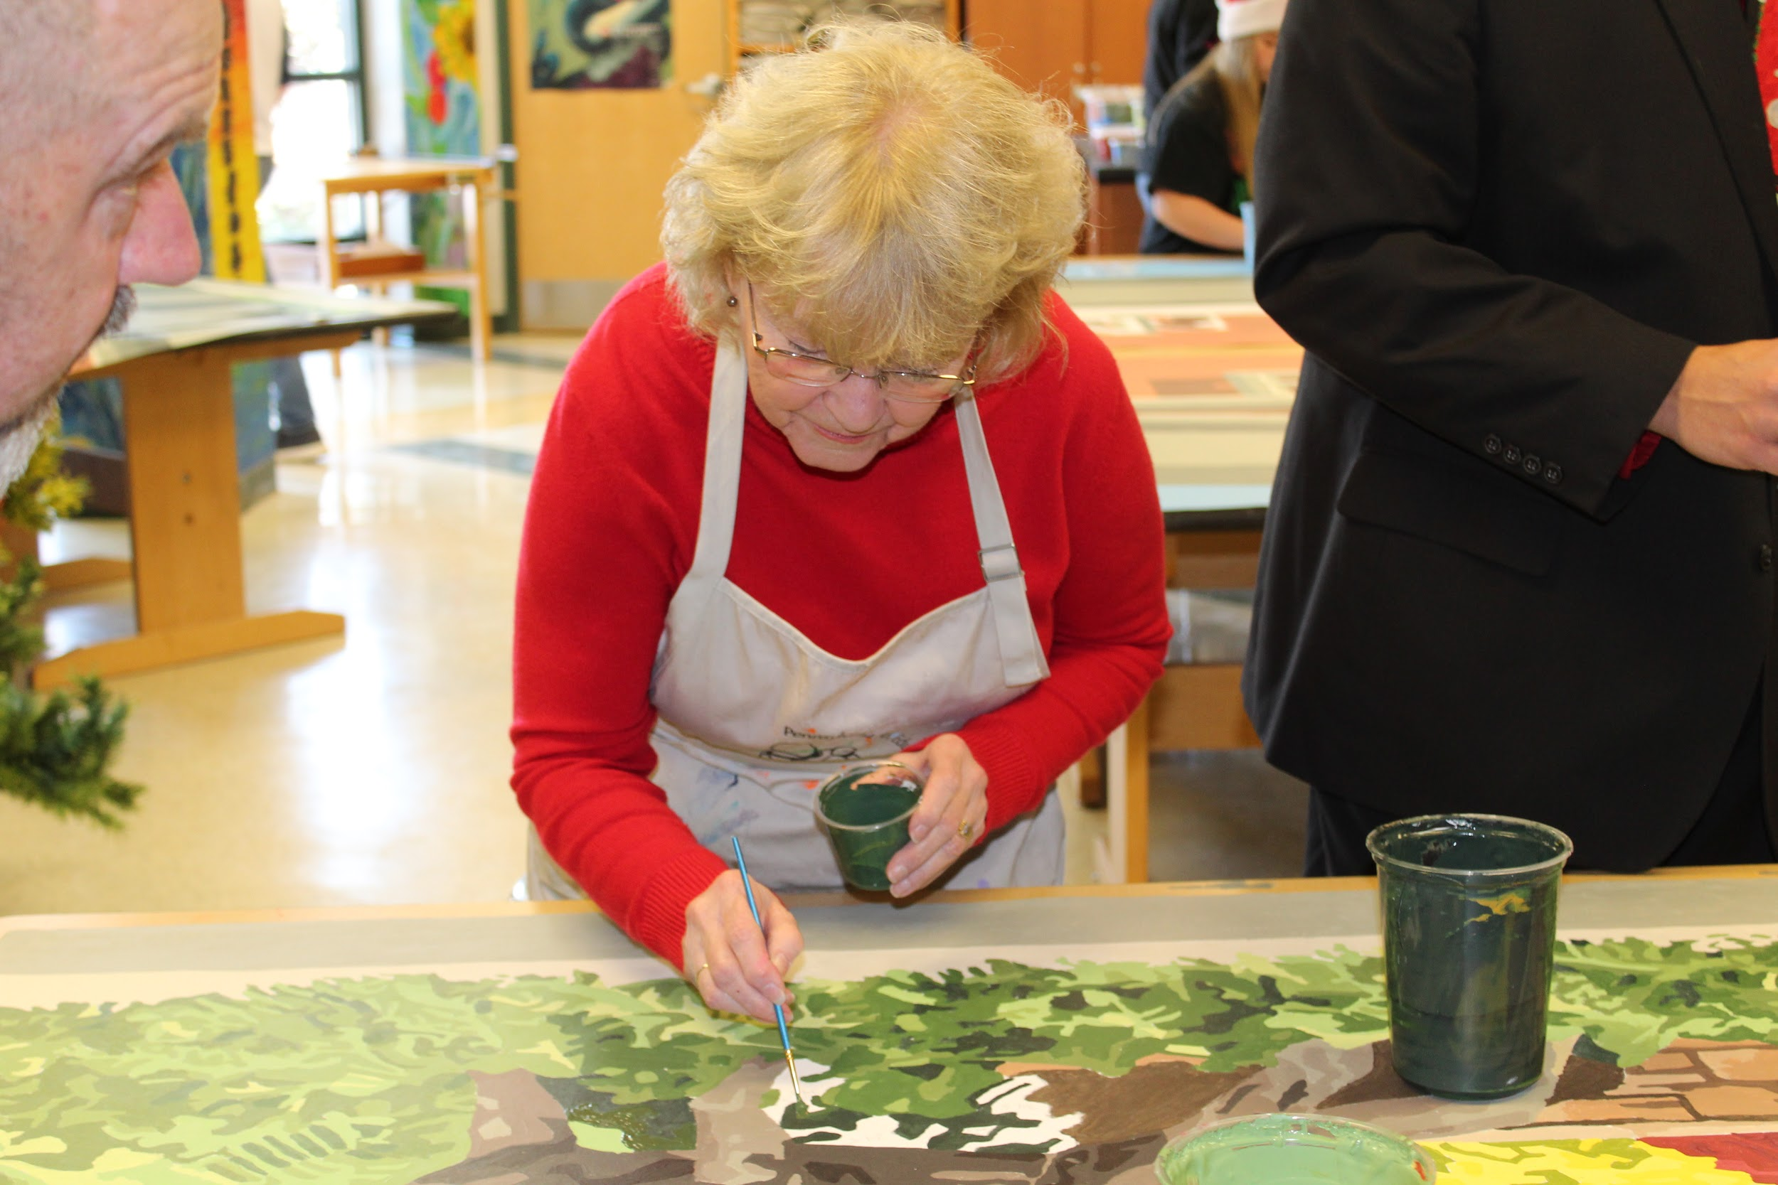
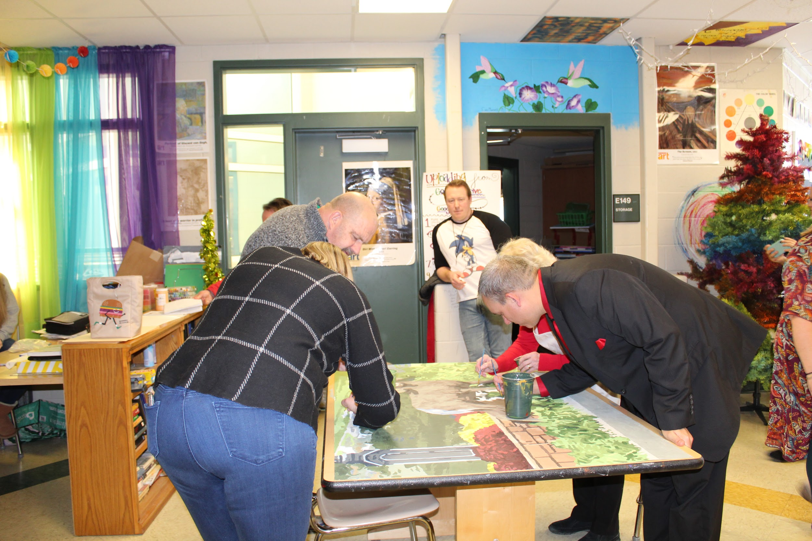
Special Visitors
On that day, we also welcomed visitors to the art room to share our progress!
Individuals from WAEF, Renae Chamberlin from BCRAC and Dr. Bottiglieri visited as well as state representative Tina Pickett! They were able to see the project in progress as well as help paint!

Slide 12
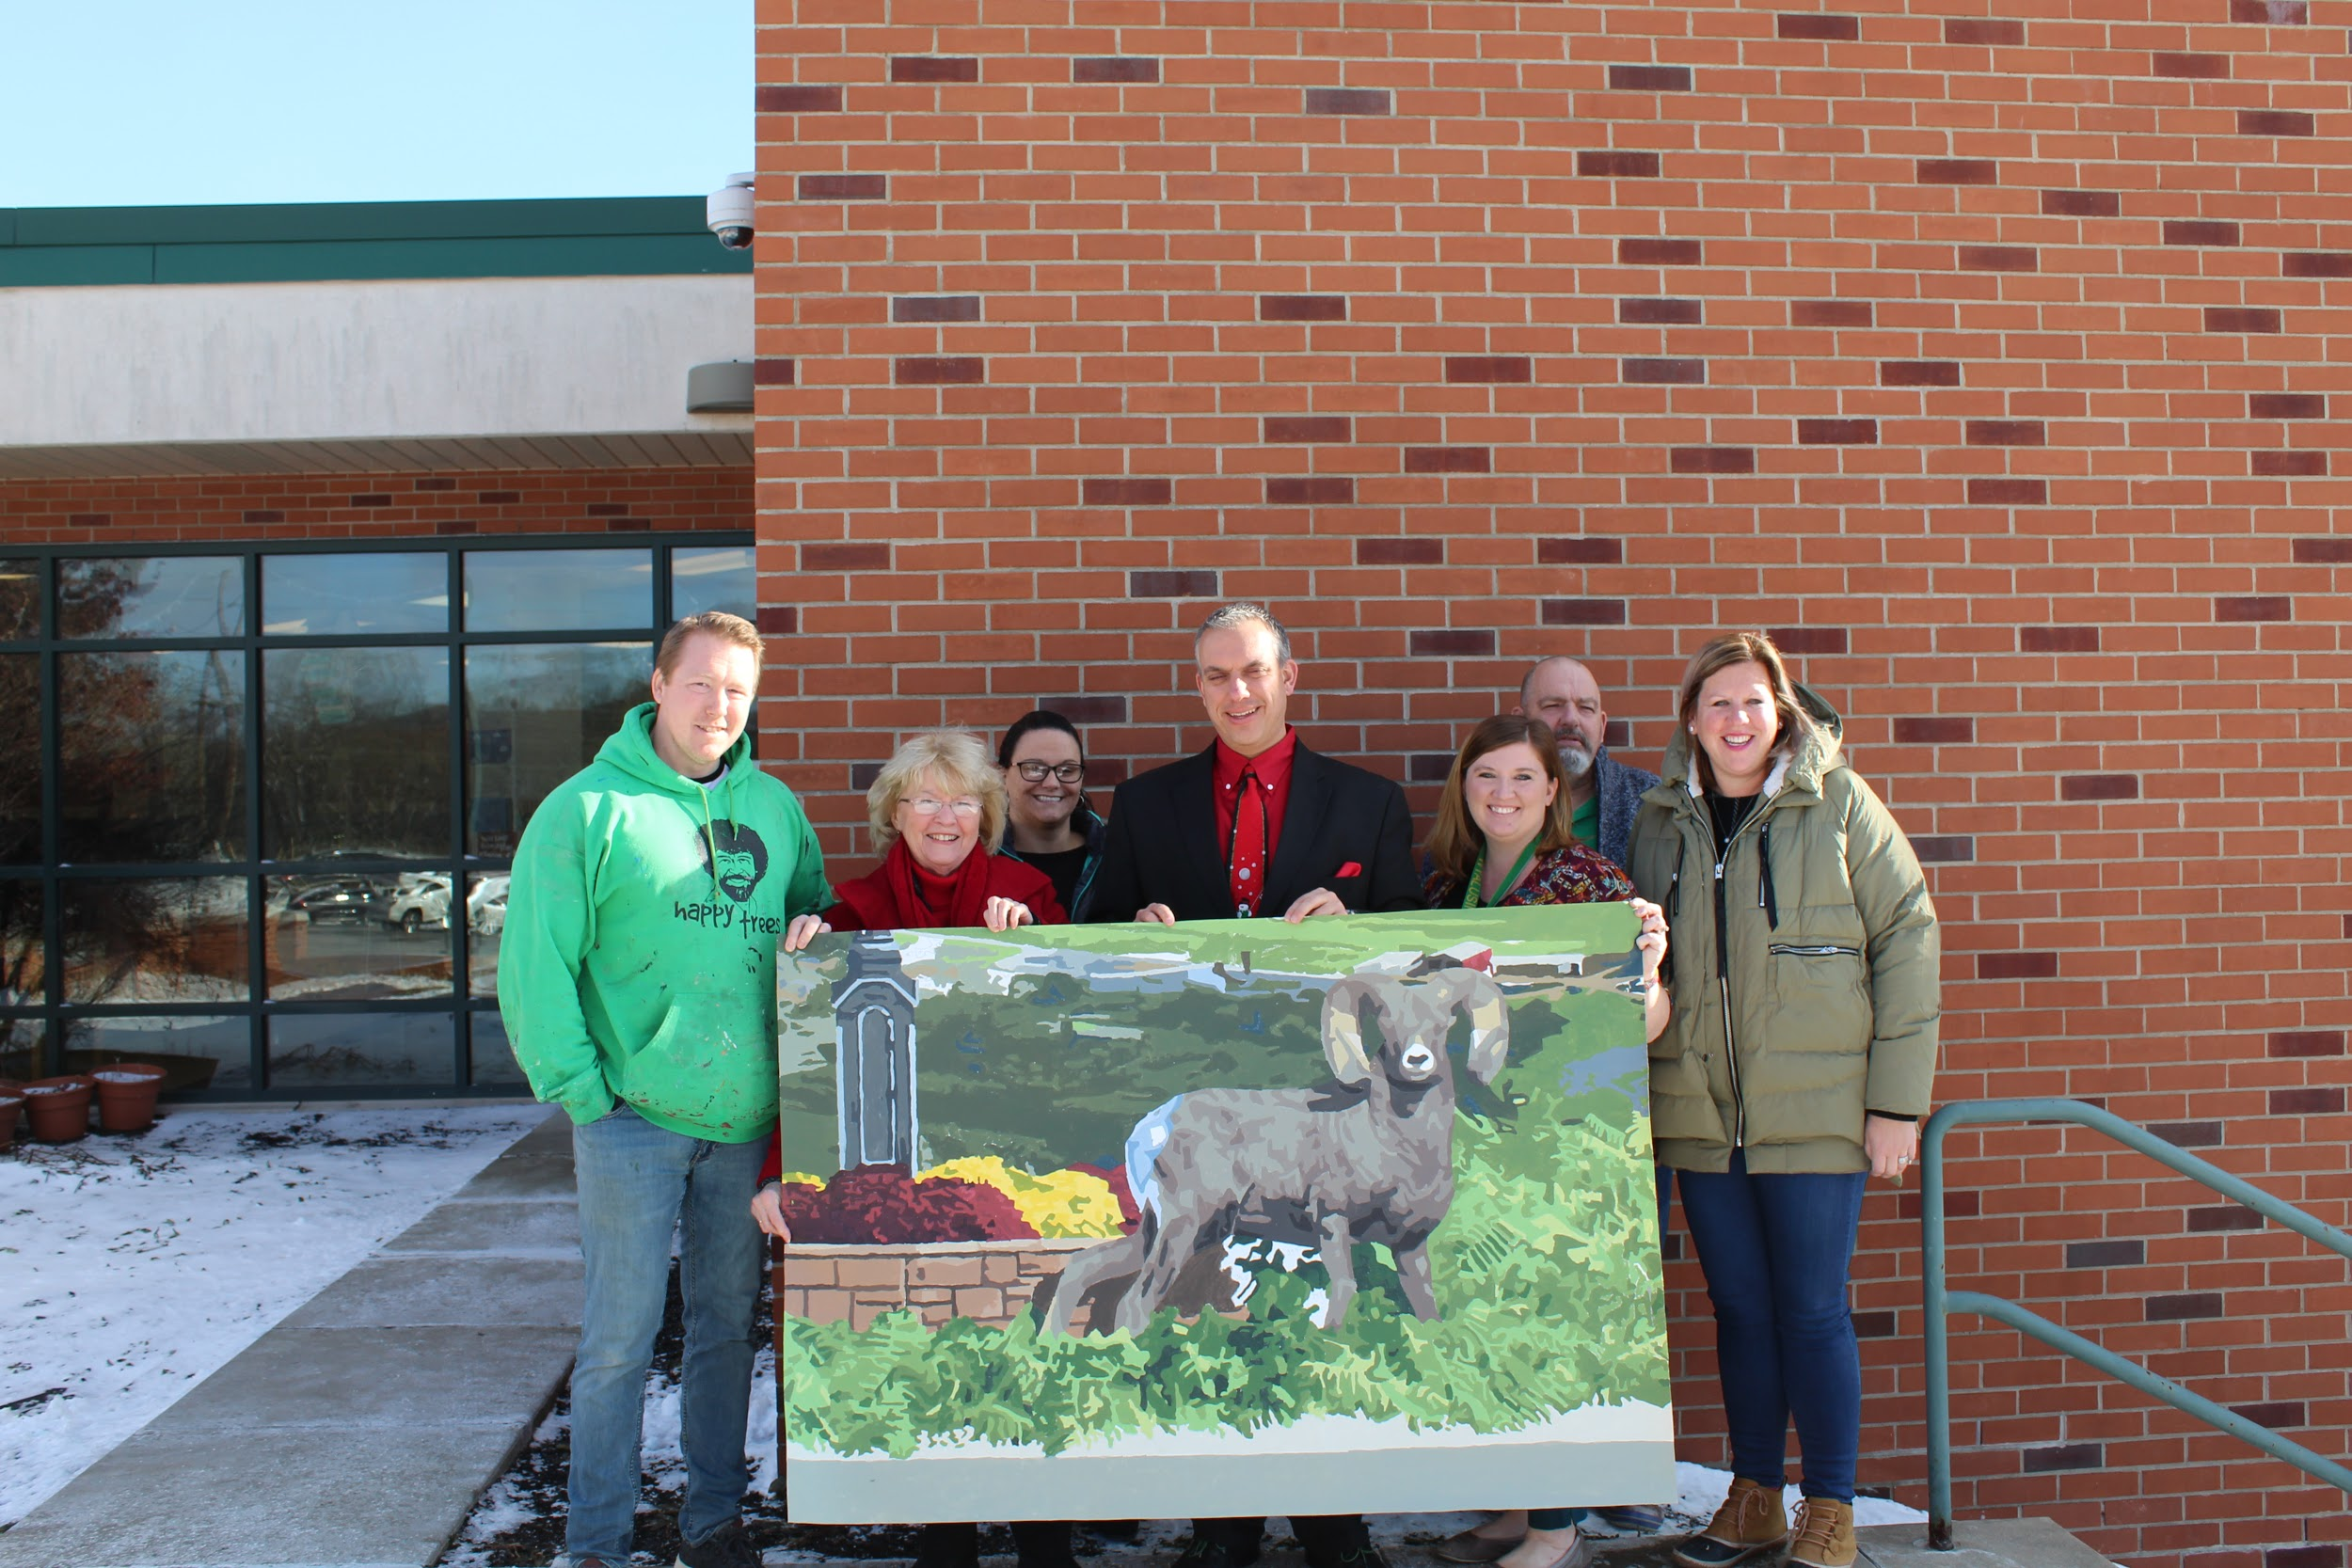

Slide 13
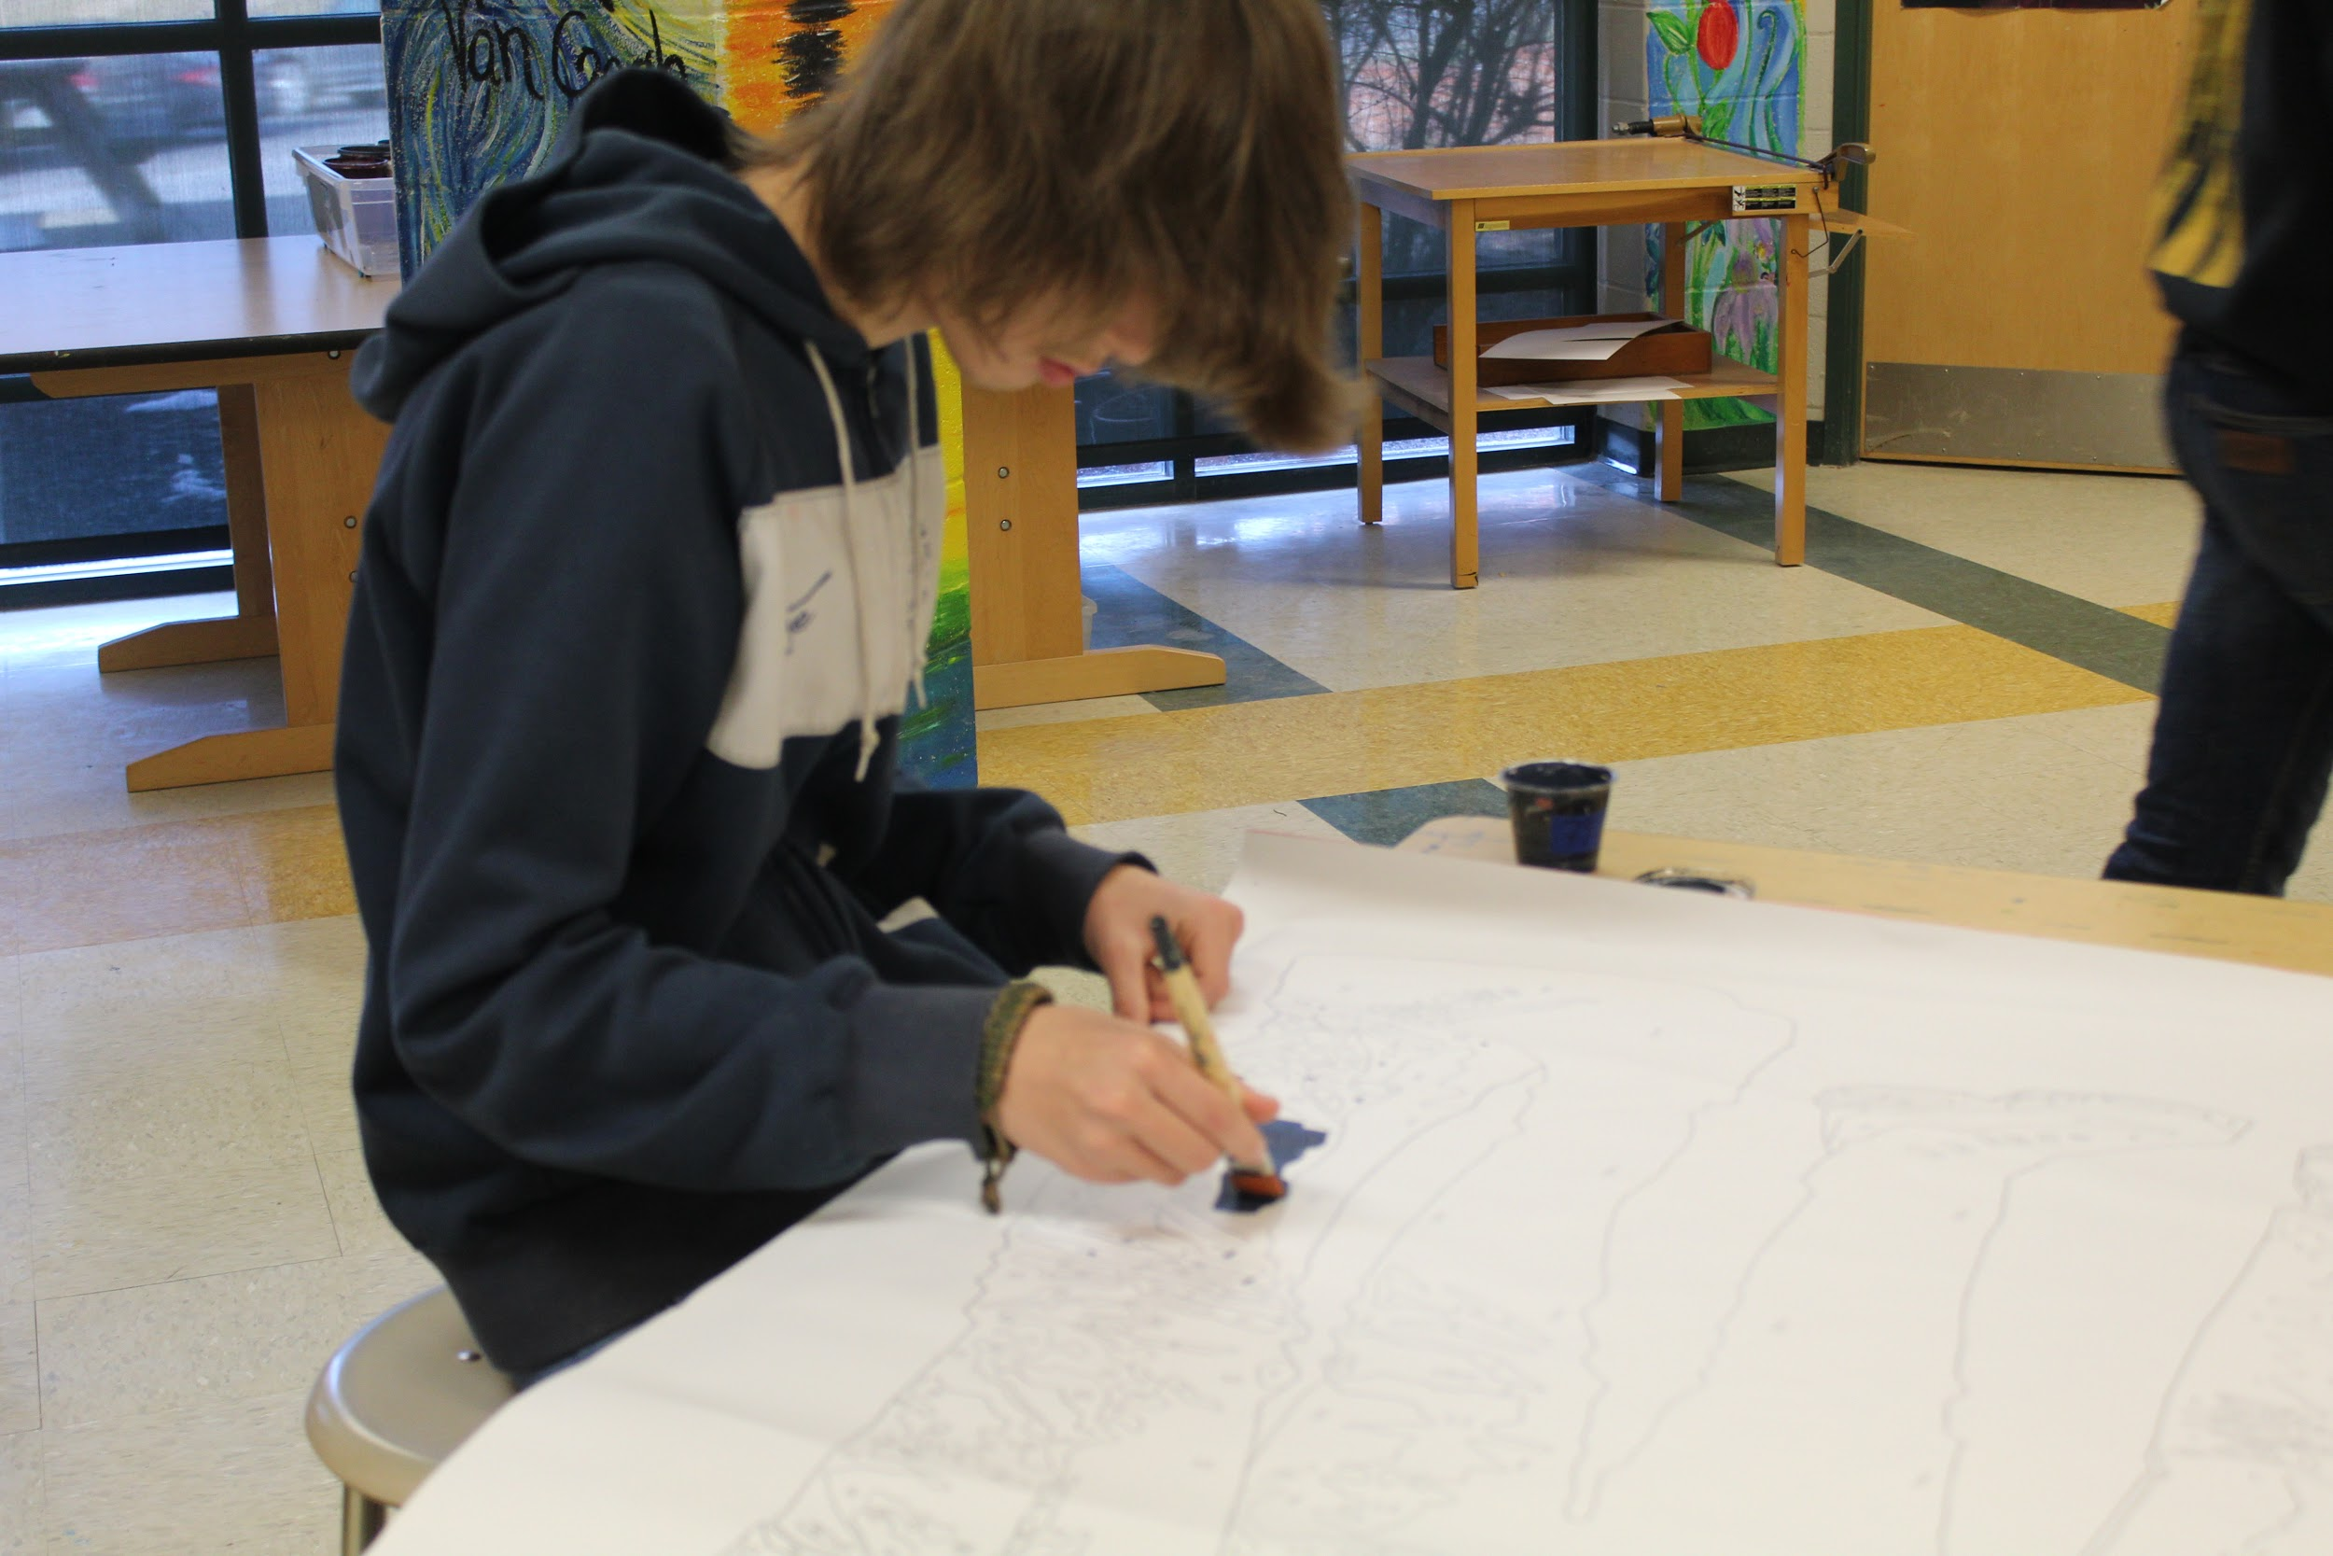
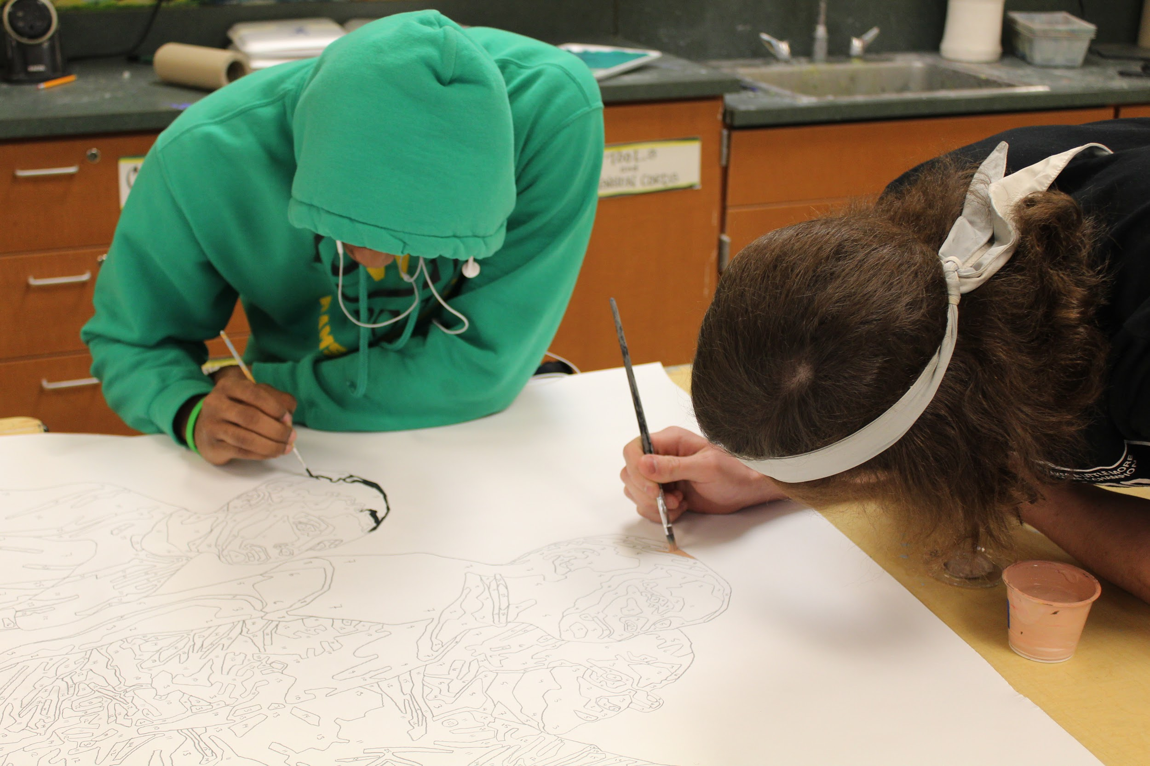
Adding People
Jon returned to WVHS February 12, 13, 14 with a little more for us to paint. He often adds people to his murals to reinforce the illusion of the mural.
He brought a new collection of about 90 colors and panels with people drawn on them.
The best part of the timing of this was that I had all new classes since we are in a new semester and a whole other group of students was able to get involved and make their mark!

Slide 14
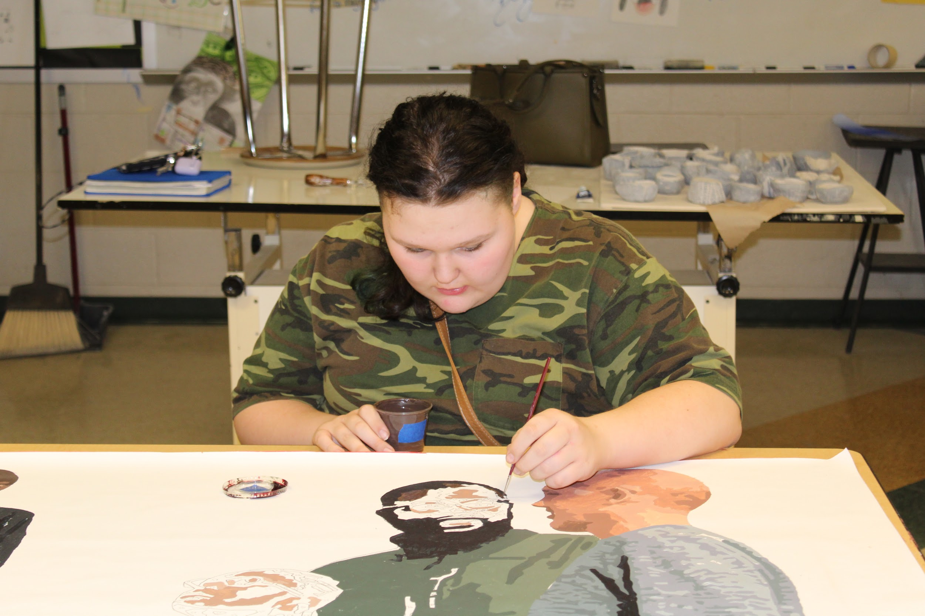
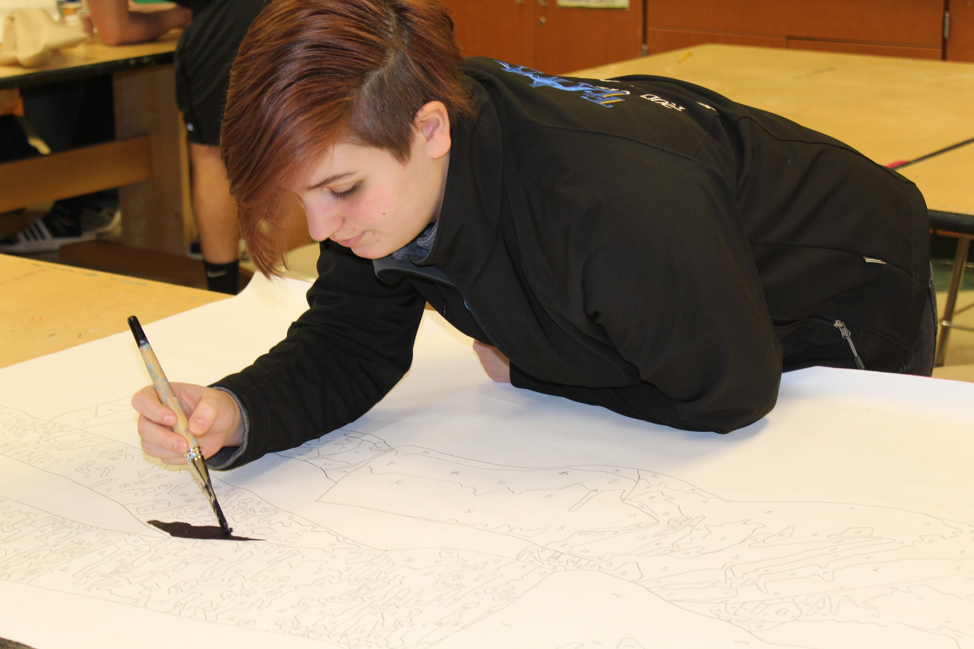

Slide 15
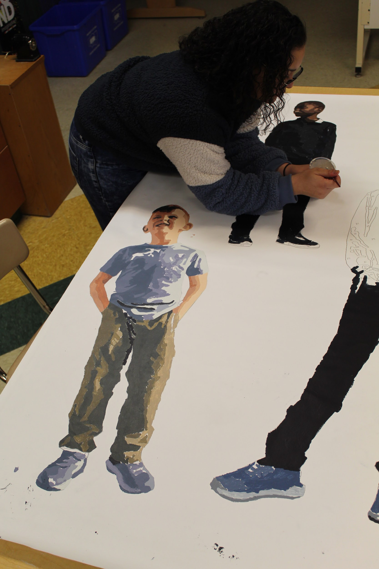
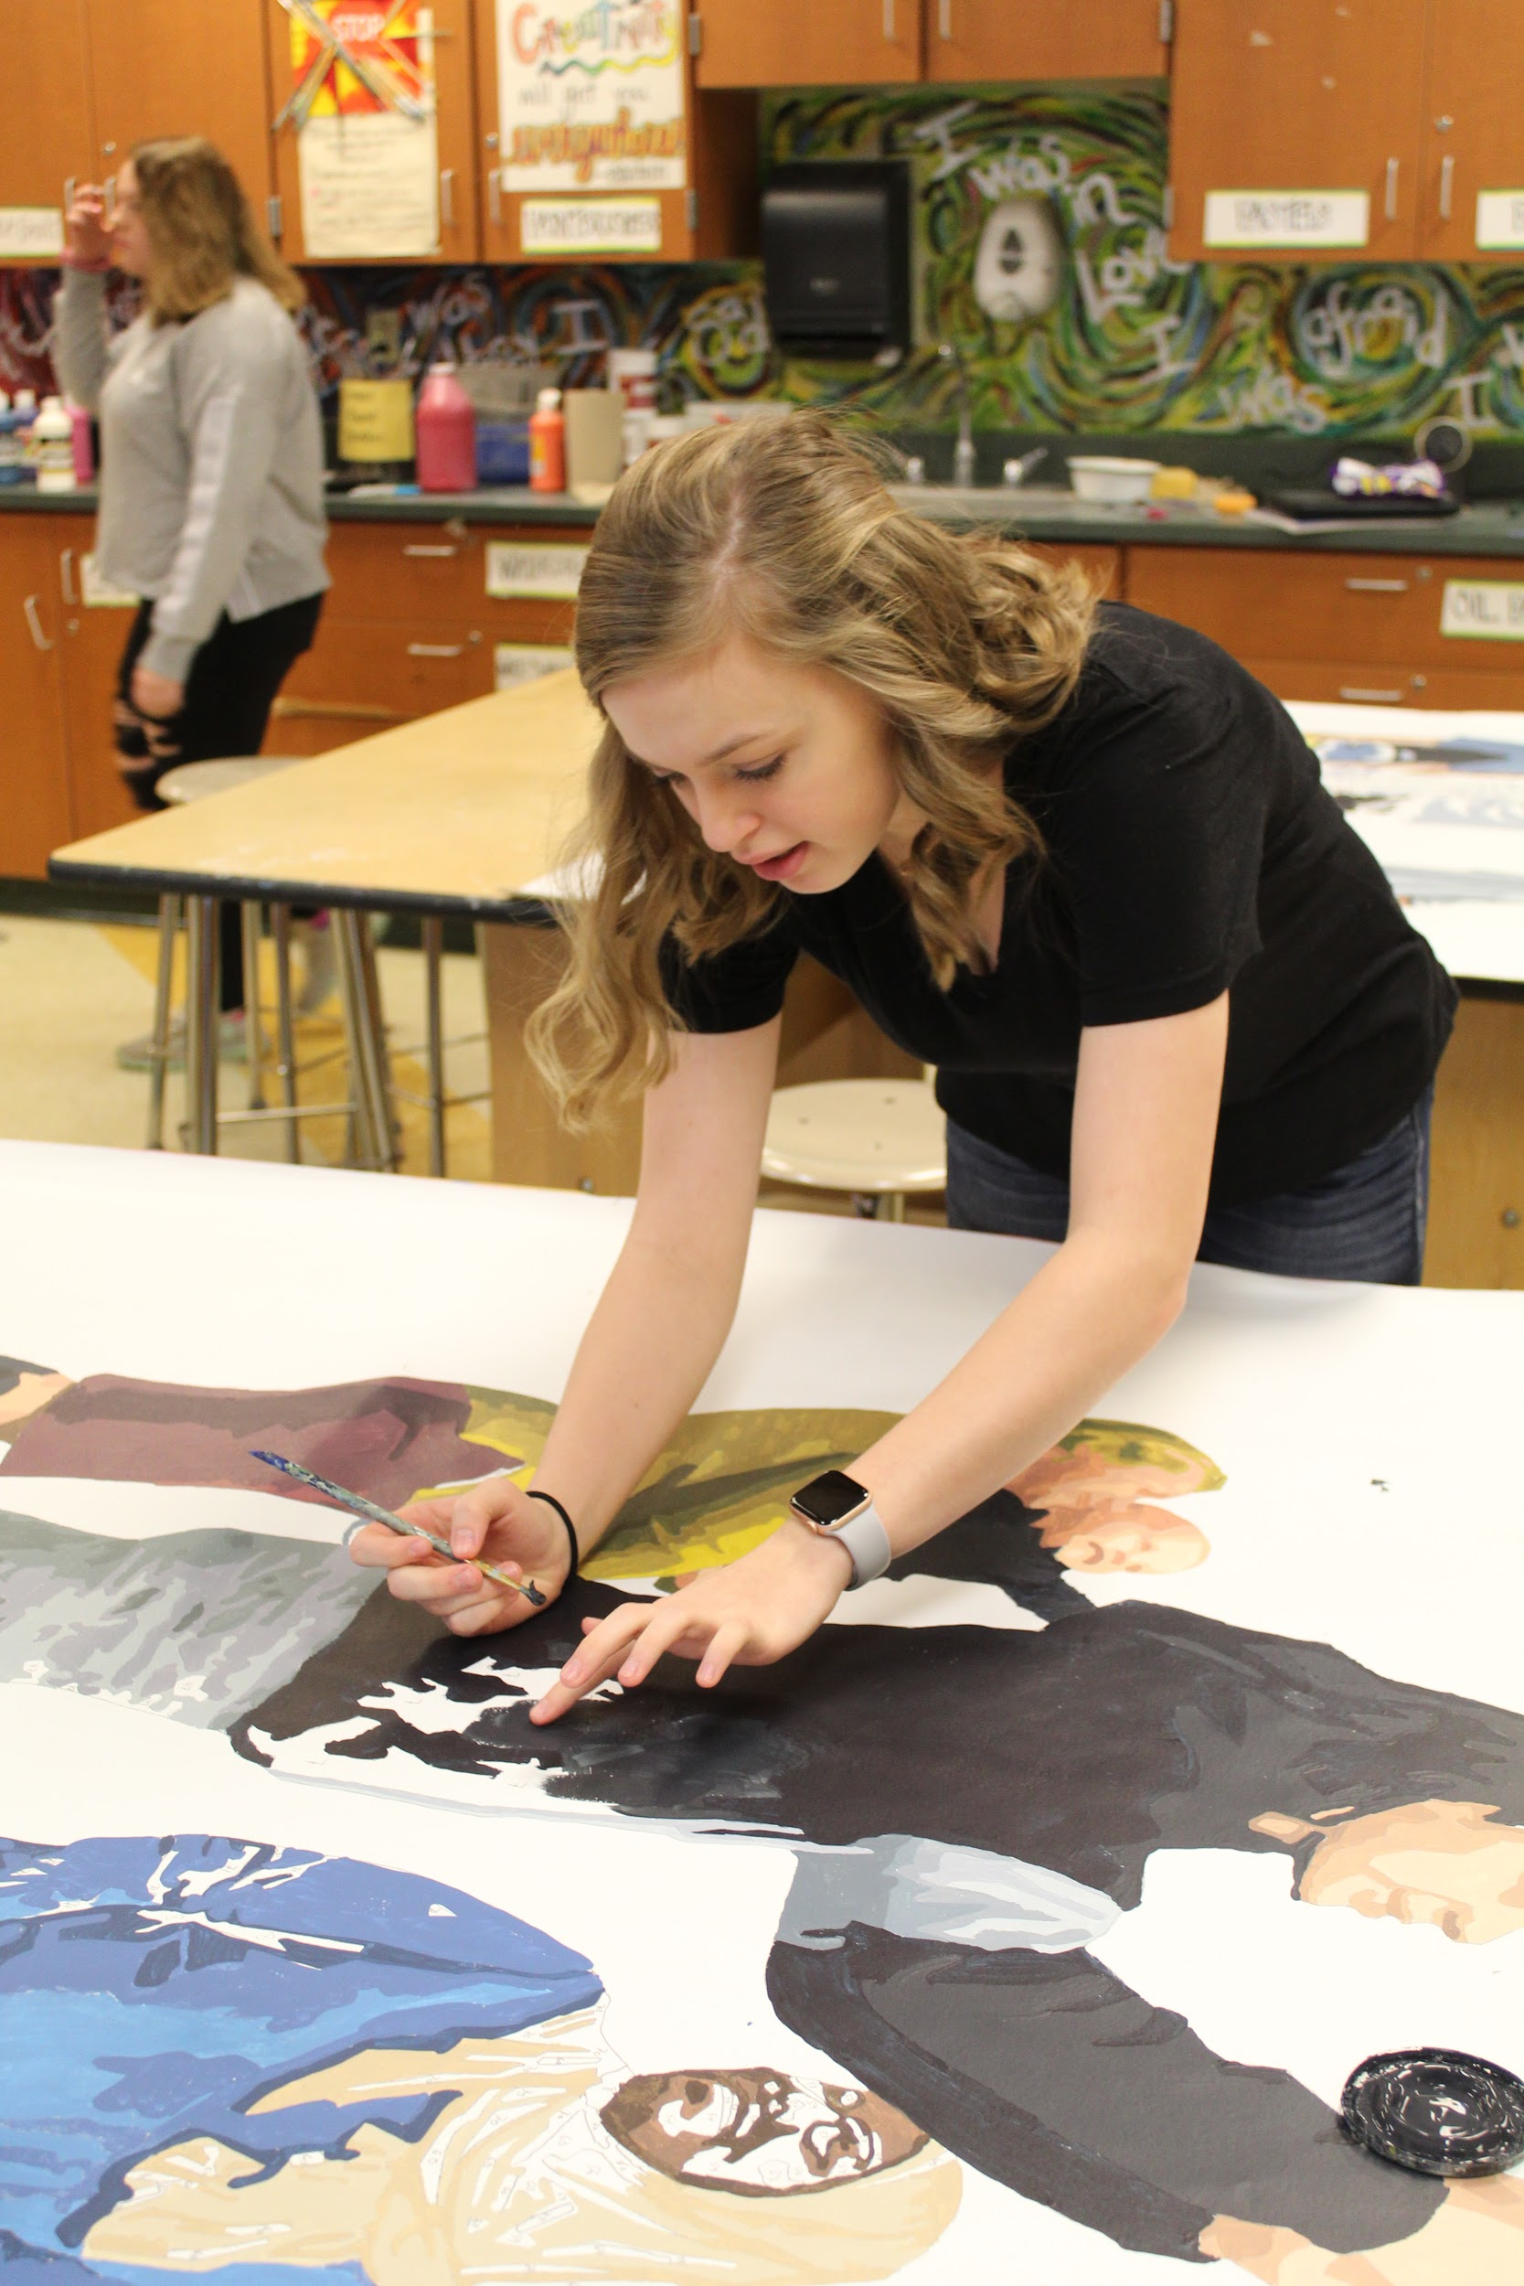

Slide 16
Next step...
After finishing the people panels on Friday, Jon took everything (all panels and paint) back to Philadelphia with him. Now he will rework the panels to make everything look more realistic and finished. He will return in May so that we can begin installing the mural! Because some the mural is ground level, students will be able to help with this process!

