Slide 1
Design, Accessibility and Tacos!
May 2024
Notes:
I am the Communications Manager for the Resource Center. Some of my job duties include the social media marketing and promotion of the work that our team is doing in our offices in Iowa and across the nation. I also brand our materials and do the video editing of webinars, network spotlights, and more. My expertise is in brand and marketing and with that comes being an expert in accessibility and 508 compliance. A fun fact about me is that I love to organize and my team knows this about me in the way I make my spreadsheets and color code things.

Slide 2

Did you know?
90% of the PDFs are largely inaccessible to people with disabilities
Notes:
90% of the PDFs that are floating around on the internet and in inboxes are largely inaccessible. Making accessible materials is a good job skill that you can hopefully add to your resume soon after this training or at least over the course of your grant period.
I want to take some time now to have you share with me how you are involved with creating materials and resources on your project.
(Share Out)
It is great to be here with you and able to share what I have learned on creating accessible documents. We will work on some of the basics within a Word document during this hour and then will share with you some resources that can help you after you leave today.

Slide 3
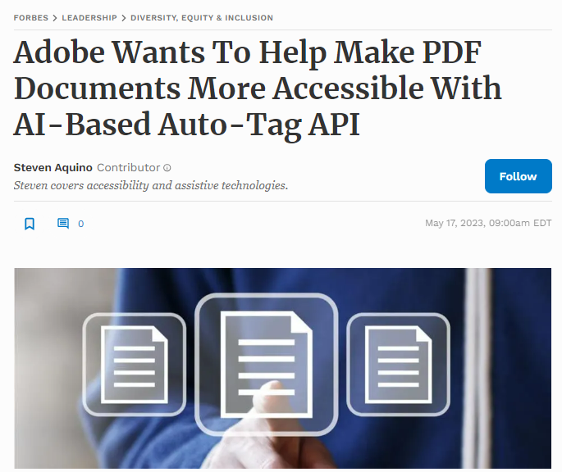
Things are always changing
Adobe Accessibility Auto-Tag API
Notes:
Technology is quickly changing both assistive technology AND the technology that we use to make our resources accessible for the end user. Two years ago I did everything myself. But now there is the help of AI technology.
on May 17, 2023 Forbes published an article about the “all-new Adobe Accessibility Auto-Tag API” stating “the tool is powered by its artificial intelligence and machine learning framework”. This advancement has been shown to save 70-80% but up to 100% of time when it comes to the process of making a PDF accessible.
My experience with this advancement has been positive for the most part. It, of course, does not always fix all the errors within a document but it does save hours of work when it works correctly.

Slide 4

KWL Chart
What I KNOW | What I WONDER | What I LEARNED
Notes:
Let’s spend a few minutes filling out the first two columns of this table.
Let’s begin with what you know. Write at least one and up to three things. (post it notes? Mentimeter?)
Let’s transition now to what you wonder. Again, write one to three things you would like to know.
Please keep in mind that I made this presentation before today and therefore I hope that some of what you wonder about will be answered but we may need to find another time to meet to cover a few of the other things that you wonder about.

Slide 5
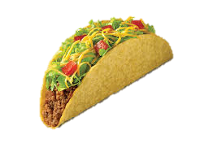
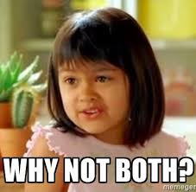
Agenda
Presentation
Let’s Work Through It
Design Time
Notes:
Design, Accessibility and Tacos.
To give a little more information about the title of my presentation. I have heard before that you can have a eye-catching designed resource or a resource that is accessible but not both. Well to me that is like saying you can have soft shell tacos or hard shell tacos. And like one of my favorite commercials I say…why not both!?

Slide 6
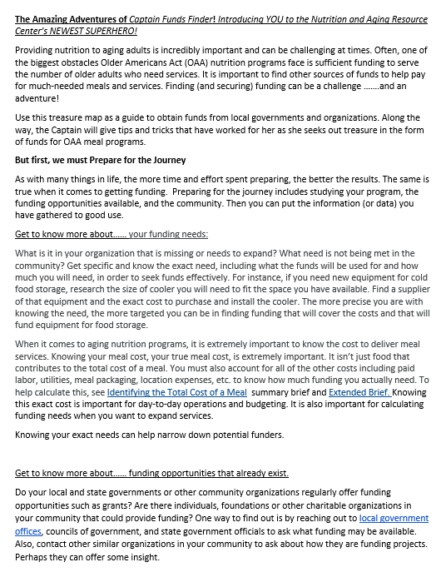
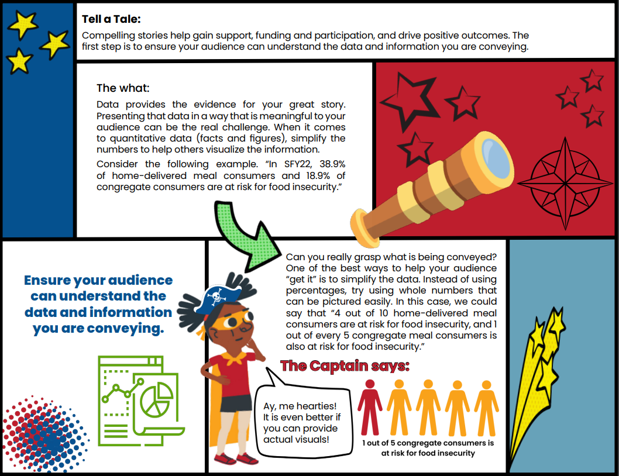
Nutrition and Aging Resource Center Example
Notes:
Share with the person to your left and say “you can have both”.
Share with the person to your right and say “It’s not that hard”.
Share with the person in across from you and say “Let’s learn how”.
Talk about Erin created the Word doc – I created the visually appealing resource that you can find on our website today.

Slide 7
Why is accessibility important?
Notes:
Alright let’s begin.

Slide 8
People Impacted Worldwide
Visual impairment 285 million
Moderate-to-profound hearing impairment 275 million
Many more have:
  Physical, speech, cognitive, neurological disabilities
  Limited understanding of English
Notes:
Accessibility ensures that all users can access the product or service, regardless of their capabilities
285 million people have some sort of visual impairment
275 million people with moderate-to-profound hearing impairment
Many more have physical, speech, cognitive, neurological disabilities or a limited understanding of English

Slide 9
Accessibility benefits everyone
Examples include the following:
Closed captions
Curb cutouts and ramps
Audio books and screen readers
Notes:
Closed captions for people with hearing impairments
Curb cutouts and ramps for people in wheelchairs and other physical challenges
Audio books and screen readers for those with visual impairments
Most of us encounter accessibility features every day that were originally created for people with disabilities. Each of these above were made to make things easier for people with disabilities but I can tell you that curb cutouts also make pushing my four month old in a stroller on walks a whole lot easier.
Can you think of any others?
Automatic door openers
Elevators
Handles in bathroom stalls
Clips to unlock a baby from their carseat

Slide 10
What is assistive technology?
Assistive Technology (AT) - any item, piece of equipment, or system that is commonly used to increase, maintain, or improve an individuals functioning related to cognition, communication, hearing, mobility, self-care and vision.
Notes:
Assistive products can range from physical products such as wheelchairs, glasses, prosthetic limbs, white canes, and hearing aids to digital solutions such as speech recognition or time management software and captioning.
Most people who use assistive technology use more than one product, making integrated services important.
Globally, more than 2.5 billion people need one or more assistive products.
With an ageing global population and a rise in noncommunicable diseases, an estimated 3.5 billion people will need assistive technology by 2050.

Slide 11
World Health Organization
“‘Leaving no one behind’ means ensuring people with disabilities, the older population, those affected by chronic diseases and everyone who needs assistive technology are included in society and able to live healthy and dignified lives.”
Notes:
This is one sentence that I think is important for us to reflect on from the World Health Organization. “‘Leaving no one behind’ means ensuring people with disabilities, the older population, those affected by chronic diseases and everyone who needs assistive technology are included in society and able to live healthy and dignified lives.”
This should sound familiar as the Older Americans Act supports a range of essential home- and community-based services to help as many older adults live as independently as possible in their homes and communities. I think we can see the overlap that Assistive Technology has with OAA services.

Slide 12
Why is it important to YOU?
Before content is made public, it must be accessible per section 508.
Electronic content includes, but is not limited to:
Electronic documents
Websites
Applications
Agency-wide emails
Notes:
Things that can create an accessibility problem are:
Images
Captions
Color
Data tables
Dynamic content/interactivity
Forms
Navigational elements/links
Remember – as I stated in a previous training (done August 2023 – recorded, link in resources) it is easier to create content that is accessible in the first place (bake it in) rather than to remediate the content after it is final (bolt it on).

Slide 13
Scenario 1
Notes:
You are tasked with designing illustrations to aid in a presentation.
You create a pie chart and a line graph.
*have the designs come in*
Your designs are rejected – PAUSE – can anyone tell me why?
They were sent to a test group for feedback and there was a user that was colorblind who could not relate the legend to the charts.

Slide 14
Colorblind View
Notes:
This is what the user who has colorblindness saw.
You cannot convey information with color alone.

Slide 15
Scenario 1 - Fixed
Notes:
As you can see here we added texture and pattern to the different data points to better show the difference.

Slide 16
Scenario 1 – Fixed and Monochromatic
Notes:
This is what the graphs would look like to the individual with colorblindness.

Slide 17
Capstone Video
PowerPoint Presentations

Slide 18

Things to consider when using PowerPoint:
When was the last presentation that you gave?
What do you remember?
Notes:
We all use them in our work and I see them a lot in Capstone Projects. My hope is to get you thinking about them in a different way including accessibility.
Consider the content you are presenting and accessibility of the content.
Would you like to have had a recording of some of the presentations you were at yesterday?
*We will expand on this a little later.

Slide 19

Text on slides
Limit text
One idea per slide
Turn a paragraph into an outline
Bullet points for short phrases – limit sentences to quotes
Notes:
Limit text *click to bring in period* PERIOD.
Text on slides “should complement your presentation, not attempt to replace or duplicate it”.
“People cannot read and listen at the same time. People with cognitive and learning disorders will find it especially difficult to listen to you and read your slides simultaneously.”

Slide 20


Images on slides
Do not use images just to use them.

Slide 21
What is the purpose of the presentation?
PowerPoint is an aid.
“Do not read word for word off of your slides. People do not want to listen to a presentation that they could have simply read a copy of the slides. This is a test slide to see if you are reading along. When you read this sentence stand and say your name and favorite color to get a prize.”
Notes:
Instead of giving PowerPoint slides as a form of information - produce a handout with additional and more complete information covered in the presentation.
I want you to think so much of your slides as being just an aid. So much that people don’t even want to ask if your slides will be made available after the presentation. They should just want the recording – which I am going to get to that now.
*wait for someone to read the slide, stand and say their name and favorite color for a prize.

Slide 22

Think Outside the Box – What is easiest for the end user?

Slide 23
PowerPoint Slides vs. Recordings
What would you prefer?
Slides with or without speaker notes?
Slides or a recording of the presentation?
Beef or chicken?
Notes:
What would you pick? With a raise of hands – and there is no wrong answer.
It is pretty clear that when it comes to getting the most valuable information we would rather have the recording. I can tell you right now that when I was preparing for this presentation I realized that it would be pointless for me to sit here and go step-by-step on how to made a document accessible because it wasn’t being recorded. And I know that there are hundreds of videos already out there that can show you how to do just that.
Don’t worry I will give you plenty of resources of video presentations where slides are not available but the content is great.

Slide 24
What to know about recordings
Things to consider:
Post presentation edits
  Trim the beginning and ending
Sharing platforms
  YouTube, Vimeo, etc.
Automatic closed captioning
  Ensure accuracy
Notes:
Trim a recording to be just the recording
Think about where you want to share your recordings – I do recommend YouTube because it is free and there are three types of videos that you can have on your channel (Public, Private, and Unlisted)
Automatic closed captioning can help to bridge “communication gaps and ensures multimedia content is inclusive and accessible to all.” However, it is not perfect and has its limitations.
YouTube is a popular video streaming service that uses automatic captions to help make the content more accessible. “Automatic captioning technology employs sophisticated AI algorithms to transcribe spoken language into text rapidly.” “A study by the University of Minnesota found that only 60-70% of YouTube’s automatic captions are accurate.” Meaning 1 in 3 automatically captioned words could be incorrect. “These inaccuracies significantly impact users with audio impairments who depend on captions for comprehension.”

Slide 25
Closed Captioning
Addressing the automatic inaccuracies
Grammatical errors
Mispronunciations
Background noise
Notes:
To ensure accuracy:
Have high-quality audio free of grammatical errors, mispronunciations, and background noise.
Incorporate human checkers, regular testing, and user feedback for continuous improvement.
My process – YouTube to AI caption, copy to Word, listen at double speed and fix the closed captioning text to match the speakers sentence flow and any other mistakes.

Slide 26
Pros vs Cons of Video Presentations
Pros
  You eliminate the need for a PDF
  Easy to view resulting in an increase audience engagement
  Link to the video(s) or playlist for easy sharing
  Add to a playlist long after the grant is complete
  Less back and forth after the grant period is over
Notes:
Pros:
You can avoid checking your PowerPoint slides for 508 compliance when transferred to PDF
You get more engagement and credit for the work that you did. Nobody can come and take your slides and play them off as their own.
Others do not have to reinvent your slides as they are in PDF format not PowerPoint and therefore they are more likely to use your video(s).
You can continue to grow your work long after the grant period is complete.
You don’t have as much back and forth with the team and I after your grant period is complete to work to get your presentation slides compliant for your Capstone Project and the website.

Slide 27
Pros vs Cons Continued
Cons
  You could have not compliant slides that you are sharing (color contrast)
  You would have to find a quiet space – potentially needing to do the presentation more than once
Notes:
Cons:
Your slides may not meet accessibility standards – therefore, I would recommend checking the slides prior to presenting.
You would either need to record the presentation before you give it and play the recording or due to the environment you may need to give the presentation more than once
Because of this too you may miss on adding information that people are asking about – you can always add that information into your next presentation though, whether you record or not

Slide 28
Other Boxed Up Items
Flyers
Handouts
Sample menus/recipes
Assessments and surveys
Notes:
Do we need all the flyers, handouts, and sample menus/recipes that you have created? Or does showing one suffice?
Is the assessment or survey usable or transferrable to other organizations? Do you have the assessment or survey available on a website? How did you give the assessment or survey?
When it comes to adding materials to your Capstone Project ask yourself 1. if you would have the time to review the material and 2. if the material would have been helpful to have prior to starting the project.

Slide 29
Speed Round!

Slide 30
PDF Training Opportunities
Section 508.gov
  Module 0: Background & Information
  Module 1: What is a PDF?
  Module 2: Testing a PDF for Accessibility
  Module 3: Remediating PDFs for Accessibility
  Module 4: Converting Scanned Documents into Section 508 Conformant PDFs
Notes:
These are free trainings that are very helpful when getting started with accessibility in PDFs. I strongly recommend at least watching Module 2 and 3. These videos are both less than 20 minutes each.

Slide 31
Images and Alt Text
Word – mark as decorative
Decorative
Acrobat (PDF) – mark as artifact
Purpose?
Meaningful
Add alternate text
Notes:
How to help you determine if you need to add alternate text to an image, graph, figure, etc.
Is the purpose to be decorative or meaningful. If it is decorative then you do not need to add alt text. In Word you will mark it as decorative. In PDF you will mark it as an artifact. If it is meaningful you will add alternate text to explain what the graph, image, etc. is showing.

Slide 32

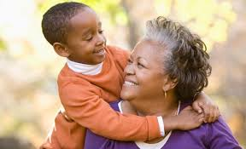
What would your alt. text be?

Slide 33
TABLES:
Structural Markup
Things to consider:
Visual cues do not make an accessible table
“People using screen readers can have the row and column headers read aloud as they navigate through the table.”
Notes:
It is best to use tables when needing to present related information in rows and columns.
What makes a table accessible is to:
Include a header row
Use a simple table structure (try to have no empty cells or merged cells)
Add alt text to the table
Do not use screenshots of the table

Slide 34
Let’s Work Through It!

Slide 35
Should We Meet Again?

Slide 36
Let Me Know Your Thoughts
Monthly, every other month, quarterly, twice a year
One hour, two hours
I would rather schedule my own time or office hours

Slide 37

Any Questions?
Marissa A. Vance MAC
marissa@.vance@iowa.gov

Slide 38
Resources
Forbes article on AI-Based Auto-Tag
limiting text and using graphics effectively
Automatic closed captioning
Watch Accessibility.com’s event on Closed Captioning
Assistive Technology
PDFs
Tables Tutorial
Building Tables
Intro to Accessibility

