Slide 1


Mini Innovation Panel:
Building and Sustaining Collaborations & Partnerships
Tim Getty
Regional Nutrition Coordinator
Notes:
This presentation template is a suggestion for what to work with when presenting to a crowd not particularly familiar with Heritage. The first handful of slides give an overview of the agency, after which your customized content can be introduced.
If you are presenting to a group already familiar with Heritage, consider cutting out some of the background info and getting right into the good stuff.
Feel free to let me know if you have any questions or concerns. Thanks!
-Harrison

Slide 2

Collaboration Building Background
AAA based in Cedar Rapids, IA
One of initial INNU Grantees-2017 (Encore Cafes)
Supplemental Food Distributions/Produce Pantries-Food Banks
Pet Assistance/TAILS
Encore Express Meal Voucher Program
Nutrition Counseling/Determine Assessments
Notes:
Options counseling services – help families plan for future long-term care needs, and coordinate with existing aging and disability service systems.
Information, referral and assistance – personalized information and referrals for supportive services that meet your needs.
Caregiver support and education – information on resources and services, along with educational sessions on topics specific to the needs of family caregivers.
Elder rights program – prevention, detection and reporting of abuse while also offering local advocacy and system coordination to ensure the protection of Iowa seniors.
Regional nutrition program – providing nutrition counseling and home delivered meals
Evidence-based health activities – Matter of Balance, water aerobics, tai chi, and others
Older-worker employment program – job assistance for persons aged 55+ with a disability.

Slide 3
Collaboration/Partnership Building-Why?
You can’t be successful without them
Existing funding will only stretch so far
Can result in a better product than first thought
Can be mutually beneficial
Sharing the workload
New opportunities to enhance existing or offer new programs
Positives to potential funders
Notes:
Options counseling services – help families plan for future long-term care needs, and coordinate with existing aging and disability service systems.
Information, referral and assistance – personalized information and referrals for supportive services that meet your needs.
Caregiver support and education – information on resources and services, along with educational sessions on topics specific to the needs of family caregivers.
Elder rights program – prevention, detection and reporting of abuse while also offering local advocacy and system coordination to ensure the protection of Iowa seniors.
Regional nutrition program – providing nutrition counseling and home delivered meals
Evidence-based health activities – Matter of Balance, water aerobics, tai chi, and others
Older-worker employment program – job assistance for persons aged 55+ with a disability.

Slide 4
Collaboration and Partnership-Who
Other Human Service Agencies: Food/Non-food/Pet
Law Enforcement/Local Governments
Local Media
Existing Partners/Subcontractors
Local Health Departments/Health Inspectors
Businesses/Banks/Industry/Manufacturers
Faith Based Organizations
Notes:
Options counseling services – help families plan for future long-term care needs, and coordinate with existing aging and disability service systems.
Information, referral and assistance – personalized information and referrals for supportive services that meet your needs.
Caregiver support and education – information on resources and services, along with educational sessions on topics specific to the needs of family caregivers.
Elder rights program – prevention, detection and reporting of abuse while also offering local advocacy and system coordination to ensure the protection of Iowa seniors.
Regional nutrition program – providing nutrition counseling and home delivered meals
Evidence-based health activities – Matter of Balance, water aerobics, tai chi, and others
Older-worker employment program – job assistance for persons aged 55+ with a disability.

Slide 5
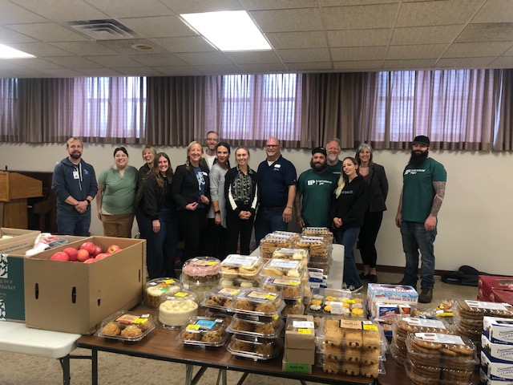
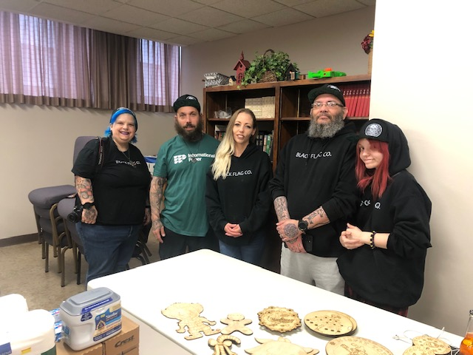
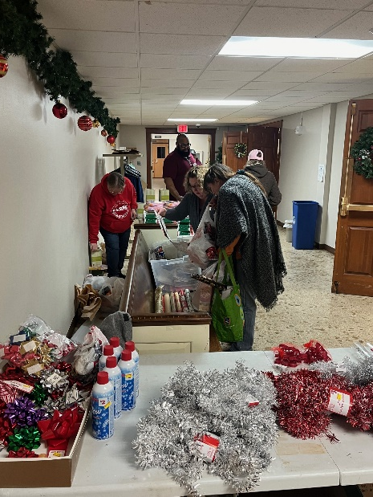
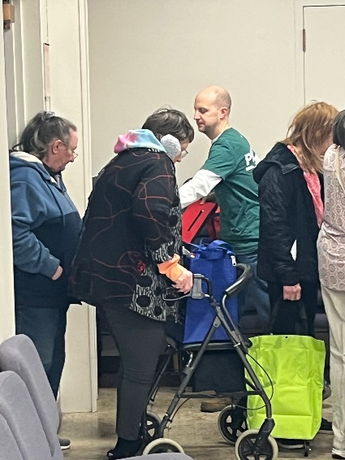
Collaboration and Partnership-In Action
Notes:
Options counseling services – help families plan for future long-term care needs, and coordinate with existing aging and disability service systems.
Information, referral and assistance – personalized information and referrals for supportive services that meet your needs.
Caregiver support and education – information on resources and services, along with educational sessions on topics specific to the needs of family caregivers.
Elder rights program – prevention, detection and reporting of abuse while also offering local advocacy and system coordination to ensure the protection of Iowa seniors.
Regional nutrition program – providing nutrition counseling and home delivered meals
Evidence-based health activities – Matter of Balance, water aerobics, tai chi, and others
Older-worker employment program – job assistance for persons aged 55+ with a disability.

Slide 6
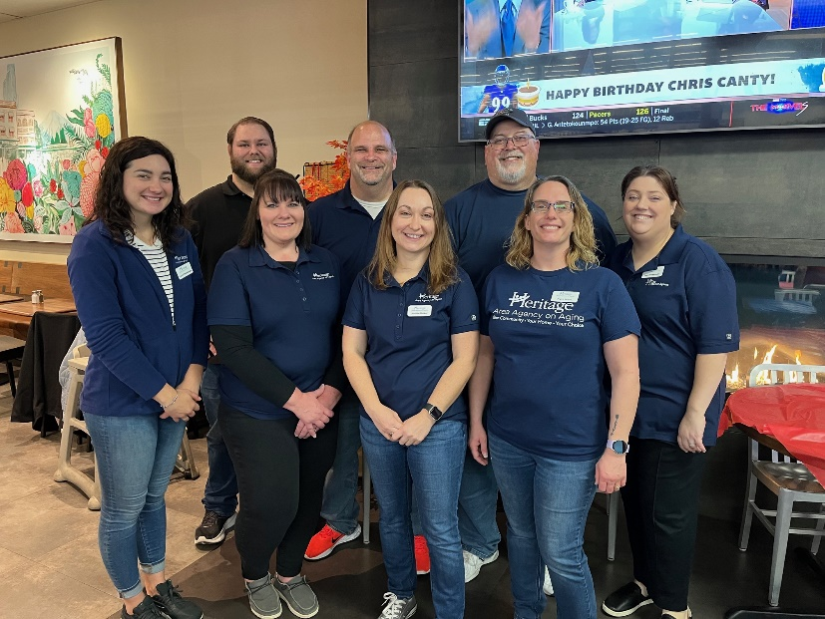
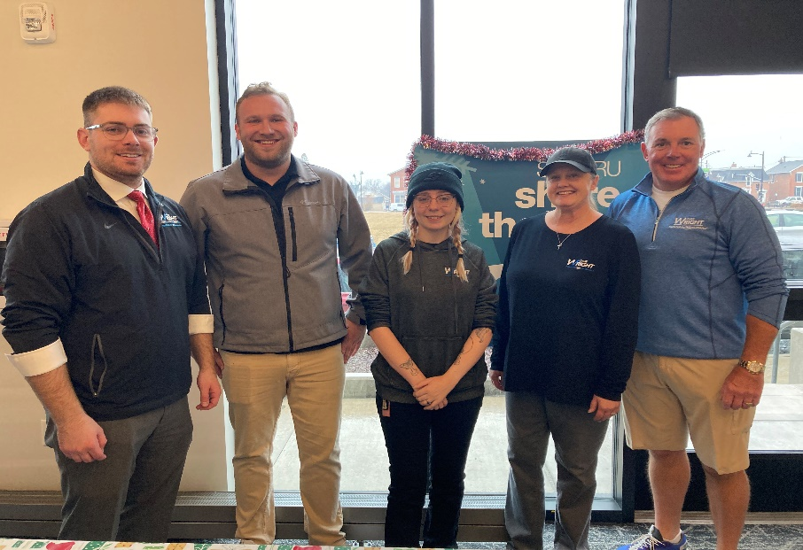
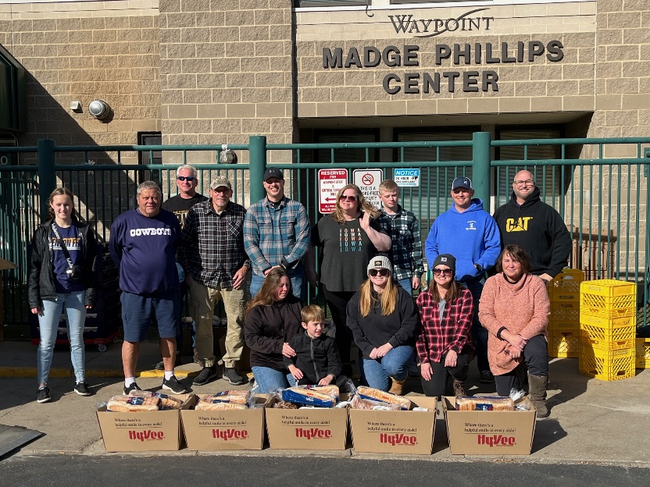
Collaboration and Partnership-In Action
Notes:
Options counseling services – help families plan for future long-term care needs, and coordinate with existing aging and disability service systems.
Information, referral and assistance – personalized information and referrals for supportive services that meet your needs.
Caregiver support and education – information on resources and services, along with educational sessions on topics specific to the needs of family caregivers.
Elder rights program – prevention, detection and reporting of abuse while also offering local advocacy and system coordination to ensure the protection of Iowa seniors.
Regional nutrition program – providing nutrition counseling and home delivered meals
Evidence-based health activities – Matter of Balance, water aerobics, tai chi, and others
Older-worker employment program – job assistance for persons aged 55+ with a disability.

Slide 7
Collaboration/Partnership Building-How?
Look for like minded organizations
Look for businesses that are not regularly asked to partner by other organizations
Network at local community fairs/Chamber of Commerce Events
Research who is doing what
Cold calling is uncomfortable but works
Build grant/funder relationship into partnership
Notes:
Options counseling services – help families plan for future long-term care needs, and coordinate with existing aging and disability service systems.
Information, referral and assistance – personalized information and referrals for supportive services that meet your needs.
Caregiver support and education – information on resources and services, along with educational sessions on topics specific to the needs of family caregivers.
Elder rights program – prevention, detection and reporting of abuse while also offering local advocacy and system coordination to ensure the protection of Iowa seniors.
Regional nutrition program – providing nutrition counseling and home delivered meals
Evidence-based health activities – Matter of Balance, water aerobics, tai chi, and others
Older-worker employment program – job assistance for persons aged 55+ with a disability.

Slide 8
Collaborative Momentum during the Grant
Give regular updates to partners during grant period
Meet in person as possible
Mention partnerships in media opportunities and marketing efforts
Ask how your organization could help their programs, market their needs at your location/service
Notes:
Options counseling services – help families plan for future long-term care needs, and coordinate with existing aging and disability service systems.
Information, referral and assistance – personalized information and referrals for supportive services that meet your needs.
Caregiver support and education – information on resources and services, along with educational sessions on topics specific to the needs of family caregivers.
Elder rights program – prevention, detection and reporting of abuse while also offering local advocacy and system coordination to ensure the protection of Iowa seniors.
Regional nutrition program – providing nutrition counseling and home delivered meals
Evidence-based health activities – Matter of Balance, water aerobics, tai chi, and others
Older-worker employment program – job assistance for persons aged 55+ with a disability.

Slide 9
Grant has Passed: Now What?
Continue same lines of communication as during the grant
Meet with them at least quarterly-can be brief
Thank them in grant reports and in any end of grant thank you’s
Visit their organization as appropriate
Share pictures/successes
Consider joining any community services boards if possible
Patronize businesses
Notes:
Options counseling services – help families plan for future long-term care needs, and coordinate with existing aging and disability service systems.
Information, referral and assistance – personalized information and referrals for supportive services that meet your needs.
Caregiver support and education – information on resources and services, along with educational sessions on topics specific to the needs of family caregivers.
Elder rights program – prevention, detection and reporting of abuse while also offering local advocacy and system coordination to ensure the protection of Iowa seniors.
Regional nutrition program – providing nutrition counseling and home delivered meals
Evidence-based health activities – Matter of Balance, water aerobics, tai chi, and others
Older-worker employment program – job assistance for persons aged 55+ with a disability.

Slide 10
Benefits of Sustaining Collaboration
Initial collaborative effort my lead to other opportunities
Have access to marketing opportunities
Develop project into great product
Open up to additional funding opportunities
Keeps successful efforts moving and relevant
Notes:
Options counseling services – help families plan for future long-term care needs, and coordinate with existing aging and disability service systems.
Information, referral and assistance – personalized information and referrals for supportive services that meet your needs.
Caregiver support and education – information on resources and services, along with educational sessions on topics specific to the needs of family caregivers.
Elder rights program – prevention, detection and reporting of abuse while also offering local advocacy and system coordination to ensure the protection of Iowa seniors.
Regional nutrition program – providing nutrition counseling and home delivered meals
Evidence-based health activities – Matter of Balance, water aerobics, tai chi, and others
Older-worker employment program – job assistance for persons aged 55+ with a disability.

Slide 11
Sustaining Collaborations Lessons Learned
Not all work out
Protect your brand and mission
Be specific in needs and know what you are looking for
Collaboration is a two way street
You don’t now what you don’t know, until you don’t know it.
Develop a short introduction/elevator speech
Notes:
Options counseling services – help families plan for future long-term care needs, and coordinate with existing aging and disability service systems.
Information, referral and assistance – personalized information and referrals for supportive services that meet your needs.
Caregiver support and education – information on resources and services, along with educational sessions on topics specific to the needs of family caregivers.
Elder rights program – prevention, detection and reporting of abuse while also offering local advocacy and system coordination to ensure the protection of Iowa seniors.
Regional nutrition program – providing nutrition counseling and home delivered meals
Evidence-based health activities – Matter of Balance, water aerobics, tai chi, and others
Older-worker employment program – job assistance for persons aged 55+ with a disability.

Slide 12
Sustaining Collaboration Final Thoughts
Participate/attend partner events
More than just money. In-kind is valuable
Give updates after the fact
Look for those who are asked less than others
Be gracious for any support An initial “no” may turn into an awesome “yes”
Build collaborations before they are needed for a grant opportunity
Notes:
Options counseling services – help families plan for future long-term care needs, and coordinate with existing aging and disability service systems.
Information, referral and assistance – personalized information and referrals for supportive services that meet your needs.
Caregiver support and education – information on resources and services, along with educational sessions on topics specific to the needs of family caregivers.
Elder rights program – prevention, detection and reporting of abuse while also offering local advocacy and system coordination to ensure the protection of Iowa seniors.
Regional nutrition program – providing nutrition counseling and home delivered meals
Evidence-based health activities – Matter of Balance, water aerobics, tai chi, and others
Older-worker employment program – job assistance for persons aged 55+ with a disability.

Slide 13
Contact
Tim Getty, MBA
Regional Nutrition Coordinator
tim.getty@Kirkwood.edu
Heritage Area Agency on Aging
6301 Kirkwood Blvd SW
Cedar Rapids, IA 52404
HeritageAAA.org
(319) 398-7676
1-800-332-5634
Notes:
Optional: add a slide with action items for attendees

