Slide 1

COVID-19 Guidelines For All Employees
Welcome Back To The Workplace
Notes:
Welcome Back! In the next few minutes, you will learn the basics of LADWP’s strategy to prevent the spread of the virus that causes COVID-19 illness and the contribution you can make ensure that our game plan is successful.

Slide 2
Key Concepts
As DWP Transitions Employees Back Into The Workplace
ALL employees are expected to comply with the requirements and guidelines in this presentation to
  Keep People Healthy
  Minimize Spread Of The Virus In The Workplace
The Coronavirus (SARS CoV-2) That Causes COVID-19 Illness Is Still Out There
Employees are expected to continue with these practices and behaviors
Until an effective vaccine is developed and in wide distribution
Notes:
As you and your coworkers begin to transition back into the work place, it is important to remember, the pandemic has not ended. SARS CoV2 that causes the COVID-19 illness is still out there, and infection can still occur.
Over the past months, LADWP has implemented a variety of controls to ensure that the work environment you are coming back to is as safe as possible.
But, it’s your diligent participation that is the key to the success of LADWP’s efforts to keep employees healthy during this pandemic.

Slide 3

Key Concepts
Primary Controls have not changed and are designed to prevent you from getting sick and from spreading the virus to others.
  EVERYONE is expected to do the following:
    If you have SYMPTOMS – STAY AT HOME
    Maintain social/physical DISTANCING protocols – wear a FACE COVERING!
    Turn away from others and COVER your coughs and sneezes.
    WASH your hands with soap and water, FREQUENTLY.
    Do NOT TOUCH YOUR FACE (especially eyes, nose, mouth).
    CLEAN high-touch surfaces, frequently.
In the Swiss Cheese Model, Each Slice of Cheese Represents A Control (Transmission Intervention) And Holes Represent Failures In The Controls
Notes:
The COVID-19 pandemic is rapidly evolving and the abundance of information available from countless different sources can be a bit overwhelming. But, you’ve probably noticed: the primary methods of controlling viral transmission and preventing illness have not changed very much from the early days of the pandemic until now.
The primary controls in LADWP’s plan include:
Keeping ill people at home where their ability to spread virus is limited
Staying a minimum of 6 feet from other people
Covering your nose and mouth when you cough or sneeze
Washing your hands frequently – scrubbing with soap and water for 20 seconds
Not touching your face – especially your eyes, nose and mouth
And frequently cleaning surfaces that are touched by many people
Some of these controls are to prevent you from becoming infected. Some are to prevent you from infecting others. You may be confident that you have not been infected and, at this moment, you have no symptoms associated with COVID-19 illness. But, some infectious disease experts have estimated that 25 to 50 percent of infected individuals never develop symptoms and, therefore, do not realize that they are capable of spreading the virus.
Your contribution is to use as many of the control methods that you can, as often as you can.

Slide 4



Controls Work Together to Reduce Risk of Infection
James Reason’s Swiss Cheese Model
Cheese Represents Controls To Prevent Infection
Implementing Multiple Controls Minimizes Risk of Infection
Restrict On-Site Presence - Only healthy individuals
Cough/Sneeze Hygiene
Face Covering
Social Distancing
Contagious Person
Frequent Surface Cleaning &
Good Personal Hygiene
Contagious Person Present
Asymptomatic Carrier
Ill person comes to work
  Poor cough/sneeze hygiene
  Large & small droplets emitted, unchecked
Nose & Mouth uncovered
Large droplets emitted, unchecked
People are too close (< 6 feet away)
Surfaces are not adequately disinfected. Less frequent hand washing.
Touching face.
Holes Represent Failures In The Controls
Multiple Failures Must Align for Infection to Occur
Healthy Person
Notes:
The Swiss Cheese Model provides a good visual representation of the principle behind layering controls to mitigate a threat. In theory, failure of any one control would not allow the risk – in this case, infection – to materialize, because other controls are present to prevent the negative consequence due to a single point of failure.
In this model, each slice of cheese represents a control, or barrier, to viral transmission. As you can see, multiple failures would have to occur for virus to be transmitted from an infected individual to an uninfected individual. Any ONE of the controls could be enough to prevent viral transmission but, if we all use multiple controls, we increase the probability of successfully blocking transmission by increasing the number barriers the virus has to get past.

Slide 5
Expectations
ILLNESS IDENTIFICATION
All employees are expected to Self Assess Every Day before coming to work
If you have any symptoms of illness…
PLEASE STAY AT HOME
Contact your supervisor for instructions
If you have:
Had a COVID-19 Test
Been exposed to a positive COVID-19 case
Your symptoms are consistent with COVID-19 or the Flu
Contact the COVID-19 Resource Office – (213) 367-4444
Notes:
One of the primary controls is to identify illness early and keep ill individuals away from the vulnerable population. To help with this, LADWP is asking all of us to do a Self-Assessment every day. A Self-Assessment checklist is available on the Corporate Health and Safety website for you to print and take home. Simply take one minute at the beginning of each day consciously check how you are feeling. If you are experiencing any of the symptoms most commonly associated with COVID-19 or the Flu such as fever, chills, persistent cough, shortness of breath or difficulty breathing, or fatigue contact the COVID-19 Resource Office for guidance. If you are experiencing symptoms of any other illness such as a common cold, contact your immediate supervisor for instruction.
Your contribution is to self-assess every day before leaving for work and, if you are experiencing symptoms, do not come to work but call in for guidance.

Slide 6
Expectations
ILLNESS IDENTIFICATION
If You Develop Symptoms Of Illness While At Work
MASK-UP – Put Your Face Covering On
Notify Your Supervisor/Manager IMMEDIATELY
Stay Away From Others
Wait For Further Instruction From Your Supervisor/Manager
Your Supervisor/Manager Will Contact The COVID-19 Resource Office And Instruct You On What To Do
Contact The DWP COVID-19 RESOURCE OFFICE – (213) 367-4444
Notes:
It is also important to pay close attention to how you are feeling throughout the day – not just once before work. If you felt no symptoms before work but, during the workday become aware of developing symptoms, you should immediately:
Put on your face covering
Distance yourself from others
Contact your supervisor and let them know what symptom or symptoms you are feeling. Your supervisor may contact the COVID-19 Resource Office for guidance or instruct you to contact them directly.
Follow whatever instructions you are given.
Your contribution is to monitor how you are feeling throughout the day and take immediate action to report symptoms if they develop.

Slide 7
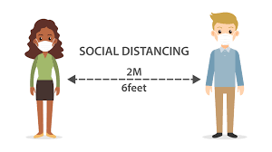

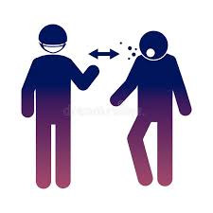
Expectations
SOCIAL/PHYSICAL DISTANCING
All employees are expected to practice Social/Physical Distancing At All Times
Maintain 6 feet of separation from others
Things to Avoid
Handshaking
Embracing
Touching Surfaces Touched By Others
People Who Appear To Be Sick
Notes:
Another control everyone is now very familiar with is Social and Physical Distancing. The virus that a causes COVID-19 illness is spread from persons to person in upper respiratory tract fluids that are emitted during coughing, sneezing and talking – yes, sometimes we spit when we talk! When an infected individual shares their upper respiratory tract fluids with others, virus can be transmitted and infection can occur. Distancing from others, at least 6 feet of separation, and avoiding direct physical contact are proven effective methods of limiting the spread of virus.
Your contribution is to continue practicing social and physical distancing as much as possible.

Slide 8
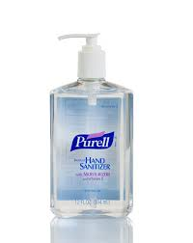

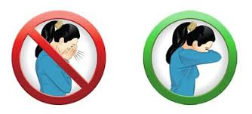
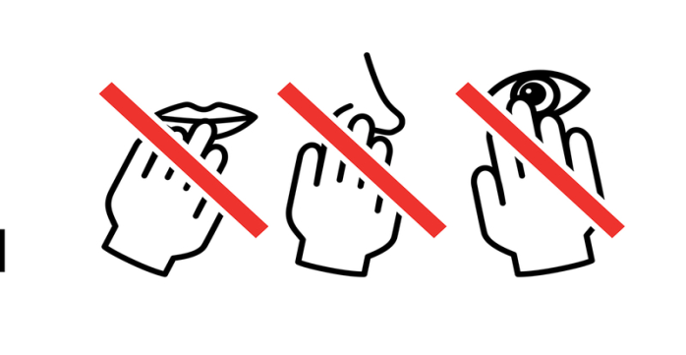
Expectations
PERSONAL HYGIENE
All employees are expected to practice Good Personal Hygiene
WASH YOUR HANDS Frequently
(At least hourly)
Hand Sanitizer Can Be
Used In A Pinch
COVER Your Coughs and Sneezes
And Turn Away From Others
Do NOT TOUCH Your Face
Especially Your Eyes, Nose, & Mouth
Notes:
Direct transmission of upper respiratory tract fluids isn’t the only way the virus finds its way from one person to another. This virus has demonstrated the ability to remain viable, or capable of causing illness, outside of a human host, on surfaces for long periods of time. When unsuspecting individuals touch contaminated surfaces, they can pick the virus up on their hands and infect themselves when they touch their eyes, nose or mouth. To block this transmission pathway, it is very important to:
Cover your nose and mouth when you cough or sneeze to prevent depositing virus contaminated fluids on surfaces
Be aware of everything you touch,
Wash your hands with soap and water, frequently – if soap and water are not available a hand sanitizer that contains 60% ethyl alcohol or 70% isopropyl alcohol can be used,
Make a conscious effort to avoid touching your face as much as possible.
Most of us don’t realize how many things we touch and how often we absent-mindedly touch our face. Some observational studies have shown that people touch their faces between 16 and 23 times each hour. That’s a lot of opportunity for virus to make its’ way to you face.
Data from the 2003 SARS CoV 1 pandemic have demonstrated that individuals who washed their hands 5 times per day reduced the likelihood of infection by 34%.
Using good personal hygiene practices is a control that can have a significant impact on reducing viral transmission and preventing you from becoming ill.
Your contribution is to practice good personal hygiene at all times including covering your coughs and sneezes and frequently washing your hands with soap as water.

Slide 9

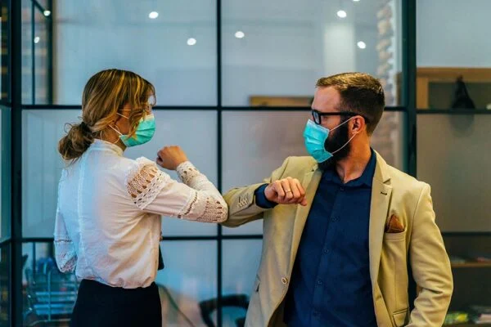
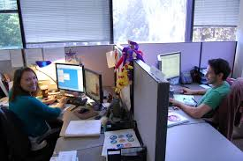

Expectations
FACE COVERINGS
Face Coverings over your nose and mouth are required:
In All Indoor Common or Shared Spaces
Anywhere 6 feet physical distancing cannot be maintained
People With No Symptoms May Be Spreading The Virus
Face Coverings Not Required
When alone in a cubicle or office
When separated by a physical barrier
When 6 feet physical distancing can maintained
Notes:
Earlier in this presentation, we mentioned that some people, when infected, will remain asymptomatic – not developing symptoms at all.
For most people, some symptoms will develop. Whether their illness becomes severe, requiring hospitalization or is mild and hardly noticeable there is a window of time between infection and onset of noticeable symptoms during which they are capable of spreading the virus and infecting others.
Both of these groups: the asymptomatic people and the pre-symptomatic people are likely going about their business not realizing they are carrying and spreading the COVID-19 virus. You could be one of these people!
Face coverings are a control intended to prevent individuals who do not know they are carrying the virus from spreading their potentially infectious upper respiratory tract fluids to others by blocking fluid emission during coughing, sneezing and talking.
To be effective, it is important that your face covering covers your nose and mouth completely.
Your contribution is to wear a face covering over your nose and mouth on all LADWP worksites, any time you are in shared or common space, or are within 6 feet of others.
Face coverings are not required when working alone in a cubicle, office or other workspace.

Slide 10

Expectations
FREQUENT DISINFECTION
All Employees are expected keep their immediate work area clean
Use DWP Provided Off-The-Shelf Disinfectant Spray or Wipes
Clean Surfaces And Items You Touch In Your Work Area At The Beginning And End Of Your Shift
Clean High Touch Surfaces
Door Handles
Copiers & Printers
Elevator Buttons
Faucets
Counter/Desk Tops
Phones
Many Other Items
Notes:
Keeping surfaces clean that we regularly touch is an important barrier – or, slice of cheese – in breaking the chain of transmission from surface – to hand – to face. Many of your coworkers are working diligently to keep “high-touch” surfaces in shared spaces clean. Custodial Services frequently cleans door handles, elevator buttons, faucets and other things that are touched often and by many people. Fleet Services cleans the interior of every pool vehicle before allowing it to be checked out.
Your efforts to keep the things that you touch in your immediate work area clean are an important part of the overall LADWP COVID-19 illness prevention strategy.
Your contribution is to use the disinfectant wipes or sprays provided to clean the things you commonly touch in your immediate work area at the beginning of your shift, after someone else has handled or touched those things, and at the end of your shift.

Slide 11
Summary
Limiting Viral Spread Requires
EVERYONE To Use The Primary Controls
Keep 6 Feet Of DISTANCE Between Yourself And Others
Use A Cloth FACE COVERING When You Are In Common Spaces
Turn Away From Others And COVER Up When You Cough Or Sneeze
WASH Your Hands With Soap And Water Frequently
Do NOT TOUCH Your Face – Especially Your Eyes, Nose And Mouth
CLEAN & Disinfect Surfaces Frequently
If You Develop Symptoms Of Illness – PLEASE STAY AT HOME
Notes:
So, when you come back to work, stay alert to your opportunities to prevent possible viral transmission.
Continue to practice social and physical distancing as much as possible, keeping a minimum of 6 feet of separation between you and others.
Wear your face covering whenever you interact with others, or are in shared or common spaces where you may interact with others. Be sure your nose and mouth are completely covered.
If you have to cough or sneeze, turn away from others and cover up – even if you are wearing a face covering.
Wash your hands frequently with soap and water. If hand washing facilities are not readily available you can use hand sanitizer with 60% ethyl alcohol or 70% isopropyl alcohol as a substitute.
Clean the things you touch in your immediate work area at the beginning of your shift, at the end of your shift and after others have come into your space.
Avoid touching your face – especially your eyes, nose and mouth.
And, if you have symptoms consistent with COVID-19 or the Flu – please stay at home.

Slide 12
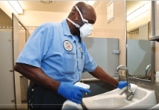

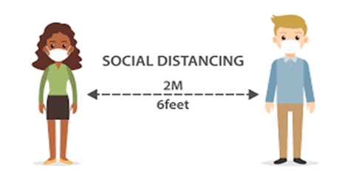
Summary
This is our NEW NORMAL
We may have to continue practicing some, or all of these viral transmission controls, indefinitely.
LADWP is committed to preventing viral transmission in the workplace and is counting on you to do your part.
Notes:
The SARS CoV2 virus and the COVID-19 illness are part of our world now. This is our
“New Normal”. We may be required to continue using some, or all, of the primary viral transmission and infection controls for a long time – possibly until a vaccine is developed and widely distributed.
LADWP is committed to preventing viral transmission and infection in the work place and is counting on you to stay resolute and continue doing your part to minimize the spread of this virus.

Slide 13

Resources Available To You
If you have any questions or any concerns about how the risk of viral transmission is being managed at LADWP, the following resources are available:
  Your Supervisor or Manager – Your first and best resource
  Your System, Division or Section Safety Office – If you don’t know who they are, your Supervisor can help
  Your Corporate Health and Safety Office – MYDWP – General Manager – Corp. Safety.
  Your LADWP COVID-19 Resource Office – (213) 367-4444
Notes:
The pandemic and information about the virus and COVID-19 illness evolves and changes quickly. As we navigate this situation in the coming months together, if you have any questions or concerns, LADWP wants you to know that the following resources available to you:
Your Supervisor – Most of the time, your first and best resource
Your System, Division or Section Safety office – If you don’t know who they are, your Supervisor can help.
Your Corporate Health and Safety Office - Their website can be easily accessed through MYDWP.
And, the COVID-19 Resource Office – available by calling (213) 367-4444.
Thank you!

