Slide 1


Slide 2


Griffin Willey (St. Andrew’s, Yr 9)

Slide 3
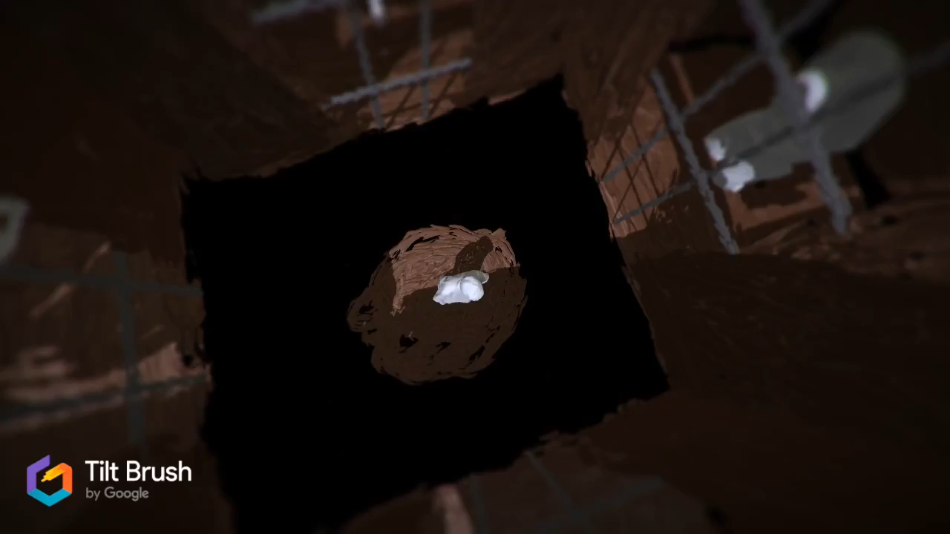
Insert 3rd place video

Slide 4

Peppa Barlow (Caloundra, Yr 7)

Slide 5

Insert 2nd place video

Slide 6

Amber Ferris (Mtn Creek, Yr 11)

Slide 7

Insert 1st place video

