Slide 1
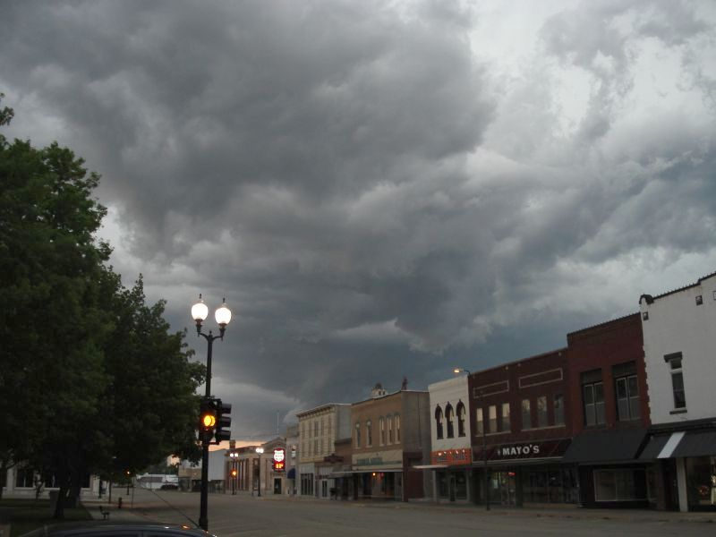
METC 490/590 Class Information for Summer 2024
Dr. Dave Call /// Ball State University
Notes:
METC 490/590 Informational Meeting Slide Show

Slide 2
Notes
Bring to the meeting:
This presentation
Handouts slides 1 (title), 6 (when), 18-21 (last 4)
Pad for people to sign in:
Name
Major
Class Standing
E-mail

Slide 3
The Forecast
Welcome!
Presentation on
Who
When
Where
What
Why
and How
of METC 490/590
All chase pictures shown are from past BSU trips!
Notes:
In person, do a sign in sheet.

Slide 4
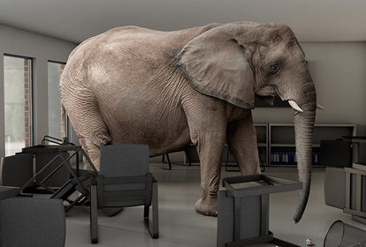
2024 But first
MY HEALTH

Slide 5
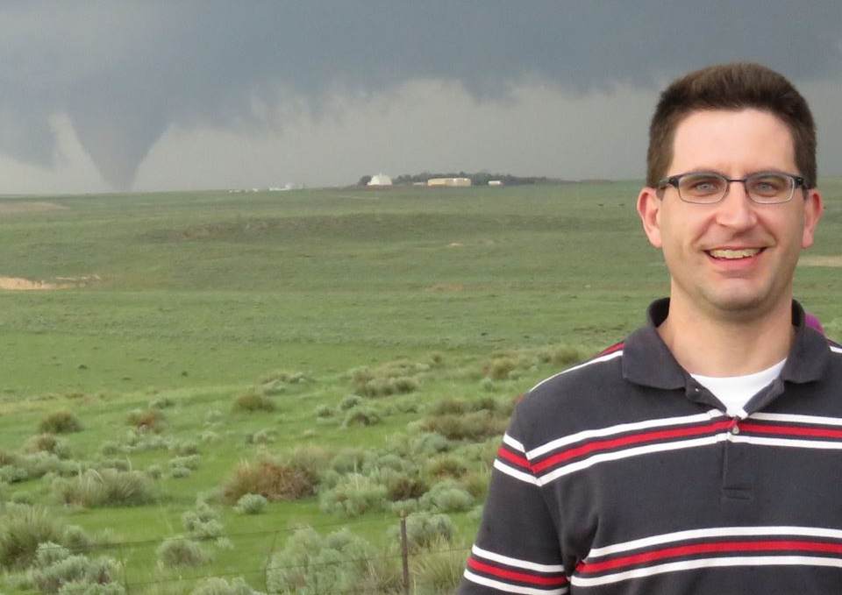
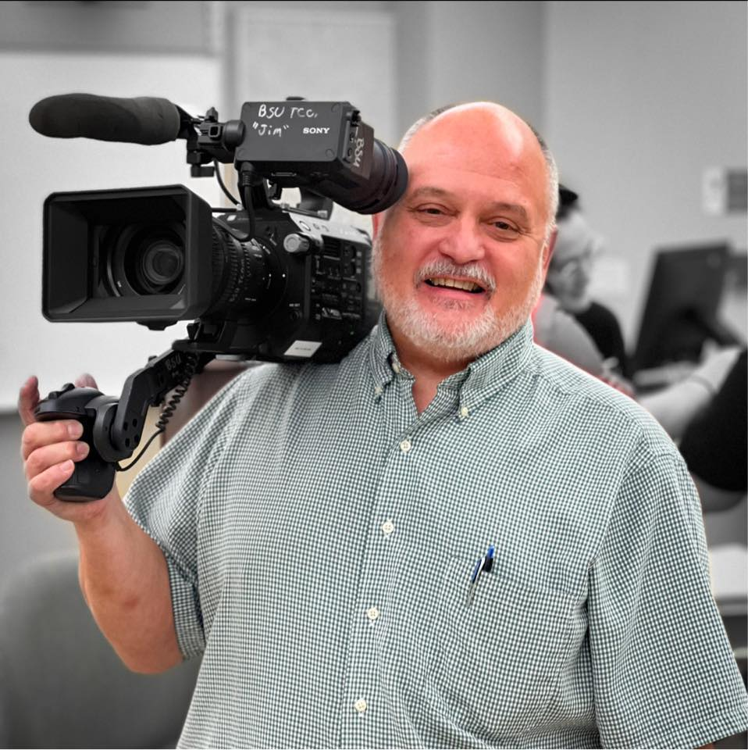
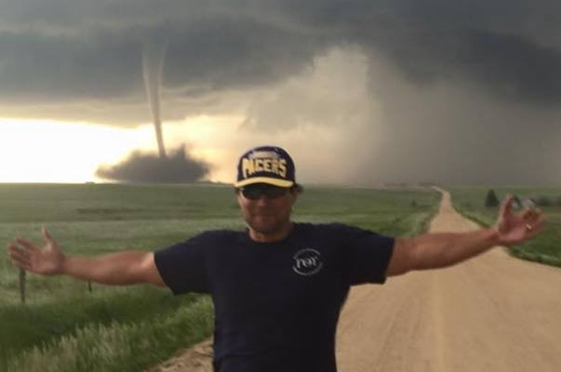
1. Who
Instructor: Dr. Dave Call
Penn State/Syracuse
At BSU since Fall 2007
18 trips / 125,000 mi.+
Assistant/Driver: TBD
(Probably Dr. Allen)

Slide 6
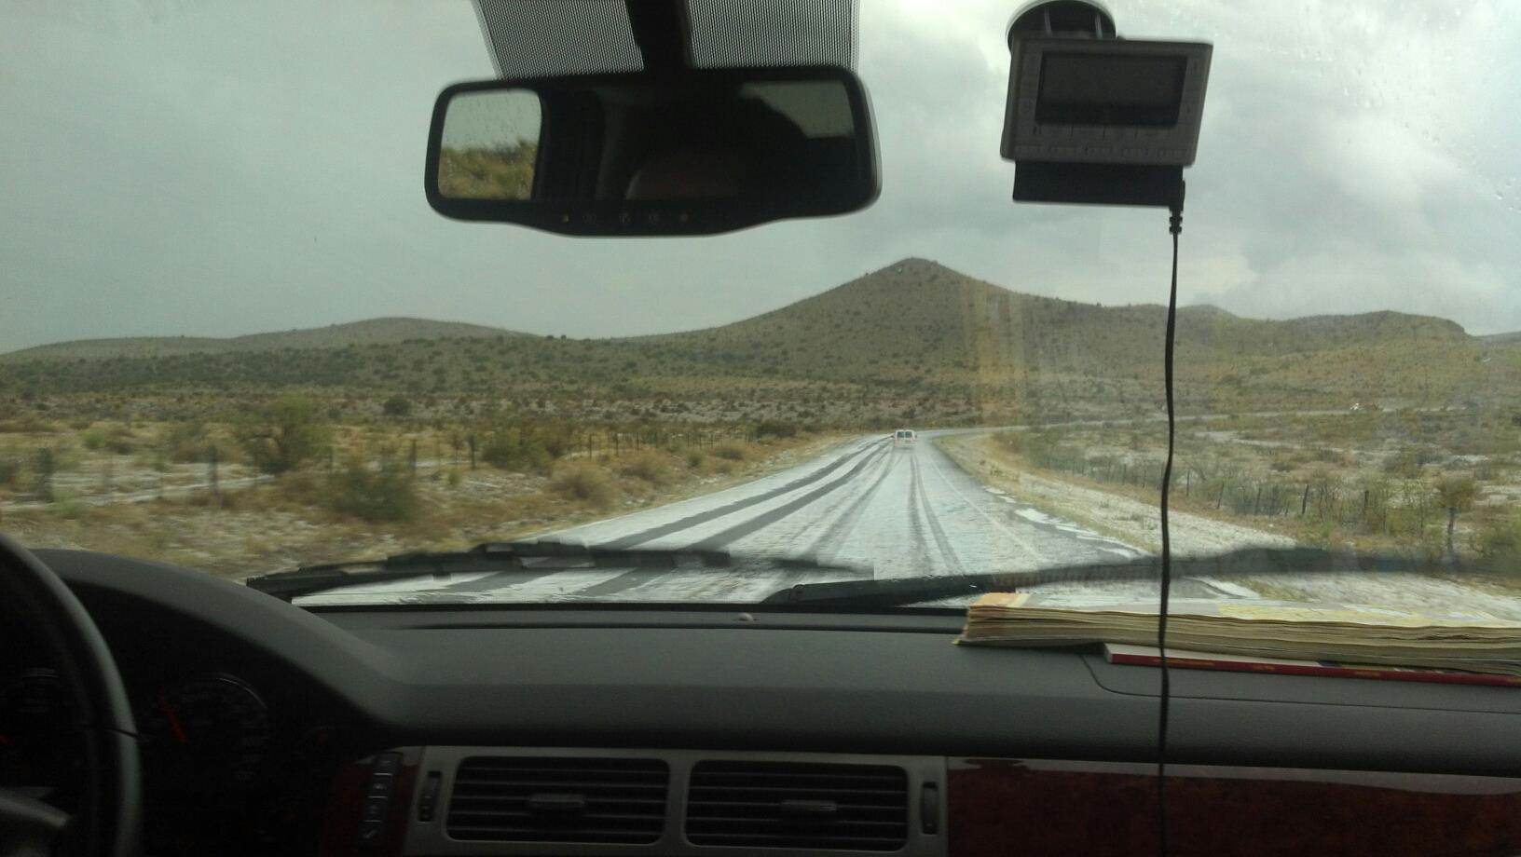
2. When
Classroom portion [In person]
May 9, 10, 13 – all day; test on 15th
Field “window”
Wed May 15-Fri May 31
Trip is 14-16 days within the window
Exact dates depend on the weather

Slide 7
3. Where: The Great Plains+
On average,
Enter 11 states
Chase in 6
445 miles / day
(~7,000 / trip)
Yellow – been there (23)
Orange – chased there (14)
Hatched – tornado seen (6)

Slide 8
4. What: Classroom
Spring meeting & 8 two-hr. class sessions
Equivalent of about 6 full weeks of class
Topics:
How to chase and stay safe when chasing
Supercells and tornadoes
Map analysis, Skew-Ts, radar, and forecasting
The Great Plains

Slide 9
What to Expect: Field
A typical chase day…
Rise and shine…somewhere
Along with a few roommates
8:30 AM: Morning wx meeting
9:30 AM: Depart or wait
1:00 PM: Lunch
On a chase day, this will usually be our “major” meal

Slide 10
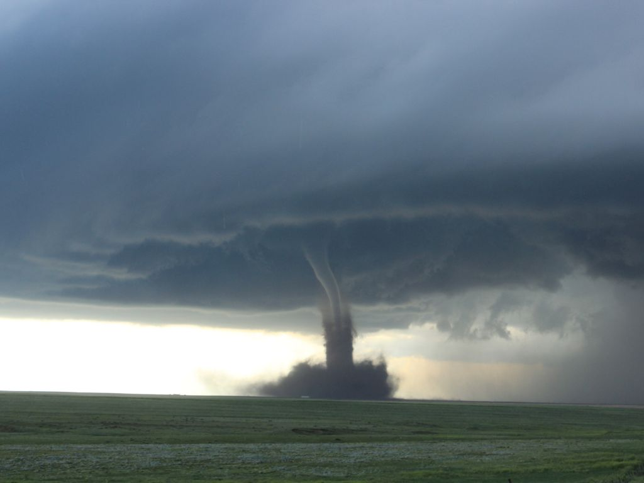
What to Expect: Field
Afternoon: Chase!
Begin anytime between 2 and 5 PM
Often chase until dark (~9:00 PM)
Dinner: Time unknown.
Likely fast food. Maybe gas station food.
Evening: Drive more
10:30 PM: Check-in someplace new

Slide 11
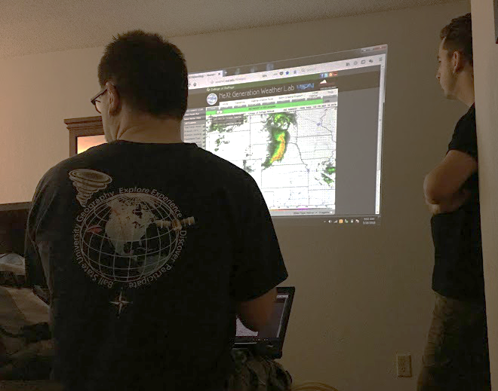
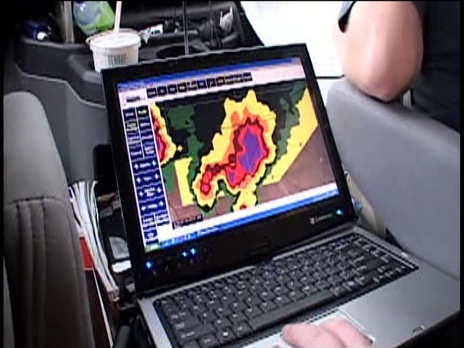
What: Wx Briefing
Two groups of two students lead the discussions and chases
One group: Day 1
Second group: Day 2 and beyond
Group decisions

Slide 12
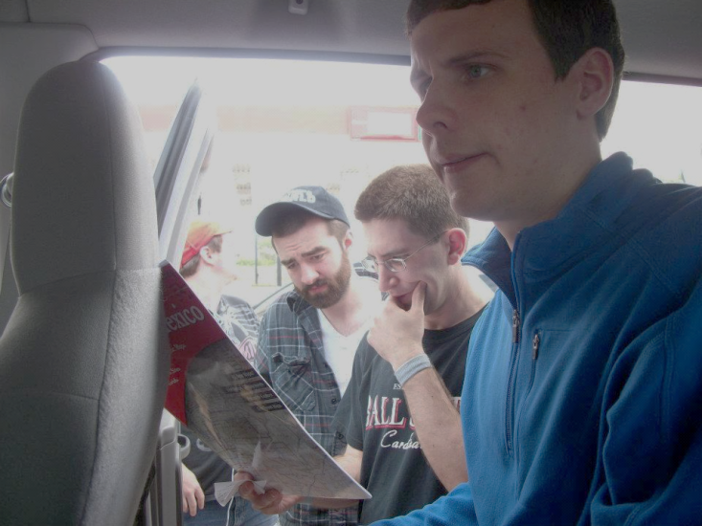
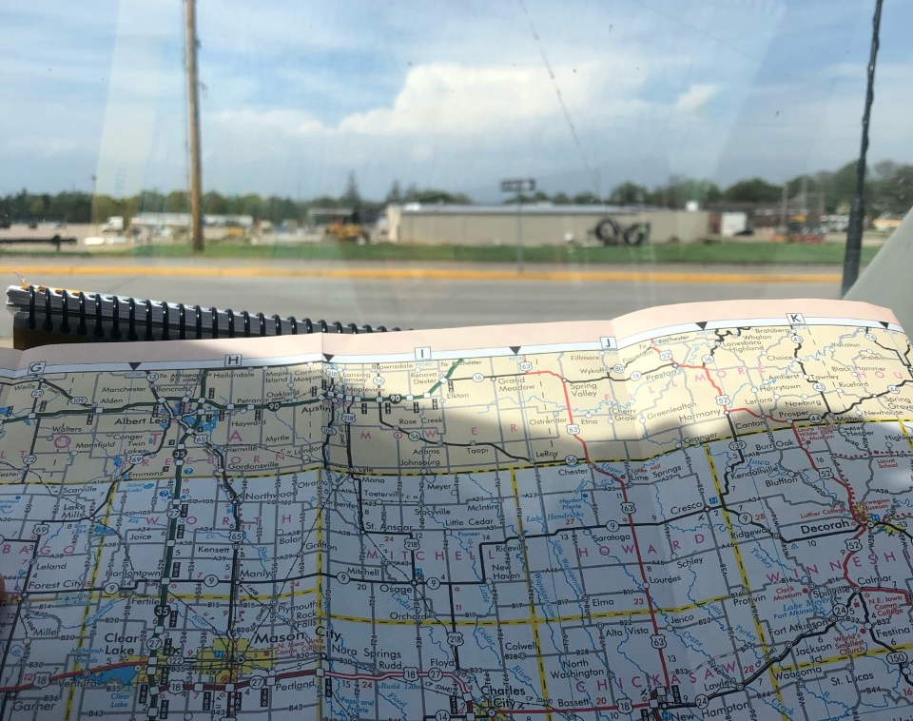
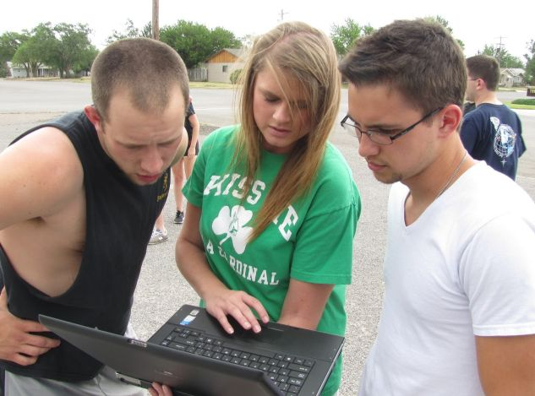
What: Tasks
You’ll have a daily task
Watching Radar
Navigating
Trip Planning
Spotting
Driving
Your success = group success!

Slide 13
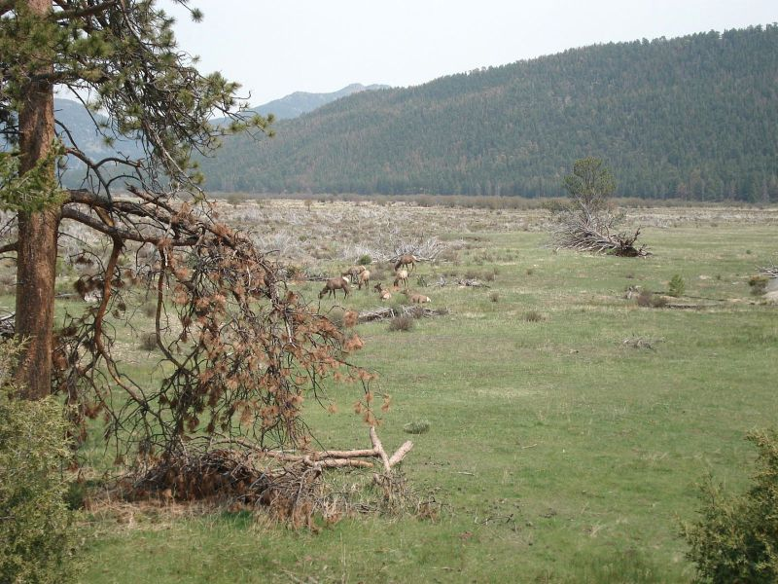
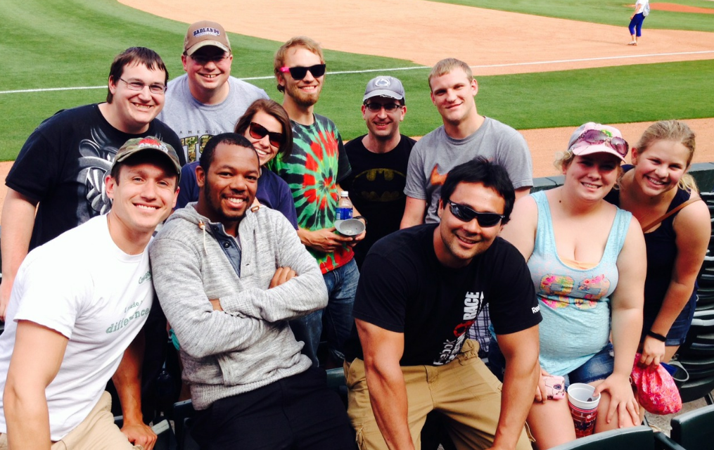
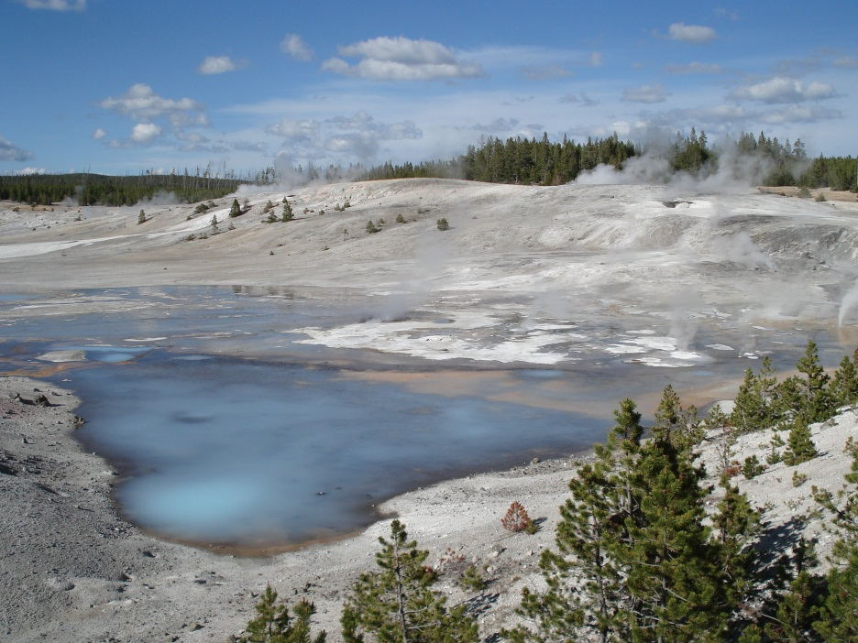
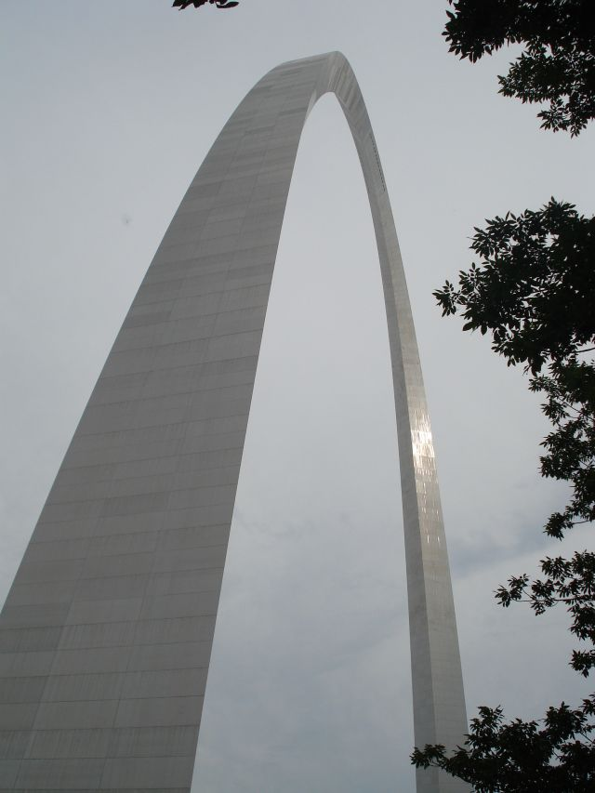
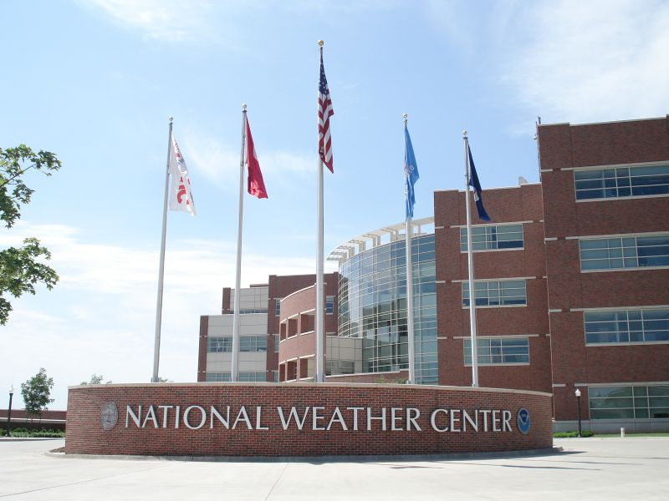
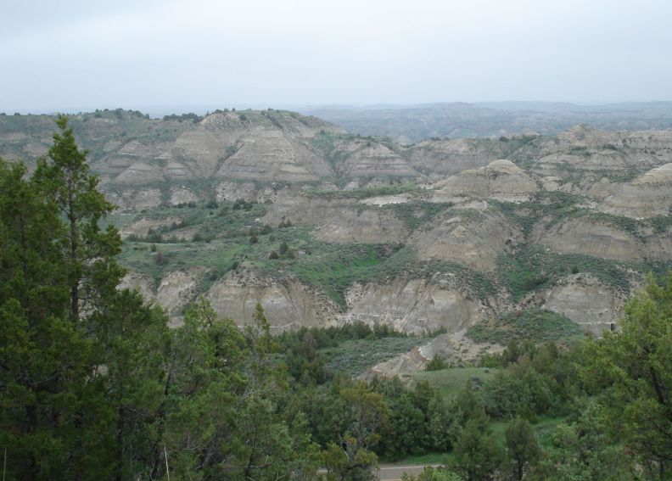
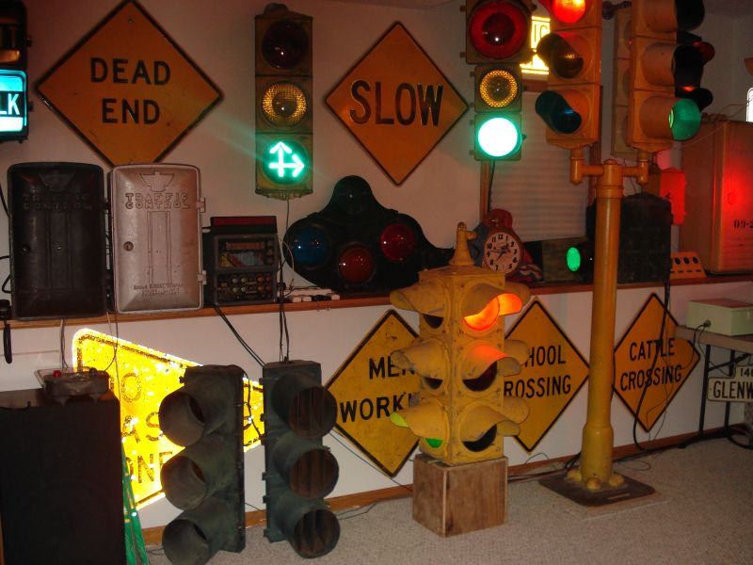
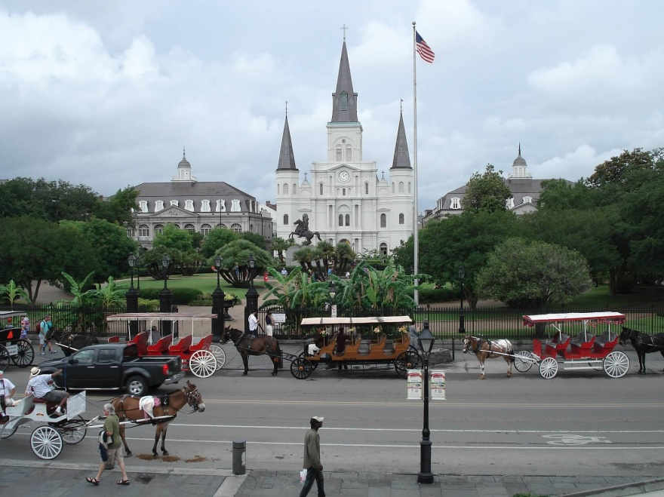
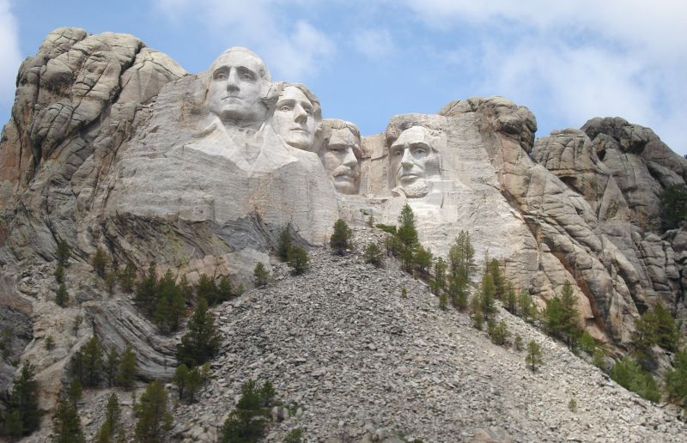
Non-chase days: We explore and have fun!
Sightseeing

Slide 14
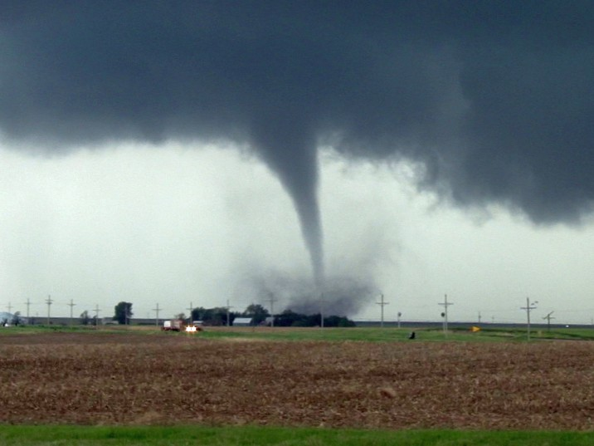
5. Why: Realistic Expectations
Should you expect to see a tornado?
Well, we average two per trip…
but none in 2009, 2012a, 2012b, 2014, 2016b, 2017, 2018, 2022
Seeing a tornado is like seeing a “grand slam”
Or this: https://www.youtube.com/watch?v=bfgptokGlgk

Slide 15
Why: Realistic Expectations
Why is it hard to see tornadoes?
Unfavorable weather pattern
Tornadoes are outside of the Plains
Tornadoes occur at night or are rain-wrapped (or dust-wrapped in 2022!)
Poor road network
Incorrect forecast
We pick the “wrong” storm
Or other reasons…tornadoes are “random freaks of nature”
Most veteran chasers see tornadoes 5-10% of chase days. This is our success rate, too.
Notes:
Note: these items gradually appear

Slide 16
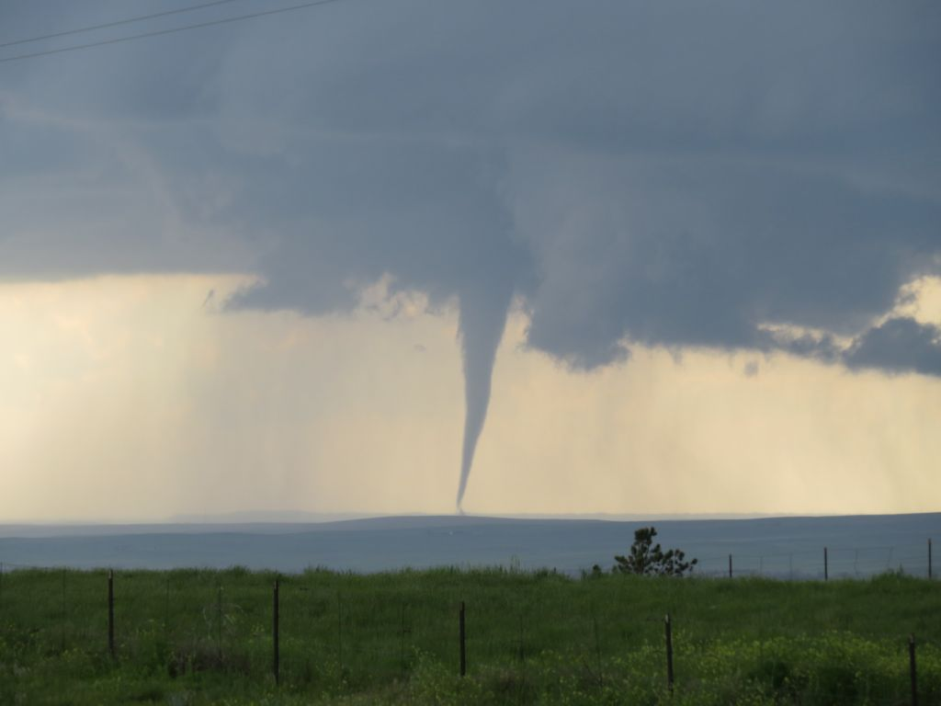
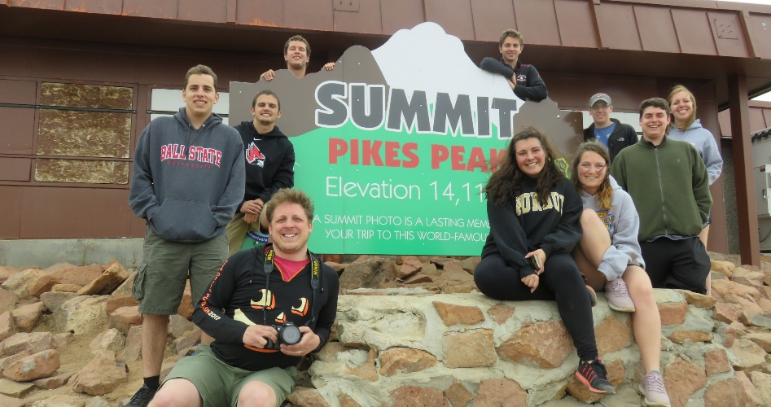
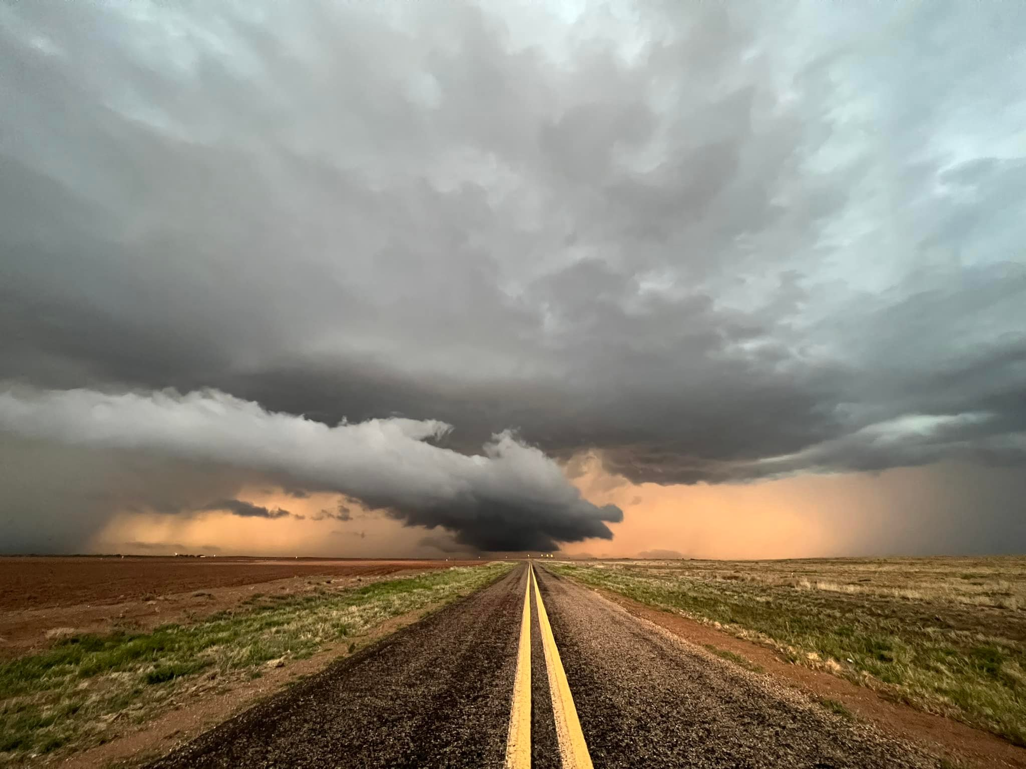
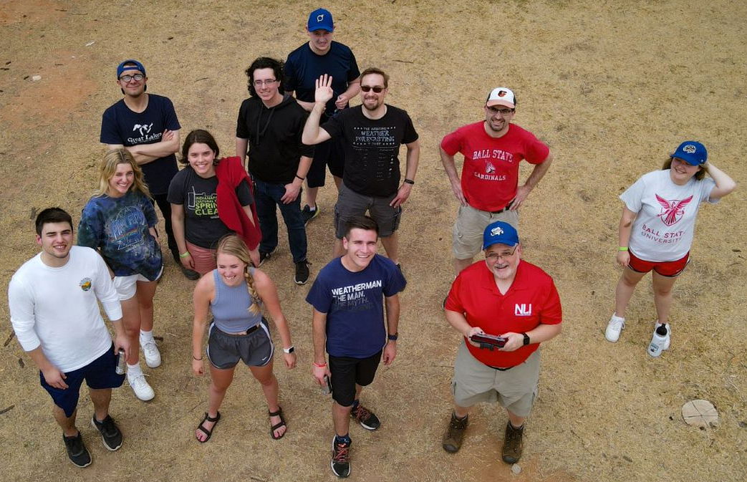
Okay, so what should you expect?
Learn A LOT about weather tools, storm forecasting, and storm dynamics
Amazing scenery
Explore a new region
Meet great people!

Slide 17
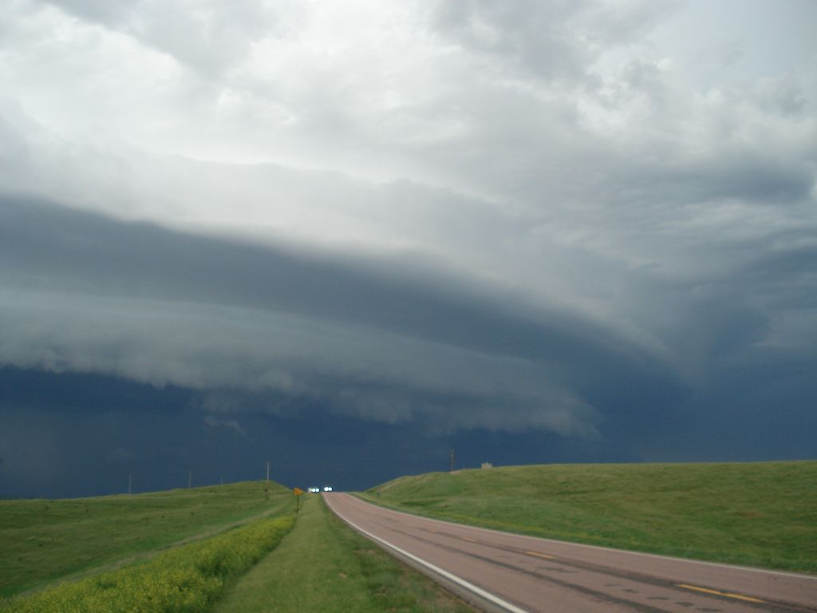
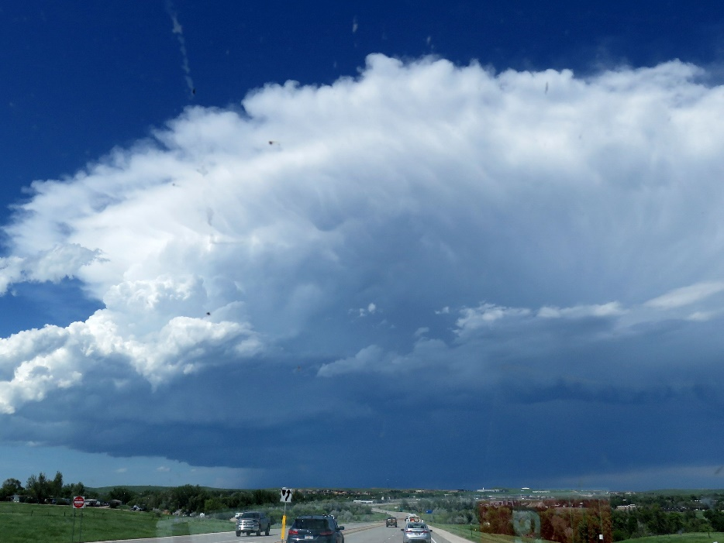
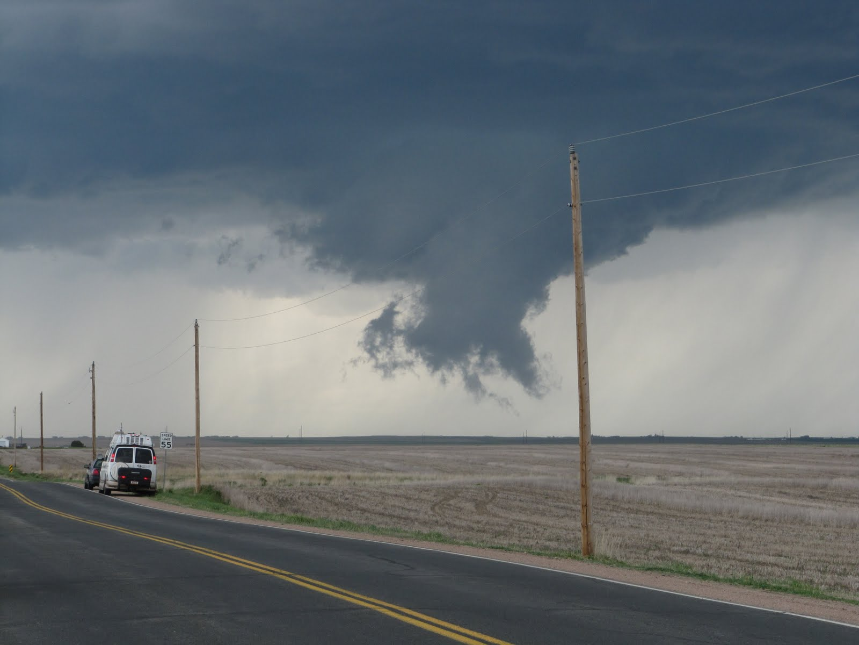
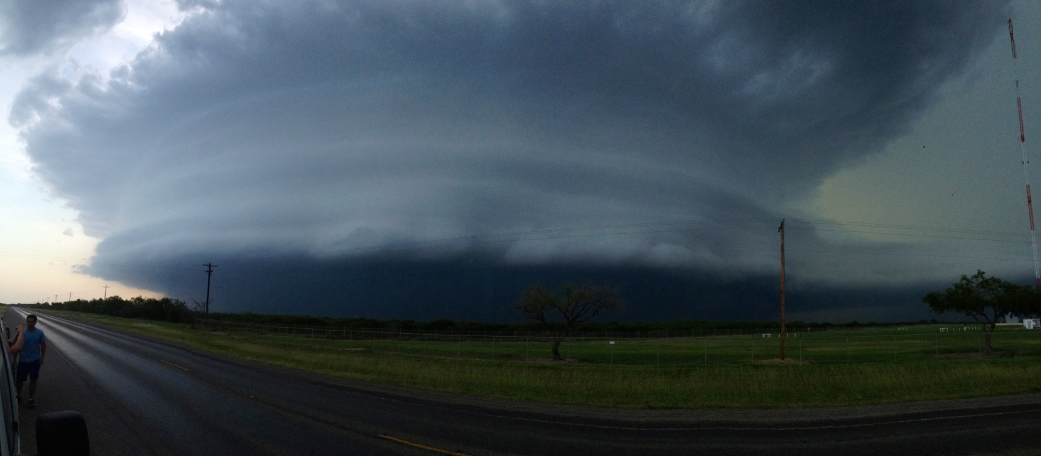
Amazing Storm Structure!
(Not guaranteed, but almost every trip)

Slide 18
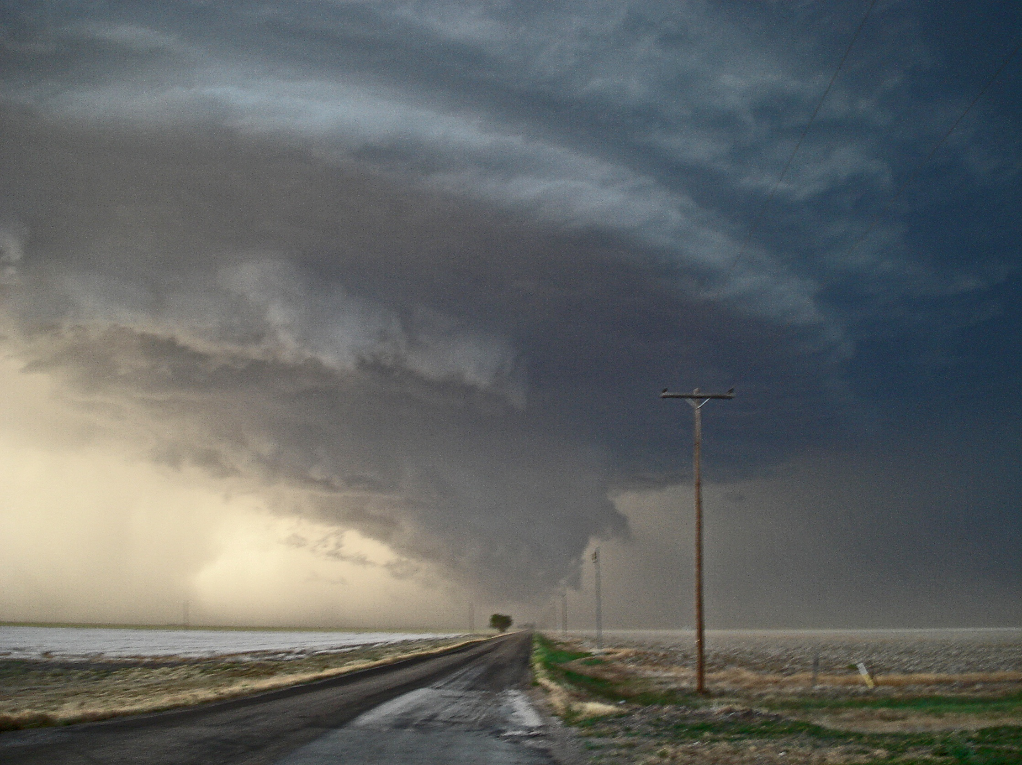
Academic Benefits
Everyone: 6 credits toward graduation
METC majors: Substitutes for GEOG 350
Other majors: May count toward electives
CHECK WITH YOUR ADVISOR

Slide 19
6. How: Cost
Trip cost is $1,580. Due April 1.
Covers lodging, gas, & group expenses.
Tuition (below) + $110 fee. Due June 1.
$2,016 In-state undergrad OR
$3,366 Out-of-state undergrad OR
See me if you are a grad student ($850?)
See Financial Aid in Lucina tomorrow!
Trip sign-ups begin in 3 weeks.
Meals and Incidentals: You pay on trip.
Estimate $25-35/day. $30 x 15 = $450

Slide 20
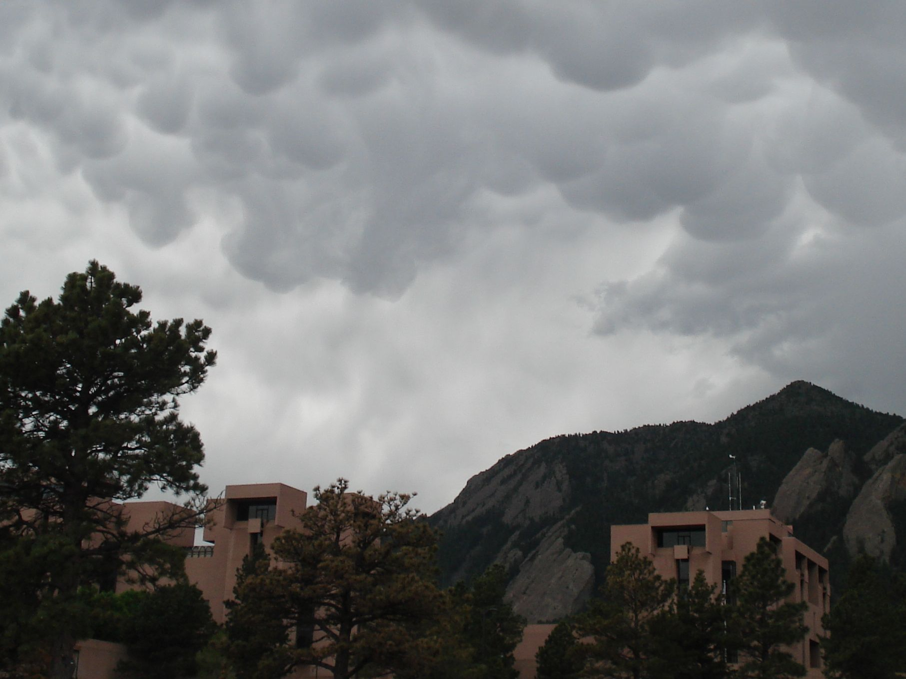
How: Next steps
Check schedule for May and early June.
Weddings? Graduations? We can return by a definite day.
Figure out how you’ll pay; see financial aid.
Determine how course fits with your program.
Sign-up meeting: 5:15 PM Thurs. Nov. 16
In case of high interest, juniors and seniors given priority. Others may have to wait until January 1.
Students on probation also have to wait until January 1.
Pay $500 by Feb 1, $500 by Mar 1 (optional), and the balance of the trip cost by April 1.
New this year: you can pay using your regular account. You no longer need to pay “cash/check” for the first $500.
Register for the credits in March.
Background: Mammatus over NCAR, Boulder, Colorado

Slide 21
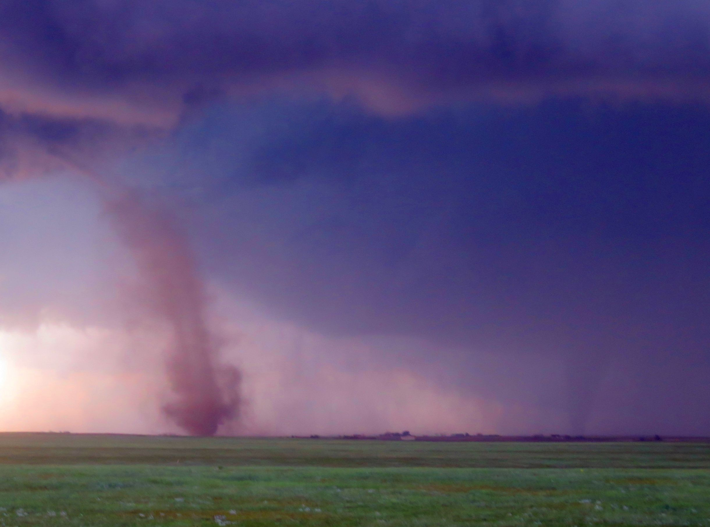
For more information…
Web: http://drdavecall.com
E-mail: dacall@bsu.edu
Visit me: NQ 187 any MWF 2 PM
Ask past drivers or participants
Thanks for your attention! Questions?

Slide 22
2021 COVID-19 and Travel
No University travel at this time
BUT, that could change in the next 7 months
BUT, we need a certain number for the trip
So sign up! (If we cancel the trip, you get a refund, of course.)
COVID-19

Slide 23
2021 COVID-19 and Your Safety
Travelling increases the risk of disease
Being in close quarters increases the risk
5 page safety plan
Self-quarantining prior to departure
Testing / temperature checks – regular
Masks – always
Meal changes
Continency plans
We can reduce the risk!
COVID-19

