Slide 1

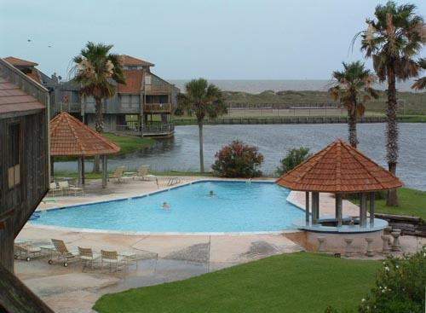
Bahia De Matagorda
2021 Annual HOA Meeting
Notes:
Notes:

Slide 2
Bahia De Matagorda
Current Board of Directors
Chairman: Karl Brown
Member: Terry Wells
Treasurer: John Skadberg
Secretary: Darayle Knause
Member: Michelle Cameron
Nominating Committee
Karl Brown
John Irving
Freddie Pekar

Slide 3

Bahia De Matagorda
Call Meeting to Order
Approve Last year Minutes

Slide 4

Bahia De Matagorda
Agenda:
Treasurer’s report
Budget discussion/approval – Pushed to Nov due to TWIA settlement is still in-process
Hurricane Nicholas CH102/103 updates
Club House repair status
Pool Gazebos
Dumpsters need to be moved in 2022/Renew lease for gate

Slide 5

Bahia De Matagorda
Treasurer’s report: (John Skadberg)
CH revenues are up 10% from last year (44k vs 40k)
2022 Mgmnt fees for 2022 will be at approx 15% lower

Slide 6

Bahia De Matagorda
Budget Discussion: BDM HOA Board
Pushed to Nov due to TWIA settlement is still in-process
Updating the CH’s 102/103 for 2022 is a priority
Moderate increase to our CH rental rates for 2022

Slide 7
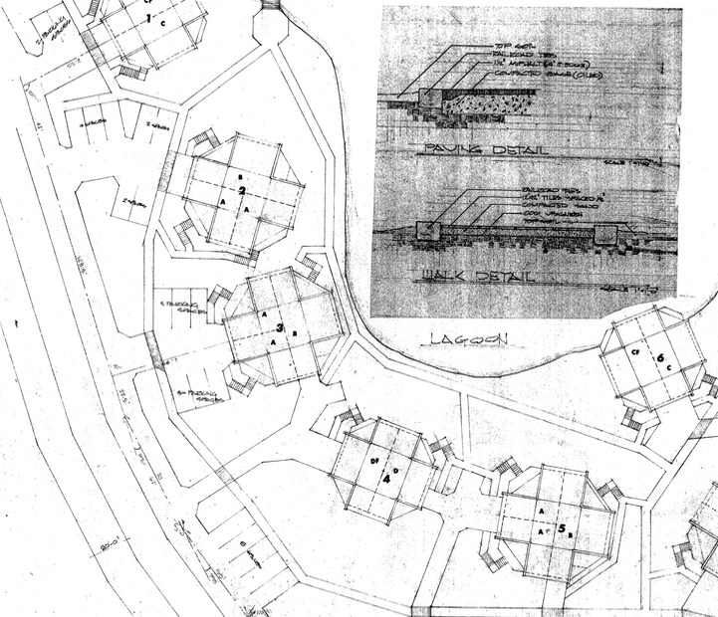
Bahia De Matagorda
Freeze (February)
Plumbing and Plants
Hurricane Nicholas
(Karl Brown, Board and Clay Bishop)
General Discussion

Slide 8
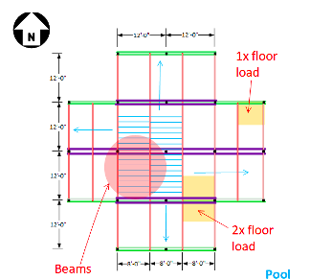
Bahia De Matagorda
CH102/103 updates
Repair for 101/102 delayed;9/12 was the start date
TWIA claim in process
  Anticipate Public Adjuster (K3 Consulting)
New CH Management
Plan to update CH102/103

Slide 9
Bahia De Matagorda
Pool updates
Replace Both Gazebos (MC)
Tiles
Ron & Helen have done a great job

Slide 10

Bahia De Matagorda
Board Position
Alexandra Meador

Slide 11

Bahia De Matagorda
Board Position
Thanks Terry!

Slide 12

Bahia De Matagorda
LCRA Leases up in March 2022
Dumpsters (not renewed)
Gate (in talks; probable)

Slide 13
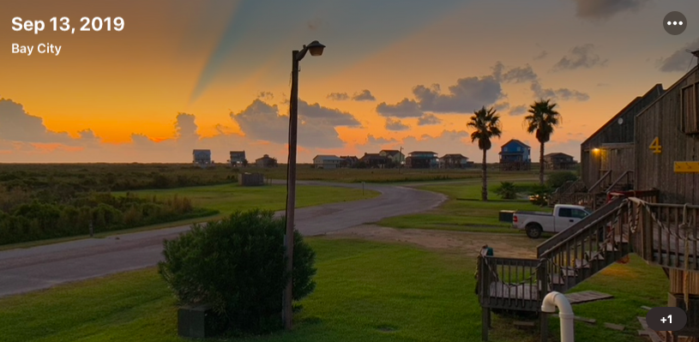
Bahia De Matagorda
Other Business
Outstanding HOA fees
Anything Else?

Slide 14
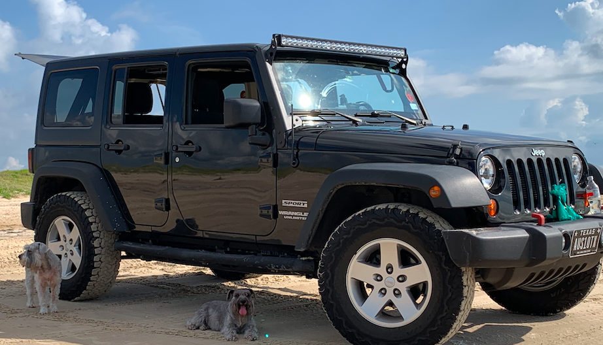
Bahia De Matagorda
Adjourn

