Slide 1
Studies of End Times Prophecies
Book of Revelation
Chapter 6
By Dr. Jose H. Rodriguez

Slide 2
Rev 6:1 I watched as the Lamb opened the first of the seven seals. Then I heard one of the four living creatures say in a voice like thunder, "Come!" ² I looked, and there before me was a white horse! Its rider held a bow, and he was given a crown, and he rode out as a conqueror bent on conquest.

Slide 3
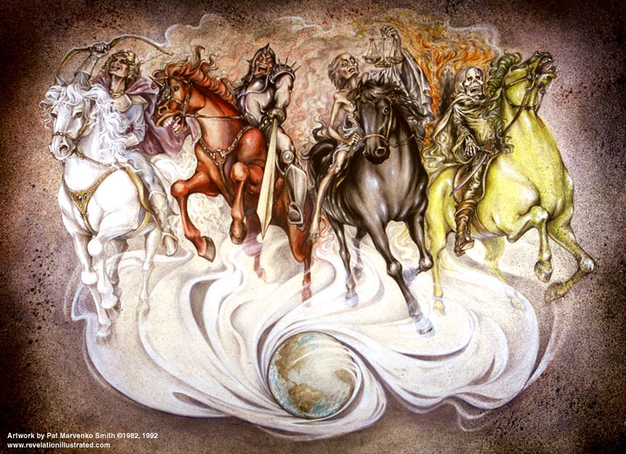
The Four Horsemen of Revelation

Slide 4
The first rider symbolizes the
government of the Antichrist. The white color of his horse means that he will come as a man of peace, also symbolized by a bow without arrows. He will be given a crown means that he will not rise to power by force but that he will be made ruler by others (appointed or elected). Once he rises to power, he will be bent on a race to conquer the world.

Slide 5
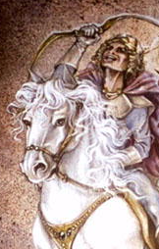
The 1st Horseman: The Kingdom of the Antichrist

Slide 6
Rev 6:3 When the Lamb opened the second seal, I heard the second living creature say, "Come!" ⁴ Then another horse came out, a fiery red one. Its rider was given power to take peace from the earth and to make men slay each other. To him was
given a large sword.

Slide 7
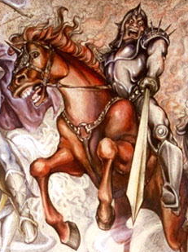
The 2nd Horseman: Worldwide War

Slide 8
The second raider represents
war. This will be the result of the
power struggles brought up by the
Antichrist thirst for power. He will
conquer those who oppose him.

Slide 9
Rev 6:5 When the Lamb opened the third seal, I heard the third living creature say, "Come!" I looked, and there before me was a black horse! Its rider was holding a pair of scales in his hand. ⁶ Then I heard what sounded like a voice among the four living creatures, saying, "A quart of wheat for a day's wages, and three quarts of barley for a day's wages, and do not damage the oil and the wine!"

Slide 10
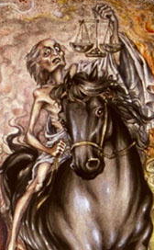
The 3rd Horseman: Worldwide Famine

Slide 11
The third rider represents famine.
This is symbolized by the high cost
of the grain, even though some
“luxury” items (e.g., oil and wine)
will still be available.

Slide 12
Rev 6:7 When the Lamb opened the fourth seal, I heard the voice of the fourth living creature say, "Come!" ⁸ I looked, and there before me was a pale horse! Its rider was named Death, and Hades was following close behind him. They were given power over a

Slide 13
fourth of the earth to kill by sword, famine and plague, and by the
wild beasts of the earth.

Slide 14
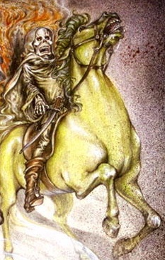
The 4th Horseman: Worldwide Death

Slide 15
The fourth rider represents
Death, which will take the lives of
25% of the earth’s population
through war, famine, plagues, and
wild animals. This was prophesied
in Ezekiel 14:21:

Slide 16
a. Ezek 14:21 "For this is what
the Sovereign LORD says: How
much worse will it be when I send
against Jerusalem my four dreadful
judgments- sword and famine and
wild beasts and plague -- to kill its
men and their animals!

Slide 17
The four horsemen of
Revelation are also presented in
the exact order the Lord in the
Olivet discourse (Matt 24:5-8).

Slide 18
a. Matt 24:5-8: ⁵ "For many will
come in My name, saying, 'I am the
Christ,' and will deceive many
(white horse). ⁶ "And you will
hear of wars and rumors of wars
(red horse). See that you are not
troubled; for all these things must
come to pass, but the end is not
yet.

Slide 19
⁷ "For nation will rise against
nation, and kingdom against
kingdom. And there will be
famines (black horse),
pestilences (pale horse), and
earthquakes in various places. ⁸
"All these are the beginning of
sorrows. (NKJ)

Slide 20
Rev 6:9 When he opened the fifth seal, I saw under the altar the souls of those who had been slain because of the word of God and the testimony they had maintained. ¹⁰ They called out in a loud voice, "How long, Sovereign Lord, holy and true, until you judge the
inhabitants of the earth and avenge our blood?"

Slide 21
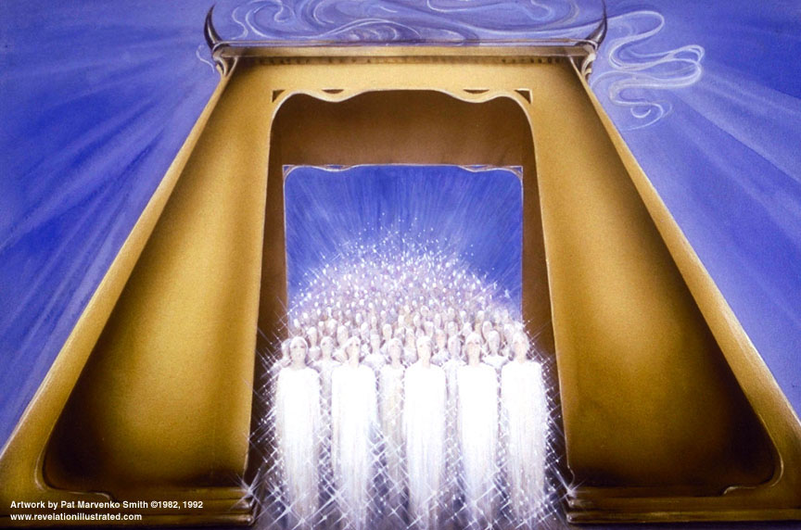

Slide 22
Rev 6:11 Then each of them was given a white robe, and they were told to wait a little longer, until the number of their fellow servants and brothers who were to be killed as they had been was completed.

Slide 23
The fifth seal reveals the tribulation saints martyred for their faith. Unlike the raptured saints who have received their glorified bodies, these saints must wait for the rest of the saints before
receiving theirs. They received white robes signifying their righteousness of Jesus.

Slide 24
Rev 6:12 I watched as he opened the sixth seal. There was a great earthquake. The sun turned black like sackcloth made of goat hair, the whole moon turned blood red, ¹³ and the stars in the sky fell to earth, as late figs drop from a fig tree when shaken by a strong wind.

Slide 25
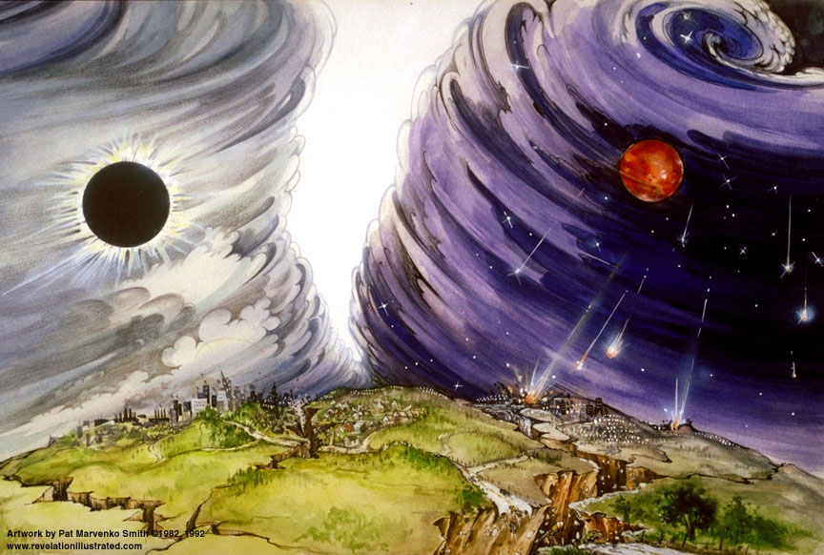

Slide 26
The earthquake mentioned here
could be a huge nuclear explosion, or a great earthquake triggered by atomic explosions. The effects of this earthquake will be felt worldwide. In the Old Testament, prophesies made regarding Damascus and Egypt bring to mind a possible nuclear holocaust
wind.

Slide 27
a. Isa 29:6 the LORD Almighty
will come with thunder and
earthquake and great noise, with
windstorm and tempest and
flames of a devouring fire.

Slide 28
b. Matt 24:7-8: ⁷ Nation will
rise against nation, and kingdom
against kingdom. There will be
famines and earthquakes in
various places. ⁸ All these are the
beginning of birth pains.

Slide 29
c. Isa 17:1 An oracle concerning
Damascus: "See, Damascus will no
longer be a city but will become a
heap of ruins.

Slide 30
d. Ezek 29:9-12: ⁹ Egypt will become
a desolate wasteland. Then they will
know that I am the LORD. "'Because
you said, "The Nile is mine; I made it,"
¹⁰ therefore I am against you and
against your streams, and I will make
the land of Egypt a ruin and a desolate
waste from Migdol to Aswan, as far as
the border of Cush.

Slide 31
¹¹ No foot of man or animal will pass
through it; no one will live there for
forty years. ¹² I will make the land of
Egypt desolate among devastated
lands, and her cities will lie desolate
forty years among ruined cities. And I
will disperse the Egyptians among the
nations and scatter them through the
countries.

Slide 32
The darkening of the sun could be
explained by the atmospheric
pollution caused by tons of debris
from the nuclear explosions or
volcanic eruptions. This could also
be the result of a solar eclipse.
The moon turning red as blood
could be the result of a lunar
eclipse.

Slide 33
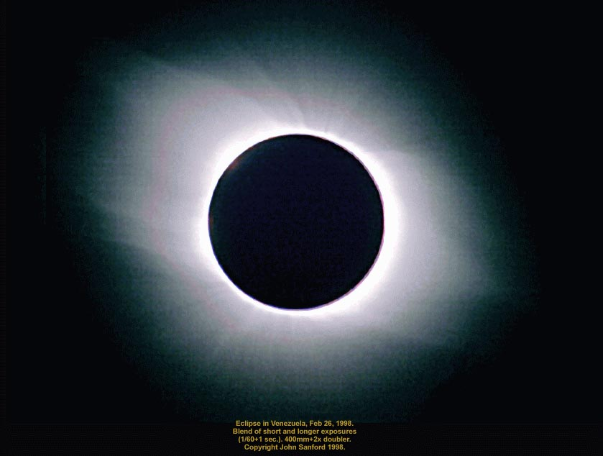

Slide 34
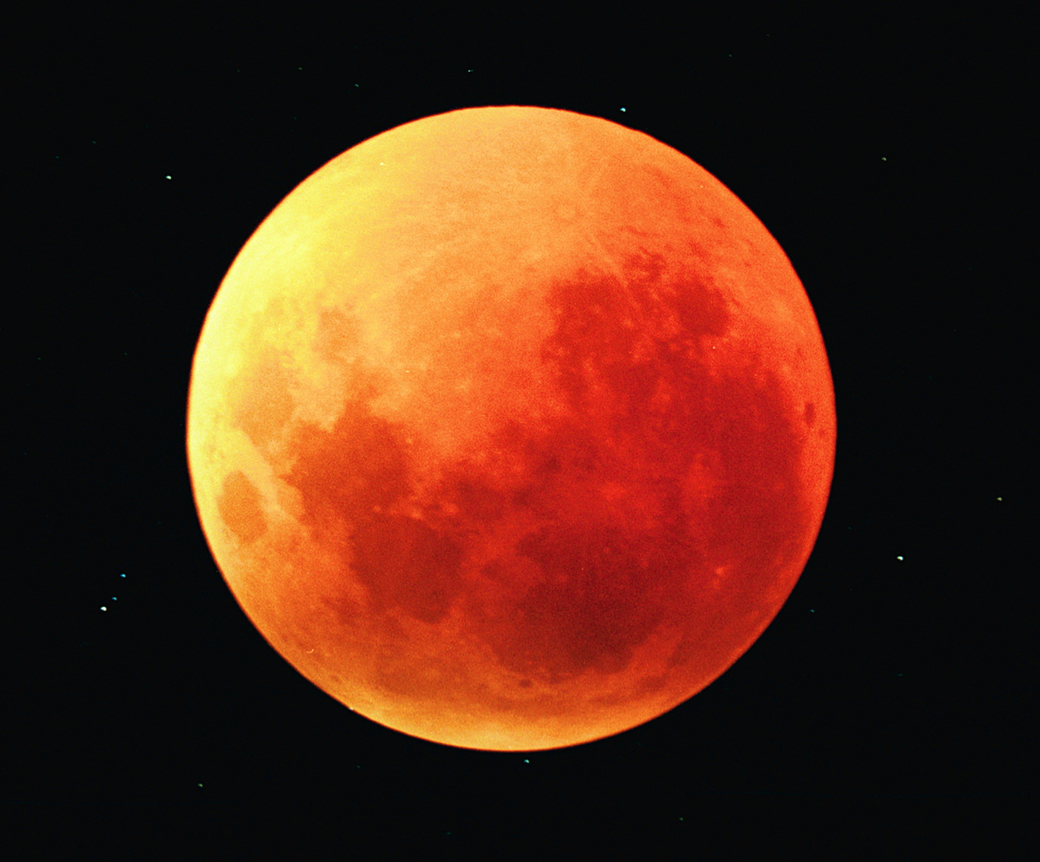

Slide 35
a. Isa 13:9-10: ⁹ See, the day of the
LORD is coming a cruel day, with wrath and fierce anger-- to make the land desolate and destroy the sinners within it. ¹⁰ The stars of heaven and their constellations will not show their light. The rising sun will be darkened and the moon will not give its light.

Slide 36
b. Joel 2:31 The sun will be
turned to darkness and the moon
to blood before the coming of the
great and dreadful day of the
LORD.

Slide 37
c. Luke 21:25-26: ²⁵ "There will
be signs in the sun, moon and
stars. On the earth, nations will be
in anguish and perplexity at the
roaring and tossing of the sea. ²⁶
Men will faint from terror,
apprehensive of what is coming on
the world, for the heavenly bodies
will be shaken.

Slide 38
d. Luke 23:44-45: ⁴⁴ It was now
about the sixth hour, and darkness
came over the whole land until the
ninth hour, ⁴⁵ for the sun stopped
shining. And the curtain of the
temple was torn in two.

Slide 39
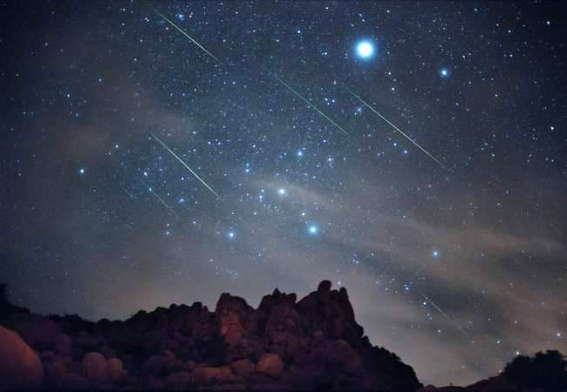
The stars falling to earth probably refer to a meteorite shower.

Slide 40
Rev 6:14 The sky receded like a scroll, rolling up, and every mountain and island was removed from its place.

Slide 41
The sky receding like a scroll can be explained as the result of a nuclear explosion. During a nuclear blast the wind is rapidly pushed out for several miles, creating a vacuum at the center
of the blast site. Suddenly, this wind, like a tidal wave, rushes back into the vacuum.

Slide 42
The sky actually rolls up on itself. The explosion will be so great that it will cause every mountain and island to move.

Slide 43
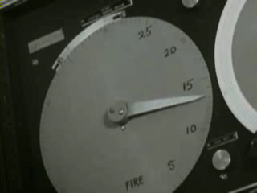

Slide 44
a. Pet 3:10-12: ¹⁰ But the day of the Lord will come like a thief. The heavens will disappear with a roar; the elements will be destroyed by fire, and the earth and everything in it will be laid bare. ¹¹ Since everything will
be destroyed in this way, what kind of
people ought you to be? You ought to live holy and godly lives

Slide 45
¹² as you look forward to the day of God and speed its coming. That day will bring about the destruction of
the heavens by fire, and the elements will melt in the heat.

Slide 46
Rev 6:15 Then the kings of the earth, the princes, the generals, the rich, the mighty, and every slave and every free man hid in caves and among the rocks of the mountains. ¹⁶ They called to the
mountains and the rocks, "Fall on us and hide us from the face of him who sits on the throne and from the
stand?"

Slide 47
wrath of the Lamb! ¹⁷ For the great day of their wrath has come, and who can stand?"

Slide 48
There will be worldwide panic due to the wrath of God:
a. Ezek 38:20 The fish of the sea,
the birds of the air, the beasts of the
field, Every creature that moves along
the ground, and all the people on the
face of the earth will tremble at my
presence. The mountains will be
overturned, the cliffs will crumble and
every wall will fall to the ground.

Slide 49
b. Nahum 1:5-6: ⁵ The mountains
quake before him and the hills melt
away. The earth trembles at his
presence, the world and all who live in
it. ⁶ Who can withstand his
indignation? Who can endure his fierce anger? His wrath is poured out like fire; the rocks are shattered before
him.

Slide 50
The Day or time of Wrath are
other names for the Tribulation
Period:
a. Dan 8:19 He said: "I am going
to tell you what will happen later in
the time of wrath, because the
vision concerns the appointed time
of the end.

Slide 51
b. Dan 11:36 "The king will do as
he pleases. He will exalt and
magnify Himself above every god
and will say unheard-of things
against the God of gods. He will be
successful until the time of wrath is
completed, for what has been
determined must take place.

Slide 52
c. Zeph 1:14-15: ¹⁴ "The great day
of the LORD is near-- near and coming quickly. Listen! The cry on the day of the LORD will be bitter, the shouting of the warrior there. ¹⁵ That day will be a day of wrath, a day of distress and anguish, a day of trouble and ruin, a day of darkness and gloom, a day of clouds and blackness,

Slide 53
These verses referring to the fact
that the day of wrath of God and
the Lamb had come proves that
the Great Tribulation begins in this
chapter. Here we see not just the
wrath of man but the wrath of
God.

Slide 54
Questions?

Slide 55
Artwork by Pat Marvenko Smith,
copyright 1992 is from a series
titled “Revelation Illustrated” and
has been used by her permission.
It is available in fine art prints and
visual teaching materials.
Call 1-800-327-7330 for a free
brochure, or go to
www.revelationillustrated.com.

