Slide 1

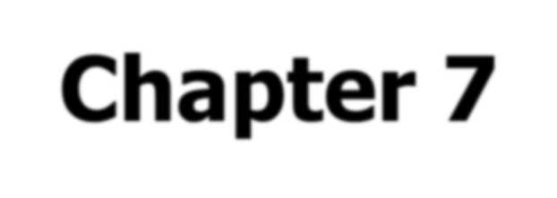
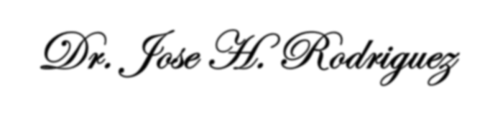
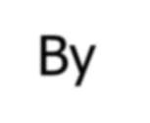
Studies of End Times Prophecies
Book of Revelation
Chapter 7
By Dr. Jose H. Rodriguez

Slide 2
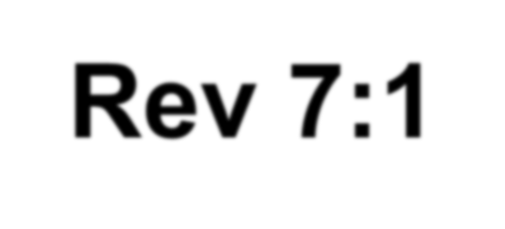
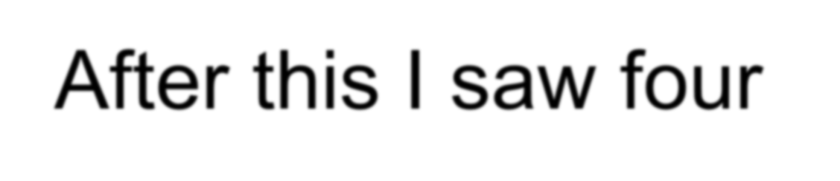
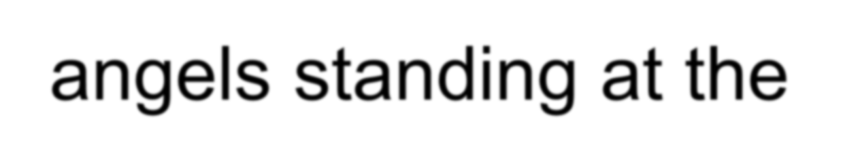
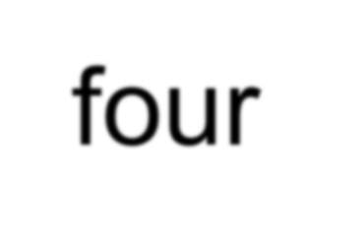
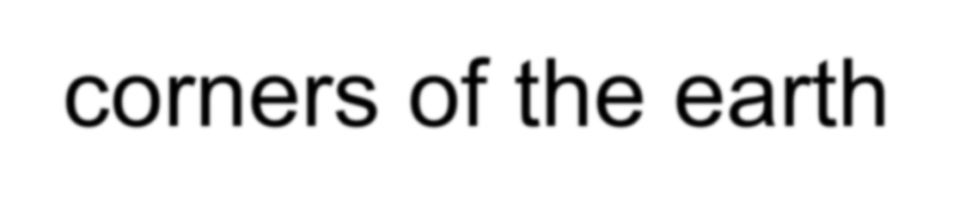
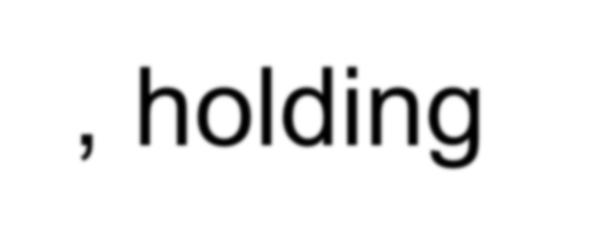
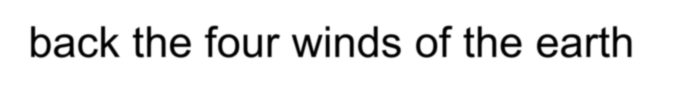
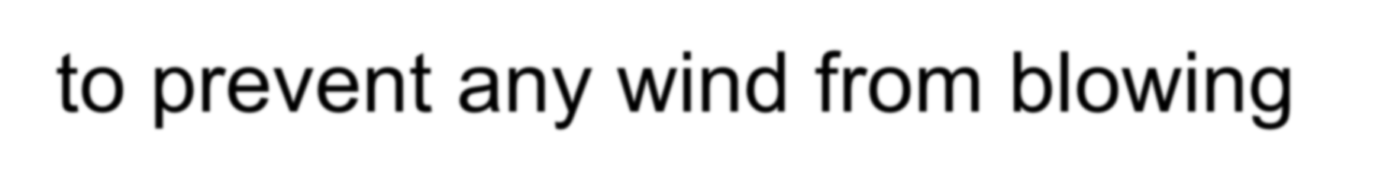
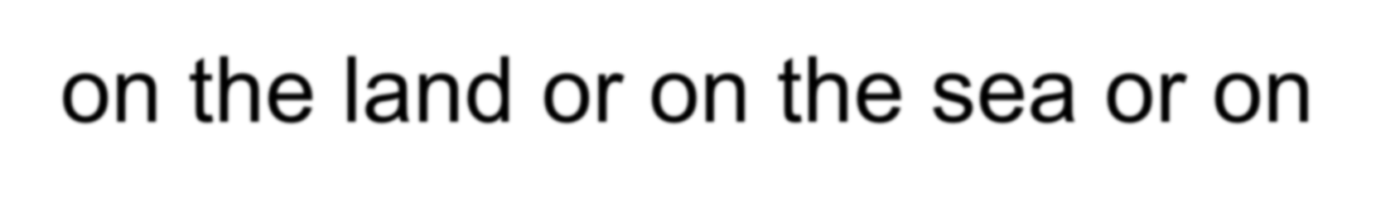
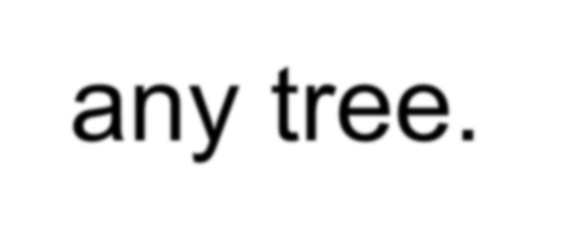

Rev 7:1 After this I saw four angels standing at the four corners of the earth, holding back the four winds of the earth to prevent any wind from blowing on the land or on the sea or on any tree.

Slide 3

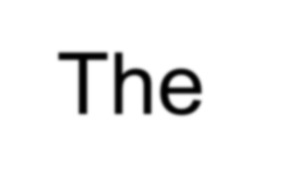
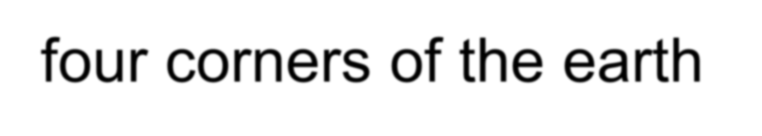
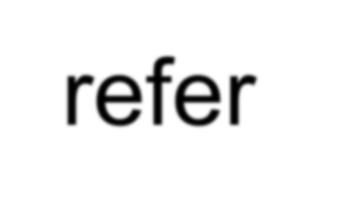
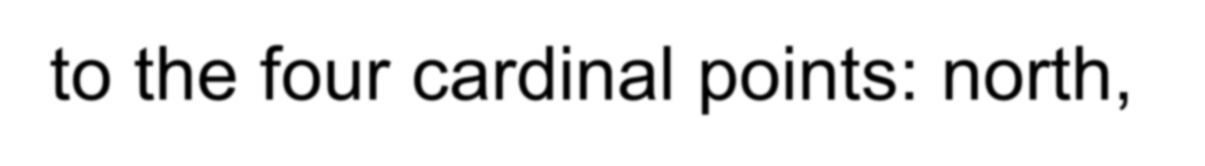
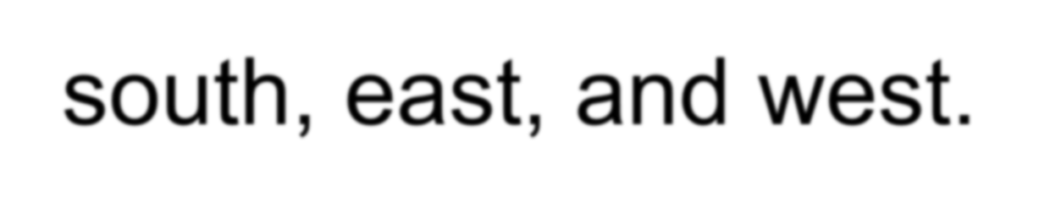

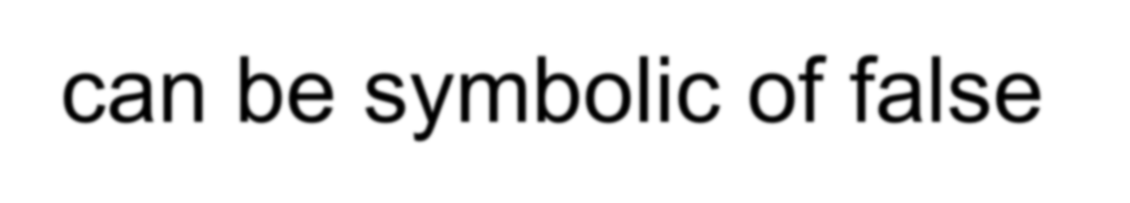
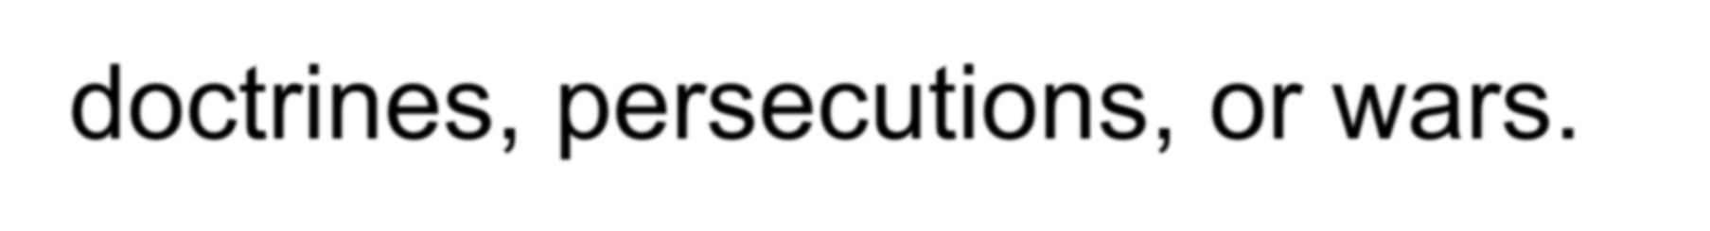
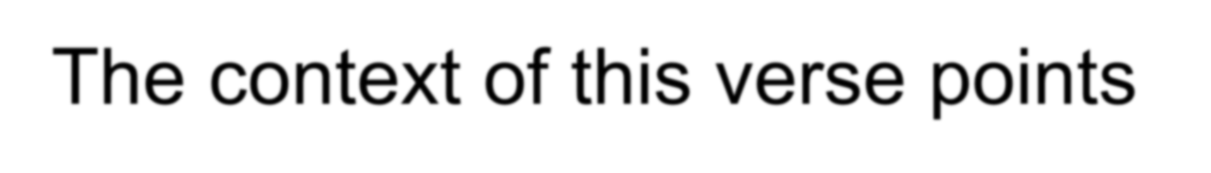
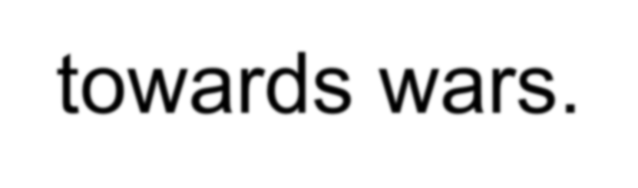

The four corners of the earth refer to the four cardinal points: north, south, east, and west.
Winds can be symbolic of false doctrines, persecutions, or wars. The context of this verse points towards wars.

Slide 4
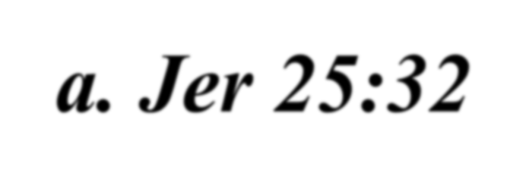

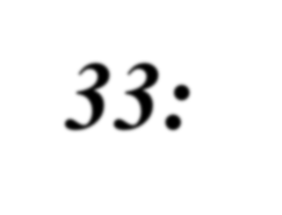
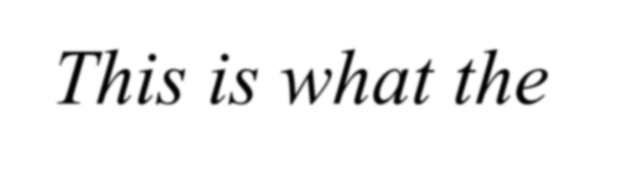
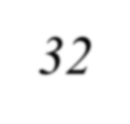
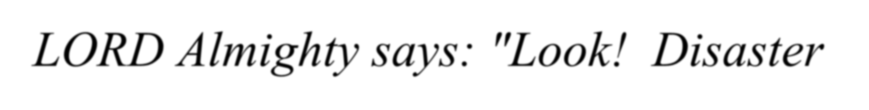
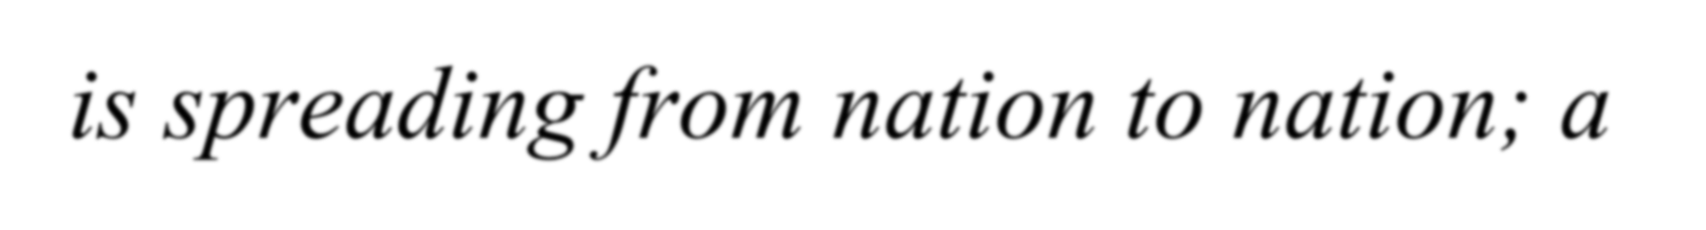

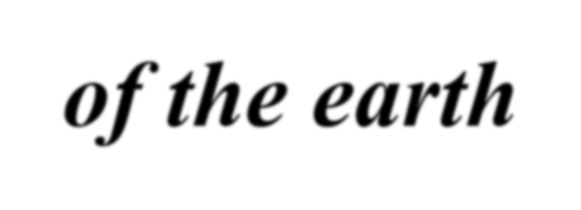

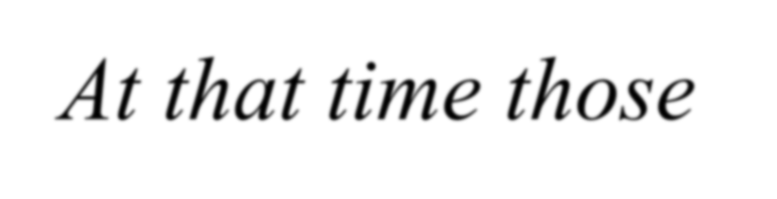
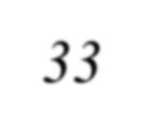
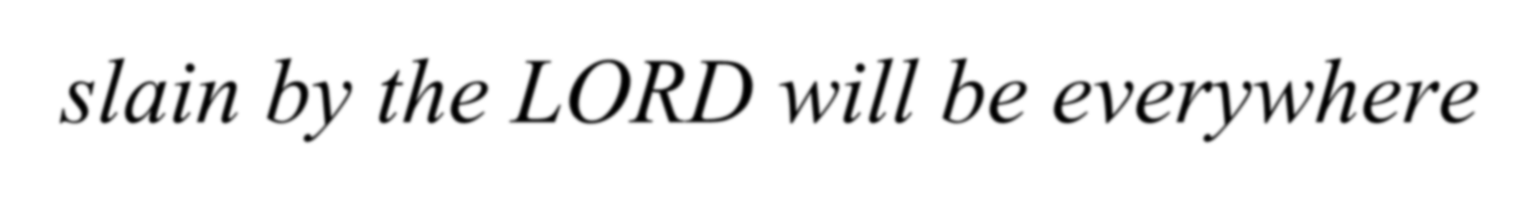

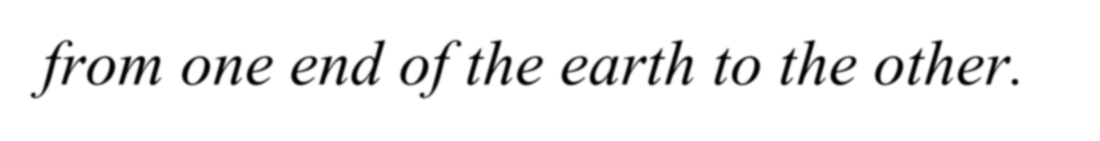
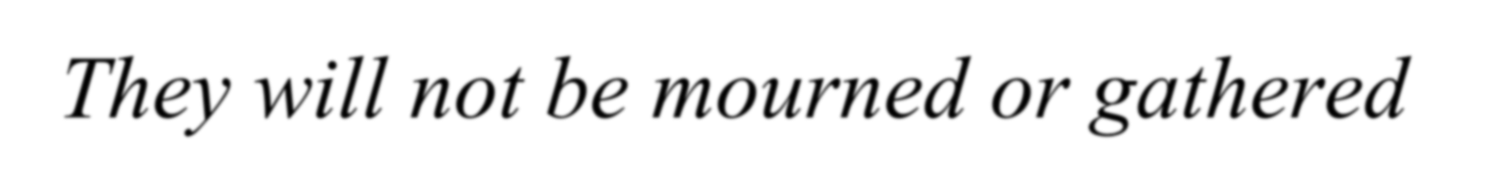
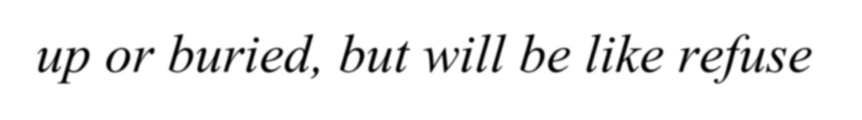
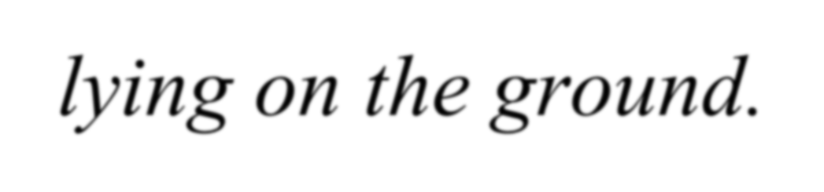

a. Jer 25:32-33: ³² This is what the LORD Almighty says: "Look! Disaster is spreading from nation to nation; a mighty storm is rising from the ends of the earth.“ ³³ At that time those slain by the LORD will be everywhere– from one end of the earth to the other. They will not be mourned or gathered up or buried, but will be like refuse lying on the ground.

Slide 5
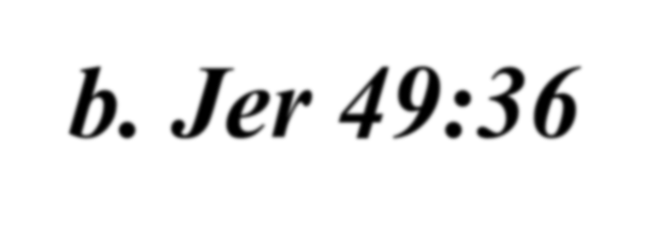

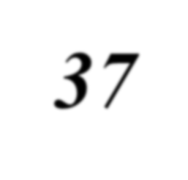
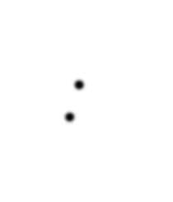
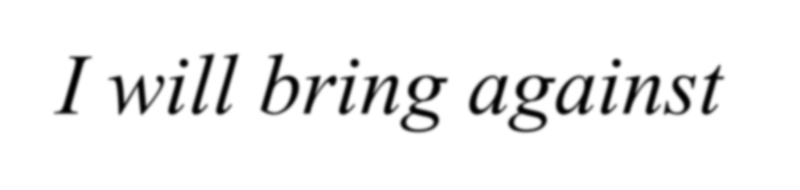
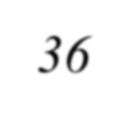
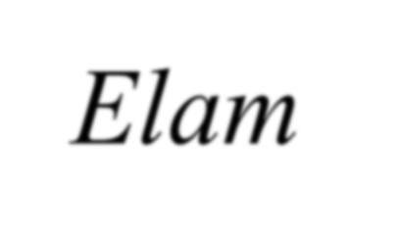
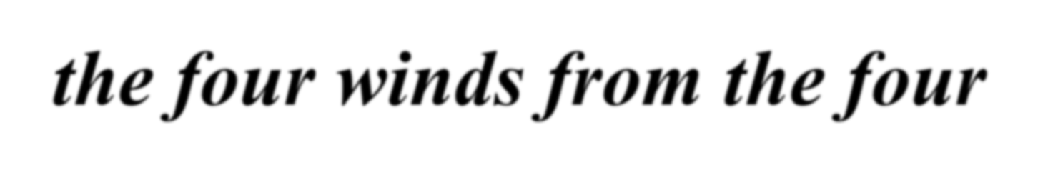
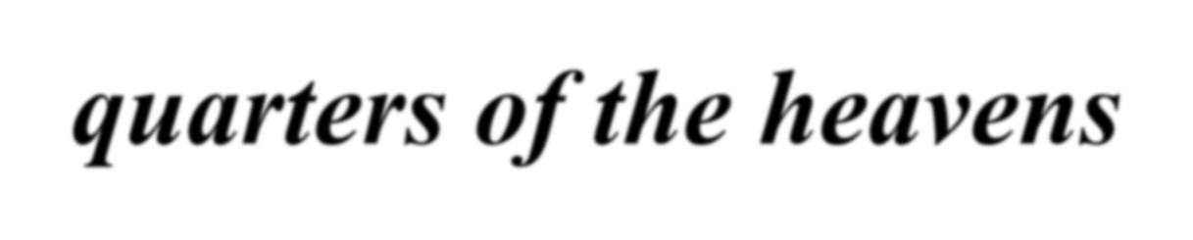
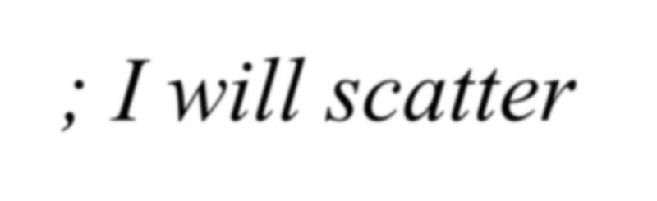
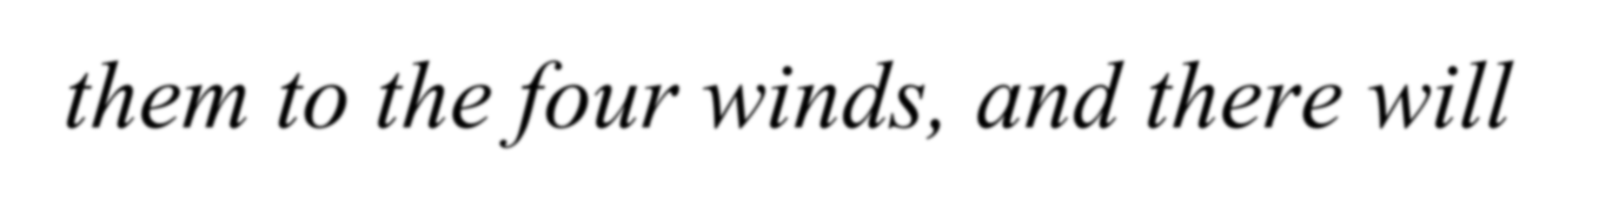
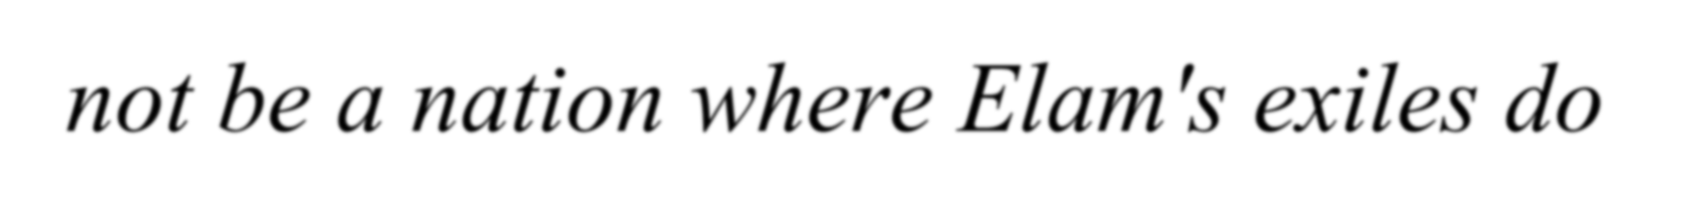
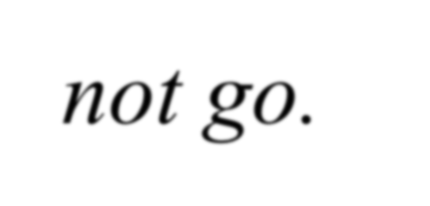
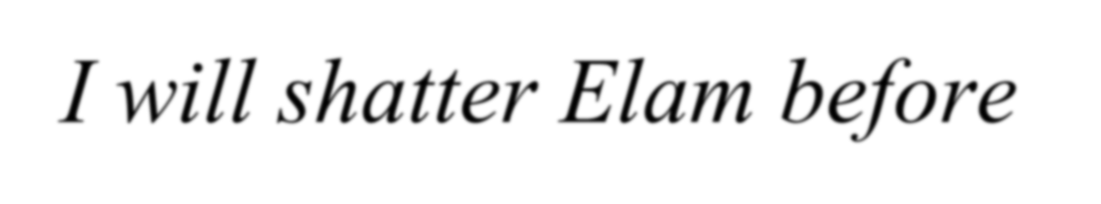
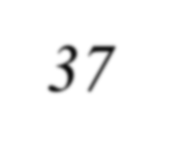




b. Jer 49:36-37: ³⁶ I will bring against Elam the four winds from the four quarters of the heavens; I will scatter them to the four winds, and there will not be a nation where Elam's exiles do not go. ³⁷ I will shatter Elam before their foes, before those who seek their lives; I will bring disaster upon them, even my

Slide 6





fierce anger," declares the LORD. "I will pursue them with the sword until I have made an end of them.

Slide 7














Rev 7:2 Then I saw another angel coming up from the east, having the seal of the living God. He called out in a loud voice to the four angels who had been given power to harm the land and the sea: ³ "Do not harm the land or the sea or the trees until we put a seal on the foreheads of the servants of our God."

Slide 8







A similar seal was mentioned in Ezekiel 9:1-6a when God also wanted to spare from His judgments those who were faithful to Him.

Slide 9

Eze 9:4 The LORD said to him, “Go all through Jerusalem. Look for those who are sad and sorry about all of the things that are being done there. I hate those things. Put a mark on the foreheads of those people.” ⁵I heard him speak to the six men. He said, “Follow him through the city. Do not show any pity or concern.

Slide 10










⁶Kill old men and women, young men and women, and children. But do not touch anyone who has the mark. Start at my temple.” So they began with the elders who were in front of the temple.

Slide 11



Slide 12

















Rev 7:4 Then I heard the number of those who were sealed: 144,000 from all the tribes of Israel. ⁵ From the tribe of Judah 12,000 were sealed, from the tribe of Reuben 12,000, from the tribe of Gad 12,000, ⁶ from the tribe of Asher 12,000, from the tribe of Naphtali 12,000, from the tribe of Manasseh

Slide 13










12,000, ⁷ from the tribe of Simeon 12,000, from the tribe of Levi 12,000, from the tribe of Issachar 12,000, ⁸ from the tribe of Zebulun 12,000, from the tribe of Joseph 12,000, from the tribe of Benjamin 12,000.

Slide 14



Slide 15











The seal mentioned here probably represents the Holy Spirit, which is promised to all believers.
Eph 1:13-14
Eph 4:30

Slide 16




















a. Eph 1:13-14: ¹³ And you also were included in Christ when you heard the word of truth, the gospel of your salvation. Having believed, you were marked in him with a seal, the promised Holy Spirit, ¹⁴ who is a deposit guaranteeing our inheritance until the redemption of those who are God's possession-- to the praise of his glory.

Slide 17








b. Eph 4:30 And do not grieve the Holy Spirit of God, with whom you were sealed for the day of redemption.

Slide 18










c. Rev 14:1 Then I looked, and there before me was the Lamb,
standing on Mount Zion, and with him 144,000 who had his name and his Father's name written on their foreheads.

Slide 19
















The tribes of Dan and Ephraim were excluded because of their idolatry.
a. IKing 12:26 Jeroboam thought to himself, "The kingdom will now likely
27 _{If}
revert to the house of David.
these people go up to offer sacrifices at the temple of the LORD in Jerusalem, they will again give their

Slide 20











allegiance to their lord, Rehoboam king of Judah. They will kill me and return to King Rehoboam." ²⁸ After seeking advice, the king made two golden calves. He said to the people, "It is too much for you to go up to Jerusalem. Here are your gods, O Israel, who brought you up out of

Slide 21












Egypt." ²⁹ One he set up in Bethel, and the other in Dan. ³⁰ And this thing became a sin; the people went even as far as Dan to worship the one there.

Slide 22






b. Gen 49:17 Dan will be a serpent by the roadside, a viper along the path, that bites the horse's heels so that its rider tumbles backward.

Slide 23
















c. Jdg 18:29 They named it Dan after their forefather Dan, who was born to Israel--though the city used to be called Laish. 30 There the Danites set up for themselves the idols, and Jonathan son of Gershom, the son of Moses, and his sons were priests for the tribe of Dan until the time of the captivity of the land.

Slide 24





31 They continued to use the idols Micah had made, all the time the house of God was in Shiloh.

Slide 25


d. Hosea 4:17 The people of Ephraim have joined themselves to other gods. And nothing can be done to help them. ¹⁸They continue to be unfaithful to me even when their drinks are gone. And their rulers love to do shameful things.
¹⁹ A windstorm will blow all of them away. And their sacrifices will bring shame on them.

Slide 26






















d. Hosea 5:3 People of Ephraim, I know all about you. What you are doing is not hidden from me. Now you have joined yourselves to other gods. You have made yourselves ‘unclean.’ ⁴“You can’t return to me because you have done so many evil things. In your hearts you long to act like prostitutes. You do not recognize me as the LORD.

Slide 27
















Rev 7:9 After this I looked and there before me was a great multitude that no one could count, from every nation, tribe, people and language, standing before the throne and in front of the Lamb.
They were wearing white robes and were holding palm branches in their hands.

Slide 28






¹⁰ And they cried out in a loud voice: "Salvation belongs to our God, who sits on the throne, and to the Lamb."

Slide 29



Slide 30








The multitude mentioned here, as opposed to the 144,000 mentioned before, comes from every nation and ethnic group. This would include both Jews and Gentiles from all over the world.

Slide 31















White robes/clothes are “the uniform of the day” in Heaven:
  Rev 3:4-5: ⁴ Yet you have a few people in Sardis who have not soiled their clothes. They will walk with me, dressed in white, for they are worthy. ⁵ He who overcomes will, like them, be dressed in white.

Slide 32












b. Rev 4:4 Surrounding the throne were twenty-four other thrones, and seated on them were twenty-four elders. They were dressed in white and had crowns of gold on their heads.

Slide 33







c. Rev 19:14 The armies of heaven were following him, riding on white horses and dressed in fine linen, white and clean.

Slide 34














Palm trees are a symbol of joy.
  Lev 23:40 On the first day you are to take choice fruit from the trees, and palm fronds, leafy branches and poplars, and rejoice before the LORD your God for seven days.

Slide 35


















Rev 7:13 Then one of the elders asked me, "These in white robes-- who are they, and where did they come from?" ¹⁴ I answered, "Sir, you know." And he said, "These are they who have come out of the great tribulation; they have washed their robes and made them white in the blood of the Lamb.

Slide 36





The multitude is composed of those who gave their life for their faith during the Great Tribulation period.

Slide 37













Rev 7:15 Therefore, "they are before the throne of God and serve him day and night in his temple; and he who sits on the throne will spread his tent over them. ¹⁶ Never again will they hunger; never again will they thirst. The sun will not beat upon them, nor any scorching heat.

Slide 38









¹⁷ For the Lamb at the center of the throne will be their shepherd; he will lead them to springs of living water. And God will wipe away every tear from their eyes."

Slide 39











a. Isa 35:10 and the ransomed of the LORD will return. They will enter Zion with singing; everlasting joy will crown their heads. Gladness and joy will overtake them, and sorrow and sighing will flee away.

Slide 40















Artwork by Pat Marvenko Smith, copyright 1992 is from a series
titled “Revelation Illustrated” and has been used by her permission. It is available in fine art prints and visual teaching materials.
Call 1-800-327-7330 for a free brochure, or go to www.revelationillustrated.com.

Slide 41


Questions?

