Slide 1

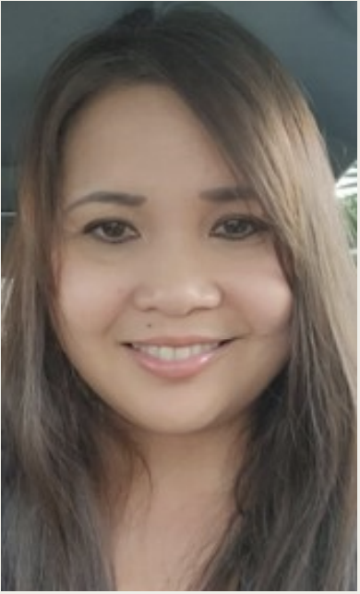
Meet your facilitator

